Slide 1
工作汇报
汇报人：李子明

Slide 2
学期工作总结
主要阅读了机器学习、人工智能领域的文献。
对于金融机器学习的研究范式有了一定的了解。
读过的文献会遗忘，养成做笔记的习惯，记录每篇文章的特别点。
基本上完成了Gu2020的复制工作。
投资组合有待改进。
元策略选择最佳机器学习模型需要进一步完成。
机器学习模型理解不深刻，之前学习的CS知识太基础。

Slide 3
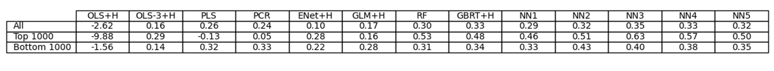
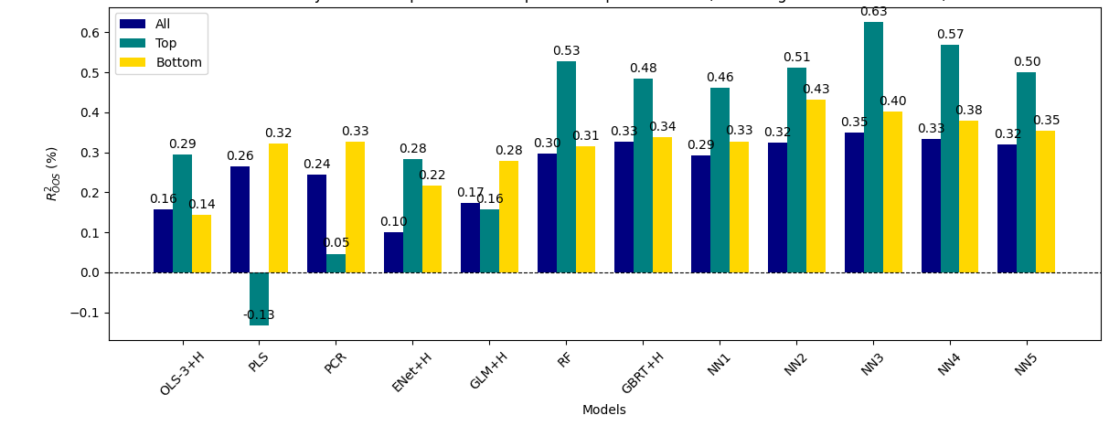
Gu2020复制
$R^{2}$在上一次的基础上有了一定的提升

Slide 4
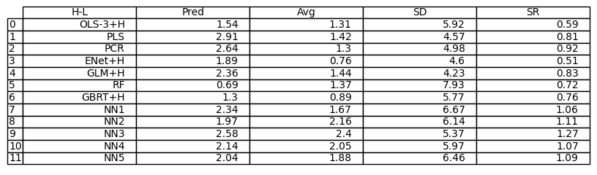
多空投资组合
神经网络的策略表现与文章有一定差异，其他模型的策略表现与文章相近，最佳的10–1策略来自 NN3（原文是NN4）。

Slide 5
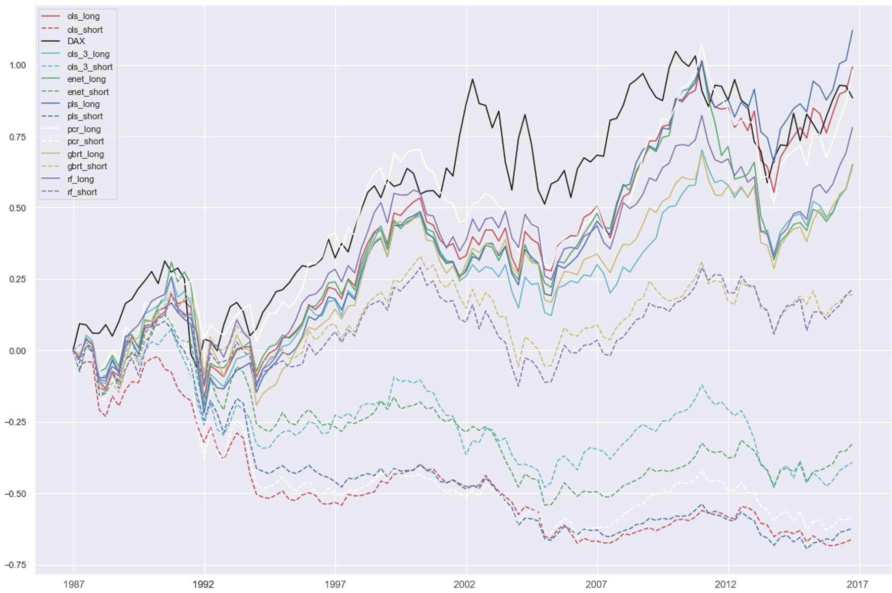
投资组合累计回报的趋势基本吻合

Slide 6
Teaching Economics to the Machines Hui Chen, Yuhan Cheng, Yanchu Liu, Ke Tang
Present by Li Ziming

Slide 7
Motivation
Is theory dead?
Simply applying AI without considering economic implications can produce powerful predictive ability.
Theory provides motivations to identify features and restrictions for forecasting.
Economic models and ML models have comparative advantages.
Structural economic models can convey appealing economic insights but suffer from poor fit with data.
Non-structural ML models offer rich flexibility but have over-fitting issues.

Slide 8
Research Questions
(1) How to combine economic models with machine learning?
(2) Do transfer learning approach outperform?
(3) Why is transfer learning better?

Slide 9
Contribution
Contribute to literature of applying ML to finance and economics.
Prior literature: solve the pricing equations (Chen et al., 2022) and Bellman equations (Kong et al., 2020) implied by structural models.
Extend: bring economic restrictions from structural models into ML model.
Contribute to literature on derivative pricing.
Prior literature: stochastic differential models outperform best ML (Jang and Lee, 2019); knowledge in finance modify performance of NN (Garcia and Gençay, 2000).
Extend: transfer learning approach better than deep learning and traditional stochastic differential models in terms of pricing power and hedging power.

Slide 10
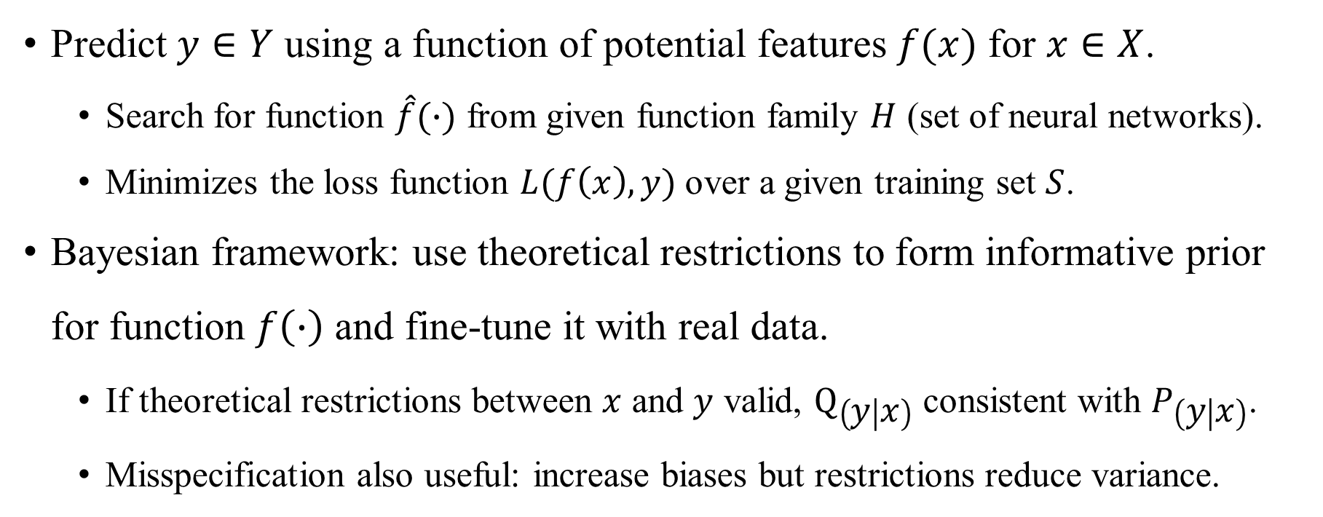
Transfer learning approach
Predict $y∈Y$ using a function of potential features $f(x)$ for $x∈X$.
Search for function $\hat{f}(∙)$ from given function family $H$ (set of neural networks).
Minimizes the loss function $L(f\left(x\right),y)$ over a given training set $S$.
Bayesian framework: use theoretical restrictions to form informative prior for function $f\left(∙\right)$ and fine-tune it with real data.
If theoretical restrictions between $x$ and $y$ valid, $Q_{\left(y | x\right)}$ consistent with $P_{\left(y | x\right)}$.
Misspecification also useful: increase biases but restrictions reduce variance.

Slide 11
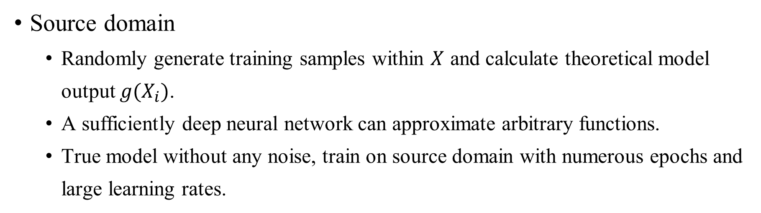
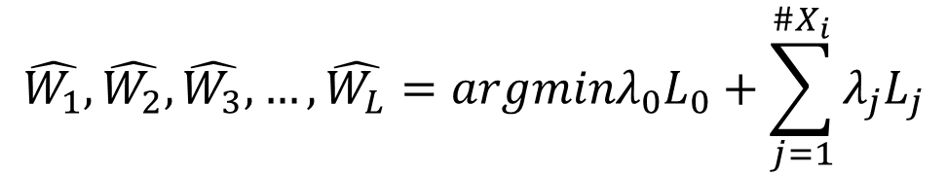
Transfer learning approach
Source domain
Randomly generate training samples within $X$ and calculate theoretical model output $g(X_{i})$.
A sufficiently deep neural network can approximate arbitrary functions.
True model without any noise, train on source domain with numerous epochs and large learning rates.
A neural network with L layers: $F(L;σ_{1},σ_{2},σ_{3},…,σ_{L};W_{1},W_{2},W_{3},…,W_{L})(X_{i})$
$$\hat{W_{1}},\hat{W_{2}},\hat{W_{3}},…,\hat{W_{L}}=argminλ_{0}L_{0}+\sum_{j=1}^{\#X_{i}}{λ_{j}L_{j}}$$

Slide 12
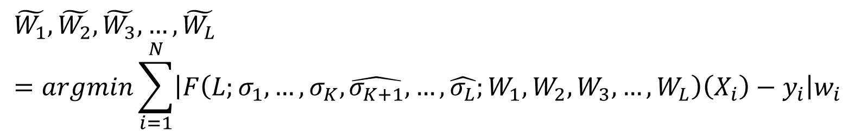
Transfer learning approach
Target domain
Fine-tune original form with the last few layers initialized according to real data, choose K and replace the layers K+1 to L.
Make the model not seriously deviate from economics theory and can flexibly modify within certain range.
Noisy in empirical data, train on target domain with low learning rate and epochs.
$$\tilde{W_{1}},\tilde{W_{2}},\tilde{W_{3}},…,\tilde{W_{L}}=argmin\sum_{i=1}^{N}{\left|F\left(L;σ_{1},…,σ_{K},\hat{σ_{K+1}},…,\hat{σ_{L}};W_{1},W_{2},W_{3},…,W_{L}\right)\left(X_{i}\right)−y_{i}\right|w_{i}}$$
Final pricing model: $F(L;σ_{1},…,σ_{K},\tilde{σ_{K+1}},…,\tilde{σ_{L}};\tilde{W_{1}},\tilde{W_{2}},\tilde{W_{3}},…,\tilde{W_{L}})(X_{i})$

Slide 13
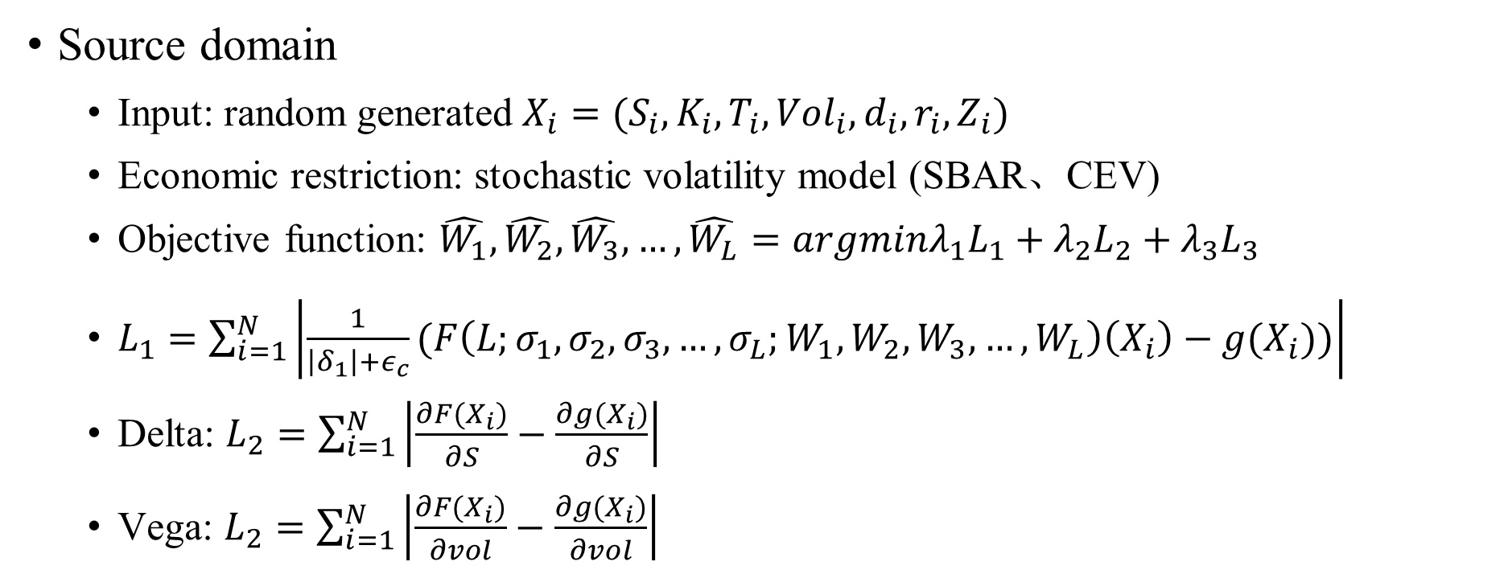
An application to option pricing
Source domain
Input: random generated $X_{i}=(S_{i},K_{i},T_{i},{Vol}_{i},d_{i},r_{i},Z_{i})$
Economic restriction: stochastic volatility model (SBAR、CEV)
Objective function: $\hat{W_{1}},\hat{W_{2}},\hat{W_{3}},…,\hat{W_{L}}=argminλ_{1}L_{1}+λ_{2}L_{2}+λ_{3}L_{3}$
$L_{1}=\sum_{i=1}^{N}{\left|\frac{1}{\left|δ_{1}\right|+ε_{c}}(F\left(L;σ_{1},σ_{2},σ_{3},…,σ_{L};W_{1},W_{2},W_{3},…,W_{L}\right)\left(X_{i}\right)−g(X_{i}))\right|}$
Delta: $L_{2}=\sum_{i=1}^{N}{\left|\frac{∂F(X_{i})}{∂S}−\frac{∂g(X_{i})}{∂S}\right|}$
Vega: $L_{2}=\sum_{i=1}^{N}{\left|\frac{∂F(X_{i})}{∂vol}−\frac{∂g(X_{i})}{∂vol}\right|}$

Slide 14
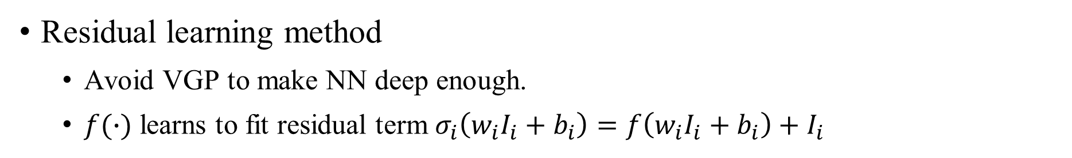
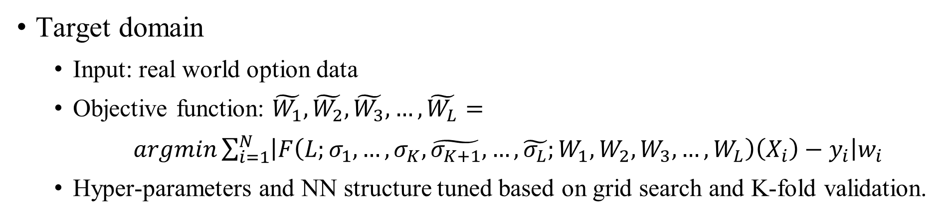
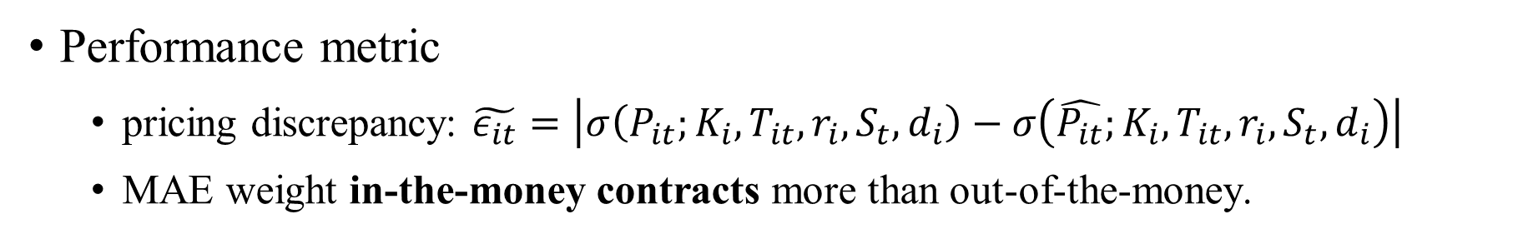
Target domain
Input: real world option data
Objective function: $\tilde{W_{1}},\tilde{W_{2}},\tilde{W_{3}},…,\tilde{W_{L}}= argmin\sum_{i=1}^{N}{\left|F\left(L;σ_{1},…,σ_{K},\tilde{σ_{K+1}},…,\tilde{σ_{L}};W_{1},W_{2},W_{3},…,W_{L}\right)\left(X_{i}\right)−y_{i}\right|w_{i}}$
Hyper-parameters and NN structure tuned based on grid search and K-fold validation.
Residual learning method
Avoid VGP to make NN deep enough.
$f(∙)$ learns to fit residual term $σ_{i}\left(w_{i}I_{i}+b_{i}\right)=f\left(w_{i}I_{i}+b_{i}\right)+I_{i}$
Performance metric
pricing discrepancy: $\tilde{ε_{it}}=\left|σ\left(P_{it};K_{i},T_{it},r_{i},S_{t},d_{i}\right)−σ\left(\hat{P_{it}};K_{i},T_{it},r_{i},S_{t},d_{i}\right)\right|$
MAE weight in-the-money contracts more than out-of-the-money.

Slide 15
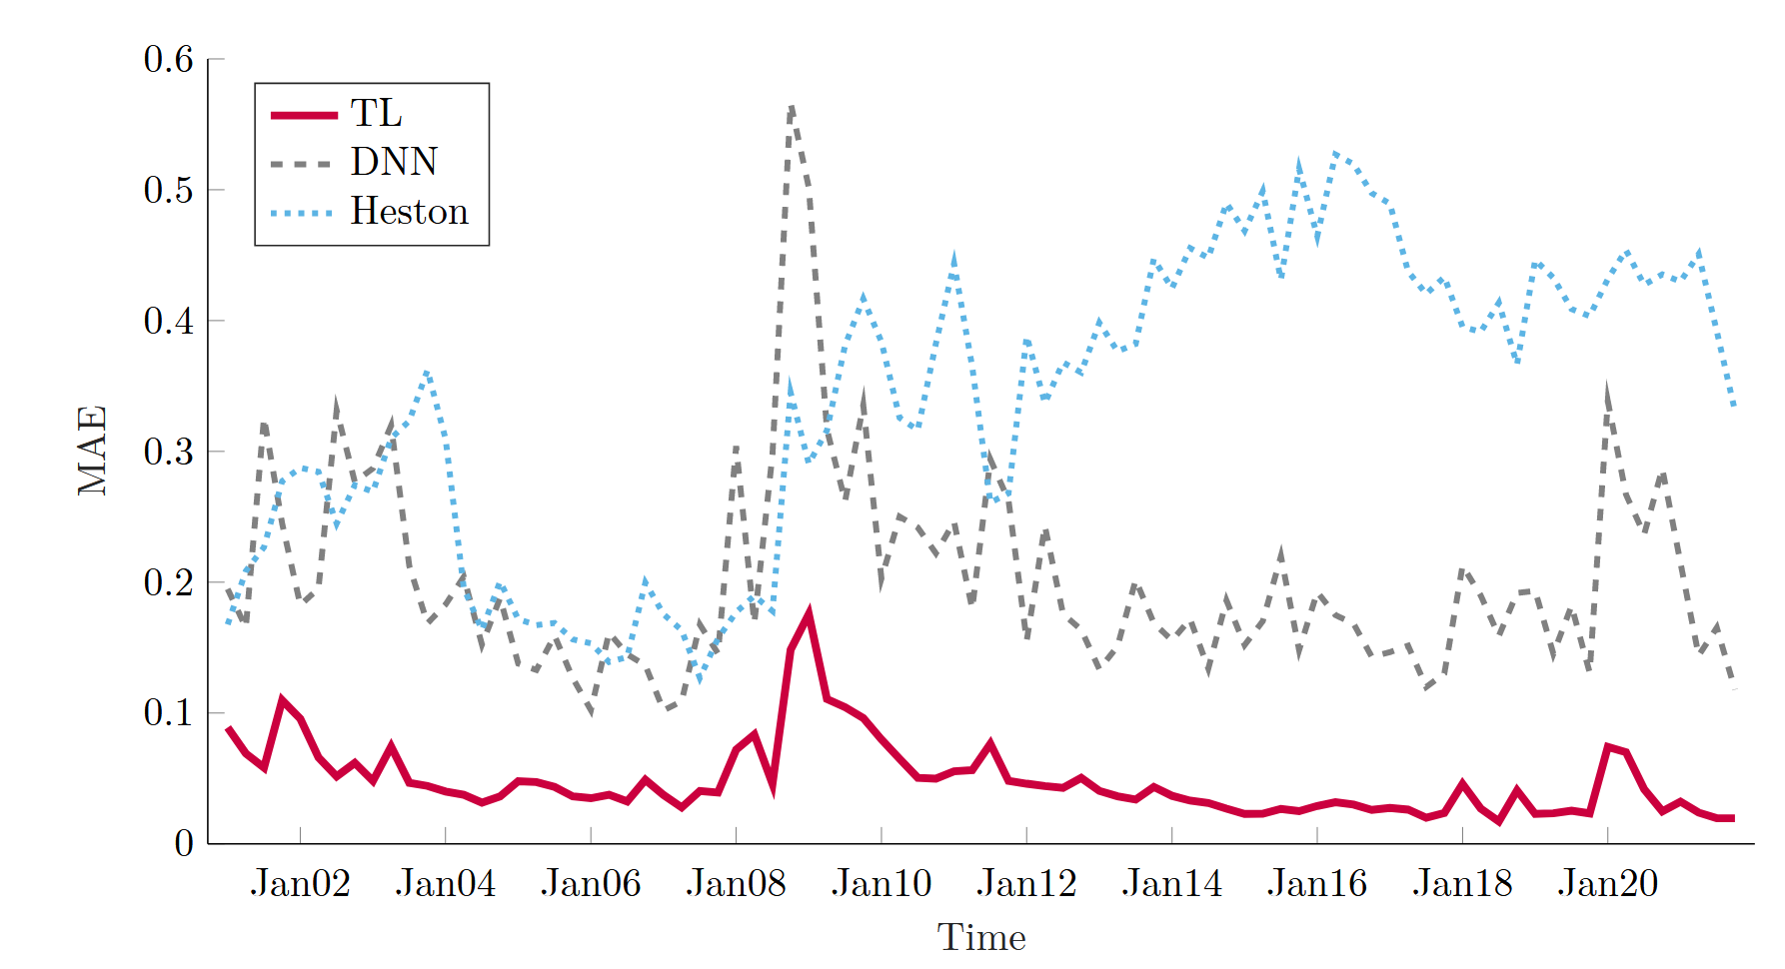
Compare implied volatility MAE of option pricing models
Representative deep learning method: DNN
Well-established parametric pricing model: Heston

Slide 16
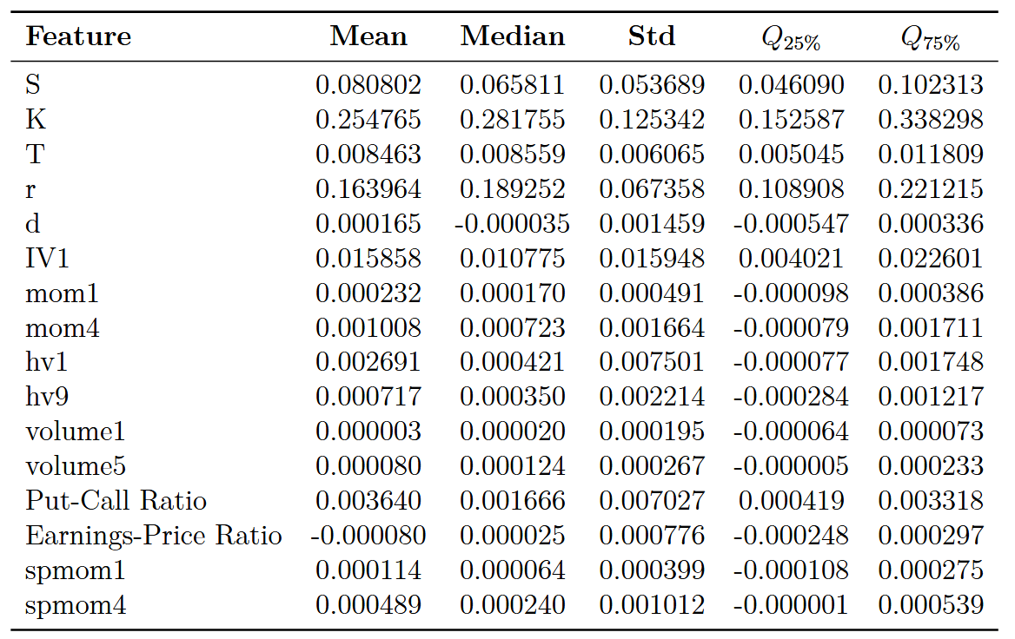
Feature importance
Incremental rise in loss function on training dataset when specific feature omitted.

Slide 17
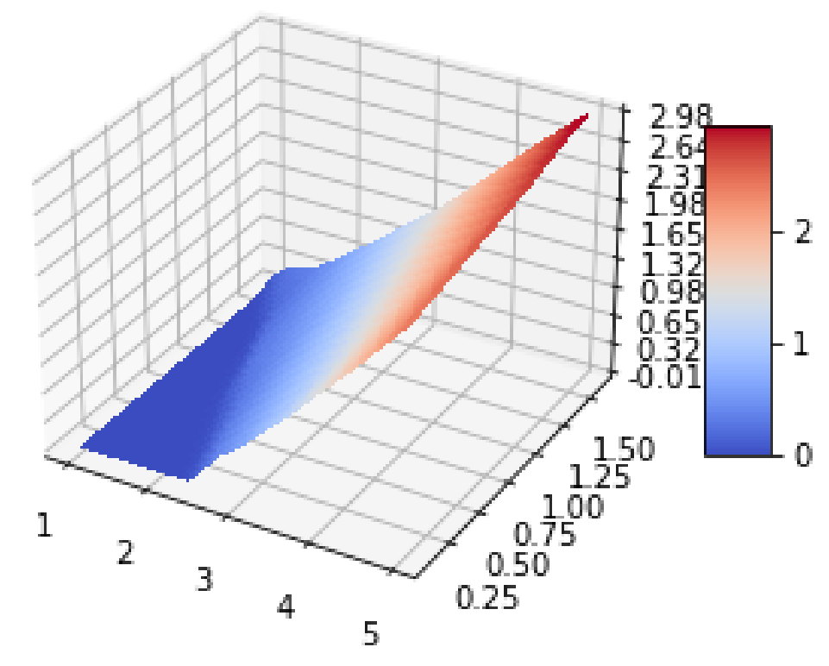
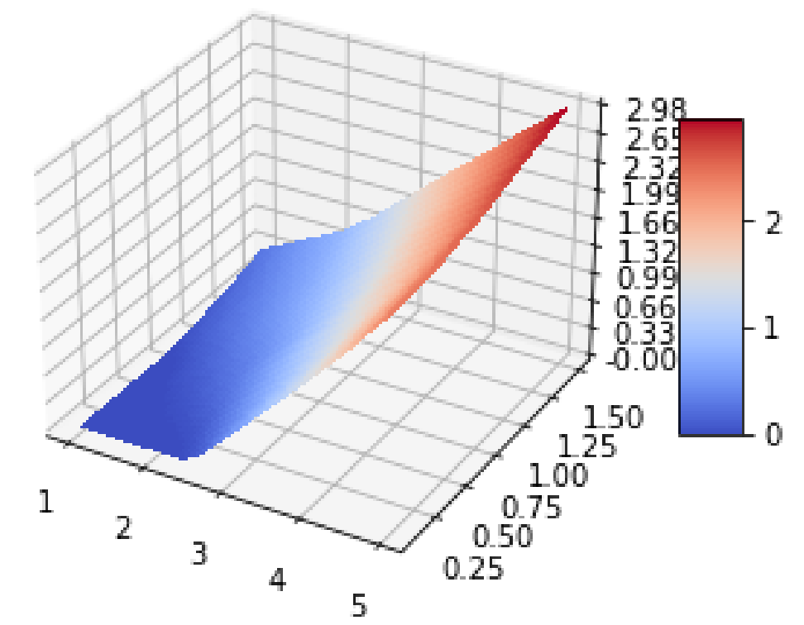
Function smoothness
the surface associated with transfer learning demonstrates a enhanced smoothness compared to the more jagged surface produced by deep learning.
Pricing surfaces for deep learning model
Pricing surfaces for transfer learning model

Slide 18
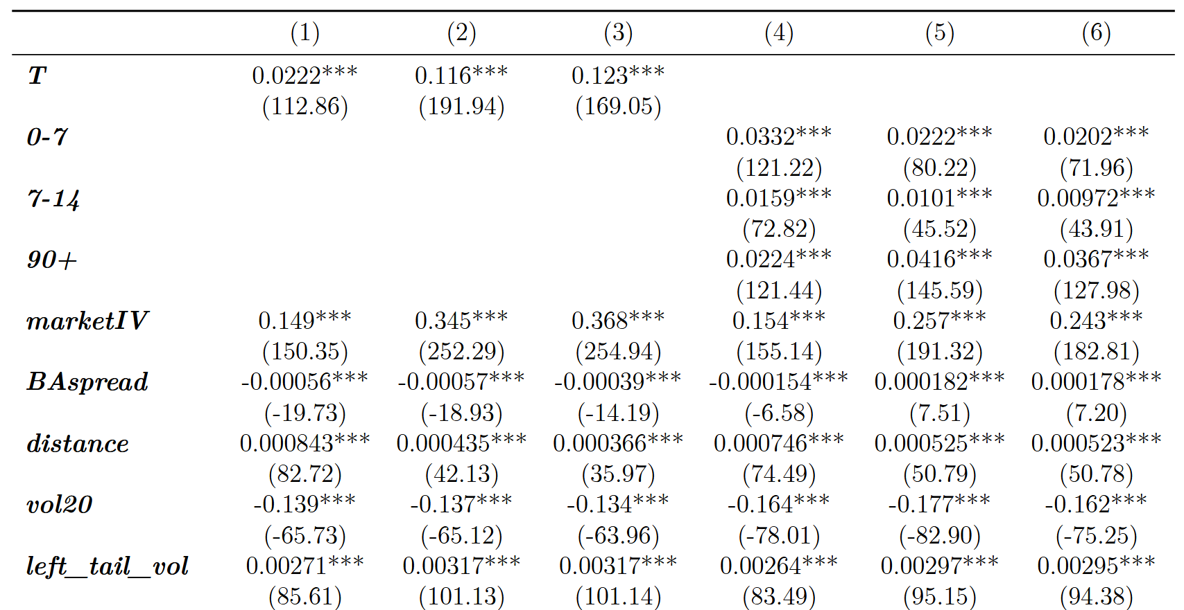
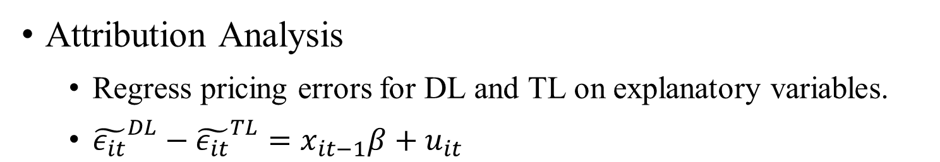
Attribution Analysis
Regress pricing errors for DL and TL on explanatory variables.
${\tilde{ε_{it}}}^{DL}−{\tilde{ε_{it}}}^{TL}=x_{it−1}β+u_{it}$

Slide 19
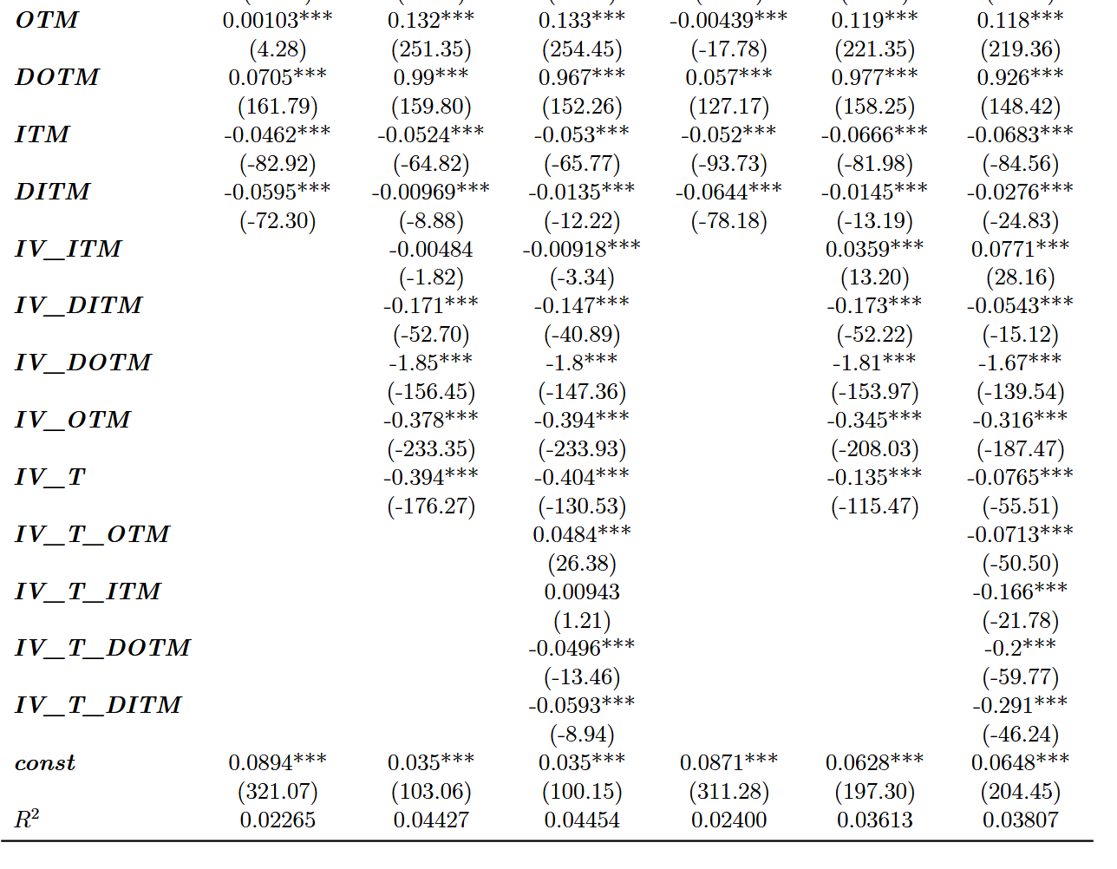

Slide 20
Conclusion
Introduce transfer learning that incorporate economic model into ML.
Transfer learning approach yields lower pricing and hedging errors compared to stochastic volatility models and direct use of deep learning.
Transfer learning overcome inherent drawbacks of data-driven methods.
Suitable for high-volatility market environments characterized by small-sample.
More robust to various shocks.
Economic models created by human help AI to overcome inherent flaws.
Even with considerable effort in feature engineering, its improvement is hard to match the help of theoretical models in the source domain for neural networks.

Slide 21
New ideas
Apply transfer learning approach to prediction tasks in other contexts.
Macroeconomic forecast (total output, inflation, labor supply, consumption)
Other pricing model (stocks, bonds, futures)

