Slide 1
Uncovering Information: Can AI Tell Us Where to Look? Anna Costello, Bradford Levy, Valeri Nikolaev (2024)
Present by Li Ziming

Slide 2
Motivation
Disclosure redundancy
Stakeholders need quickly and easily to find relevant information.
But information buried in sea of unstructured disclosure released by firm.
Information content and associated market reactions
Prior studies mostly focus on quantitative information (Ball and Brown, 1968).
Narrative information highly multidimensional and challenging to find surprise.
What is expected values for textual data is not well-defined.

Slide 3
Motivation
Measuring new information in narrative disclosures
Properties of the text(tone, proportion of words belong to reference dictionary)
Rely on subjective classification of words and unable to assess surprise.
Similarity between documents (bag of words)
Difficult to compare different disclosure type from period to period.
Shannon information
Consistent with “surprise” used in prior literature
Same modeling objective as LLMs (standard causal language modeling).

Slide 4
Research Questions
(1) How to measure surprise in narrative disclosures?
(2) Where new information is most prevalent?
(3) When surprise is released?
(4) Can explain market reaction?

Slide 5
Contribution
Contribute to literature using output of LLMs to predict returns.
Prior literature: LLM transform a source document into another representation (Lopez-Lira and Tang, 2023; Kim et al., 2023; Chen et al., 2022).
Extend: preserve source and overlay measure of information eliminating output hallucination and lookahead bias in predictability.
Contribute to literature on costly information processing.
Prior literature: measure informativeness as similarity of text across annual and quarterly reports (Cohen et al., 2020).
Extend: develop a method for forming priors and identifying new information.

Slide 6
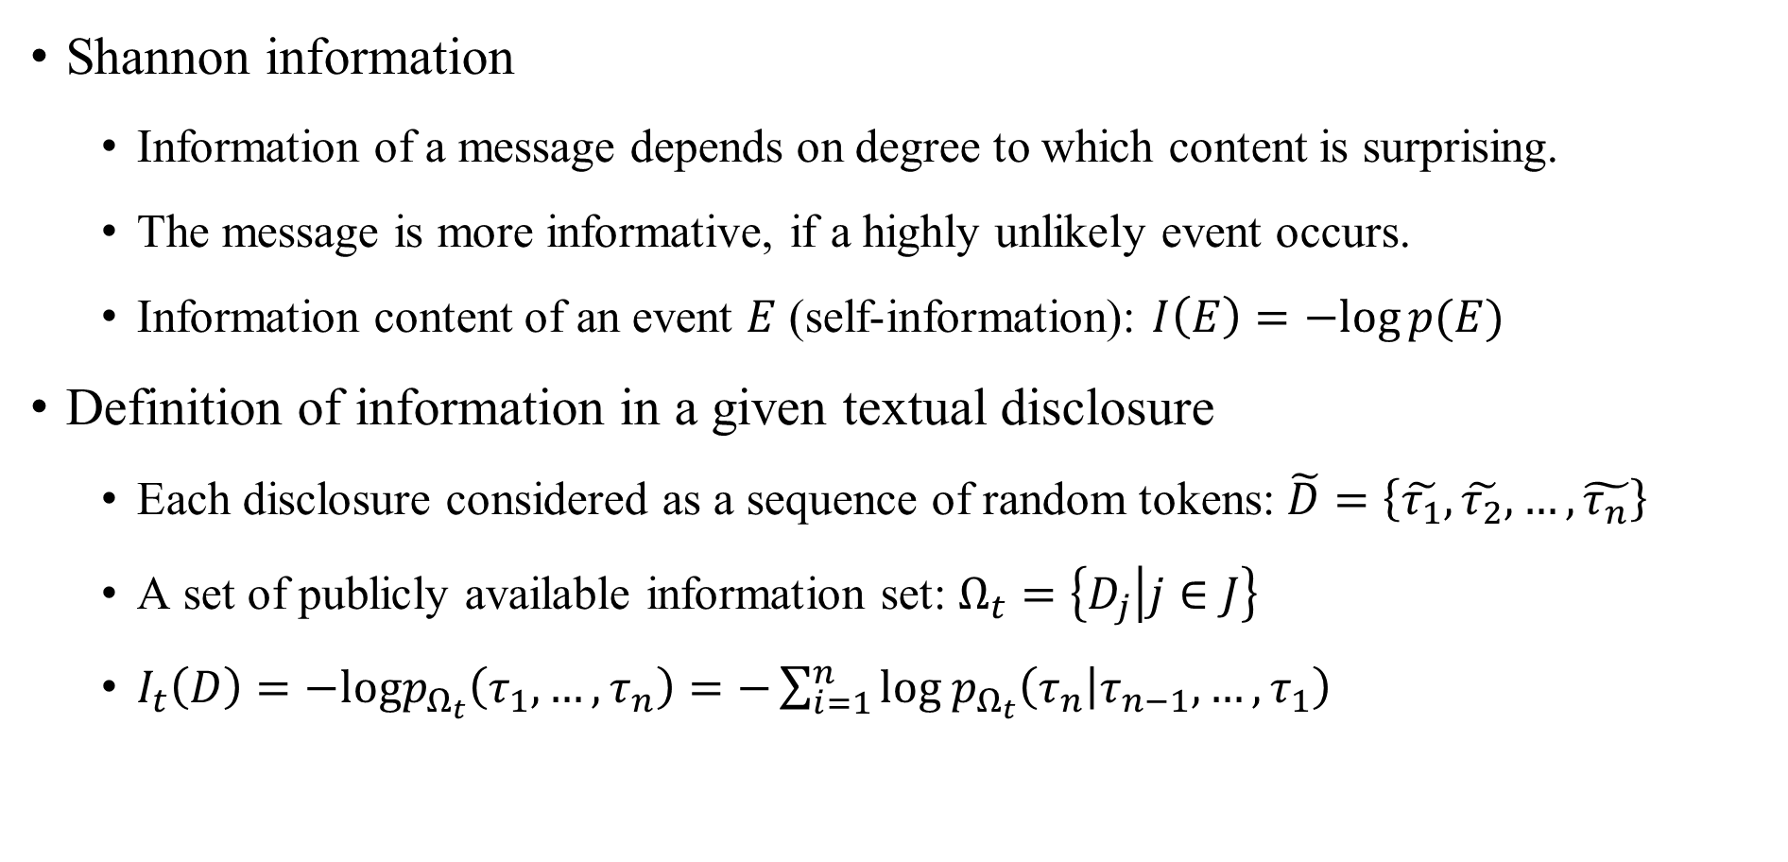
Information theory
Shannon information
Information of a message depends on degree to which content is surprising.
The message is more informative, if a highly unlikely event occurs.
Information content of an event $E$ (self-information): $I\left(E\right)=−log⁡p(E)$
Definition of information in a given textual disclosure
Each disclosure considered as a sequence of random tokens: $\tilde{D}=\left\{\tilde{τ_{1}},\tilde{τ_{2}}, …,\tilde{τ_{n}}\right\}$
A set of publicly available information set: $Ω_{t}=\left\{D_{j} | j∈J\right\}$
$I_{t}\left(D\right)=−logp_{Ω_{t}}\left(τ_{1}, …,τ_{n}\right)=−\sum_{i=1}^{n}{{log p}_{Ω_{t}}\left(τ_{n} | τ_{n−1}, …,τ_{1}\right)}$

Slide 7
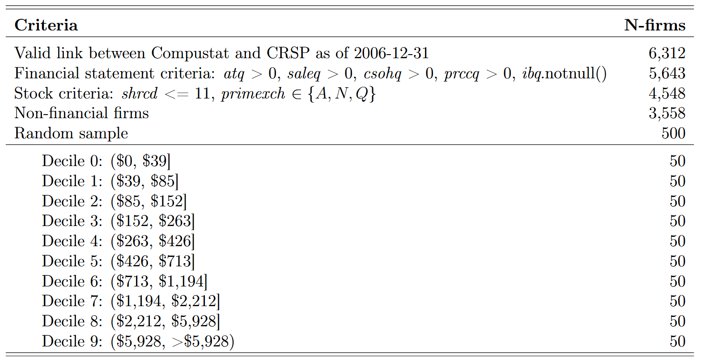
Sample Construction

Slide 8
Sample Construction
Extracting narrative disclosure
BeanCounter corpus (Wang and Levy, 2024)
Plain text versions of all filings accepted by SEC EDGAR system from 1996 to 2023
Annual and quarterly reports (10-K, 10-Q), current reports (8-K), proxy statements (DEF 14A), registrations of material M&A information (S-4)
Tokenization
BPE: Byte-Pair Encoding (Sennrich et al., 2016)
Train a tokenizer from scratch using in-sample disclosures within corpus

Slide 9
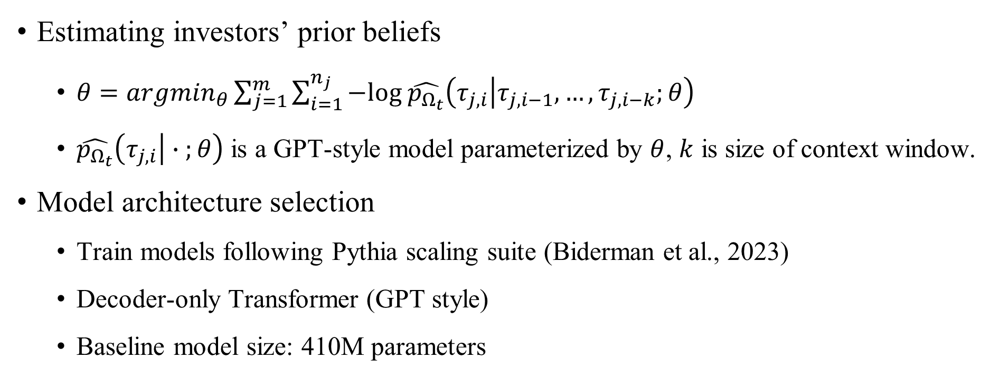
Model Training and Inference
Estimating investors’ prior beliefs
$θ=arg\min_{θ}\sum_{j=1}^{m}{\sum_{i=1}^{n_{j}}{−log \hat{p_{Ω_{t}}}\left(τ_{j,i} | τ_{j,i−1}, …,τ_{j,i−k};θ\right)}}$
$\hat{p_{Ω_{t}}}\left(τ_{j,i} | ∙ ;θ\right)$ is a GPT-style model parameterized by $θ$, $k$ is size of context window.
Model architecture selection
Train models following Pythia scaling suite (Biderman et al., 2023)
Decoder-only Transformer (GPT style)
Baseline model size: 410M parameters

Slide 10
Model Training and Inference
Cross-sectional model
Pre-train a single model on narrative disclosures of all firms from 1996 to 2007
Firm and time-specific models
Initialize cross-sectional model and continue pretrain using a single firm’s disclosures prior to 2007 to yield a firm-specific model for each firm.
Iteratively apply each firm-specific model to firm’s new disclosures in time order from 2007 through 2023 to measure information content and then update firm-specific model by continued pretraining on the new disclosure.

Slide 11
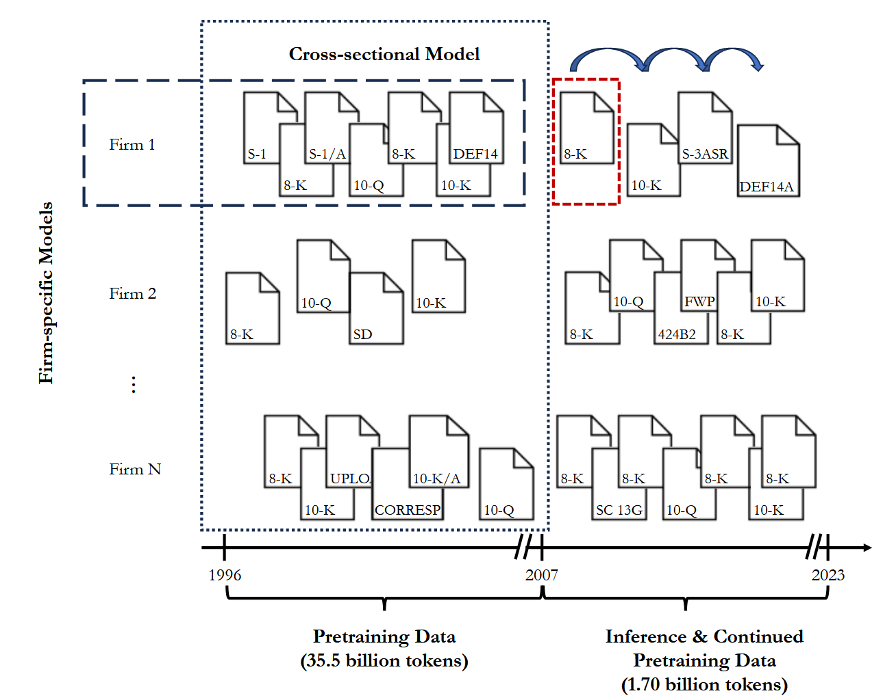

Slide 12
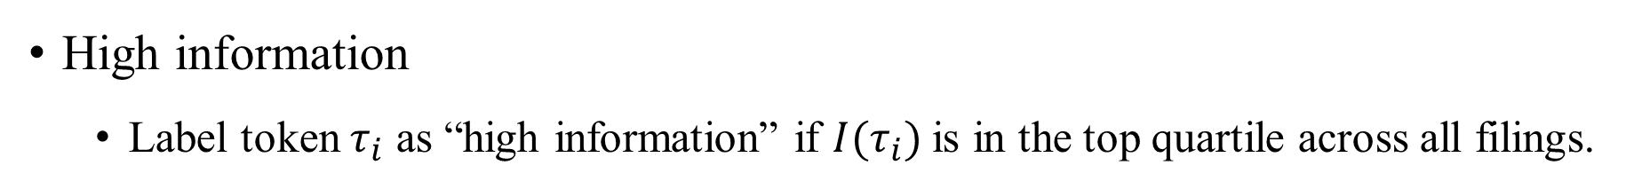
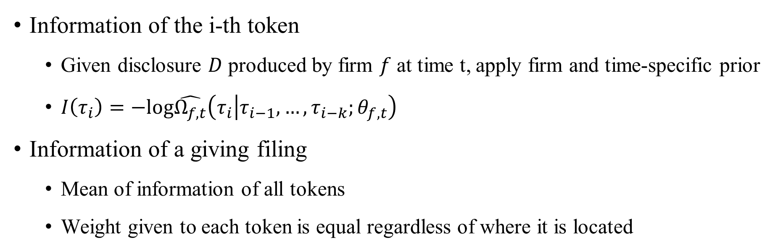
Measure of Information
Information of the i-th token
Given disclosure $D$ produced by firm $f$ at time t, apply firm and time-specific prior
$I\left(τ_{i}\right)=−log\hat{Ω_{f,t}}\left(τ_{i} | τ_{i−1}, …,τ_{i−k};θ_{f,t}\right)$
Information of a giving filing
Mean of information of all tokens
Weight given to each token is equal regardless of where it is located
High information
Label token $τ_{i}$ as “high information” if $I(τ_{i})$is in the top quartile across all filings.

Slide 13
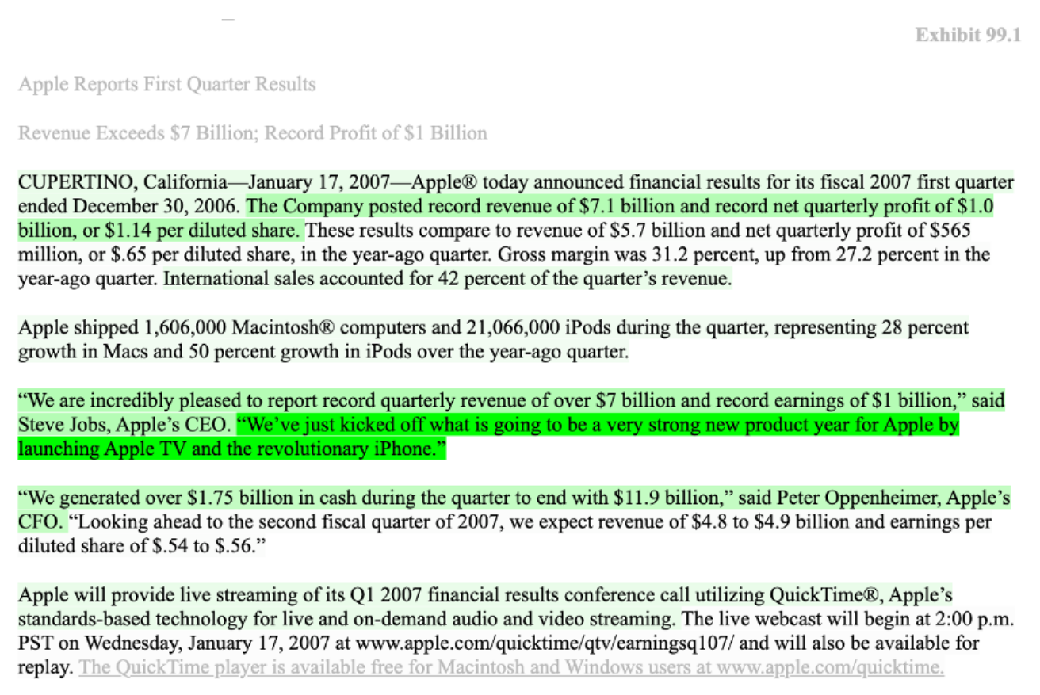

Slide 14
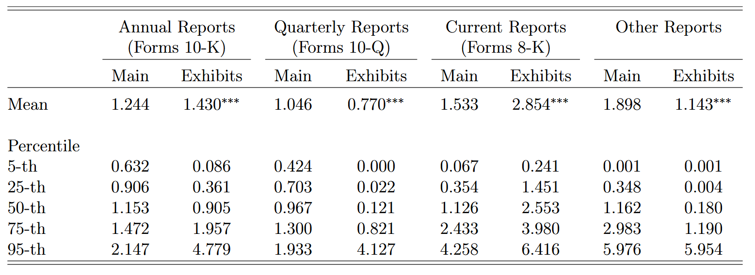
Location of Information

Slide 15
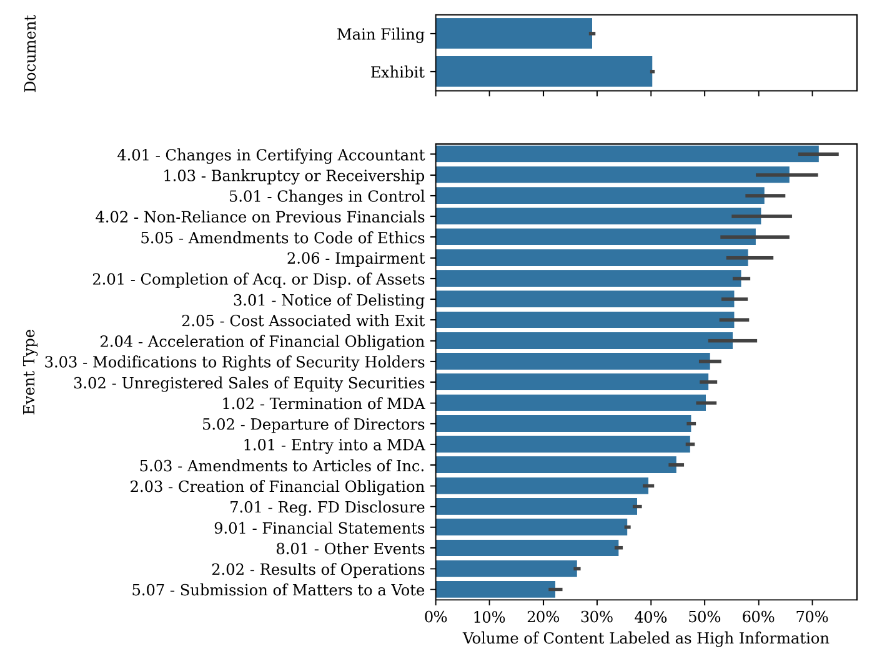
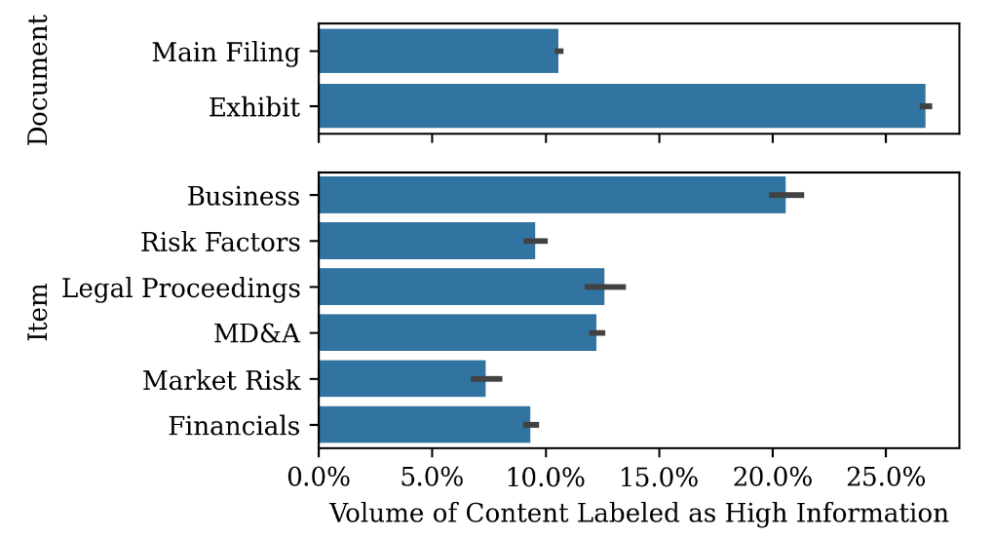
Location of Information

Slide 16
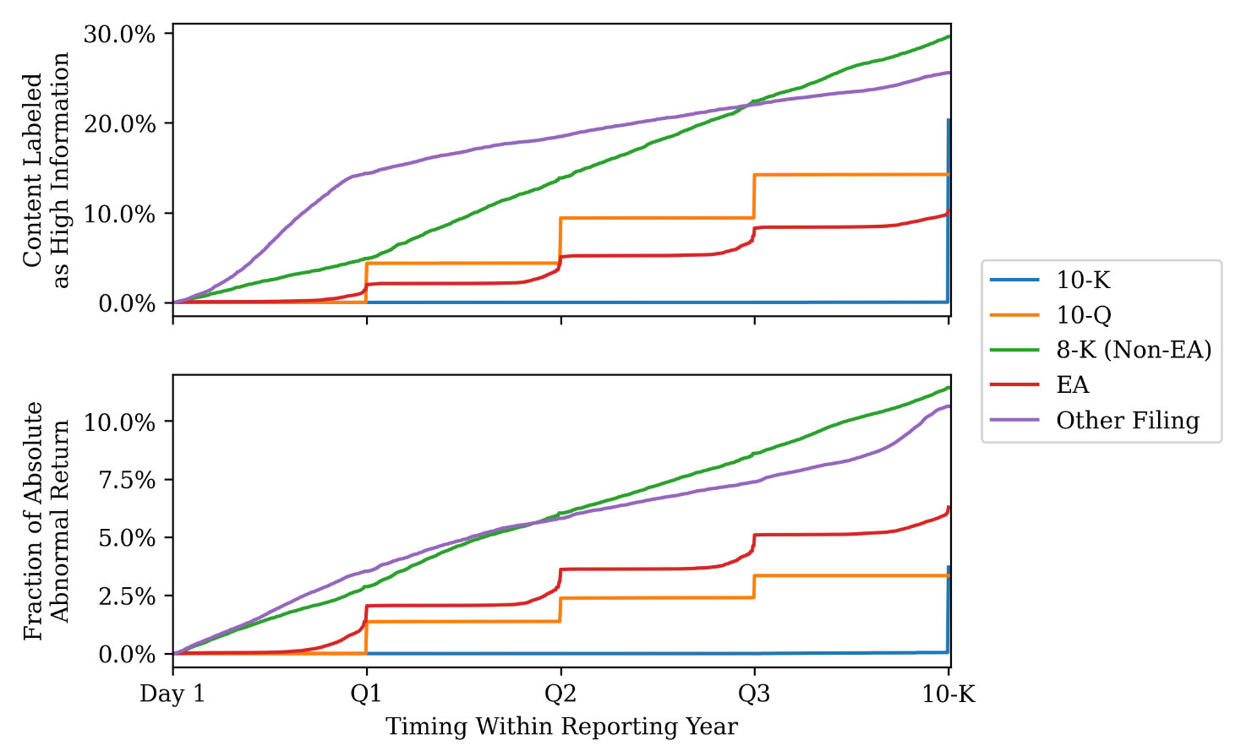
Timing of Information Release

Slide 17
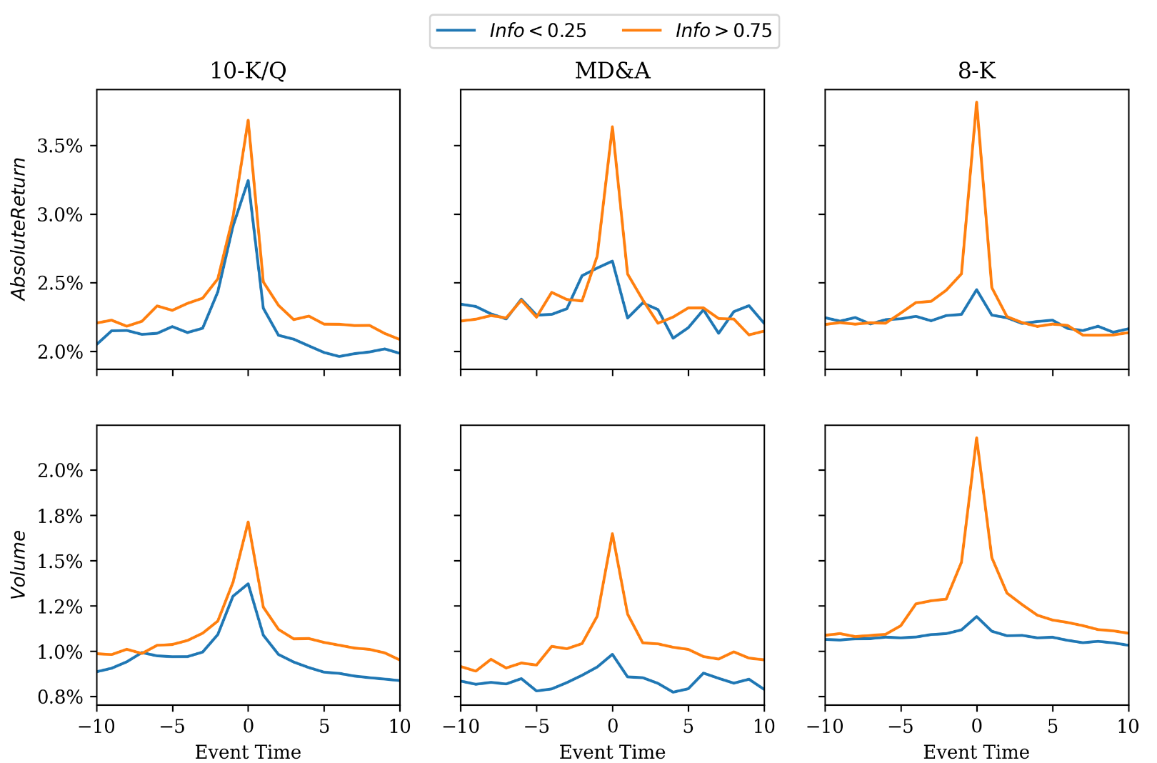
Market Reaction

Slide 18
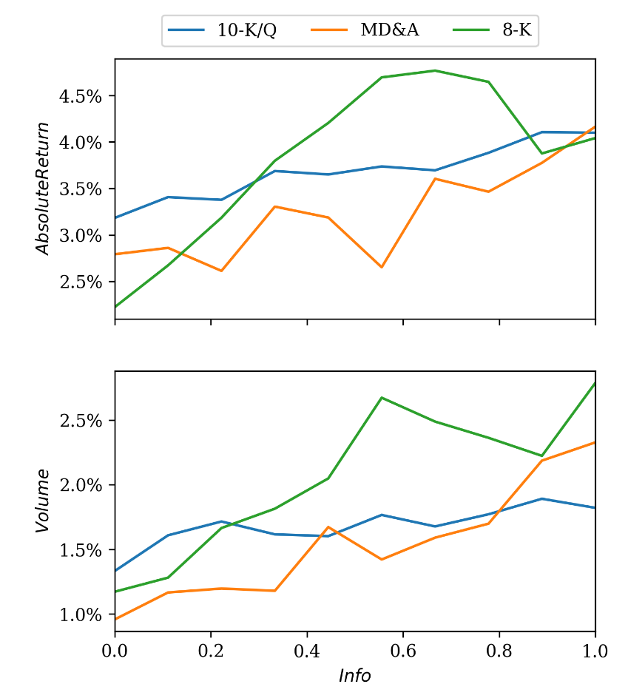

Slide 19
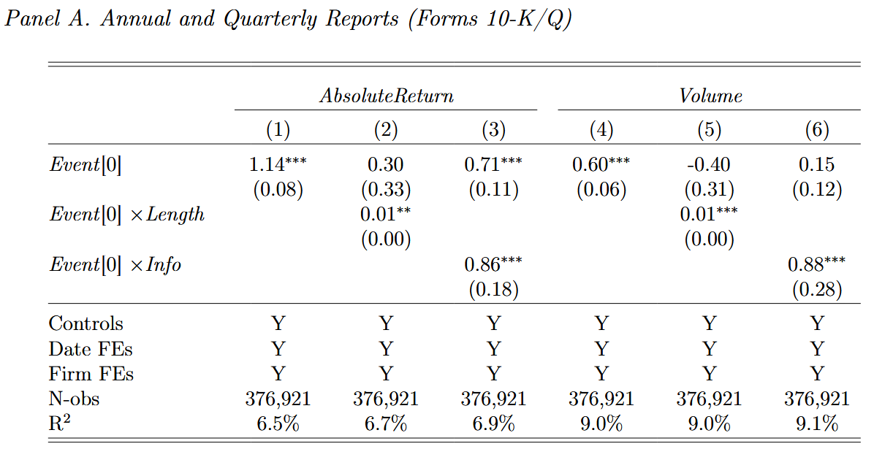
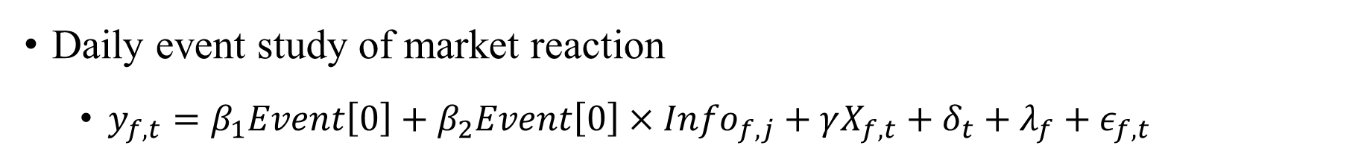
Daily event study of market reaction
$y_{f,t}=β_{1}Event\left[0\right]+β_{2}Event\left[0\right]×{Info}_{f,j}+γX_{f,t}+δ_{t}+λ_{f}+ε_{f,t}$

Slide 20
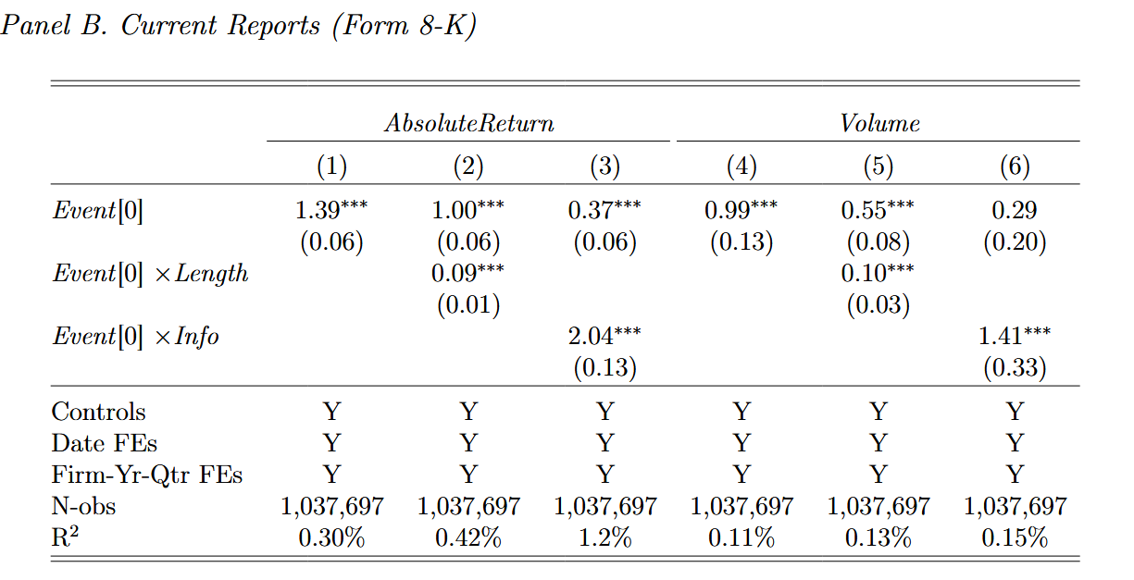
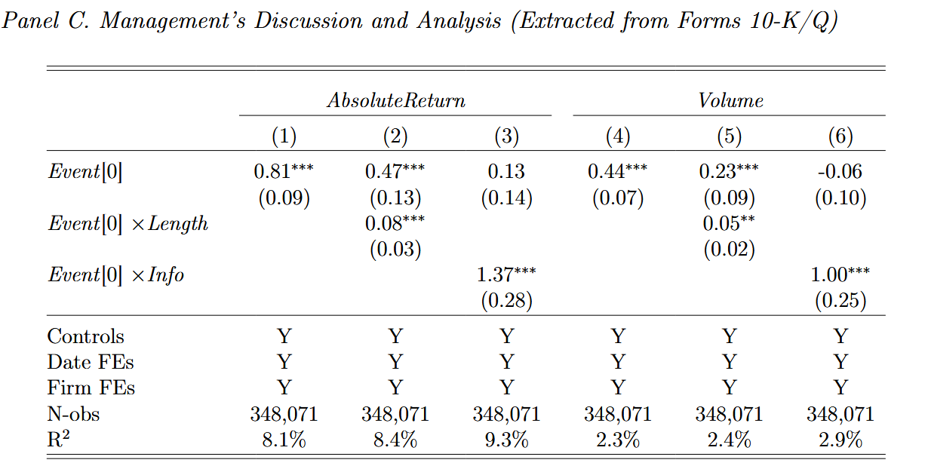

Slide 21
New ideas
Combine measurement of multimodal data
Can LLMs measure new information in data and tables?
Directly input pdf type filings?
Has information in filings been released through other channels?
Insider information, industry information, macro information
Conference Call, news, social media

