Slide 1

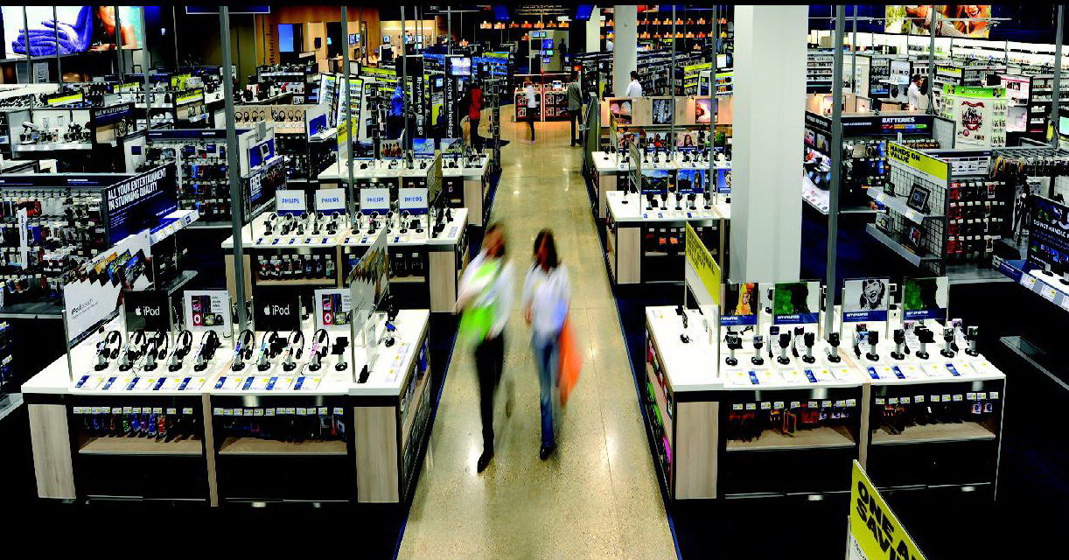
Big Data 从洞察到价值
薄云 2013年11月

Slide 2


















Portfolio
<number> | 42
About big data：
The next frontier for innovation, competition, and productivity .The amount of data in our world has been exploding, and analyzing large data sets—so-called big data.
프로젝트 명
프로젝트 명
프로젝트 명
프로젝트 명
프로젝트 명
프로젝트 명
프로젝트 명
프로젝트 명
프로젝트 명
프로젝트 명
프로젝트 명
프로젝트 명
프로젝트 명
프로젝트 명
프로젝트 명
프로젝트 명
프로젝트 명
프로젝트 명

Slide 3
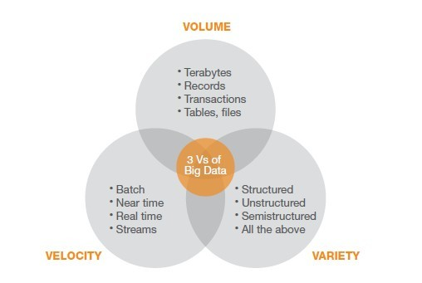

Slide 4
价值
内部洞察
外部洞察
管理者素质
决策
企业文化
预测
管理使命

Slide 5
内部洞察
管理使命、管理者素质和企业文化
some of the best performing retailers are using big data analyties not just for finance and operational activities ,but to boost competitive advantage on everthing from displays to market, cunstomer service and customer experience management.

Slide 6
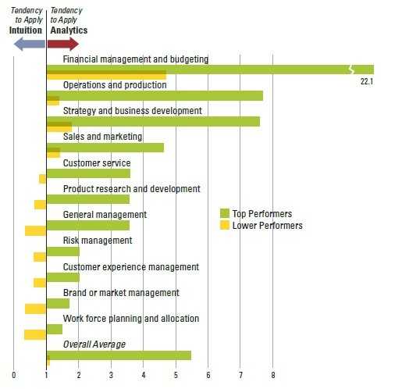

Slide 7
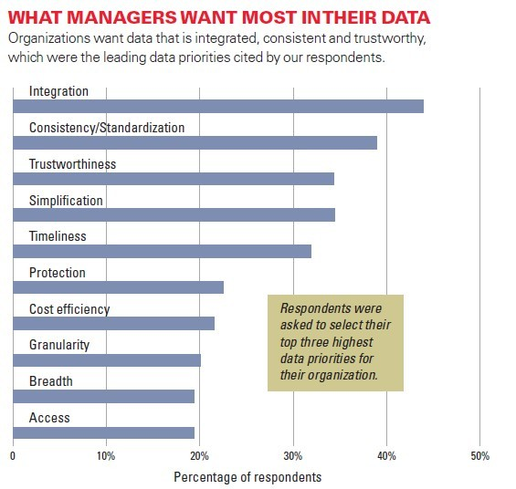

Slide 8
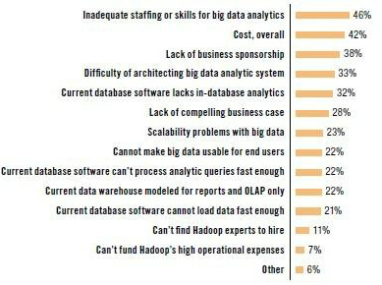

Slide 9
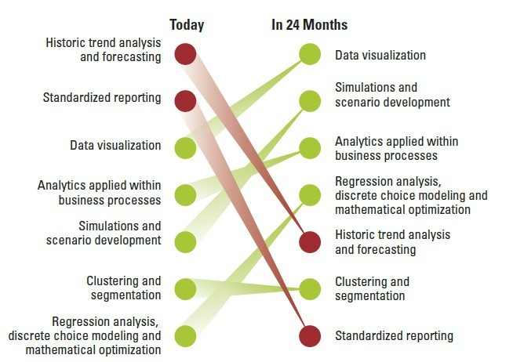

Slide 10



Three levels of capabilities emerged, each with distinct opportunnities.
Aspirational.
Experienced.
Transformed.
86%
4%
10%

Slide 11
Aspirational.
Often they are focusing on efficiency or automation of existing processes and searching for ways to building blocks — people, processes or tools — to collect, understand, incorporate or act on analytic insights.

Slide 12
Experienced.
often through successes with efficiencies at the Aspirational phase — these organizations are looking to go beyond cost management. Experienced organizations are developing better ways to collect, incorporate and act on analytics effectively so they can begin to optimize their organizations.

Slide 13
Transformed.
They use analytics as a competitive differentiator and are already adept at organizing people, processes and tools to optimize and differentiate. They aremost focused on driving customer profitability and making targeted investments in niche analytics.

Slide 14
 | aspirational | experienced | transformed
Motive | Use analytics to justify actions | •Use analytics to guide actions | Use analytics to prescribe actions
Functional proficiency | •Financial management and budgeting •Operations and production •Sales and marketing | •All Aspirational functions •Strategy/business development •Customer service •Product research/development | • All Aspirational and Experienced • Risk management •Customer experienceWork force planning/allocation •General management •Brand and market management

Slide 15
 | aspirational | experienced | transformed
Business challenges | • Competitive differentiation through innovation •Cost efficiency (primary) •Revenue growth (secondary) | • Competitive differentiation through innovation •Revenue growth (primary) •Cost efficiency (secondary) | • Competitive differentiation through innovation •Revenue growth (primary) • Profitability acquiring/retaining
Key obstacles | • Lack of understanding how to leverage analytics for business value • value•Executive sponsorship • Culture does not encourage sharing information | • Lack of understanding how to leverage analytics for business value •Skills within line of business • Ownership of data is unclear | • Lack of understanding how to leverage analytics for business value • Management bandwidth due to •Accessibility of the data

Slide 16
 | aspirational | experienced | transformed
Data management | • Limited ability to capture, aggregate, analyze or share information and insights | • Moderate ability to capture, and analyze data • Limited ability to share information and insight | • Strong ability to capture, aggregate and analyze data • Effective at sharing information and insights.
Analytics in action | • Rarely use rigorous approaches to make decisions • Limited use of insights to guide future strategies or day-to-day operations | • Some use of rigorous approaches to make decisions •Growing use of insights to guide future strategies, but still limited use of insights to guide day-to-day operations | • Most use rigorous approaches to make decisions • Almost all use insights to guide future strategies, and most use insights to guide day-to-day operations

Slide 17
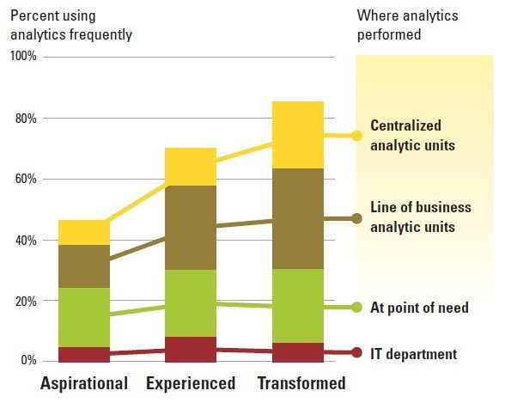

Slide 18
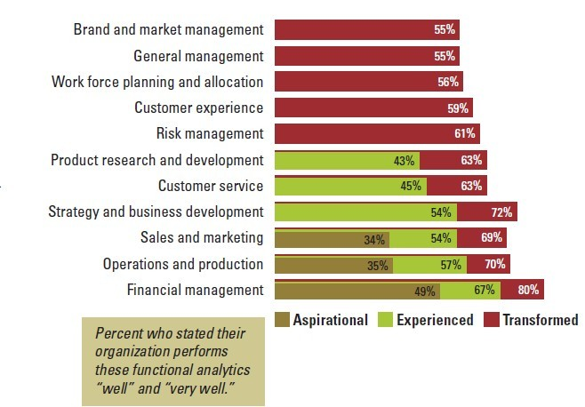

Slide 19
外部洞察
管理最重要的是决策
决策最重要的是预测

Slide 20
本研究的相关界定：
相对于大数据模型，那些我们以前使用的，数据量以千为单位的那些模型，我们称之为传统模型。
这些传统模型包括仿真技术、回归分析、优化建模、聚类和细分等。
指标：设计统计心理、地理、个人性格、心理对产品和品牌优先购买特征的参数系。
数据样本：对多样化目标有关联的指标矢量。

Slide 21
问题一：随着云平台的搭建，数据增长能够让传统的预测模型获得新收益吗？
结论：目前的工作表明，尽管拥有丰富的描述性数据，现有的模型并不能从增长的数据中获得更多的价值。但是，对于非传统预测模型的分析，大数据打开了我们的视野。

Slide 22
uy7u7yy
问题二：传统的预测模型为什么对大数据无能为力？
big data: Sparse, Fine-Grained (Behavior) Data.A key aspect of such datasets is that they are sparse: for any given instance, the vast majority of the features have a value of zero or “not present”.

Slide 23
到目前为止，大数据有巨大的价值，还只是从文化的角度在给我们暗示。希望云平台的巨型计算机扮演起上帝，资源池里有足够大的数据，让我们拥有上帝之眼，去看每一个人的行为，把数据串联成画面般的故事，我们就能看得到每一个消费者的特征、动机，我们就能预测、引导他们的行为。
each data point may incorporate less information, but when taken in aggregate perhaps provide much more.

Slide 24
背景：长尾理论（The Long Tail）
是网络时代兴起的一种新理论，由美国人克里斯·安德森提出。长尾理论认为，由于成本和效率的因素，当商品储存流通展示的场地和渠道足够宽广，商品生产成本急剧下降以至于个人都可以进行生产，并且商品的销售成本急剧降低时，几乎任何以前看似需求极低的产品，只要有卖，都会有人买。这些需求和销量不高的产品所占据的共同市场份额，可以和主流产品的市场份额相比，甚至更大。

Slide 25
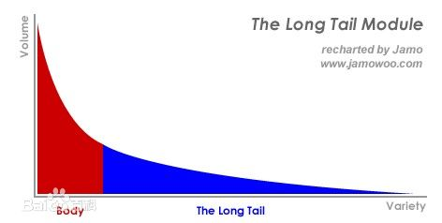

Slide 26
“长尾”实际上是统计学中幂律（Power Laws）和帕累托分布（Pareto distributions）特征的一个口语化表达。过去人们只能关注重要的人或重要的事，如果用正态分布曲线来描绘这些人或事，人们只能关注曲线的“头部”，而将处于曲线“尾部”、需要更多的精力和成本才能关注到的大多数人或事忽略。例如，在销售产品时，厂商关注的是少数几个所谓“VIP”客户，“无暇”顾及在人数上居于大多数的普通消费者。而在网络时代，由于关注的成本大大降低，人们有可能以很低的成本关注正态分布曲线的“尾部”，关注“尾部”产生的总体效益甚至会超过“头部”。长尾所涉及的冷门产品涵盖了几乎更多人的需求，当有了需求后，会有更多的人意识到这种需求，从而使冷门不再冷门。

Slide 27
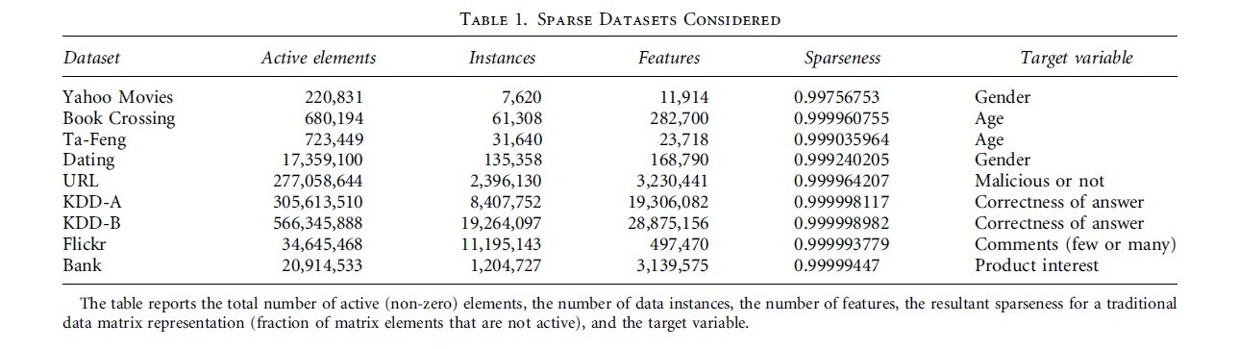

Slide 28
背景：学习曲线
学习曲线有时又称练习曲线（practice curves）利用数据和资料为企业经营管理工作提供预测和决策依据的一种方法，是引起非线性成本的一个重要原因。美国康乃尔大学的商特博士总结飞机制造经验而得出了学习曲线规律，认为每当飞机的产量积累增加1倍时，平均单位工时就下降约20%，即下降到产量加倍前的80%。商特则将累积平均工时与产量的函数称为“学习曲线”。学习曲线learning curve 以横轴表示反复次数（探索次数）。以纵轴表示各种学习测试的学习过程的曲线。

Slide 29
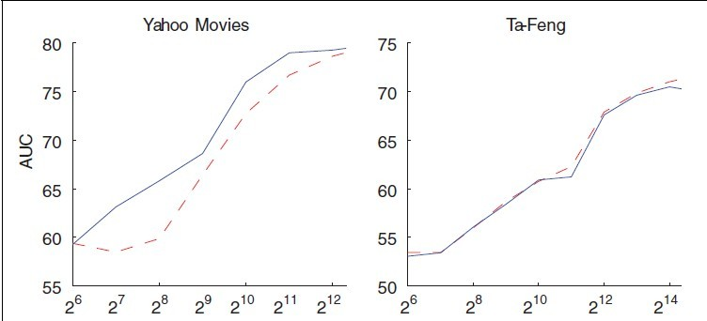

Slide 30
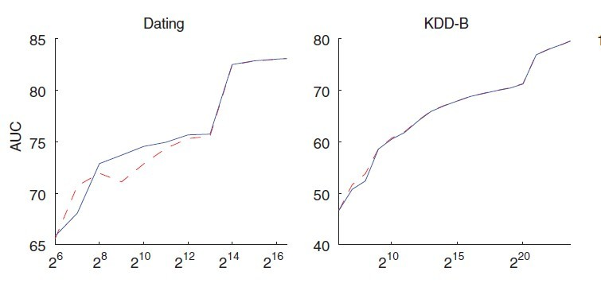

Slide 31
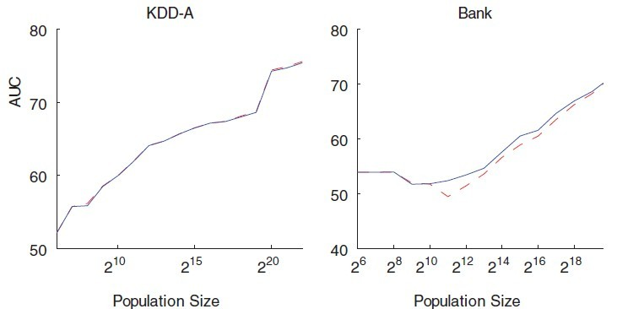

Slide 32
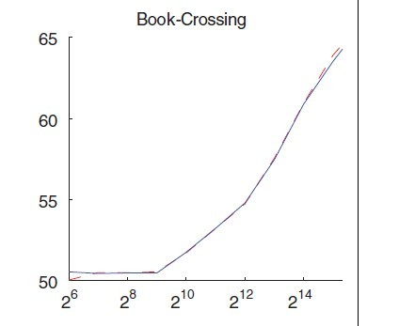
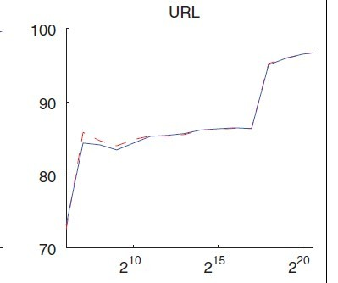

Slide 33
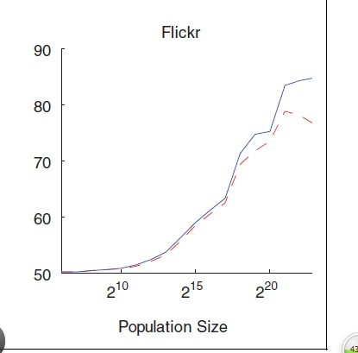
蓝色曲线为多元抽样,红色曲线为多项抽样。

Slide 34
conclusion
For most of the datasets the performance,keeps improving even when we sample more than millions of individuals for training the models.
The curves do seem to show some diminishing returns to scale. This is typical for the relationship between the amount of data and predictive performance, especially for linear models.
even for this simple, linear model, a ceiling on generalization accuracy is not reached even after sampling a very large number of data points. We would expect more sophisticated modeling procedures (esp., non-linear methods) to extend the advantages with larger data“

Slide 35
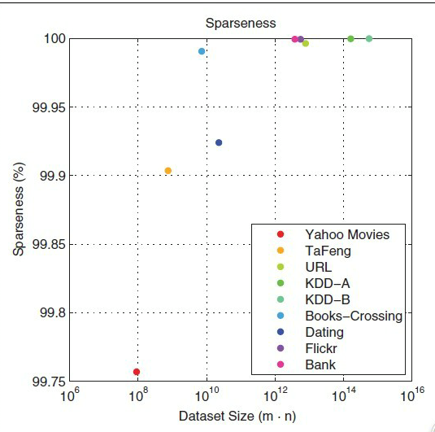

Slide 36
conclusion
these datasets are quite sparse, and the sparseness increases as the datasets grow bigger.
explanation
For behavioral data there is a clear explanation as to why the sparseness increases as dataset size increases. People only have a limited amount of "behavioral capital."any person only can take a limited number of actions. when the total number of possible actions is huge, any individual only can take a very small but increasing . This sparseness provides a key to efficient predictive modeling from massive data. It also provides a key reason why massive data are crucial to effective predictive modeling in these domains.

Slide 37
BIG is better(variety)
增大数据有两种方法, 增大样本和增大指标。

Slide 38
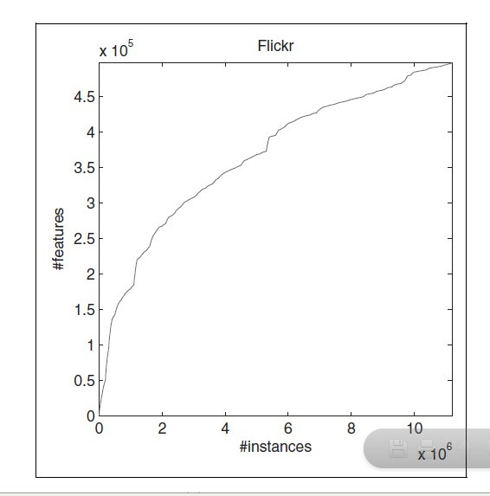

Slide 39
指标选择性增大的意义：
We would like to believe that indeed, more variety in the features ought to lead to richer models with better predictive ability.
Therefore, we should think carefully about what are the deeper motivations for feature selection and whether we believe that they indeed apply in our context.

Slide 40
指标选择出于两点:
大指标在预测模型中会导致更高的方差和关联增加过度拟合，并且会导致预测失误。
动机判断隐藏在指标的选择技术中，包括隐含和明显的。

Slide 41
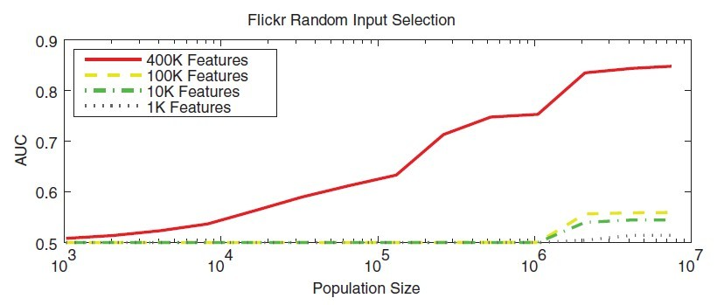

Slide 42
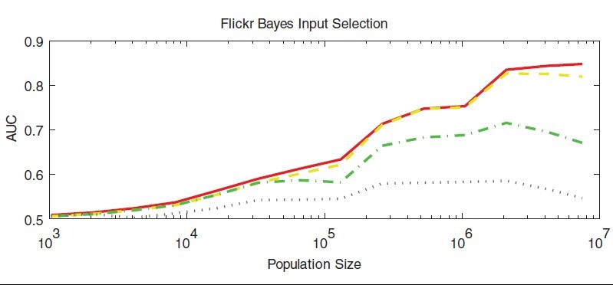

Slide 43
我们使用朴素贝叶斯分类器到学习模型，并做出预测。尽管它很简单，但是在处理系数数据的时候，表现出惊人的优越性。一个非常有吸引力的特点是朴素贝叶斯在大的，稀疏的数据集上运行时，它速度极快。主要的加速源于这样一个事实，奈¨ VE ，贝叶斯完全忽略内部指标的依赖关系，假设类内协方差的特点是零。考虑到这样的特点，我们给出朴素贝叶斯分类器的计算公式：

Slide 44
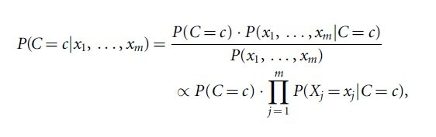

Slide 45
Thank you !

