Slide 1
Identification of a company’s suitability for the adoption of cloud computing and modelling its corresponding Return on Investment^{[1]} -企业采纳云计算的适合性识别及 云计算投资回报建模
邓国华
2014.5.9
[1] Mathematical and Computer Modelling Volume 53, Issues 3–4, February 2011, Pages 504–521

Slide 2
Outline
Background and motivation
Identification of a company’s suitability for the adoption of cloud computing
（企业采纳云计算的适合性识别）
Modelling its corresponding Return on Investment(云计算投资回报)
Conclusions

Slide 3
Ⅰ Background and motivation
A limited number of takers using CC, owing to some of challenges of its widespread adoption such as security, trust and cost effectiveness.
The lack of proper understanding of the cloud architecture, pricing model and its suitability to different requirements and scenarios of different companies with different business environments.
Dargha’s work proposed the suitability index about adopting CC^{[2]}
The cloud to be cost saving VS The cloud to be more expensive
Some surveys: Cloud is suitable for SMES
No criteria: Which make a company big ,medium or small.(Annual revenue of other factors)
No valuation to the intangible benefits of CC.
This paper helps not just identify the suitability of a company for the cloud by clearly spelling out all the factors that need to be considered ,but also tries to give a certain profitability valuation of the benefits associated with CC.
[2] Dargha R. Cloud Computing Key Considerations for Adoption[J]. Infosys Technol ogies Whitepaper, 2009.

Slide 4
Ⅱ 云计算适合性的因素及适合性值计算
采用云需考虑公司业务资源的4大特点：
Size of the IT resources.
The utilization pattern of the resources.
Sensitivity of the data they are handling.
Criticality of work done by the company.

Slide 5
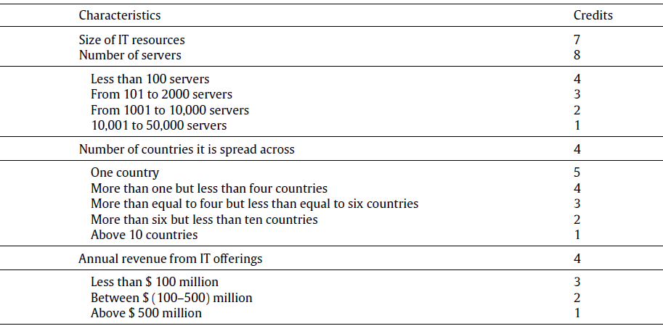
Weights of all factors according to relative importance
Size of the IT resources

Slide 6
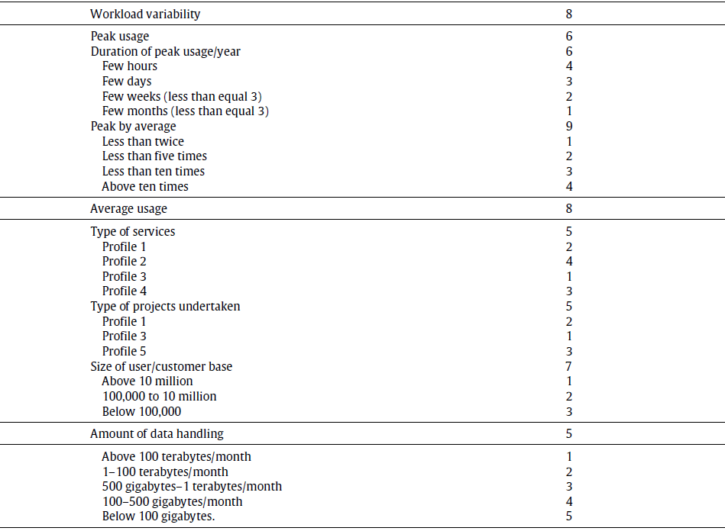
Utilization pattern of the resources

Slide 7
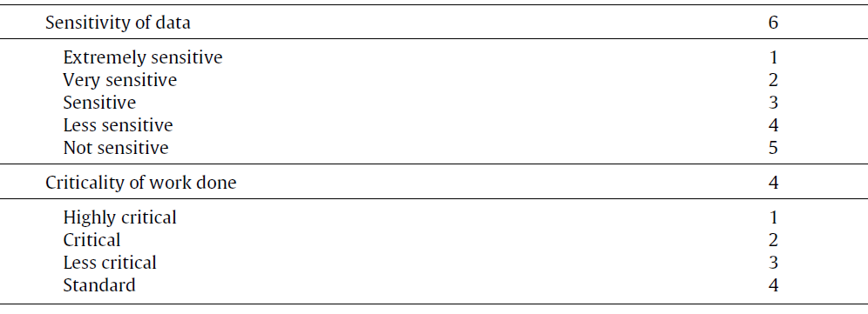
Sensitivity of data handled
Criticality of work done by the company

Slide 8

IT资源使用的5种情形（按平均使用和峰值）
注：影响因素第二部分

Slide 9
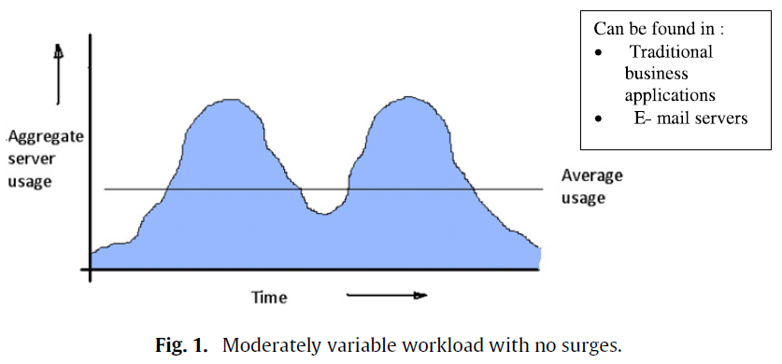
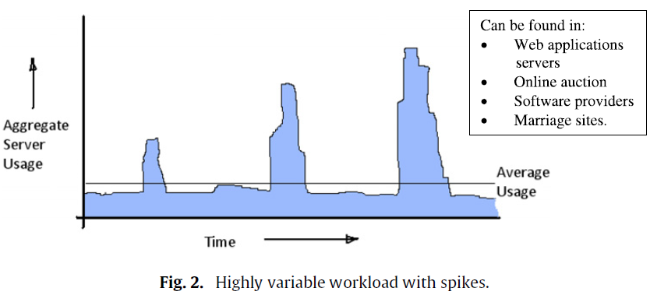
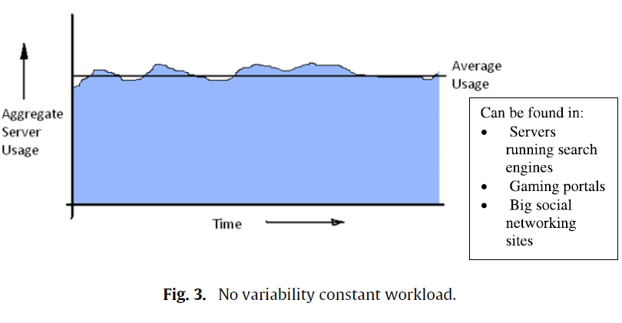

Fig1：无激增、适度变化的负载 情形1
Fig2：有激增顶峰值、高度变化的负载 情形2
Fig3：无变化的稳定负载 情形3

Slide 10
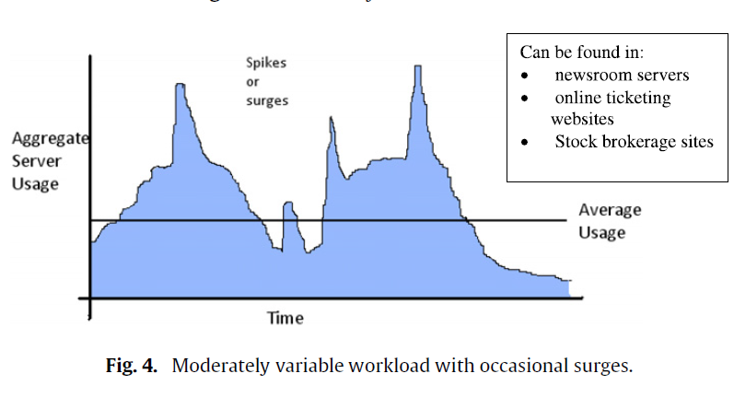
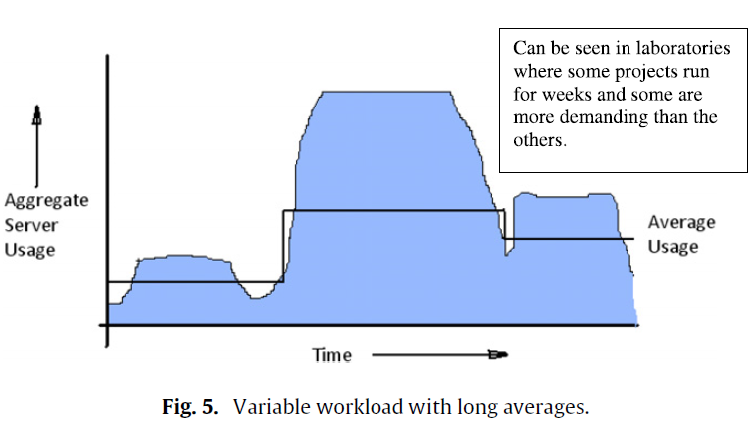
Fig4：有偶然激增、中度变化的负载 情形4
Fig5：有长时间稳定使用、变化的负载 情形5

Slide 11
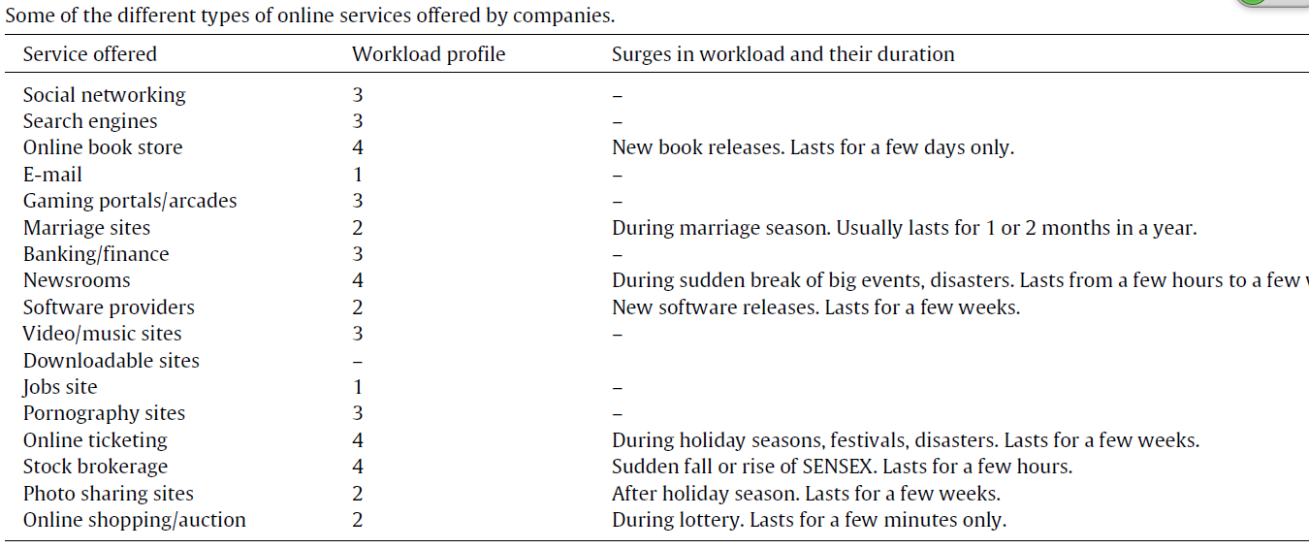
企业不同应用系统的负载类型

Slide 12
云计算的适合性值计算
Various calculations can be carried out using the following formulae:
Largeness value (L) = NoS × C_{NoS} + NoC × C_{NoC} + AR × C_{AR}.
Average Usage value (AU) = ToS × C_{ToS} (or) ToP × C_{ToP} + (4 − SCB) × C_{SCB}.
Peak Usage value (PU) = DoP × C_{DoP} + PbA × C_{PbA}.
Value of Workload Variability (WV) = PU × C_{PU} + AU × C_{AU} + ADH × C_{ADH}.
Value of Data Sensitivity (DS) = SoD.
Value of Criticality (C) = CWD.
Finally, Suitability index = L × C_{L} + WV × C_{WV} + DS × C_{DS} × ADH + C × C_{C} × (65 − L).
NoS = Number of Servers
C_{NoS} = Credit of Number of Servers
NoC = Number of Countries it is Spread Across
C_{NoC} = Credit of Number of Countries it is Spread Across
AR = Annual Revenue
C_{AR} = Credit of Annual Revenue
SCB = Size of Customer Base
C_{SCB} = Credit of Size of Customer Base
ToS = Type of Service
C_{ToS} = Credit of Type of Service
ToP = Type of Project
C_{ToP} = Credit of Type of Project
顶峰使用
PU
DoP = Duration of Peak
C_{DoP} = Credit of Duration of Peak
PbA = Peak by Average
C_{PbA} = Credit of Peak by Average
C_{PU} = Credit of Peak Usage
ADH = Amount of Data Handling
C_{ADH} = Credit of Amount of Data Handling
C_{WV} = Credit of Work Variability
C_{C} = Credit of Criticality.
规模值
数据处理量
平均使用
AU
负载变化权重
业务关键性

Slide 13
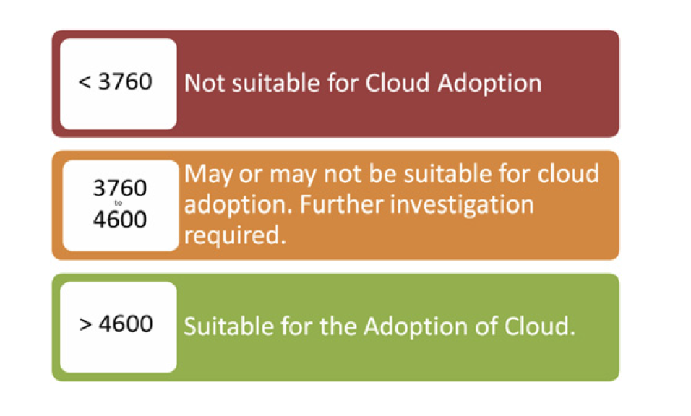
Suitability of a company for adoption of cloud

Slide 14
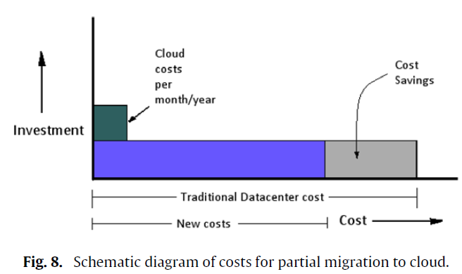
Ⅲ 云计算投资回报 (RoI)

Slide 15
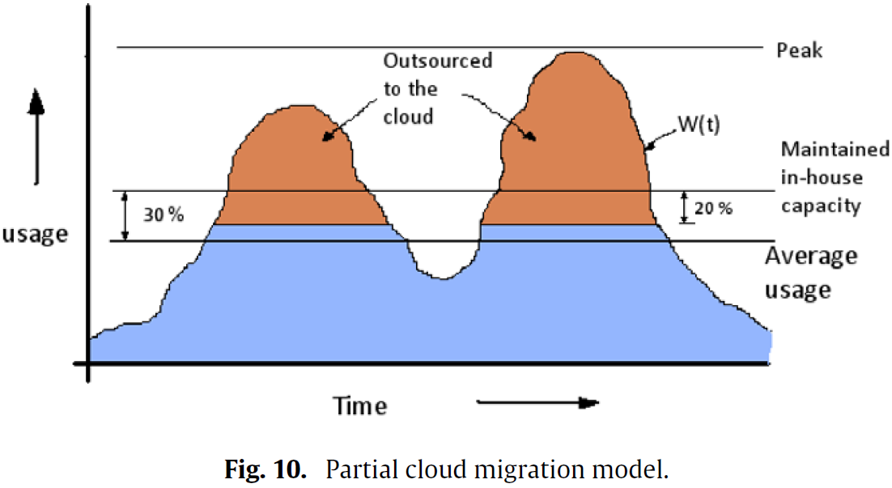
部分迁移到云中的情形：内部数据中心能维持超过平均负载30%，外包其他计算需求到云中。当超过内部服务器负载能力80%时，外包到云中。
资源总的负载^{[3]}

Slide 16
Traditional cost：
Traditional cost before cloud adoption = number of servers × cost behind each server.
Cost behind each server or TCO = costs of (electricity + cooling + maintenance + manpower + software + backup power)^{[4].}
Cost savings：
Cost saved = (initial no. of servers − present no. of servers) × TCO of each server.
Intangible benefits(采用云计算的无形收益):
（1）Profitability from Flexibility
F=contant(B)/f(L)=B/(65-L)
其中，常数B为采用云服务之前的初始年利润，f（L）是关于企业规模的函数
（2）scalability
Scalability = f (time value, customer satisfaction, faster time to market).
下面分别对time value, customer satisfaction, faster time to market可扩展性的3大收益定量分析
[3] S. Chari, Confronting the data center crisis: a cost–benefit analysis of the IBM computing on demand (CoD) cloud offering, March 2009.
[4] Li X, Li Y, Liu T, et al. The method and tool of cost analysis for cloud computing[C]Cloud Computing, 2009. CLOUD'09. IEEE International Conference on. IEEE, 2009: 93-100.

Slide 17
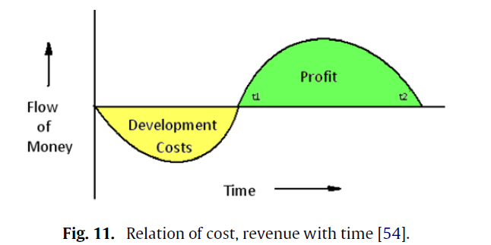
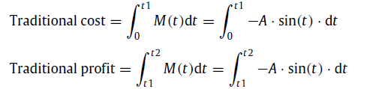
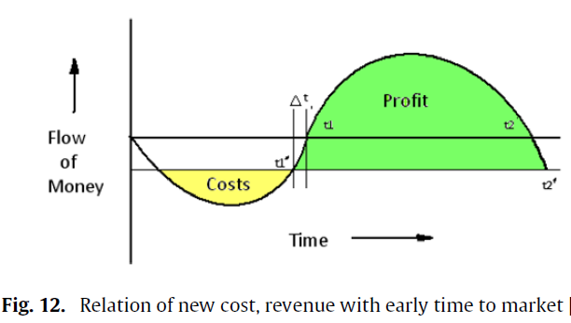
Scalability -Faster time to market
快速进入市场的资金流向示意图fig.11,
假设函数类似于正弦曲线。
flow of money M(t) = −A ・ sin(t)
where,
t1 = original time taken to market.
t2 = time for which product stays in market.
Let the time saved be Δt.
Now, the reference line becomes
y = −A ・ sin(t1 − Δt).
Therefore,

Slide 18

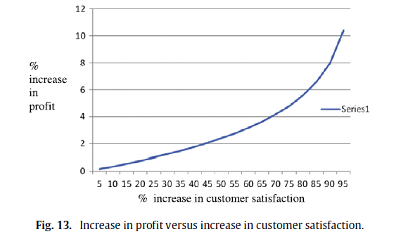
Scalability -Customer satisfaction
The increase of customer satisfaction6 can be measured by any of the general traditional methods of survey.Assuming a logarithmic curve,
where, % increase = (final% − initial%) of customer satisfaction.
B is a constant whose value (varying from 8 to 15) depends upon the type of the services

Slide 19
Scalability -Time value
CC dramatically alleviates this problem through automation, business workflows and resource abstraction reducing the lead time required from months to minutes.
Saved time in the cloud:
Focus on core competencies
Improvement in productivity can be quantified in terms of decrease in marginal cost (Mc) and increase in marginal benefits (Mb).
Disaster recovery
Disaster recovery planning is done by replicating resources in a number of places. This fear is very much reduced in the cloud as data in the cloud is replicated thrice and stored in servers which are geographically scattered.

Slide 20
Conclusion
The discussed model provides both the objective as well as the subjective decision making to find the suitability of a company for adopting CC. Companies only need calculate their suitability values using the suitability index.
CIOS and CFOS are being required to justify projects financially based on their RoI.
The analysis presented herein provides a much broader perspective and insight into Cloud Computing to its prospective adopters.

Slide 21
Thanks！

