Slide 1

OnePlusOne
Hangyu Wang
Notes:
Hello, welcome to today’s presentation and now I will introduce you an amazing Extended Multi-feature Query Processor produced by OnePlus One team.

Slide 2
Project Description
Architecture
Input structure:
SQL
JSON
PhiStruct and Opt
Algorithm
For EMF
For Optimization
Platform and Packages
Walk through DEMO
Summary and Improvement
Problem:
For standard SQL, the process of dealing with the complex relational algebraic expressions with group-bys, and sub-queries are not performed effectively.
Solution:
We can provide a syntactic framework by extending the group by statement and adding such that clause to get a more efficient and scalable algorithm for the process.
Technical Points:
Save the scan times of table;
If the grouping variables are independent then 2 scans are needed.
Notes:
So Why we need a new type processor?
For standard SQL, the process of dealing with the complex relational algebraic expressions with group-bys, and sub-queries are not performed effectively. Since sometimes, the the algorithm will cause extra but meaningless scans of the table, which is time consuming.
So to solution this problem, we can provide a framework by extending the group by statement and adding such that clause to get a more efficient algorithm for the process, so the meaningless and extra scans can be avoid.
For this project the core Technical Points is to save the scan times of table. And If the grouping variables are independent then 2 scans are needed.

Slide 3
How it works – high level architecture
First type:
1
Input (*.sql)
MFStruct
Demo List
Second type:
2
EXIT
Input (*.json)
Your SQL
0
First Scan
3
INPUT PART
Your JSON
Other Scan(s)
CODE GENERATOR
PhiStruct(6 ops)
Print Out
Opt
GeneratedCodeFor{NAME}.java
PROCESSOR PRE
PROCESSOR CORE

Slide 4
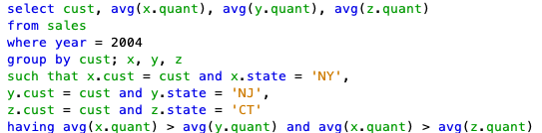
How it works – Input Structure (SQL)
ESQL:
select YOUR_PROJECTED_OUTPUTS
from YOUR_TABLE
where YOUR_WHERE_CONDITION
group by YOUR_GROUPBY_CONDITION
such that YOUR_SUCHTHAT_CONDITION
having YOUR_HAVING_CONDITION

Slide 5
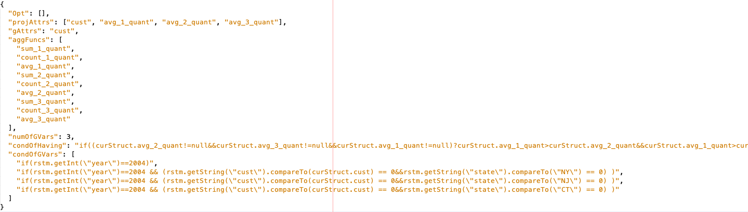
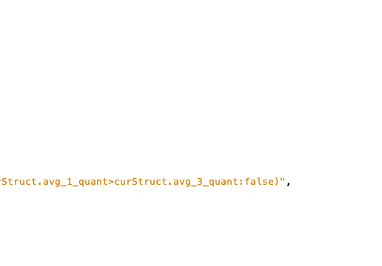
How it works – Input Structure (JSON)
JSON:
{
"Opt": [],
"projAttrs": [ PROJECTED_OUTPUTS ],
"gAttrs": GROUP_ATTRIBUTES,
"aggFuncs": [ AGG_ID_ATTR ],
"numOfGVars": NUMBER_OF_GROUP_VARS,
"condOfHaving": HAVING_CLAUSE,
"condOfGVars": [ COND_GROUP_VARS ]
}
For Opt part:
[
{
“from”: variable id,
“to”: variable id
}, …
]

Slide 6

How it works – PhiStruct & Opt
Operands Def | JSON (key) | PhiStruct | Function
Output Attributes | projAttrs | projectedAttributes List<String> | getProjATTR()
Number of GVs | numOfGVars | numOfGVars Integer | getNumOfGV()
Grouping Attributes | gAttrs | gAttributes List<String> | getG_ATTR()
Aggregation Functions | aggFuncs | aggregateFuncs List<Group> | getAggFunc()
Condition of GVs | condOfGVars | predicateOfGVars List<String> | getCond_GV()
Having Clause | condOfHaving | predicateOfHaving String | getCond_Having()
Optimazation | JSON (key) | Variables
topoSort | Opt | order List<List<Integer>>
 |  | cnt int

Slide 7
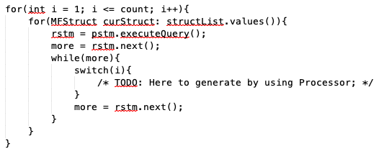
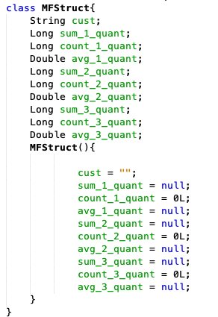
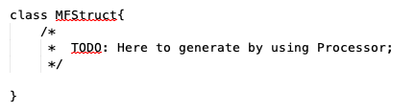
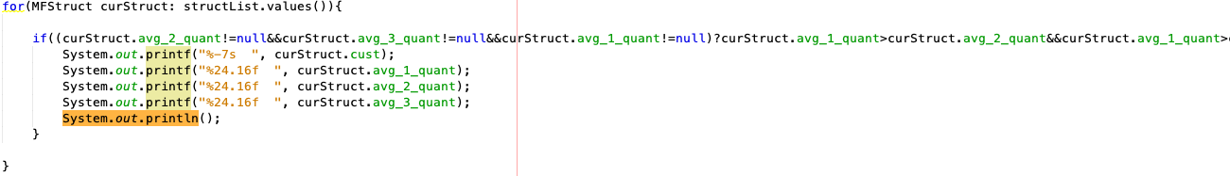
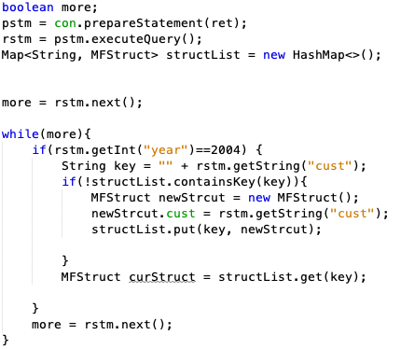
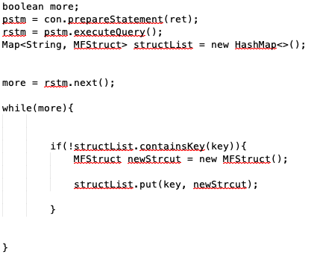
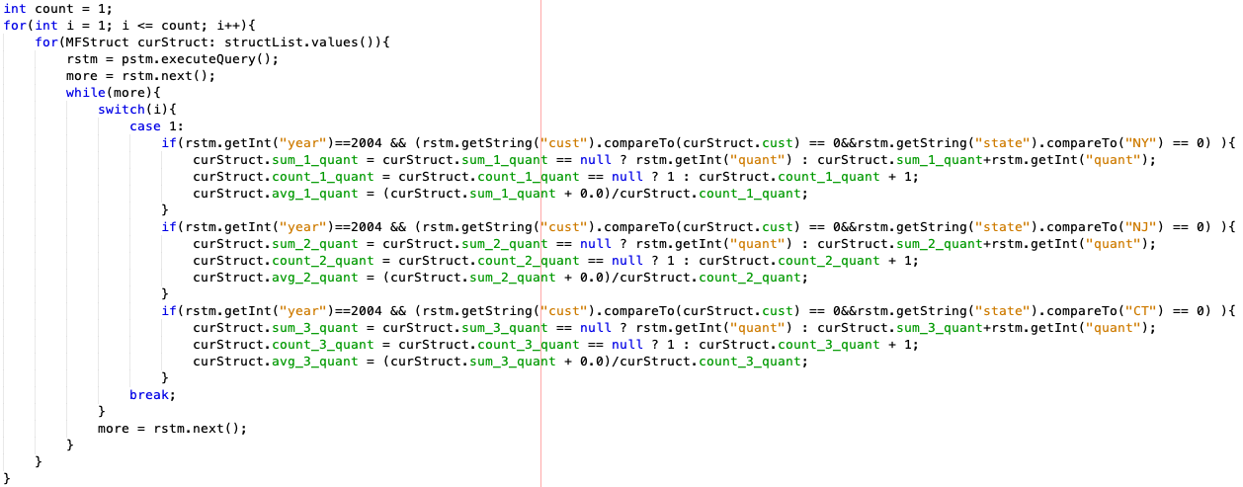

How it works – Algorithm for EMF
MFStruct
First Scan
Other Scan(s)
Print Out

Slide 8
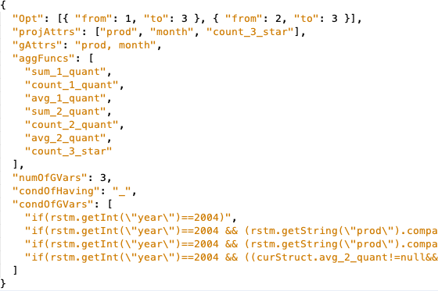
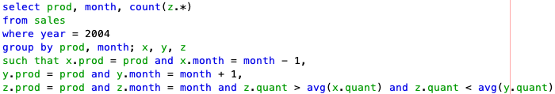
How it works – Algorithm For TopoSort
independent relations:
dependent relations:

Slide 9
More about Our Product
Development Platform: NetBeans 8.2 (Ant Build Script) and Java (JDK8)
Packages: postgresql-8.3-604.jdbc4.jar => for connecting database and fetching data
java-json.jar => for transform to/read JSON format
commons-lang3-3.10.jar => for SQL parser to identify numbers
commons-io-2.6.jar => for SQL parser and processor
to read the JSON in one time.
Limitation: 1. Not enough error throws;
2. Not good enough SQL Parser;
3. Not that intelligent on NULL value comparison

Slide 10
Summary
SQL DEMO | Scan time for Standard SQL | Scan time for ESQL
SQL1: Pivoting | 5 | 2
SQL2: Hierarchies | 3 | 2
SQL3: Trends | 5 | 2
SQL4: Dependent Aggregation | 3 | 3
SQL5: Complex Comparison | 3 | 2
SQL6: Medians | 3 | 2
Thus, the extended SQL can query in a more efficient way and the ESQL is more succinct compared to the standard one.
What to be improved:
More intelligent and powerful parser => have a better to deal with NULL value no group by clause SQL
More error check and instruction to improve the user experience.

