Slide 1
Improving Performance and Scalability of Algebraic Multigrid through a Specialized MATVEC
Majid Rasouli
Vidhi Zala
Robert M. Kirby
Hari Sundar

Slide 2
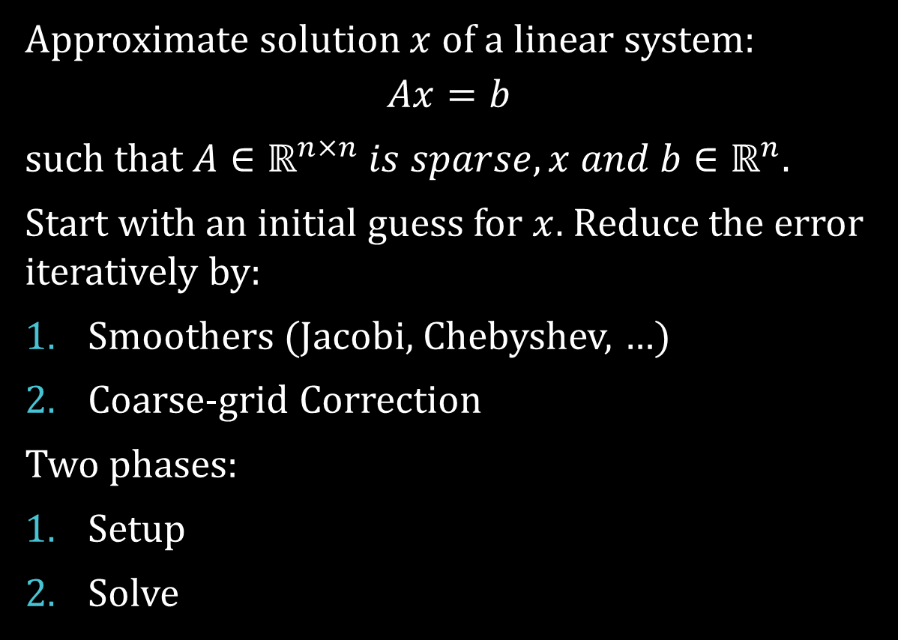
Algebraic Multigrid
Approximate solution $x$ of a linear system:
$$Ax=b$$
such that $A∈ℝ^{n×n} is sparse, x and b∈ℝ^{n}$.
Start with an initial guess for $x$. Reduce the error iteratively by:
Smoothers (Jacobi, Chebyshev, …)
Coarse-grid Correction
Two phases:
Setup
Solve

Slide 3


Setup phase: two-grid
coarsening
$$A_{coarse}=R×A×P$$
$R$: restriction, $P$: prolongation
$$A_{coarse}$$
R
A
P

Slide 4

Setup phase: multigrid
$$As\left[l+1\right]=Rs\left[l\right]×As\left[l\right]×Ps\left[l\right]$$
$As\left[0\right]$ is the finest matrix $A$.
As: coarse matrices
$Rs$: restriction matrices
$Ps$: prolongation matrices

Slide 5
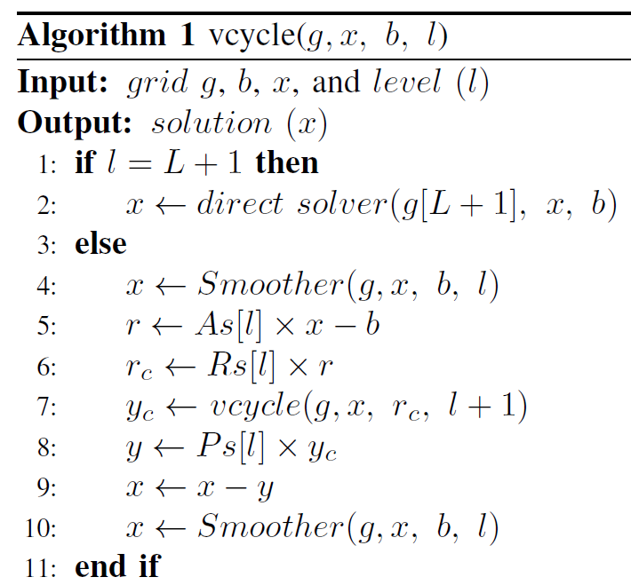
Solve phase:
MATVEC

Slide 6
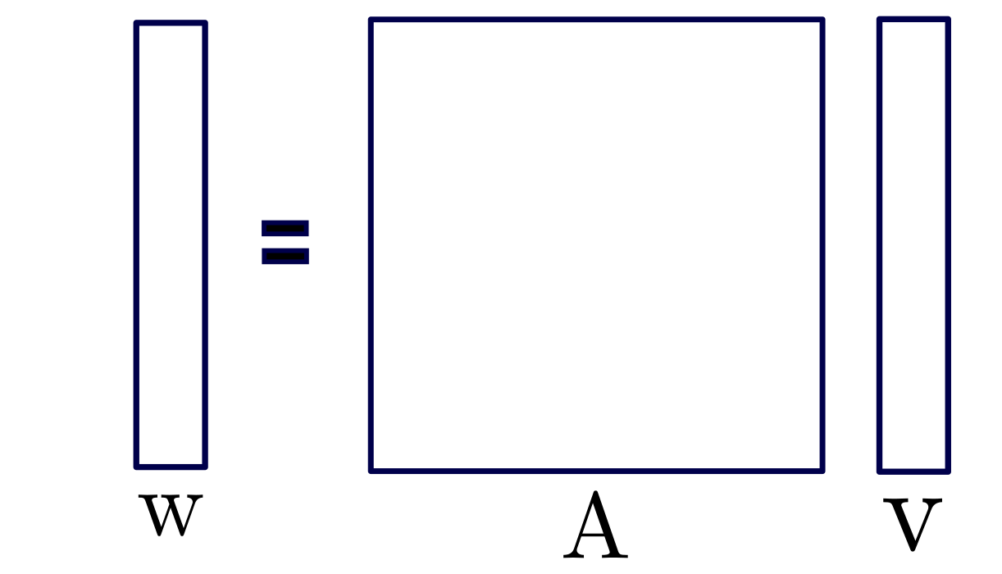
MATVEC

Slide 7
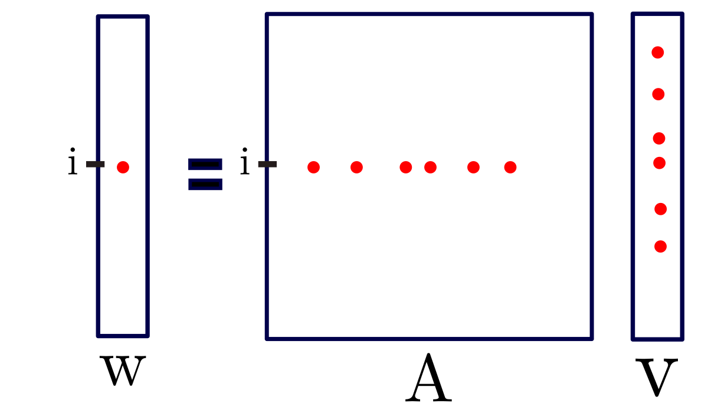
MATVEC

Slide 8
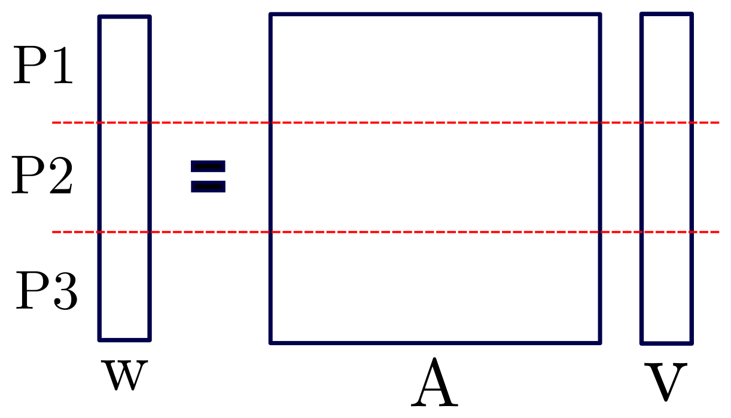
Distributed MATVEC

Slide 9
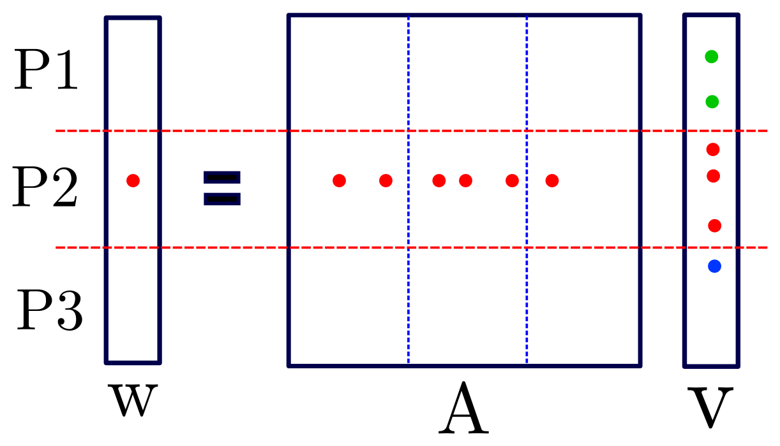
Distributed MATVEC

Slide 10
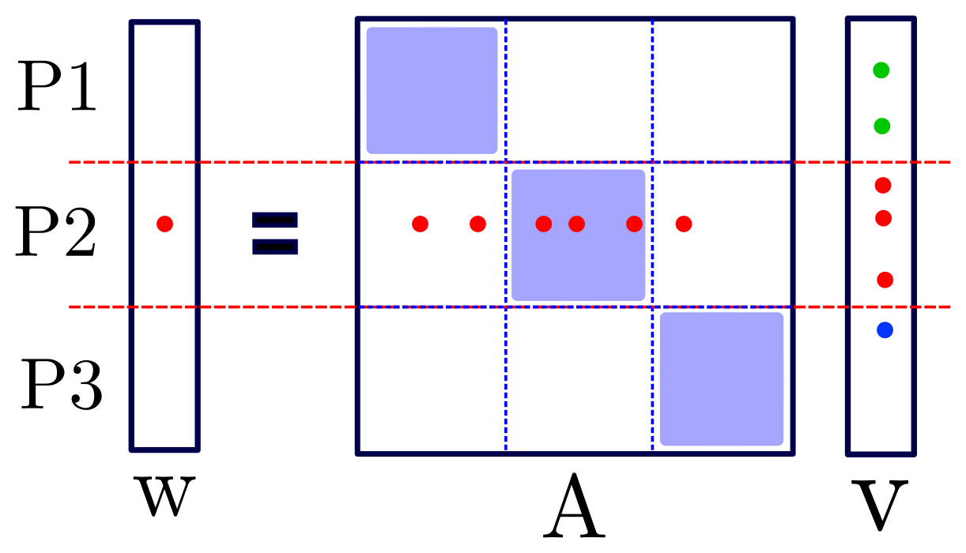
Distributed MATVEC
Local loop
Communication
Remote loop
Notes:
Now I’m gonna show you where we the issue is.

Slide 11

Problem
$$A_{coarse}$$
R
A
P

Slide 12
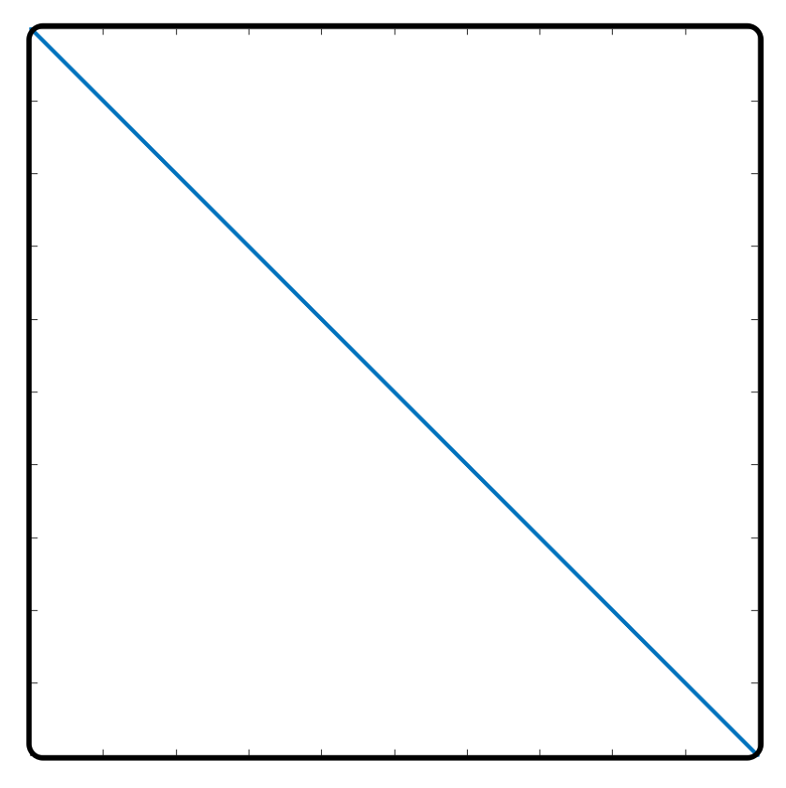
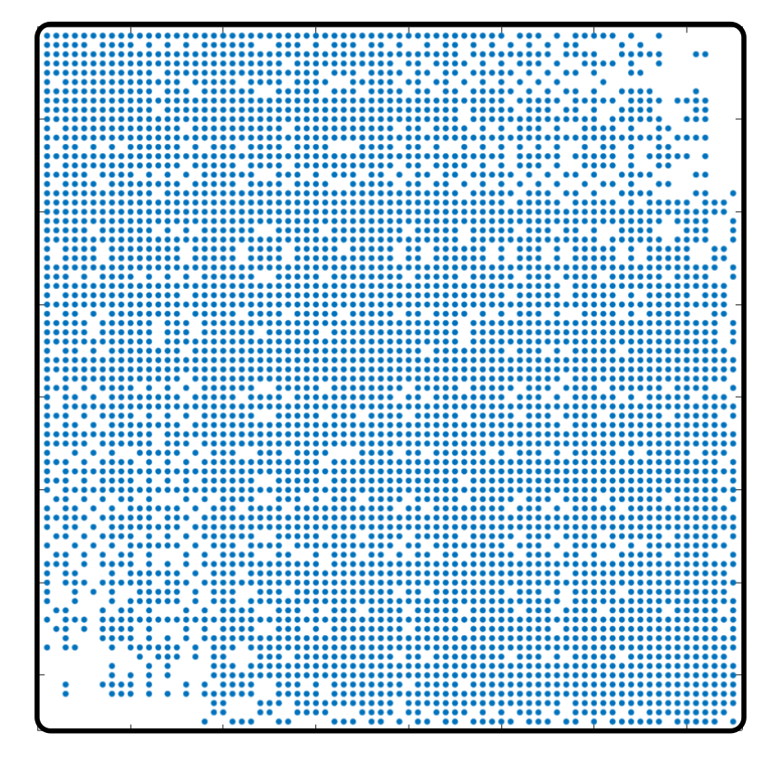
Problem
Florida Matrix Collection: ecology2
Left: input matrix, right: level 5

Slide 13
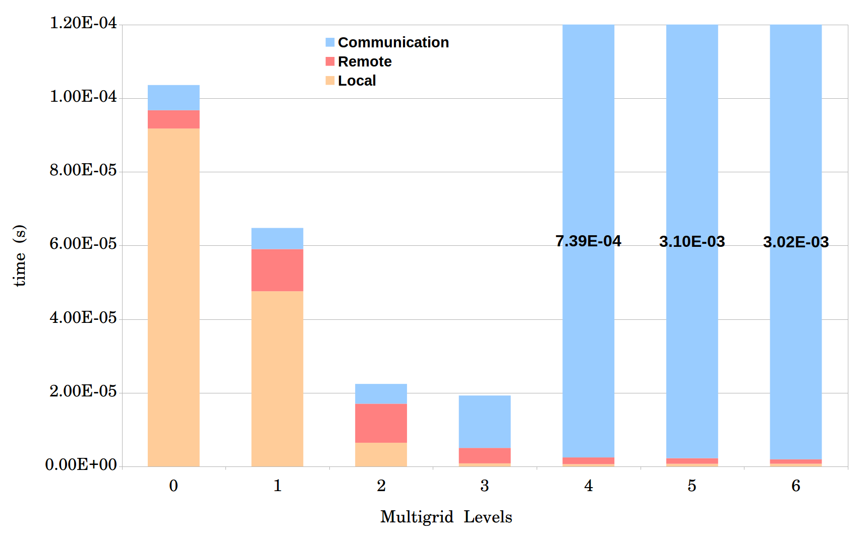
Problem
Average time for one MATVEC
Matrix ID 1883 from Florida Matrix Collection
On 1008 processors

Slide 14
Improving MATVEC
Optimized in both shared memory and distributed memory aspects.
Process Shrinking
Local MATVEC
Load-balance
Dense MATVEC

Slide 15
I. Process Shrinking
More Computing Power
More Processors
More Communication
How: Dummy MATVEC when creating coarse matrices.
When: If the communication time becomes significantly higher than local and remote loops.

Slide 16
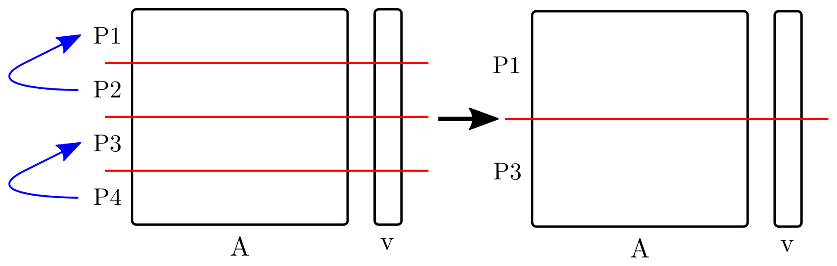
I. Process Shrinking
Simple version:
Advanced version:
There is a load-balance function for each level of multigrid.
Combine process shrinking with the load-balance function.

Slide 17
I. Process Shrinking
Average time for one MATVEC
Matrix ID 1883 from Florida Matrix Collection
On 1008 processors

Slide 18
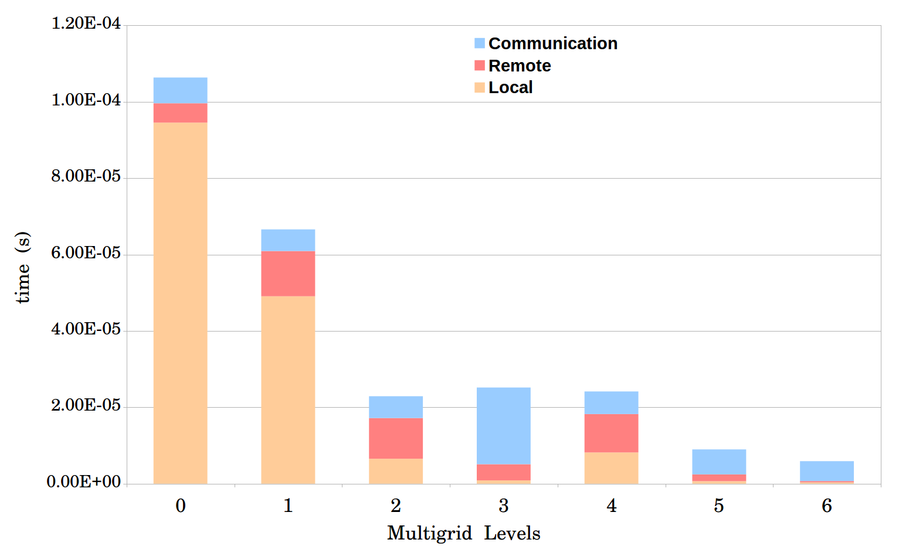
I. Process Shrinking
Notes:
Next step is improving local and remote loops.

Slide 19
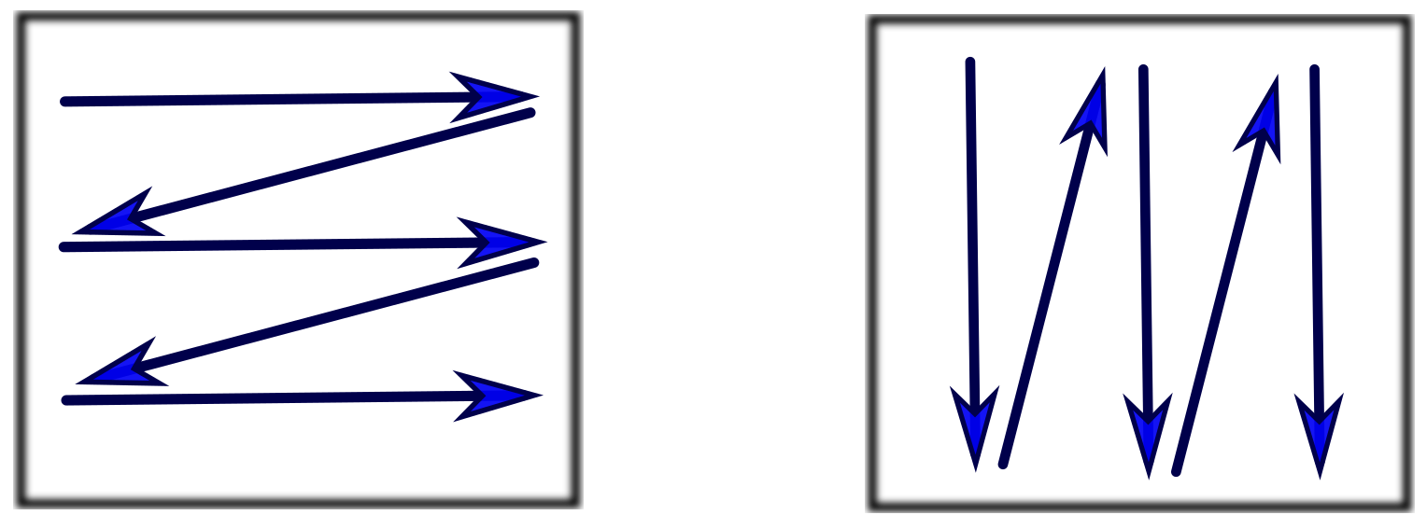
II. Local MATVEC
Shared memory optimization.
OpenMP: Using multiple threads for computations.
Column-Major
Row-Major
Staggered Row-Major
Column-Major with optimized reduction

Slide 20
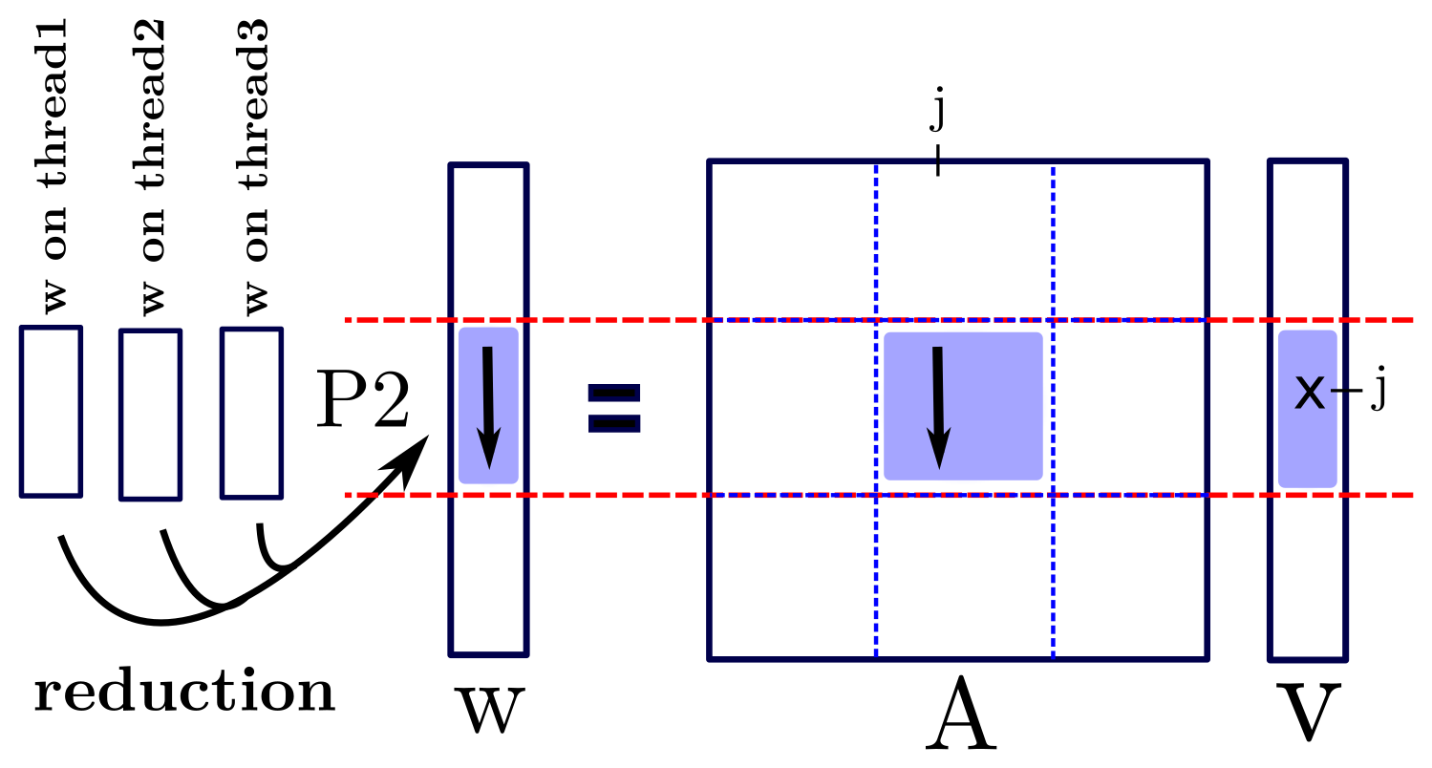
II. Local MATVEC
I. Column-Major:

Slide 21
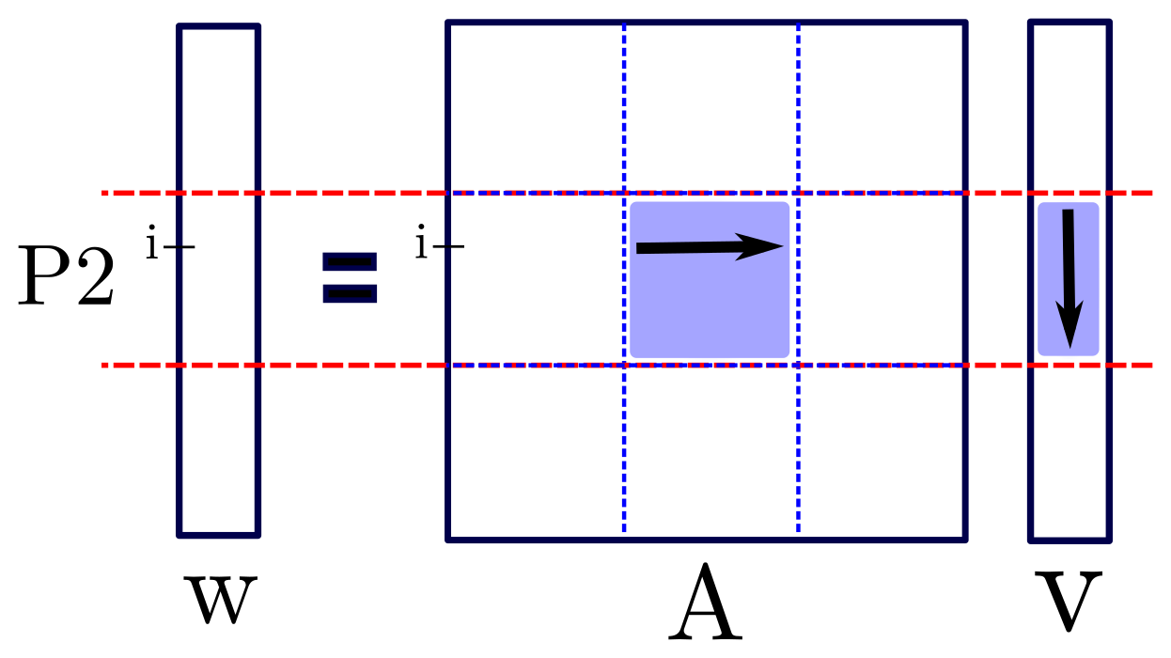
II. Local MATVEC
II. Row-Major:

Slide 22
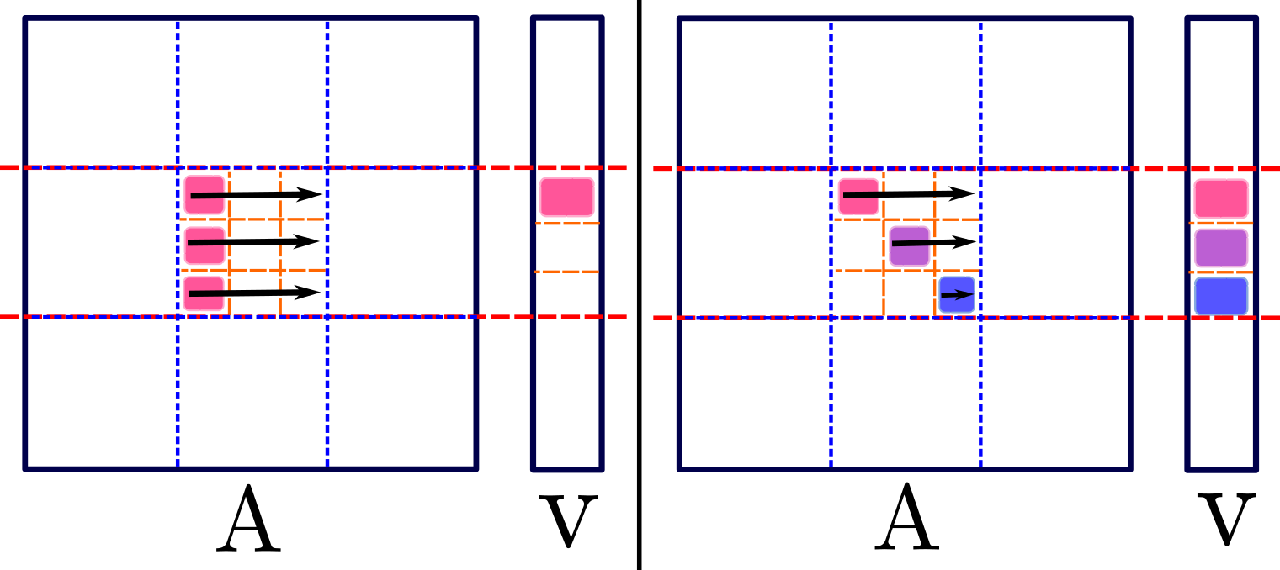
II. Local MATVEC
III. Staggered Row-Major:

Slide 23
II. Local MATVEC
IV. Column-Major with optimized reduction

Slide 24
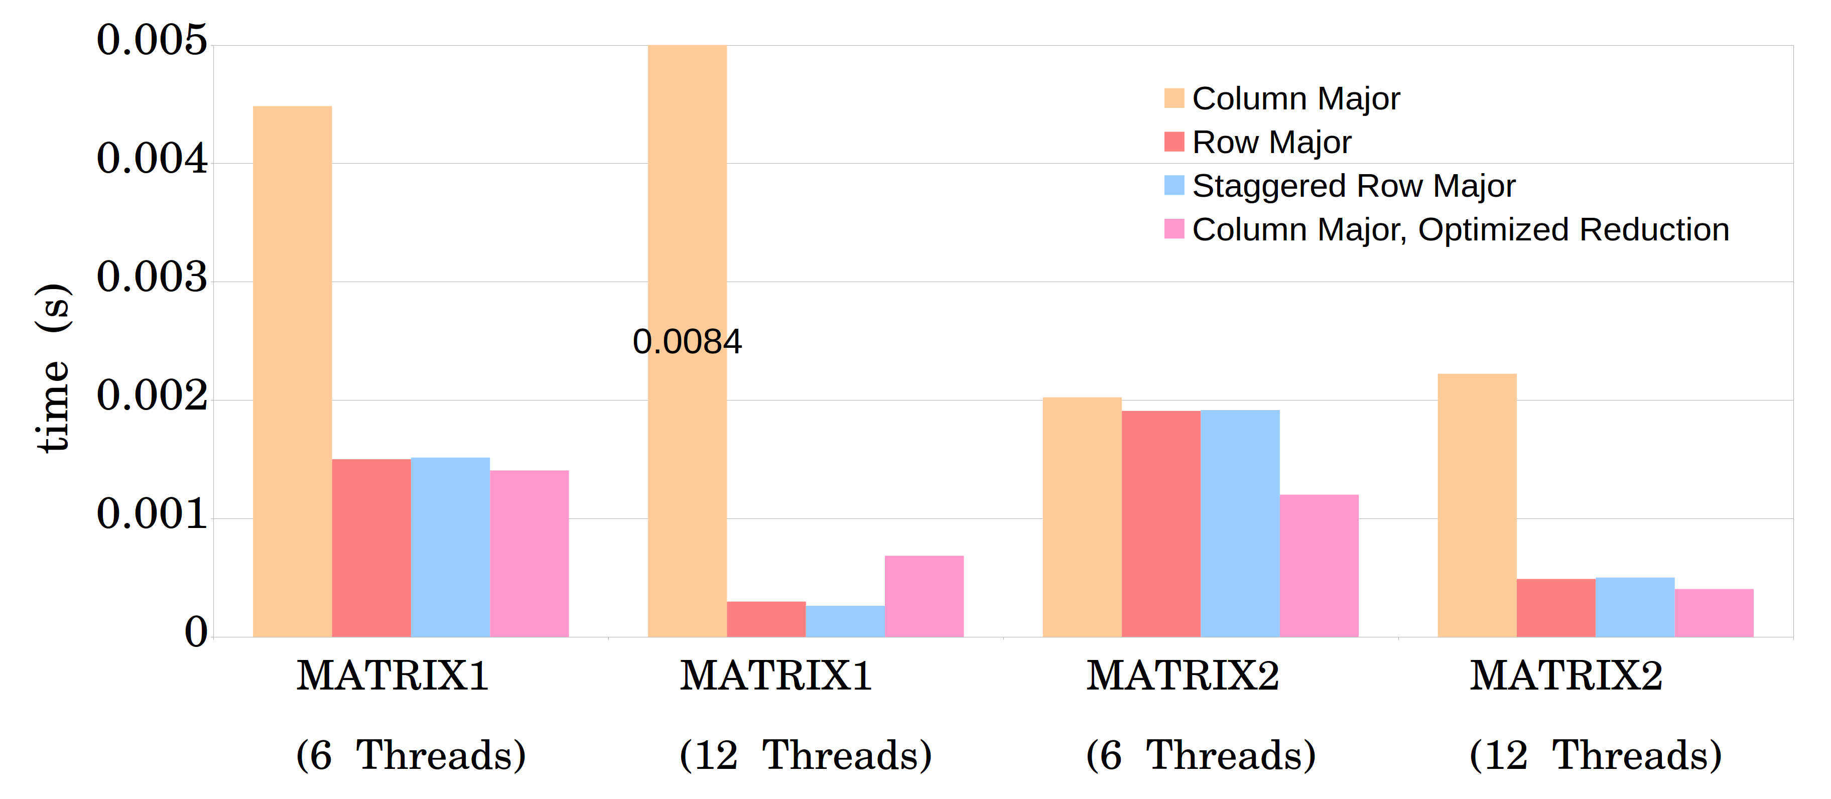
II. Local MATVEC
384 cores, 32 MPI tasks.

Slide 25
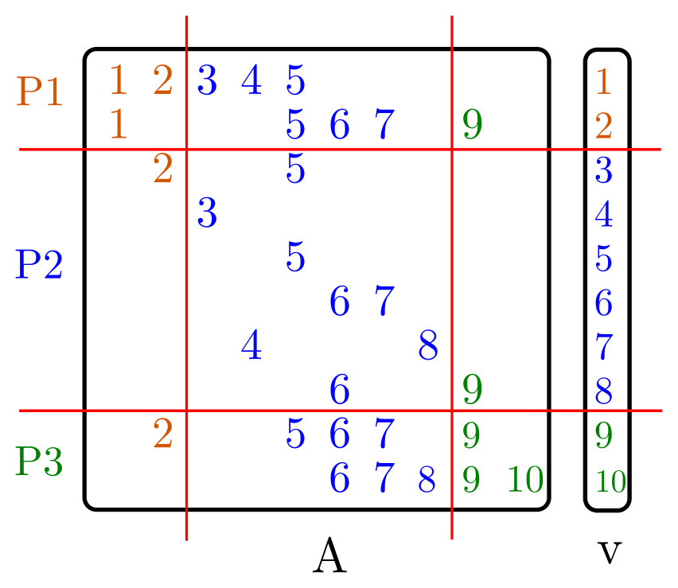
III. Load-balance

Slide 26
III. Load-balance
Load-balance based on:
Number of non-zeros (euqi-NNZ)
Number of rows (equi-row)

Slide 27
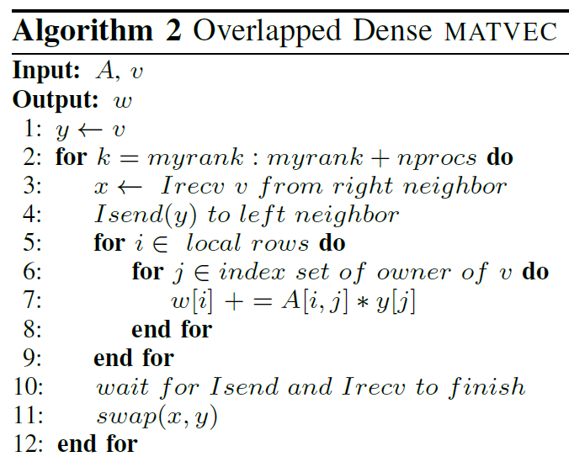
IV. Dense MATVEC

Slide 28
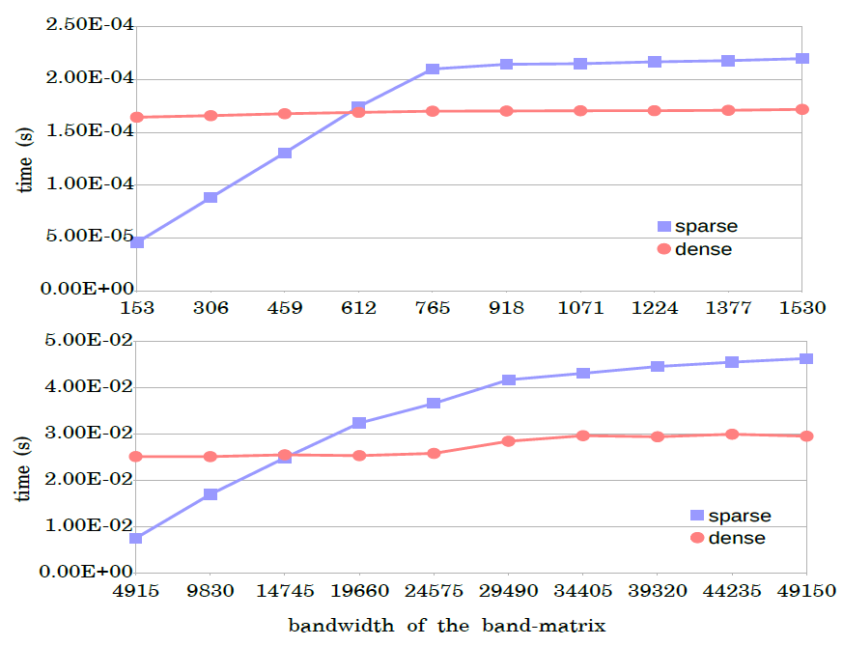
IV. Dense MATVEC

Slide 29
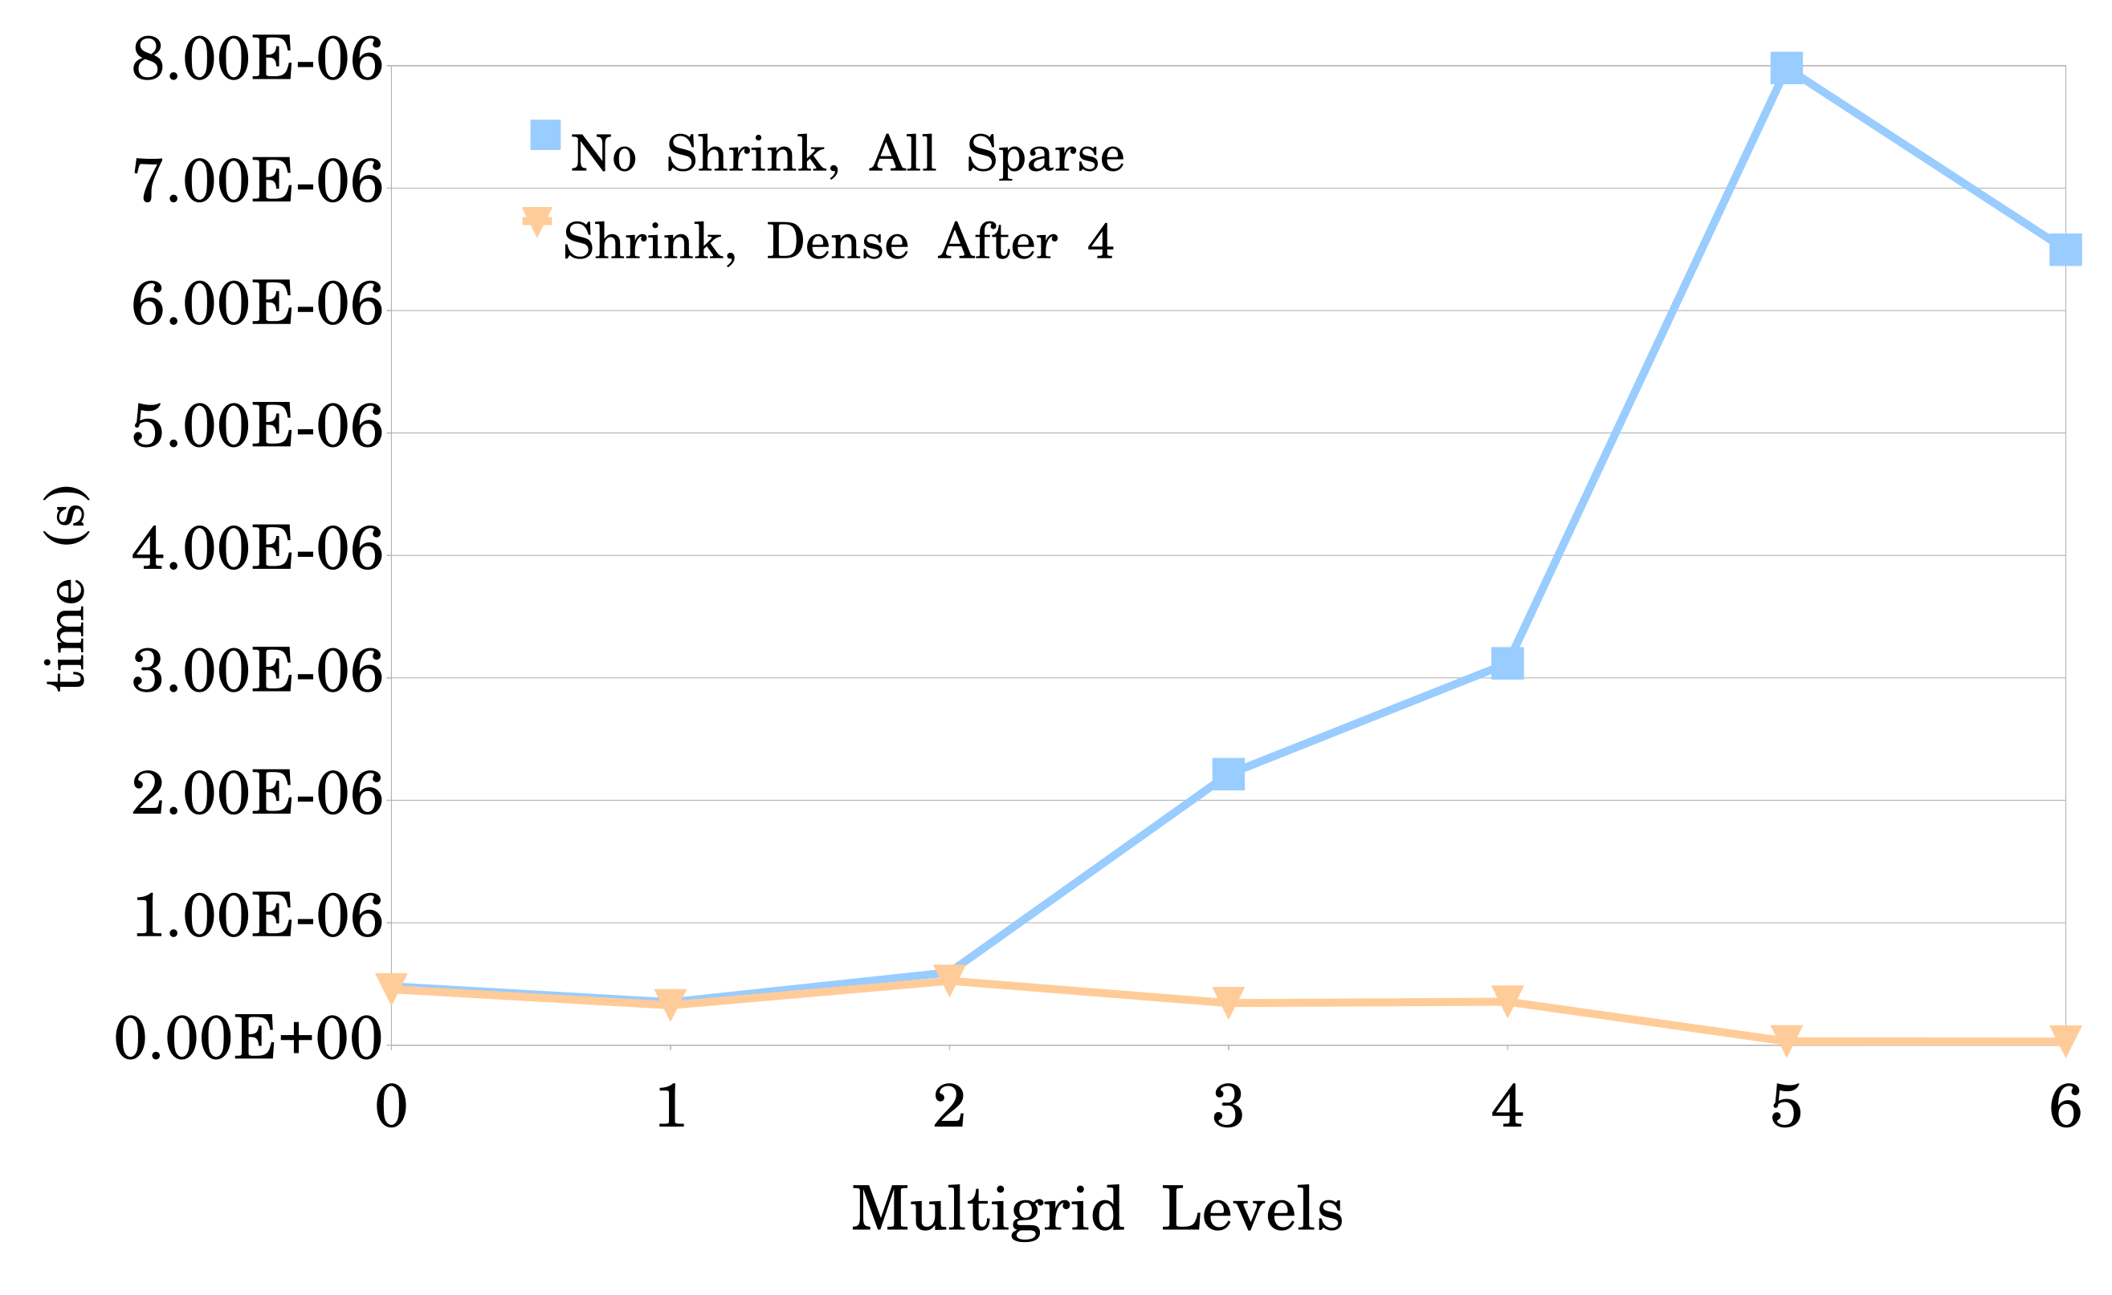
Results
Average time for one MATVEC.
Matrix ID 1883 from Florida Matrix Collection
On 1728 processors

Slide 30
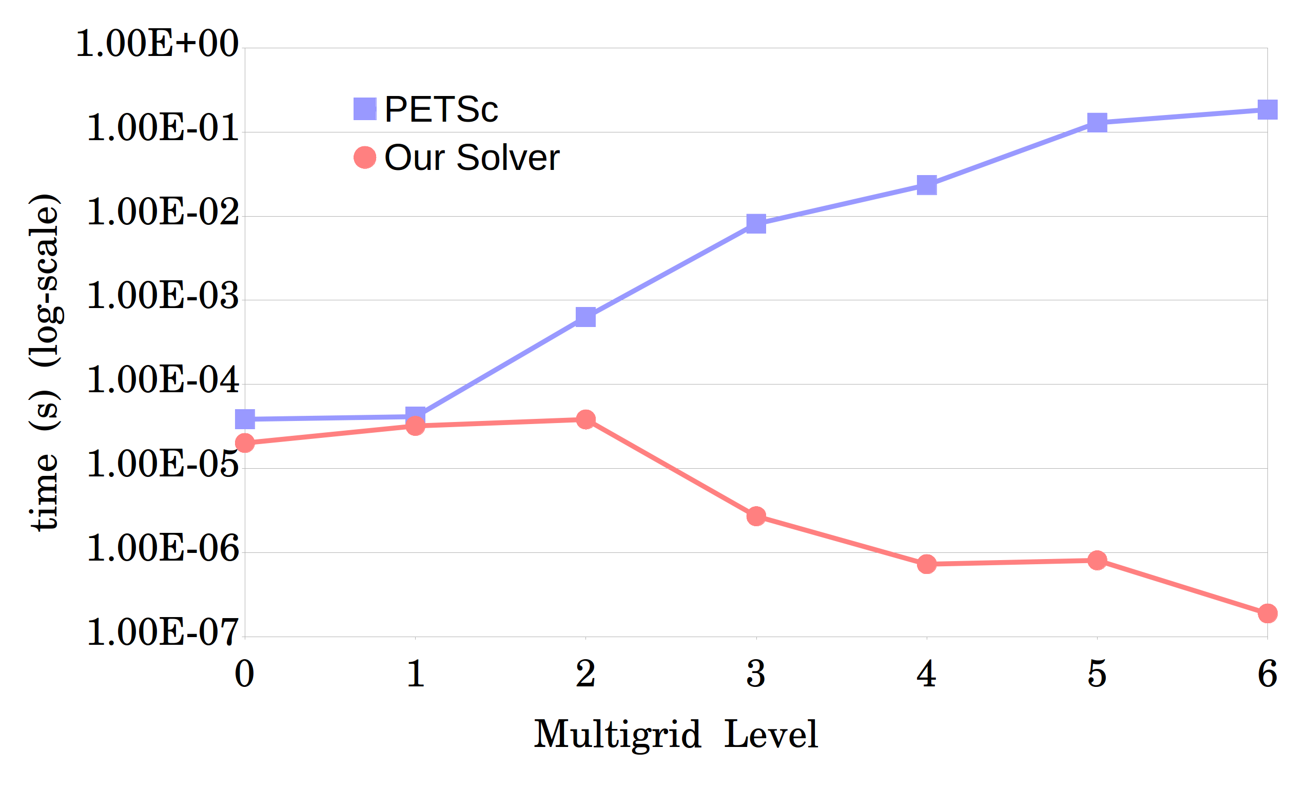
Results
Average time for one MATVEC.
Matrix ID 1883 from Florida Matrix Collection
On 1008 processors

Slide 31
Acknowledgement
Many thanks to my adviser, Dr. Hari Sundar, for his generous help.
This work was supported in part by:
NSF: ACI-1464244, CCF-1643056
Army Research Office: W911NF1510222
And also used resources of:
XSEDE: TG-PHY180002

Slide 32
Thank You

