Slide 1
Improving Performance and Scalability of Algebraic Multigrid through a Specialized MATVEC
Majid Rasouli
Vidhi Zala
Robert M. Kirby
Hari Sundar

Slide 2

Algebraic Multigrid
Approximate solution $x$ of a linear system:
$$Ax=b$$
such that $A∈ℝ^{n×n}, x and b∈ℝ^{n}$.
Start with an initial guess for $x$. Reduce the error iteratively by:
Smoothers (Jacobi, Chebyshev, …)
Coarse-grid Correction

Slide 3
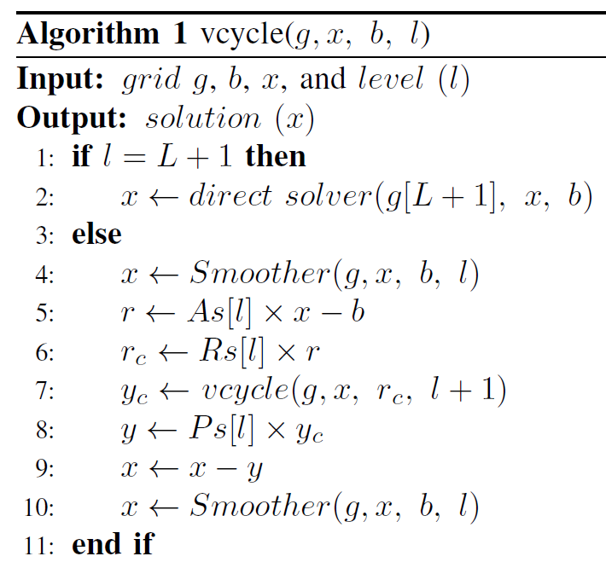
Solve phase:
MATVEC

Slide 4
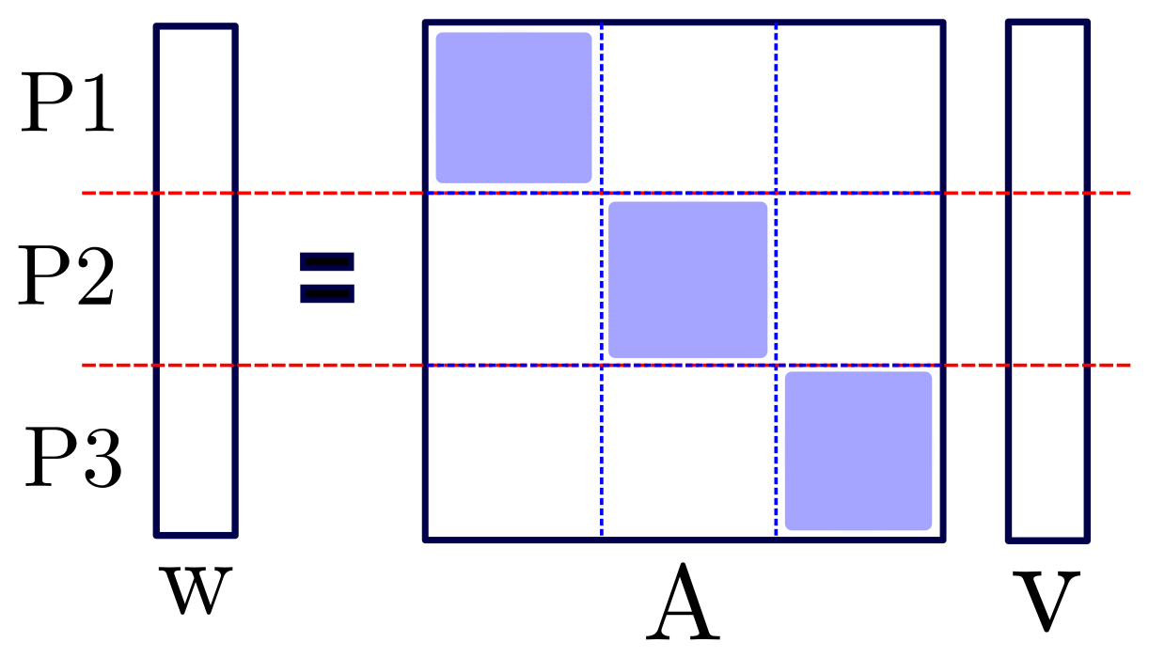
Parallel Configuration
Distributed MATVEC:
Local loop
Communication
Remote loop

Slide 5


Setup phase:
$$As\left[l+1\right]=Rs\left[l\right]×As\left[l\right]×Ps\left[l\right]$$
$As\left[0\right]$ is the finest matrix $A$.
As: coarse matrices
$Rs$: restriction, $Ps$: prolongation
$$A_{C}$$
R
A
P

Slide 6

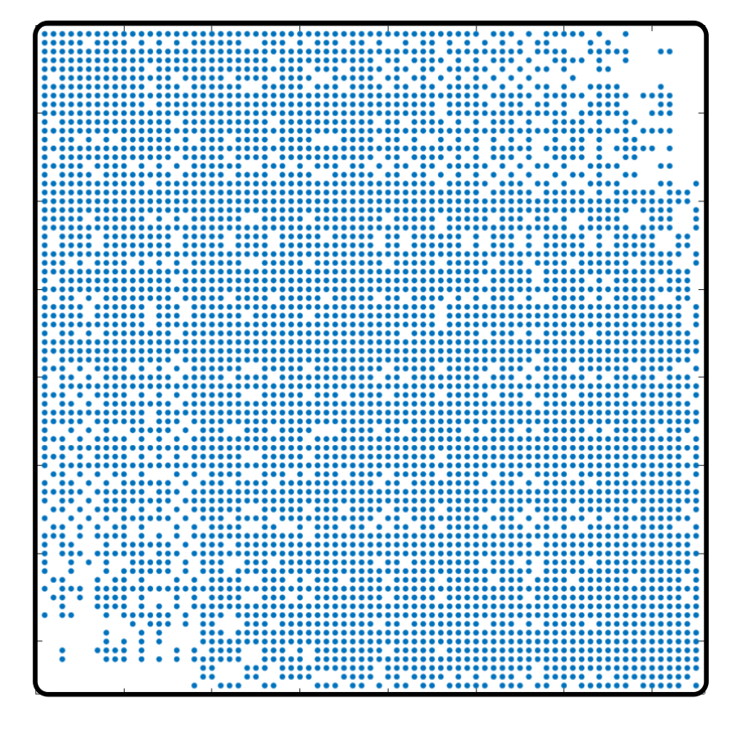
Problem
Florida Matrix Collection: ecology2
Left: input matrix, right: level 5

Slide 7
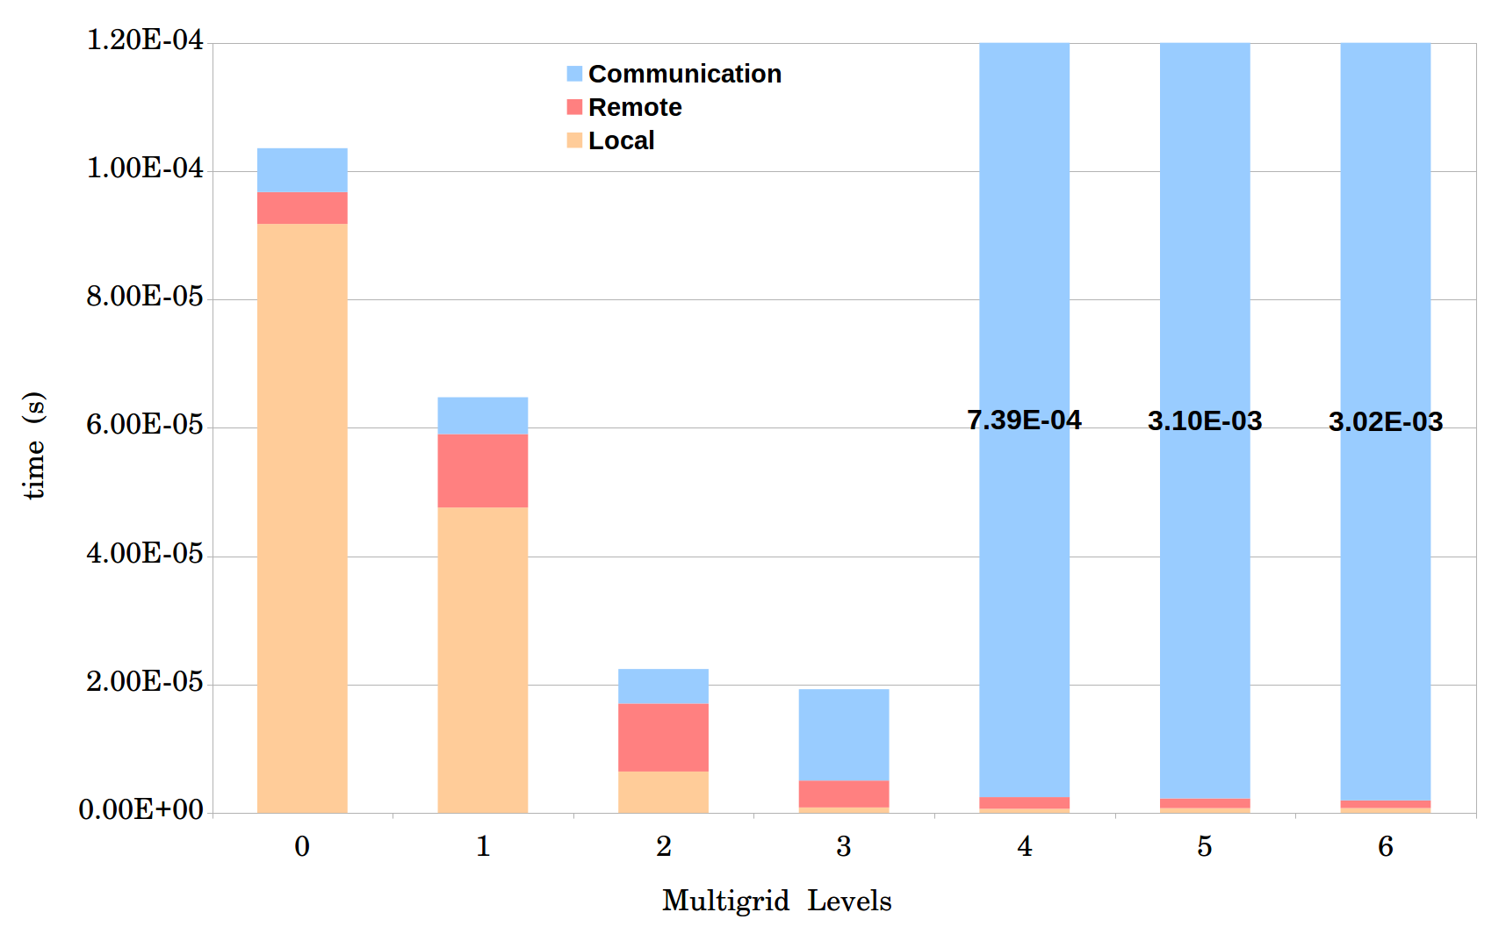
Problem
Matrix ID 1883 from
Florida Matrix Collection
On 1008 processors

Slide 8
Improving MATVEC
Process Shrinking
Local MATVEC
Load-balance
Dense MATVEC

Slide 9
1. Process Shrinking
Simple

Slide 10
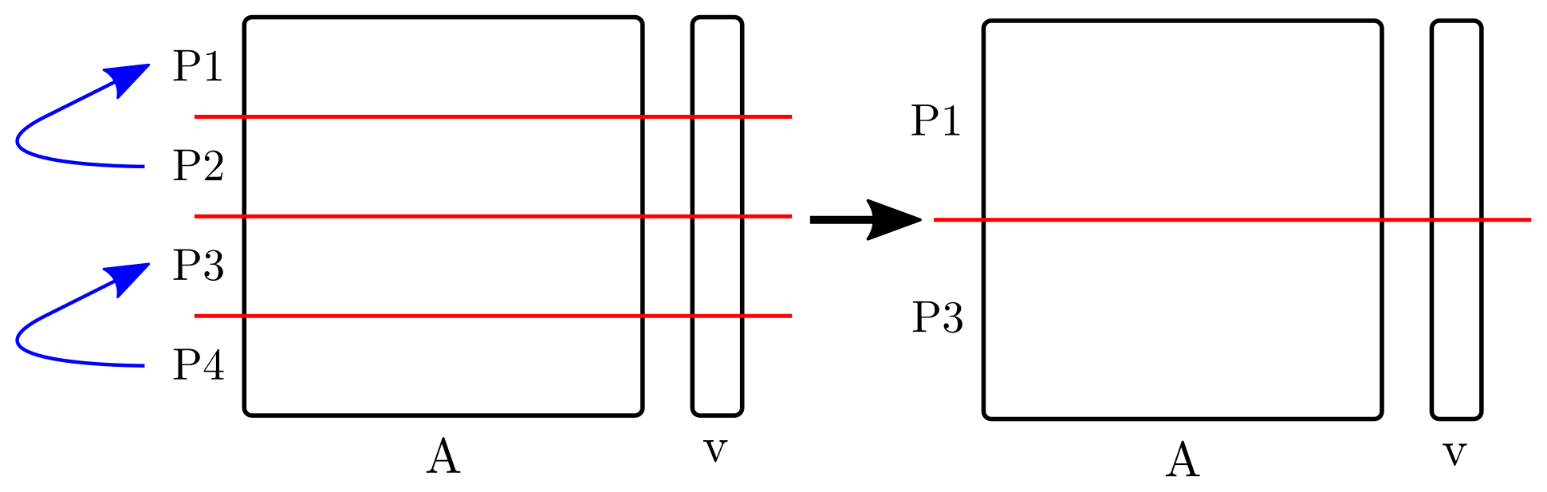
1. Process Shrinking
Simple version:
Advanced version:
combine it with the load-balance function.

Slide 11
1. Process Shrinking

Slide 12
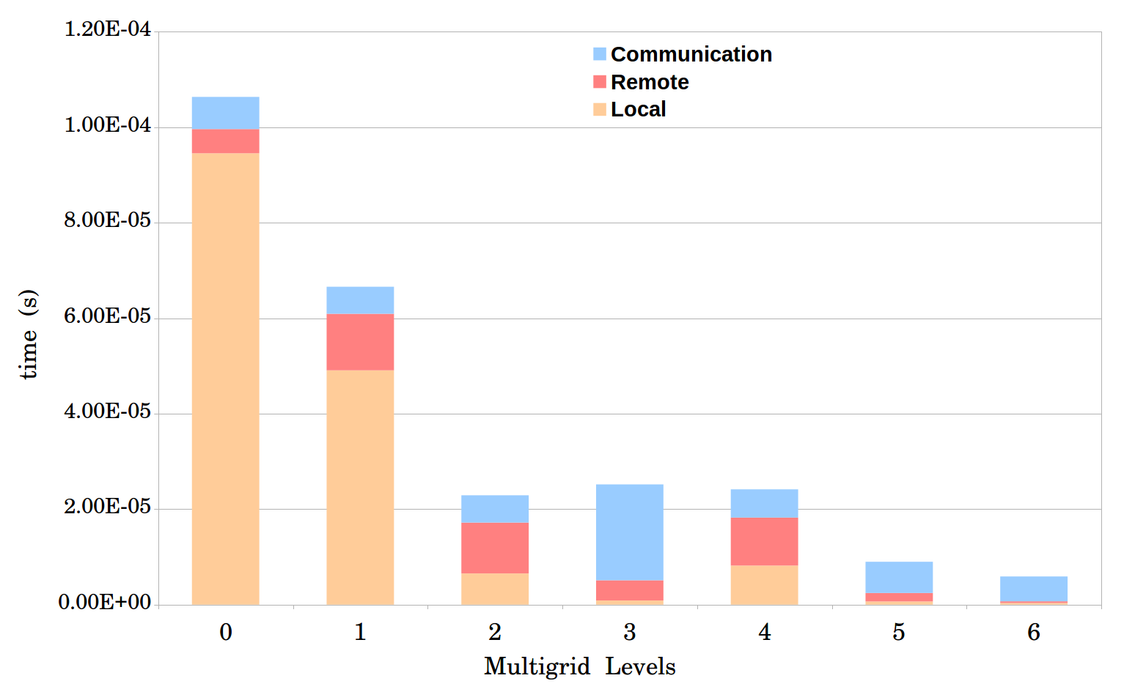
1. Process Shrinking

Slide 13
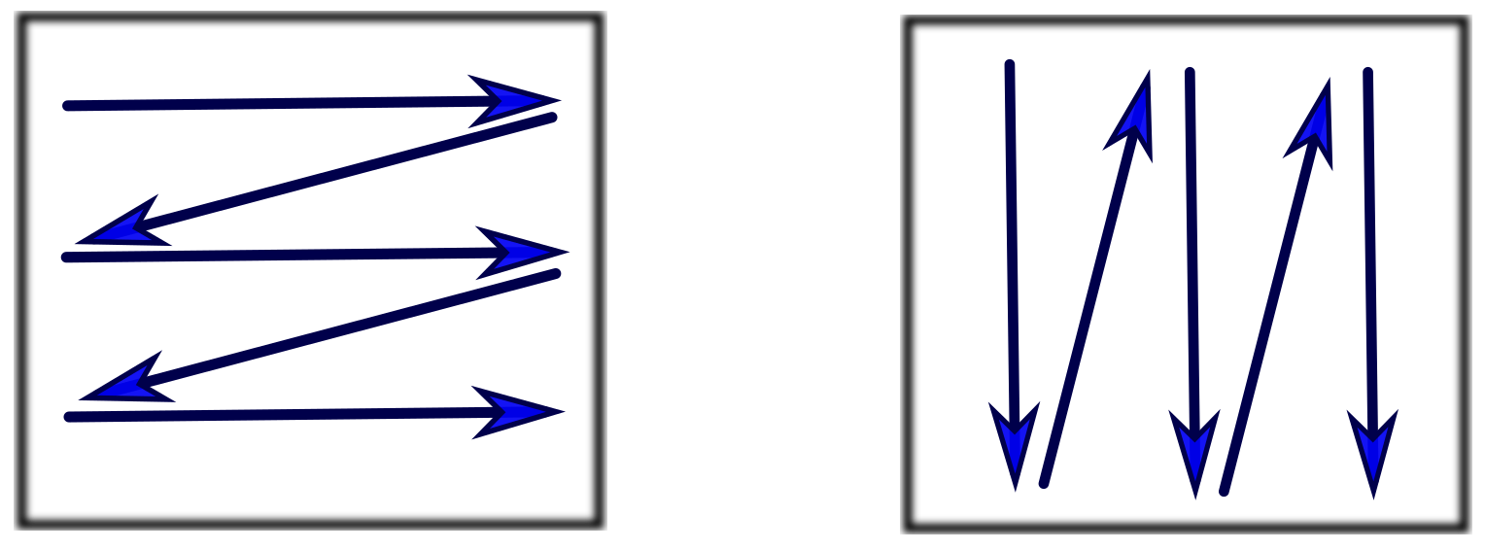
2. Local MATVEC
Column-Major
Row-Major
Staggered Row-Major
Column-Major with optimized reduction

Slide 14
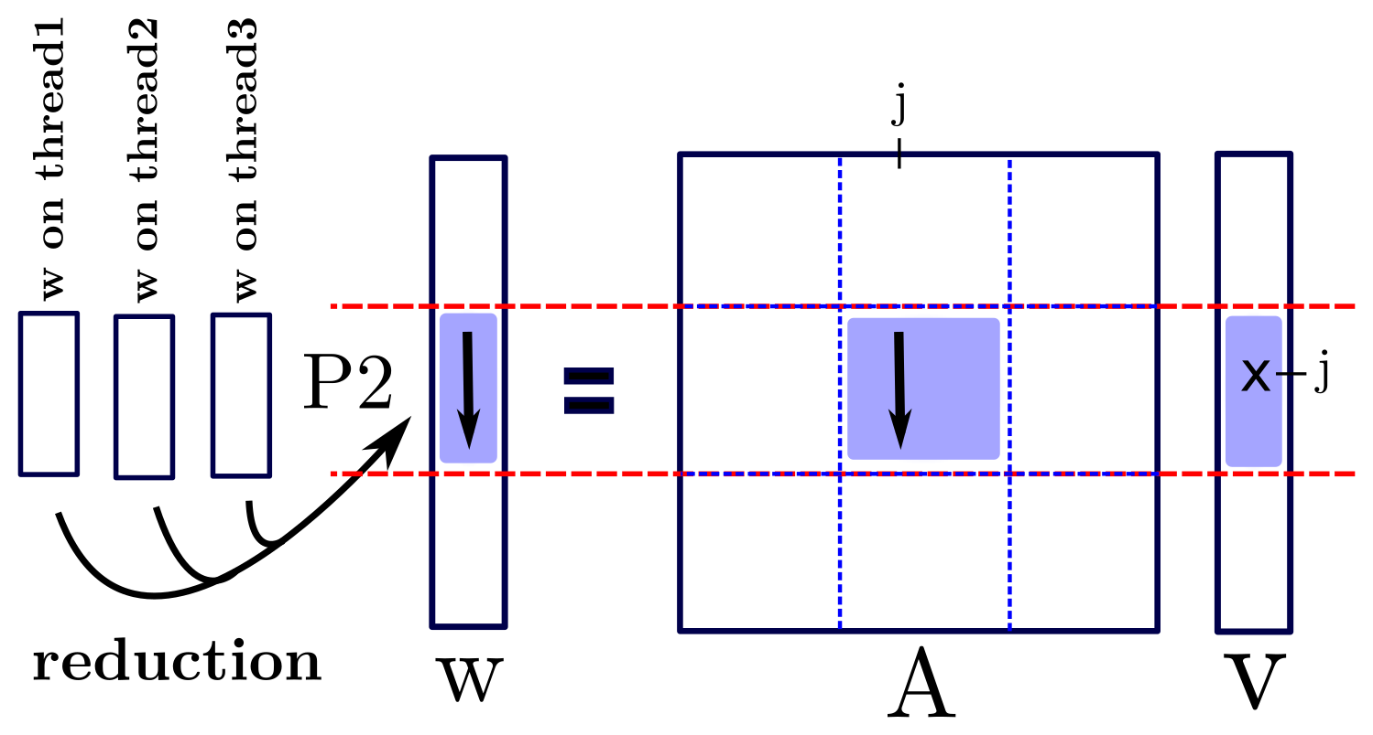
2. Local MATVEC
I. Column-Major:

Slide 15
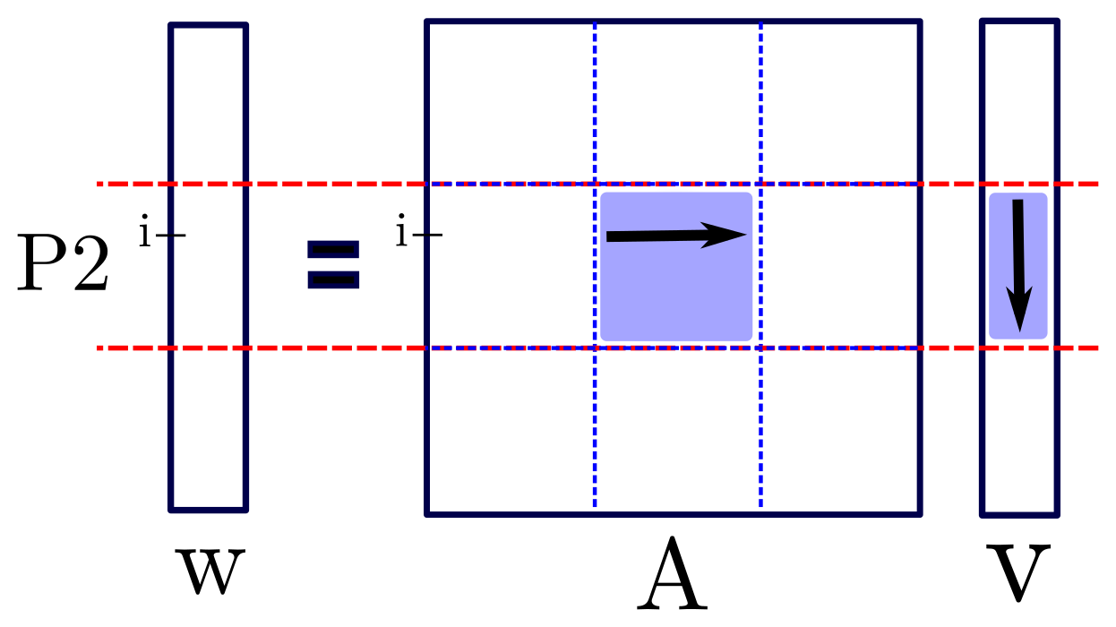
2. Local MATVEC
II. Row-Major:

Slide 16
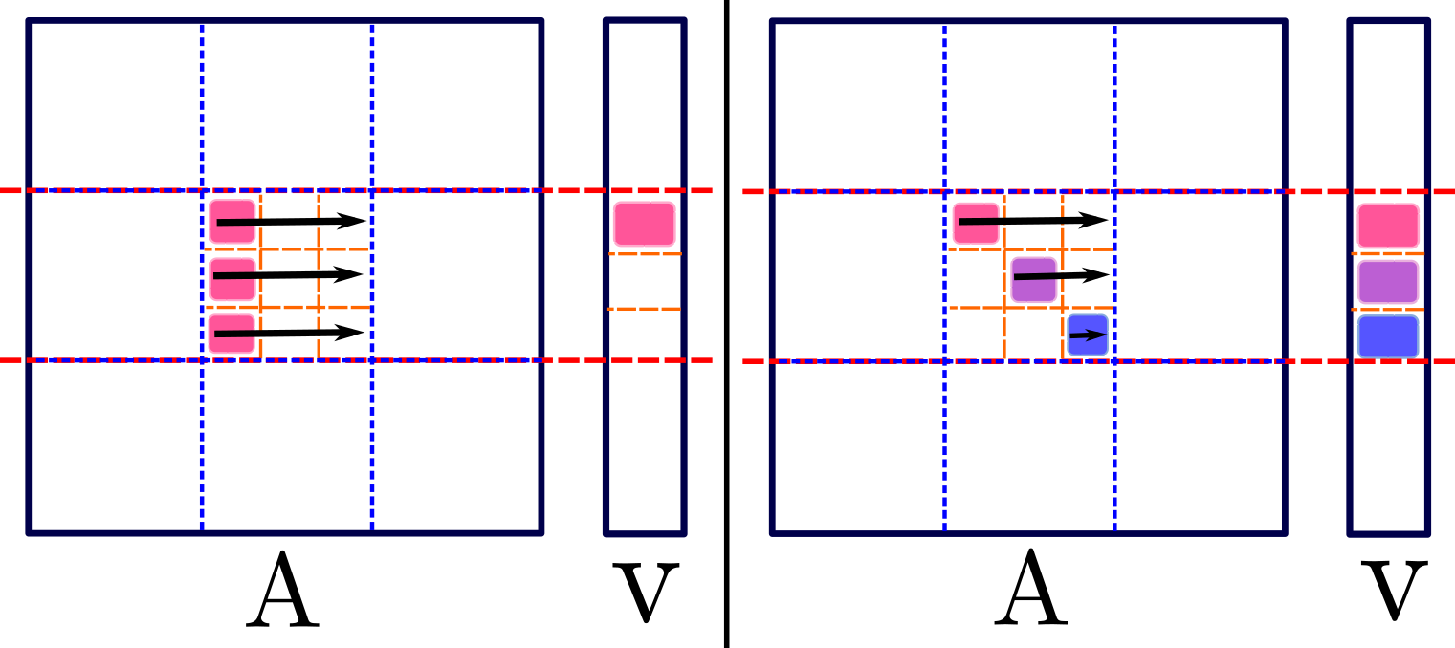
2. Local MATVEC
III. Staggered Row-Major:

Slide 17
2. Local MATVEC
IV. Column-Major with optimized reduction

Slide 18
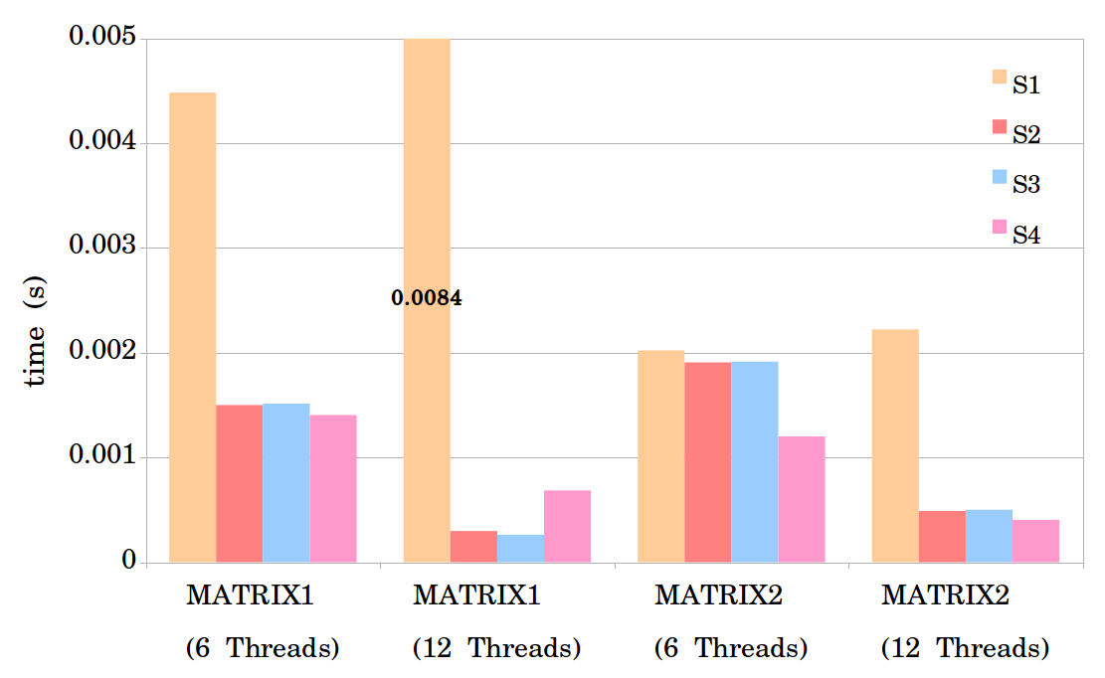
2. Local MATVEC

Slide 19
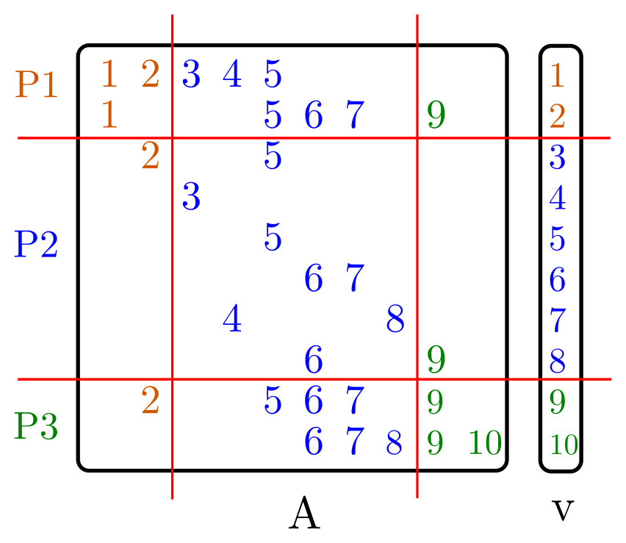
3. Load-balance

Slide 20
3. Load-balance
Load-balance based on:
Number of non-zeros (euqi-NNZ)
Number of rows (equi-row)

Slide 21
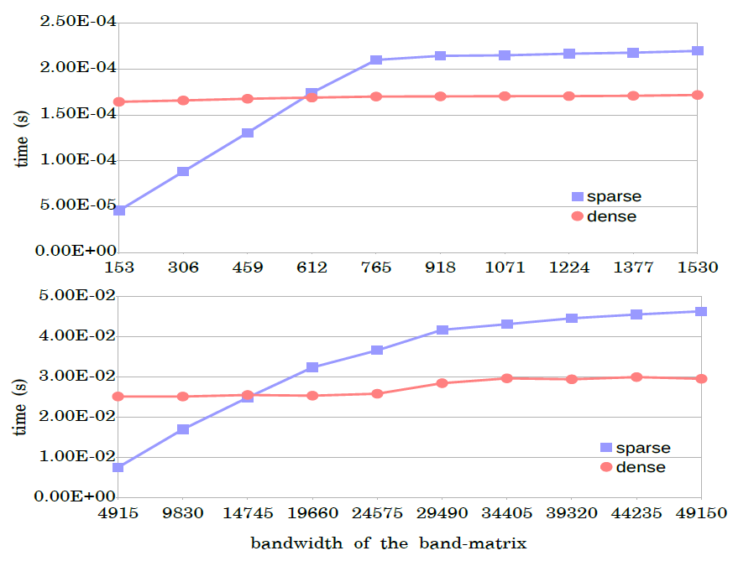
4. Dense MATVEC

Slide 22
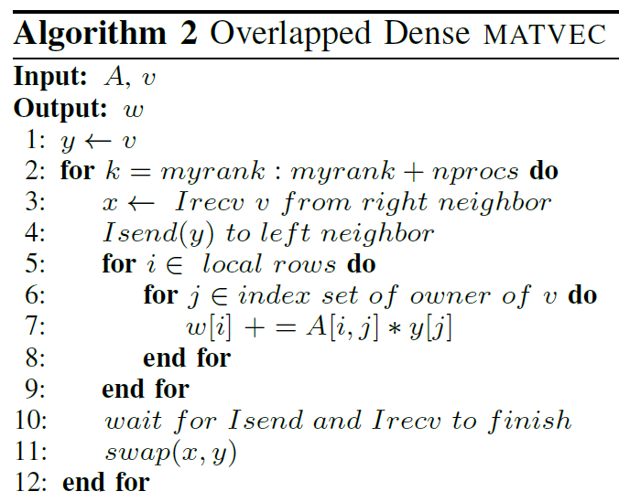
4. Dense MATVEC

Slide 23
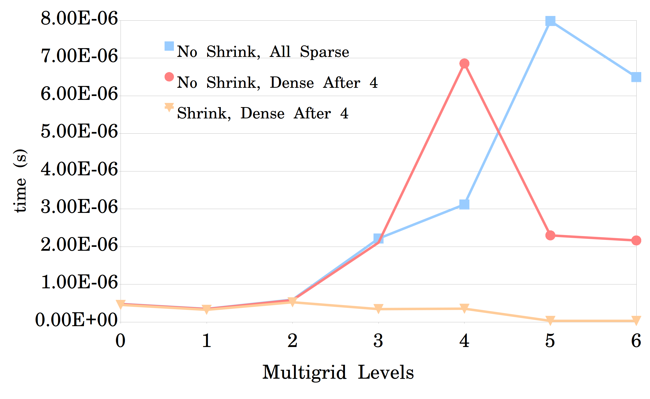
Results
Matrix ID 1883 from
Florida Matrix Collection
On 1008 processors

Slide 24
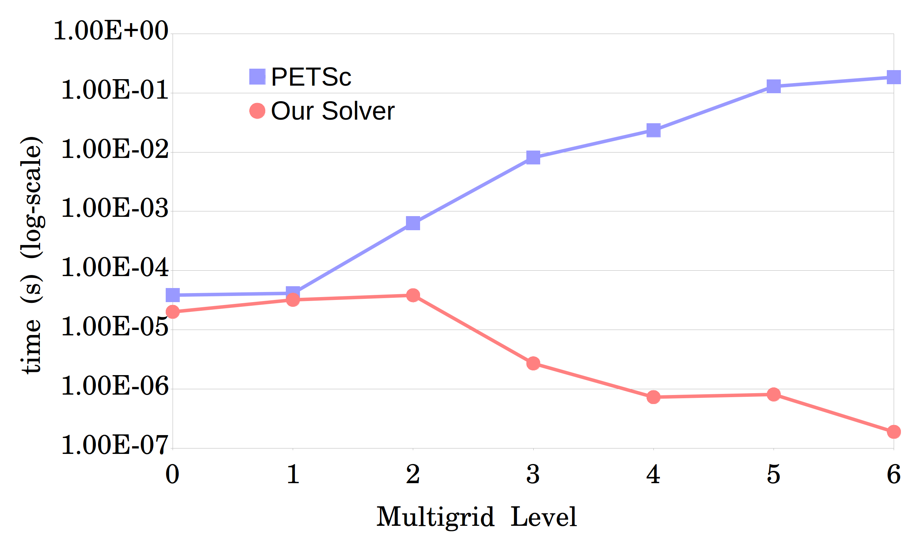
Results
Matrix ID 1883 from
Florida Matrix Collection
On 1008 processors

Slide 25
Acknowledgement
Many thanks to my adviser, Dr. Hari Sundar, for his generous help.
This work was supported in part by:
NSF: ACI-1464244, CCF-1643056
Army Research Office: W911NF1510222
And also used resources of:
XSEDE: TG-PHY180002

Slide 26
Thank You

