Slide 1
Saena: A Scalable Algebraic Multigrid Solver
Majid Rasouli
University of Utah

Slide 2

Introduction
PhD Student in Scientific Computing in School of Computing, University of Utah
www.cs.utah.edu/~rasouli/
Research Area: Scientific Computing and HPC
Focus: Developing Saena, an Algebraic Multigrid Solver, in C++ (MPI + OpenMP)

Slide 3

Algebraic Multigrid
Approximate solution $x$ of a linear system:
$$Ax=b$$
such that $A∈ℝ^{n×n} is sparse, x and b∈ℝ^{n}$.
Start with an initial guess for $x$. Reduce the error iteratively by:
Smoothers (Jacobi, Chebyshev, …)
Coarse-grid Correction
Two phases:
Setup
Solve

Slide 4





Setup phase: two-grid
$$=$$
$$×$$
$$×$$
$$A_{coarse}$$
R
A
P
$P$: Prolongation
$R$: Restriction

Slide 5
Problem
Lower Levels of Multigrid => Loss of Sparsity (Fill-in) => Higher Communication Cost
Matrix-Vector product (MATVEC): The dominant operation in algebraic multigrid, especially in the solve phase.
Matrix-Matrix product (MATMULT): An expensive operation in the setup phase.
Our goal is to improve these two operations.

Slide 6

Introduction

Slide 7
Matrix-Vector Product (MATVEC)

Slide 8
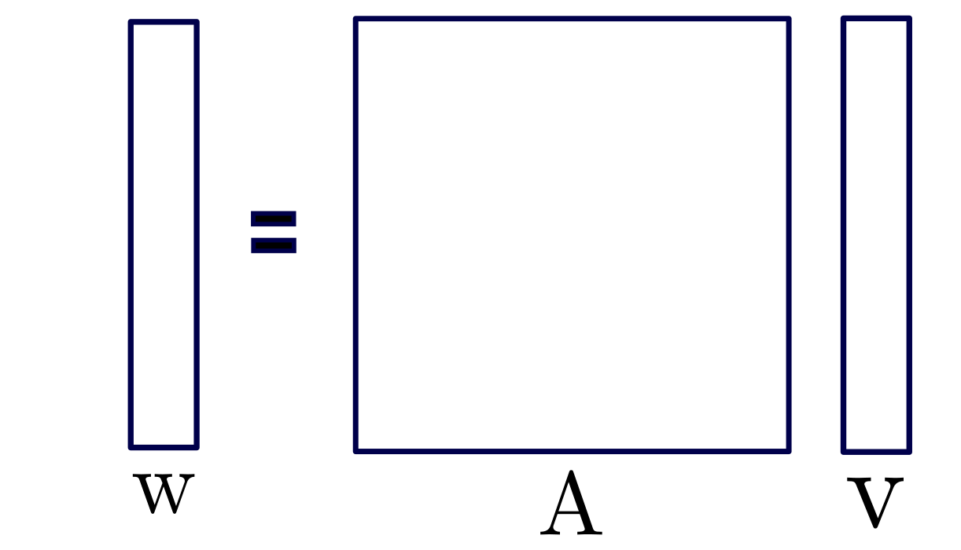
MATVEC

Slide 9
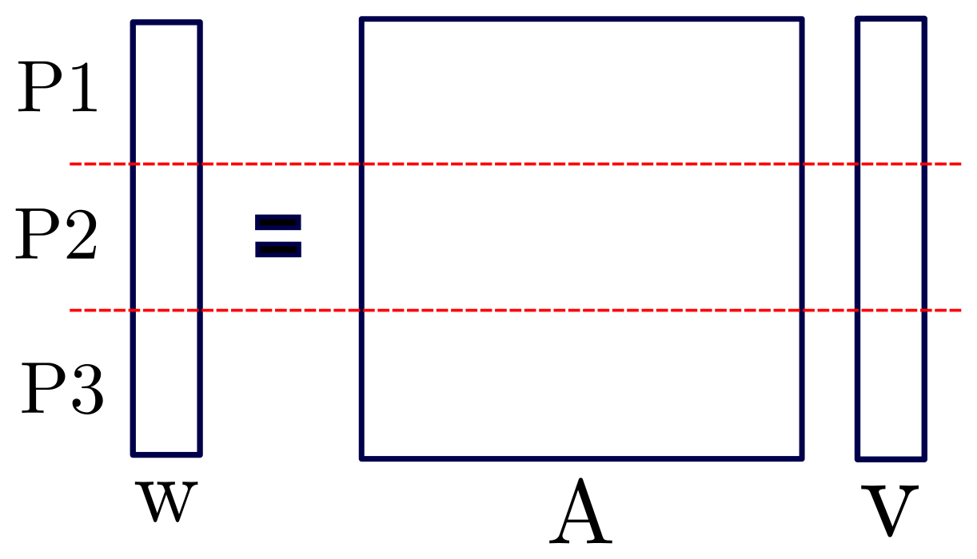
Distributed MATVEC

Slide 10
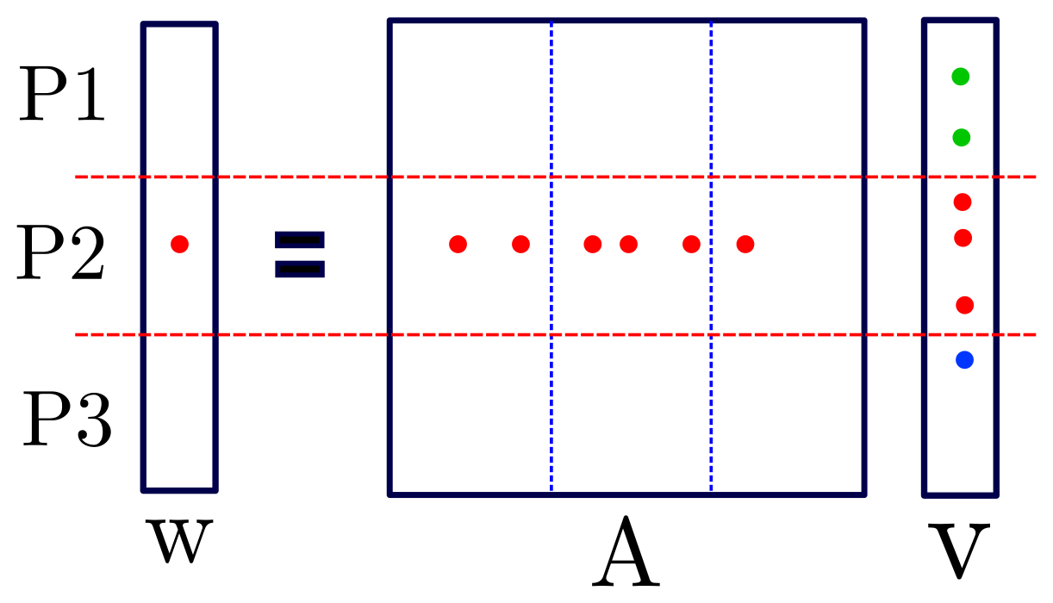
Distributed MATVEC

Slide 11
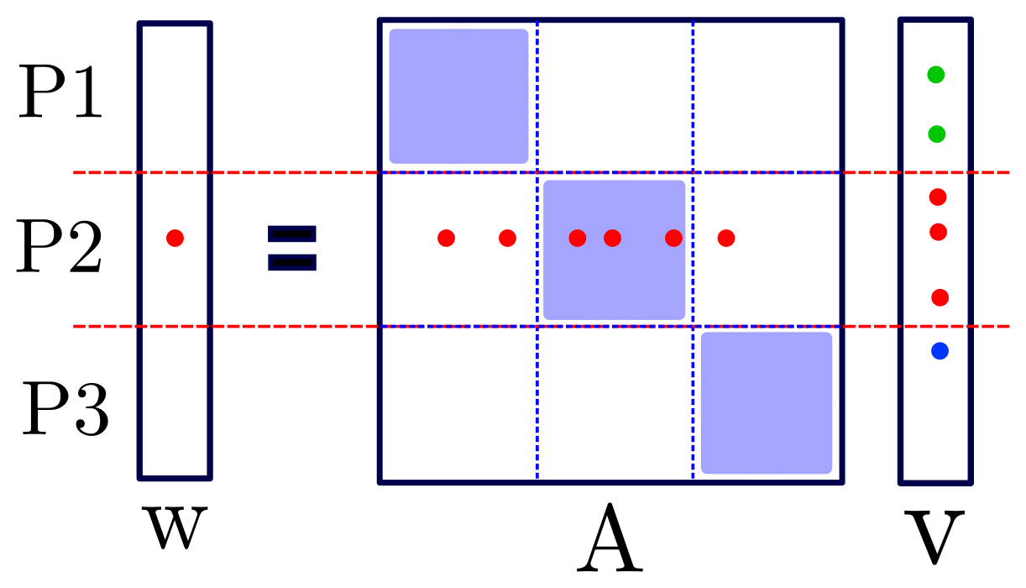
Distributed MATVEC
Local loop
Communication
Remote loop
Notes:
Now I’m gonna show you where we the issue is.

Slide 12

Problem
$$A_{coarse}$$
R
A
P

Slide 13
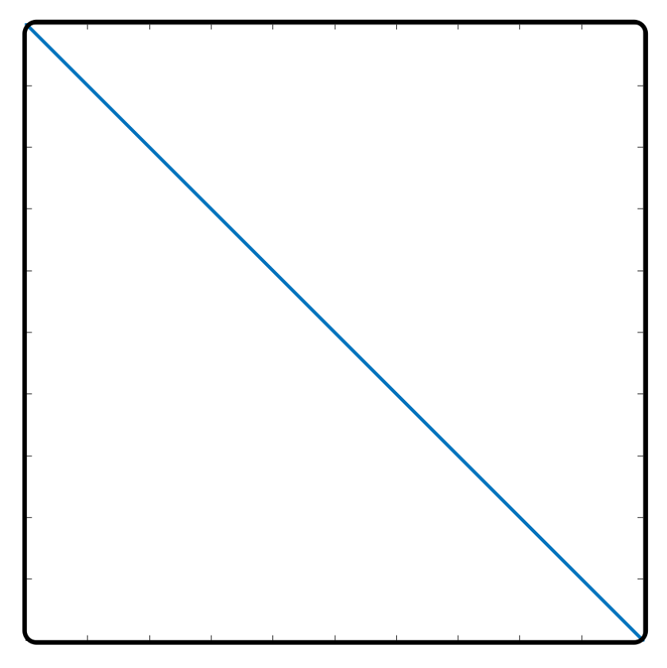
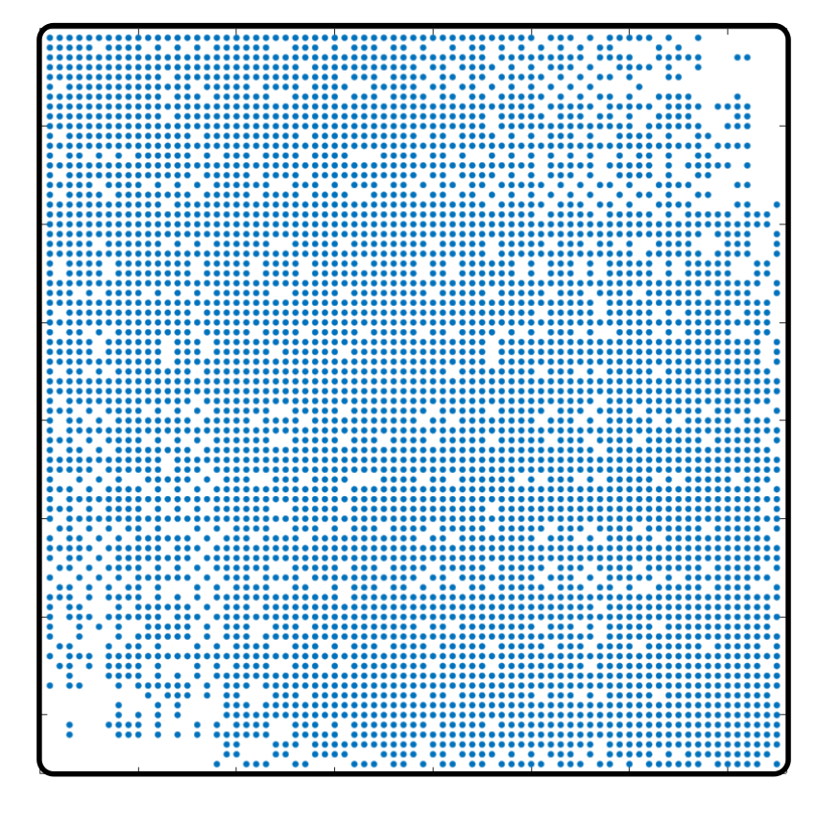
Problem
Florida Matrix Collection: ecology2
Left: input matrix, right: level 5

Slide 14
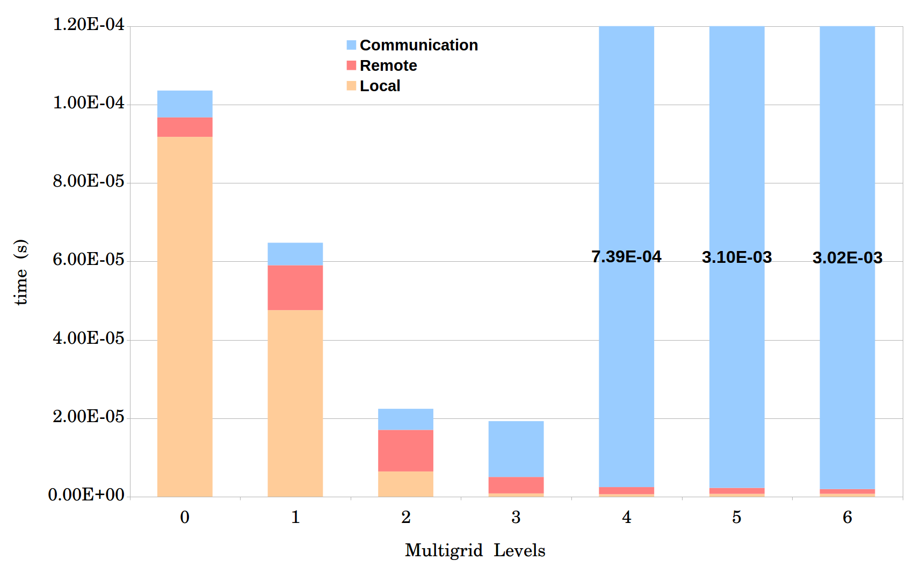
Problem
Average time for one MATVEC
Matrix ID 1883 from Florida Matrix Collection
On 1008 processors

Slide 15
Improving MATVEC
Optimized in both shared memory and distributed memory aspects.
Process Shrinking
Local MATVEC
Load-balance
Dense MATVEC

Slide 16
I. Process Shrinking
More Computing Power
More Processors
More Communication
How: Dummy MATVEC when creating coarse matrices.
When: If the communication time becomes significantly higher than local and remote loops.

Slide 17
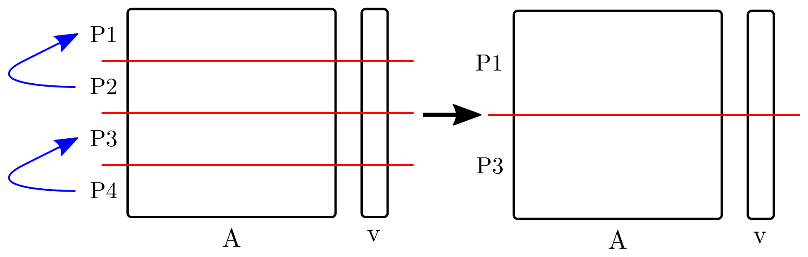
I. Process Shrinking
Simple version:
Advanced version:
There is a load-balance function for each level of multigrid.
Combine process shrinking with the load-balance function.

Slide 18
I. Process Shrinking
Average time for one MATVEC
Matrix ID 1883 from Florida Matrix Collection
On 1008 processors

Slide 19
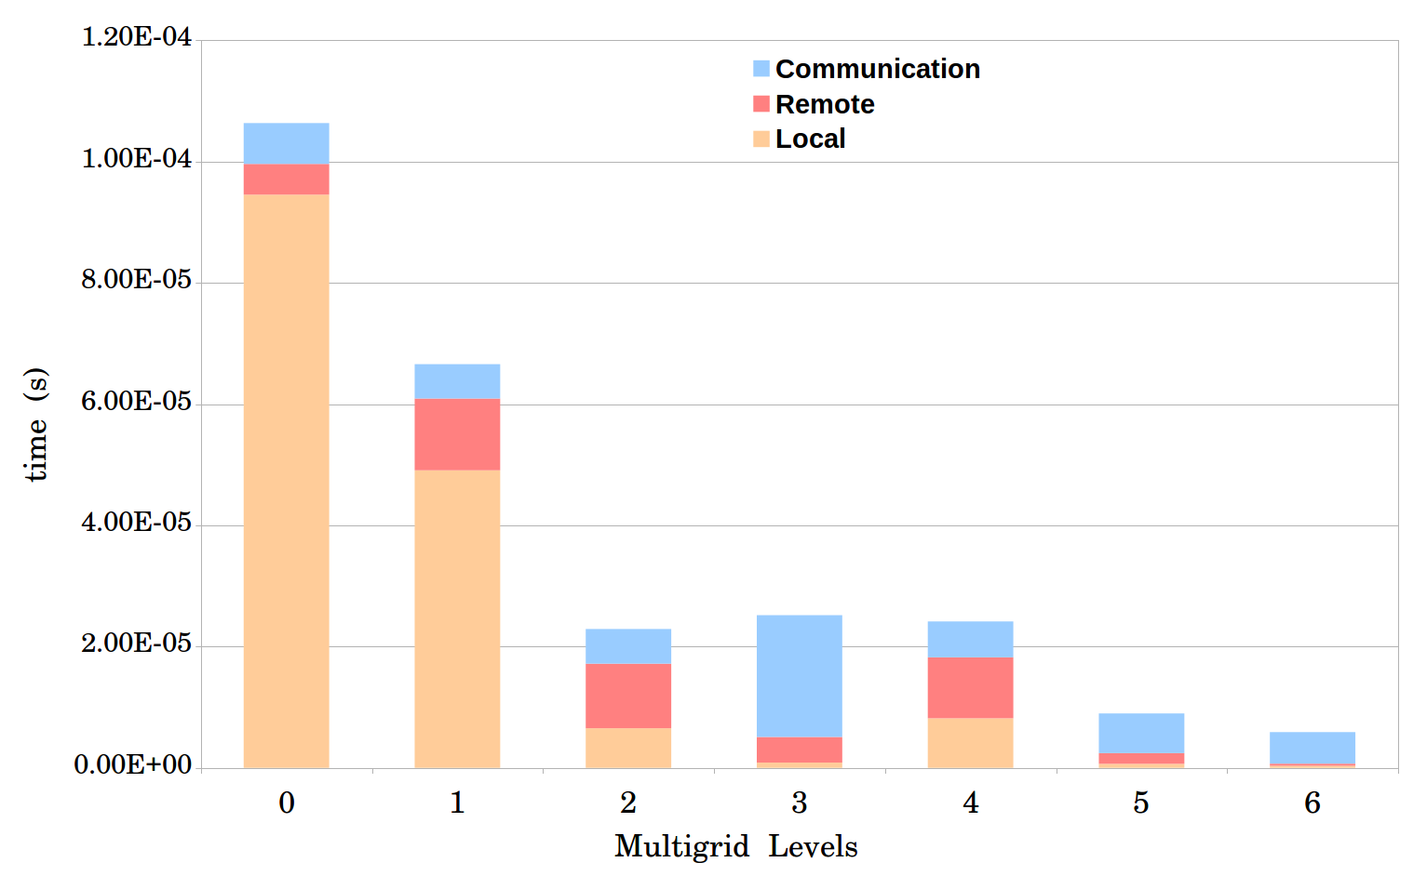
I. Process Shrinking
Notes:
Next step is improving local and remote loops.

Slide 20
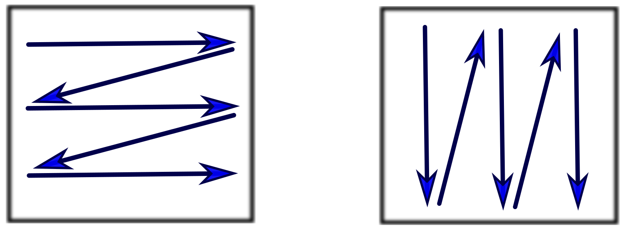
II. Local MATVEC
Shared memory optimization.
OpenMP: Using multiple threads for computations.
Column-Major
Row-Major
Staggered Row-Major
Column-Major with optimized reduction

Slide 21
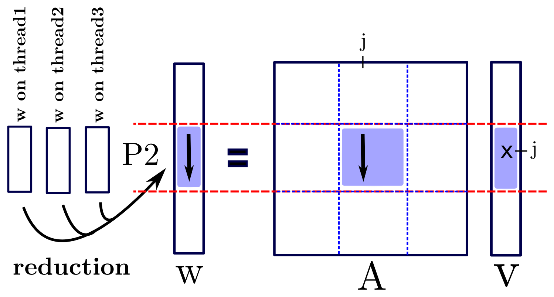
II. Local MATVEC
I. Column-Major:

Slide 22
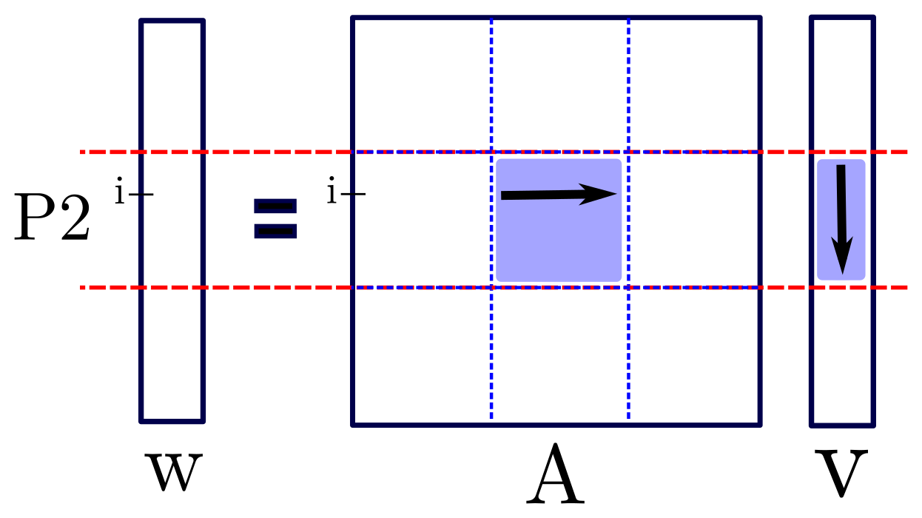
II. Local MATVEC
II. Row-Major:

Slide 23
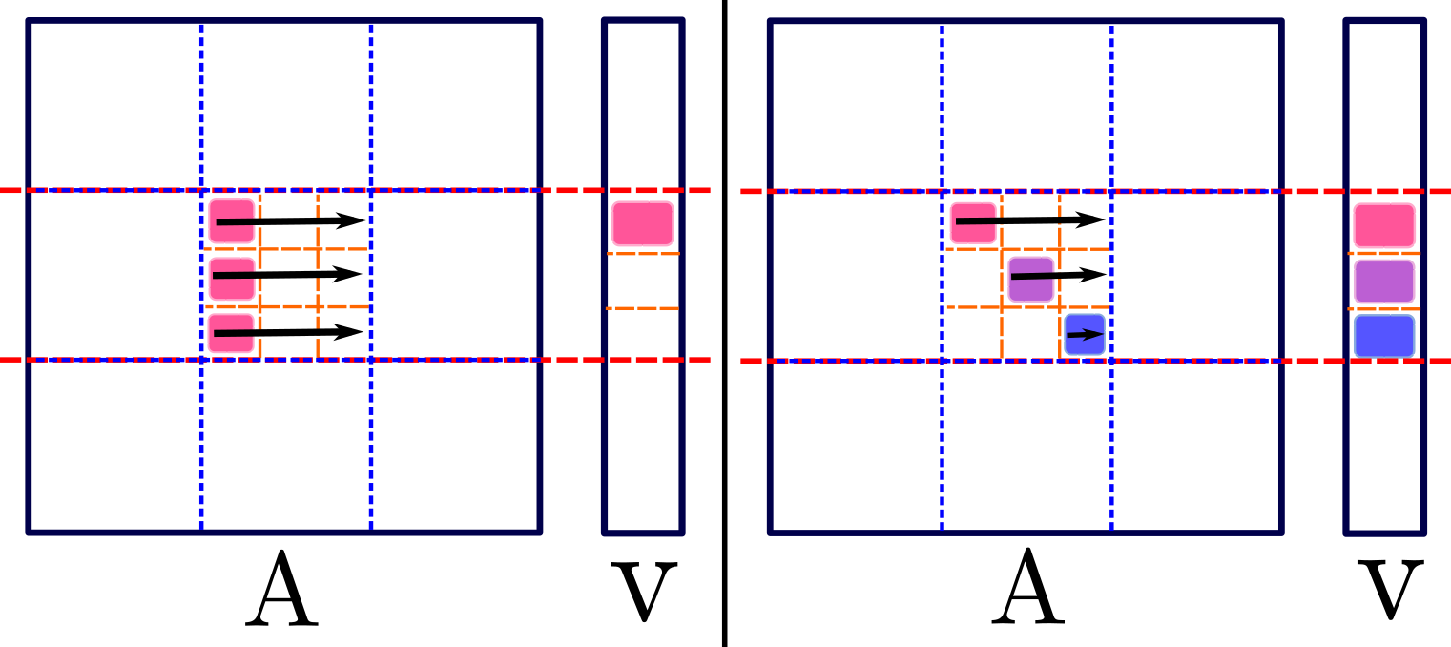
II. Local MATVEC
III. Staggered Row-Major:

Slide 24
II. Local MATVEC
IV. Column-Major with optimized reduction

Slide 25
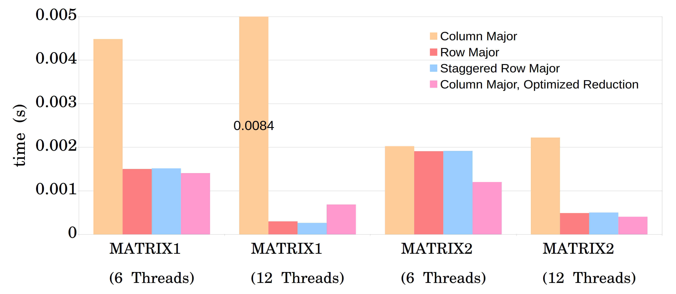
II. Local MATVEC
384 cores, 32 MPI tasks.

Slide 26
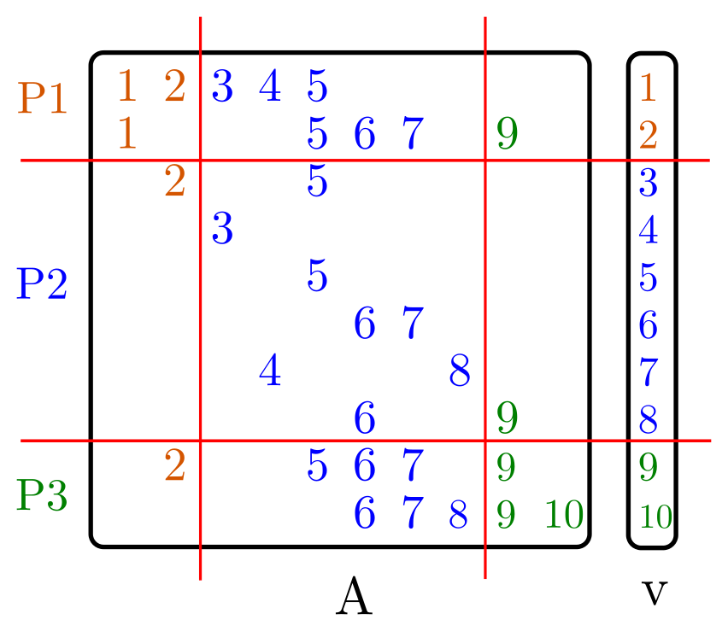
III. Load-balance
Load-balance based on number of non-zeros.

Slide 27
III. Load-balance
Load-balance based on:
Number of non-zeros (euqi-NNZ)
Number of rows (equi-row)

Slide 28
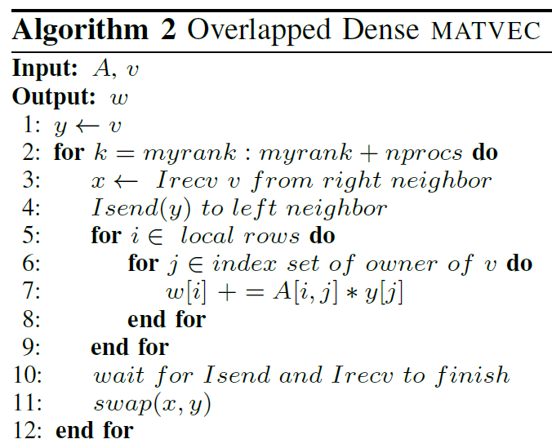
IV. Dense MATVEC

Slide 29
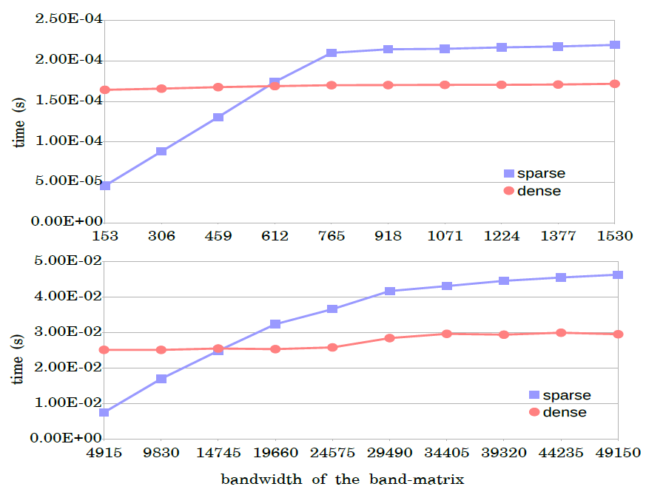
IV. Dense MATVEC

Slide 30
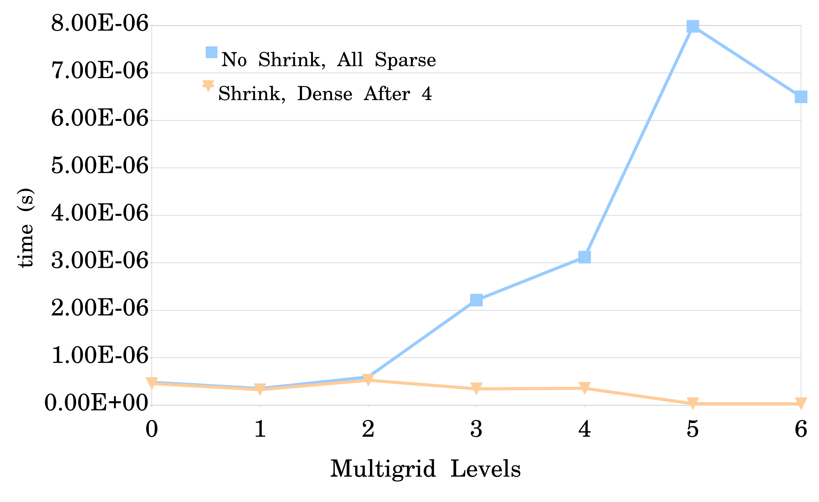
Results
Average time for one MATVEC.
Matrix ID 1883 from Florida Matrix Collection
On 1728 processors

Slide 31
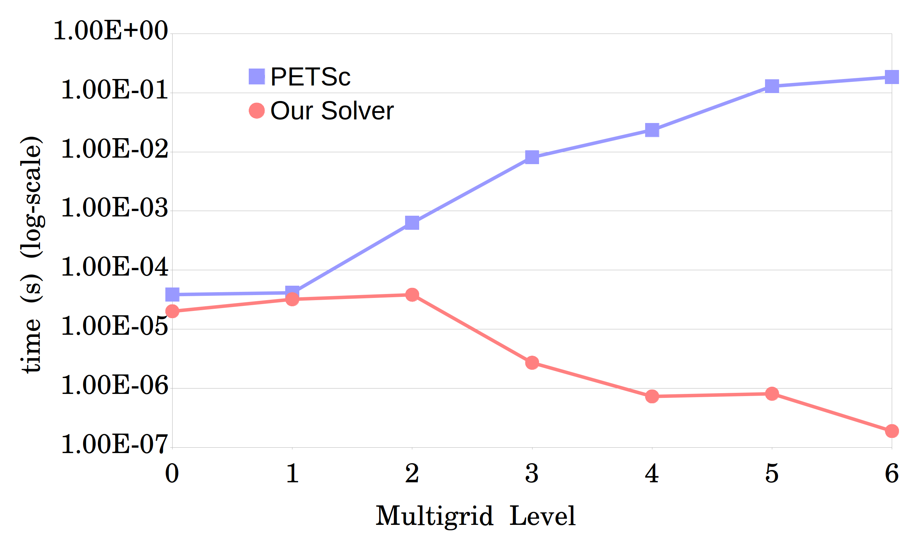
Results
Average time for one MATVEC.
Matrix ID 1883 from Florida Matrix Collection
On 1008 processors

Slide 32
Matrix-Matrix Product (MATMULT)

Slide 33


Setup phase: two-grid
coarsening
$$A_{coarse}=R×A×P$$
$R$: restriction, $P$: prolongation
$$A_{coarse}$$
R
A
P

Slide 34
Structure
Divide and conquer approach to perform the MATMULT. We assume the data is available locally.
Communication (will be skipped)

Slide 35

Recursive MATMULT
Idea: Keep splitting the matrices, until threshold is reached. Then, perform the multiplication.
Reason: We perform the multiplication for small chunks where the resulting matrix can fit into an appropriate cache.

Slide 36

Recursive MATMULT
$$C=A×B$$
Case 1: Threshold is reached: stop the recursion and perform the multiplication.
Case 2: If A is horizontal, split by column.
Case 3: If A is vertical, split by row.

Slide 37
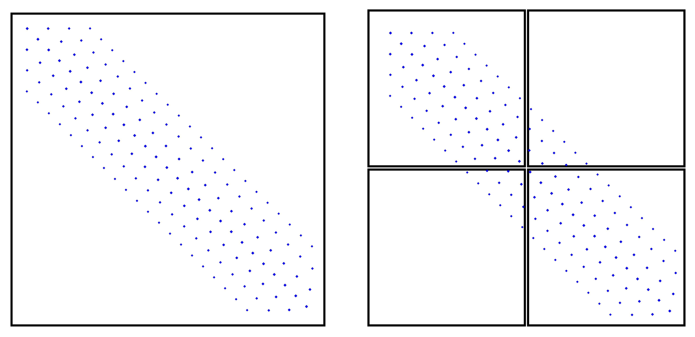
Threshold
To decide when to stop the splitting process, using row and column sizes of sub-matrices is not always the best.

Slide 38

Threshold
$$C=A×B$$
$$NNZ_MAT_SIZE :=A_nnz_row ∗ B_nnz_col$$
$A_nnz_row=$nonzero rows of A
$B_nnz_col=$nonzero columns of B
$NNZ_MAT_SIZE <threshold=>$Perform Multiplication

Slide 39
Splitting Methods
We split the matrices recursively in two ways:
based on the matrix size
based on number of nonzeros.

Slide 40
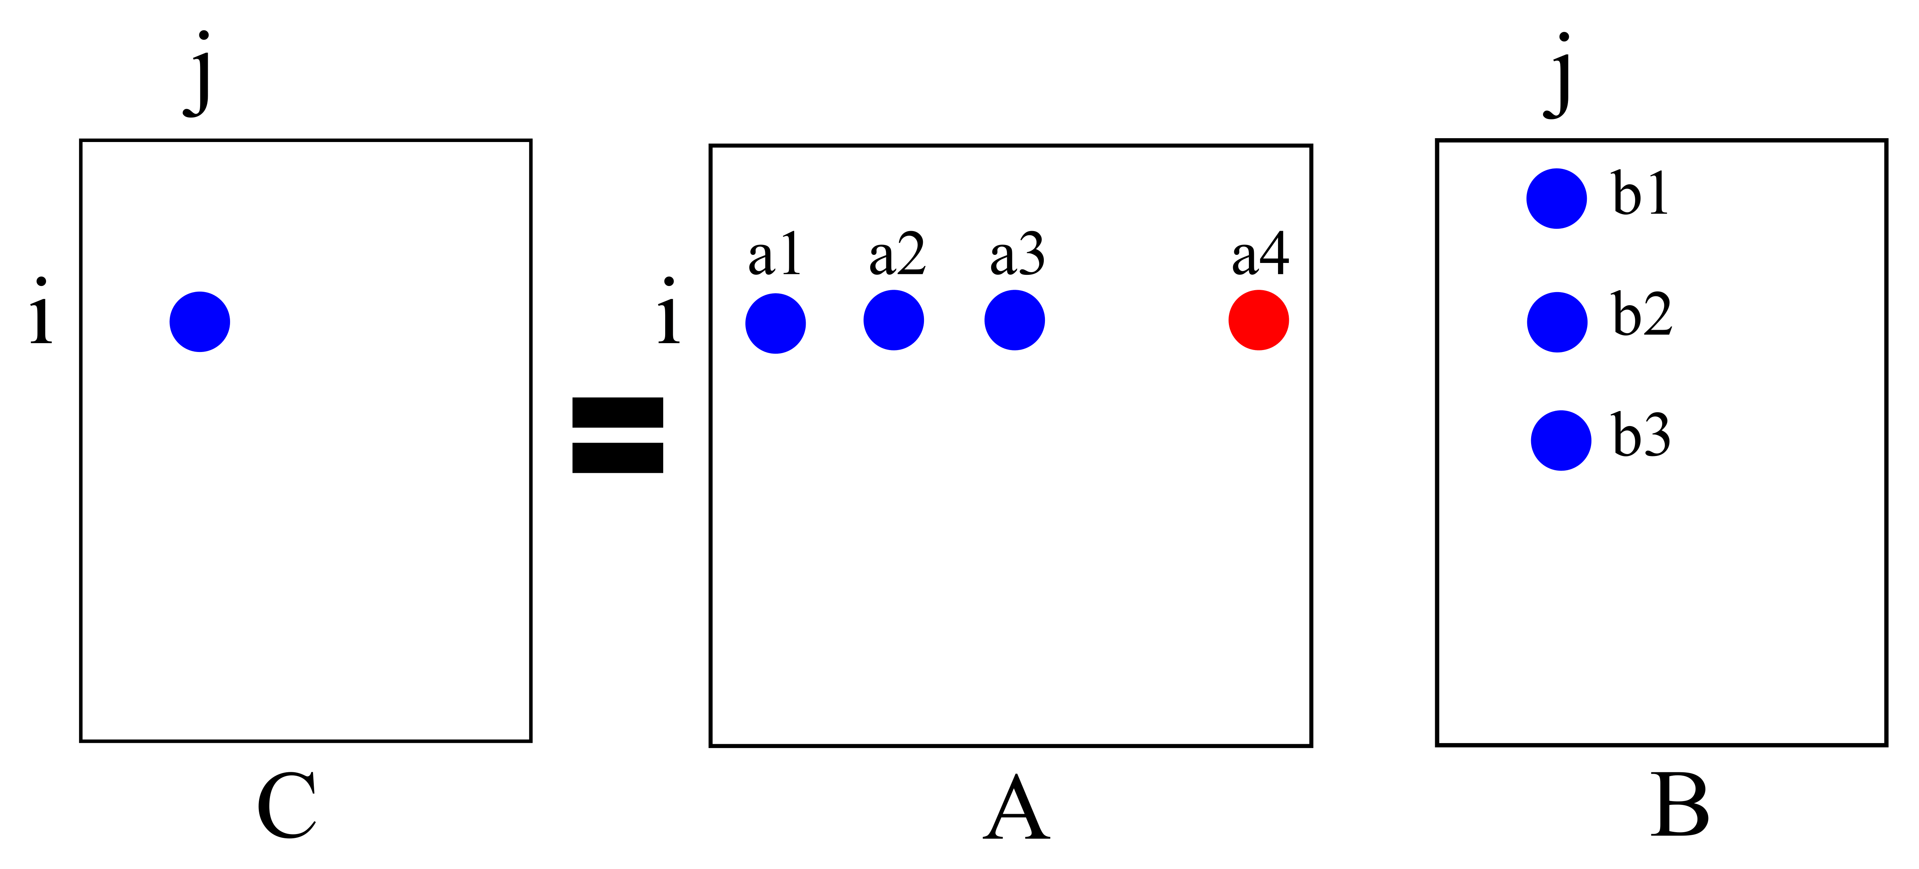

Duplicates
$$C\left(i,j\right)=a1 ×b1$$
$$C\left(i,j\right)=a2 ×b2$$
$$C\left(i,j\right)=a3 ×b3$$
We call the entries with the same index duplicates.
We need to add duplicates to have the correct value.

Slide 41
Case1: Method1
First idea: A dense matrix (array) is used as buffer.
Before starting MATMULT, allocate a memory block of size of the threshold.
Initialize the first NNZ_MAT_SIZE entries to 0.
Perform the multiplication and add the result entry to the buffer matrix.
Extract nonzeros from the dense matrix and add them to C.
Notes:
Explain when each one is better

Slide 42
Case1: Method2
Problem with method1: when the ratio of nonzeros in the buffer that should be extracted is low (sometimes 0), it is not efficient to go through all the buffer for that many nonzeros.
Solution: Hashmap: (index, value).
If the entry is not available, add a new entry.
Otherwise, add the value to the existing one.
Notes:
Explain when each one is better

Slide 43
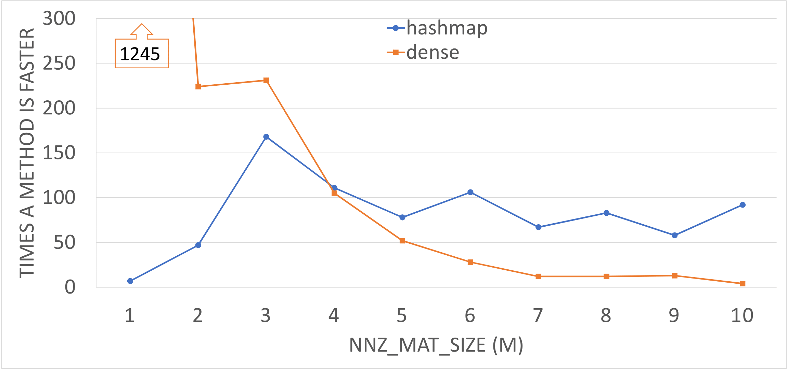

Case1
Comparison for dense structure method with hashmap to compute coarse matrix $Ac = R×A×P$ in which A is the 3D Poisson problem of size 216k. The plot shows the number of times each method is faster than the other one in intervals of 1M for NNZ_MAT_SIZE.

Slide 44
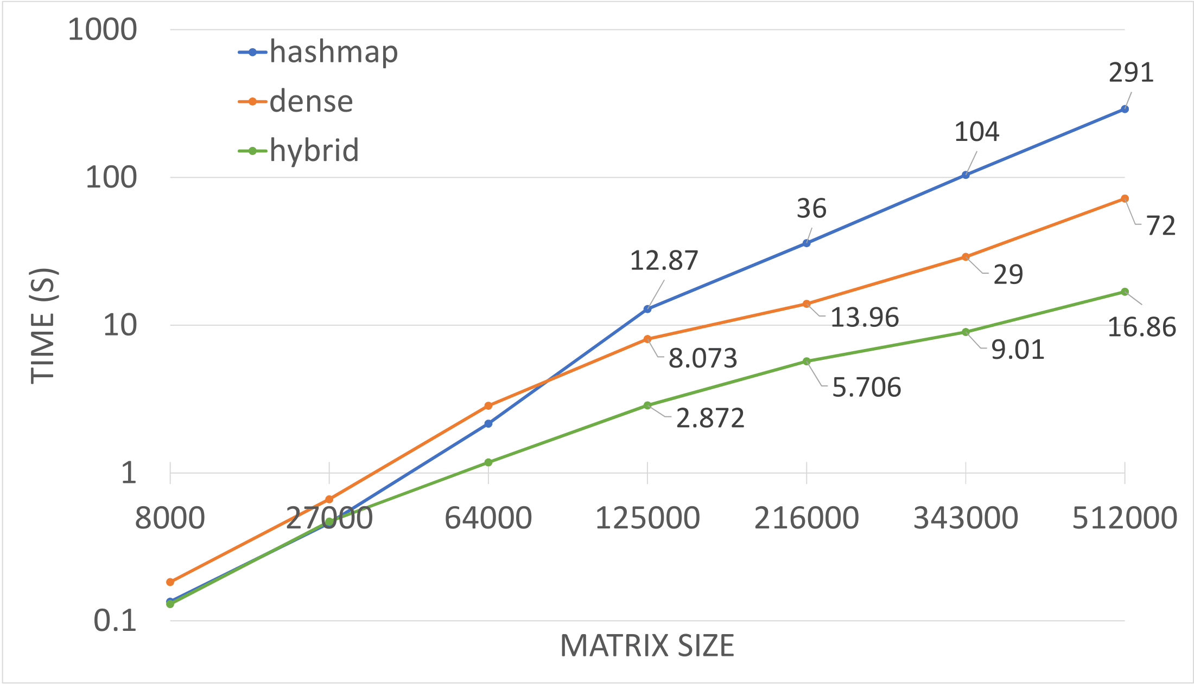
Case1
Comparison for computing the coarse matrix (the triple multiplication) on 7 matrices (3D-Poisson) of different sizes.

Slide 45
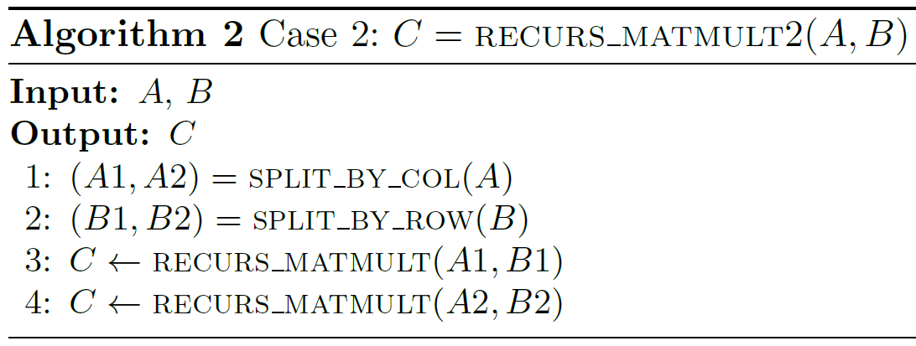
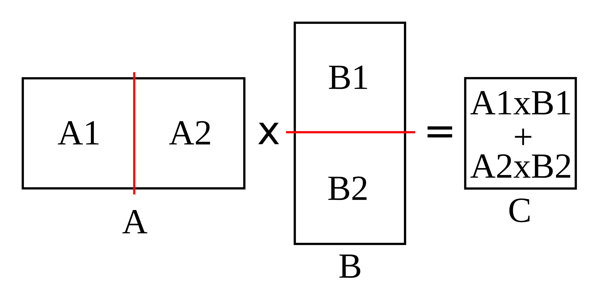
Case2
If A is horizontal, split A by column and B by row.
Notes:
When A is horizontal, we halve A by column based on its column size. Since row size of B equals column size of A, we halve B by row, so it will be a split similar to A, but horizontally.

Slide 46
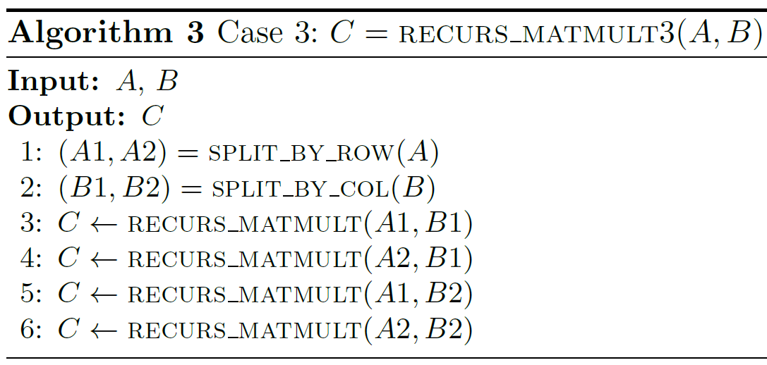
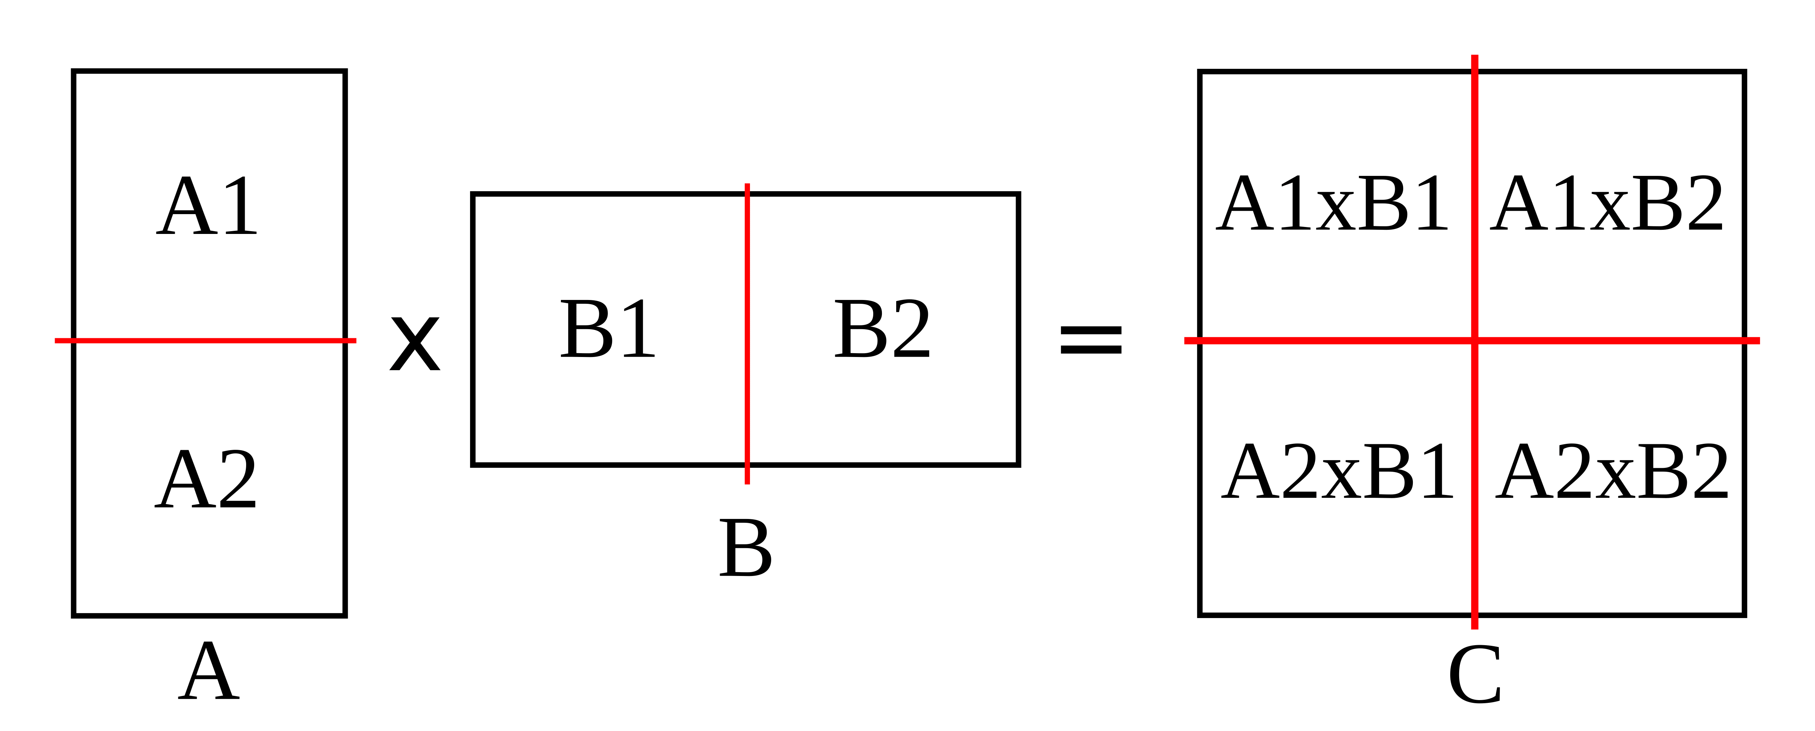
Case3
If A is vertical, split A by row and B by column.

Slide 47
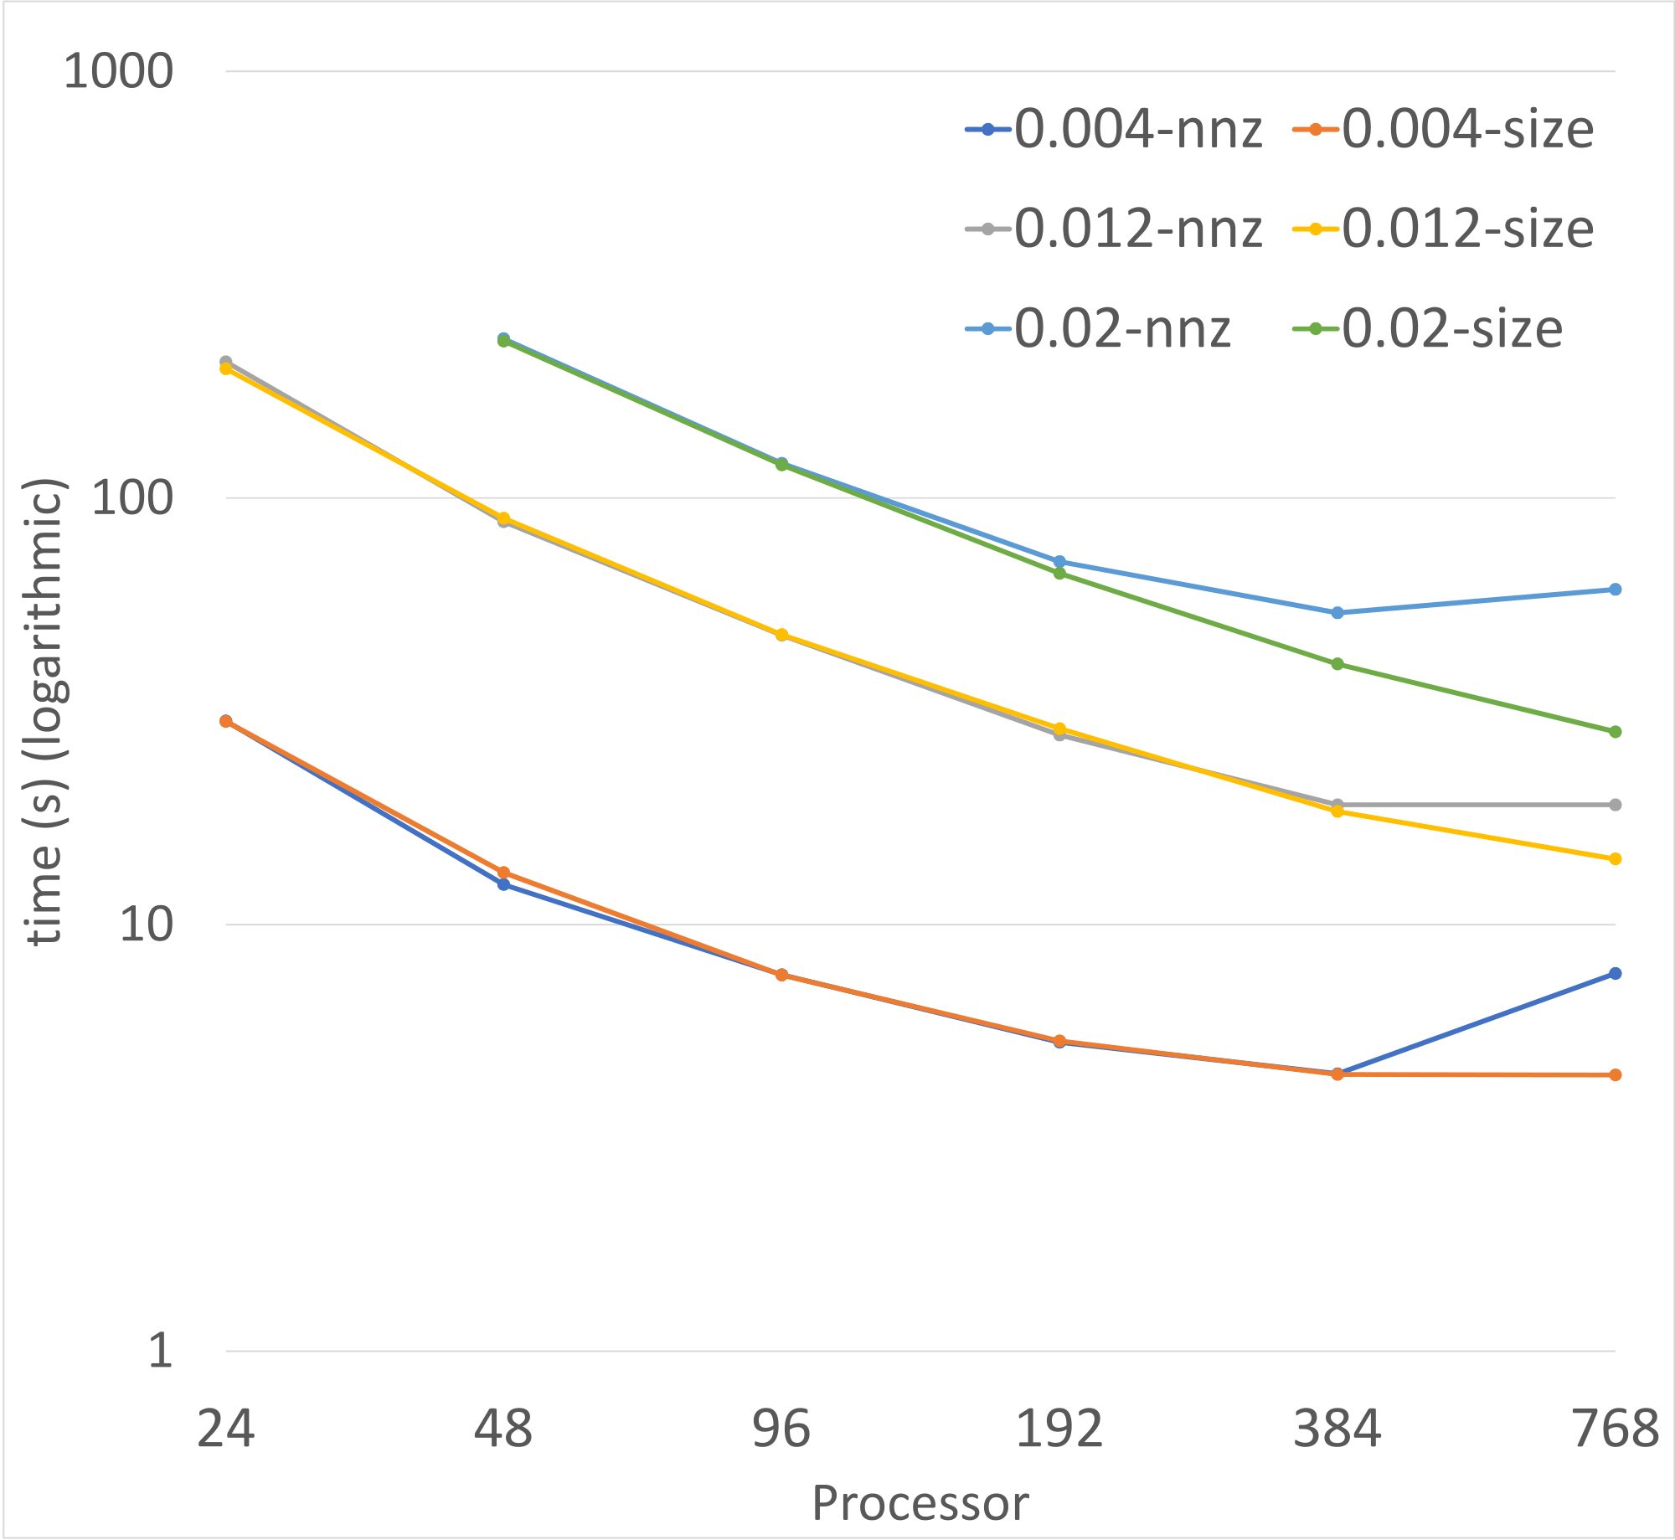

Early Results
Strong scaling of MATMULT for 4 banded matrices of the same size (192k), but with different bandwidth.
Comparing split based on size vs. split based on nonzero.
Legend: $density=\frac{nonzero}{{size}^{2}}$

Slide 48
Other Projects
Randomized Sparsification
Compression -> zfp from LLNL
Machine Learning for Algebraic Multigrid
Lazy-update Algebraic Multigrid
Collaborations
Imperial College London and University of Exeter
Brown

Slide 49
Thank You!

