Slide 1
Saena

Slide 2


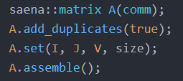
Matrix
Read from file:
Matrix Market (mtx); e.g. Florida Matrix Collection
Binary
Dense
Set each entry one by one:
Pass arrays of row, column and values:
Example:

Slide 3
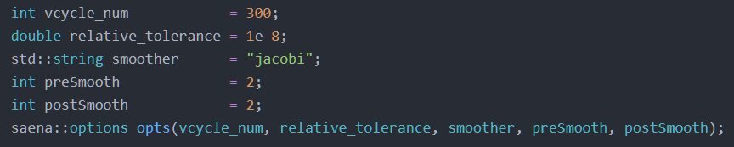
Options
There are 3 ways to set options:
Use the default:
Read from an xml file:
Set them manually:

Slide 4


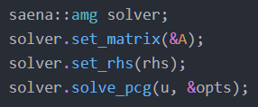
Solver
AMG as a solver:
AMG as preconditioner; Preconditioned Conjugate Gradient (PCG):
Example:

Slide 5




Auxiliary Functions
Linear Algebra:
Matrix-vector product
Matrix-matrix product
Smoothers (Jacobi, Chebyshev)
Information
Matrix Generators:

