Slide 1
LAZY-UPDATE MULTIGRID PRECONDITIONERS
Majid Rasouli
Vidhi Zala
Robert M. Kirby
Hari Sundar

Slide 2

Algebraic Multigrid (AMG)
Approximate solution $x$ of a linear system:
$$Ax=b$$
such that $A∈ℝ^{n×n} is sparse, x and b∈ℝ^{n}$.
Start with an initial guess for $x$. Reduce the error iteratively by:
Smoothers (Jacobi, Chebyshev, …)
Coarse-grid Correction
AMG has two phases:
Setup: compute the required operators to solve the system
Solve

Slide 3


Setup phase: two-grid
coarsening
$$A_{coarse}=R×A×P$$
$R$: restriction, $P$: prolongation
$$A_{coarse}$$
R
A
P

Slide 4

Setup phase: multigrid
$$As\left[l+1\right]=Rs\left[l\right]×As\left[l\right]×Ps\left[l\right]$$
$As\left[0\right]$ is the finest matrix $A$.
As: coarse matrices
$Rs$: restriction matrices
$Ps$: prolongation matrices

Slide 5
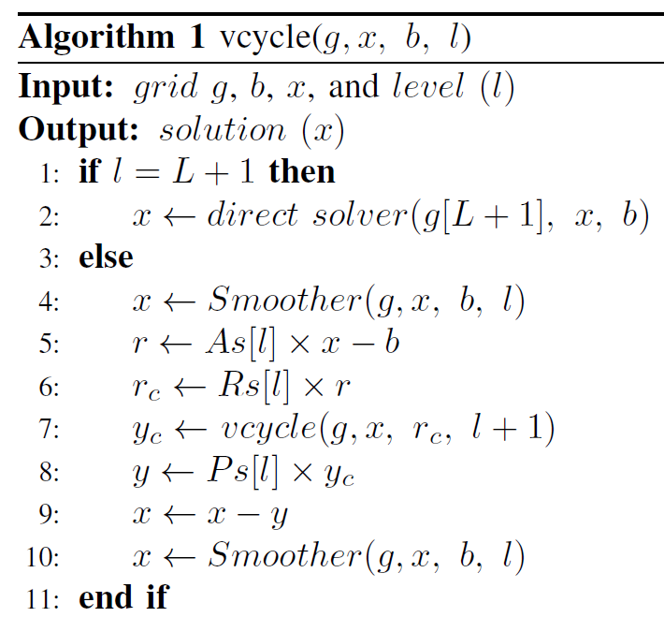
Solve phase:

Slide 6
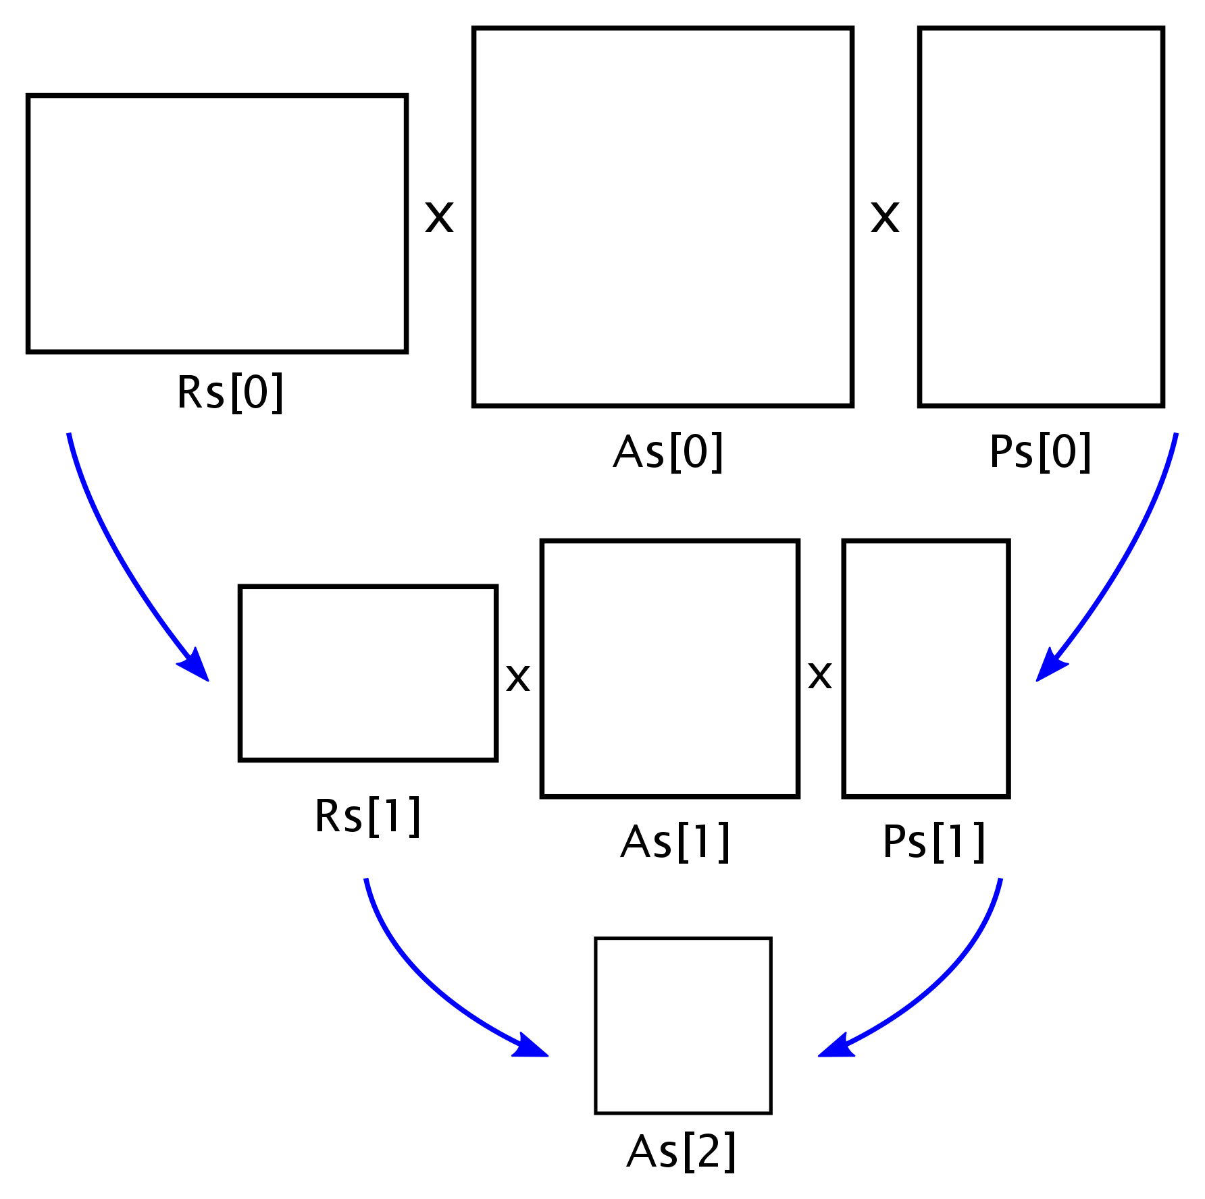
Strategies
We propose 3 strategies to partly update the AMG hierarchy, and consequently avoiding repeating the whole setup phase.
The figure shows the hierarchy for a 3-level multigrid.

Slide 7
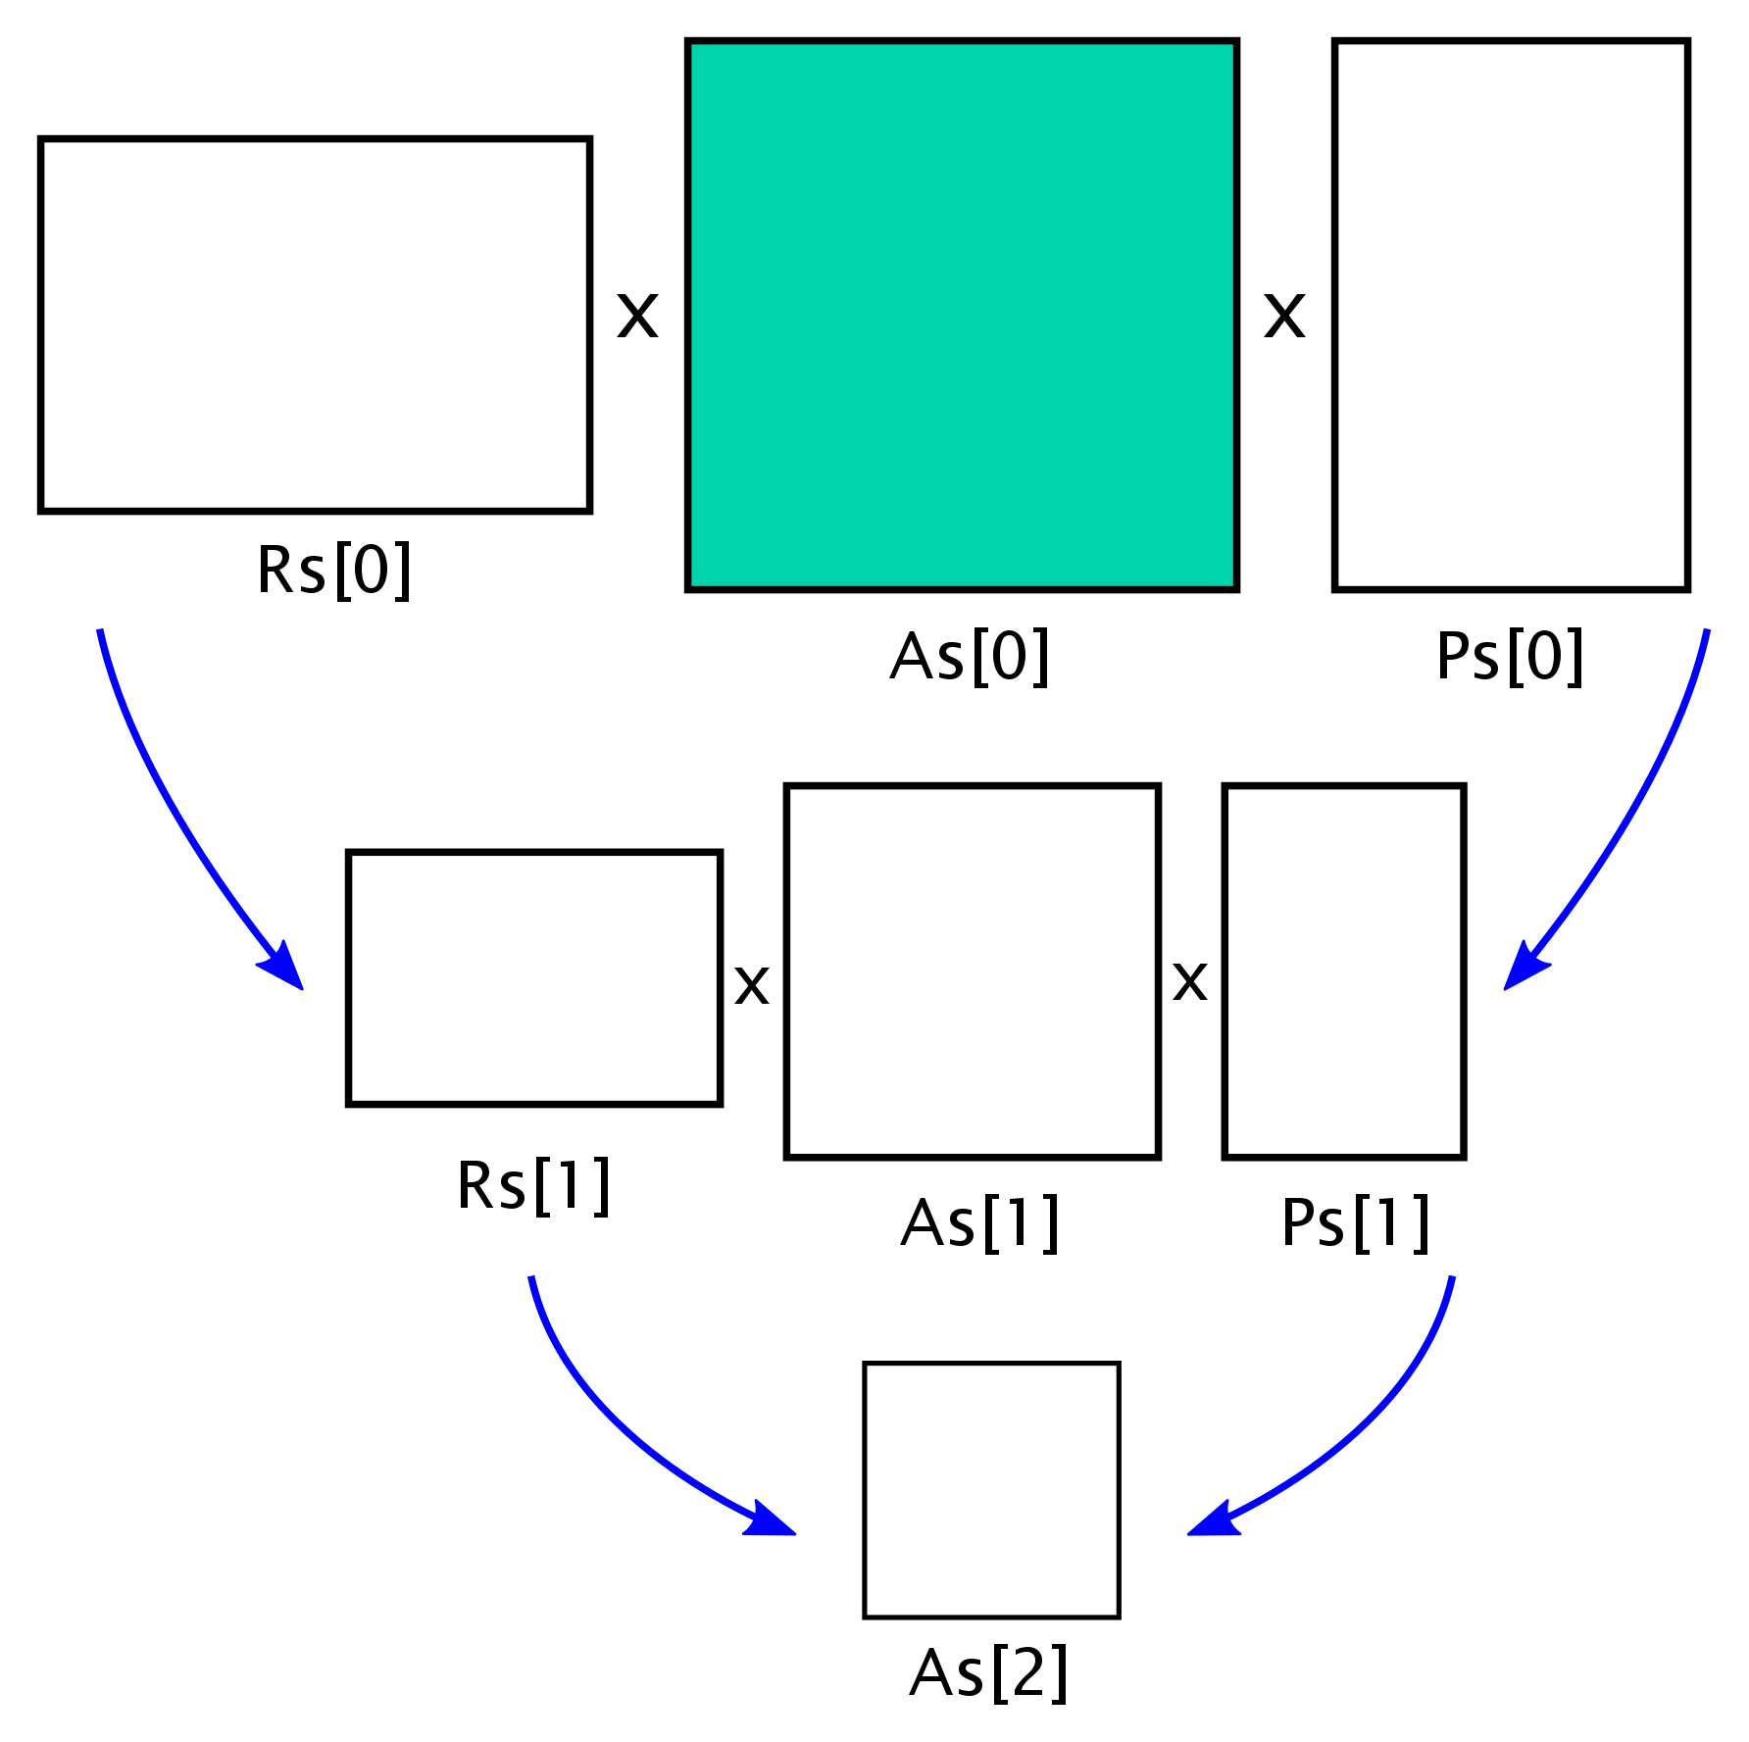
Strategy1
The parts that should be updated are colored as green.
Only the first level coarse matrix (As[0]), which is the input matrix, is being replaced with the new matrix.

Slide 8
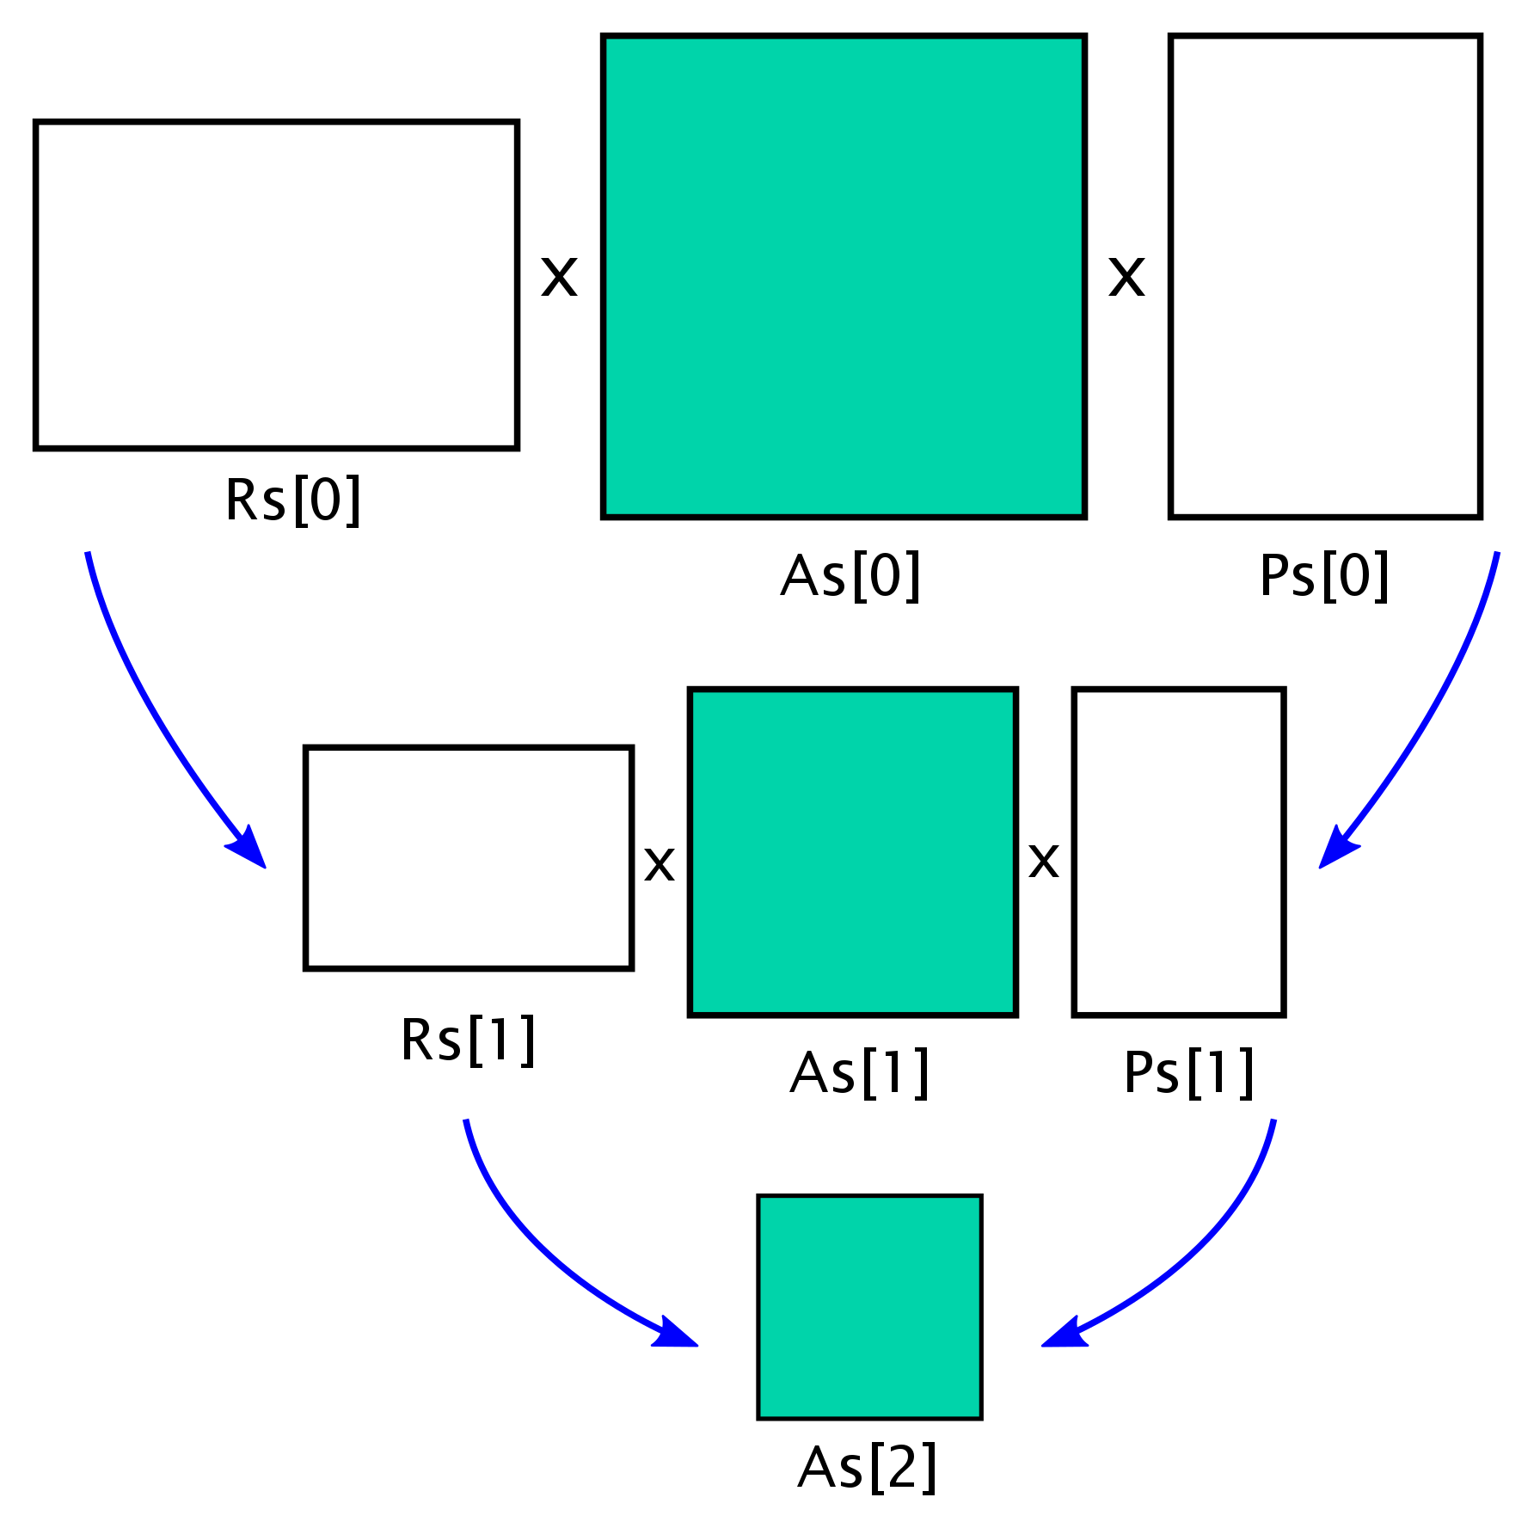

Strategy2
All coarse matrices (As) are being replaced. Ps and Rs are kept unchanged.
First the input matrix As[0] is being replaced with the new updated matrix. Then, As[1] is being replaced by:
$$As\left[1\right]=Rs\left[0\right]×As\left[0\right]×Ps\left[0\right]$$
And so on.

Slide 9
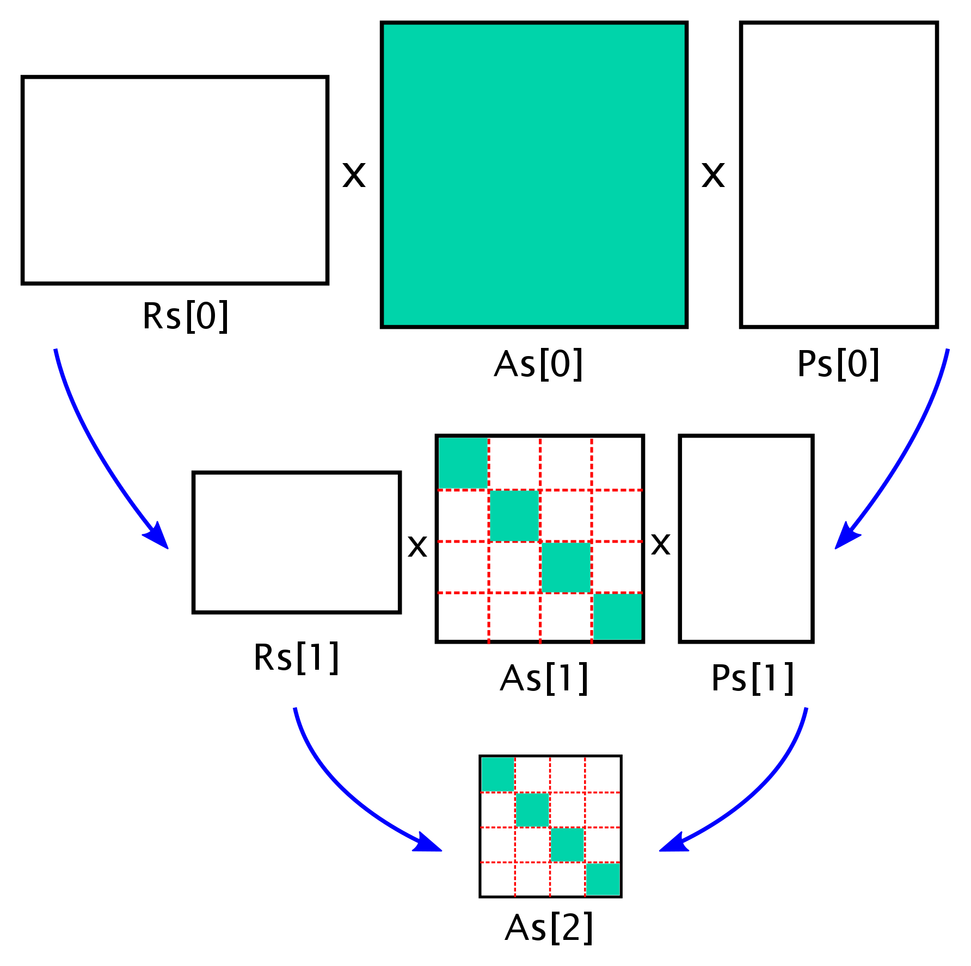

Strategy3
To perform the coarsening operation (triple matrix product):
$$As\left[l+1\right]=Rs\left[l\right]×As\left[l\right]×Ps\left[l\right]$$
different parts of these matrices should be communicated between processors, which is an expensive operation.
In this strategy only the diagonal blocks of As matrices are being updated, which can be done locally and does not require any communication.

Slide 10

Early Results
The experiments are done on Kingspeak clusters on CHPC in University of Utah.
First the linear system $Ax=b$ is being solved based on the original matrix. The right-hand side $b$ is being generated randomly.
Then the left-hand side $A$ will be updated based on a sine function. The AMG hierarchy will be updated following one of the 3 strategies explained earlier. The number of vcycle iterations, setup and solve phases are being compared.
This example uses 5 processors on a mesh from Nektar++ of size of almost 1k and 70k nonzeros.

Slide 11
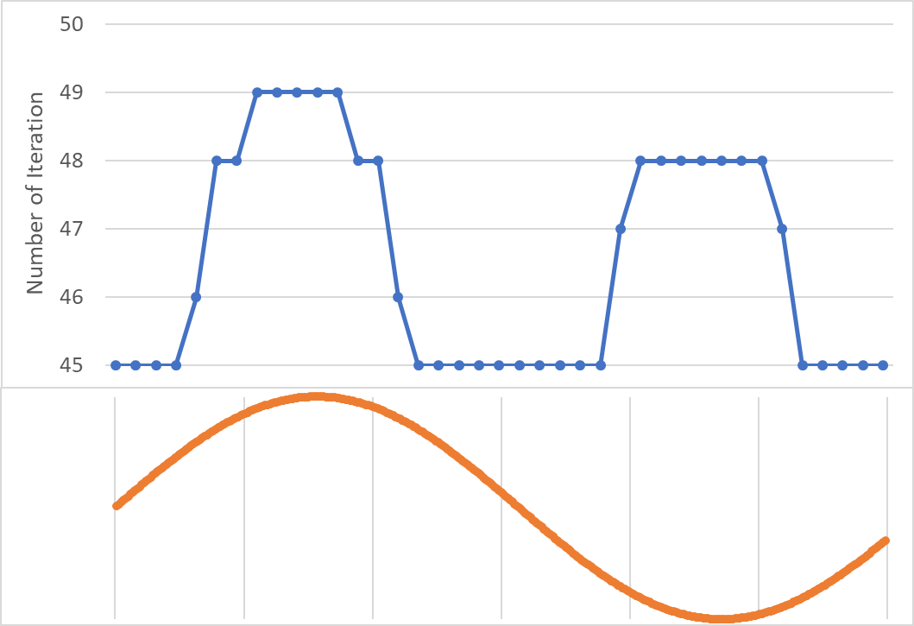
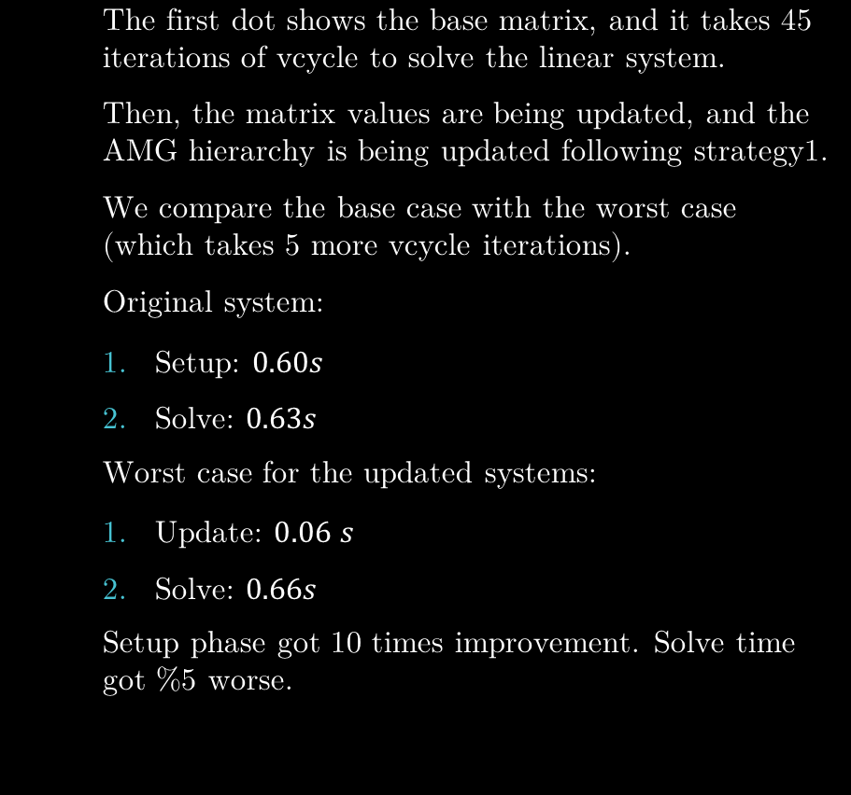
Early Results: Strategy1
The first dot shows the base matrix, and it takes 45 iterations of vcycle to solve the linear system.
Then, the matrix values are being updated, and the AMG hierarchy is being updated following strategy1.
We compare the base case with the worst case (which takes 5 more vcycle iterations).
Original system:
Setup: $0.60s$
Solve: $0.63s$
Worst case for the updated systems:
Update: $0.06$ $s$
Solve: $0.66s$
Setup phase got 10 times improvement. Solve time got %5 worse.
The orange line shows how the coefficients change based on a sine function. (I will ask Vidhi to explain this part in more details for the paper.)

Slide 12
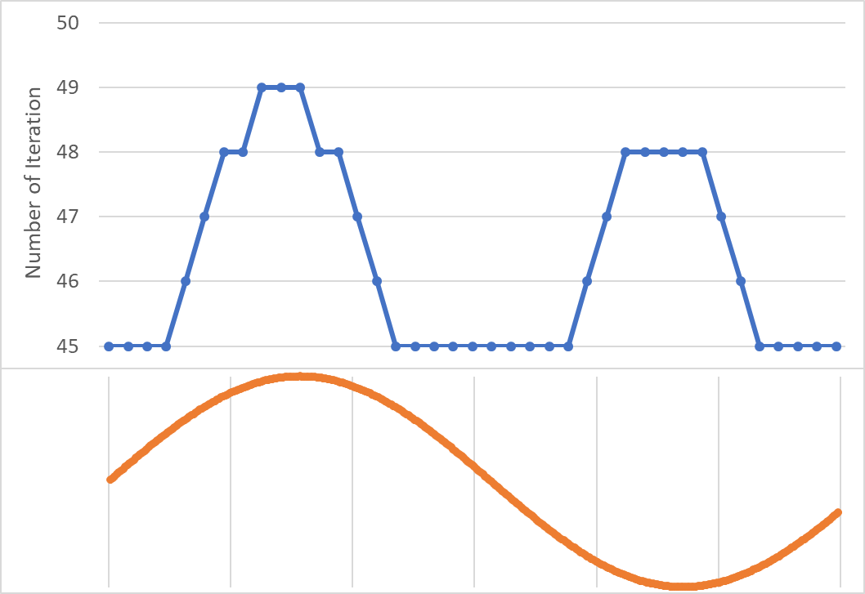
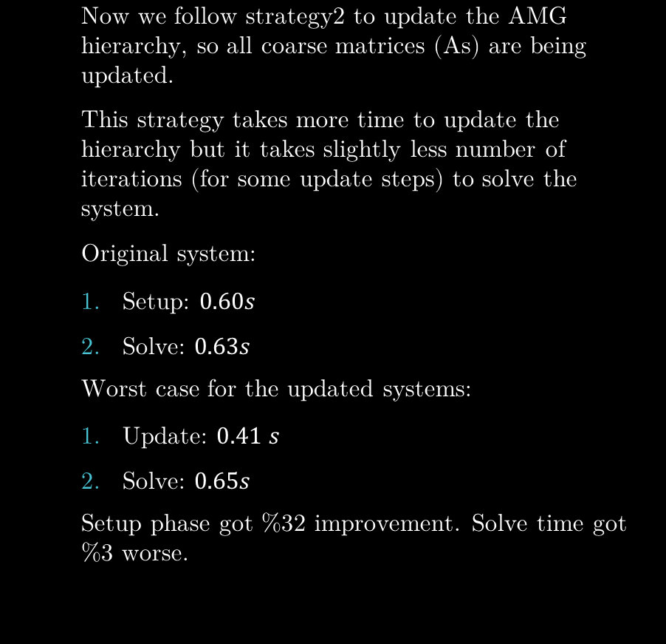
Early Results: Strategy2
Now we follow strategy2 to update the AMG hierarchy, so all coarse matrices (As) are being updated.
This strategy takes more time to update the hierarchy but it takes slightly less number of iterations (for some update steps) to solve the system.
Original system:
Setup: $0.60s$
Solve: $0.63s$
Worst case for the updated systems:
Update: $0.41$ $s$
Solve: $0.65s$
Setup phase got %32 improvement. Solve time got %3 worse.

Slide 13
Early Results: Strategy3
This experiment follows strategy3 to update the AMG hierarchy, so the local parts of all coarse matrices (As) are being updated.

