Slide 1
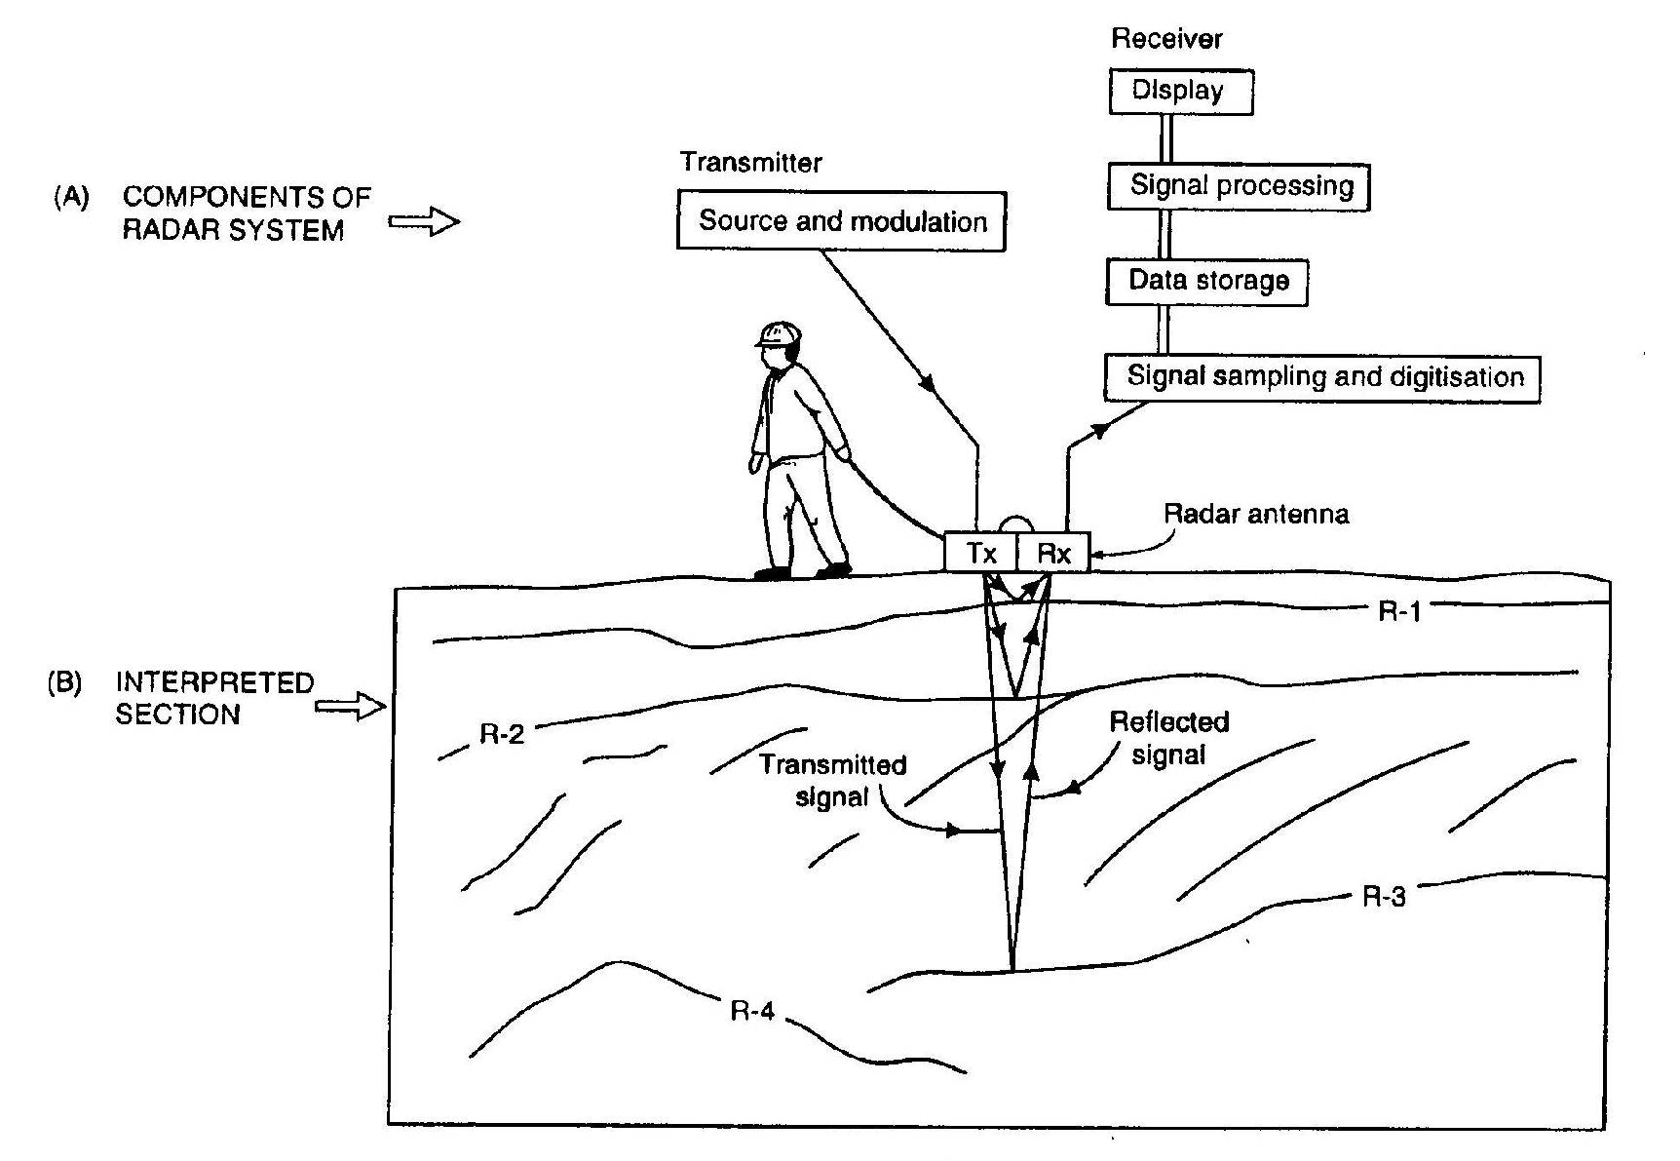
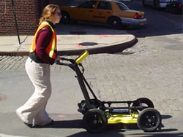
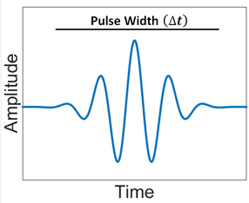
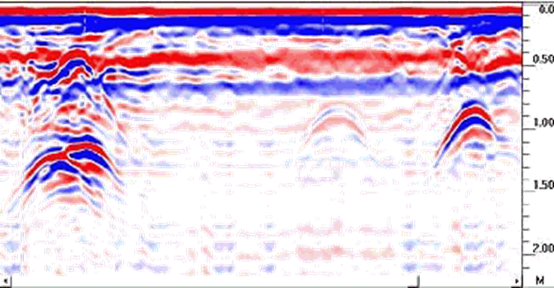
Ground Penetrating Radar (day 3)
EOSC 350 ‘06
Slide 1

Slide 2
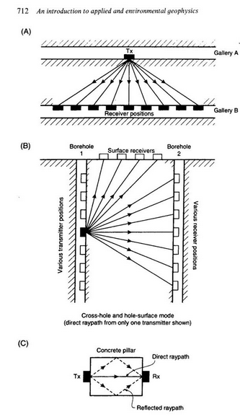
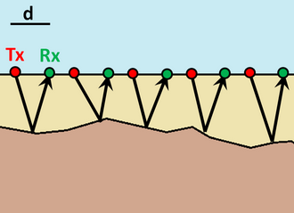
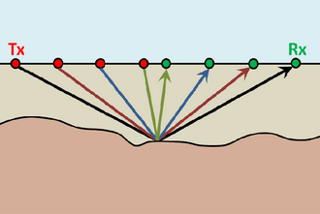
From Last Time
Common Offset
Transillumination
Common Midpoint

Slide 3
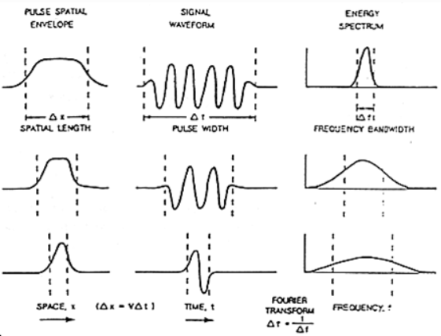



From Last Time
Shorter pulses contain a wider range of frequencies
Shorter pulse overall contain higher frequencies
Spatial length increases as pulse length increases

Slide 4


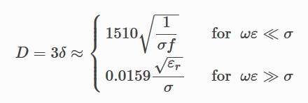
From Last Time
There is a compromise between resolution and probing distance: Higher frequencies Better resolution Layers: Objects: Higher frequencies Lower probing distance

Slide 5
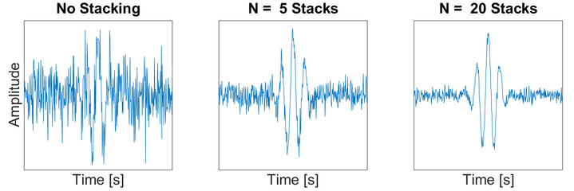
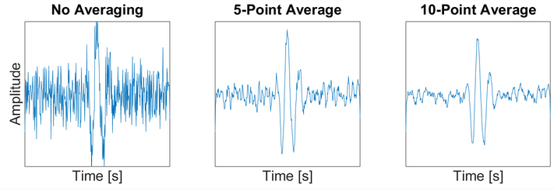
From Last Time

Slide 6
Today’s Topics
Interpretation and some examples

Slide 7
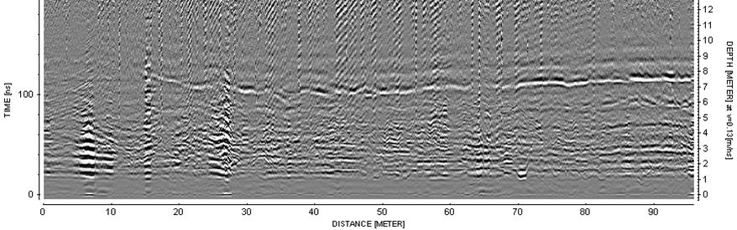
Example: Potash Mine
Water was leaking into the potash mine Reducing structural integrity of mine shafts Want to know where water is and its source Water infiltration produces a strong reflector

Slide 8
Example: Potash Mine
Zero offset survey performed.
Arrival time to depth conversion performed Q: Without a direct ground wave measurement or hyperbola to obtain propagation speed, how could they do conversion?

Slide 9
Example: Potash Mine
A: Potash in an anhydrite mineral. From known physical properties, V ~ 0.13 m/ns da = Vt/2

Slide 10
Example: Potash Mine
Q: What kinds of features do you see in the data?

Slide 11
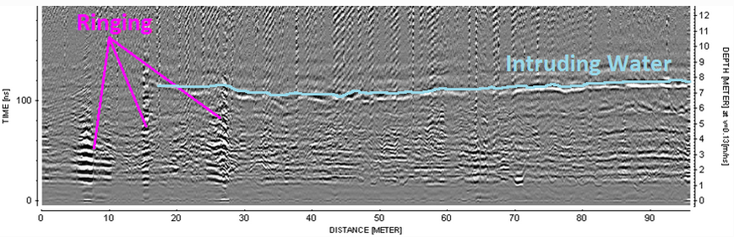
Example: Potash Mine
Strong reflector from intruding water (7 - 8 m from shaft)
Water is delineated and seems to be coming from the right
Ringing from mine infrastructure

Slide 12
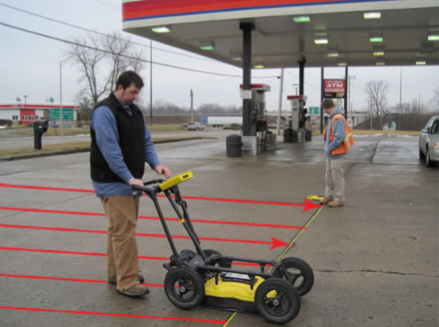
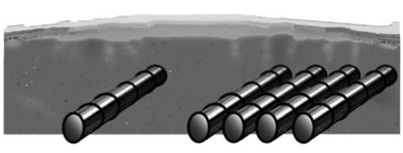
Example: Underground Storage Tanks
Want to locate a set of underground storage tanks. Q: What direction would you orient your survey lines? Why? Q: What features do you expect in your radargram?
Diagram of problem
Notes:
A: Perpendicular to the tanks lengthwise. Because it will act hopefully as a point reflector.
A: Something like a hyperbola.

Slide 13
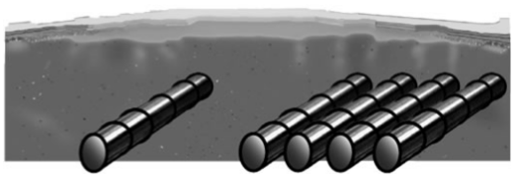
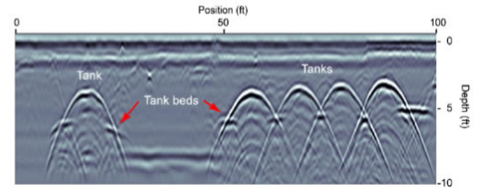
Example: Underground Storage Tanks
Q: If tanks too big to be point reflectors, can you still obtain layer velocity? How?
Q: How can you figure out the horizontal location and depth to each tank? (assume you know the velocity)
Q: Why aren’t signatures from tank beds entirely visible?
Notes:
A: Yes. Use their slope.
A: Top of hyperbola is over top of the tank. Eq for shortest travel time can be used to get depth.
A: Tanks are conductive metal so no signal gets through and reflects of beds at certain orientations.

Slide 14
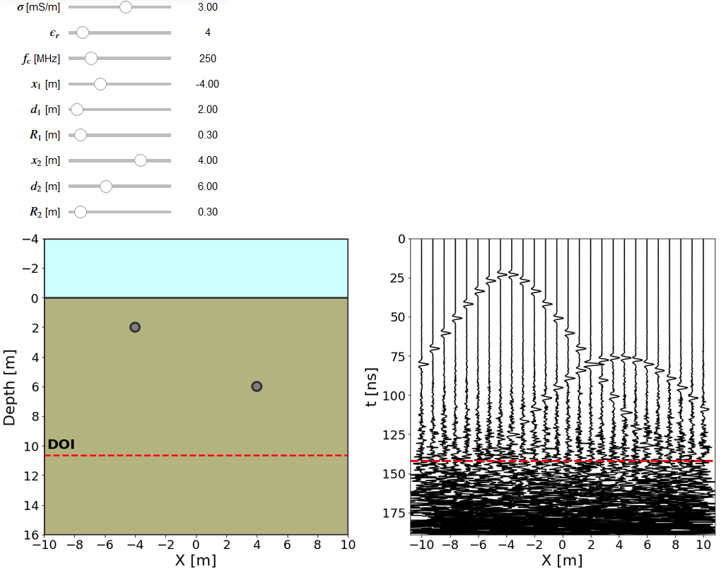
Example: GPR App Problem
Zero offset survey
Two buried reflectors
Wave regime!!!

Slide 15
Example: GPR App Problem
Q1: From the radargram, use the slope to determine the propagation velocity.
Q2: From the preset parameters, compute the probing distance (or DOI) using the quasi-static AND wave regime approximation. Compare to the DOI in the app. What regime are we in?
Q3: Determine the relative permittivity of the host media from the medium velocity you computed. Does it match the value set in the app?

Slide 16
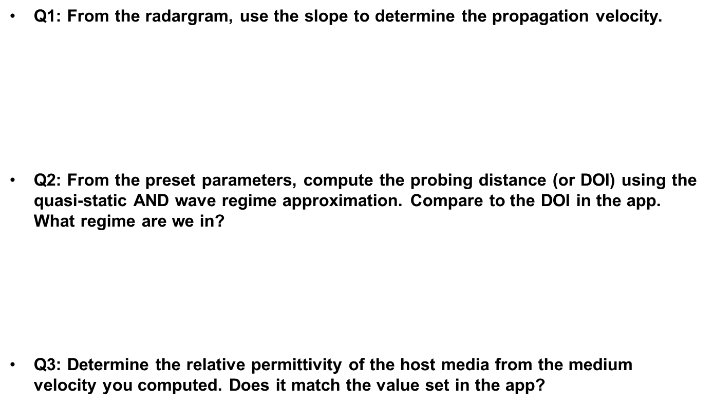
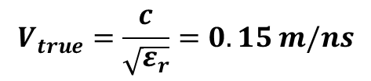
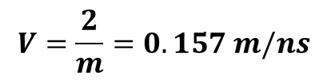
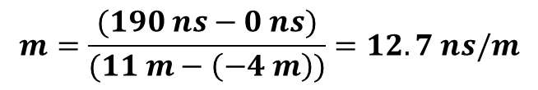
Example: GPR App Problem
Q1: From the radargram, use the slope to determine the propagation velocity.
Q2: From the preset parameters, compute the probing distance (or DOI) using the quasi-static AND wave regime approximation. Compare to the DOI in the app. What regime are we in?
Q3: Determine the relative permittivity of the host media from the medium velocity you computed. Does it match the value set in the app?
$$m=\frac{(190 ns−0 ns)}{(11 m−\left(−4 m\right))}=12.7 ns/m$$
$$V=\frac{2}{m}=0.157 m/ns$$
$$V_{true}=\frac{c}{\sqrt{ε_{r}}}=0.15 m/ns$$

Slide 17
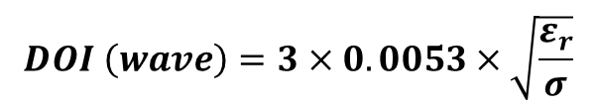
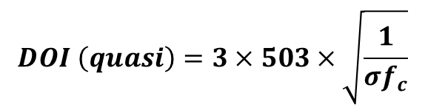
Example: GPR App Problem
Q1: From the radargram, use the slope to determine the propagation velocity.
Q2: From the preset parameters, compute the probing distance (or DOI) using the quasi-static AND wave regime approximation. Compare to the DOI in the app. What regime are we in?
Q3: Determine the relative permittivity of the host media from the medium velocity you computed. Does it match the value set in the app?
$$m=\frac{(190 ns−0 ns)}{(11 m−\left(−4 m\right))}=12.7 ns/m$$
$$V=\frac{2}{m}=0.157 m/ns$$
$$V_{true}=\frac{c}{\sqrt{ε_{r}}}=0.15 m/ns$$
$$DOI \left(quasi\right)=3×503×\sqrt{\frac{1}{σf_{c}}}$$
$$DOI \left(wave\right)=3×0.0053×\sqrt{\frac{ε_{r}}{σ}}$$

Slide 18
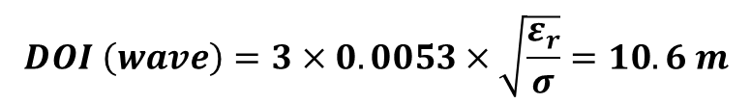
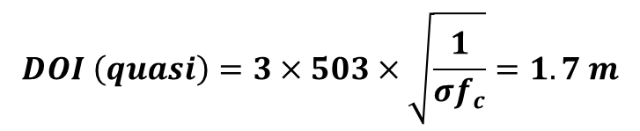
Example: GPR App Problem
Q1: From the radargram, use the slope to determine the propagation velocity.
Q2: From the preset parameters, compute the probing distance (or DOI) using the quasi-static AND wave regime approximation. Compare to the DOI in the app. What regime are we in?
Q3: Determine the relative permittivity of the host media from the medium velocity you computed. Does it match the value set in the app?
$$m=\frac{(190 ns−0 ns)}{(11 m−\left(−4 m\right))}=12.7 ns/m$$
$$V=\frac{2}{m}=0.157 m/ns$$
$$V_{true}=\frac{c}{\sqrt{ε_{r}}}=0.15 m/ns$$
$$DOI \left(quasi\right)=3×503×\sqrt{\frac{1}{σf_{c}}}=1.7 m$$
$$DOI \left(wave\right)=3×0.0053×\sqrt{\frac{ε_{r}}{σ}}=10.6 m$$

Slide 19
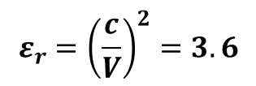
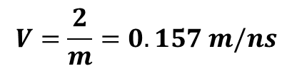
Example: GPR App Problem
Q1: From the radargram, use the slope to determine the propagation velocity.
Q2: From the preset parameters, compute the probing distance (or DOI) using the quasi-static AND wave regime approximation. Compare to the DOI in the app. What regime are we in?
Q3: Determine the relative permittivity of the host media from the medium velocity you computed. Does it match the value set in the app?
$$m=\frac{(190 ns−0 ns)}{(11 m−\left(−4 m\right))}=12.7 ns/m$$
$$V=\frac{2}{m}=0.157 m/ns$$
$$V_{true}=\frac{c}{\sqrt{ε_{r}}}=0.15 m/ns$$
$$DOI \left(quasi\right)=3×503×\sqrt{\frac{1}{σf_{c}}}=1.7 m$$
$$DOI \left(wave\right)=3×0.0053×\sqrt{\frac{ε_{r}}{σ}}=10.6 m$$
$$V=\frac{2}{m}=0.157 m/ns$$
$$ε_{r}={\left(\frac{c}{V}\right)}^{2}=3.6$$

Slide 20
Example: GPR App Problem
Q4: What is the horizontal resolution of the survey at a depth of 4m? Adjust the location of the reflectors to confirm this with the app.
Q5: How could we improve the survey resolution? What drawback might this have?
Q6: If we increases the radius of one of the reflectors, what happens to its signature?

Slide 21

Example: GPR App Problem
Q4: What is the horizontal resolution of the survey at a depth of 4m? Adjust the location of the reflectors to confirm this with the app.
Q5: How could we improve the survey resolution? What drawback might this have?
Q6: If we increases the radius of one of the reflectors, what happens to its signature?
$$L=\sqrt{\frac{Vd}{2f_{c}}}$$

Slide 22

Example: GPR App Problem
Q4: What is the horizontal resolution of the survey at a depth of 4m? Adjust the location of the reflectors to confirm this with the app.
Q5: How could we improve the survey resolution? What drawback might this have?
Q6: If we increases the radius of one of the reflectors, what happens to its signature?
$$L=\sqrt{\frac{Vd}{2f_{c}}}=1.1 m$$

Slide 23
Example: GPR App Problem
Q4: What is the horizontal resolution of the survey at a depth of 4m? Adjust the location of the reflectors to confirm this with the app.
Q5: How could we improve the survey resolution? What drawback might this have?
Increase frequency → Reduces probing distance
Q6: If we increases the radius of one of the reflectors, what happens to its signature?
$$L=\sqrt{\frac{Vd}{2f_{c}}}=1.1 m$$

Slide 24
Example: GPR App Problem
Q4: What is the horizontal resolution of the survey at a depth of 4m? Adjust the location of the reflectors to confirm this with the app.
Q5: How could we improve the survey resolution? What drawback might this have?
Increase frequency → Reduces probing distance
Q6: If we increases the radius of one of the reflectors, what happens to its signature?
No longer a hyperbola, slope trick works, early observed signals.
$$L=\sqrt{\frac{Vd}{2f_{c}}}=1.1 m$$

Slide 25
Concluding Thoughts: GPR in a Nutshell
Electromagnetic Method
Exploits contrasts in dielectric permittivity and conductivity
Sends a pulse of radiowaves into the ground
Signals reflect, refract and transmit at interfaces
Measured signals represented using radargrams

Slide 26
Concluding Thoughts: When to use GPR
Generally near-surface applications (10s metres or less)
Images the interfaces which define subsurface structures
Examples: - Geotechnical problems (rock fractures, slope stability …) - Find buried infrastructure (pipes, wires, storage tanks …) - Near surface soil properties and structures - Forensics - Archaeology

Slide 27
Concluding Thoughts: Planning a Survey
What do I know about the local physical properties?
How deep do I need to image?
What are the dimensions and separations of structures I want to image? Allows you to pick optimum grid spacing and operating frequency

Slide 28
Concluding Thoughts: Optimum Frequency
Resolution: Layers Objects
Probing Distance:
Choice in operating frequency is a compromise between resolution and probing distance!!!!

Slide 29
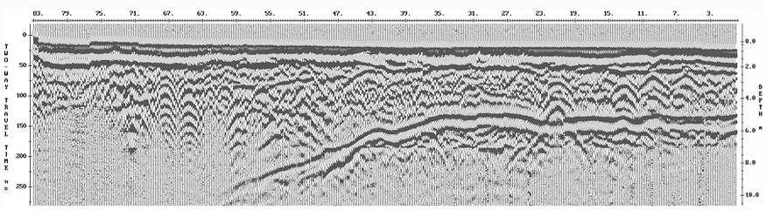
Concluding Thoughts: What to Look For
Hyperbolas
Linear
Features
Geometry can give us layer velocities, location of objects and depths of interfaces.

Slide 30
Questions About GPR?

