Slide 1
z
y
x

Slide 2
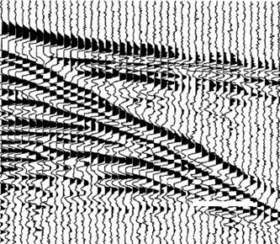

Slide 3
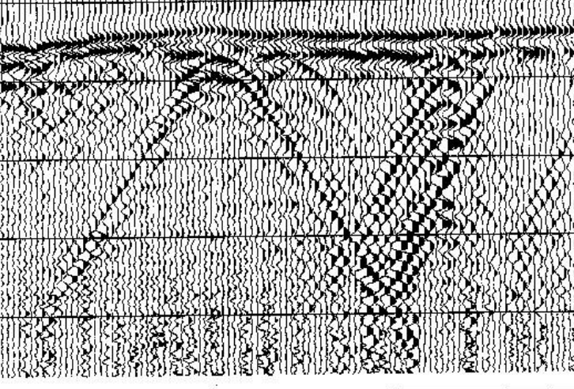

Slide 4
z
y
x
The number of receivers: 100
Minimum separation b/w source and receivers: 0.4 m
Separation b/w receivers: 0.4 m
Air
Source
Receivers
……
h = 5 m
Layer 1
Layer 2

Slide 5
z
y
x
Air
Source
Receiver
h = 5 m
Layer 1
Layer 2

Slide 6
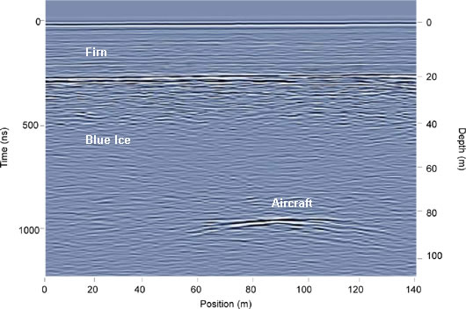
Air layer
z
y
Snow layer
x
Ice layer
Air
h = ? m
Snow layer
Ice layer

Slide 7
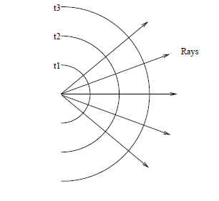

Slide 8
z
y
x
layer1
layer2

Slide 9
z
y
Air
x
xc
x1
x2
Layer 1
Layer interface
h
h
Layer 2
Pipe
r
Concrete casing

Slide 10

z
y
Air
x
xc
h
epsr
Pipe
r

Slide 11
z
y
Air
x
x1
x2
h
epsr
Concrete casing

Slide 12

z
y
x
x
h

Slide 13
z
y
x
layer1
layer2

Slide 14
y
z
x

