Slide 1
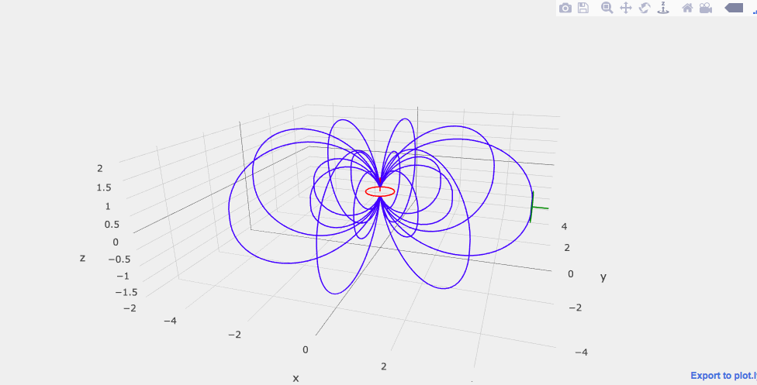
Notebook: Loop, dipole and field lines
Hands-on practice in TBL teams
“MagDipoleLoops3D.ipynb”
Clone or download from https://github.com/yangdikun/magLab.git
Finish the following tasks in teams
Tips:
The buttons on the top-right corner of the figure area can help you zoom, pan and rotate.

Slide 2
Task 1: Loop by default
“Run All” to get the default result
Shown is a loop wire carrying an 1A current. The equivalent dipole moment is calculated as the product of loop area and current. Your estimate of the dipole moment is ________.
The straight line perpendicular to the loop surface indicates the direction of the dipole moment. The plot you see represents a horizontal or vertical loop with a horizontal or vertical dipole moment. (circle one of the two choices)

Slide 3
Task 2: Reorient loop
Adjust the declination and inclination of Loop 1, so the dipole moment points to the +x direction. Now the loop represents a horizontal or vertical dipole. (circle one of the two choices)
Take a screenshot of the figure and paste it below. Remember to include the axis labels.

Slide 4
Task 3: Loop-loop coupling
Check “Show Loop 2” to turn on the second loop.
Keep the orientation of Loop 2 unchanged and adjust the location of Loop 2 to a point where it has the best geometric coupling with Loop 1 through the magnetic flux linkage (tangential direction of field lines is parallel to the dipole moment direction of a loop). Take a screenshot and paste it below. Remember to include the axis labels.

Slide 5
Task 4: Loop-loop coupling
Change the orientation of Loop 2, so the dipole moment points to the +x direction.
Move Loop 2 around to find two locations where (1) Loop 1 and 2 are fully coupled and (2) Loop 1 and Loop 2 are null coupled. Paste the TWO screenshots below. Remember to include the axis labels.

Slide 6
Submission
If you have Microsoft PowerPoint, you can directly work in em_intro_tasks.pptx (download from the course website)
You can also choose to copy the contents in the pptx file to your preferred word processing software and work in it
Or send an email including your answers in plain text and pictures as attachment
Each team needs to send a document or an email to yangdikun@gmail.com
Submissions will be reviewed next week

