Slide 1
THE SAFE SPACE HUB
Project Documentation

Slide 2
Abstract
THE SAFE SPACE HUB is a mental wellness web prototype focused on accessible mood tracking, assessments, and resources to support young adults.
This document presents the current system, proposed improvements, architecture, and future directions.

Slide 3
Existing System
Current demo uses frontend-only flows with localStorage for user sessions and data.
Limitations: no persistent authenticated backend, limited analytics, demo user store.

Slide 4
Proposed System
Move to full-stack with secure SQLite-backed API, proper authentication, and data export for clinicians.
Add analytics, user roles, encrypted storage, and professional integration (telehealth links).

Slide 5
Advantages
Benefits of the proposed system
Persistent, secure user data storage
Scalable analytics for population insights
Improved clinical integration and export
Better privacy and compliance controls

Slide 6
Disadvantages
Potential drawbacks and trade-offs
Higher development and maintenance cost
Requires secure hosting and compliance work
Need for clinician oversight and validation
Possible user privacy concerns to manage

Slide 7
Software Requirements
Component | Requirement
Frontend | HTML5, CSS3, JavaScript
Backend | Node.js, Express
Database | SQLite (or production DB)
Runtime | Node 14+; Python only for tooling

Slide 8
About Project
Author: Sage Williamz
Version: 1.0.0
Purpose: Provide a supportive, accessible prototype for young adults to track moods and access resources.

Slide 9
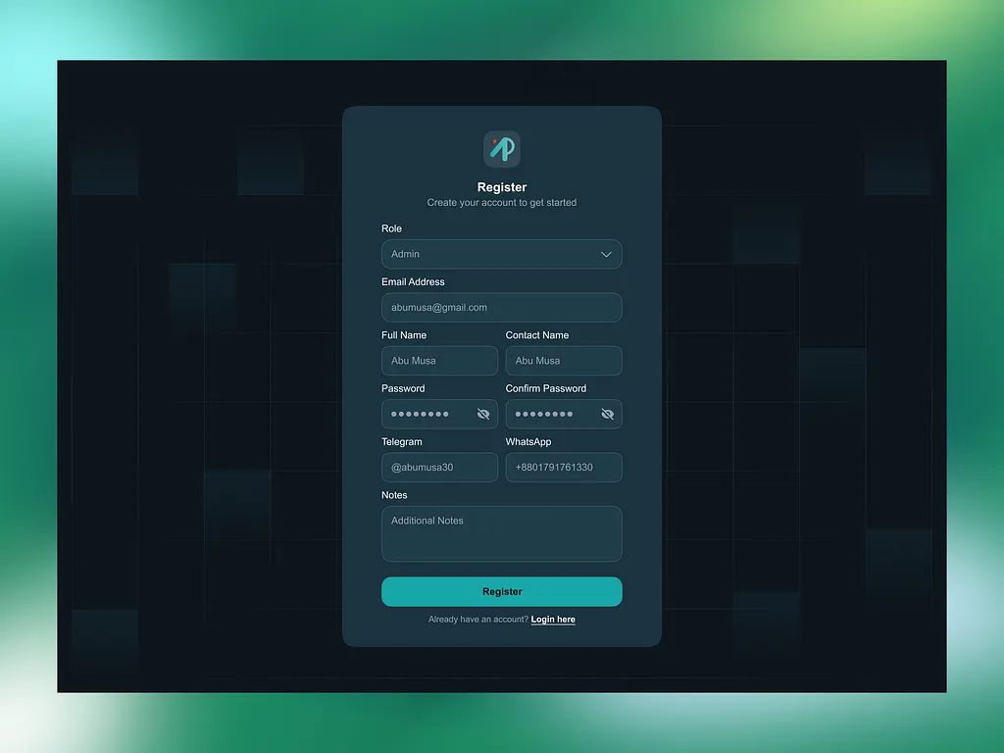
System Architecture
Client (Browser) <-> Node.js API <-> SQLite (persistent store)
PWA-ready frontend, optional service worker, and local demo fallback.

Slide 10
Conclusion
THE SAFE SPACE HUB is a promising prototype that can become a clinically valuable tool with further development.
Next steps focus on security, data persistence, and clinician collaboration.

Slide 11
Future Work
Planned improvements
Implement secure authentication and role-based access
Add encrypted database storage and backup
Integrate telehealth and clinician dashboards
Run validation studies and usability testing

