Slide 1

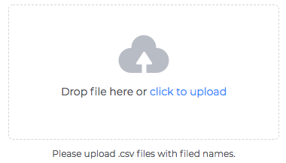
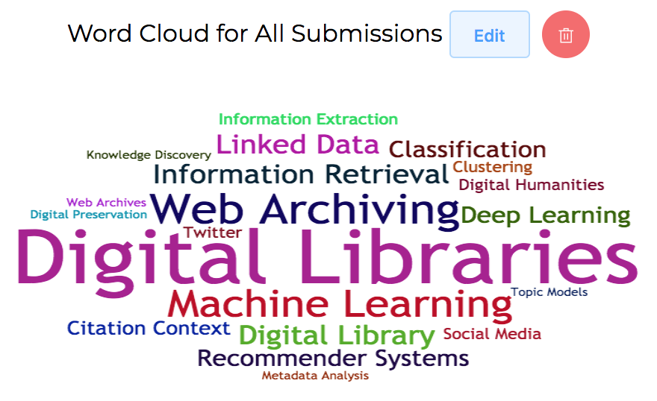
Share and Download
Upload Data
Google Log-in Page
Visualisations

