Slide 1
Interactive Second Language Learning from News Websites
Tao Chen, Naijia Zheng, Yue Zhao,
Muthu Chandrasekaran, Min-Yen Kan
Notes:
I am goting to talk about our work on ...

Slide 2

Second Language Learning
31 Jul 2015
NLP-TEA-2 - WordNews
Formal language learning is time-consuming, and learning materials are often limited.
Image courtesy: http://www.skyscanner.net/sites/default/files/image_import/language.learning.jpg
Notes:
We want to learn, but do not have time to attend course.

Slide 3

35,000,000,000 hours/month
31 Jul 2015
NLP-TEA-2 - WordNews
Image courtesy: http://p-fst1.pixstatic.com/54f3cb35dbfa3f76f000ab84/_w.270_h.190_s.centercrop_/promo-img@2x.png
Notes:
On the contrary, we spent a lot of time on news reading.
35 billion hours

Slide 4
31 Jul 2015
NLP-TEA-2 - WordNews
✚
WordNews
A chrome extension to enable
vocabulary learning in reading online news
Notes:
Learning in context, and casually.

Slide 5
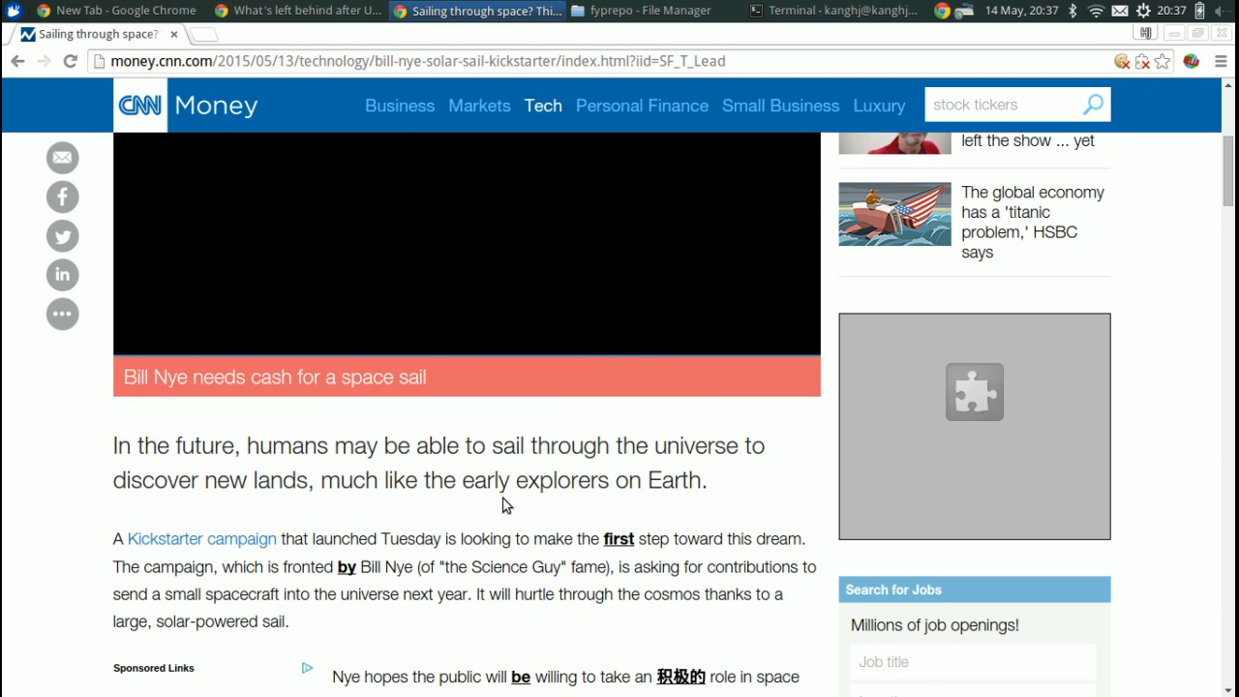
31 Jul 2015
NLP-TEA-2 - WordNews
WordNews Chrome Extension
Image Courtesy: http://www.heley-int.com/images/hello.jpg
Notes:
Currently, our system focuses on Chinese learning from reading English news.
----- 会议笔记(7/10/15 14:40) -----
make clear

Slide 6
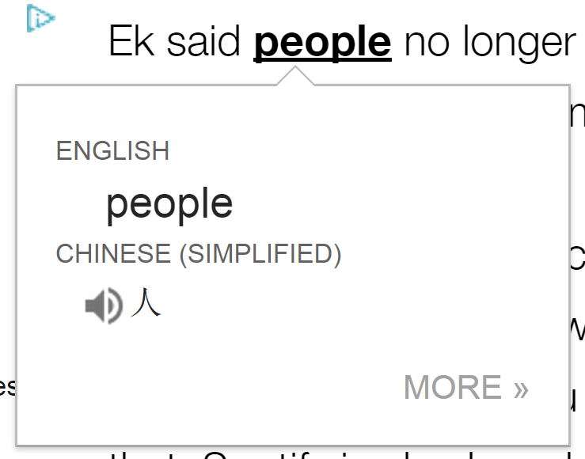
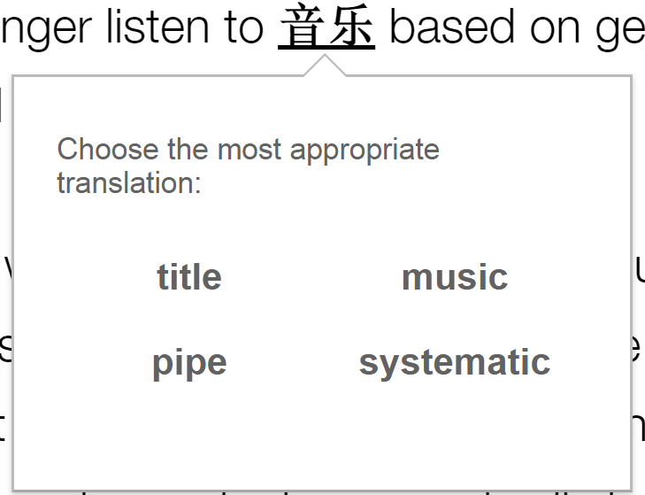
Two Key Research Components
31 Jul 2015
NLP-TEA-2 - WordNews
Translating
Word Sense Disambiguation (WSD)
Testing
Distractor Generation
Notes:
additional slides for distractor generation

Slide 7
News Context
31 Jul 2015
NLP-TEA-2 - WordNews
Identify the news category by URL pattern
  http://edition.cnn.com/2015/07/08/entertainment/feat-tom-selleck-droughtshaming-water/index.html
  7 categories: Entertainment, World, Finance, Sports, Fashion, Technology, Travel
Classify words based on category document frequency
  E.g., “superstar” belongs to “Entertainment”
For both English and Chinese news/words
Notes:
Our system helps users to learn language in a context.

Slide 8
Outline
31 Jul 2015
NLP-TEA-2 - WordNews
Introduction
The WordNews Chrome Extension
Word Sense Disambiguation (WSD)
Distractor Generation
Conclusion
Notes:
5min

Slide 9
Word Sense Disambiguation
31 Jul 2015
NLP-TEA-2 - WordNews
Expanded College English Test 4 Dictionary
  English, Chinese (relative frequency), part-of-speech
  33,664 English-Chinese pairs and
  ~4k unique English words
Baseline: always choose the most frequent relative Chinese translation
  100% of coverage as it always has a translation
  Low accuracy as it lacks context modeling

Slide 10
Word Sense Disambiguation
31 Jul 2015
NLP-TEA-2 - WordNews
Approach 1: News Category
  Pick up the Chinese translation with the same category as the news article
  E.g., “利息” ->“interest” in Finance news
Approach 2: Part-of-Speech (POS)
  Pick up the Chinese translation with the same POS as the target English word
  E.g., “书” ->“book” (noun) and “预定”->”book” (verb)
Notes:
----- 会议笔记(7/10/15 14:40) -----
image credit

Slide 11
WSD: Bing Translator Based Methods
31 Jul 2015
NLP-TEA-2 - WordNews
Approach 3: Substring Match
2. Look up dictionary
… into the world’s top 40 clubs
noun: 俱乐部, 棒, …
verb: 凑份子, …
1.Bing Translator
3.Matched: 俱乐部 (Bing) is a substring of 俱乐部 （dict)
…进入世界顶级40名
俱乐部
Limited by dictionary coverage!
Notes:
Neighboring words provide the necessary context to perform WSD in many contexts. Here, we consider the sentence in which the target word appears as our context.
We need to post-process the Bing translation in order to recover the alignment of the Chinese and English sentence.
----- 会议笔记(7/10/15 14:40) -----
subtitle -> title

Slide 12
WSD: Bing Translator Based Methods
31 Jul 2015
NLP-TEA-2 - WordNews
2. Look up dictionary
… into the world’s top 40 clubs
noun: 顶部,顶端, 顶,
adj:上面的, 最大的,…
verb: 盖
1.Bing Translator
3. No output using substring match
…进入世界顶级40名
俱乐部

Slide 13
WSD: Bing Translator Based Methods
31 Jul 2015
NLP-TEA-2 - WordNews
Approach 4: Relaxed Match
2. Look up dictionary
… into the world’s top 40 clubs
noun: 顶部,顶端, 顶,
adj:上面的, 最大的,…
verb: 盖
1.Bing Translator +
Chinese Segmentation
3.Relaxed Match: 顶级 (Bing) is superset of 顶 (dict)
… 进入 世界 顶级 40名 俱乐部

Slide 14
WSD: Bing Translator Based Methods
31 Jul 2015
NLP-TEA-2 - WordNews
2. Look up dictionary
... state department spokeswomen said …
noun: 态, 国, 州, …
verb: 声明, 陈述, … 发言, …
adj：国家的
1.Bing Translator +
Chinese Segmentation
3. Two relaxed matches
国家 (Bing)->国(dict)
发言人(Bing)->发言(dict)
… 国家 部门 的 发言人 说 …
Notes:
department spokeswoman jen psaki said

Slide 15
WSD: Bing Translator Based Methods
31 Jul 2015
NLP-TEA-2 - WordNews
  Approach 5: Bing Alignment
2. Look up dictionary
... state department spokeswomen said …
noun: 态, 国, 州, …
verb: 声明, 陈述, … 发言, …
adj：国家的
1.Bing Translator +
Bing Alignment
… 国家 部门 的 发言人 说 …
No output if the alignment is phrase to phrase
Notes:
department spokeswoman jen psaki said

Slide 16
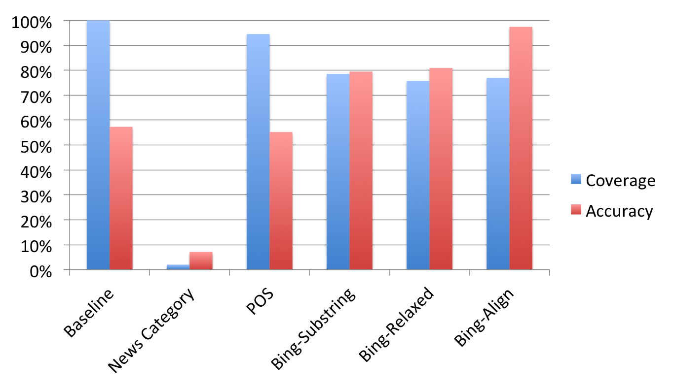
WSD: Evaluation
31 Jul 2015
NLP-TEA-2 - WordNews
Notes:
707 randomly sampled words
Sentence-level context is useful in WSD

Slide 17
Outline
31 Jul 2015
NLP-TEA-2 - WordNews
Introduction
The WordNews Chrome Extension
Word Sense Disambiguation (WSD)
Distractor Generation
Conclusion
Notes:
10min

Slide 18
What is a set of suitable distractors?
31 Jul 2015
NLP-TEA-2 - WordNews
Have the same form as the target word
  Same POS tag
Fit the sentence context
  News category
Have proper difficulty level according to user’s level of mastery
  Difficult distractors are more semantically similar to the target words_x0013_

Slide 19

Distractor with Proper Difficulty
31 Jul 2015
NLP-TEA-2 - WordNews
Difficulty level is measured by the Lin Distance of the target word and distractor in WordNet
A distractor is deemed hard when its similarity to target word is above threshold (e.g., 0.1)
Lowest common subsumer synset
Notes:
Subsumer: the lowest node that is the hypernym of c1, and c2 in WordNet

Slide 20
Distractor Generation
31 Jul 2015
NLP-TEA-2 - WordNews
WordNews Hard: Same word form + Same news category + Semantically Similar
Random News: Same word form + Same news category
Vary the number of hard distractors based on user’s knowledge level
  Beginner: two random + one hard
  Intermediate: three hard
Notes:
criteria |-ˈti(ə)rēə| )
Beginner: encounter the target word at least 3 times,
Intermediate: passed the easy task for 6 times

Slide 21
Human Evaluation
31 Jul 2015
NLP-TEA-2 - WordNews
Baseline
  WordGap System (Knoop and Wilske, 2013)
    Distractor: target’s synonyms of synonyms in WordNet
Evaluation1: WordGap vs. Random News
Evaluation2: WordGap vs. WordNews Hard

Slide 22
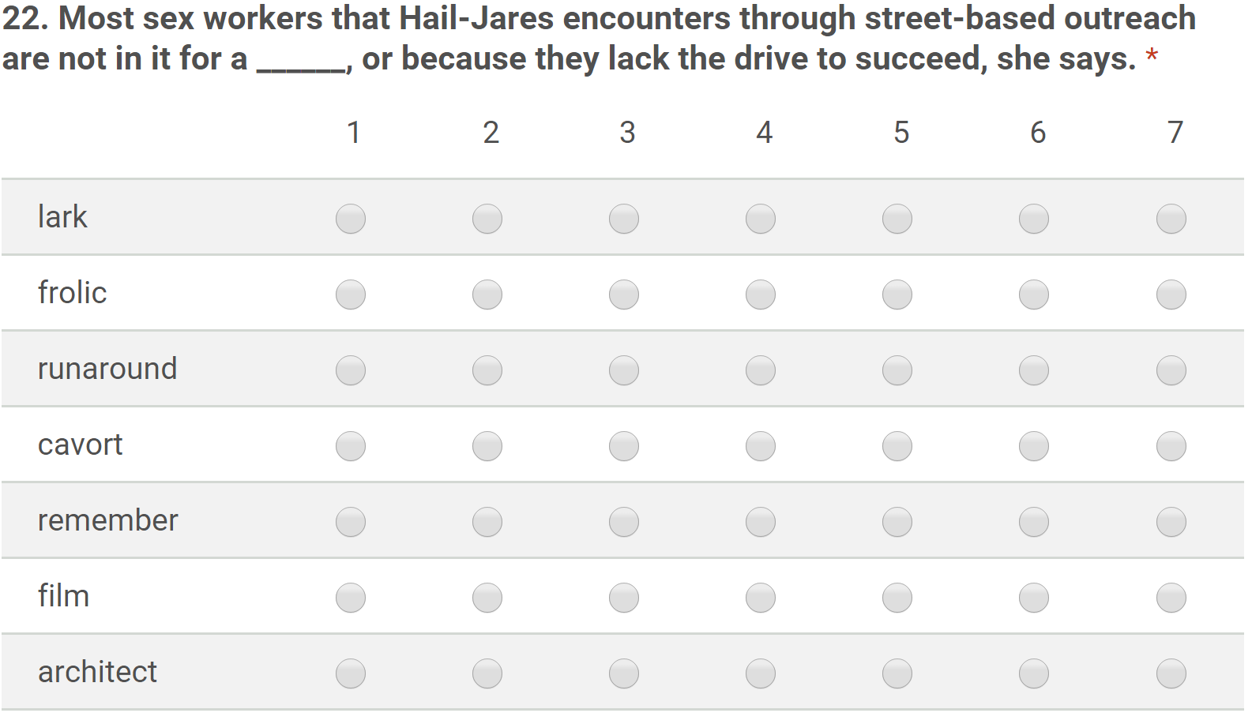
Human Evaluation
31 Jul 2015
NLP-TEA-2 - WordNews
One is the target word,
three from WordGap, and the other three from WordNews Hard/Random News
Notes:
Each question is labeled by five users, and we compute the average score for each choice

Slide 23
Human Evaluation
31 Jul 2015
NLP-TEA-2 - WordNews
WordGap vs. Random News.
WordGap vs. WordNews Hard.
 | # of wins | Avg. Score
WordGap | 27 | 3.84
Random News | 23 | 4.10
Lower scores are better
 | # of wins | Avg. Score
WordGap | 21 | 4.16
WordNews Hard | 29 | 3.49
Notes:
Context and semantic information are complementary for distractor generation
----- 会议笔记(7/10/15 14:40) -----
explanation for the score and wins

Slide 24
Outline
31 Jul 2015
NLP-TEA-2 - WordNews
Introduction
The WordNews Chrome Extension
Word Sense Disambiguation (WSD)
Distractor Generation
Conclusion

Slide 25
Conclusion
31 Jul 2015
NLP-TEA-2 - WordNews
WordNews: a chrome extension to enable interactive vocabulary learning in reading online news
Future work
  Mobile client and longitudinal user study
Word Sense Disambiguation based on
Machine Translation
Distractor Generation based on
news context and semantic similarity
Notes:
lon·gi·tu·di·nal /ˌlɔndʒɪˈtjuːdɪnəl US ˌlɑːndʒɪˈtuː-/

Slide 26

31 Jul 2015
NLP-TEA-2 - WordNews
Image Countersy: http://www.heley-int.com/images/hello.jpg

