Slide 1
Interactive Second Language Learning from News Websites
Tao Chen, Naijia Zheng, Yue Zhao,
Muthu Chandrasekaran, Min-Yen Kan

Slide 2

Second Language Learning
31 Jul 2015
NLP-TEA-2 - WordNews
Formal language learning is time-consuming, and learning materials are often limited.
Image courtesy: http://www.skyscanner.net/sites/default/files/image_import/language.learning.jpg
Notes:
We want to learn, but do not have time to attend course.

Slide 3

7,000,000,000 hours/month
31 Jul 2015
NLP-TEA-2 - WordNews
Image courtesy: http://p-fst1.pixstatic.com/54f3cb35dbfa3f76f000ab84/_w.270_h.190_s.centercrop_/promo-img@2x.png
Notes:
On the contrary, we spent a lot of time on news reading.
global Time spent on reading: 7 billion hours/month = 35 billion hours (global Time spent online per month) * 20% (reading content)
http://www.go-gulf.com/blog/online-time/
In a requirements survey prior to the pro- totype development, two-thirds of the respondents indicated that although they have interest in learn- ing a second language, they only have only used language learning software infrequently (less than once per week) yet frequently read news, giving us motivation for our development.

Slide 4
31 Jul 2015
NLP-TEA-2 - WordNews
✚
WordNews
A chrome extension to enable
vocabulary learning in reading online news
Notes:
Learning in context, and casually.

Slide 5
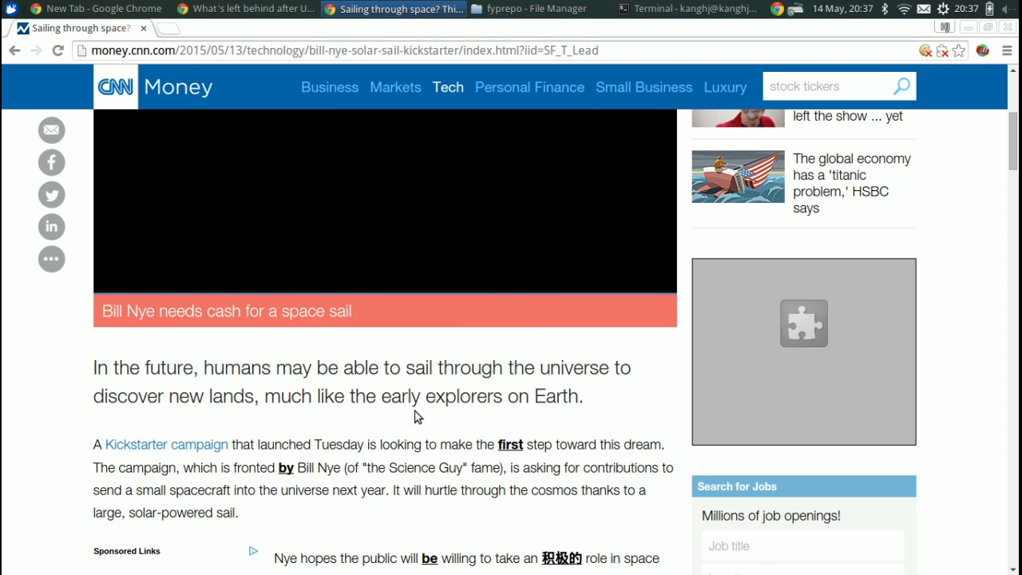
31 Jul 2015
NLP-TEA-2 - WordNews
WordNews Chrome Extension
Notes:
Currently, our system focuses on learning Chinese from reading English news.

Slide 6
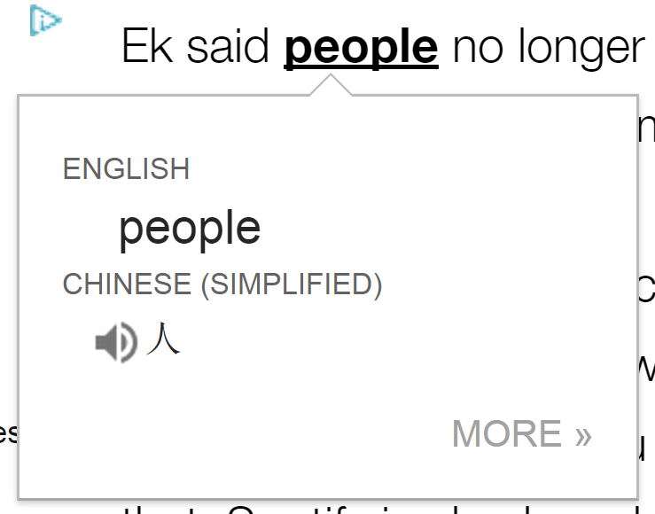
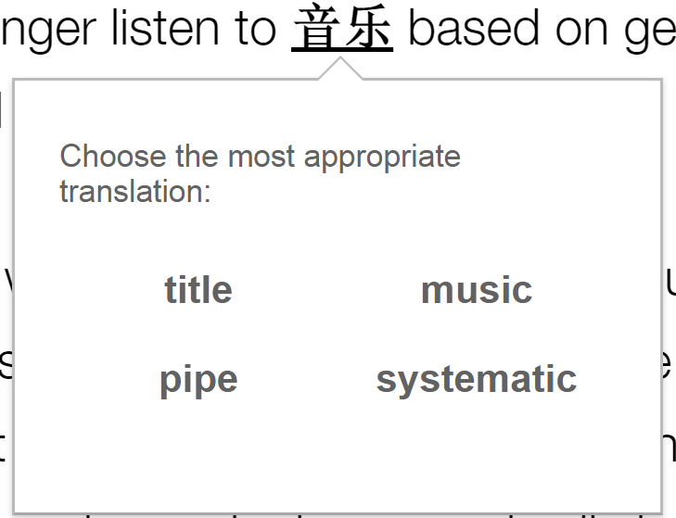
Two Key Research Components
31 Jul 2015
NLP-TEA-2 - WordNews
Translating
Word Sense Disambiguation (WSD)
Testing
Distractor Generation

Slide 7
News Context
31 Jul 2015
NLP-TEA-2 - WordNews
Identify the news category by URL pattern
  http://edition.cnn.com/2015/07/08/entertainment/feat-tom-selleck-droughtshaming-water/index.html
  7 categories: Entertainment, World, Finance, Sports, Fashion, Technology, Travel
Classify words based on category document frequency
  E.g., “superstar” belongs to “Entertainment”
For both English and Chinese news/words
Notes:
Our system helps users to learn language in a context.

Slide 8
Outline
31 Jul 2015
NLP-TEA-2 - WordNews
Introduction
The WordNews Chrome Extension
Word Sense Disambiguation (WSD)
Distractor Generation
Conclusion
Notes:
5min

Slide 9
Word Sense Disambiguation
31 Jul 2015
NLP-TEA-2 - WordNews
Expanded College English Test 4 (CET-4) Dictionary
  English, Chinese (relative frequency), part-of-speech
  ~4k unique English words and 33,664 English-Chinese pairs
Baseline: always choose the most frequent relative Chinese translation
  100% of coverage as it always has a translation
  Low accuracy as it lacks context modeling

Slide 10
Word Sense Disambiguation
31 Jul 2015
NLP-TEA-2 - WordNews
Approach 1: News Category
  Pick up the Chinese translation with the same category as the news article
  E.g., “利息” ->“interest” in Finance news
Approach 2: Part-of-Speech (POS)
  Pick up the Chinese translation with the same POS as the target English word
  E.g., “书” ->“book” (noun) and “预定”->”book” (verb)
Notes:
----- 会议笔记(7/10/15 14:40) -----
image credit

Slide 11
3-5: Bing Translator Based Methods
31 Jul 2015
NLP-TEA-2 - WordNews
… into the world’s top 40 clubs
  Longer context: the whole sentence
Bing Translator
…进入世界顶级40名
俱乐部
Need to recover the alignment
Notes:
Neighboring words provide the necessary context to perform WSD in many contexts. Here, we consider the sentence in which the target word appears as our context.
We need to post-process the Bing translation in order to recover the alignment of the Chinese and English sentence.

Slide 12
Approach 3: Substring Match
31 Jul 2015
NLP-TEA-2 - WordNews
… into the world’s top 40 clubs
2. Look up dictionary
noun: 俱乐部, 棒, …
verb: 凑份子, …
1.Bing Translator
3. Matched: 俱乐部 (Bing) is a substring of 俱乐部 (dict)
…进入世界顶级40名
俱乐部
Limited by dictionary coverage!

Slide 13
Approach 4: Relaxed Match
31 Jul 2015
NLP-TEA-2 - WordNews
… into the world’s top 40 clubs
3. Look up dictionary
noun: 俱乐部, 棒, …
verb: 凑份子, …
1.Bing Translator
4. Matched: 顶级 (Bing) is superset of 顶 (dict)
2. Chinese segmentation
…进入世界顶级40名
俱乐部
… 进入 世界 顶级 40名 俱乐部

Slide 14
Approach 4: Relaxed Match
31 Jul 2015
NLP-TEA-2 - WordNews
... state department spokeswomen said …
2. Look up dictionary
noun: 态, 国, 州, …
verb: 声明, 陈述, … 发言,
adj: 国家的
4. Two Matches:
国家 (Bing)->国(dict)
发言人(Bing)->发言(dict)
1.Bing Translator
3. Chinese segmentation
… 国家部门的发言人说 …
… 国家 部门 的 发言人 说 …

Slide 15
Approach 5: Bing Alignment
31 Jul 2015
NLP-TEA-2 - WordNews
... state department spokeswomen said …
1.Bing Translator
No output if the alignment is phrase to phrase
2. Bing Alignment
… 国家部门的发言人说 …
… 国家 部门 的 发言人 说 …

Slide 16
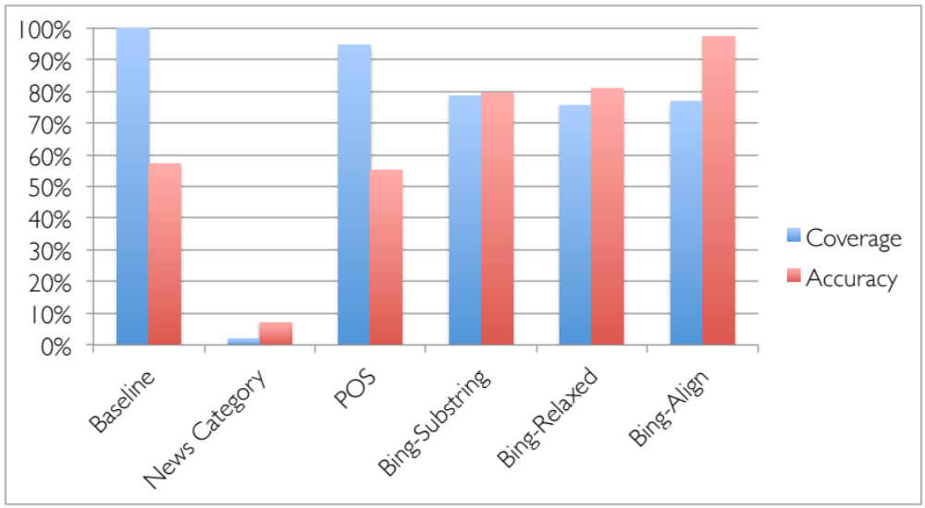
WSD: Evaluation
31 Jul 2015
NLP-TEA-2 - WordNews
Dataset: 707 Randomly sampled words and their sentence from CNN news.
Notes:
To evaluate the effectiveness of our proposed methods, we randomly sampled 707 words and their sentences from recent CNN8 news articles, manually annotating the ground truth translation for each target English word.
We report both the coverage (i.e., the ability of the system to return a translation) and accuracy (i.e., whether the translation is contextually accurate)
Performance of news category is poor: Chinese/English words in category list are very limited.
Sentence-level context is useful in WSD

Slide 17
Outline
31 Jul 2015
NLP-TEA-2 - WordNews
Introduction
The WordNews Chrome Extension
Word Sense Disambiguation (WSD)
Distractor Generation
Conclusion
Notes:
10min

Slide 18
What is a set of suitable distractors?
31 Jul 2015
NLP-TEA-2 - WordNews
Have the same form as the target word
  Same POS tag
Fit the sentence context
  Same news category
Have proper difficulty level according to user’s level of mastery
  Difficult distractors are more semantically similar to the target words_x0013_
Notes:
Context is not considered in related work.

Slide 19

Distractor with Proper Difficulty
31 Jul 2015
NLP-TEA-2 - WordNews
Difficulty level is measured by the Lin Distance of the target word and distractor in WordNet
A distractor is deemed hard when its similarity to target word is above threshold (e.g., 0.1)
Lowest common
subsumer synset
Notes:
Subsumer: the lowest node that is the hypernym of c1, and c2 in WordNet

Slide 20
Distractor Generation
31 Jul 2015
NLP-TEA-2 - WordNews
WordNews Hard: Same word form + Same news category + Semantically Similar
Random News: Same word form + Same news category
Vary the number of hard distractors based on user’s knowledge level
  Beginner: two random + one hard
  Intermediate: three hard
Notes:
Beginner: encounter the target word at least 3 times,
Intermediate: passed the easy task for 6 times

Slide 21
Human Evaluation
31 Jul 2015
NLP-TEA-2 - WordNews
Baseline
  WordGap System (Knoop and Wilske, 2013)
    Distractor: target’s synonyms of synonyms in WordNet
Evaluation1: WordGap vs. Random News
Evaluation2: WordGap vs. WordNews Hard
Notes:
WordGap adopts a knowledge-based ap- proach: selecting the synonyms of synonyms (also computed by WordNet) as distractors. They first select the most frequently used word, w1, from the target word’s synonym set, and then select the synonyms of w1, called s1. Finally, WordGap selects the three most frequently-used words from s1 as distractors.

Slide 22
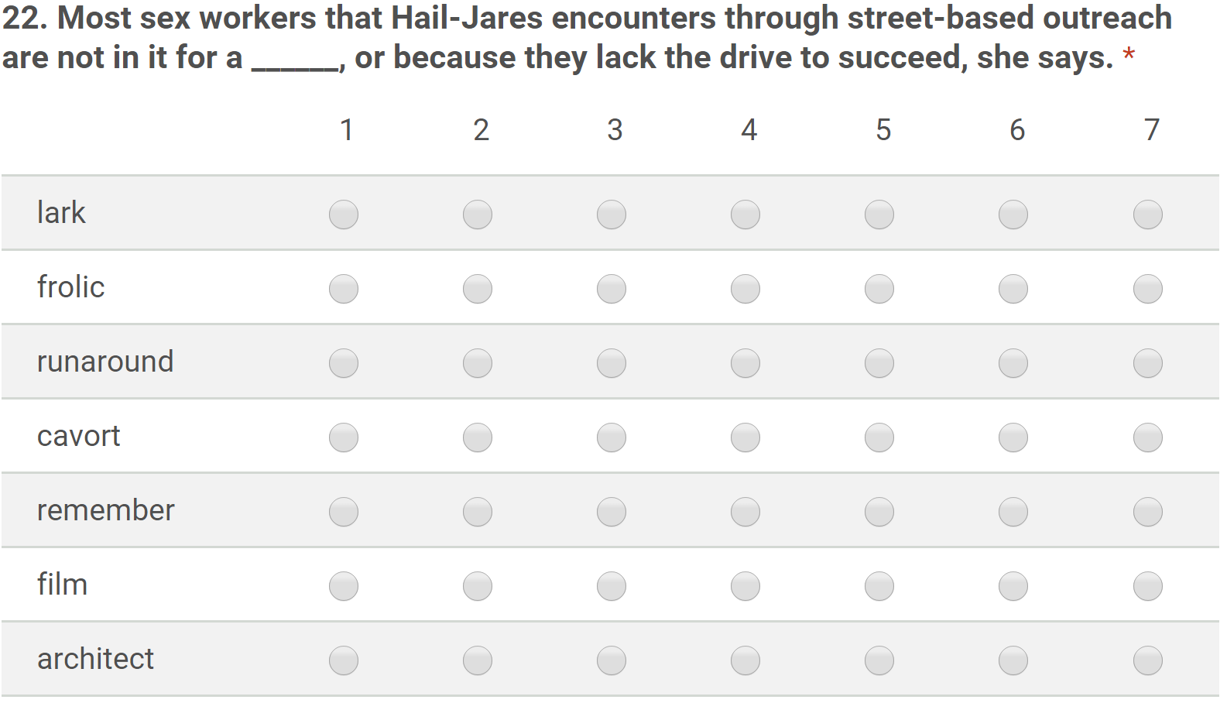
Human Evaluation
31 Jul 2015
NLP-TEA-2 - WordNews
One is the target word,
three from WordGap, and the other three from WordNews Hard/Random News
50 questions and each was labeled by 5 subjects, and compute the average score
Notes:
Each question is labeled by five users, and we compute the average score for each choice

Slide 23
Human Evaluation
31 Jul 2015
NLP-TEA-2 - WordNews
WordGap vs. Random News.
WordGap vs. WordNews Hard.
 | # of wins | Avg. Score
WordGap | 27 | 3.84
Random News | 23 | 4.10
Lower avg. scores are better
 | # of wins | Avg. Score
WordGap | 21 | 4.16
WordNews Hard | 29 | 3.49
Notes:
For each question, we deem an algorithm to be the winner if its three distractors as a whole (the sum of three average ratings) are assessed to be more plausible than the distractors by its competitor.
Context and semantic information are complementary for distractor generation

Slide 24
Outline
31 Jul 2015
NLP-TEA-2 - WordNews
Introduction
The WordNews Chrome Extension
Word Sense Disambiguation (WSD)
Distractor Generation
Conclusion

Slide 25
Conclusion
31 Jul 2015
NLP-TEA-2 - WordNews
WordNews: a chrome extension to enable interactive vocabulary learning in reading online news
Future work
  Mobile client and longitudinal user study
Word Sense Disambiguation based on
Machine Translation
Distractor Generation based on
news context and semantic similarity

Slide 26

31 Jul 2015
NLP-TEA-2 - WordNews
Image Countersy: http://www.heley-int.com/images/hello.jpg

Slide 27
Supplemental slides
31 Jul 2015
NLP-TEA-2 - WordNews

Slide 28
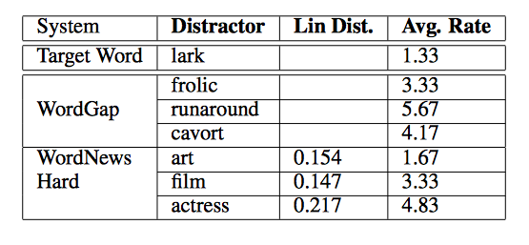
Example Distractors
31 Jul 2015
NLP-TEA-2 - WordNews

