Slide 1
SDP 2020: Shared Task Track
Muthu Kumar Chandrasekaran, Guy Feigenblat,
Ed Hovy, Abhilasha Ravichander,
Michal Shmueli-Scheuer, Anita de Waard

Slide 2
Next →Oral Sessions: Zoom Link 2
Now →Teaser to Shared Task Track
Overview of Evaluation and Results
Poster Session - Gather.Town – Room N

Slide 3
Shared Task Track The Computational Linguistics Scientific Summarization Task (CL-SciSumm) @ SDP 2020
Muthu Kumar Chandrasekaran
Amazon, Seattle

Slide 4
Outline
Now
Background
Corpus
Tasks
Task 1A – Identify text span in the RP
Task 1B – Discourse Facet of the RP text
Task 2 – 250 words or less of summary
Later (14:50 ET – After poser presentation)
Evaluation and Results

Slide 5
Background: CL-SciSumm
Continuing effort to advance scientific document summarization by encouraging the incorporation of semantic and citation information.
2014
10 ref papers
100 citing papers
No separate test set
TAC @ NIST
2016
30 documents
Separate test set 10 docs
JCDL
2017
10 documents
Separate test set 10 docs
ACM SIGIR
Comparable
2018
New Blind Test Set of 20 docs
ACM SIGIR
2019
+ scisumnet + large autoannotated data
Blind Test Set 20 docs
ACM SIGIR
2020
40 documents
Blind Test Set now released!
EMNLP
https://github.com/WING-NUS/scisumm-corpus/

Slide 6
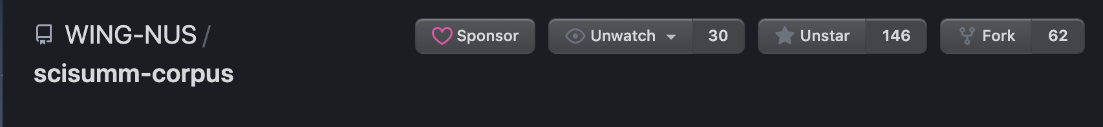
CL-SciSumm over half a decade!
Continuing effort to advance scientific document summarization by encouraging the incorporation of semantic and citation information.
- Has inspired, spawned other resources in the community
SciSummnet, TalkSumm
Several state of the art papers/ systems published at EMNLP, ACL, AAAI that benchmark and improve on CL-SciSumm
Evolved into a de facto standard corpora for scientific document summarization with human written summaries
Introducing two new tasks this year:
LaySumm. – Scientific Summaries for the lay person
LongSumm – Longer Scientific Summaries (e.g., a paper blog)
https://github.com/WING-NUS/scisumm-corpus/

Slide 7
State of the Corpus in 2020
Task 1A and B: 40 target articles and 500+ citing articles
Task 2 (Summarization): 40 + 1000 from SciSummnet = 1040 human written summaries and abstracts
All tasks annotated by 6 paid and trained annotators from U-Hyderabad, India from 2016-2018
Corpus development from 2016-2018 was sponsored by MSRA
Details about Annotation and Corpus Construction are in the GitHub repo and in our previous overview papers:
Chandrasekaran, M. K., Yasunaga, M., Radev, D., Freitag, D., & Kan, M. Y. (2019). Overview and results: Cl-scisumm shared task 2019. arXiv preprint arXiv:1907.09854.
Jaidka, K., Chandrasekaran, M. K., Rustagi, S., & Kan, M. Y. (2018). Insights from CL-SciSumm 2016: the faceted scientific document summarization Shared Task. International Journal on Digital Libraries, 19(2-3), 163-171.

Slide 8
Oral Sessions (Zoom Link 2)
Teaser to Shared Task Track
09:15 – 09:27 | CL-SciSumm (Task 1a): Chai et al., NLP-PINGAN-TECH @ CL-SciSumm 2020
09:55 –10:10 | Li et al., CIST@CL-SciSumm 2020, LongSumm 2020: Automatic Scientific Document Summarization
10:10-10:25 | LongSumm 3 & CL-SciSumm (Task 2): Reddy et al., IIITBH-IITP@CL-SciSumm20, CL-LaySumm20, LongSumm20
11:50 – 12:05 | CL-SciSumm (Task 1a): Aumiller et al., UniHD@CL-SciSumm 2020: Citation Extraction as Search
12:30 - 12:42 | Umapathy et al., CiteQA@CLSciSumm 2020
Poster Session – 3:45 to 14:50 ET
Gather.Town – Room N

Slide 9
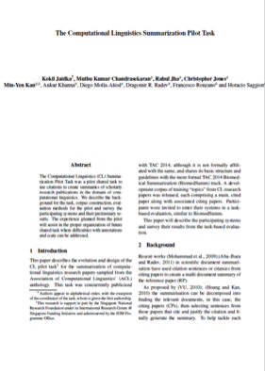
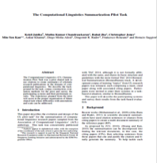
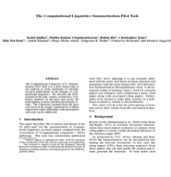
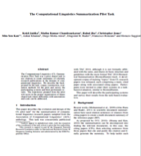
Tasks: Task 1A
I​​dentify the text span in the RP which corresponds to the citances from the CP.
Reference
Paper (RP)
Citing papers
Citing text is called citance
Citing paper (CP)
Task 1A
Match the citing text in the CP to text in the RP

Slide 10
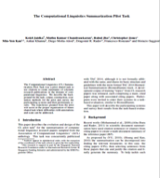
Tasks: Task 1B
Task 1B: ​Identify the discourse facet for every cited text span from a predefined set of facets.
Reference
Paper (RP)
Classify the cited text in RP into one of several facets
Citing paper (CP)
CPs
Task 1B

Slide 11
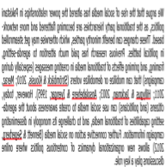
Tasks: Task 2
Task 2: ​Generate a faceted summary of up to 250 words, of the reference paper, using itself and the citing papers.​
Reference
Paper (RP)
Citing paper (CP)
Use citances and the RP to create a summary
Summary of RP
Task 2

Slide 12
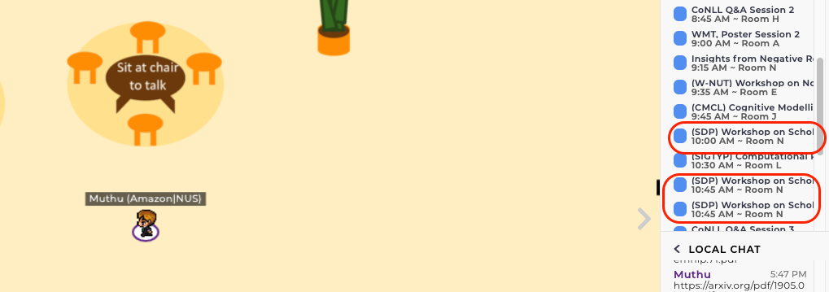
Oral Sessions (Zoom Link 2)
Teaser to Shared Task Track
Shared Task Poster Sessions 13:45 to 14:50 ET
Gather.Town – Room N and Room A

Slide 13
Shared Task Track The Computational Linguistics Summarization Pilot Task @ SDP 2020
Muthu Kumar Chandrasekaran
Amazon, Seattle

Slide 14
Recap Tasks: Task 1A
I​​dentify the text span in the RP which corresponds to the citances from the CP.
Reference
Paper (RP)
Citing papers
Citing text is called citance
Citing paper (CP)
Task 1A
Match the citing text in the CP to text in the RP

Slide 15
Recap Tasks: Task 1B
Task 1B: ​Identify the discourse facet for every cited text span from a predefined set of facets.
Reference
Paper (RP)
Classify the cited text in RP into one of several facets
Citing paper (CP)
CPs
Task 1B

Slide 16
Recap Tasks: Task 2
Task 2: ​Generate a faceted summary of up to 250 words, of the reference paper, using itself and the citing papers.​
Reference
Paper (RP)
Citing paper (CP)
Use citances and the RP to create a summary
Summary of RP
Task 2

Slide 17
Submissions
11 Systems Submitted for Evaluation
Task 1A and B: All 11 systems
Task 2 (Summarization): 4 out of the 11 systems
5 teams presented their systems in the forenoon session
Notes:
12 mins here

Slide 18
Evaluation
Run centrally from the CL-SciSumm repository. Replicable by anyone and everyone at anytime
Task 1A –
Exact sentence id match
ROUGE 1, 2
Task 1B –
conditional on Task 1A
Precision, Recall and F₁ over four discourse facets (classes)
Task 2 - ROUGE-2
Notes:
12 mins here

Slide 19
Best Performing System (Task 1A)
Team / System | Run | Exact Match |  |  | ROUGE-2
 |  | Precision | Recall | F₁ | Precision | Recall | F₁
NLP_PINGAN TECH | sembert_scibert_all_top2 | 0.13 | 0.25 | 0.17 | 0.30 | 0.11 | 0.15
uniHD | intersection_2_field | 0.26 | 0.12 | 0.16 | 0.32 | 0.08 | 0.11
CMU | run110 | 0.09 | 0.25 | 0.13 | 0.31 | 0.05 | 0.08
CIST | runs 22-42 | 0.07 | 0.26 | 0.11 | 0.34 | 0.03 | 0.05
AUTH | run 2 | 0.08 | 0.13 | 0.10 | 0.17 | 0.07 | 0.09
IITBH-IITP | variantU | 0.05 | 0.22 | 0.08 | 0.30 | 0.02 | 0.03
IITP-AI-NLP-ML | runs 1-10 | 0.02 | 0.10 | 0.04 | 0.19 | 0.01 | 0.01
Martin-Luther-Universität Halle-Wittenberg |  | 0.01 | 0.01 | 0.01 | 0.02 | 0.03 | 0.02

Slide 20
Best Performing System (Task1B)
Team / System | Run | Precision | Recall | F₁
CMU | run26 | 0.58 | 0.21 | 0.31
CIST | run40 | 0.41 | 0.24 | 0.30
uniHD | intersection_3_field | 0.48 | 0.48 | 0.29
NLP_PINGAN TECH | run_sembert_scibert_all_top3 | 0.19 | 0.29 | 0.23
IITBH-IITP | variantU | 0.49 | 0.15 | 0.23
AUTH | run 1 | 0.48 | 0.10 | 0.17
IITP-AI-NLP-ML |  | 0.02 | 0.01 | 0.02
Martin-Luther-Universität Halle-Wittenberg | Martin-Luther-Universität Halle-Wittenberg | 0.09 | 0.01 | 0.01

Slide 21
Best Performing System – Task 2
Team / System | Run | Vs. Abstract
 |  | P | R | F₁
AUTH | run 2 2 | 0.36 | 0.48 | 0.41
CIST | run43, 46, 49, 52, 55, 58, 61 | 0.14 | 0.37 | 0.21
IIT-NLP-AI-ML | run4 | 0.13 | 0.36 | 0.20
IITBH-IITP | variantA2, E2, F2, S2, U2, X2 | 0.11 | 0.25 | 0.15
Team / System | Run | Vs. Human
 |  | P | R | F₁
AUTH | run 2 2 | 0.23 | 0.22 | 0.22
CIST | run22, 25, 28, 31, 34, 37, 40 | 0.17 | 0.25 | 0.20
IIT-NLP-AI-ML | run4 | 0.14 | 0.25 | 0.17
IITBH-IITP | variantA2, E2, F2, S2, U2, X2 | 0.12 | 0.20 | 0.15

Slide 22
Best Performing System – Task 2
Team / System | Run | Vs. Community Summary
 |  | P | R | F₁
IITBH-IITP | variantU | 0.20 | 0.43 | 0.27
CIST | run22, 25, 28, 31, 34, 37, 40 | 0.34 | 0.19 | 0.25
IIT-NLP-AI-ML | run4 | 0.27 | 0.15 | 0.19
AUTH | run 2 2 | 0.25 | 0.07 | 0.11

Slide 23
What do we see in CL-SciSumm 2020?
Use of pretrained models, mostly transformer based models which have become ubiquitous in NLP
Out of domain data e.g., arXiv, pubmed to train
Graph Attention Network (CIST) models appears to be generating the holy grail summary that evaluates well on all human, abstract and community summaries
AUTH’s system (transformers / Pegasus) tops human and abstract summaries but ends up at the bottom of the list when evaluated on community summaries
Neural models on Task B appear to saturate at 30% F1. Previous best is around ~38% on logistic regression / ensemble with rule based features

Slide 24
Limitations
Supporting SoTA neural model training from scratch
Preprocessing: OCR + Parsing from ACL Anthology PDFs
Task 1A Evaluation
Task 1B: limited number of samples for most (e.g., hypothesis) discourse facets, inconsistent labeling
Scaling the corpus was difficult: key bottleneck in the corpus development
Participant feedback?
Guidelines
The Task
The Corpus – size, #citing papers
Evaluation metrics

Slide 25

Acknowledgements
Min-Yen Kan, National University of Singapore
Dragomir Radev (Yale), Michihiro Yasunaga (Stanford), Rahul Jha (Microsoft)
Chin-Yew Lin (MSRA)
NIST and Hoa Dang
Lucy Vanderwende, MSR
Anita de Ward, Elsevier Data Services
Kevin B. Cohen and colleagues (U. Colorado, Boulder)
Annotation Recruitment and Support: Vasudeva Varma, IIIT-H, India and group
U-Hyderabad Annotators:
Aakansha Gehlot, Ankita Patel, Fathima Vardha, Swastika Bhattacharya and Sweta Kumari
CL-SciSumm corpus was developed over with funding from
over 2016-2018

Slide 26
Conclusions
Successfully established a human annotator reference corpora for evaluating scientific document summarization
Garnered interest and support of communities across fields (CS, NLP, Information Science, Bibliometrics, Linguistics)
De facto standard for benchmarking Scientific Document Summarization
Future: Summaries towards more depth – for researchers and practitioners; more breadth – wider reach through public understanding of science
We invite teams to examine the detailed results available with the GitHub repo: https://github.com/WING-NUS/scisumm-corpus/tree/master/CLSciSumm_2020_Evaluation
Thanks to all teams’ participation and various co-organizers for the success of CL-SciSumm shared task series from 2014 through 2020!

Slide 27
Additional Slides

Slide 28
Scientific Document Summarization
Abstractive summary
Authors’ own summary
Extractive summary
Surface, lexical, semantic or rhetorical features of the paper
Citation summary
Community creates a summary when citing
Faceted summary
Capture all aspects of a paper

Slide 29
In summary
Community concurs that a citation-based summary of a scientific document is important.
Citing papers cite different aspects of the same reference paper.
Assigning facets to these citances may help create coherent summaries.

Slide 30


Annotation Pipeline
<xml>
<abstract>
…….
</abstract>……
OCR & Section Parse
CL-SUMM
DOC
<xml>
<abstract>
…….
</abstract>……
CLAIR -Umich’s Python module
Annotation!
Post Processing with U-Colorado’s python scripts

Slide 31

Annotating the SciSumm corpus
…………..
<xml>
<abstract>
…….
</abstract>……
<xml>
<abstract>
…….
</abstract>……
6 annotators selected from a pool of 25
6 hours of training
Gold standard annotations for Task 1A and 1B, per topic or reference paper
Community and hand-written summaries for Task 2, per topic
………..

