Slide 1
Discussion for the Shared Task at
TAC 2015
Kokil Jaidka*, Muthu Kumar Chandrasekaran
* Nanyang Technological University, Singapore
koki0001@e.ntu.edu.sg

Slide 2
TAC 2015: CL-Summ task rollout
18 November 2014
TAC BiomedSumm: The Computational Linguistics Summarization Pilot Task
We propose to have a full-fledged official shared task for an expanded CL corpus
20 training topics
10 test topics
4 annotators per summary
We will need 120 sets annotated!

Slide 3
Checklist
18 November 2014
TAC BiomedSumm: The Computational Linguistics Summarization Pilot Task
Human Resources
  Coordinator(s)
  Assignment / Responsibilities
  Funding
Timeline
Dataset Preparation
Evaluation Plan

Slide 4
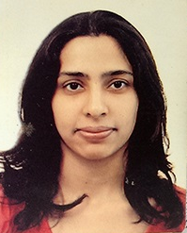
Kokil Jaidka
Currently a Senior Computer Scientist at Adobe Research Labs India
PhD, Information Studies, Nanyang Technological University Singapore – “A Framework for Multi-Document Summarization of Research Papers”
Has published and presented her research in several international journals and conferences and also chaired a session at IAMCR 2014
Has previously coordinated three annotation efforts for creating scientific summaries, and one survey-based evaluation of summary quality
Reviewer for Applied Linguistics, Aslib Journal of Information Management and eJournal of eDemocracy and Open Government
Areas of expertise – summarization, applied linguistics, NLP/text analytics, information behavior

Slide 5
Kokil Jaidka
Why I want to do this?
Current approaches in summarization may not address the readers’ needs
Automatic summaries are not focused on capturing the rich arguments in human-written scientific summaries
There is a lack of available corpora, gold standard summaries and evaluation resources
As a coordinator for the SciSumm CL Task, my main ambition is to engage the interest of the summarization community in the challenges and relevance of faceted, multi-document scientific summarization, and to push the current state of the art by supporting research efforts on a hand-annotated CL corpus.

Slide 6
TAC 2015: CL-Summ task rollout
18 November 2014
TAC BiomedSumm: The Computational Linguistics Summarization Pilot Task
Important dates:
Expression of interest: End Jan
Go / no go decision: Early Feb
Release of training data: End May, 2015
Participant registration closes: June, 2015
Release of test data: Early Sep, 2015

Slide 7

TAC 2015: We need your help
18 November 2014
TAC BiomedSumm: The Computational Linguistics Summarization Pilot Task
We welcome all volunteer efforts
We’d appreciate resources – human or software
It would be great if all participating teams contribute
Universities may get funding to run annotation efforts
We seek support from the summarization community, the CL community in particular
Because, together we can!

Slide 8
How you can help
18 November 2014
TAC BiomedSumm: The Computational Linguistics Summarization Pilot Task
Option 1. Would you like share the responsibility for annotating?
  What would this involve:
  “every team provides number of annotations”
  Pooled evaluation, à la Cranfield.
  Estimation of effort:
    4 annotators each for 30 sets = 120 sets to be annotated
    4 man-hours for annotating 1 set (10-15 citances per set)

Slide 9
How you can help
18 November 2014
TAC BiomedSumm: The Computational Linguistics Summarization Pilot Task
Option 2: Run the annotation task at your institution
  We, and volunteers from your team use instructions to school Master's/PhD students for annotating; Aim: train and select annotators
  Total 4 to 6 hours' training spread over a few days
    Some walkthroughs
    Iterative rounds of coding/discussion
    A "test" coding task and selection of final coders
    Monthly status update meetings to supervise

Slide 10
Data format
18 November 2014
TAC BiomedSumm: The Computational Linguistics Summarization Pilot Task
XML instead of text
  Sections of the paper clearly encapsulated within tags
  Tables, figures may also have their own tags

Slide 11
Evaluation Metric
18 November 2014
TAC BiomedSumm: The Computational Linguistics Summarization Pilot Task
Task 1A: Overlap vs Rouge
  Proximity to point in RP
  Scope: Is enough being retrieved? How to measure if enough was retrieved?
Task 2: Evaluate over human summaries
  from the paper vs from the citances vs hybrid
  difficulties in getting the annotators to do this

Slide 12
REPEATED / BACKUP SLIDES
18 November 2014
TAC BiomedSumm: The Computational Linguistics Summarization Pilot Task

Slide 13
CL-Summ Pilot: highlights
18 November 2014
TAC BiomedSumm: The Computational Linguistics Summarization Pilot Task
First corpus in the computational linguistics community incorporating prior research on citation based summaries
10 teams registered
3 teams participated in the evaluation
2 teams submitted their systems’ performance
1 more proposed algorithms to solve the tasks

Slide 14
CL training Corpus
18 November 2014
TAC BiomedSumm: The Computational Linguistics Summarization Pilot Task
10 reference papers or topics randomly sampled from the ACL live anthology
Up to 10 citing papers per reference paper including those outside ACL live anthology
Annotated corpus publicly available
https://github.com/WING-NUS/scisumm-corpus/

Slide 15






Annotation Pipeline
18 November 2014
TAC BiomedSumm: The Computational Linguistics Summarization Pilot Task
<xml>
<abstract>
…….
</abstract>……
OCR & Section Parse
CL-SUMM
DOC
<xml>
<abstract>
…….
</abstract>……
ParsCit‘s
SectLabel module
Annotation!
Post Processing to BiomedSumm format

Slide 16

Annotating the SciSumm corpus
18 November 2014
TAC BiomedSumm: The Computational Linguistics Summarization Pilot Task
…………..
<xml>
<abstract>
…….
</abstract>……
<xml>
<abstract>
…….
</abstract>……
3 annotators
Released data has one gold standard annotation per topic or reference paper
Discourse facet has a minor change from Biomedsumm’s categories
………..

Slide 17
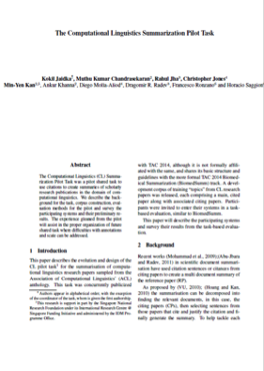
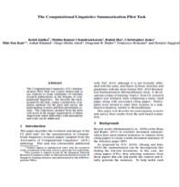
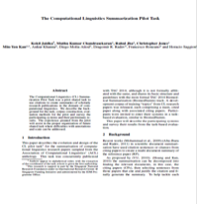
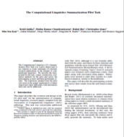
Tasks
18 November 2014
TAC BiomedSumm: The Computational Linguistics Summarization Pilot Task
Task 1A:​ I​​dentify the text span in the RP which corresponds to the citances from the CP.
Reference
Paper (RP)
Citing papers
Citing text is called citance
Citing paper (CP)
Task 1A
Match the citing text in the CP to text in the RP

Slide 18
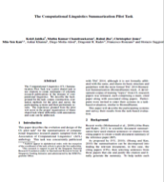
Tasks
18 November 2014
TAC BiomedSumm: The Computational Linguistics Summarization Pilot Task
Task 1B: ​Identify the discourse facet for every cited text span from a predefined set of facets.
Reference
Paper (RP)
Classify the cited text in RP into one of several facets
Citing paper (CP)
CPs
Task 1B

Slide 19
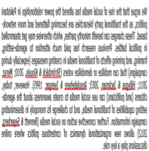
Tasks
18 November 2014
TAC BiomedSumm: The Computational Linguistics Summarization Pilot Task
Task 2: ​Generate a faceted summary of up to 250 words, of the reference paper, using itself and the citing papers.​
Reference
Paper (RP)
Citing paper (CP)
Use citances and the RP to create a summary
Summary of RP
Task 2

Slide 20
Evaluation
18 November 2014
TAC BiomedSumm: The Computational Linguistics Summarization Pilot Task
Small corpus: 10 fold cross validated evaluation over the 10 documents
Task 1A scored by ROUGE-L metric
Task 1B scored by classification metrics:
Precision, Recall and F₁
Task 2 also scored by ROUGE-L metric
Notes:
12 mins here

Slide 21
Results – Task 1A
18 November 2014
TAC BiomedSumm: The Computational Linguistics Summarization Pilot Task
MQ |  |  | Clair_UMich
Precision | Recall | F₁ | Precision | Recall | F₁
0.212 | 0.335 | 0.223 | 0.444 | 0.574 | 0.487
MQ was unsupervised while Clair_Umich was supervised
Challenging classification problem: Task seeks to map each citation sentence with a few out of 100s of potential matches in the Reference paper (RP)
Lexical, semantic and structural similarities between citances and RP sentences somewhat help

Slide 22
Results – Task 1A
18 November 2014
TAC BiomedSumm: The Computational Linguistics Summarization Pilot Task
Paper ID | MQ | Clair_UMich
C90_2039 | 0.235 | 0.635
C94_2154 | 0.288 | 0.536
E03_1020 | 0.239 | 0.478
H05_1115 | 0.350 | 0.375
H89_2014 | 0.332 | 0.546
J00_3003 | 0.196 | 0.559
J98_2005 | 0.101 | 0.344
N01_1011 | 0.221 | 0.498
P98_1081 | 0.200 | 0.367
X96_1048 | 0.248 | 0.535
Large deviation in scores, across topics, from both systems

Slide 23
Results – Task 2
18 November 2014
TAC BiomedSumm: The Computational Linguistics Summarization Pilot Task
Paper ID | MQ (using Task 1A MMR)
C90_2039 | 0.293
C94_2154 | 0.120
E03_1020 | 0.196
H05_1115 | 0.321
H89_2014 | 0.320
J00_3003 | 0.367
J98_2005 | 0.233
N01_1011 | 0.284
P98_1081 | 0.206
Average | 0.260
ROUGE-L scores here measure overlap over the abstract since we did not have human summaries
Low scores could be due to deviation between summary of citances and the abstract of the paper

Slide 24
Errors – Task 1A
18 November 2014
TAC BiomedSumm: The Computational Linguistics Summarization Pilot Task
Citing text: “The line of our argument below follows a proof provided in… for the maximum likelihood estimator based on nite tree distributions.”
False negative: “We will show that in both cases the estimated probability is tight.”
Clair_UMich
Target text from RP: “The work described here also makes use of hidden Markov model.”
False positive: “The statistical methods can be described in terms of Markov models.”
MQ

Slide 25
Learning from the Pilot Task
18 November 2014
TAC BiomedSumm: The Computational Linguistics Summarization Pilot Task
Offset mismatch between the text file and the XML that annotators used
  Corpus sentence segmented and sentences assigned a sentence ID
Problems with handling non-contiguous spans in Protégé
Character offsets can be miscounted by different parsers
Handling non-UTF8 characters

Slide 26
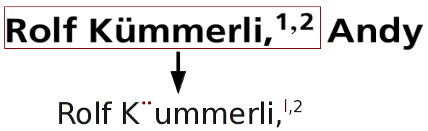
Limitations of this corpus
18 November 2014
TAC BiomedSumm: The Computational Linguistics Summarization Pilot Task
No gold standard citation based summaries
OCR errors:
The use of “...” where text spans are snippets
Errors in citation/reference offset numbers
Different text encodings
Errors in file construction
Small size of corpus!

