Slide 1




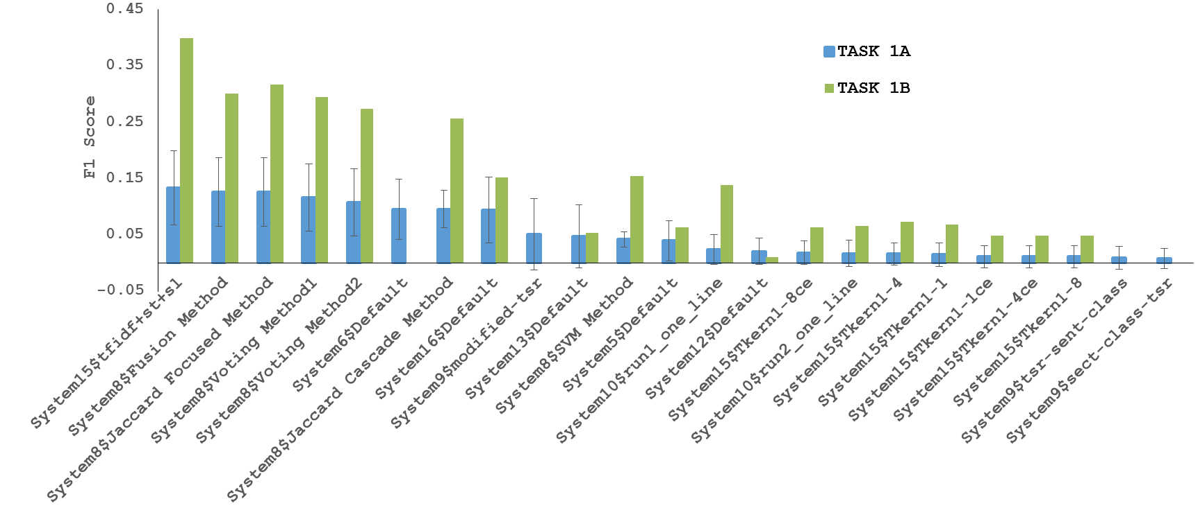
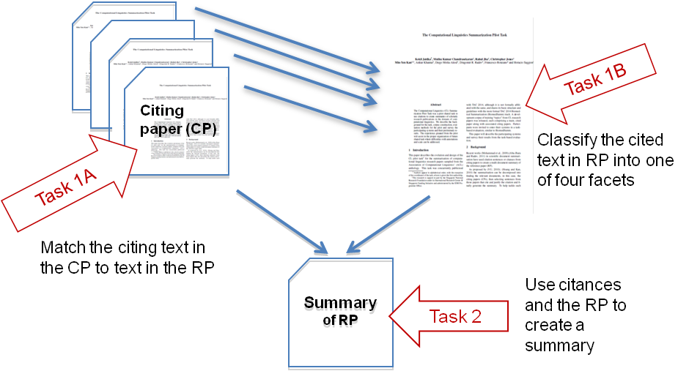
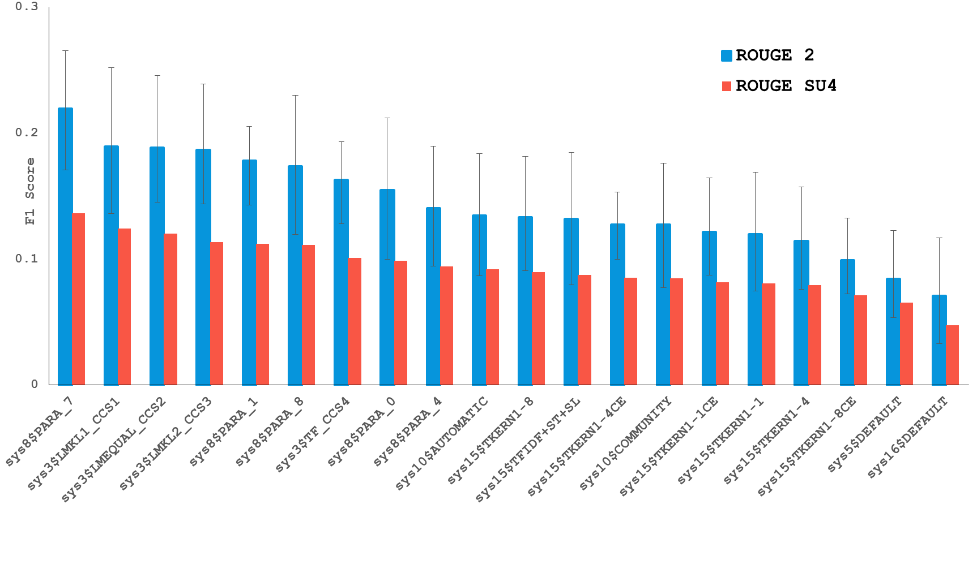
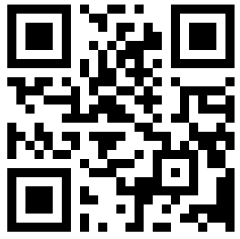
Scientific Document Summarization
Standardized Reference Corpus and Shared Task
A/P Min-Yen Kan*, Dr. Kokil Jaidka⁺, Muthu Kumar Chandrasekaran*
*National University of Singapore
⁺University of Pennsylvania
Dr. Chin-Yew Lin, Microsoft Research
Where we are after 3 years?
2014
10 target papers; 100 citing papers; annotated by three of the organisers
at NUS
CLSciSumm Pilot Shared Task @ TAC, 2014, MD, USA
Self-reported evaluation cross-validated on a single corpus
2016
30 target papers; 500 citing papers; annotated by a 5+ Applied Linguistics students @U.Hyderabad, Indias
Largest such corpus in the world
CLSciSumm – 16 @ JCDL, 2016, NJ, USA
Centralised evaluation on a test set of 10 papers
2017
Upcoming! Expanding to 50 target papers
Centralised, automated, transparent evaluation on codalab.org
CLSciSumm – 17 @ SIGIR, 2017, Tokyo, Japan . Sign up! http://wing.comp.nus.edu.sg/cl-scisumm2017
Tasks
Result Overview from CLSciSumm – 16
Task 1A:​ Identify the text span in the RP which corresponds to the citances from the CP.
Task 1B: ​Identify the discourse facet for every cited text span from a predefined set of facets.
Task 2: Output a summary of the Reference Paper!
Systems performance on Task 1A of CLSumm-16 Shared Task
Annotated Corpus
Gold standard annotations for Task 1A and 1B,
per topic or reference paper
Community and hand-written summaries for Task 2,
per topic
Systems performance vs. human summaries (part of Task 2) of CLSumm-16 Shared Task
Download the corpus form GitHub repo, accessible using this QR code.
https://github.com/WING-NUS/scisumm-corpus
Acknowledgements: Chin-Yew Lin (MSRA), Hoa Dang and NIST, Lucy Vanderwende (MSR), Anita de Ward (Elsevier Data Services), Kevin B Cohen and team (U. Colorado, Boulder), Rahul Jha (Google), CLAIR, (U.Michigan, Ann Arbor) and University of Hyderabad (India)

