Slide 1



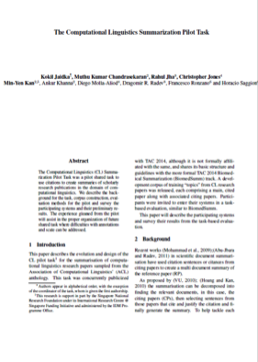
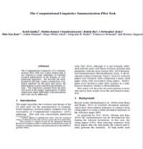
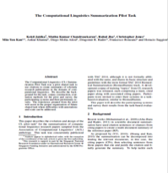
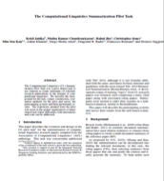
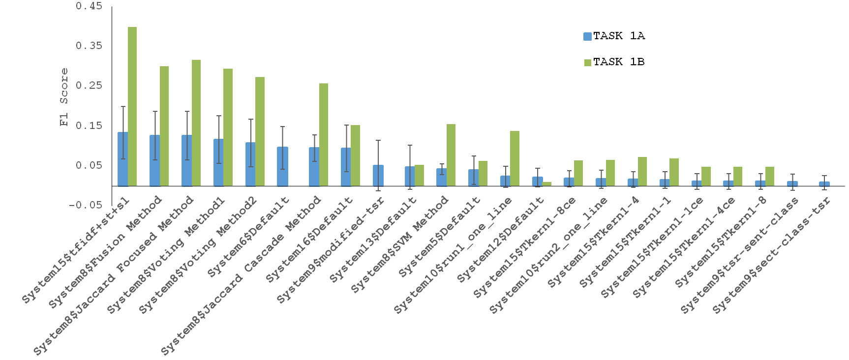
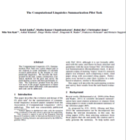
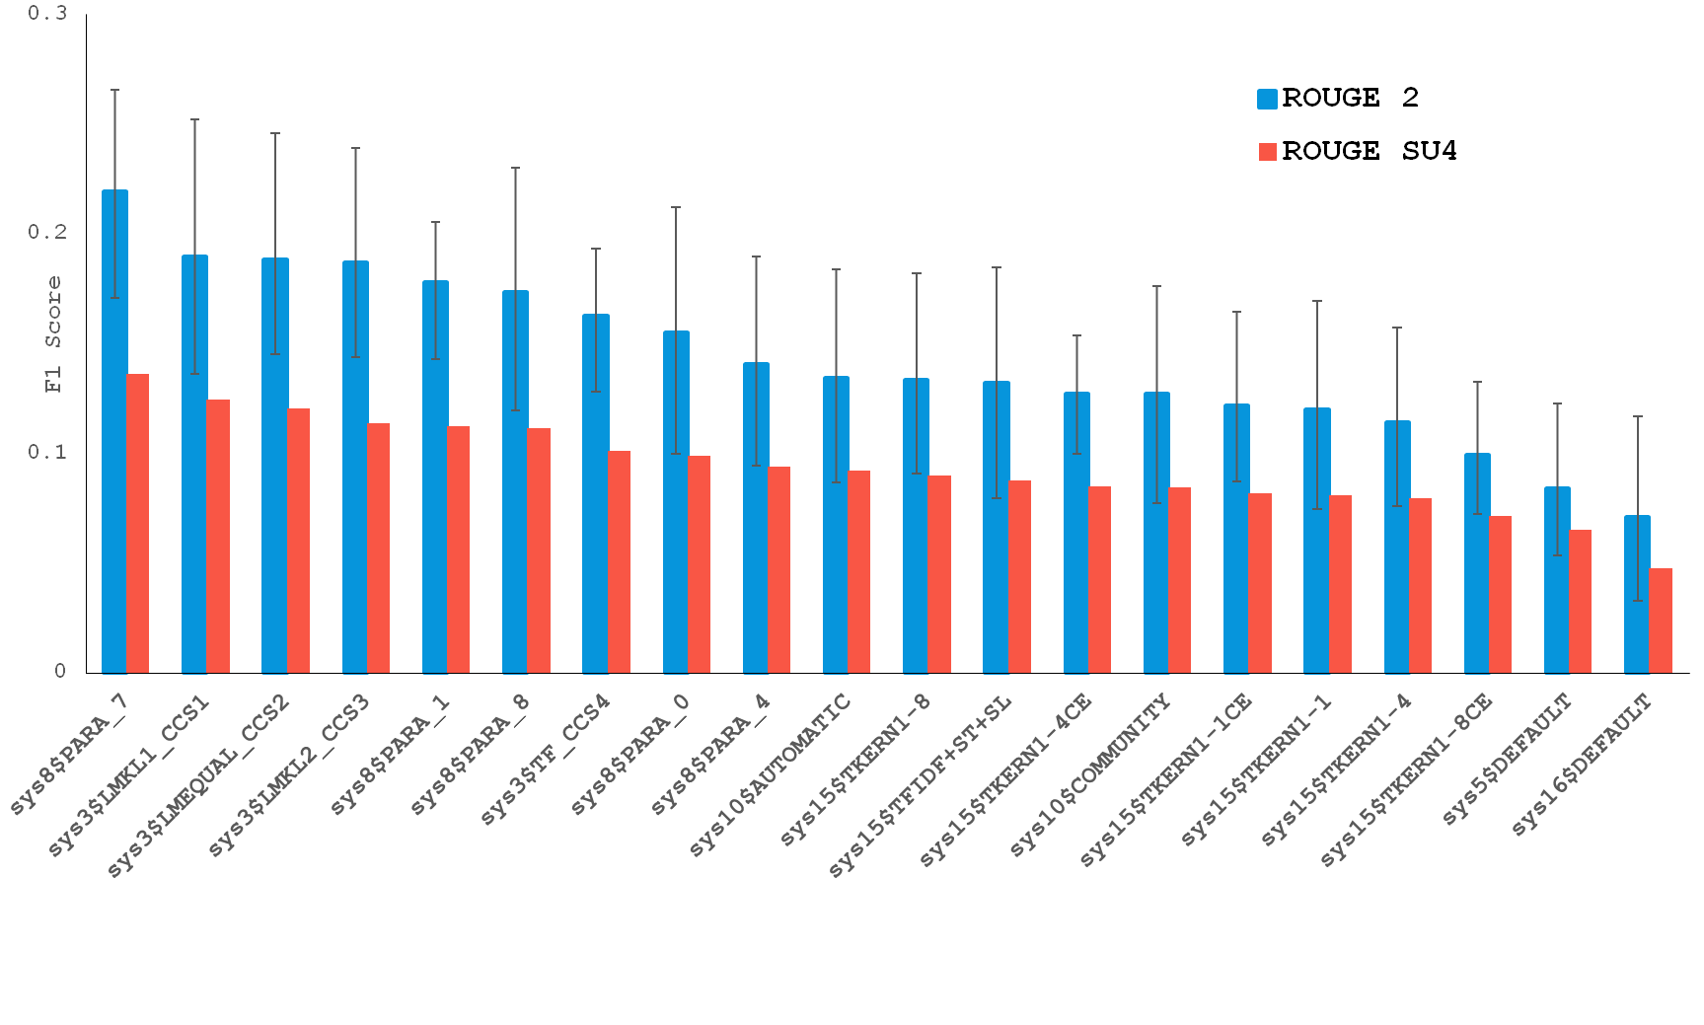
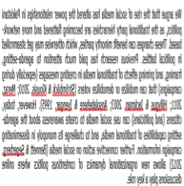
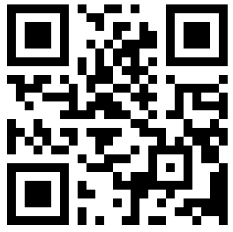
Scientific Document Summarization
Standardized Reference Corpus and Shared Task
A/P Min-Yen Kan, National University of Singapore
Dr. Chin-Yew Lin, Microsoft Research
Overview
Shared Task Events
Summarization Challenge
3 years, 7 countries, 17 participating teams
Effort to advance scientific document summarization by encouraging the incorporation of semantic and citation information.
Upcoming: CLSciSumm – 17 @ SIGIR, 2017, Tokyo, Japan
Sign up! http://wing.comp.nus.edu.sg/cl-scisumm2017
CLSciSumm – 16 @ JCDL, 2016, NJ, USA
CLSciSumm Pilot Shared Task @ TAC, 2014, MD, USA
Tasks
Annotated Corpus
Task 1A:​ I​​dentify the text span in the RP which corresponds to the citances from the CP.
Corpus of 30 articles; 500 citing papers
Gold standard annotations for Task 1A and 1B,
per topic or reference paper
Community and hand-written summaries for Task 2, per topic
Reference
Paper (RP)
Citing papers
Citing text is called citance
Citing paper (CP)
Task 1A
Match the citing text in the CP to text in the RP
Result Overview from CLSciSumm – 16 @ JCDL
Task 1B: ​Identify the discourse facet for every cited text span from a predefined set of facets.
Reference
Paper (RP)
Classify the cited text in RP into one of several facets
Task 1B
Citing paper (CP)
CPs
Systems performance on Task 1A of CLSumm-16 Shared Task
Task 2: Output a summary of the Reference Paper!
Reference
Paper (RP)
Citing paper (CP)
Task 2
Use citances and the RP to create a summary
Download the corpus form GitHub repo, accessible using this QR code.
https://github.com/WING-NUS/scisumm-corpus
Systems performance vs. human summaries (part of Task 2) of CLSumm-16 Shared Task
Acknowledgements: Chin-Yew Lin (MSRA), Hoa Dang and NIST, Lucy Vanderwende (MSR), Anita de Ward (Elsevier Data Services), Kevin B Cohen and team (U. Colorado, Boulder), Rahul Jha (Google), CLAIR, (U.Michigan, Ann Arbor) and University of Hyderabad (India)

