Slide 1
SDP 2020: Shared Task Track
Muthu Kumar Chandrasekaran, Guy Feigenblat,
Ed Hovy, Abhilasha Ravichander,
Michal Shmueli-Scheuer, Anita de Waard

Slide 2
Next →Oral Sessions: Zoom Link 2
Now →Teaser to Shared Task Track
Overview of Evaluation and Results
Poster Session - Gather.Town – Room N

Slide 3
Shared Task Track The Computational Linguistics Summarization Pilot Task @ SDP 2020
Muthu Kumar Chandrasekaran
Amazon, Seattle

Slide 4
Outline
Now
Background
Corpus
Tasks
Task 1A – Identify text span in the RP
Task 1B – Discourse Facet of the RP text
Task 2 – 250 words or less of summary
Later (14:50 ET – After poser presentation)
Evaluation and Results

Slide 5
Background: CL-SciSumm
Continuing effort to advance scientific document summarization by encouraging the incorporation of semantic and citation information.
2014
10 ref papers
100 citing papers
No separate test set
TAC @ NIST
2016
30 documents
Separate test set 10 docs
JCDL
2017
10 documents
Separate test set 10 docs
ACM SIGIR
2018
New Blind Test Set of 20 docs
ACM SIGIR
2019
+ scisumnet + large autoannotated data
Blind Test Set 20 docs
ACM SIGIR
2019
40 documents
Blind Test Set now released!
EMNLP
https://github.com/WING-NUS/scisumm-corpus/

Slide 6
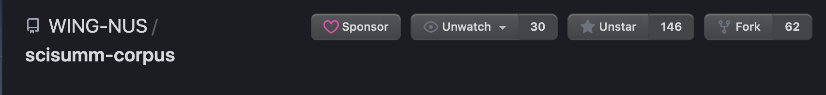
CL-SciSumm over half a decade!
Continuing effort to advance scientific document summarization by encouraging the incorporation of semantic and citation information.
- Has spawned other resources in the community
SciSummnet
TalkSumm
Several state of the art papers/ systems published at EMNLP, ACL, AAAI that benchmark and improve on CL-SciSumm
A defacto standard corpora for scientific document summarization with human written summaries
Introducing two new tasks this year:
LaySumm. – Scientific Summaries for the lay person
LongSumm – Longer Scientific Summaries (e.g., a paper blog)
https://github.com/WING-NUS/scisumm-corpus/

Slide 7
State of the Corpus in 2020
Task 1A and B: 40 target documents to summarize plus about 10 citing articles each = 500+
Task 2 (Summarization): 40 + 1000 from SciSummnet = 1040 human written summaries and abstracts
All tasks annotated by 6 paid and trained annotators from U-Hyderabad, India from 2016-2018
Corpus development from 2016-2018 was sponsored by MSRA
Details about Annotation and Corpus Construction are in the GitHub repo and in our previous overview papers:
Jaidka, K., Chandrasekaran, M. K., Rustagi, S., & Kan, M. Y. (2018). Insights from CL-SciSumm 2016: the faceted scientific document summarization Shared Task. International Journal on Digital Libraries, 19(2-3), 163-171.

Slide 8
Oral Sessions (Zoom Link 2)
Teaser to Shared Task Track
09:15 – 09:27 | CL-SciSumm (Task 1a): Chai et al., NLP-PINGAN-TECH @ CL-SciSumm 2020
09:55 –10:10 | Li et al., CIST@CL-SciSumm 2020, LongSumm 2020: Automatic Scientific Document Summarization
11:50 – 12:05 | CL-SciSumm (Task 1a): Aumiller et al., UniHD@CL-SciSumm 2020: Citation Extraction as Search
Poster Session
Gather.Town – Room N

Slide 9
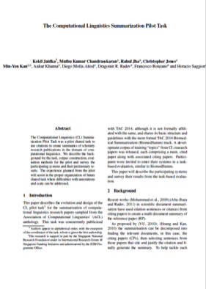
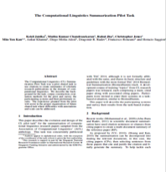
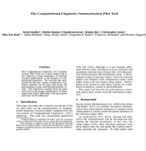
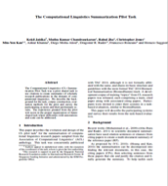
Tasks: Task 1A
I​​dentify the text span in the RP which corresponds to the citances from the CP.
Reference
Paper (RP)
Citing papers
Citing text is called citance
Citing paper (CP)
Task 1A
Match the citing text in the CP to text in the RP

Slide 10
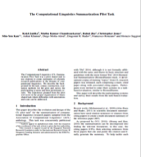
Tasks: Task 1B
Task 1B: ​Identify the discourse facet for every cited text span from a predefined set of facets.
Reference
Paper (RP)
Classify the cited text in RP into one of several facets
Citing paper (CP)
CPs
Task 1B

Slide 11
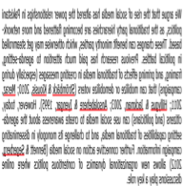
Tasks: Task 2
Task 2: ​Generate a faceted summary of up to 250 words, of the reference paper, using itself and the citing papers.​
Reference
Paper (RP)
Citing paper (CP)
Use citances and the RP to create a summary
Summary of RP
Task 2

Slide 12
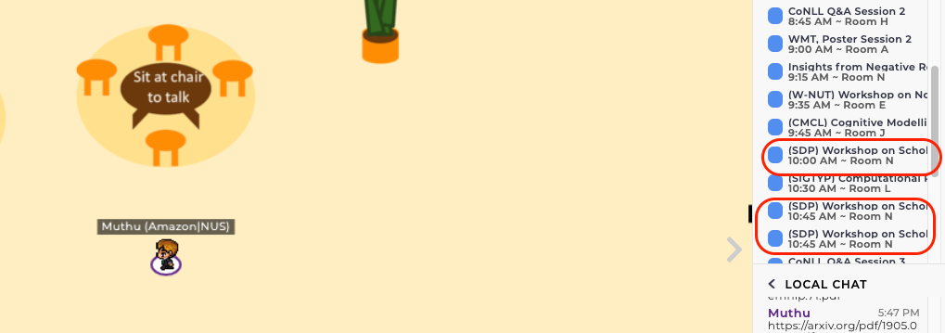
Oral Sessions (Zoom Link 2)
Teaser to Shared Task Track
Shared Task Poster Sessions 13:45 to 14:50 ET
Gather.Town – Room N and Room A

Slide 13
Evaluation
Task 1A –
Exact sentence id match
ROUGE 1, 2
Task 1B –
conditional on Task 1A
Precision, Recall and F₁ over four discourse facets (classes)
Task 2 - ROUGE-2
Notes:
12 mins here

Slide 14
Best Performing System (Task 1A)
Team / System | Exact Match |  |  | ROUGE-2
 | Precision | Recall | F₁ | Precision | Recall | F₁

Slide 15
Best Performing System (Task1B)
Team / System | Precision | Recall | F₁

Slide 16
Best Performing System – Task 2
System ID
System ID
System ID

Slide 17
Limitations
Supporting SoTA neural model training from scratch
Preprocessing: OCR + Parsing
Task 1A Evaluation
Task 1B: limited number of samples for most (e.g., hypothesis) discourse facets, inconsistent labeling
Scaling the corpus was difficult: key bottleneck in the corpus development
Participant feedback?
Guidelines
The Task
The Corpus – size, #citing papers
Evaluation metrics

Slide 18

Acknowledgements
Min-Yen Kan, National University of Singapore
Dragomir Radev (Yale), Michihiro Yasunaga, Rahul Jha
Chin-Yew Lin (MSRA)
NIST and Hoa Dang
Lucy Vanderwende, MSR
Anita de Ward, Elsevier Data Services
Kevin B. Cohen and colleagues (U. Colorado, Boulder)
Annotation Recruitment and Support: Vasudeva Varma, IIIT-H, India
U-Hyderabad Annotators:
Aakansha Gehlot, Ankita Patel, Fathima Vardha, Swastika Bhattacharya and Sweta Kumari
CL-SciSumm corpus was developed over with funding from
over 2016-2018

Slide 19
Conclusions
Successful enlargement of the 2014 pilot task, albeit with some clarification issues
We invite teams to examine the detailed results available with the GitHub repo: https://github.com/WING-NUS/scisumm-corpus/
Results and finalized analyses still in development;
Look forward to your discussion for the planning and coordination of the next iteration!
Thanks to all teams’ participation and various co-organisers for the success of CL-SciSumm shared task series from 2014 through 2020!

Slide 20
Supplemental Analyses

Slide 21
Additional Slides

Slide 22
Scientific Document Summarization
Abstractive summary
Authors’ own summary
Extractive summary
Surface, lexical, semantic or rhetorical features of the paper
Citation summary
Community creates a summary when citing
Faceted summary
Capture all aspects of a paper

Slide 23
In summary
Community concurs that a citation-based summary of a scientific document is important.
Citing papers cite different aspects of the same reference paper.
Assigning facets to these citances may help create coherent summaries.

Slide 24


Annotation Pipeline
<xml>
<abstract>
…….
</abstract>……
OCR & Section Parse
CL-SUMM
DOC
<xml>
<abstract>
…….
</abstract>……
CLAIR -Umich’s Python module
Annotation!
Post Processing with U-Colorado’s python scripts

Slide 25

Annotating the SciSumm corpus
…………..
<xml>
<abstract>
…….
</abstract>……
<xml>
<abstract>
…….
</abstract>……
6 annotators selected from a pool of 25
6 hours of training
Gold standard annotations for Task 1A and 1B, per topic or reference paper
Community and hand-written summaries for Task 2, per topic
………..

