Slide 1
Image Captioning
Group 8

Slide 2
Contents
Dataset
Preprocess
Data generation
Inference and prediction

Slide 3
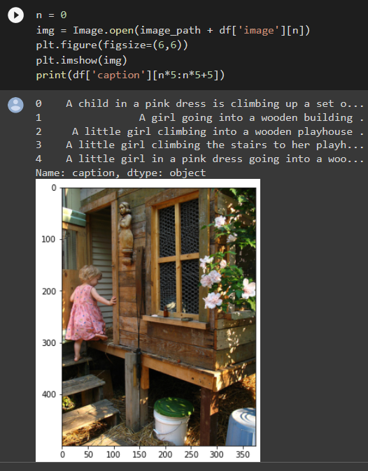
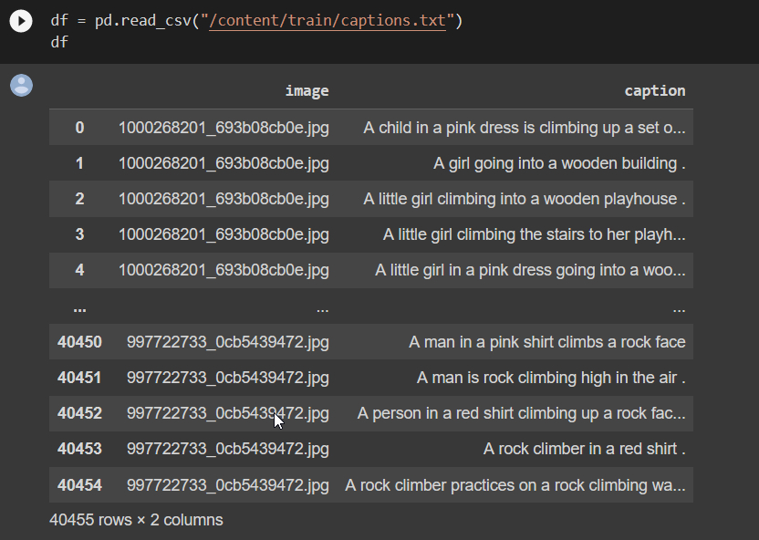
Dataset: flickr8k
This dataset contains: images for model training and captions to describe the images

Slide 4
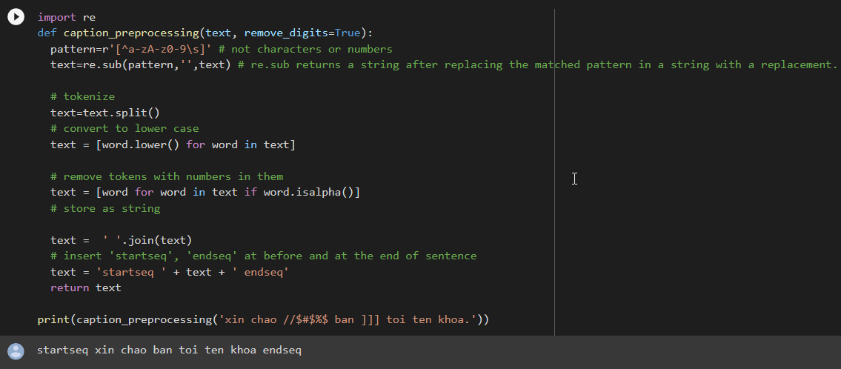
Preprocess
Preprocessing captions: Remove punctuations, special characters, words containing numbers for every caption.

Slide 5
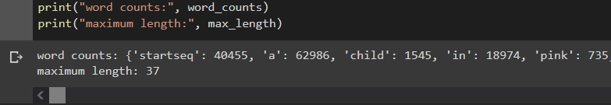
Preprocess
Finding max character in a sentence and number of sentences in the caption dataset.

Slide 6
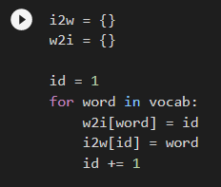
Preprocess
Index to word & word to index: create two dictionaries, one to store tokens of sentences and one to store index of the tokens.

Slide 7
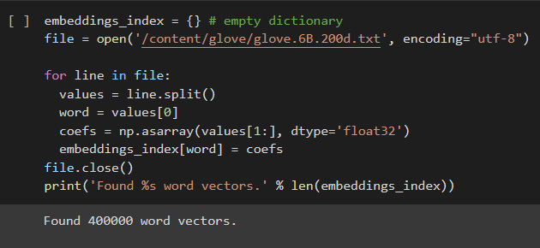
Preprocess
Embedding word using Glove:
Mapping the every word (index) to a 200-long vector and for this purpose, we will use a pre-trained GLOVE Model
GLOVE provides 4 text files containing word vectors. We use glove.6B which was trained on Wikipedia 2014 + Gigaword 5

Slide 8
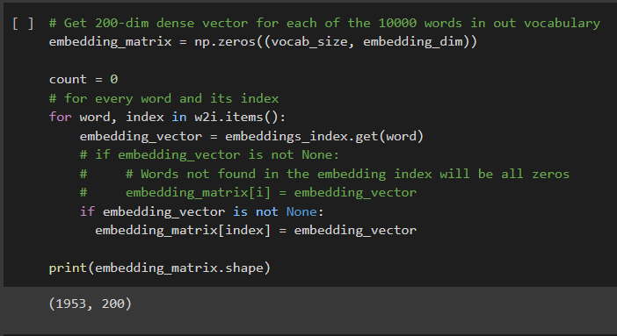
Preprocess
Concatenate vectors into matrix

Slide 9
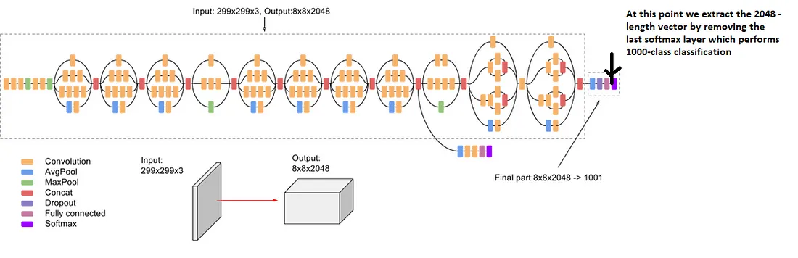
Training
We use Inception V3, remove the last layer (fully connected layer) to get the features vectors of images
Our purpose here is to get fixed-length informative vector for each image. This process is called automatic feature engineering.

Slide 10
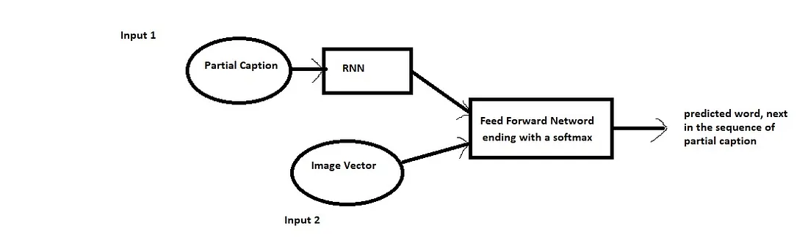
Training
We use merge architecture, process image and caption separately then merge the image with the output of RNN after processing the word

Slide 11
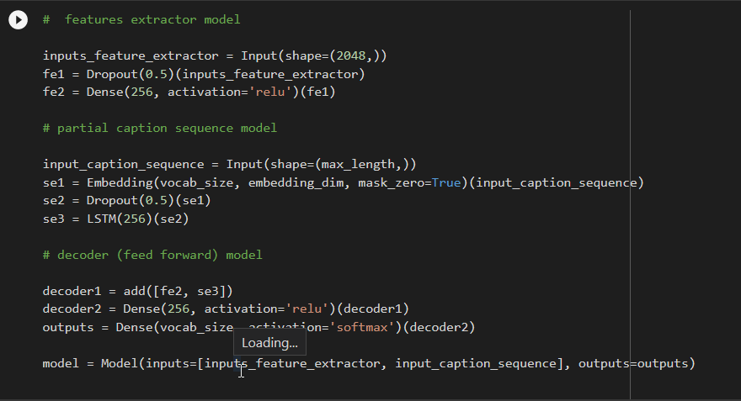
Training
Create models to train from input

Slide 12
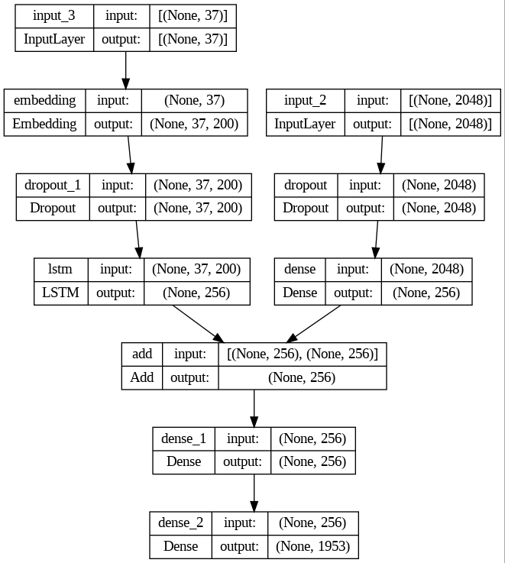
Training
Plotting model:

Slide 13
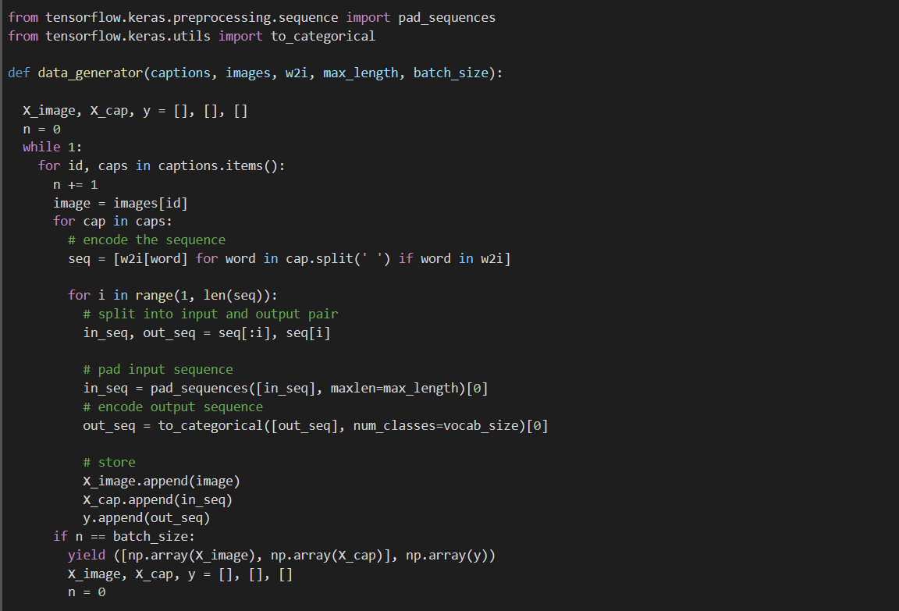
Data Generation

Slide 14
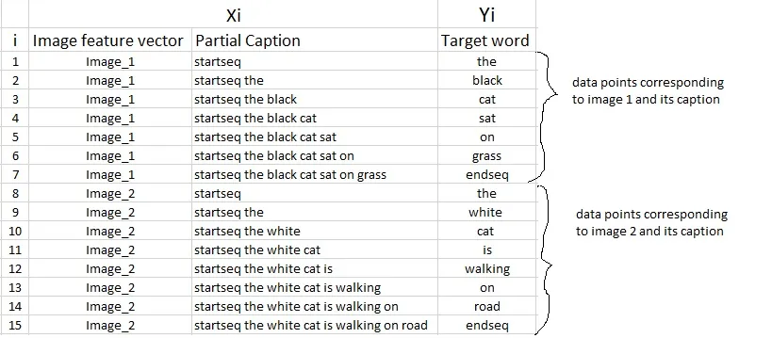
Data Generation
The data matrix is the picture below. First we need to convert both the images to their corresponding 2048 length feature vector as discussed above. Let “Image_1” and “Image_2” be the feature vectors of the first two images respectively. Secondly, let’s build the vocabulary for the first two (train) captions by adding the two tokens “startseq” and “endseq” in both of them.
Now let’s try to frame it as a supervised learning problem where we have a set of data points D = {Xi, Yi}, where Xi is the feature vector of data point ‘i’ and Yi is the corresponding target variable.
For the first time, we provide the image vector and the first word as input and try to predict the second word, i.e.: Input = Image_1 + ‘startseq’; Output = ‘the’ Then we provide image vector and the first two words as input and try to predict the third word, i.e.: Input = Image_1 + ‘startseq the’; Output = ‘cat’ And so on…

Slide 15
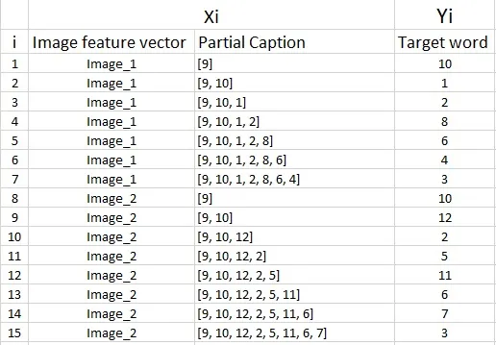
Data Generation
We must now understand that in every data point, it’s not just the image which goes as input to the system, but also, a partial caption which helps to predict the next word in the sequence.
However, we have already discussed that we are not going to pass the actual English text of the caption, rather we are going to pass the sequence of indices where each index represents a unique word. Since we have already created an index for each word, let’s now replace the words with their indices and understand how the data matrix will look like:

Slide 16
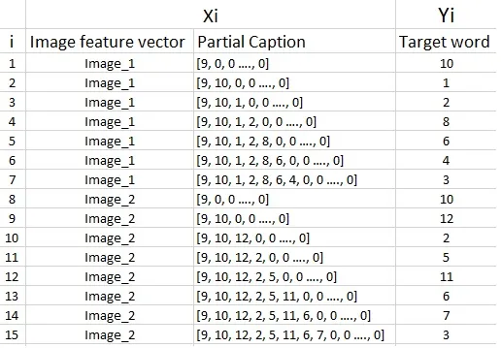
Data Generation
Since we would be doing batch processing, we need to make sure that each sequence is of equal length. Hence we need to append 0’s (zero padding) at the end of each sequence.
In the above example, 2 images and captions which have lead to 15 data points. However, in our actual training dataset we have 8000 images, each having 5 captions. This makes a total of 40000 images and captions. Even if we assume that each caption on an average is just 7 words long, it will lead to a total of 40000*7 i.e. 280000 data points.

Slide 17
Data Generation
Size of the data matrix = n*m
Where n-> number of data points (assumed as 280000)
And m-> length of each data point
Clearly m= Length of image vector(2048) + Length of partial caption(x).
m = 2048 + x
Every word (or index) will be mapped (embedded) to higher dimensional space through one of the word embedding techniques. Later, during the model building stage, we will see that each word/index is mapped to a 200-long vector using a pre-trained GLOVE word embedding model. Now each sequence contains 34 indices, where each index is a vector of length 200. Therefore x = 34*200 = 6800 Hence, m = 2048 + 6800 = 8848. Finally, size of data matrix= 280000* 8848 blocks.
This is pretty huge requirement and even if we are able to manage to load this much data into the RAM, it will make the system very slow.

Slide 18
Data Generation
If you know the basics of Deep Learning, then you must know that to train a model on a particular dataset, we use some version of Stochastic Gradient Descent (SGD) like Adam, Rmsprop, Adagrad, etc.
With SGD, we do not calculate the loss on the entire data set to update the gradients. Rather in every iteration, we calculate the loss on a batch of data points (typically 64, 128, 256, etc.) to update the gradients.
This means that we do not require to store the entire dataset in the memory at once.
A generator function in Python is used exactly for this purpose. It’s an iterator which resumes the functionality from the point it left the last time it was called.

Slide 19
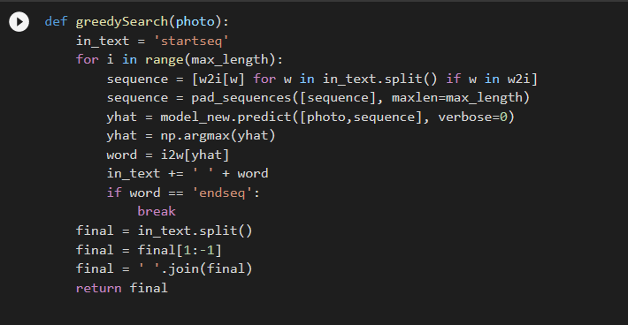
Inference and prediction
We use Greedy search algorithm to predict caption for the image. We greedily select the word with the maximum probability, given the feature vector and partial caption.

Slide 20
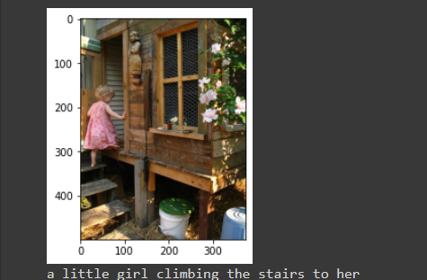
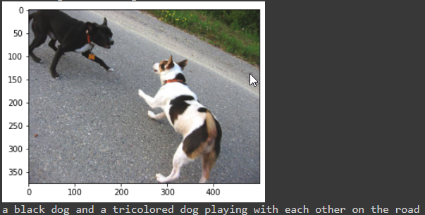
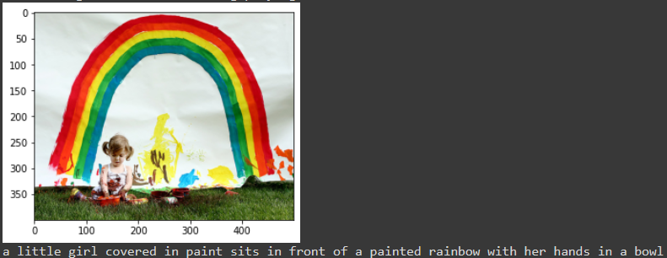
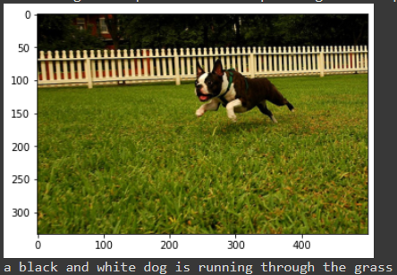
Inference and prediction

