Slide 1
Multilayer Perceptron for Regression and classification Problems

Slide 2
Backpropagation algorithm
Definition
In simple terms, after each forward pass through a network, backpropagation performs a backward pass while adjusting the model’s parameters (weights and biases).

Slide 3
Backpropagation algorithm
Algorithms Steps
Initialize The Neural Network.
Forward Propagatation.
Back Propagatation
Train Network.
Predict.

Slide 4
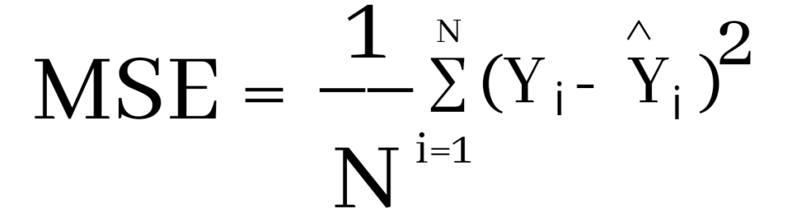
Regression
For regression problems, Mean Squared Error loss function (cost function) is often used to evaluate the difference between the predicted value and actual value by measuring the average of error squares.

Slide 5
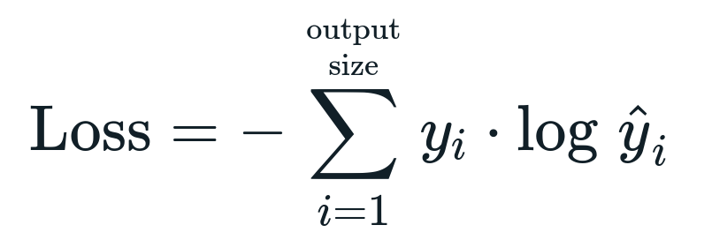
Classification
For classification problems, Cross Entropy loss function (cost function) is used. Cross-entropy calculating the difference between two probability distributions or calculate the total entropy between the distributions.

Slide 6
General idea
The principle of the backpropagation approach is to model a given function by changing weights of input to produce an expected output. The system is trained using a supervised learning method, where the error between the predicted output and a n expected output used to modify.
The backpropagation algorithm modifies the weights and biases of the neurons to minimize the loss function, which improves the model. It uses gradient descent to update the weights and biases to reduce the cost

