Slide 1
Second Level git
Working with a remote repository

Slide 2
How to get a repository
Initialize
$ git init
Clone an existing remote repository
$ git clone https://github.com/libgit2/libgit2

Slide 3
Remote Repositories
Remote location
Save and backup files
Collaborate on projects
Show remotes
$ git remote -v
Add a remote
$ git remote add https://github.com/libgit2/libgit2
Fetch data from remote
$ git fetch [remote-name]
Remote name defaults to origin
Push your local changes to remote
$ git push origin master

Slide 4
Notes about git and github
Github.com hosts free public remote repositories
bitbucket.com is another alternative
Starting a repository on github.com
Make a new repo on github.com
Do this first!
Then (locally) Either
git clone OR
git init → git add → git commit→ git remote → git push
Frequently push your changes to github.com.
Use git pull to get the latest version.

Slide 5

Pushing ExampleRepo
We will push the ExampleRepo created in the last set of slides to Github
Currently, there is no remote:
To add a remote, you will first need to create a profile on github.com, then create a new repository

Slide 6
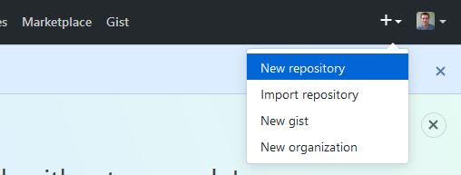
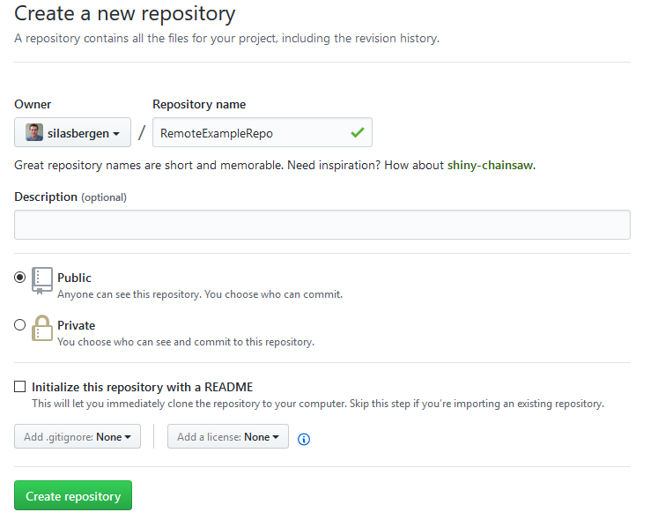
Step 1: Create new remote repo
No spaces!!
We have already initialized locally with $ git init, so leave blank
Click here

Slide 7
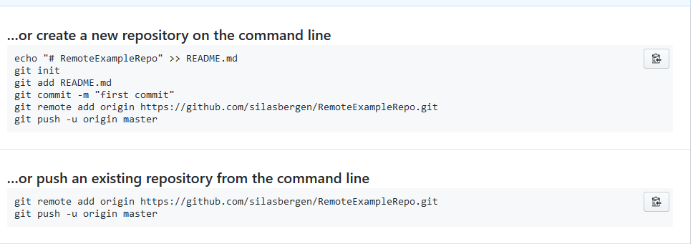
GitHub gives helpful hints!

Slide 8
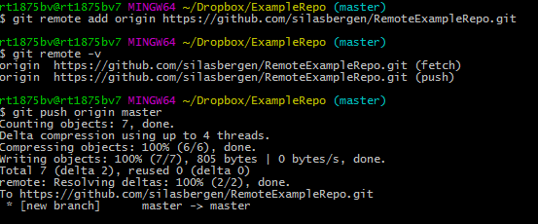
Step 2 – Add a remote and push your changes

Slide 9
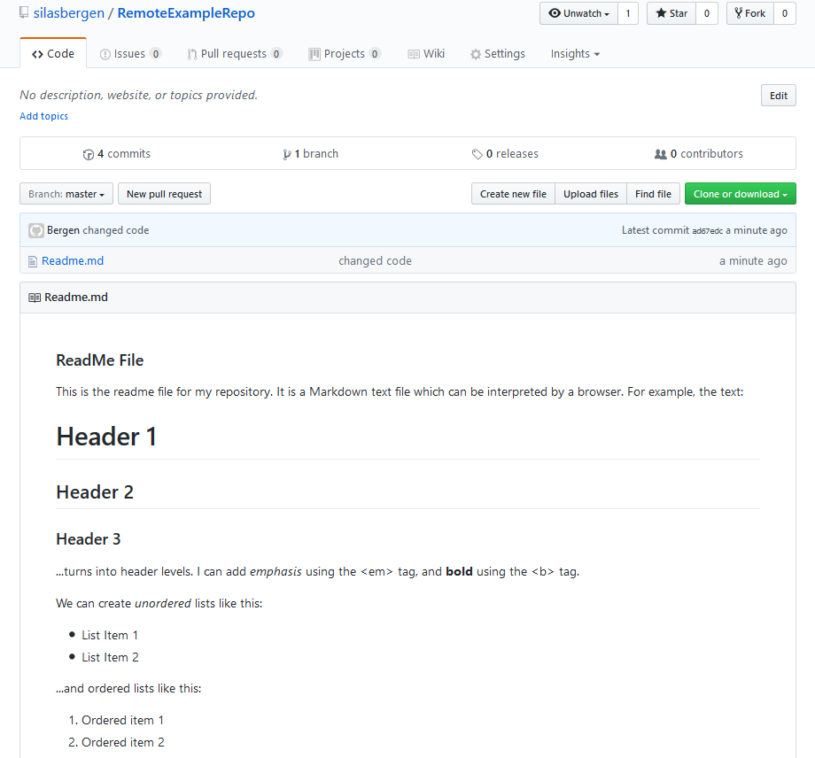
Step 3 – Refresh Github repo:

Slide 10
This is a single-user, single-machine workflow
Works well if
Only contributor
Work on one machine
If working with others or on many machines
Always pull before you push!
Never push broken code!

Slide 11
Notes
Good practice to name remote repository the same as the local repository
You can alternatively create the remote repository first, then clone it.
For example…

Slide 12
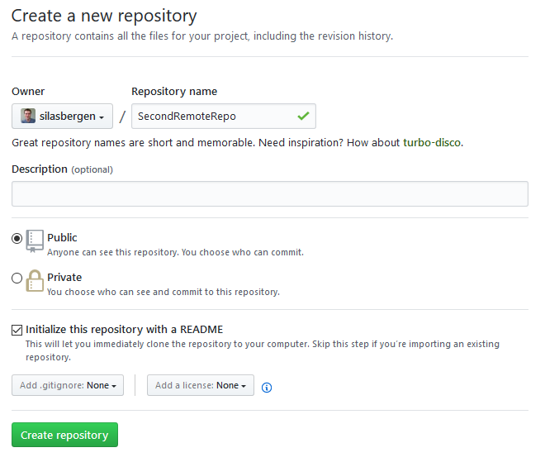
Step 1 - Create 2nd remote repo
Click here now!

Slide 13
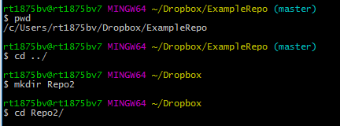
Step 2 – create and navigate to local directory for repo

Slide 14
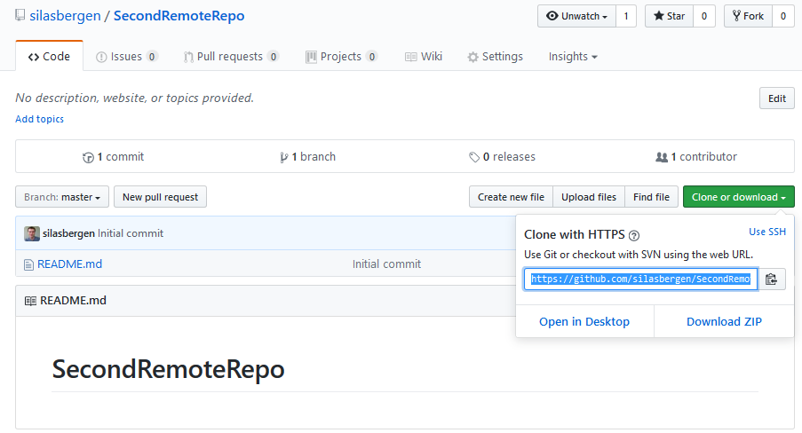
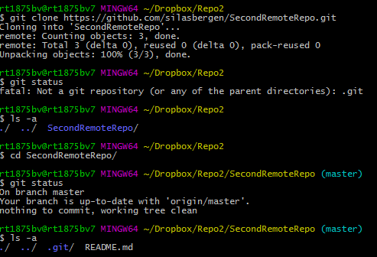
Step 3 – clone remote repo

Slide 15
Git & GitHub: Overview
Assuming initialized, local git repository:
$ git pull <remote> <branch> ALWAYS DO FIRST!!
(Modify/add/delete documents)
$ git add -A STAGE CHANGES
$ git commit -m “what you changed” COMMIT CHANGES
$ git push <remote> <branch> PUSH TO REMOTE
<remote> <branch> typically origin master
These few commands get you very far!!

Slide 16
IF WORKING COLLABORATIVELY…
ALWAYS PULL BEFORE YOU PUSH!!

Slide 17
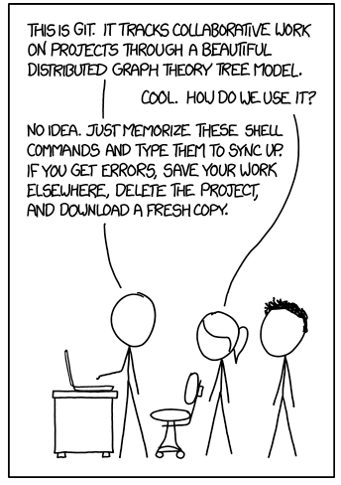
Don’t feel bad if you can relate to this!!

Slide 18
.gitignore

Slide 19
Why?
You may have directories or files that you want to store in your local repository, but don’t want to track/push to Github
Huge data files
Private data files
A .gitignore file is a text file that tells git what to ignore

Slide 20

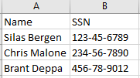
Example
For example:
Create these Excel files, and save them to ExampleRepo
Public.xlsx
Private.xlsx

Slide 21
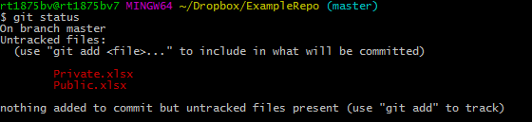
Note:
If the repository doesn’t already have a .gitignore file, we will need to create one
$ notepad .gitignore

Slide 22
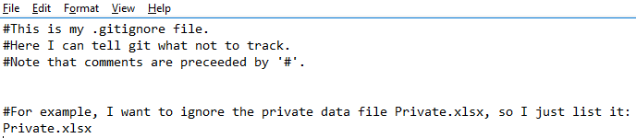

Slide 23
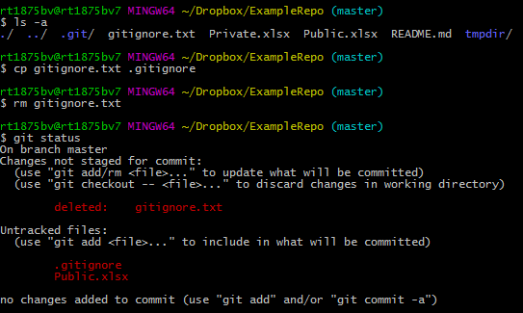
Note that Private.xlsx is no longer tracked!

Slide 24
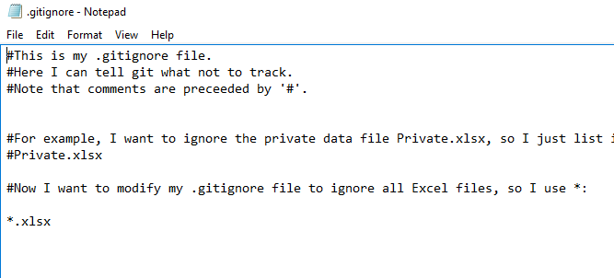
See https://git-scm.com/docs/gitignore for more details on the .gitignore
For example, if I want to ignore all .xlsx files…
$ notepad .gitignore, then:

Slide 25
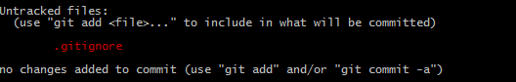
Neither Excel files are now tracked:
Still need to make sure to stage & commit the .gitignore!

