Slide 1
A differentiable RF simulator for indoor robotics
Transmitter, receiver and material results using RFDT
github.com/WIRES-UB/SimranRFDT
Simran Koul
Notes:
A differentiable RF ray tracer written from scratch on PyTorch, implementing the RFDT method (MobiCom 2026), applied to a mobile robot in a furnished indoor room. Not Sionna: the point of RFDT is correct gradients with respect to scene geometry, which the paper shows Sionna does not provide, so the tracer had to be built rather than wrapped. 29 regression tests validate the physics against closed-form results: line of sight against Friis to under 0.001 dB, a two-ray ground reflection to under 0.05 dB, and reciprocity to 1e-13 dB.

Slide 2
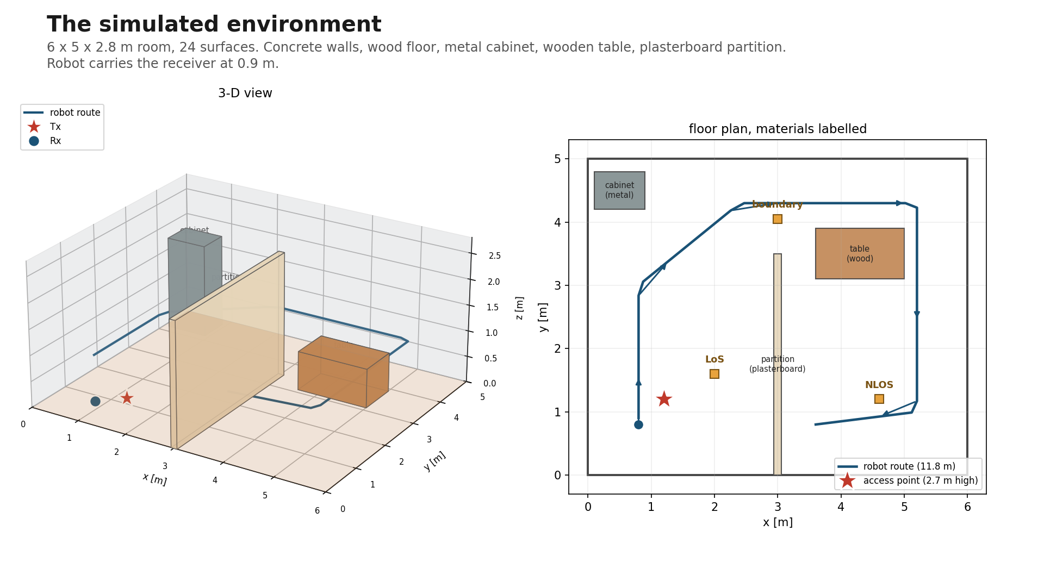
Notes:
6 x 5 x 2.8 m room, 24 surfaces. Access point on the ceiling at (1.2, 1.2, 2.7), robot carries the receiver at 0.9 m along an 11.8 m route. Concrete walls, wood floor, ceiling board, metal cabinet, wooden table, plasterboard partition. The partition runs from the wall to y = 3.5 at x = 3 and stands 2.4 m tall, so it shadows the far half of the room but leaves a gap the robot drives around. Every route is checked against the furniture; a point inside a solid raises an error.

Slide 3
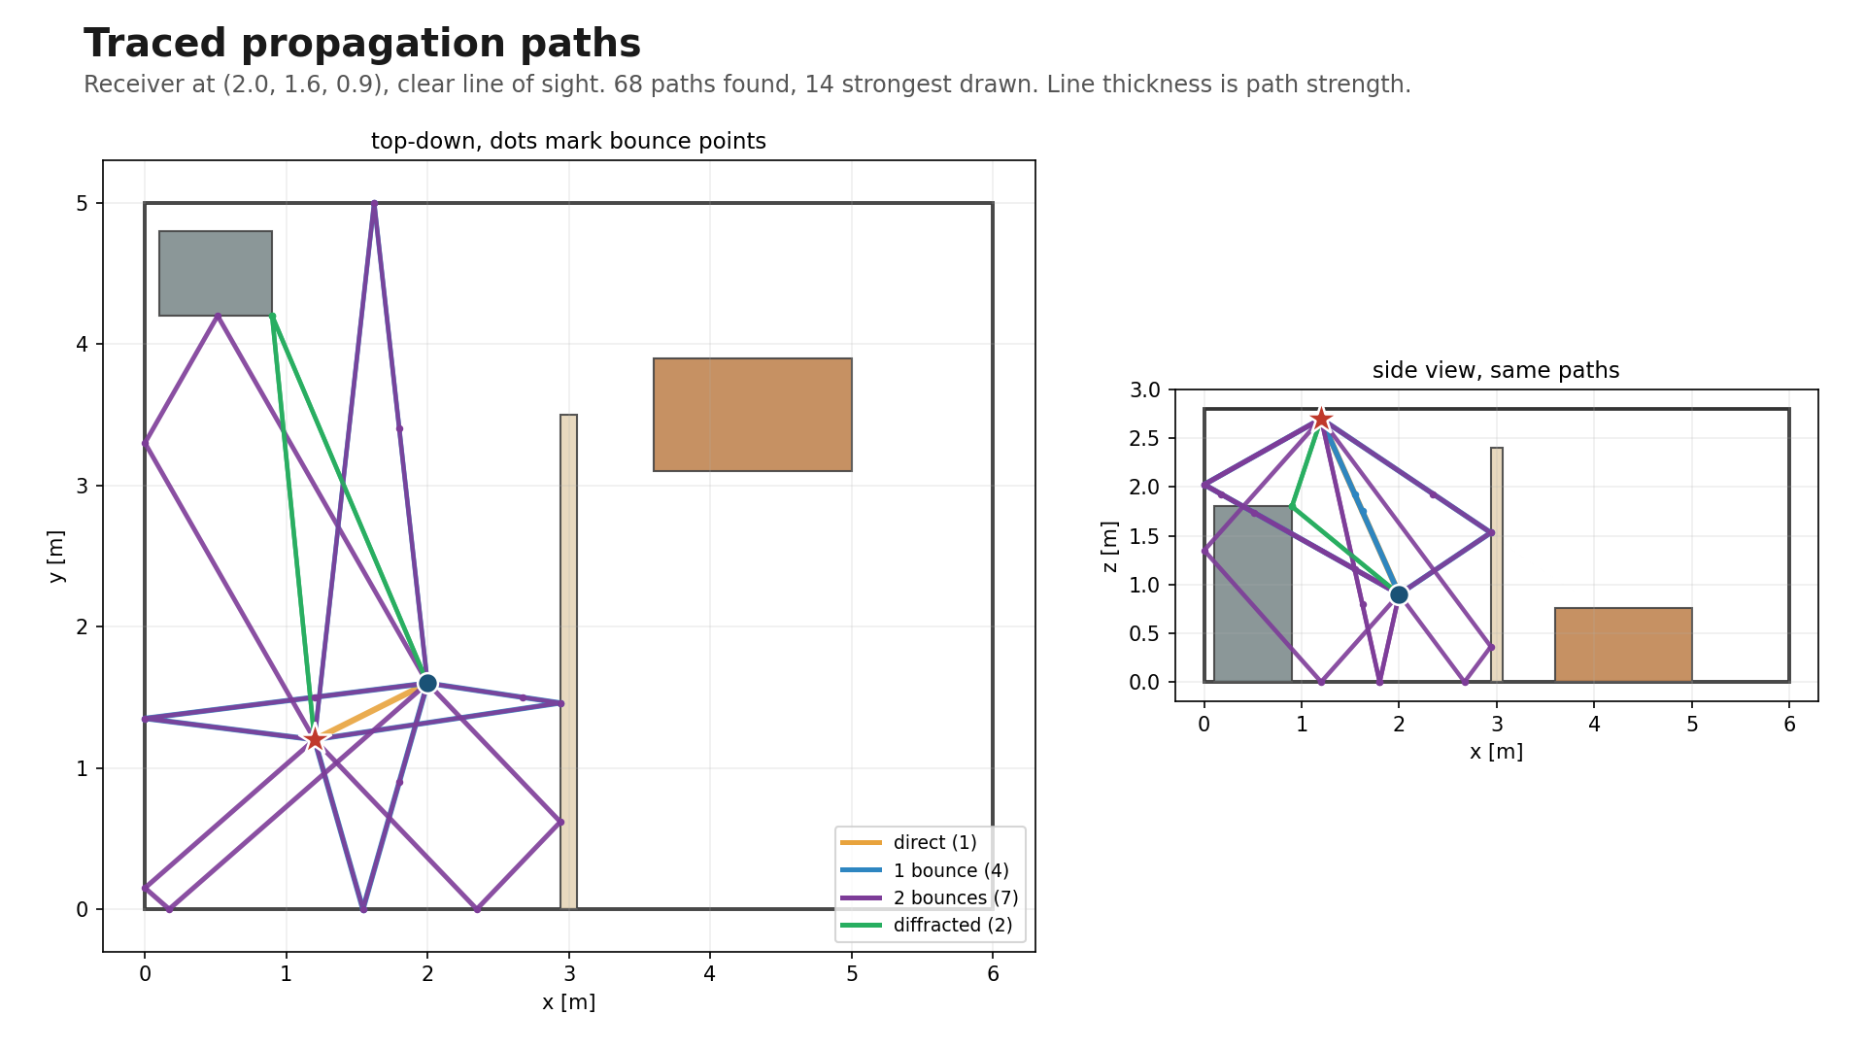
Notes:
68 paths found at this position, 14 strongest drawn. Line thickness is path strength. Top-down shows the bounce points, side view shows how paths clear obstacles vertically. These are the traced polylines, not a sketch: the drawn length equals the reported path length exactly.

Slide 4
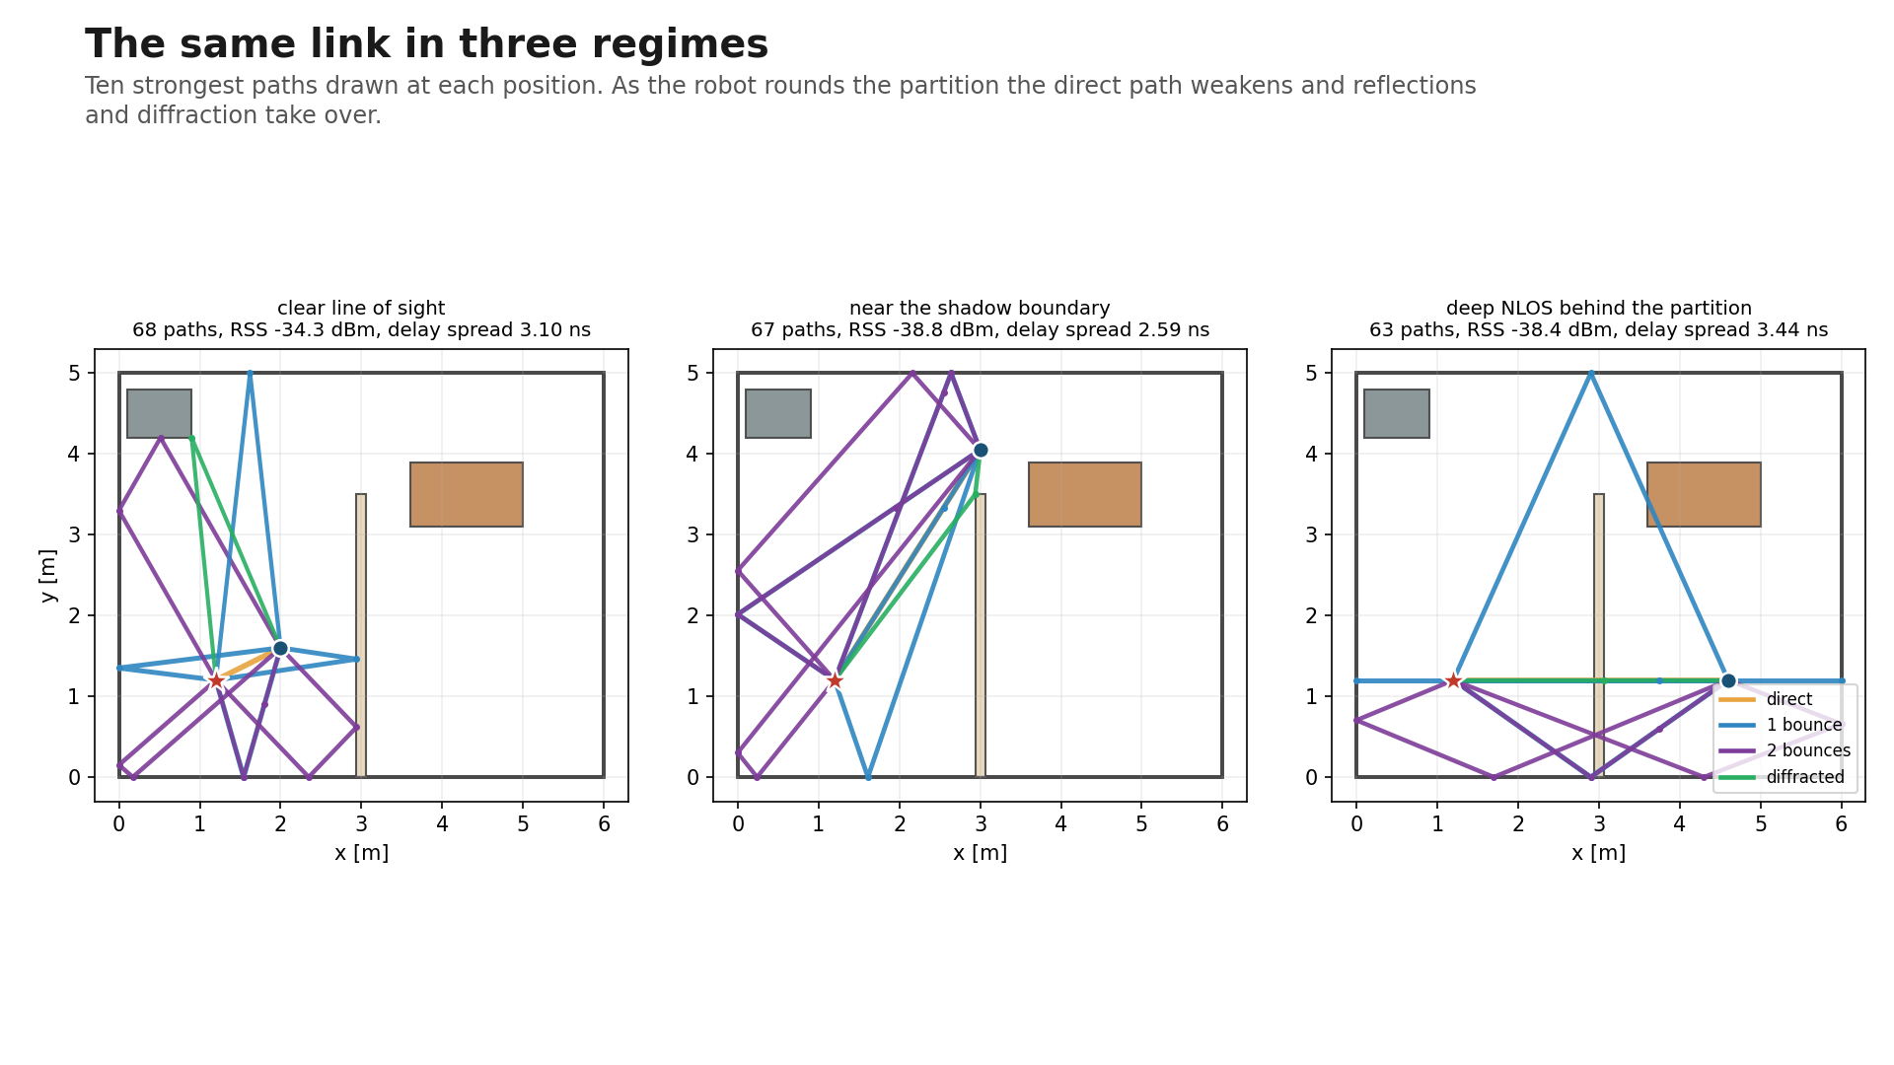
Notes:
Ten strongest paths at each of three positions. In line of sight the direct path carries the link. Near the shadow boundary it weakens. In deep NLOS behind the partition the channel is carried by reflections and diffraction. Delay spread and received power quoted per position.

Slide 5
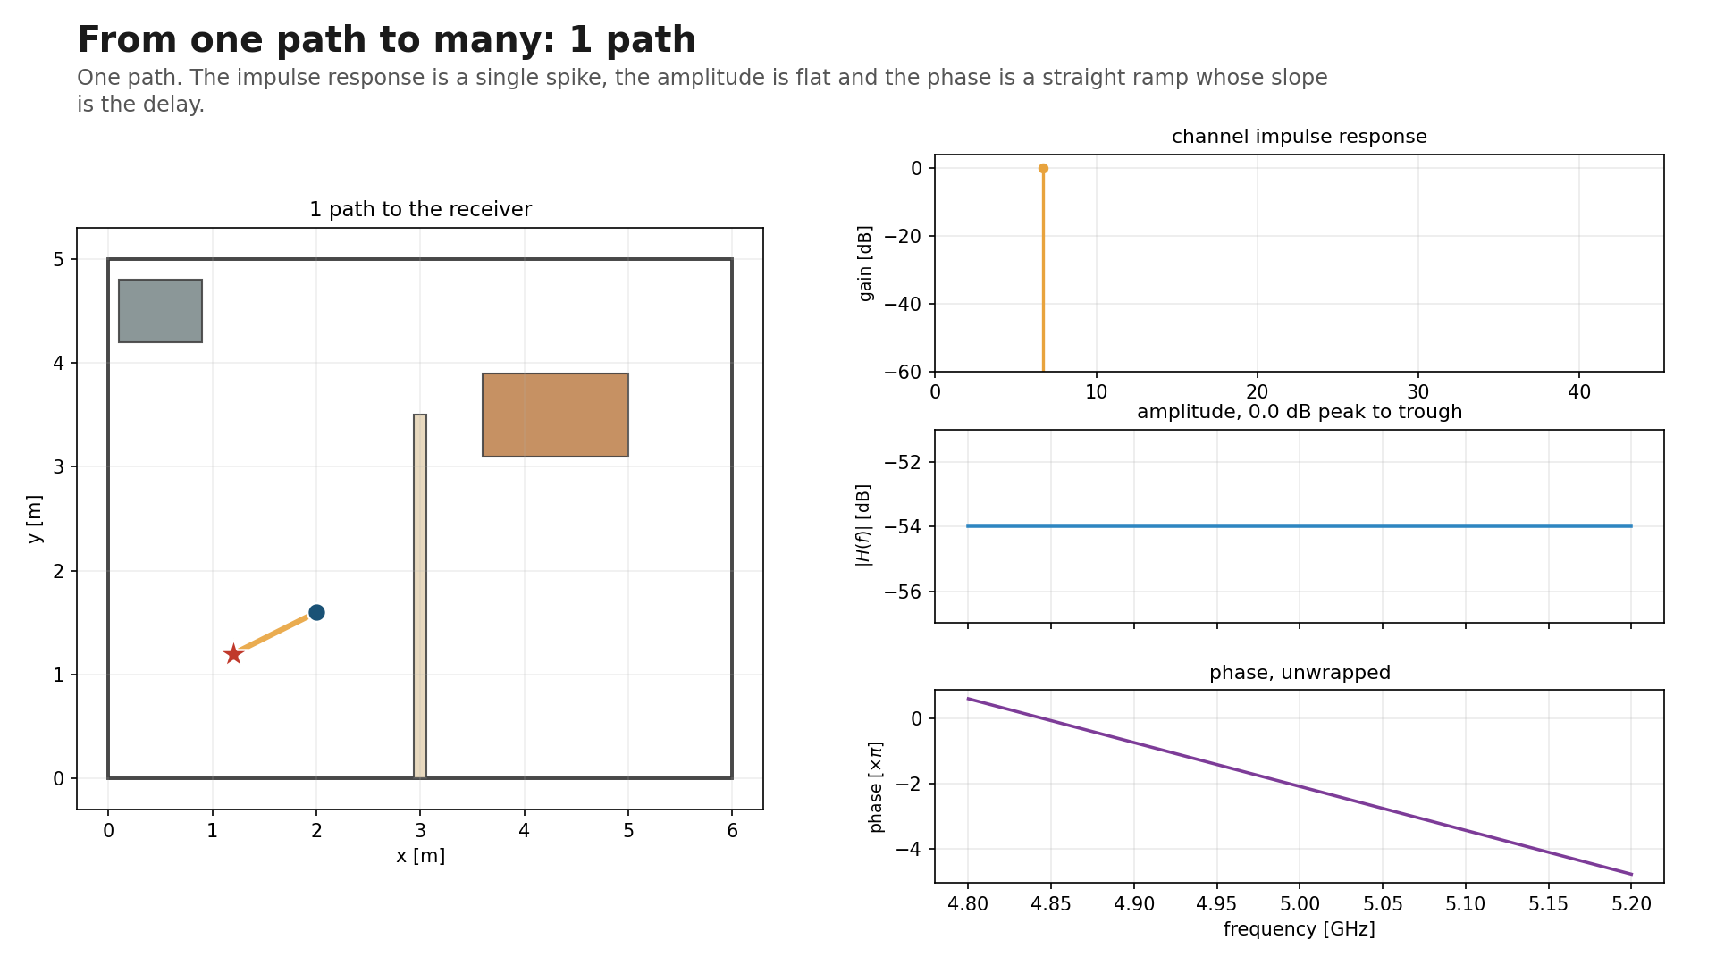
Notes:
One path. The impulse response is a single spike, the amplitude is flat and the phase is a straight ramp whose slope is exactly the propagation delay. A single-path channel treats every frequency identically.

Slide 6
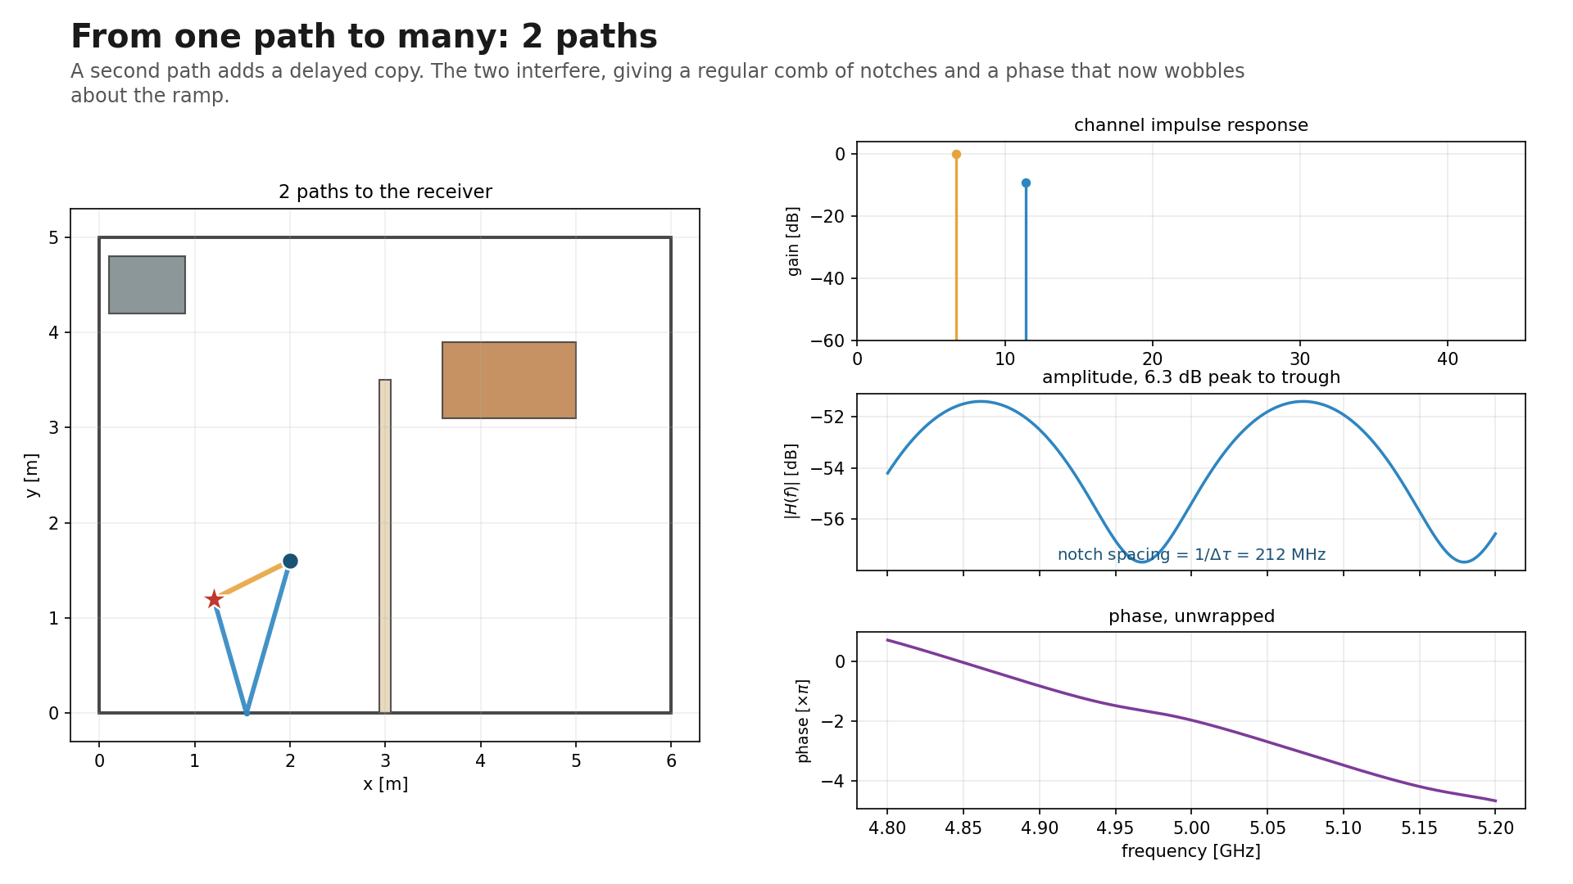
Notes:
Two paths. A delayed copy interferes with the direct path and produces a regular comb of notches. Notch spacing is 1/dtau, annotated on the slide. This is the same closed form validated to 0.06 percent in the frequency-response experiment. Selectivity 6.28 dB, delay spread 1.46 ns.

Slide 7
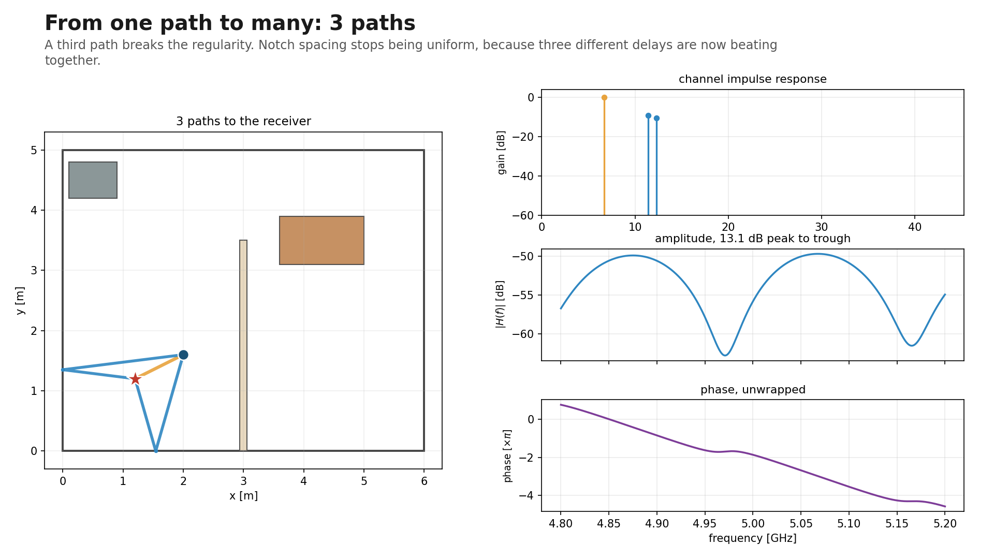
Notes:
Three paths. The comb stops being regular, because three different delays are now beating against one another. Selectivity 13.05 dB, delay spread 1.93 ns.

Slide 8
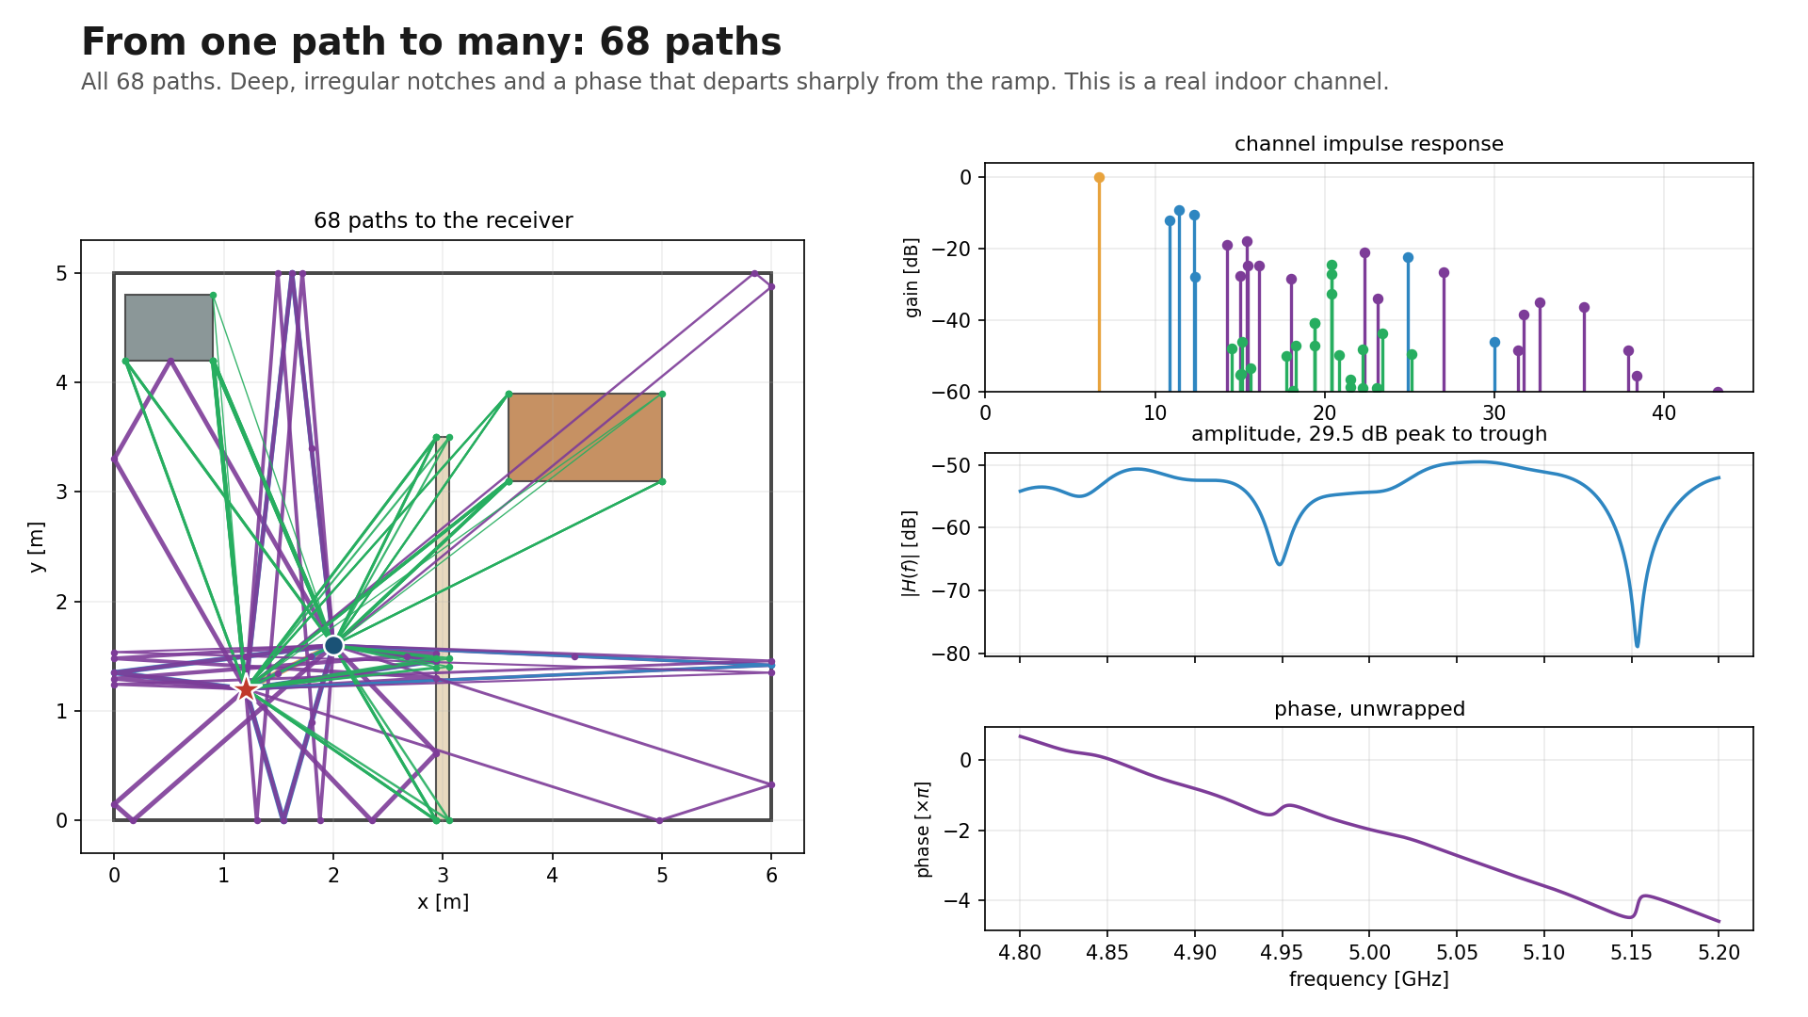
Notes:
All 68 paths. Deep irregular notches, and the phase tears away from the linear ramp at each one. Selectivity 29.46 dB, delay spread 3.10 ns. This is what a real indoor channel looks like.

Slide 9
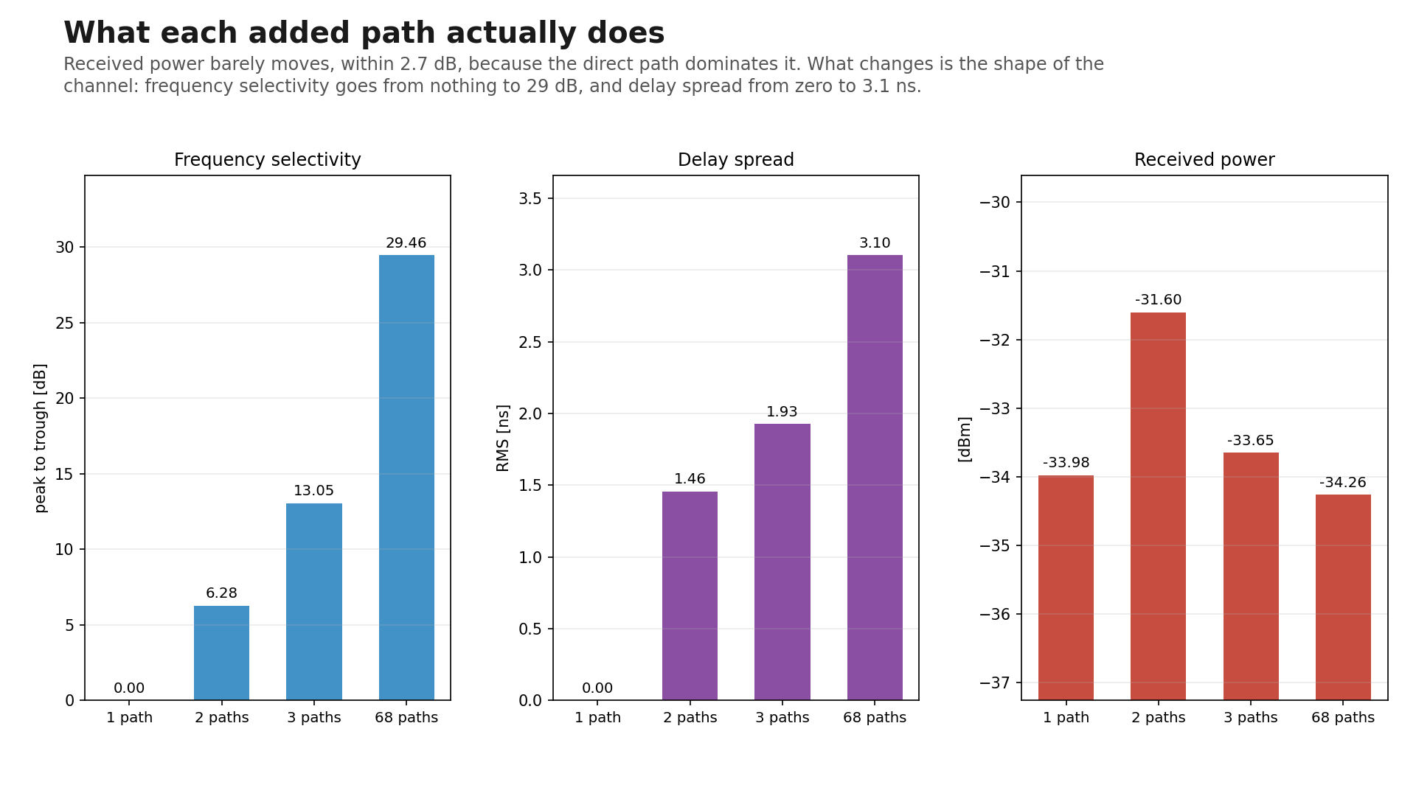
Notes:
The takeaway. Received power moves by under 3 dB across the whole sequence, because the direct path dominates it and the direct path never touches a wall. What multipath changes is the shape of the channel: frequency selectivity from nothing to 29 dB, delay spread from zero to 3.1 ns. This is why average signal strength is a poor way to characterise an indoor link.

Slide 10
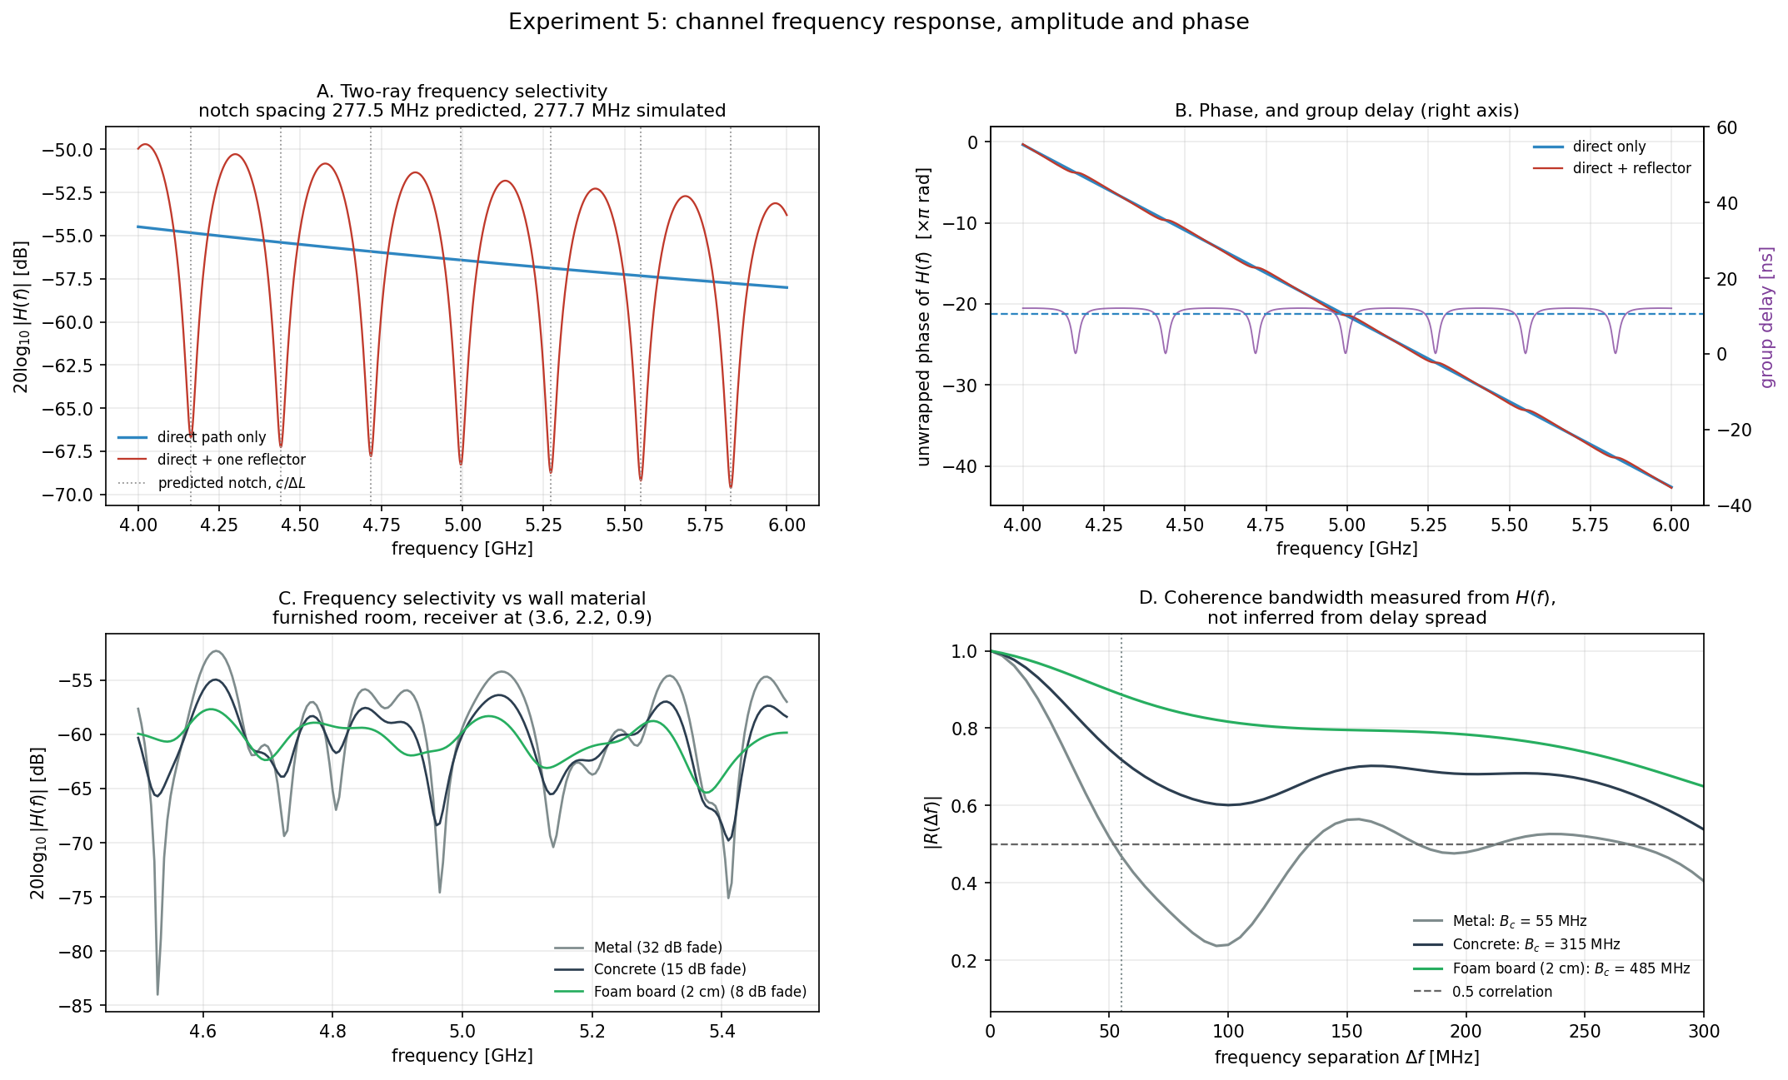
Notes:
Frequency domain, validated against closed form. Two-ray notch spacing should be c/dL: 277.49 MHz predicted, 277.67 MHz simulated, 0.06 percent error. The direct-only response has zero notches and falls 3.522 dB across 4 to 6 GHz, exactly matching the 1/f free-space prediction. Single-path group delay equals L/c to 1e-15 s. Panel D measures coherence bandwidth directly and shows the usual 1/(5 sigma) rule of thumb is fine for metal walls but understates it about fourfold for concrete and foam.

Slide 11
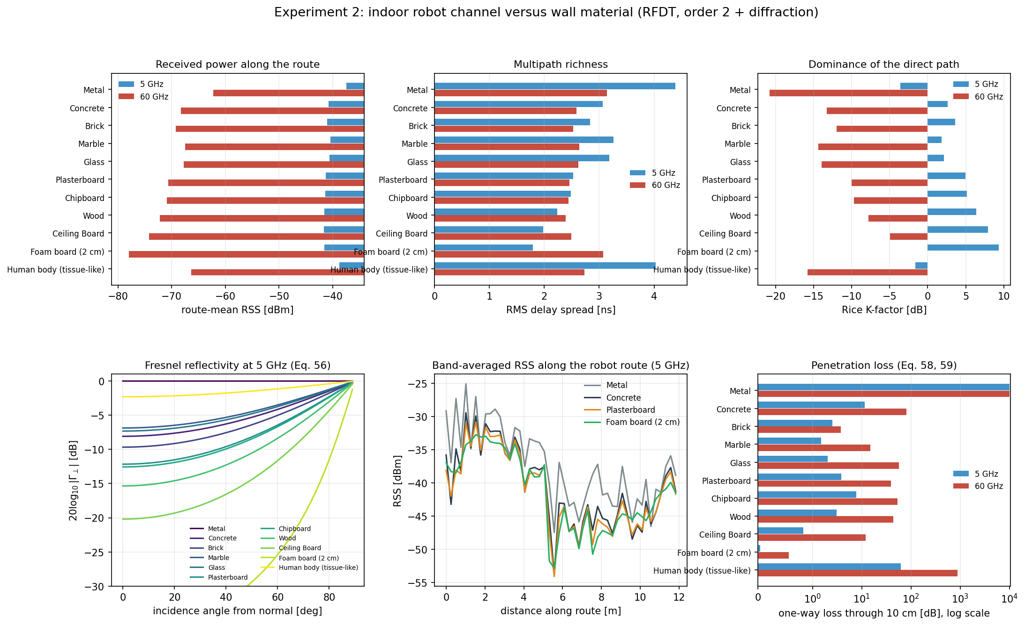
Notes:
Eleven materials from ITU-R P.2040, robot driving the full route, averaged over the route and a 2 percent frequency band so the result is not just fading. Delay spread, K-factor and angular spread are strictly monotone in reflectivity. Metal room behaves like a reverberation chamber, foam like an anechoic one. At 60 GHz it inverts: reflective walls raise received power by 16 dB, because the partition blocks the direct path and bounces are the only energy reaching the far half.

Slide 12
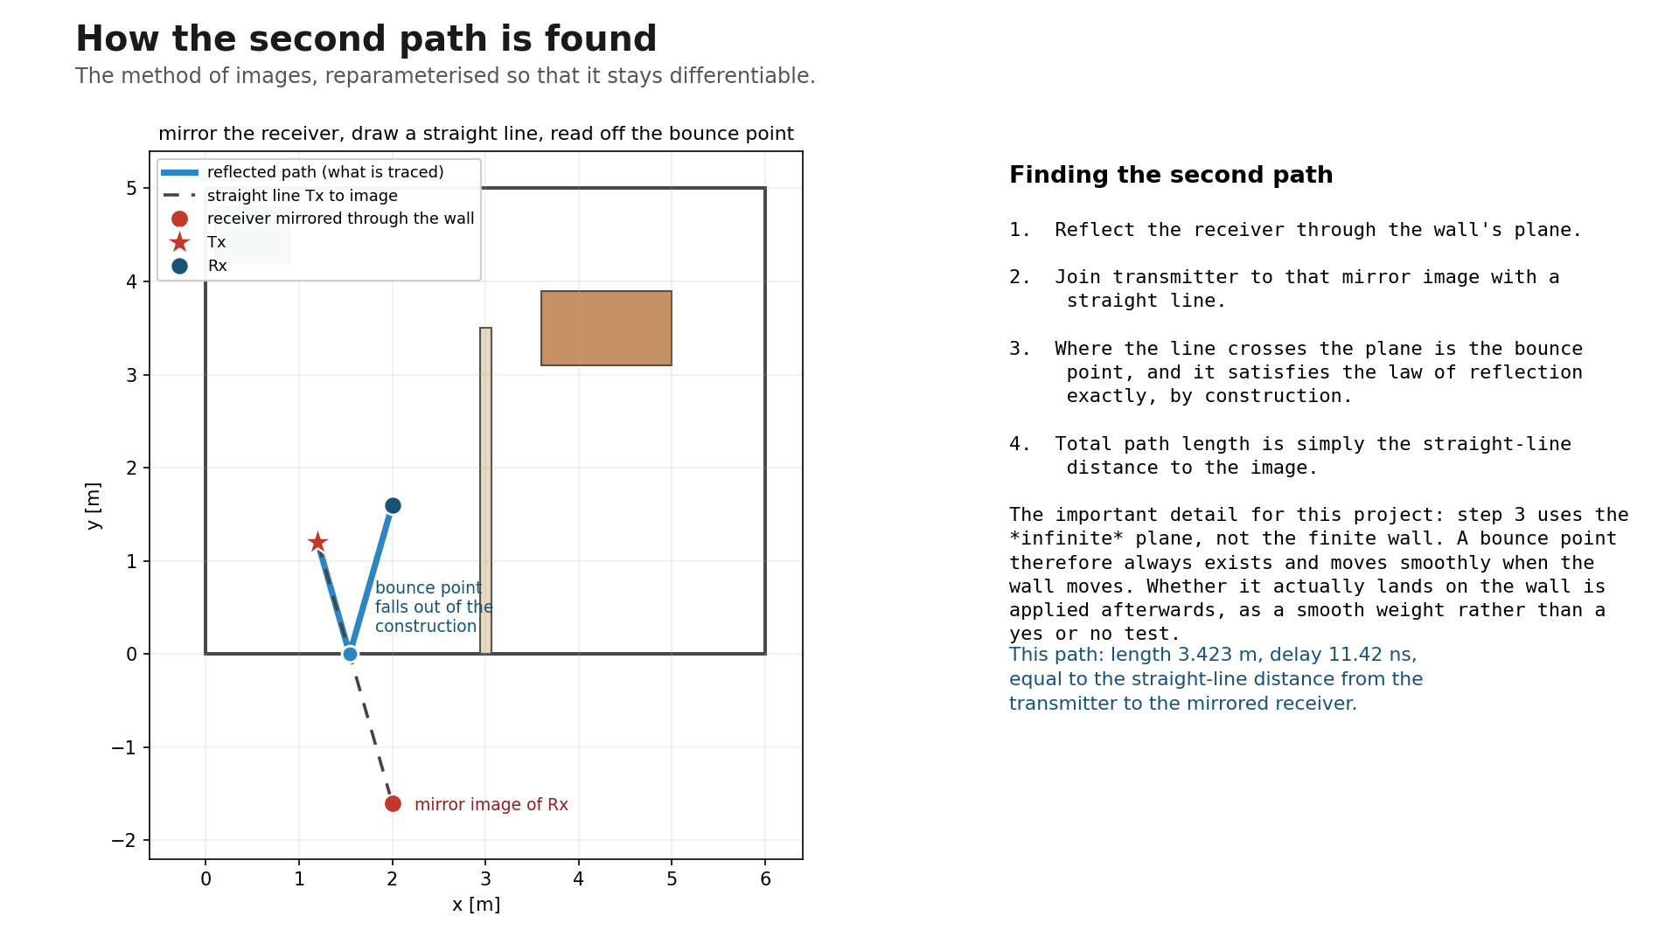
Notes:
How the second path is found. Mirror the receiver through the wall plane, join the transmitter to that image with a straight line, and the bounce point is where the line crosses. Path length equals the straight-line distance to the image. The detail that matters for this project: the crossing is computed on the infinite plane, so a bounce point always exists and moves smoothly when the wall moves. Whether it lands on the actual wall is applied afterwards as a smooth weight rather than a yes or no test, which is what keeps the simulator differentiable with respect to geometry.

Slide 13
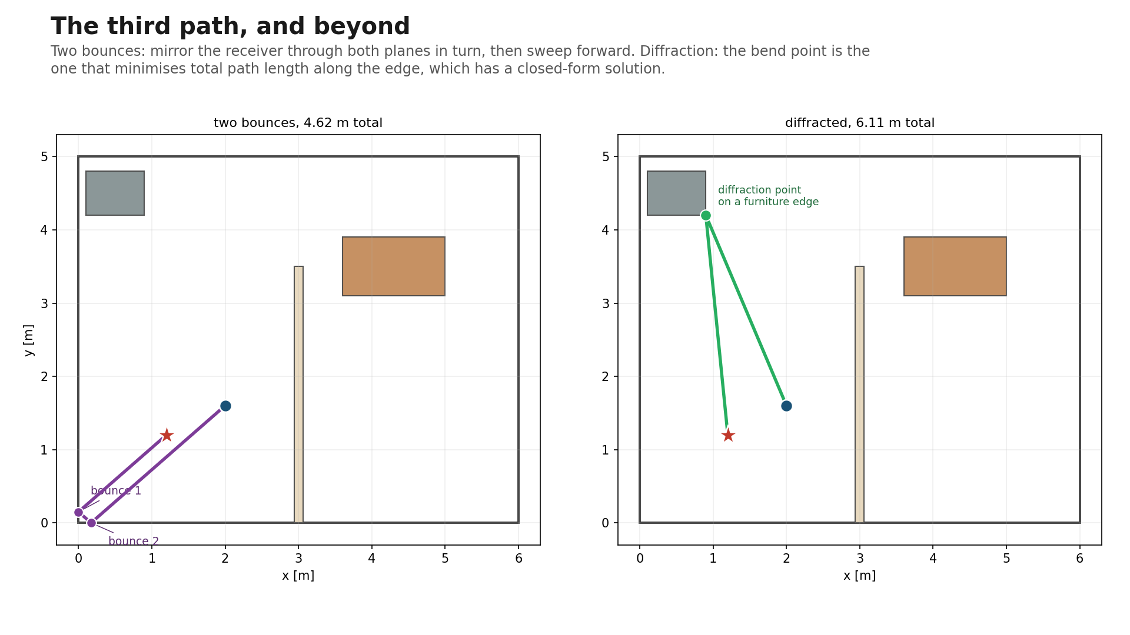
Notes:
Third path and beyond. Two bounces: mirror the receiver through both planes in turn, then sweep forward intersecting each plane. Diffraction: the bend point on an edge is the one minimising total path length, which has a closed-form solution, so no iteration is needed and the gradient stays clean.

Slide 14
Validation, and what this does not do
Checked against closed-form physics, 29 tests
Line of sight against the Friis equation, under 0.001 dB
Two-ray ground reflection against the analytic sum, under 0.05 dB
Reciprocity when transmitter and receiver swap, 1e-13 dB
Two-ray notch spacing against c/dL, 0.06 percent
Autograd against central finite differences, 1e-9 relative
Known limitations
Scalar polarisation, one complex coefficient per path
First-order diffraction only, none from concave junctions
No measured ground truth: validated against theory, not a measurement campaign or a full-wave solver
Foam, plastic, paper and human body are approximate literature values, not ITU data, and are labelled as such in every output
Small scenes: fast for 24 surfaces, not a replacement for a GPU tracer at 10^5 triangles
Notes:
Worth stating the limitations out loud. The validation is against theory and internal consistency, not against measurements, so the honest claim is that the physics is implemented correctly, not that it has been confirmed in a real room.

