Slide 1

Congestion Analysis for Global Routing via Integer Programming
Hamid Shojaei, Azadeh Davoodi,
and Jeffrey Linderoth*
Department of Electrical and Computer Engineering
*Department of Industrial and Systems Engineering
University of Wisconsin-Madison
WISCAD Electronic Design Automation Lab http://wiscad.ece.wisc.edu

Slide 2
Goals
Goals of congestion analysis for global routing (GR)
Capture factors that contribute to congestion in modern design
Significant variations in wire size and spacing at different metal layers, virtual pins located at the higher metal layers, routing blockages, impact of vias, etc.
Requires handling a flexible model of global routing
Create an accurate congestion map
Accurately identify the utilization of routing resources at different locations on the layout, especially the “congestion hotspot” and the amount of utilization or congestion at each location
Runs fast to allow iterative calls when integrated within the design flow, e.g., with routability-driven placement

Slide 3
Contributions
An Integer Programming (IP) formulation expressing “the congestion analysis problem”
Introduces a new objective of regional minimization of overflow
In the special case, simplifies to a traditional GR IP formulation
New ideas for a practical realization of the IP as an integration with a standard rip-up and reroute framework
Reduced-sized Linear Programming
Multiple Rip-up Single Reroute (MRSR)
Other: flexible layer assignment, intra-iteration edge history update
CGRIP: congestion analysis tool
Stable, fast, flexible router, handling many factors contributing to congestion in modern designs
Simpler variation, coalesCgrip, judged the ISPD 2011 contest
Released at http://wiscad.ece.wisc.edu/~adavoodi/gr/cgrip.htm

Slide 4
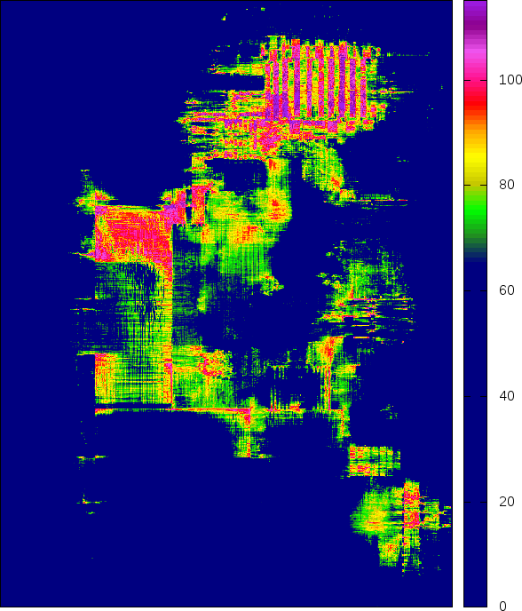
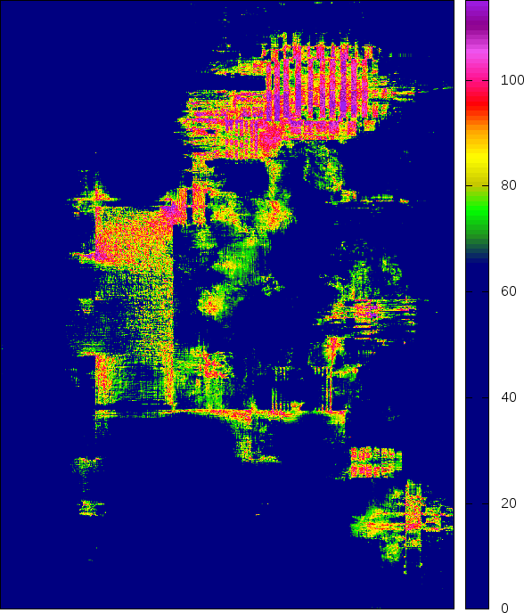

Motivation
To quickly obtain an accurate congestion map, what is an effective optimization objective?
Example: ran different variations of CGRIP on a placement of superblue2
Case (a) minimizes TOF in a short time i.e., 15 minutes
Case (b) regionally minimizes overflow in a short time, 15 minutes on 100 regions
Case (c) minimizes TOF in a long time, i.e., 60 minutes
Congestion maps (a) and (b) have similar TOF, however congestion map (b) is more accurately matching (c) in terms of locations of the highly-utilized edges
100
80
60
40
20
0
(a) TOF=380K
(b) TOF=380K
(c) TOF=353K (reference)
Notes:
For each heatmap only edges with a utilization higher than 70% is shown

Slide 5
Motivation
To quickly obtain an accurate congestion map, what is an effective optimization objective?
Minimizing TOF is NOT a good objective within a short runtime budget
The global router may not have the chance to optimize some regions in a short run but this is not an indication of unroutability
Need to find the locations that are unroutable, even after a long run of the reference global router
100
80
60
40
20
0
(a) TOF=380K
(b) TOF=380K
(c) TOF=353K (reference)

Slide 6
Region Definition
Two input resolution parameters control the number of regions
For a small time-budget
Resolution is set to be much lower than the global routing grid
Identification of the congestion hotspots is with respect to the granularity defined by the regions rather than each edge of the GR grid-graph and thus can be done more accurately
Definition and computation of overflow remains with respect to the edges of the GR grid-graph
r_{y}=2
r_{x} =3
# regions = 6

Slide 7
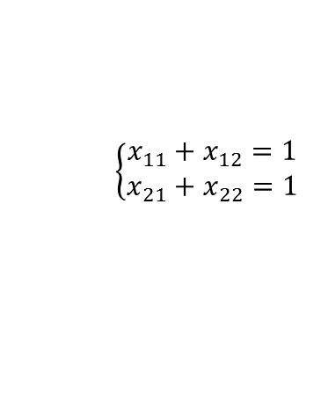
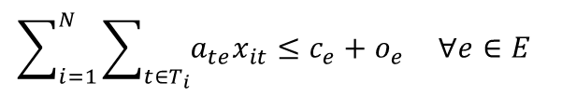
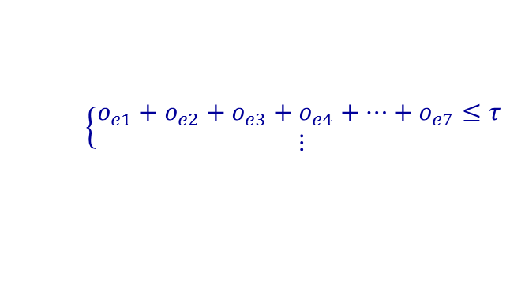
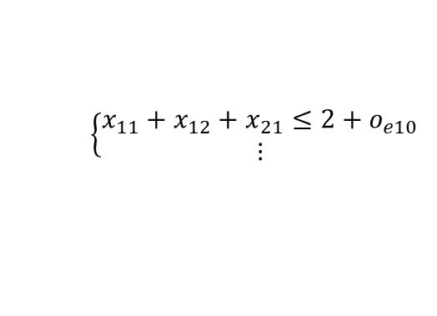
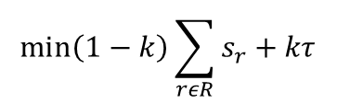

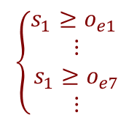

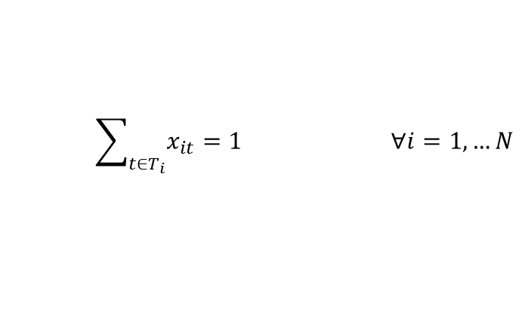
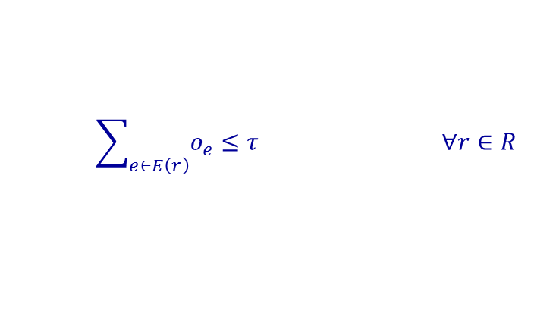
IP-CA: An IP for Congestion Analysis
$$\min\left(1−k\right)\left(s_{1}+s_{2}+s_{3}+s_{4}\right)+kτ$$
T₁
$\left\{\begin{aligned}x_{11}+x_{12}=1 \\ x_{21}+x_{22}=1\end{aligned}\right.$
$$\left\{\begin{aligned}x_{11}+x_{12}+x_{21}≤2+o_{e10} \\ ⋮\end{aligned}\right.$$
o₁₀
T₂
o₆
o₇
T₂
total overflow at each region
o₃
o₄
$$\left\{\begin{aligned}o_{e1}+o_{e2}+o_{e3}+o_{e4}+…+o_{e7}≤τ \\ ⋮\end{aligned}\right.$$
o₅
T₁
o₁
o₂
maximum overflow at each region
$$\left\{\begin{aligned}s_{1}≥o_{e1} \\ ⋮ \\ s_{1}≥o_{e7} \\ ⋮\end{aligned}\right.$$
$$\min\left(1−k\right)\sum_{rεR}{s_{r}+kτ}$$
$$\sum_{t∈T_{i}}{x_{it}=1 ∀i=1,…N}$$
Special case: k=0 and |R|=|E|
s_{r}=o_{e}
formulation minimizes TOF
simplifies to our GRIP work in [TCAD’11]
$$\sum_{i=1}^{N}{\sum_{t∈T_{i}}{{a_{te}x}_{it}≤c_{e}+o_{e} ∀e∈E }}$$
$$\sum_{e∈E\left(r\right)}{o_{e}≤τ ∀r∈R}$$
$$s_{r}≥o_{e } ∀r∈R, ∀e∈E(r)$$

Slide 8
CGRIP: Framework Overview
Solving IP-CA directly is impractical
Large problem size with binary variables
Our solution for realizing a fast procedure
Solve a reduced-sized and relaxed version of IP-CA as a Reduced Linear Program (RLP)
Effectively integrate RLP in a standard rip-up and reroute framework
Both INIT and RRR steps evoke RLP
2D projection
Initial solution (INIT)
(evokes RLP)
Rip-up and re-route (RRR)
(evokes RLP, MRSR)
No
no-OF or time-limit?
Yes
Congestion-aware Layer Assignment (CLA)

Slide 9


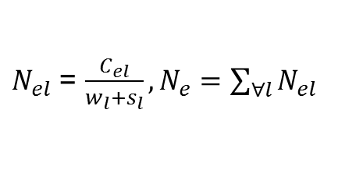







CGRIP: 2D Projection
Computing capacity of an edge in the projected 2D graph
Compute $N_{el}$, the normalized capacity for each edge on layer l from its capacity $C_{el}$ and add the 3D edge capacities corresponding to the same edge on the 2D projected grid-graph
Example:
Blockages are accounted for
See the ISPD 2011 contest website for details about blockage modeling
$$w_{l}$$
$$c_{el}$$
$$s_{l}$$
$N_{el}$ = $\frac{C_{el}}{w_{l}+s_{l}},N_{e}=\sum_{∀l}{N_{el}}$
$c_{e,l=2}$ = 80, $w_{l=2}=s_{l=2}=2$
$N_{e,l=2}$ = 20
$N_{e}$ = 60
$c_{e,l=1}$ = 80, $w_{l=1}=s_{l=1}=1$
$N_{e,l=1}$ = 40
80 80 80 80 80 80
80 40 40 40 80 80
80 0 0 0 40 80
80 0 0 0 0 80
80 80 80 80 80 80

Slide 10
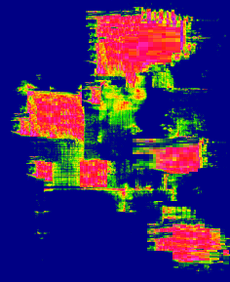
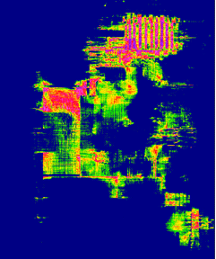
RLP: Overview
inputs
outputs
Approximate congestion map in the form of estimated utilization of each edge in the GR grid
A new routing solution per net
RLP: A reduced version of IP-CA with a subset of relaxed variables, (should generate an approximate solution in minutes)
Regions defined by the resolution parameter
Utilization of each edge in the grid graph
Edge costs during RRR
A small set of candidate routes per net

Slide 11
RLP: Procedure
Critical edges and nets
Estimated to have high overflow
Highly overlapping edges and nets allows having a meaningful optimization
Budget regions for 5K critical edges
critical nets and edges
Select 5K critical edges
Solve RLP: the reduced and relaxed IP-CA
dual
values of the edge capacity constraints
Utilization of the critical edges
Select 1K critical nets & up to 10 candidate routes per selected net
Route for the critical nets
greedy heuristic
Utilization of remaining edges
Adjust edge capacities for the impact of the remaining nets
Route for remaining nets

Slide 12
INIT: Procedure
Decompose multi-terminal nets
Two-terminal subnets using MST*
Solve RLP to generate initial solution
2D projection
Initial solution (INIT)
(evokes RLP)
candidate routes
Rip-up and re-route (RRR)
(evokes RLP)
Maze routing (1)
used to approximate congestion to identify critical nets and edges
No
no-OF or time-limit?
RLP
Pattern routing** (4)
Yes
Congestion-aware Layer Assignment (CLA)
*Similar to FGR [TCAD’08], BFGR [ISPD’10] and NTUgr [ASPDAC’09]
**Similar to Sidewinder [SLIP’08]

Slide 13
RRR: Procedure
Solve RLP to estimate utilization of each GR grid edge
Takes the solution of previous RRR iteration (or INIT in the first RRR) to find critical nets and edges
Uses up to 10 candidate routes from the solutions of the previous RRR iterations
Order nets based on estimated overflow using the route generated by RLP
Apply Multiple Rip-up Single Reroute* (MRSR) in the first iterations to improve speed
Apply Single Rip-up Single Reroute* in remaining iterations
* A user-defined bounding-box constraint can be provided to restrict how scenic each net is routed
Update edge utilization
(evokes RLP)
Order decomposed nets
Improved overflow by MRSR in previous RRR?
Yes
No
(MRSR)
(SRSR)
Multiple Rip-up Single Reroute for all overflow nets
Single Rip-up Single Reroute for all overflow nets

Slide 14

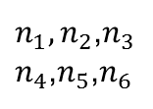




Multiple Rip-up Single Reroute
Subnets of different nets often have the terminals mapping to the same vertices in the GR grid graph
In the first step of RRR for superblue1, 595K nets out of 1409K can be removed by MRSR
n1
n2
$$n_{1},n_{2}$$
$$n_{3},n_{4}$$
G1:
P1
P2
3
n4
p2
n1
n2
n3
$n_{1},n_{2}$,$n_{3}$
$n_{4}$,$n_{5}$,$n_{6}$
n3
p1
n5
Util. Factor
n6
G2:
P1
P2
1
p3
n4
$n_{5}$,$n_{6}$
G2
$G_{1}$,$G_{2}$
G3:
P1
P3
2
G1
p2
n6
n5
$G_{1}$,$G_{2}\text{,}G_{3}$
p1
G3
p3
# of sub-nets = 6
Average edge capacity = 3
$$G_{3}$$

Slide 15
CGRIP: Layer Assignment
Steiner points of each 2D route after merging its two-terminal subnets are identified and cycles removed
Eliminates the inaccuracy introduced by the overlapping subnets
Subnets are sorted based on the number of bends
Greedy layer assignment such that
wirelength and overflow are minimized
different wire size per layer is considered
virtual pins are connected
2D projection
Initial solution (INIT)
(evokes RLP)
Rip-up and re-route (RRR)
(evokes RLP)
No
no-OF or time-limit?
Yes
Congestion-aware Layer Assignment (CLA)
Notes:
Hamid this is unclear. Do you have one 3 terminal net in this figure? Your sentence “Steiner point … are identified” is unclear

Slide 16
About coalesCgrip
For the variation used to judge the ISPD 2011 contest on routability-driven placement
Uses FGR for 5 minutes to generate an initial solution (INIT step)
Changed FGR to handle the new benchmark formats considering wire size and spacing, virtual pins, blockages, etc.
Runs a simpler version of CGRIP for an additional 10 minutes
Maximum resolution (number of regions equal to the edge in the GR grid-graph)
Uses RLP but for IP-CA which minimizes the total overflow
Uses a different net ordering during RRR
Does not have the MRSR step
Has a less accurate edge cost update during RRR
CGRIP updates the edge history within an RRR iteration
Lacks several enhancements in the data structures

Slide 17
Simulations Configuration
Both coalesCgrip and CGRIP support the new bookshelf format used in the ISPD 2011 benchmark suites
Has different wire sizes and spacings for 9 metal layers
Non-rectangular cells and routing obstacles
Virtual pins located at the higher metal layers
Bench | Nodes | Terminals | Terminal_NI | Nets | X x Y
superblue1 | 847441 | 52627 | 29712 | 822744 | 704x516
superblue2 | 1014029 | 59312 | 33444 | 990899 | 770x1114
superblue4 | 600220 | 40550 | 38204 | 567607 | 467x415
superblue5 | 772457 | 74365 | 20676 | 786999 | 774x713
superblue10 | 1129144 | 153595 | 60628 | 1085737 | 638x968
superblue12 | 1293433 | 8953 | 6396 | 1293436 | 444x518
superblue15 | 1123963 | 252053 | 42296 | 1080409 | 399x495
superblue18 | 483452 | 25063 | 15984 | 468918 | 381x404

Slide 18
1) Minimizing Total Overflow (TOF)
Bench | Placer | coalesCgrip |  | CGRIP
 |  | TOF | WL(*10 -5) | TOF | WL(*10 -5) | TOF Imp.%
superblue1 | SimPLR | 0 | 150.24 | 0 | 150.91 | 0
superblue2 | Ripple | 797898 | 307.73 | 138544 | 317.83 | 82.64
superblue4 | Ripple | 85538 | 108.57 | 2968 | 111.51 | 96.53
superblue5 | Ripple | 126186 | 172.86 | 28676 | 176.32 | 77.27
superblue10 | RADIANT | 616742 | 250.16 | 112720 | 256.55 | 81.72
superblue12 | SimPLR | 415428 | 228.85 | 35954 | 241.56 | 91.35
superblue15 | Ripple | 125936 | 179.11 | 14052 | 185.19 | 88.84
superblue18 | mPL11 | 31440 | 98.44 | 0 | 102.4 | 100
Took placement instances from the ISPD 2011 contest website
Used maximum resolution in CGRIP to minimize TOF
15 minutes runtime budget for both coalesCgrip and CGRIP
TOF is improved by 72% compared to coalesCgrip

Slide 19
Impact of the Features in CGRIP
Bench | Total Overflow (TOF) |  |  | % improvement
 | w/o RLP and MRSR | with MRSR (w/o RLP) | with RLP (w/o MRSR) | %MRSR Imp. | %RLP Imp.
superblue1 | 0 | 0 | 0 | 0.0 | 0.0
superblue2 | 435816 | 207270 | 135490 | 34.6 | 68.9
superblue4 | 22438 | 2586 | 2506 | 3.1 | 88.8
superblue5 | 34972 | 23798 | 12842 | 46.0 | 63.3
superblue10 | 162022 | 123904 | 110742 | 10.6 | 31.7
superblue12 | 94136 | 103176 | 35954 | 65.2 | 61.8
superblue15 | 46114 | 21040 | 14364 | 31.7 | 68.9
superblue18 | 0 | 0 | 0 | 0.0 | 0.0
avg. |  |  |  | 23.9 | 47.9

Slide 20
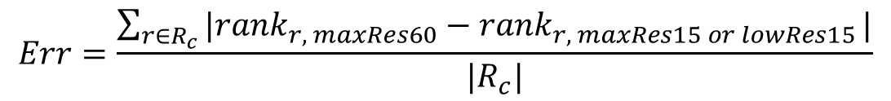
2) Ranking the Congestion Hotspots
Ran CGRIP in three modes:
maxRes60: minimizing TOF with a time budget of 60 minutes
maxRes15: minimizing TOF with a time-budget of 15 minutes
lowRes15: regional minimization of overflow for r_{x}xr_{y}=15x15 regions with a time-budget of 15 minutes
In all cases, all nets were forced to be routed within 110% of their bounding boxes
Defined an error metric to evaluate the congestion map of each case
Took maxRes60 as reference
Identified critical regions Rc with non-zero overflow
Ranked the critical regions in descending degree of overflow within a region
$$Err=\frac{\sum_{r∈R_{c}}{|{rank}_{r, maxRes60}−{rank}_{r, maxRes15 or lowRes15}}|}{|R_{c}|}$$

Slide 21
2) Ranking the Congestion Hotspots
% Err
TOF
lowRes15 always provides a better ranking
Average error of lowRes15 is 8.6% but maxRes15 is 14%
despite both having a 110% constraint for controlling how scenic each net is routed
maxRes15 has a slightly better overflow than lowRes15

Slide 22
Recommended CGRIP Usage for Routability-Driven Placement
Congestion estimation during routability-driven placement: use CGRIP with a lower resolution (e.g. resolution = 10)
Should have a better layout matching
Let us know how it went and give us feedback to add more APIs
Routability-Driven Placement
Congestion Estimation using CGRIP
Option 1:
CGRIP with a low resolution
Option 2:
CGRIP with maximum resolution
minimization of TOF

Slide 23
Conclusions and Future Works
Conclusions
Showed minimizing total overflow is not a good objective for a short runtime of a congestion analysis tool
Proposed a new IP formulation and its practical realization to regionally minimize overflow and obtain a fast, stable and flexible routing congestion analysis tool
On-going efforts
Integrating CGRIP with different routability-driven placers
to better understand the needs of different placers to improve the analysis and generate a more useful interface
Considering other factors that contribute to congestion such as local congestion inside a global bin and the effects of vias
Both CGRIP and coalesCgrip are available for download http://homepages.cae.wisc.edu/~adavoodi/gr/cgrip.htm

