Slide 1

Planning for Local Net Congestion in Global Routing
Hamid Shojaei, Azadeh Davoodi,
and Jeffrey Linderoth*
Department of Electrical and Computer Engineering
*Department of Industrial and Systems Engineering
University of Wisconsin-Madison
WISCAD Electronic Design Automation Lab http://wiscad.ece.wisc.edu

Slide 2
Motivation
Observation: in the placement solutions of winners of ISPD11 contest on routability-driven placement, on average 31.20% of (decomposed) nets are local
Issues with local nets
Local nets are not captured during global routing (GR) → create mismatch between GR and detailed routing (DR) stages
Local nets consume wire tracks and block access to the pins
especially in combination with other routability issues such as those captured in the ISPD 11 benchmarks: variations in wire sizes over the metal layers & virtual pins (→ local nets in higher layers?)
Local net
(local) connection of pins which falls completely inside a single global cell (gcell)
Increase in the number of local nets
due to higher pin density, e.g., complex standard cells

Slide 3
Contributions
Planning for local nets during GR
Reduce the number local nets
using non-uniform binning (i.e., non-uniform gcell generation from uniform)
Approximate routing usage of local nets in the graph model of GR
using vertex capacity in addition to edge capacities
An Integer (Linear) Program formulation and GR graph model with the above two planning techniques
as well as layer-specific wire size/spacing and virtual pins
Integration with CGRIP for a practical tool
extensions to various stages in CGRIP to accommodate the above planning techniques
Both the formulation and the final tool capture (1) variation in wire size/spacing per layer; (2) virtual pins in higher layers; (3) routing blockage; (4) non-uniform bins; (5) global routing with vertex and edge capacities simultaneously

Slide 4
Putting in Perspective
Goals of congestion analysis during GR
Model as many factors which contribute to routing congestion
Factors which can fairly accurately be modeled at the GR stage
such as variations in wire sizes over the metal layers and virtual pins
Factors which may only be approximated during GR and are only known during DR in a conventional design flow
such as local nets
This work focuses on goal 1b (while capturing goal 1a)

Slide 5
Putting in Perspective
Goals of congestion analysis during GR
Fast identification of unroutable regions on the layout for feedback to placement with as high resolution as possible
Need point of reference to claim a location is unroutable
Unroutable with respect to congestion map created at the DR stage?
Note, this claim only be accurate if both items 1a & 1b are considered
Or unroutable with respect to the global router running much longer duration
Our prior work CGRIP focused on goal 2 (while capturing goal 1a)
For a small analysis time budget, CGRIP identifies unroutable regions with “lower resolution”
modeled by introducing a new objective for the GR stage (i.e., regional minimization of overflow controlled by an input resolution parameter)
CGRIP: Shojaei, Davoodi, Lindeorth, “Congestion Analysis for Global Routing Using Integer Programming”, ICCAD’11

Slide 6
Binning Procedure
Binning procedure
given
an existing grid for GR with uniform gcells with certain offset with respect to the placement grid
cell pin locations specified with respect to the placement grid graph
output
GR grid with non-uniform gcells
features
trades off increase in global nets with decrease in local nets
increases the GR effort but in turn decreases the error associated with approximating or ignoring local nets
an input parameter allows controlling this tradeoff
GR grid remains the same
as far as size (i.e., number of gcells) and topology of the GR graph (i.e., grid) and the offset with respect to the placement grid
changes in the graph model of GR are reflected in the weights of the edges and vertex which relate to capacity and wirelength

Slide 7
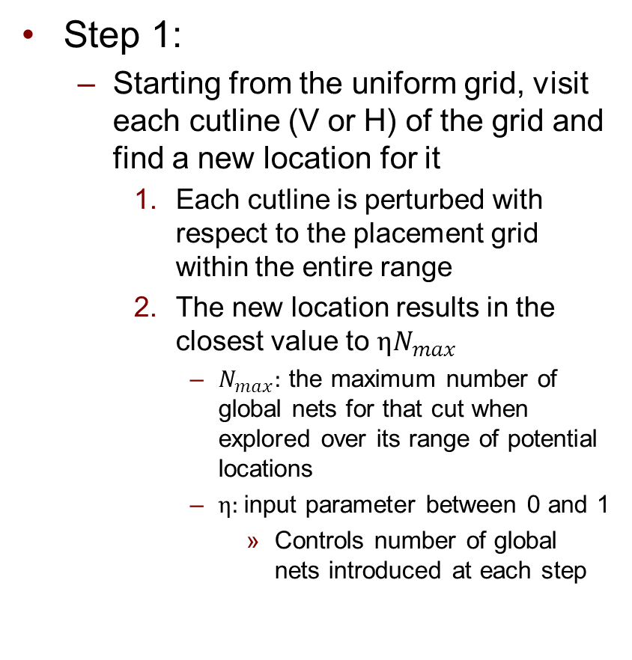
Binning Procedure
Step 1:
Starting from the uniform grid, visit each cutline (V or H) of the grid and find a new location for it
Each cutline is perturbed with respect to the placement grid within the entire range
The new location results in the closest value to $ηN_{max}$
$N_{max}:$ the maximum number of global nets for that cut when explored over its range of potential locations
$η:$input parameter between 0 and 1
Controls number of global nets introduced at each step
Example
uniform
non-uniform
# of global nets: 2
# of local nets: 6
# of global cells: 9
1
1
3
0
0
1
1
0
1
1 1 4 1 2
0 0 0 2
# of global nets: 8
# of local nets: 0
# of global cells: 9

Slide 8
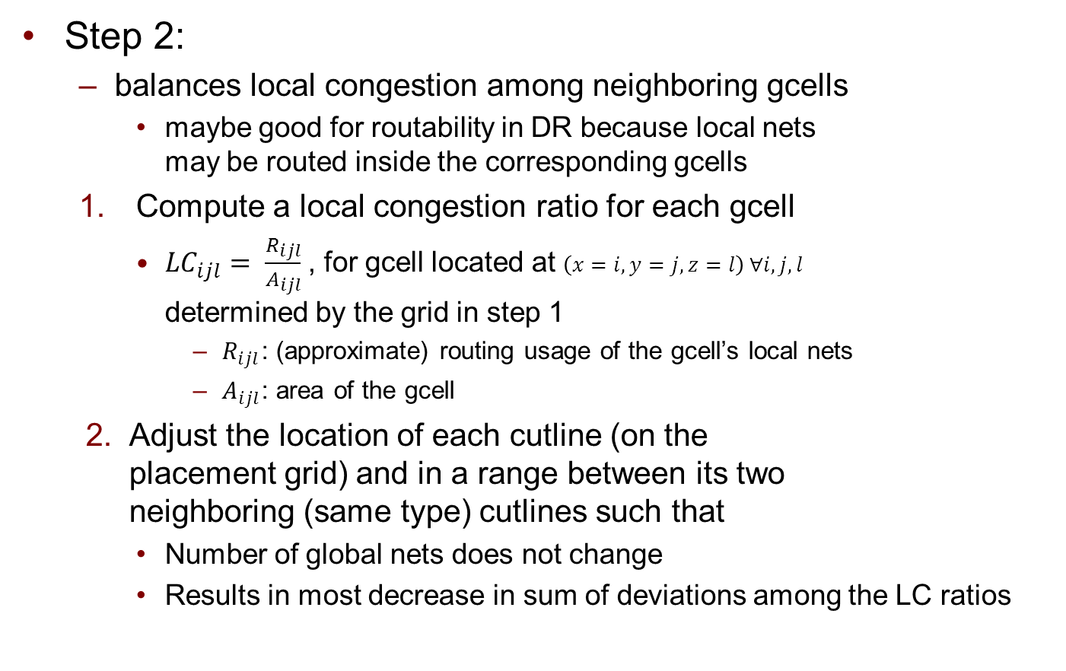
Binning Procedure
Step 2:
balances local congestion among neighboring gcells
maybe good for routability in DR because local nets may be routed inside the corresponding gcells
Compute a local congestion ratio for each gcell
${LC}_{ijl}= \frac{R_{ijl}}{A_{ijl}}$, for gcell located at $\left(x=i,y=j,z=l\right) ∀i,j,l$ determined by the grid in step 1
$R_{ijl}$: (approximate) routing usage of the gcell’s local nets
$A_{ijl}$: area of the gcell
Adjust the location of each cutline (on the placement grid) and in a range between its two neighboring (same type) cutlines such that
Number of global nets does not change
Results in most decrease in sum of deviations among the LC ratios

Slide 9
Binning Procedure
Summary
Step 1 is more aggressive than step 2
In the presence of many routing blockages step 1 may not be appropriate
e.g., in superblue 10 (of ISPD11 benchmarks) over 67% of the first four metal layers are routing blockages
Currently, in our framework, we only apply step 1 if the amount of routing blockage compared to the total chip area is below 50%
Otherwise step 2 is solely applied
This strategy works for ISPD11 benchmarks based on our experiments
For other cases not captured by these benchmarks, e.g., design with more complex routing blockages and containing various sized macros, it would be interesting to apply the non-uniform binning (selectively) to only some “appropriate” regions on the layout

Slide 10
GR Graph Model: Motivation
GR graph model with local nets
assuming routing resource usage of local nets inside a gcell is somehow approximated*
Reduce the corresponding edge capacities (i.e., number of routes passing from the gcell boundaries)
Our proposal: Use a vertex capacity reflecting the reduced routing resource available inside each gcell along with unreduced edge capacities
Comparison
Approach 1 restricts the search space and may yield to suboptimal solutions while approach 2 does not result in any restrictions
we show it does not add further complexity to a standard rip-up and reroute process
24
6
24
16
24
6
6
6
24
4
4
4
4
24
16
6
24
6
6
6
24
24
Focus of “GLARE: global and local wiring aware routability evaluation”, DAC12

Slide 11




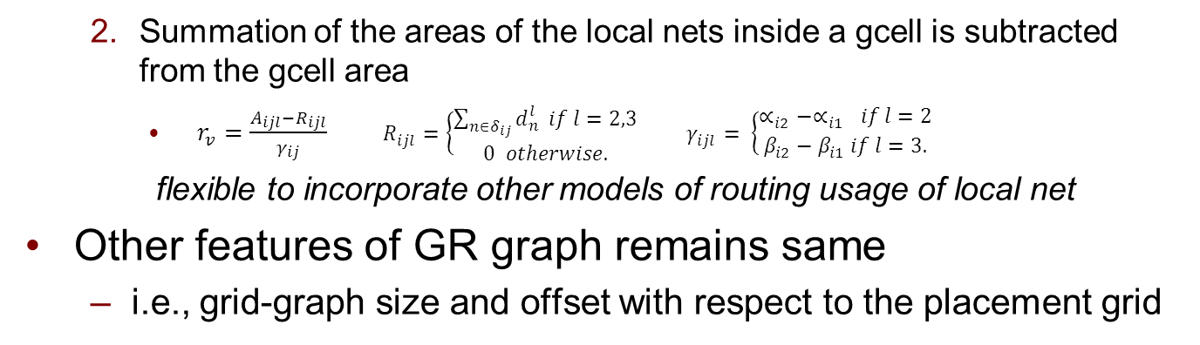
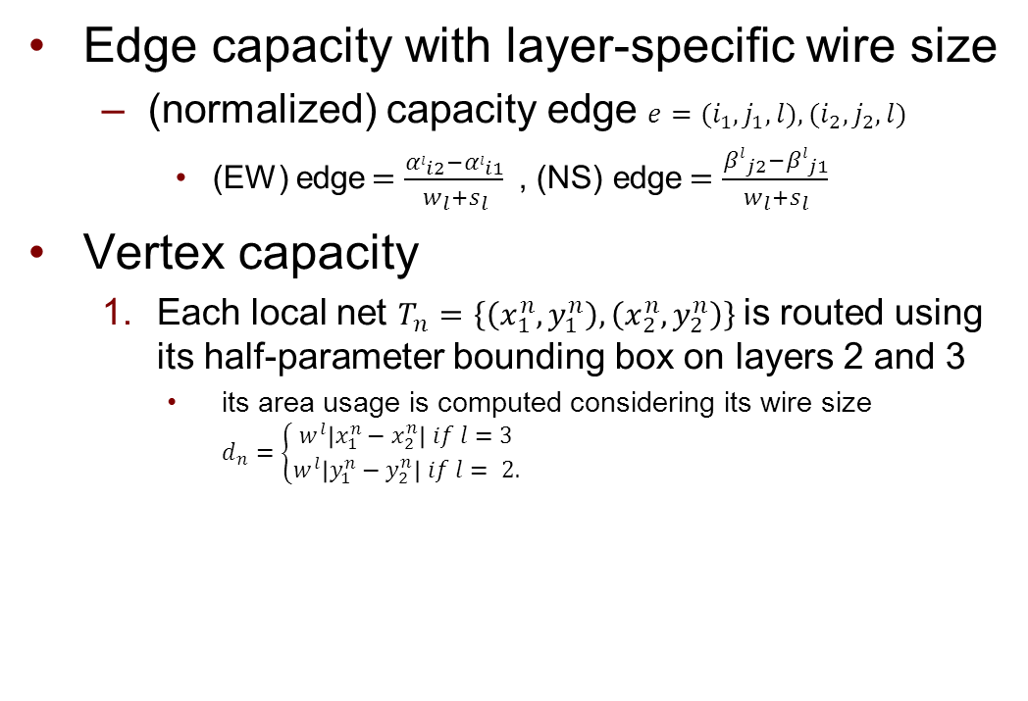
GR Graph Model
Edge capacity with layer-specific wire size
(normalized) capacity edge ${e=(i}_{1},j_{1},l),{(i}_{2},j_{2},l)$
(EW) edge$=\frac{α_{li2}−α_{li1}}{w_{l}+s_{l}}$ , (NS) edge$=\frac{{βl}_{j2}−{βl}_{j1}}{w_{l}+s_{l}}$
Vertex capacity
Each local net $T_{n}=\left\{\left(x_{1}^{n},y_{1}^{n}\right),\left(x_{2}^{n},y_{2}^{n}\right)\right\}$is routed using its half-parameter bounding box on layers 2 and 3
its area usage is computed considering its wire size $d_{n}=\left\{\begin{aligned}w^{l}\left|x_{1}^{n}−x_{2}^{n}\right| if l=3 \\ w^{l}\left|y_{1}^{n}−y_{2}^{n}\right| if l= 2.\end{aligned}\right.$
α^{l}_{i1}
α^{l}_{i2}
β^{l}_{i2}
β^{l}_{i1}
Summation of the areas of the local nets inside a gcell is subtracted from the gcell area
$r_{v}=\frac{A_{ijl}−R_{ijl}}{γ_{ij}} R_{ijl}=\left\{\begin{aligned}\sum_{n∈δ_{ij}}{d_{n}^{l}} if l=2,3 \\ 0 otherwise.\end{aligned} \right. γ_{ijl}= \left\{\begin{aligned}∝_{i2}−∝_{i1} if l=2 \\ β_{i2}−β_{i1} if l=3.\end{aligned}\right.$
flexible to incorporate other models of routing usage of local net
Other features of GR graph remains same
i.e., grid-graph size and offset with respect to the placement grid

Slide 12
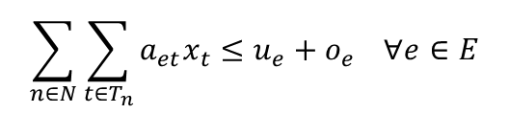
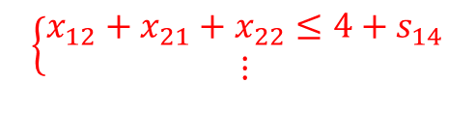
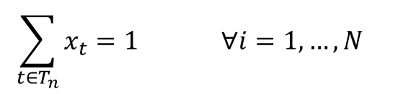

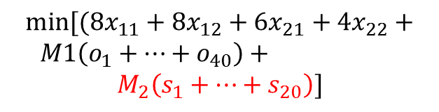

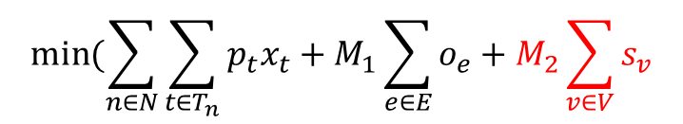
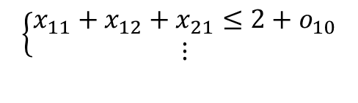
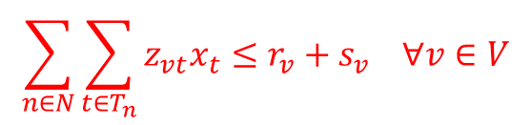
Integer Program Formulation
$$u_{e}=2 r_{v}=4$$
$$min⁡[(8x_{11}+8x_{12}+6x_{21}+4x_{22}+$$
$M1\left(o_{1}+…+o_{40}\right)+$
$$M_{2}\left(s_{1}+…+s_{20}\right)]$$
T₁
$$\left\{\begin{aligned}x_{11}+x_{12}=1 \\ x_{21}+x_{22}=1\end{aligned}\right.$$
o₁₀
s₁₄
S₂
T₂
$$\left\{\begin{aligned}x_{11}+x_{12}+x_{21}≤2+o_{10} \\ ⋮\end{aligned}\right.$$
$$\left\{\begin{aligned}x_{12}+x_{21}+x_{22}≤4+s_{14} \\ ⋮\end{aligned}\right.$$
S₁
$$min⁡(\sum_{n∈N}{\sum_{t∈T_{n}}{p_{t}x_{t}+M_{1}\sum_{e∈E}{o_{e}}+M_{2}\sum_{v∈V}{s_{v}}}}$$
This IP is extension of the one in CGRIP when using maximum resolution
(Shown for uniform binning, only for demonstration but IP handles generic (non-uniform) case)
$$\sum_{t∈T_{n}}{x_{t}=1} ∀i=1,…,N$$
$$\sum_{n∈N}{\sum_{t∈T_{n}}{a_{et}x_{t}≤u_{e}+o_{e} ∀e∈E}}$$
$$\sum_{n∈N}{\sum_{t∈T_{n}}{z_{vt}x_{t}≤r_{v}+s_{v} ∀v∈V}}$$

Slide 13
CGRIP: Overview of Framework
Solves RLP
a reduced-sized and relaxed version of Integer Program formulation
Significant amount of reduction in overflow of CGRIP is due to RLP
Integration of RLP in a standard rip-up and reroute framework
RLP is formed by selection of very small subset of “critical” variables
Selection changes at each iteration of RRR based on the latest RRR routing solution
2D projection
Initial solution (INIT)
(evokes RLP)
Rip-up and re-route (RRR)
(evokes RLP)
No
no-OF or time-limit?
Yes
Congestion-aware Layer Assignment (CLA)

Slide 14
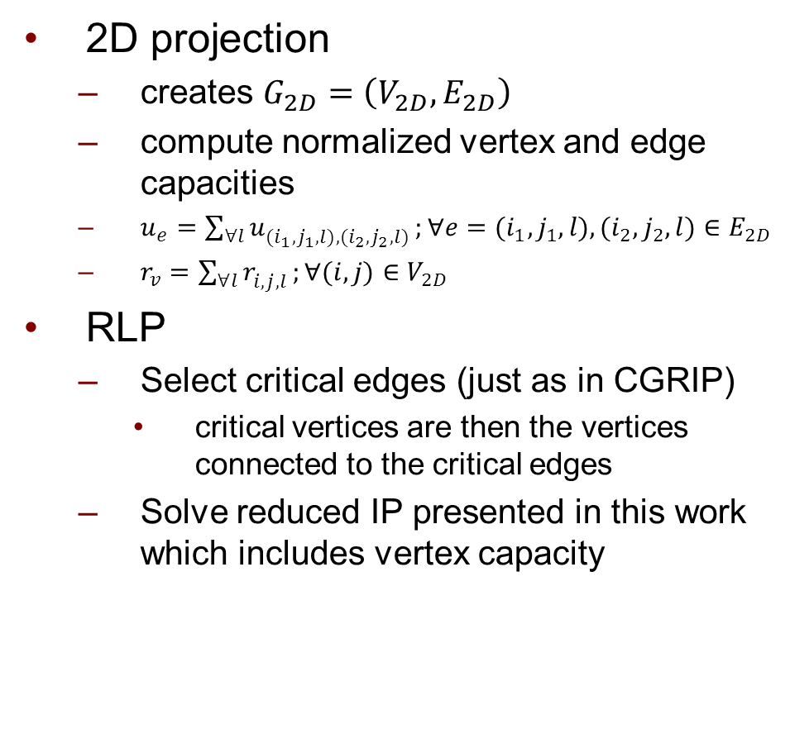
Integration with CGRIP
2D projection
creates $G_{2D}=\left(V_{2D},E_{2D}\right)$
compute normalized vertex and edge capacities
$u_{e}=\sum_{∀l}{u_{{(i}_{1},j_{1},l),{(i}_{2},j_{2},l)}^{}};{∀e=(i}_{1},j_{1},l),{(i}_{2},j_{2},l)∈E_{2D}$
$r_{v}=\sum_{∀l}{r_{i,j,l}^{}};∀(i,j)∈$ $V_{2D}$
RLP
Select critical edges (just as in CGRIP)
critical vertices are then the vertices connected to the critical edges
Solve reduced IP presented in this work which includes vertex capacity
2D projection
Initial solution (INIT)
(evokes RLP)
Rip-up and re-route (RRR)
(evokes RLP)
No
no-OF or time-limit?
Yes
Congestion-aware Layer Assignment (CLA)

Slide 15
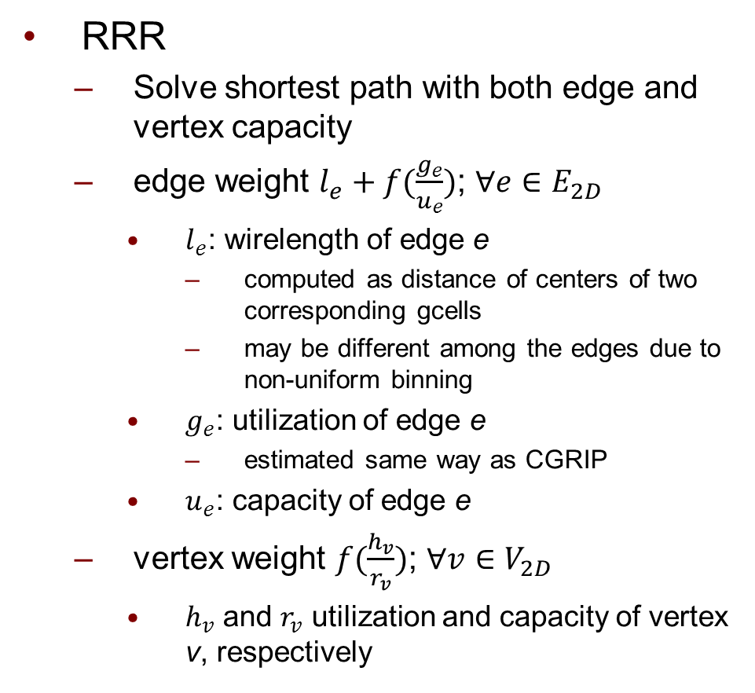
Integration with CGRIP
RRR
Solve shortest path with both edge and vertex capacity
edge weight $l_{e}+f(\frac{g_{e}}{u_{e}})$; $∀e∈E_{2D}$
$l_{e}$: wirelength of edge e
computed as distance of centers of two corresponding gcells
may be different among the edges due to non-uniform binning
$g_{e}$: utilization of edge e
estimated same way as CGRIP
$u_{e}$: capacity of edge e
vertex weight $f(\frac{h_{v}}{r_{v}})$; $∀v∈V_{2D}$
$h_{v}$ and $r_{v}$ utilization and capacity of vertex v, respectively
2D projection
Initial solution (INIT)
(evokes RLP)
Rip-up and re-route (RRR)
(evokes RLP)
No
no-OF or time-limit?
Yes
Congestion-aware Layer Assignment (CLA)

Slide 16
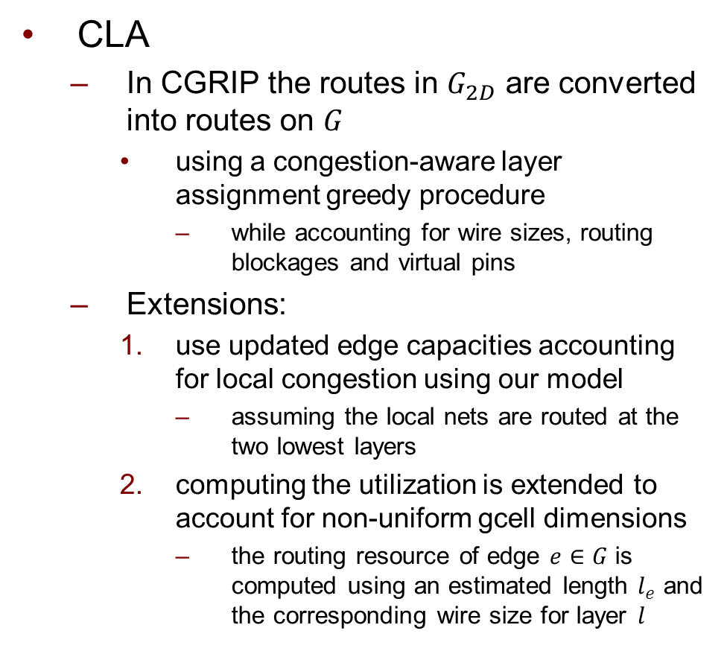
Integration with CGRIP
CLA
In CGRIP the routes in $G_{2D}$ are converted into routes on $G$
using a congestion-aware layer assignment greedy procedure
while accounting for wire sizes, routing blockages and virtual pins
Extensions:
use updated edge capacities accounting for local congestion using our model
assuming the local nets are routed at the two lowest layers
computing the utilization is extended to account for non-uniform gcell dimensions
the routing resource of edge $e∈G$ is computed using an estimated length $l_{e}$ and the corresponding wire size for layer $l$
2D projection
Initial solution (INIT)
(evokes RLP)
Rip-up and re-route (RRR)
(evokes RLP)
No
no-OF or time-limit?
Yes
Congestion-aware Layer Assignment (CLA)

Slide 17
Simulation Setup
Experimented with the ISPD 2011 benchmarks
Have large number of local nets when using the winning solutions from ISPD 2011 contest on routability-driven placement
Design | X x Y | # Nets | # 2T-Nets | %LC Uniform Non-uniform
superblue1 | 704x516 | 822744 | 2038444 | 30.8 | 14.1
superblue2 | 770x1114 | 990899 | 2237446 | 28.9 | 13.5
superblue4 | 467x415 | 567607 | 1316401 | 35.2 | 16.8
superblue5 | 774x713 | 786999 | 1713307 | 29.4 | 12.2
superblue10 | 638x968 | 1085737 | 2579974 | 34.1 | 34.0
superblue12 | 444x518 | 1293436 | 3480633 | 28.6 | 14.6
superblue15 | 399x495 | 1080409 | 2736271 | 34.4 | 15.8
superblue18 | 381x404 | 468918 | 1395388 | 28.2 | 15.0
average |  |  |  | 31.2% | 17.0%

Slide 18
Simulation Setup
Experimented with the following variations
U-E (CGRIP): Uniform grid with Edge capacity only
U-AE: Uniform grid with Adjusted Edge capacity
no vertex capacity
U-AV: Uniform grid with Adjusted Vertex capacity
with (unreduced edge capacity)
NU-AV (LCGRIP): Non-Uniform grid with Adjusted Vertex capacity
similar to U-AV but with non-uniform global cells
For each variation we allow our framework to run until there is no further overflow improvement
24
24
16
24
24
6
6
6
6
4
4
4
4
24
16
6
24
6
6
6
24
24

Slide 19
Simulation Setup
Detailed routing emulator
There is no way to pass a GR solution as input to a commercial DR
We implemented our own detailed routing emulator for validation
visits the gcells sequentially on a 2D projected model
applies one iteration of RRR to route the nets inside each gcell
reflects immediate picture right at the beginning of the DR stage
n2
n5
n1
n3
n1
n1
n2
n6
n7
n5
n2
n6
n7
n5
n3

Slide 20
Simulation Setup
Evaluation metrics
GR-OF: overflow of GR with un-adjusted capacities
DR-OF: total overflow computed by our detailed routing emulator
GR-WL
In NU-AV, the wirelength is computed while accounting for non-uniform gcells for fair comparison
an edge in NU-AV which is twice than an edge in U-E due to non-uniform gcells is counted as 2 units of wirelength

Slide 21
Simulation Results: Overflow
Design | U-E (CGRIP) | U-AE | U-AV | NU-AV (LCGRIP)
superblue1 | 0 | 0 | 0 | 0
superblue2 | 3168 | 14496 | 10526 | 7756
superblue4 | 228 | 2024 | 880 | 420
superblue5 | 0 | 322 | 0 | 448
superblue10 | 124 | 4502 | 872 | 766
superblue12 | 0 | 274 | 302 | 12232
superblue15 | 0 | 1022 | 846 | 2582
superblue18 | 0 | 0 | 0 | 0
average | 1.0X | 6.4X | 3.8X | 6.9X
GR-OF
Design | U-E (CGRIP) | U-AE | U-AV | NU-AV (LCGRIP)
superblue1 | 23142 | 23020 | 12740 | 806
superblue2 | 18880 | 18506 | 13154 | 9140
superblue4 | 28696 | 27476 | 13296 | 888
superblue5 | 10878 | 9256 | 2588 | 1032
superblue10 | 84842 | 73862 | 66780 | 65232
superblue12 | 44556 | 44416 | 36414 | 15566
superblue15 | 29982 | 29800 | 18886 | 7922
superblue18 | 11406 | 11184 | 558 | 444
average | 1.0x | 0.9x | 0.7x | 0.4x
DR-OF
The GR-WL of U-AE, U-AV, NU-AV are up to 1% larger than U-E

Slide 22
Simulation Results: Runtime (min)
Design | U-E (CGRIP) | U-AE | U-AV | NU-AV (LCGRIP)
superblue1 | 3 | 7 | 5 | 7
superblue2 | 352 | 321 | 303 | 381
superblue4 | 180 | 60 | 201 | 62
superblue5 | 135 | 184 | 164 | 220
superblue10 | 251 | 341 | 329 | 342
superblue12 | 238 | 360 | 309 | 302
superblue15 | 212 | 269 | 259 | 221
superblue18 | 10 | 20 | 16 | 10
average | 1.0X | 1.1X | 1.1X | 1.1X
GR-T
Design | U-E (CGRIP) | U-AE | U-AV | NU-AV (LCGRIP)
superblue1 | 28 | 21 | 18 | 7
superblue2 | 22 | 17 | 17 | 16
superblue4 | 39 | 25 | 25 | 10
superblue5 | 42 | 33 | 24 | 4
superblue10 | 62 | 51 | 32 | 33
superblue12 | 41 | 42 | 37 | 22
superblue15 | 34 | 24 | 19 | 11
superblue18 | 32 | 20 | 15 | 9
average | 1.0X | 0.8X | 0.6X | 0.4X
DR-T
Increase in effort in GR results in significant decrease in (single iteration) DR

Slide 23
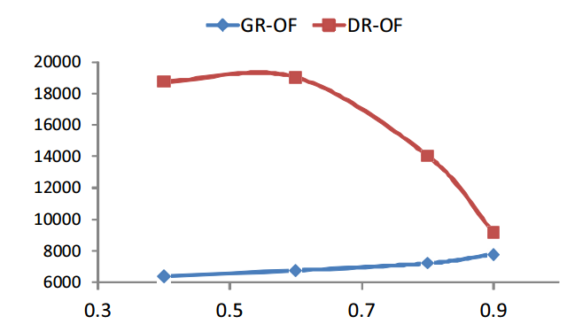


Tradeoff with $η$
Tradeoff in DR-OF and GR-OF with input parameter $η$ in Superblue2

Slide 24
Conclusions
Proposed two techniques for considering local nets
reducing the number of local nets by non-uniform binning
approximating their routing usage by adding a vertex capacity
Our work can consider other models of local net routing usage in a gcell as long as it can be translated into a single usage number
this modeling was not the main focus of our work
Showed significant reduction in the detailed routing effort using our emulator
traded off with increase in effort in the global routing stage
Other factors contributing to unroutability (i.e. wire sizes, routing blockages, virtual pins) also important
should be considered along with local nets
(See paper for details of related experiment)

Slide 25
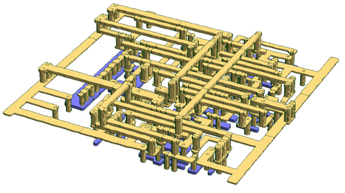
Thank You
Visit CGRIP’s page for more information:
http://homepages.cae.wisc.edu/~adavoodi/gr/cgrip.htm
or google “CGRIP”
Notes:
25

