Slide 1

Rethinking Global Routing: Congestion Reduction and Multiobjective Optimization
PhD Defense Exam on 05/21/2012
Hamid Shojaei
Department of Electrical and Computer Engineering
University of Wisconsin, Madison
WISCAD VLSI Design Automation Lab http://wiscad.ece.wisc.edu

Slide 2
Outline
Introduction
CGRIP
LCGRIP
Summary
Conclusions
Introduction
CGRIP
A framework for routing congestion analysis
LCGRIP
Planning for local congestion in global routing
Summary of contributions
Conclusions

Slide 3

Standard Global Routing
Introduction
CGRIP
LCGRIP
Summary
Conclusions
Objectives of standard global routing
Serves as a critical step after placement
Provides coarse routes for detailed routing
Provides congestion map for placement
Partitioning
Floorplanning
Placement
Global Routing
GR
Detailed Routing
Timing Closure

Slide 4
Standard Global Routing
Introduction
CGRIP
LCGRIP
Summary
Conclusions
Design after Placement
Design after Detailed Routing
C1
n1
n2
C2
C1
n5
n3
n1
n2
C2
n5
n3
n1
n5
n1
n5
n4
n2
C3
n4
n2
C3
n1
n4
n1
n4
n5
n3
n5
n3
Design after Global Routing
C1
n1
n2
C2
n5
n3
n1
n5
C3
n4
n2
n1
n4
n5
n3

Slide 5
Global Routing Grid Graph
Introduction
CGRIP
LCGRIP
Summary
Conclusions
n2
n5
C2
n1
n3
C1
n5
n3
n1
n2
n1
n1
n5
n1
n2
C3
n5
n1
n4
n4
n2
n5
n3
n5
n3
Vias

Slide 6
Global Routing Grid Graph
Introduction
CGRIP
LCGRIP
Summary
Conclusions
n2
n5
C2
n1
n3
C1
n5
n3
n1
n2
n1
n1
n5
n1
n2
C3
n5
n1
n4
n4
n2
n5
n3
n5
n3
Routes are trees on the grid graph
Local nets (e.g. n4) are ignored

Slide 7












Global Routing Grid Graph
Introduction
CGRIP
LCGRIP
Summary
Conclusions
Horizontal global cell
Vertical global cell
β_{i+2}
$$c_{e}$$
β_{i+1}
$$c_{e}$$
β_{i}
α_{i}
α_{i+1}
α_{i+2}
edge capacity $c_{e}=α_{i+1}−α_{i}$
edge capacity $c_{e}=β_{i+1}−β_{i}$
normalized capacity: $b_{e}=\frac{c_{e}}{w_{l}+s_{l}}$
edge utilization: $u_{e}$= # of wires that pass edge
normalized overflow $o_{e}=$ $\max\left(0, u_{e}−b_{e}\right)$
Overflow!!
actual overflow: $r_{e}= o_{e}×(w_{l}+s_{l})$

Slide 8
Rethinking Global Routing
Introduction
CGRIP
LCGRIP
Summary
Conclusions
Standard Flow
Proposed Flow
Congestion Analysis for Modern Designs
CGRIP
Placement
Placement
Congestion-aware
Global Routing
LCGRIP
Other Global Routers
Global Routing
Detailed Routing
Multi-objective
Global Routing
Coll-MGR
Covered in prelim exam
Detailed Routing

Slide 9
CGRIP: A Framework for Routing Congestion Analysis
in Modern Designs
Placement
Congestion Analysis for Modern Designs
CGRIP
Congestion-aware
Global Routing
LCGRIP
Other Global Routers
Multi-objective
Global Routing
Coll-MGR
Detailed Routing

Slide 10
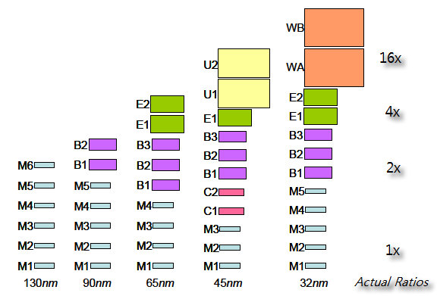
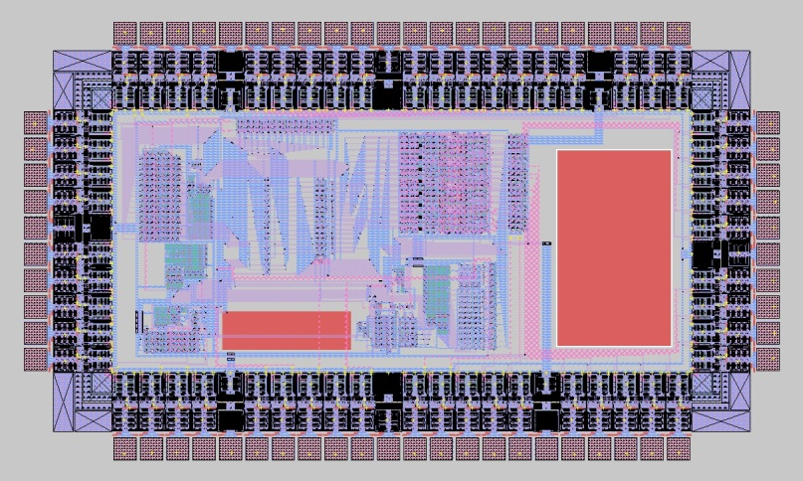
Goals of Congestion Analysis
Introduction
CGRIP
LCGRIP
Summary
Conclusions
Captures factors that contribute to congestion in modern design
Variations in wire size and spacing at different metal layers
Virtual pins located at the higher metal layers
Routing blockages, reserved for embedded IPs and memories
Requires handling a flexible model of global routing
(Alpert et al. DAC2010)

Slide 11
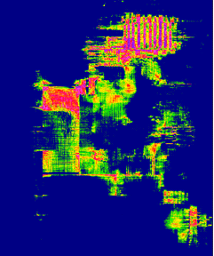

Goals of Congestion Analysis
Introduction
CGRIP
LCGRIP
Summary
Conclusions
Creates an accurate congestion map
Accurately identifies the locations of the congested “regions” on the layout and the amount of congestion at each location
Runs fast to allow iterative calls when integrated within the design flow, e.g., with routability-driven placement
Routability-driven Placement
Congestion
Analysis

Slide 12
Contributions
Introduction
CGRIP
LCGRIP
Summary
Conclusions
An Integer Programming (IP) formulation expressing “the congestion analysis problem”
Allows finding the locations of the congested regions using a resolution parameter
New ideas for a practical realization of the IP
Reduced-sized Linear Programming (RLP)
Multiple Ripup Single Re-route (MRSR)
Congestion-aware Minimum Spanning Tree for multi-terminal net deomposition (CMST)
Congestion-aware Layer Assignment (CLA)
CGRIP: congestion analysis tool
Stable, fast, flexible router, handling complicating factors
Simpler variation, coalesCgrip, judged the ISPD 2011 contest
Released at http://wiscad.ece.wisc.edu/gr/cgrip

Slide 13
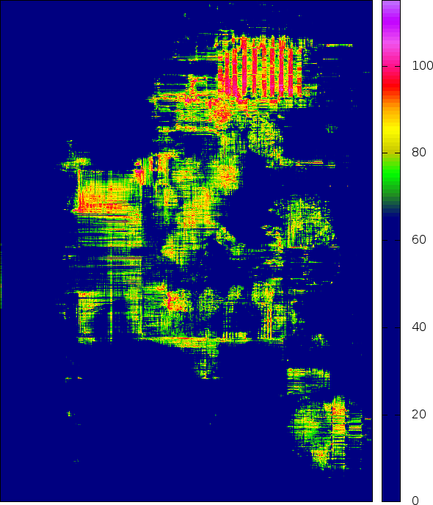
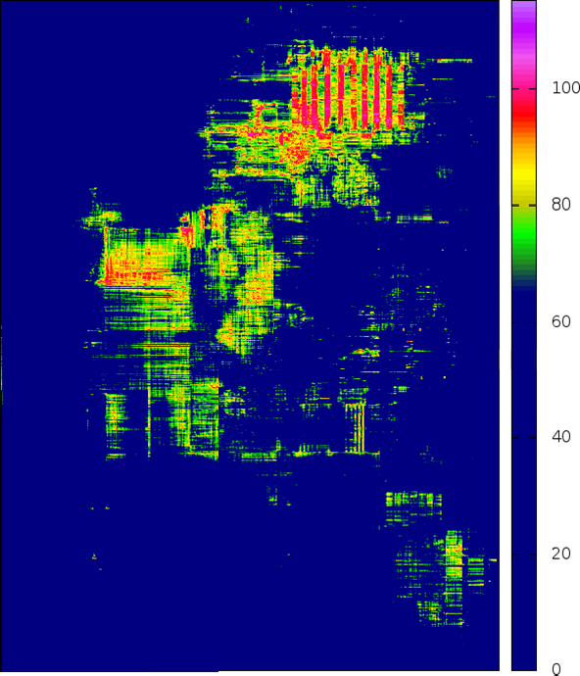
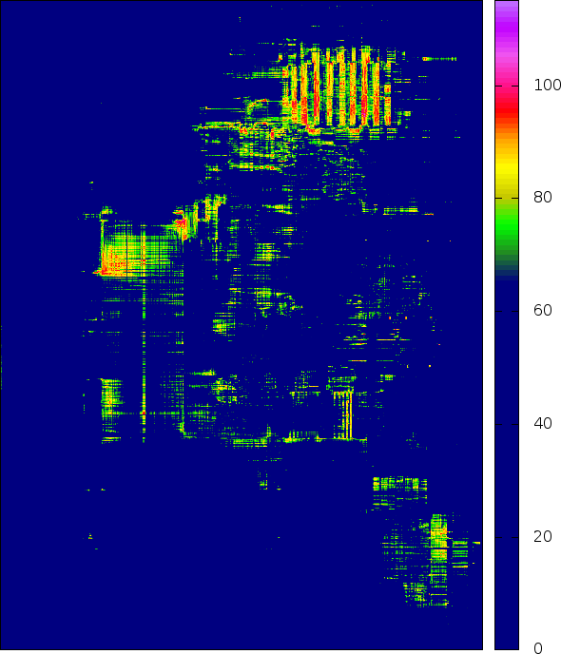
Motivational Example
Introduction
CGRIP
LCGRIP
Summary
Conclusions
To quickly obtain an accurate congestion map, what is an effective optimization objective?
Example: ran different variations of CGRIP on a placement of superblue2
Case (a) minimizes TOF in a short time i.e., 15 minutes
Case (b) regionally minimizes overflow in a short time, 15 minutes on 100 regions
Case (c) minimizes TOF in a long time, i.e., 60 minutes
Maps (a) and (b) have similar TOF, however map (b) is more accurately matching (c) in terms of the locations of highly-utilized edges on the GR grid-graph
15min
15min
60min
(reference)
(a) TOF=329K
(b) TOF=330K
(c) TOF=64K (reference)
(c) TOF=64K
Notes:
For each map only edges with a utilization higher than 70% is shown

Slide 14
Motivational Example
Introduction
CGRIP
LCGRIP
Summary
Conclusions
To quickly obtain an accurate congestion map, what is an effective optimization objective?
Minimizing TOF is NOT a good objective within a short runtime budget
Router prioritizes different regions based on its ripup and re-route procedure, typically to get maximum reduction in TOF
May not have the chance to optimize some regions in a short run but this is not an indication of unroutability since the same router could fix these regions for a longer run
15min
15min
60min
(reference)
(a) TOF=329K
(b) TOF=330K
(c) TOF=64K (reference)
(c) TOF=64K

Slide 15
Defining Regions
Introduction
CGRIP
LCGRIP
Summary
Conclusions
Two input resolution parameters control the size and the number of regions
For a small time-budget
Resolution is set to be much lower than the global routing grid
Identification of the congestion regions is with respect to the granularity defined by the regions rather than each edge of the GR grid-graph and thus can be done more accurately
r_{y}=2
# regions = 6
r_{x} =3

Slide 16
Overlapping Regions
Introduction
CGRIP
LCGRIP
Summary
Conclusions
r3
r4
r3
r4
r5
r1
r2
r1
r2
(a)
(b)
(c)
In (a) r1-r4 are equally ranked in terms of congestion
The location of the congested region is not identified accurately
Adding the overlapping region r5 in (b) allows capturing the location of the congested region more accurately

Slide 17

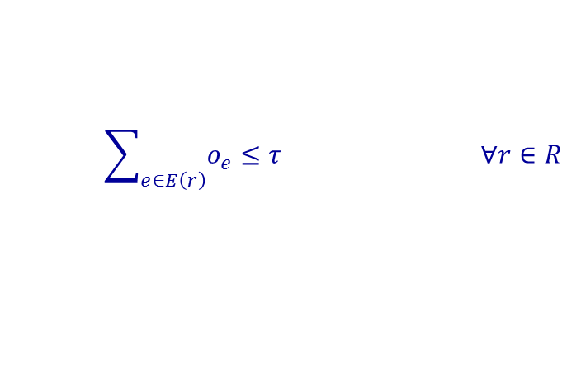


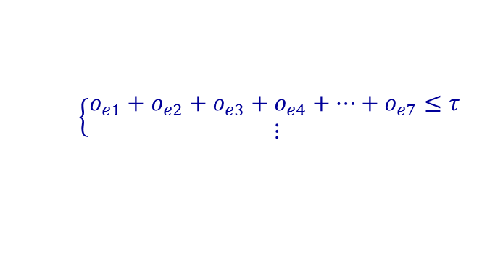

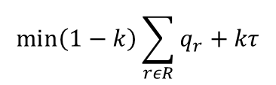
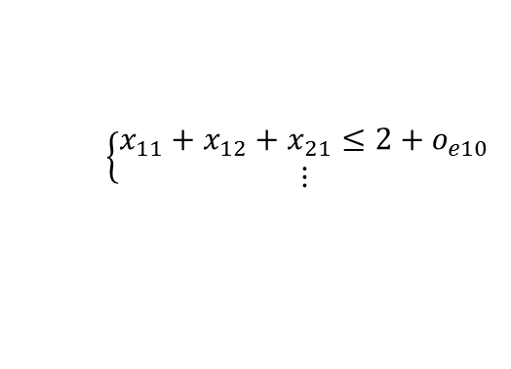
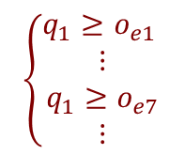
IP-CA: An IP for Congestion Analysis
Introduction
CGRIP
LCGRIP
Summary
Conclusions
$$b_{e}=2$$
$$\min\left(1−k\right)\left(q_{1}+q_{2}+q_{3}+q_{4}\right)+kτ$$
T₁
$\left\{\begin{aligned}x_{11}+x_{12}=1 \\ x_{21}+x_{22}=1\end{aligned}\right.$
$$\left\{\begin{aligned}x_{11}+x_{12}+x_{21}≤2+o_{e10} \\ ⋮\end{aligned}\right.$$
o₁₀
S₂
o₆
o₇
T₂
total overflow at each region
o₃
o₄
$$\left\{\begin{aligned}o_{e1}+o_{e2}+o_{e3}+o_{e4}+…+o_{e7}≤τ \\ ⋮\end{aligned}\right.$$
o₅
S₁
o₁
o₂
maximum overflow at each region
$$\left\{\begin{aligned}q_{1}≥o_{e1} \\ ⋮ \\ q_{1}≥o_{e7} \\ ⋮\end{aligned}\right.$$
$$\min\left(1−k\right)\sum_{rεR}{q_{r}+kτ}$$
$$\sum_{t∈T_{i}}{x_{it}=1 ∀i=1,…N}$$
Special case: k=0 and |R|=|E|
q_{r}=o_{e}
Formulation minimizes TOF (GRIP [TCAD’11])
$$\sum_{i=1}^{N}{\sum_{t∈T_{i}}{{a_{te}x}_{it}≤b_{e}+o_{e} ∀e∈E }}$$
$$\sum_{e∈E\left(r\right)}{o_{e}≤τ ∀r∈R}$$
$$q_{r}≥o_{e } ∀r∈R, ∀e∈E(r)$$

Slide 18
CGRIP: Framework Overview
Introduction
CGRIP
LCGRIP
Summary
Conclusions
Solving IP-CA directly is impractical
Large problem size with binary variables
Our solution for realizing a fast procedure
Solve a reduced-sized and relaxed version of IP-CA as a Reduced Linear Program (RLP)
Effectively integrate RLP in a standard ripup and re-route framework
Both INIT and RRR steps evoke RLP
Other new features added to the standard ripup and re-route framework
Accounting for wire size and spacing and virtual pins for each metal layer in 2D projection and CLA steps
2D projection
Initial solution (INIT)
(evokes RLP)
Ripup and re-route (RRR)
(evokes RLP)
No
Terminate?
Yes
Congestion-aware Layer Assignment (CLA)

Slide 19
CGRIP: 2D Projection
Introduction
CGRIP
LCGRIP
Summary
Conclusions
Computing normalized capacity of an edge in the projected 2D graph
The normalized capacity of a 2D edge is summation of normalized capacities of corresponding edges in the 3D graph
Accounts for routing blockages
b=1
2x
1x
b=3
b=2

Slide 20
CGRIP: Framework Overview
Introduction
CGRIP
LCGRIP
Summary
Conclusions
Solving IP-CA directly is impractical
Large problem size with binary variables
Our solution for realizing a fast procedure
Solve a reduced-sized and relaxed version of IP-CA as a Reduced Linear Program (RLP)
Effectively integrate RLP in a standard ripup and re-route framework
Both INIT and RRR steps evoke RLP
Other new features added to the standard ripup and re-route framework
Accounting for wire size and spacing and virtual pins for each metal layer in 2D projection and CLA steps
2D projection
Initial solution (INIT)
(evokes RLP)
Ripup and re-route (RRR)
(evokes RLP)
No
Terminate?
Yes
Congestion-aware Layer Assignment (CLA)

Slide 21
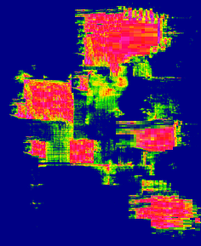
RLP: Overview
Introduction
CGRIP
LCGRIP
Summary
Conclusions
inputs
outputs
Previous congestion map
Updated congestion map
RLP: A reduced version of IP-CA with a subset of relaxed variables, generates an approximate solution in minutes
A small set of candidate routes per net
A new routing solution per net
Regions defined by the resolution parameter

Slide 22


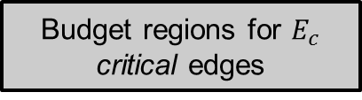

RLP: Procedure
Introduction
CGRIP
LCGRIP
Summary
Conclusions
Budget regions for $E_{c}$ critical edges
critical nets and edges
Select $E_{c}$critical edges
Solve RLP: the reduced and relaxed IP-CA
Utilization of the critical edges from dual values
Select $N_{C}$ critical nets & up to 10 candidate routes per selected net
Route for the critical nets
greedy heuristic
Utilization of all the edges
Adjust edge capacities for the impact of the remaining nets
Route for all the nets
$E_{c}$ and $N_{C}$ are set to be 5k and 1k

Slide 23
INIT: Procedure
Introduction
CGRIP
LCGRIP
Summary
Conclusions
Decompose multi-terminal nets into two-terminal subnets
Solve RLP to generate initial solution
2D projection
Initial solution (INIT)
(evokes RLP)
candidate routes
Maze routing (1)
used to approximate congestion to identify critical nets and edges
Ripup and re-route (RRR)
(evokes RLP)
RLP
No
Terminate?
Pattern routing (4)
Yes
Congestion-aware Layer Assignment (CLA)

Slide 24

RRR: Procedure
Introduction
CGRIP
LCGRIP
Summary
Conclusions
Standard RRR
Proposed RRR
Order decomposed nets
Update edge utilization
(evokes RLP)
Order decomposed nets
SRSR
Single Ripup Single Re-route
Improved overflow
by MRSR
in previous RRR
?
yes
no
Multiple Ripup
Single Re-route
MRSR
SRSR
Improved overflow
by SRSR?
Congestion-aware Minimum
Spanning Tree
for net decomposition
no
CMST

Slide 25


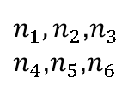



Multiple Ripup Single Re-route
Introduction
CGRIP
LCGRIP
Summary
Conclusions
Subnets of different nets often have the terminals mapping to the same vertices in the GR grid graph
In the first step of RRR for benchmark superblue1, 595K nets out of 1409K can be removed by MRSR
n1
n2
$$n_{1},n_{2}$$
$$n_{3},n_{4}$$
G1:
P1
P2
3
n4
p2
n1
n2
n3
$n_{1},n_{2}$,$n_{3}$
$n_{4}$,$n_{5}$,$n_{6}$
n3
p1
n5
Utilization Factor
n6
G2:
P1
P2
1
p3
n4
$n_{5}$,$n_{6}$
G2
G3:
P1
P3
2
$G_{1}$,$G_{2}$
n6
n5
G1
p2
$G_{1}$,$G_{2}\text{,}G_{3}$
p1
G3
# of sub-nets = 6
Average edge capacity = 3
p3
$$G_{3}$$

Slide 26

Congestion-aware Net Decomposition
Introduction
CGRIP
LCGRIP
Summary
Conclusions
Standard MST
Congestion-aware MST

Slide 27
CGRIP: Layer Assignment
Introduction
CGRIP
LCGRIP
Summary
Conclusions
Removes overlap between subnets
For each net assigns 2D edges into 3D
Maze routing procedure
Minimizes wirelength and overflow
Accounts for
Varying wire sizes and spacing
Virtual pins located on higher layers
Routing blockages
2D projection
Initial solution (INIT)
(evokes RLP)
Ripup and re-route (RRR)
(evokes RLP)
No
Terminate?
Yes
Congestion-aware Layer Assignment (CLA)
Notes:
Hamid this is unclear. Do you have one 3 terminal net in this figure? Your sentence “Steiner point … are identified” is unclear

Slide 28

About coalesCgrip
Introduction
CGRIP
LCGRIP
Summary
Conclusions
The variation of CGRIP used to judge the ISPD 2011 contest on routability-driven placement
Uses FGR [TCAD’08] to generate an initial solution (INIT step)
Runs a simpler variation of CGRIP after initial solution
Maximum resolution
Uses RLP but for IP-CA which minimizes the total overflow
Does not have the MRSR and CMST steps
Uses a greedy approach for layer assignment
CGRIP
coalesCgrip

Slide 29
Simulation Setup
Introduction
CGRIP
LCGRIP
Summary
Conclusions
Both coalesCgrip and CGRIP support the new bookshelf format used in the ISPD 2011 benchmark suites
Has different wire sizes and spacings for 9 metal layers
Non-rectangular cells and routing obstacles
Virtual pins located at the higher metal layers
Design | Nodes | Terminals | Terminal_NI | Nets | X x Y
superblue1 | 847441 | 52627 | 29712 | 822744 | 704x516
superblue2 | 1014029 | 59312 | 33444 | 990899 | 770x1114
superblue4 | 600220 | 40550 | 38204 | 567607 | 467x415
superblue5 | 772457 | 74365 | 20676 | 786999 | 774x713
superblue10 | 1129144 | 153595 | 60628 | 1085737 | 638x968
superblue12 | 1293433 | 8953 | 6396 | 1293436 | 444x518
superblue15 | 1123963 | 252053 | 42296 | 1080409 | 399x495
superblue18 | 483452 | 25063 | 15984 | 468918 | 381x404

Slide 30
1) Minimizing Total Overflow (TOF)
Introduction
CGRIP
LCGRIP
Summary
Conclusions
Design | Placer | coalesCgrip |  | CGRIP
 |  | TOF | WL | TOF | WL | TOF Imp.%
superblue1 | SimPLR | 0 | 150.24 | 0 | 151.14 | 0.00
superblue2 | Ripple | 797898 | 307.73 | 115332 | 330.14 | 85.55
superblue4 | Ripple | 85538 | 108.57 | 1414 | 114.38 | 98.35
superblue5 | Ripple | 126186 | 172.86 | 20252 | 180.56 | 83.95
superblue10 | RADIANT | 616742 | 250.16 | 59306 | 267.84 | 90.38
superblue12 | SimPLR | 415428 | 228.85 | 35298 | 243.16 | 91.50
superblue15 | Ripple | 125936 | 179.11 | 12832 | 192.17 | 89.81
superblue18 | mPL11 | 31440 | 98.44 | 0 | 104.34 | 100.00
Took placement instances from the ISPD 2011 contest website
Used maximum resolution in CGRIP to minimize TOF
15 minutes runtime budget for both coalesCgrip and CGRIP
TOF is improved by 80% compared to coalesCgrip
* WL should be scaled up to 10^5

Slide 31
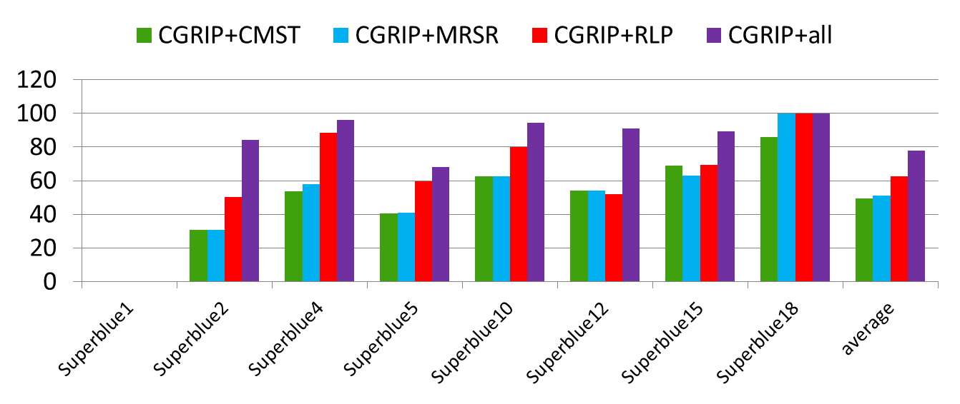
1) Impact of Features in CGRIP
Introduction
CGRIP
LCGRIP
Summary
Conclusions
% overflow Improvement
Compared to CGRIP-all
CMST, MRSR, and RLP on average can improve OF by 49%, 51%, and 63%
CGRIP+all in average improves OF by 78%

Slide 32

2) Ranking the Congested Regions
Introduction
CGRIP
LCGRIP
Summary
Conclusions
Ran CGRIP in three modes:
maxRes60: minimizing TOF with a time budget of 60 minutes
maxRes15: minimizing TOF with a time-budget of 15 minutes
lowRes15: regional minimization of overflow for r_{x}xr_{y}=10x10 regions with a time-budget of 15 minutes and in two modes:
NOV: no overlap between regions
OV: overlap between regions

Slide 33
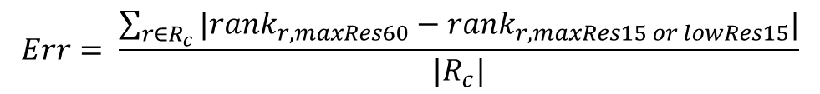
2) Ranking the Congested Regions
Introduction
CGRIP
LCGRIP
Summary
Conclusions
Evaluated the solution of each case by:
Imposing a 10x10 resolution and ranking the resulting regions based on descending overflow in each case
Took maxRes60 as reference
Identified critical regions Rc with non-zero overflow and their ranks
Evaluated the accuracy of maxRes15 and lowRes15 by this metric
$$Err= \frac{\sum_{r∈R_{c}}{|{rank}_{r,maxRes60}−{rank}_{r,maxRes15 or lowRes15}|}}{|R_{c}|}$$

Slide 34
2) Ranking the Congested Regions
Introduction
CGRIP
LCGRIP
Summary
Conclusions
% Err for NOV
% Err for OV
lowRes15 always provides a better ranking than maxRes15
OV always provides a better ranking than NOV

Slide 35
LCGRIP: Planning for Local Net Congestion
in Global Routing
Placement
Congestion Analysis for Modern Designs
CGRIP
Congestion-aware
Global Routing
LCGRIP
Other Routers
Multi-objective
Global Routing
Coll-MGR
Detailed Routing

Slide 36
Congestion Impact of Local Nets
Introduction
CGRIP
LCGRIP
Summary
Conclusions
Modern designs have high pin density translating to high number of local nets
In ISPD11 benchmarks, 31.20% of nets are local
Local nets consume wire track and block access to pins
Local nets are ignored in standard global routing
They can cause serious routability issues at the detailed routing stage
It is desirable to have a global router that comprehensively
accounts for congestion impact of local nets
in addition to the previously-mentioned factors

Slide 37

LCGRIP: Contributions
Introduction
CGRIP
LCGRIP
Summary
Conclusions
To deal with local nets
A procedure to generate non-uniform global cells to reduce the number of local nets while keeping the number of global cells intact
A technique to approximate area required for routing local nets and adjust the area of affected global cells
A complete graph model and IP formulation that
Accounts for non-uniform global cells
Includes vertex capacity in addition to edge capacity to address resource usage by local nets
Accounts for other complicating factors that are supported by CGRIP
Integration with CGRIP

Slide 38
LCGRIP: Framework Overview
Introduction
CGRIP
LCGRIP
Summary
Conclusions
Binning Procedures
New graph and IP model with edge and vertex capacities
A framework to support new graph and new formulation
Detailed routing emulator
for validation

Slide 39
Binning Procedure
Introduction
CGRIP
LCGRIP
Summary
Conclusions
uniform
# of global nets: 2
# of local nets: 6
# of global cells: 9
(a)
(b)
non-uniform
# of global nets: 8
# of local nets: 0
# of global cells: 9
1
1
3
0
0
0
1
1
0
1
1 1 4 1 2
0 0 0 0 2
(c)
(d)
(e)

Slide 40
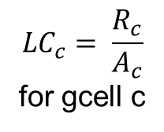
Local Congestion Balancing
Introduction
CGRIP
LCGRIP
Summary
Conclusions
0.125
0.0
0.0
0.0
0.125
0.1
0.0
0.1
0.1
0.1
$${LC}_{c}= \frac{R_{c}}{A_{c}}$$
for gcell c
0.0
0.0
0.375
0.375
0.0
0.0
0.0
0.33
0.33
0.0
0.0
0.0
0.0
0.0
0.0
0.0
0.0
0.0
0.0
0.0
0.125
0.0
0.125
0.0
0.125
0.125
0.0
0.125
0.0
0.125
average: 0.196
deviation: 3.26
(b) average: 0.160
deviation : 2.17
0.1
0.0
0.1
0.1
0.1
0.1
0.0
0.1
0.1
0.1
0.0
0.0
0.25
0.25
0.0
0.0
0.0
0.25
0.25
0.0
0.0
0.0
0.125
0.125
0.0
0.0
0.0
0.1
0.1
0.0
0.1
0.0
0.1
0.0
0.1
0.125
0.0
0.125
0.0
0.125
(d) average: 0.130
deviation: 1.63
(c) average: 0.134
deviation: 1.67

Slide 41
New Graph Model
Introduction
CGRIP
LCGRIP
Summary
Conclusions
Β₃= Y
β₂
β₁
β₀
n2
n5
C1
C2
n1
n3
n1
n1
n2
C3
n5
0
n5
α₀ α₁ α₂ α₃=X
n3
b_{e}
r_{v}
The size of the grid graph does not change
The normalized edge capacities remain the same
Corresponding to gcells of non-uniform size
Vertex capacity is introduced
Based on approximation of routing resource usage of each local net

Slide 42
New Graph Model
Introduction
CGRIP
LCGRIP
Summary
Conclusions
Β₃= Y
β₂
β₁
β₀
n2
n5
C1
C2
n1
n3
n1
n1
n2
C3
n5
0
n5
α₀ α₁ α₂ α₃=X
n3
b_{e}
r_{v}
To approximate resource usage by local nets
Each local net is routed on its half-parameter bounding box on layers 2 and 3
The area usage of each local net is computed considering its wire size
Then summation of the areas of the local nets inside a gcell is subtracted from the gcell area

Slide 43
Example
Introduction
CGRIP
LCGRIP
Summary
Conclusions
24
6
24
24
6
6
16
6
24
Graph model without considering local congestion
24
4
6
24
16
24
4
4
6
6
4
6
edge capacity adjustment
24
edge and vertex capacity

Slide 44

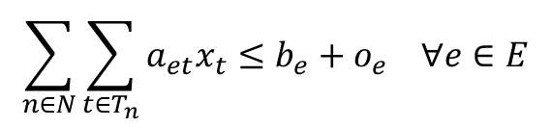
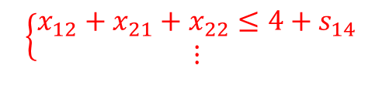
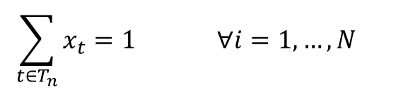

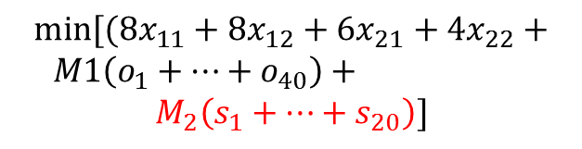

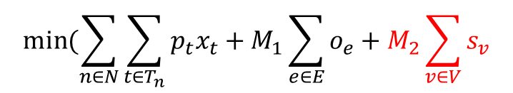
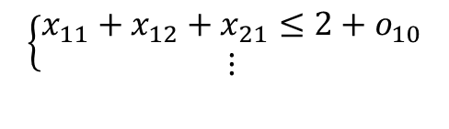

IP-LC: An IP for Local Congestion
Introduction
CGRIP
LCGRIP
Summary
Conclusions
$$b_{e}=2 r_{v}=4$$
$$min⁡[(8x_{11}+8x_{12}+6x_{21}+4x_{22}+$$
$M1\left(o_{1}+…+o_{40}\right)+$
$$M_{2}\left(s_{1}+…+s_{20}\right)]$$
T₁
$$\left\{\begin{aligned}x_{11}+x_{12}=1 \\ x_{21}+x_{22}=1\end{aligned}\right.$$
o₁₀
s₁₄
S₂
T₂
$$\left\{\begin{aligned}x_{11}+x_{12}+x_{21}≤2+o_{10} \\ ⋮\end{aligned}\right.$$
$$\left\{\begin{aligned}x_{12}+x_{21}+x_{22}≤4+s_{14} \\ ⋮\end{aligned}\right.$$
S₁
$$min⁡(\sum_{n∈N}{\sum_{t∈T_{n}}{p_{t}x_{t}+M_{1}\sum_{e∈E}{o_{e}}+M_{2}\sum_{v∈V}{s_{v}}}}$$
$$\sum_{t∈T_{n}}{x_{t}=1} ∀i=1,…,N$$
$$\sum_{n∈N}{\sum_{t∈T_{n}}{a_{et}x_{t}≤b_{e}+o_{e} ∀e∈E}}$$
$$\sum_{n∈N}{\sum_{t∈T_{n}}{z_{vt}x_{t}≤r_{v}+s_{v} ∀v∈V}}$$

Slide 45

LCGRIP: Integration with CGRIP
Introduction
CGRIP
LCGRIP
Summary
Conclusions
2D Projection
Similar to edge capacities, 2D vertex capacities are computed by adding their corresponding 3D vertex capacities
Reduced-sized linear programming (RLP)
Based on formulation with vertex capacity (IP-LC)
Ripup and re-route (RRR)
The shortest path algorithm considers both vertex and edge weights
Congestion-aware layer assignment (CLA)
Wirelength minimization is based on gcells with non-uniform sizes
LCGRIP
CGRIP

Slide 46
Simulation Setup
There is no detailed router that supports global routing solution
We implemented a detailed routing emulator for validation
Visits the gcells sequentially
Applies one iteration of RRR to route the nets inside each gcell
n2
n5
n1
n3
n1
n1
n2
n6
n7
n5
n2
n6
n7
n5
n3

Slide 47
Simulation Setup
Introduction
CGRIP
LCGRIP
Summary
Conclusions
ISPD 2011 benchmarks
Released as challenging benchmarks for routability
Have large number of local nets when using the winning solutions from ISPD 2011 contest on routability-driven placement
Design | X x Y | # Nets | # 2T-Nets | %LC Uniform Non-uniform
superblue1 | 704x516 | 822744 | 2038444 | 30.8 | 14.1
superblue2 | 770x1114 | 990899 | 2237446 | 28.9 | 13.5
superblue4 | 467x415 | 567607 | 1316401 | 35.2 | 16.8
superblue5 | 774x713 | 786999 | 1713307 | 29.4 | 12.2
superblue10 | 638x968 | 1085737 | 2579974 | 34.1 | 34.0
superblue12 | 444x518 | 1293436 | 3480633 | 28.6 | 14.6
superblue15 | 399x495 | 1080409 | 2736271 | 34.4 | 15.8
superblue18 | 381x404 | 468918 | 1395388 | 28.2 | 15.0
average |  |  |  | 31.2% | 17.0%

Slide 48

Simulation Setup
Introduction
CGRIP
LCGRIP
Summary
Conclusions
Global Routing Variations
U-E: Uniform grid with Edge capacity only
It is identical to CGRIP
U-AE: Uniform grid with Adjusted Edge capacity
Similar to U-E but edge capacities are reduced based on the local nets in corresponding global cells
U-AV: Uniform grid with Adjusted Vertex capacity
Similar to U-E but we also consider vertex capacities
NU-AV: Non-Uniform grid with Adjusted Vertex capacity
Similar to U-AV but here the global cells are not uniform
NU-AV includes all the proposed features
6
6
6
6
4
4
4
4
24
6
16
24
6
6
24
6
24

Slide 49
Simulation Setup
Introduction
CGRIP
LCGRIP
Summary
Conclusions
For each variation we allow our framework to run until there is no further overflow improvement
Used as a congestion-aware global router that optimizes overflow as much as possible
Evaluation metrics
GR-OF: overflow of GR with un-adjusted capacities
DR-OF: total overflow computed by detailed routing emulator
GR-T: runtime of global routing
DR-T: runtime of detailed routing

Slide 50
Comparison of Evaluation Metrics
Introduction
CGRIP
LCGRIP
Summary
Conclusions
Design | U-E | U-AE | U-AV | NU-AV
superblue1 | 0 | 0 | 0 | 0
superblue2 | 3168 | 14496 | 10526 | 7756
superblue4 | 228 | 2024 | 880 | 420
superblue5 | 0 | 322 | 0 | 448
superblue10 | 124 | 4502 | 872 | 766
superblue12 | 0 | 274 | 302 | 12232
superblue15 | 0 | 1022 | 846 | 2582
superblue18 | 0 | 0 | 0 | 0
average | 1.0X | 6.4X | 3.8X | 6.9X
GR-OF
Design | U-E | U-AE | U-AV | NU-AV
superblue1 | 23142 | 23020 | 12740 | 806
superblue2 | 18880 | 18506 | 13154 | 9140
superblue4 | 28696 | 27476 | 13296 | 888
superblue5 | 10878 | 9256 | 2588 | 1032
superblue10 | 84842 | 73862 | 66780 | 65232
superblue12 | 44556 | 44416 | 36414 | 15566
superblue15 | 29982 | 29800 | 18886 | 7922
superblue18 | 11406 | 11184 | 558 | 444
average | 1.0x | 0.9x | 0.7x | 0.4x
DR-OF
The WL of U-AE, U-AV, NU-AV are up to 1% larger than U-E

Slide 51
Comparison of Runtime (minutes)
Introduction
CGRIP
LCGRIP
Summary
Conclusions
Design | U-E | U-AE | U-AV | NU-AV
superblue1 | 3 | 7 | 5 | 7
superblue2 | 352 | 321 | 303 | 381
superblue4 | 180 | 60 | 201 | 62
superblue5 | 135 | 184 | 164 | 220
superblue10 | 251 | 341 | 329 | 342
superblue12 | 238 | 360 | 309 | 302
superblue15 | 212 | 269 | 259 | 221
superblue18 | 10 | 20 | 16 | 10
average | 1.0X | 1.1X | 1.1X | 1.1X
GR-T
Design | U-E | U-AE | U-AV | NU-AV
superblue1 | 28 | 21 | 18 | 7
superblue2 | 22 | 17 | 17 | 16
superblue4 | 39 | 25 | 25 | 10
superblue5 | 42 | 33 | 24 | 4
superblue10 | 62 | 51 | 32 | 33
superblue12 | 41 | 42 | 37 | 22
superblue15 | 34 | 24 | 19 | 11
superblue18 | 32 | 20 | 15 | 9
average | 1.0X | 0.8X | 0.6X | 0.4X
DR-T
Increase in effort in GR results in decrease in effort in DR

Slide 52
Conclusions
Introduction
CGRIP
LCGRIP
Summary
Conclusions
Proposed two techniques for considering local nets
A technique for constructing non-uniform global cells that can decrease the number of local nets
A new graph and IP model which include vertex capacity in addition to edge capacity
The framework accounts for other complicating factors
Different wire size and spacing
Virtual pins
Routing blockages
Showed significant reduction in the detailed routing effort using our emulator

Slide 53
Summary of Contributions
Introduction
CGRIP
LCGRIP
Summary
Conclusions
Congestion prediction and reduction in modern designs
H. Shojaei, A. Davoodi, J. T. Linderoth: Congestion analysis for global routing via integer programming. ICCAD 2011
H. Shojaei, A. Davoodi, P. Ramanathan: Confidentiality preserving Integer Programming for Global Routing. To appear in DAC 2012*
H. Shojaei, A. Davoodi, J. T. Linderoth: Planning for Local Net Congestion in Global Routing. Submitted to ICCAD 2012
H. Shojaei, A. Davoodi, J. T. Linderoth: Congestion analysis for global routing via integer programming. Under progress, plan to submit to TCAD in May
We made our framework available online at http://wiscad.ece.wisc.edu/gr/cgrip
First version of CGRIP was used to judge the ISPD 2011 contest on routability-driven placement
It was mentioned in EETimes as “gold standard in routability”
* This work proposes to use CGRIP in cloud in a secure mode

Slide 54
Summary of Contributions
Introduction
CGRIP
LCGRIP
Summary
Conclusions
Collaborative multi-objective global routing
H. Shojaei, T. Wu, A. Davoodi, T. Basten: A Pareto-algebraic framework for signal power optimization in global routing. ISLPED 2010
H. Shojaei, A. Davoodi, T. Basten: Collaborative Multi-objective global routing. Under revision in TVLSI
H. Shojaei, A. H. Ghamarian, T. Basten, M. Geilen, S. Stuijk, R. Hoes: A parameterized compositional multi-dimensional multiple-choice knapsack heuristic for CMP run-time management. DAC 2009
Extended global routing ideas to FPGA
N. Steiner, A. Wood, H. Shojaei, J. Couch, P. Athanas, M. French: Torc: towards an open-source tool flow. FPGA 2011
N. Steiner, A. Wood, H. Shojaei, J. Couch, P. Athanas, M. French: TORC: Tools for Open Reconfigurable Computing. FCCM 2011
Torc is hosted on http://torc-isi.sourceforge.net
Other contributions
H. Shojaei, A. Davoodi: Trace signal selection to enhance timing and logic visibility in post-silicon validation. ICCAD 2010

Slide 55
Conclusions
Introduction
CGRIP
LCGRIP
Summary
Conclusions
Presented CGRIP as a fast congestion analysis framework that opens the doors to new research opportunities for routability improvement at early stages of the design flow like floorplanning and placement
Presented LCGRIP which optimizes congestion by treating global and detailed routing in a more holistic manner while modeling other factors contributing to congestion in modern designs
Presented Coll-MGR which provides a collaborative and multi-objective global routing framework to optimize several performance metrics simultaneously
Presented in my prelim exam

Slide 56

Question?

Slide 57
Backup Slides

Slide 58
Overlapping Regions
Introduction
CGRIP
LCGRIP
Summary
Conclusions
r_{x}=6
r_{y}=6
X_{r}
Y_{r}
(c)
We have [(r_{x}-1)(r_{y}-1)] regions that have overlap with other regions
The overlapping regions are defined by the red grid and start form X_{r}/2 and Y_{r}/2

Slide 59

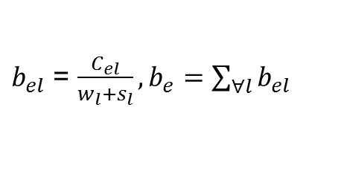








CGRIP: 2D Projection
Introduction
CGRIP
LCGRIP
Summary
Conclusions
Computing capacity of an edge in the projected 2D graph
Compute $b_{el}$, the normalized capacity for each edge on layer l from its capacity $C_{el}$ and add the 3D edge capacities corresponding to the same edge on the 2D projected grid-graph
Example:
$b_{el}$ = $\frac{C_{el}}{w_{l}+s_{l}},b_{e}=\sum_{∀l}{b_{el}}$
$$w_{l}$$
$$c_{el}$$
$$s_{l}$$
$c_{e,l=2}$ = 80, $w_{l=2}=s_{l=2}=2$
$b_{e,l=2}$ = 20
$b_{e}$ = 60
$c_{e,l=1}$ = 80, $w_{l=1}=s_{l=1}=1$
$b_{e,l=1}$ = 40

Slide 60
CGRIP: Blockages
Introduction
CGRIP
LCGRIP
Summary
Conclusions
Blockages are accounted for
Blockages are the parts reserved for embedded IPs and memories
The modern designs have irregular routing blockages
80 80 80 80 80 80
80 40 40 40 80 80
80 0 0 0 40 80
80 0 0 0 0 80
80 80 80 80 80 80

Slide 61
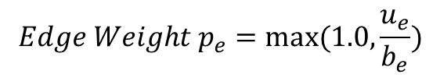
Congestion-aware Net Decomposition
Introduction
CGRIP
LCGRIP
Summary
Conclusions
Standard MST
Congestion-aware MST
10
$$Edge Weight p_{e}=max⁡(1.0, \frac{u_{e}}{b_{e}})$$
3
3
12
12
4
4

Slide 62
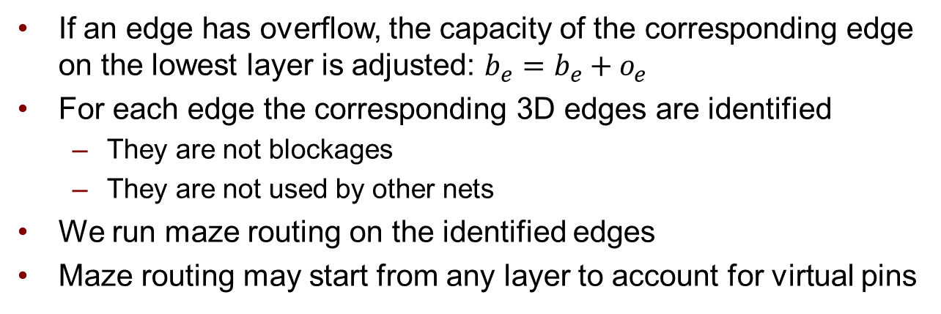
Layer Assignment
Introduction
CGRIP
LCGRIP
Summary
Conclusions
Greedy
Approach
Maze
Routing
If an edge has overflow, the capacity of the corresponding edge on the lowest layer is adjusted: $b_{e}=b_{e}+o_{e}$
For each edge the corresponding 3D edges are identified
They are not blockages
They are not used by other nets
We run maze routing on the identified edges
Maze routing may start from any layer to account for virtual pins
Notes:
Hamid this is unclear. Do you have one 3 terminal net in this figure? Your sentence “Steiner point … are identified” is unclear

Slide 63
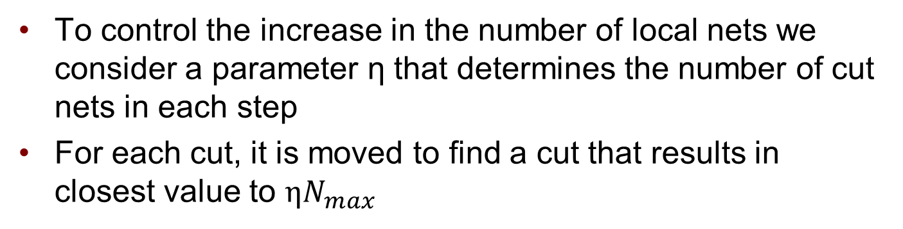
Binning Procedure
Introduction
CGRIP
LCGRIP
Summary
Conclusions
# of global nets: 8
# of local nets: 0
# of global cells: 9
1
1
3
0
0
0
1
1
0
1
1 1 4 1 2
0 0 0 0 2
(a)
(b)
(c)
To control the increase in the number of local nets we consider a parameter η that determines the number of cut nets in each step
For each cut, it is moved to find a cut that results in closest value to $ηN_{max}$

Slide 64
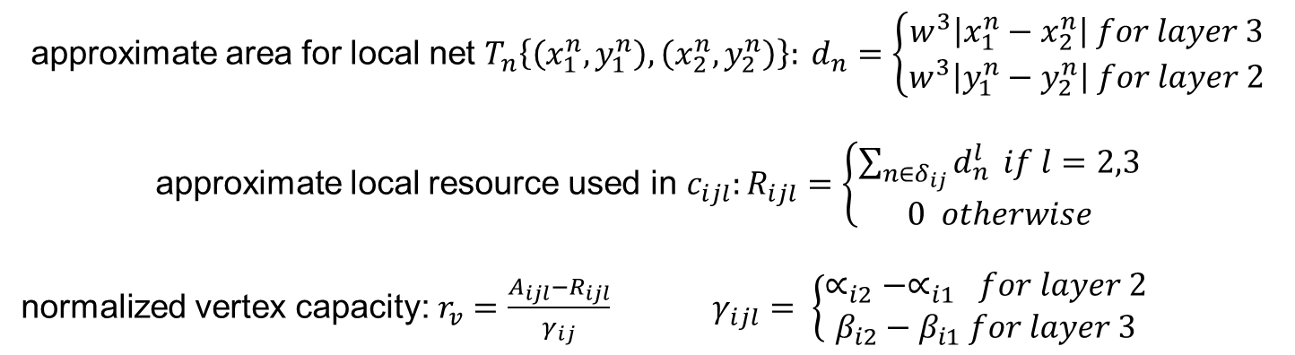
New Graph Model
Introduction
CGRIP
LCGRIP
Summary
Conclusions
Β₃= Y
β₂
β₁
β₀
n2
n5
C1
C2
n1
n3
n1
n1
n2
C3
n5
0
n5
α₀ α₁ α₂ α₃=X
n3
b_{e}
r_{v}
approximate area for local net $T_{n}\left\{\left(x_{1}^{n},y_{1}^{n}\right),\left(x_{2}^{n},y_{2}^{n}\right)\right\}: d_{n}=\left\{\begin{aligned}w^{3}\left|x_{1}^{n}−x_{2}^{n}\right| for layer 3 \\ w^{3}\left|y_{1}^{n}−y_{2}^{n}\right| for layer 2\end{aligned}\right.$
approximate local resource used in $c_{ijl}:R_{ijl}=\left\{\begin{aligned}\sum_{n∈δ_{ij}}{d_{n}^{l}} if l=2,3 \\ 0 otherwise\end{aligned}\right.$
normalized vertex capacity: $r_{v}=\frac{A_{ijl}−R_{ijl}}{γ_{ij}} γ_{ijl}= \left\{\begin{aligned}∝_{i2}−∝_{i1} for layer 2 \\ β_{i2}−β_{i1} for layer 3\end{aligned}\right.$

Slide 65
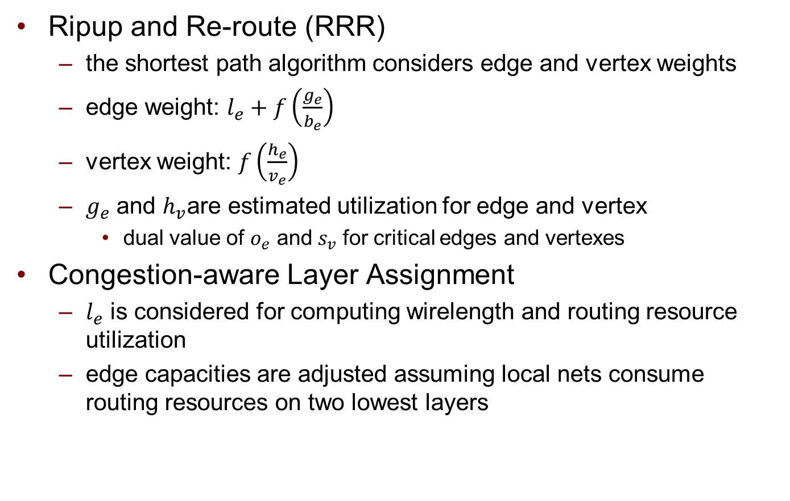

LCGRIP: Integration with CGRIP
Introduction
CGRIP
LCGRIP
Summary
Conclusions

Slide 66
Detailed Routing Emulation
Introduction
CGRIP
LCGRIP
Summary
Conclusions
Works on a projected detailed routing
one vertical and one horizontal layer
When there is a via, utilization of 1 unit is considered
n2
n5
n1
n3
n1
n1
n2
n6
n7
n5
n2
n6
n7
n5
n3

