Slide 1

GRIP: Scalable 3-D Global Routing using Integer Programming
Tai-Hsuan Wu, Azadeh Davoodi
Department of Electrical and Computer Engineering
Jeffrey Linderoth
Department of Industrial and Systems Engineering
University of Wisconsin-Madison
WISCAD VLSI Design Automation Lab http://wiscad.ece.wisc.edu
Notes:
Title?

Slide 2
Outline
Preliminaries
Global routing contributions
Integer Program formulation
Candidate route generation
Subregion extraction / IP decomposition
Simulation results

Slide 3
Global Routing: Problem Definition
v11
v11
v12
v13
v14
v21
v22
v23
v24
v31
v32
v33
v33
v34
v41
v42
v42
v43
v44
cap. = C

Slide 4
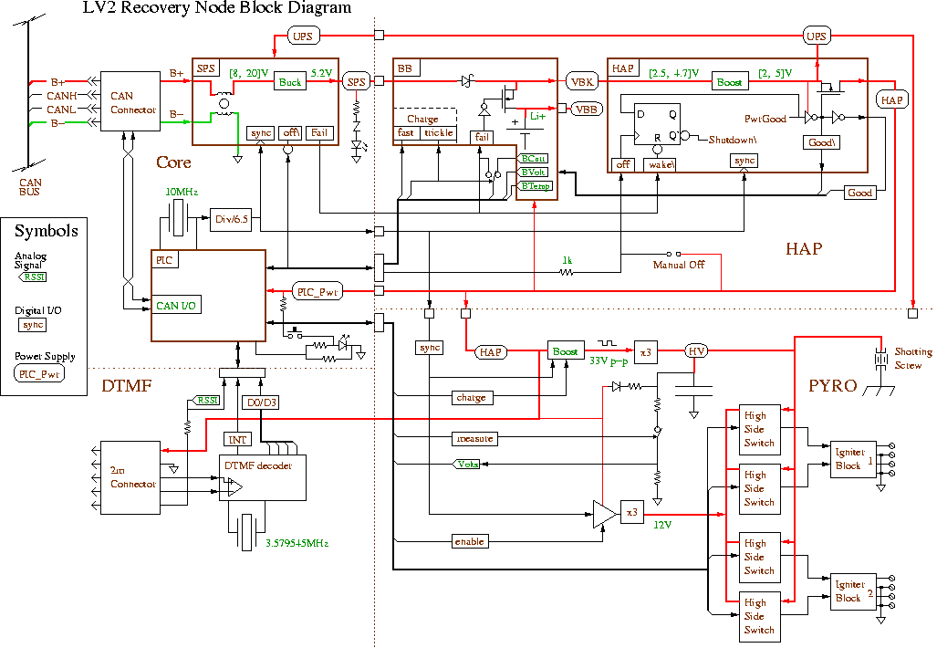

Another View…
Benchmark adaptec1:
Contains 176K multi-terminal nets
Grid size – 324 x 324
Layers – 6

Slide 5
Previous Works
[Hadsell and Madden]
[Westra and Groeneveld]
[BoxRouter 2.0]
[NTHU-Route 2.0]
[Westra et al.]
[MaizeRouter]
[FastRoute 4.0]
[Labyrinth]
[BoxRouter]
[FastRoute]
[DPRouter]
[SideWinder]
[Muller]
[Archer]
[FGR]
2002
2003
2004
2005
2006
2007
2008
Global Routing
Original formulation
[Nair, DAC’82]
Pattern Routing
History-based
IP/Lagrangian
Labyrinth [Kastner, TCAD’02]
DPRouter [Cho, ASPDAC’07]
Archer [Ozdal, ICCAD’07]
MaizeRouter [Moffitt, ASPDAC’08]
NTHU-Route 2.0 [Chang, ICCAD’08]
Fast Route 4.0 [Pan, ASPDAC’09]
BoxRouter 2.0 [Cho, ICCAD’07]
FGR [Roy, DAC’08]
SideWinder [Hu, SLIP’08]

Slide 6
Shortcomings of Existing Approaches
Highly rely on a sequential ordering for routing the nets
Net decomposition
3-D Global Routing
Vias
Vertical edges
global bins
global edges
Horizontal edges
(Without resource sharing)
(With resource sharing)

Slide 7
Our Contributions
Global Routing
Global Routing
IP Formulation
In terms of all potential candidate routes for a net
Considers 3D routes directly
Price and Branch
Price and Branch
Problem Decomposition
(parallel execution)
Problem Decomposition
Systematic pricing approach to identify candidate routes
Decompose problem into “balanced” subproblems to improve runtime
Scalable IP for GR
GRIP: Global Routing via
Integer Programming

Slide 8
Integer Programming Formulation
(IP-GR)
T₁
S₂
T₂
S₁

Slide 9
IP-GR: Features
Solves the 3-D Global Routing Problem directly
Does not apply layer assignment and directly works on 3-D Steiner routes
Minimizes wirelength and via cost simultaneously, and cost in general
Does not decompose into multi-terminal nets
Tends to route as many nets as possible without overflow
Quickly gets rid of the dummy variables S_{i} by assigning large penalty factor M

Slide 10
Solving IP-GR: Motivation
Large number of decision variables (Steiner trees) for each net
T
T
S
S
3x3 bounding box: 12 routes
Routes go outside the bounding box?
Routes can go up and down
Solution: Pricing via Column Generation*!!
* “Decomposition principle for linear programs”, Operations Research 1960

Slide 11
Our Contributions
Global Routing
Global Routing
IP Formulation
(handle 3-D GR)
IP Formulation
(handle 3-D GR)
Price and Branch
Problem Decomposition
Problem Decomposition
(parallel execution)
Scalable IP for GR
GRIP
Notes:
reference

Slide 12
Price and Branch Procedure
Create initial routes via pattern routing
Solve LP, get dual sol.
Setup edge weight
Pricing Phase:
Identify “promising” routes for each net
Identify new routes for each net
yes
Have new routes?
no
Solve IP-GR via branch and bound
Solve IP
Notes:
Change font color

Slide 13
Price and Branch Procedure
Create initial routes via pattern routing
Solve LP, get dual sol.
Setup edge weight
Identify new routes for each net
T₁
S₂
1.0
yes
Have new routes?
1.0
1.0
1.0
99.0
1.0
no
T₂
Solve IP
1.0
1.0
1.0
1.0
S₁
Notes:
Solve the relaxed Linear Programming of IP-GR
Apply Column Generation to solve Linear Programming
Only explicitly include a subset of possible routes which may reduce the objective value

Slide 14
Identifying New Routes
Edge weights
Quantity larger than or equal to 1 expressed based on the solution of the dual problem
Relates to congestion of the relaxed problem and reflects the impact of all the candidate routes generated so far
Used to identify new routes while capturing impact of all previously generated candidate routes
99.0
1.0
99.0
1.0
1.0
99.0
99.0
99.0
99.0
1.0
1.0
1.0
1.0
1.0
1.0
1.0
1.0
1.0
1.0
1.0
1.0

Slide 15
Our Contributions
Global Routing
Global Routing
IP Formulation
(handle 3-D GR)
IP Formulation
(handle 3-D GR)
Price and Branch
Price and Branch
Problem Decomposition
Scalable IP for GR
GRIP

Slide 16
IP Decomposition: Motivation
Benchmark adaptec1:
Contains 176K multi-terminal nets
Grid size – 324 x 324
Layers – 6
# of Net constraints : 176K
# of Edge constraints : 629K
# of total constraints : 805K
+
=
Solution: Problem Decomposition
Big instance – too many rows in IP-GR

Slide 17
Solving IP-GR for A Subregion
0.0
T
T
S
auxiliary
node
0.0
Floating terminal

Slide 18
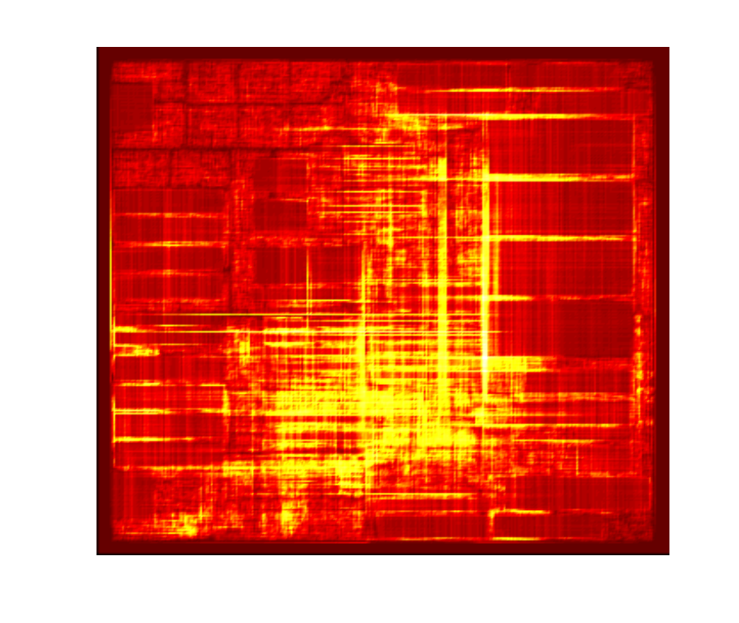
Subregion Extraction / IP Decomposition
Procedure:
Fix nets based on fast and approximate route generated by “Flute”*
Recursively bi-partition the chip area into rectangles
At each bi-partition balance “Average Edge Utilization”
Go through the subregions in the order of their “Total Edge Overflow” and before solving a subregion detour as many inter-region nets as possible
adaptec1 3D benchmark
*“Flute: Fast lookup table based rectilinear steiner minimal tree algorithm for VLSI design.”, [Chu, TCAD’08]

Slide 19
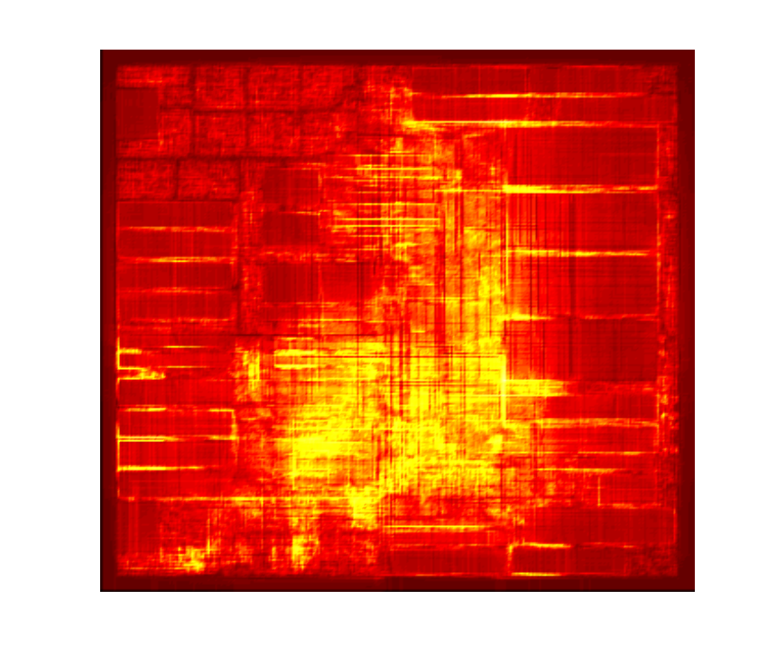
Detouring Inter-Region Nets
4
6
3
9
1
2
5
8
7
12
11
10
Ordered in terms of their total edge overflow.
(Before detouring)
(After detouring)
Notes:
Need to replace figures

Slide 20
Processing of Subregions with Limited Parallelism
4
6
3
9
1
2
5
8
7
12
11
10
Floating terminal
Traversed in terms of their total edge overflow.
Fixed terminal

Slide 21
Further Improving Connection Between Subregions
Disconnect segments connecting rout fragments in adjacent subregions
Use similar IP formulation to reconnect boundary nets
0.0
0.0
0.0
0.0
0.0
0.0
0.0
0.0
0.0
0.0
Subregion 1
Subregion 2

Slide 22
Simulation Setup
Column Generation procedure was implemented using MOSEK 5.0
CPLEX 6.5 was used to solve IP
All jobs were submitted to CS grid at UW-Madison using Condor
Evaluated 8 ISPD07’ benchmarks using the ISPD08 script
Manually changed via cost in the script from 1 to 3 units
Results in the paper were verified with an inaccurate version of the ISPD07 script
Benchmark | # of nets | Grid size | # of layers
adaptec1 | 176715 | 324x324 | 6
adaptec2 | 207972 | 424x424 | 6
adaptec3 | 368494 | 774x779 | 6
adaptec4 | 401060 | 774x779 | 6
adaptec5 | 548073 | 465x468 | 6
newblue1 | 270713 | 399x399 | 6
newblue2 | 373790 | 557x463 | 6
newblue3 | 442005 | 973x1256 | 6

Slide 23
Comparison of Solution Quality (3D)
Benchmark | Best reported solution* |  |  | GRIP
 | OF | WL | Router | OF | WL | Edge Cost | Via Cost | %WL-impr.
adaptec1 | 0 | 88.59 | FGR | 0 | 81.0 | 36.4 | 44.5 | 8.57%
adaptec2 | 0 | 90.08 | FGR | 0 | 82.4 | 33.7 | 48.7 | 8.53%
adaptec3 | 0 | 200.59 | FGR | 0 | 185.4 | 97.5 | 87.9 | 7.57%
adaptec4 | 0 | 182.99 | FGR | 0 | 172.3 | 91.5 | 80.7 | 5.84%
adaptec5 | 0 | 260.18 | NTHU-R | 0 | 238.9 | 104.8 | 134.1 | 8.18%
newblue1 | 0 | 90.96 | NTHU-R | 0 | 83.9 | 24.9 | 59 | 7.76%
newblue2 | 0 | 132.54 | FGR | 0 | 121.4 | 48 | 73.4 | 8.41%
newblue3 | 31024 | 197.3 | NTUgr | 52518 | 156.1 | 76.2 | 79.9 | N/A
* Determined by looking at other reported results from the routers that have optimized for ISPD07 benchmarks using the 07 rules (via cost = 3)
GRIP can improve total wire length by about 7.84%
Solutions are available for download at http://wiscad.ece.wisc.edu/gr/

Slide 24
GRIP Runtime Results (3D)
 |  | # of subregions | Runtime (min) |  | # Iterations | # Parallel executed subproblems
 |  |  | Wall Clock Time | Estimated Sequential Runtime
 |  |  |  |  |  | Ave. | Max
adaptec1 | 324x324 | 100 | 388 | 3118 | 12 | 8.3 | 18
adaptec2 | 424x424 | 169 | 455 | 5585 | 16 | 10.6 | 23
adaptec3 | 774x779 | 576 | 478 | 8776 | 32 | 18.0 | 38
adaptec4 | 774x779 | 570 | 509 | 8218 | 30 | 19.0 | 51
adaptec5 | 465x468 | 225 | 584 | 8168 | 16 | 14.1 | 30
newblue1 | 399x399 | 144 | 483 | 4086 | 18 | 8.0 | 15
newblue2 | 557x463 | 238 | 467 | 5151 | 23 | 10.4 | 18
newblue3 | 973x1256 | 1170 | 1430 | 28379 | 61 | 19.2 | 39
GRIP runs in 6 to 23 hours if limited parallelism is used.
Sequential runtime takes 1 to 23 days!
Ran on machines with at most 2G memory.
Selected time-consuming subproblems used only a fraction of 2G memory.

Slide 25
Conclusions and Future Directions
GRIP achieves significant improvement in solution quality using Integer Programming without any tuning
We believe runtimes can be significantly improved with much more aggressive parallelism and independent solving of the subproblems
We plan to develop similar IP formulation and route generation to resolve overflows in ISPD08 benchmarks
We plan to extend route generation procedure to generate routes that are also optimized for delay

Slide 26
Thank You
Notes:
26

Slide 27
Comparison of Solution Quality (2D)
Benchmark | Best reported solution |  |  | GRIP
 | OF | WL | Router | OF | WL | Edge | Via | %WL-impr.
adaptec1 | 0 | 54.7 | FGR | 0 | 53.5 | 36.0 | 17.5 | 2.19%
adaptec2 | 0 | 52.4 | FGR | 0 | 51.3 | 33.3 | 18.0 | 2.10%
adaptec3 | 0 | 131.5 | FGR | 0 | 129.1 | 96.6 | 32.5 | 1.83%
adaptec4 | 0 | 125.0 | FGR | 0 | 123.4 | 90.2 | 33.2 | 1.28%
adaptec5 | 0 | 153.2 | FGR | 0 | 149.5 | 103.8 | 45.7 | 2.42%
newblue1 | 0 | 48.6 | NTHU-R | 0 | 47.7 | 25.2 | 22.5 | 1.85%
newblue2 | 0 | 76.5 | FGR | 0 | 75.0 | 48.4 | 26.6 | 1.96%
newblue3 | 31454 | 110.8 | NTHU-R | 50091 | 106.5 | 77.8 | 28.7 | -

Slide 28
Column Generation – Pricing Problem
Solve the relaxed Linear Programming of ILP-GR
Apply Column Generation to solve Linear Programming
Only explicitly include a subset of possible routes
Restricted Primal Problem:
Dual Problem:
Primal Solution
Dual Solution
If a route with
Then adding this route to the Restricted Primal Problem reduces the objective value

Slide 29
Identify New Routes
How to identify a new route with ?
Create initial routes using pattern routing
Solve LP, get dual sol.
Setup edge weight
T₁
identify new routes for each net
e₂₈
yes
Have new routes?
e₆
S₁
no
Solve ILP

