Slide 1

A Parallel Integer Programming Approach to Global Routing
Tai-Hsuan Wu, Azadeh Davoodi
Department of Electrical and Computer Engineering
Jeffrey Linderoth
Department of Industrial and Systems Engineering
University of Wisconsin-Madison
WISCAD Electronic Design Automation Lab http://wiscad.ece.wisc.edu

Slide 2
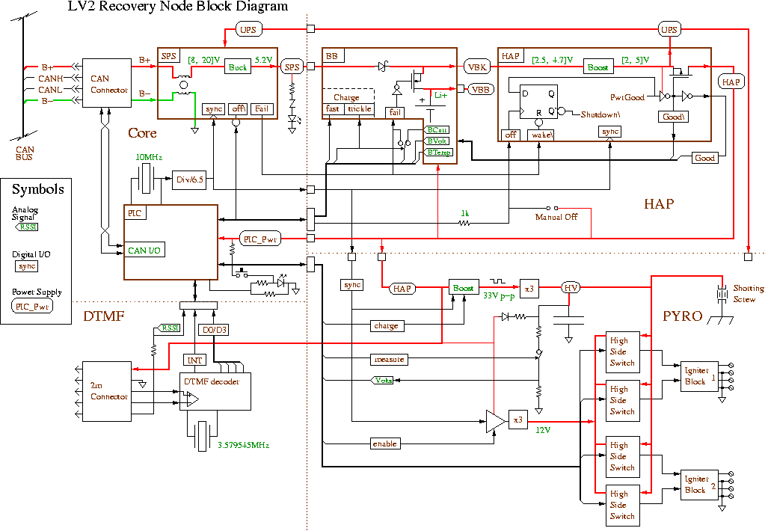

Overview of Global Routing
v11
v11
v12
v13
v14
v21
v22
v23
v24
v31
v32
v33
v33
v34
v41
v42
v42
v43
v44
cap. = C
Benchmark bigblue4:
More than 2M nets
Grid size – 403 x 405
Layers – 8

Slide 3
GRIP*: Overview
Global Routing
IP Formulation
Price and Branch
Problem
Decomposition
GRIP
* [Wu, Davoodi, Linderoth--DAC09]

Slide 4
GRIP: The IP Formulation
T₁
T₂
T₂
T₁
(ILP-GR)

Slide 5
GRIP: Solution via Price-and-Branch
Price:
Solve linear program relaxation of (ILP-GR) using “column generation”
Step 0: Start with S(Ti)={t1i}
Step 1: Solve linear program relaxation version of (ILP-GR) using current S(Ti)
Generates a set of promising candidate routes S(Ti) ⊂ Ω(Ti)
for each net Ti
Step 2: Based on solution of step 1, solve pricing problem for each net to identify new route t*
Step 2: Based on solution of step 1, solve a pricing problem for a net Ti to identify new route t*
Branch:
Solve (ILP-GR) using S(Ti) instead of Ω(Ti)
Pass pricing condition?
Yes
Pass pricing condition?
S(Ti) = S(Ti) U t*
S(T)

Slide 6
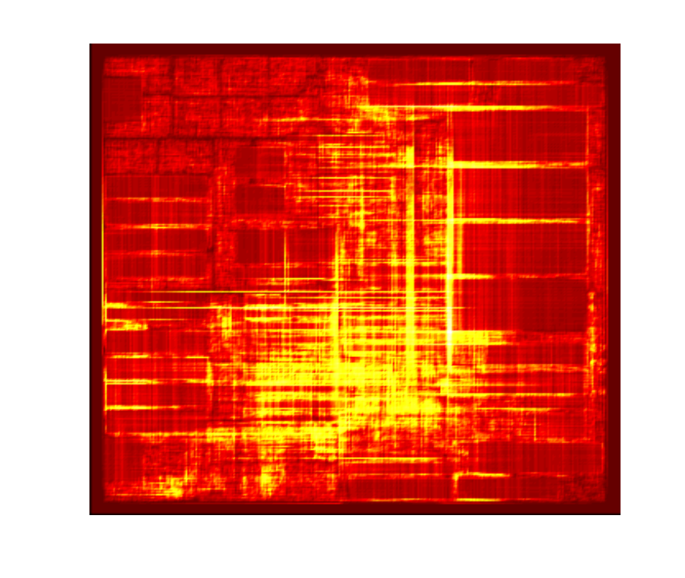
GRIP: Problem Decomposition
A subproblem is represented by
A rectangular area on the chip
A set of nets assigned to it
Subproblems should be defined to have similar complexity for: 1) workload balance, 2) avoiding overflow
GRIP’s strategy:
Recursive bi-partitioning to define the subproblem boundaries
Net assignment based on FLUTE* combined with dynamic detouring before solving each subproblem
adaptec1 3D benchmark
* [Chu, Wong--TCAD’08]

Slide 7
GRIP: Solving the Subproblems
4
6
3
9
Floating
1
2
Fixed
5
8
7
12
11
10
0.0
0.0
0.0
0.0

Slide 8
GRIP: Connecting Subproblems
Using IP-based procedure is essential to connect subproblems with low (or no) overflow
0.0
0.0
0.0
0.0
0.0
0.0
0.0
0.0
0.0
0.0

Slide 9
GRIP: Results
Significantly high improvement in wirelength
9.23% and 5.24% in ISPD2007 and ISPD2008 benchmarks, respectively
Comparable or improved overflow in three unroutable benchmarks
However, even wall runtime (with the limited parallelism) prohibitively large
6 to 22 hours on a grid with CPUs of 2GB memory

Slide 10
PGRIP: Overview
Goal: Remove synchronization barrier between subproblems
Allowing a much higher degree of parallelism without much degradation in wirelength or overflow
IP-Based
“Patching”
Feedback to enhance connectivity
Partial routing solution
Subproblem 1
Subproblem 2
Subproblem n

Slide 11
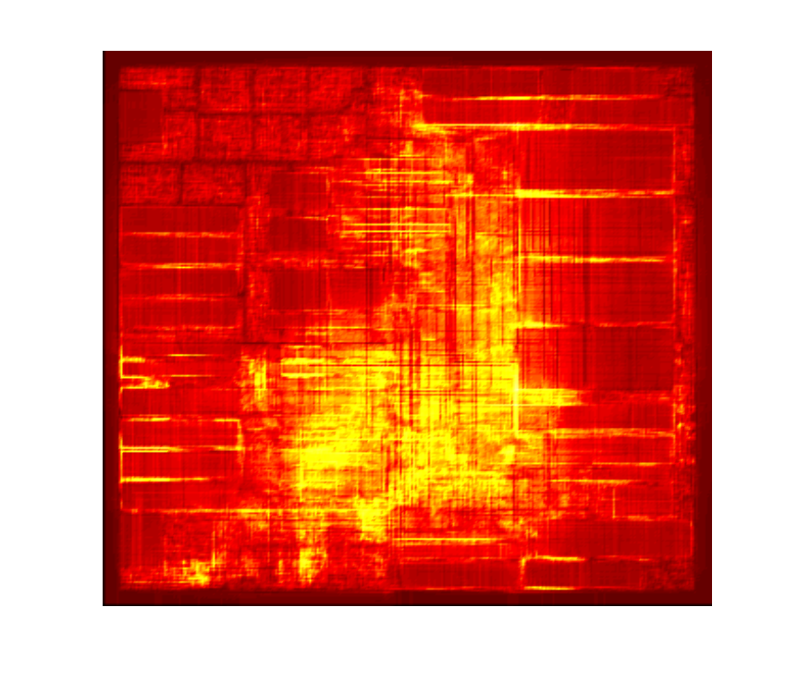
PGRIP: 1) Subproblem Definition
Quickly generate a routing solution
Solve relaxed version of (ILP-GR) after fixing some short nets using column generation
(set to 10 minutes)
Apply randomized rounding to get integer solution
Recursive bi-partition to define boundaries of rectangular subregions
To get subproblems with similar complexity, it balances number of nets at each rectangle during bi-partitioning
Stop when number of nets inside a subproblem is less than 4000
3. Traverse subproblems and apply some detouring to further enhance the net assignments
In order of Total Edge Overflow similar of GRIP

Slide 12
PGRIP: 2) Initial Subproblem Pricing
Procedure
Apply pricing to solve each subproblem independently in a bounded-time (set to 5 minutes)
Allow inter-region nets to connect to anywhere on the subproblem boundaries
When solving relaxed (ILP-GR), Qe set to be equal to the Manhattan distance of edge e from the center of the subproblem

Slide 13
PGRIP: 3) IP-Based Patching
Patcher’s feedback
Pseudo-terminal locations per boundary per inter-region net
Goal is to define restricted window to enhance connectivity
T1
T2

Slide 14
PGRIP: 3) IP-Based Patching
T1
T1
T2
T2
T1
T1
T2
Subproblem 1
T2
Subproblem 2

Slide 15
PGRIP: 3) IP-Based Patching
T1
T1
T2
T2
T1
T1
T2
Subproblem 1
T2
Subproblem 2
(ILP-Patch)
C11
V’
C12
e’
C23
C21
C22
C24
C13
C14

Slide 16
PGRIP: 3) Adjusted Pricing
Subproblems apply adjusted pricing
Nets only allowed to connect within their provided spanning window per boundary
(set to 20 minutes)
Branching is then used to solve the subproblems independently
T1
T2

Slide 17
PGRIP: 4) Distributed Connecting of Subproblems
Subproblems are connected simultaneously (in parallel)
Similar procedure as in GRIP
Inside each subproblem, the remaining edge capacities are allocated uniformly among its boundary connection problems
c
c
c
c

Slide 18
Simulation Setup
Pricing using MOSEK 5.0
Branching using CPLEX 6.5
All parallel jobs in CS grid at UW-Madison
Machines of similar speed and same 2GB memory
Network managed by Condor
Each CPU does one job at a time

Slide 19
Simulation Setup
Runtime limits in PGRIP [target runtime: 75 minutes]
Defining subproblems:10 minutes
Initial pricing: 5 minutes
Adjusted pricing: 20 minutes
Branch-and-bound for solving subproblems: 10 minutes
Pricing to connect subproblems: 20 minutes
Branch-and-bound for connecting subproblems: 10 minutes

Slide 20
Simulation Results: Comparison of QoS
 | PGRIP |  | GRIP |  | FGR |  | FR 4.0 |  | NTHU 2.0
 | TOF | WL | TOF | WL(%) | TOF | WL(%) | TOF | WL(%) | TOF | WL(%)
a1 (07) a2 (07) a3 (07) a4 (07) a5 (07) n1 (07) n2 (07) n3 (07) | 0 0 0 0 0 0 0 41K | 82.3 83.4 186.5 173.2 241.5 84.9 123.3 156.3 | 0 0 0 0 0 0 0 52K | -1.56 -1.24 -0.58 -0.52 -1.07 -1.14 -1.55 -1.03 | 0 0 0 0 0 526 0 30K | 7.00 7.20 6.61 3.44 7.13 9.97 4.73 10.02 | 0 0 0 0 0 0 0 32K | 9.60 8.90 8.87 7.36 10.79 7.46 9.11 14.17 | 0 0 0 0 0 0 0 31K | 7.38 8.21 7.15 6.88 7.20 6.71 8.43 6.38
Average |  |  |  | -1.09% |  | 6.58% |  | 8.87% |  | 7.42%
n4 (08) n5 (08) n6 (08) n7 (08) b1 (08) b2 (08) b3 (08) b4 (08) | 132 0 0 54 0 0 0 176 | 124.9 223.8 172.0 338.4 54.0 86.5 126.5 221.1 | 152 0 0 74 0 0 0 186 | -0.44 -0.44 -0.88 -0.83 -0.54 -0.64 -0.24 -0.22 | 262 0 0 1458 0 0 0 414 | 3.65 3.95 4.61 3.37 5.81 5.38 4.20 4.54 | 144 0 0 62 0 0 0 152 | 6.78 5.47 5.83 5.17 6.72 9.50 3.24 8.50 | 138 0 0 68 0 0 0 162 | 4.29 3.38 2.78 4.22 3.49 4.50 3.22 4.30
Average |  |  |  | -0.53% |  | 4.44% |  | 6.40% |  | 3.77%

Slide 21
Simulation Results: Runtime
 | PGRIP |  |  | GRIP
 | #Parallel | WCPU (min) | TCPU (min) | E[#Parallel] | WCPU (min) | TCPU (min)
a1 (07) a2 (07) a3 (07) a4 (07) a5 (07) n1 (07) n2 (07) n3 (07) | 90 110 211 221 280 122 215 258 | 76 76 77 79 77 76 77 82 | 2101 2704 6319 5221 3175 2306 4192 14590 | 8.3 10.6 18.0 19.0 14.1 8.0 10.4 19.2 | 388 455 478 509 584 483 467 1430 | 2247 2677 5168 5258 7133 3076 5228 6768
n4 (08) n5 (08) n6 (08) n7 (08) b1 (08) b2 (08) b3 (08) b4 (08) | 255 504 459 725 124 243 326 453 | 77 80 78 86 76 77 78 82 | 2944 4953 2219 4788 956 3411 2690 3096 | 8.5 9.5 8.9 9.0 3.9 8.0 7.3 7.6 | 529 821 448 985 339 690 731 726 | 3974 6598 5096 5377 2770 3793 3448 4400
Average | 287 | 78 | 4104 | 11 | 629 | 4563

Slide 22
Conclusions & Future Works
Conclusions
Removed synchronization barrier in GRIP
High-level of distributed processing
High use of IP—considered impractical for GR—shown to be practical when combined with distributed processing, allowing significant improvement in solution quality
Future works
Explore use of pricing for quick congestion estimation
Incorporate restrictive routing constraints within pricing, e.g. on net topology for delay consideration, metal usage for manufacturability

Slide 23
Thank You
Notes:
23

