Slide 1

Power-Driven Global Routing for Multi-Supply Voltage Domains
Tai-Hsuan Wu, Azadeh Davoodi
Department of Electrical and Computer Engineering
Jeffrey Linderoth
Department of Industrial and Systems Engineering
University of Wisconsin-Madison
WISCAD VLSI Design Automation Lab http://wiscad.ece.wisc.edu
Notes:
Title?

Slide 2
Contributions
Interconnect power optimization for multiple supply voltage (MSV) domains
power metric for global routing in MSV domains
nonlinear Integer Program (IP) formulation with level converters
approximation as a two-phase linear IP and parallel solving by IP decomposition

Slide 3
Global Routing
v11
v12
v13
v14
cells
global bins
v21
v22
v23
v24
global bins
v31
v32
v33
v34
global edges
global edges
v41
v42
v43
v44
cap. = C

Slide 4
Motivation
Interconnect power minimization
reported to be around 30% of dynamic power for a 45nm high performance microprocessor*
can significantly increase with wiring congestion and higher wire size at the higher metal layers
one-time optimization in the design flow after (any combination) of placement and global routing
Why address at global routing?
flexibility compared to detail routing
metal layer and size known for each wire
wire spacing can be approximated from utilization
*[R. Shelar and M. Patyra, ISPD 2010]

Slide 5
Our Contributions
Global Routing
Global Routing
Net decomposition based on supply voltage level
Estimate edge capacitance based on its utilization
Power Model for GR
Power aware IP for GR
Power aware IP for GR
Problem Decomposition
Problem Decomposition
MSV-based GR
MSV-based GR

Slide 6
Interconnect Modeling for MSV
level converter
cell
V_{L}
V_{H}
global bins
V_{H}
V_{L}
V_{H}
V_{H}
Each voltage island has either a low (VL) or high (VH) supply voltage
Place level converters (LCs) based on the terminal locations
Decompose a net which contains a LC into a set of sub-nets

Slide 7
Interconnect Power Modeling*
Total interconnect power is estimated as where f_{clk} is the frequency
Each net has corresponding switching activity α_{i}, supply voltage V_{i}, the capacitances of its sink cell and its route
For route t_{i} , the capacitance is the sum of the capacitances of the edges in t_{i}
*[Shojaei, Wu, Davoodi, Basten, ISLPED 2010]

Slide 8
GR Edge Capacitance Modeling
The capacitance of each GR edge is a function of the metal layer l_{e}, wire width w_{e} and wire spacing s_{e} :
where Ca and Cf are the area and fringe capacitances with respect to substrate, and Cc is the coupling capacitance
Cc
Cc
Cf
Cf
Substrate
Ca

Slide 9
GR Edge Capacitance Modeling
Metal layer l_{e} is known for each GR edge, and we assume only one (minimum) wire width w_{e} at GR stage
The spacing s_{e} for an edge is estimated from the edge utilization r_{e}
Area, fringe, and coupling capacitances for metal layer 1 with respect to edge utilization for a 45nm library (i.e., NANGATE library)

Slide 10
Our Contributions
Global Routing
Global Routing
Power Model for GR
Power Model for GR
Power Aware IP for GR
Problem Decomposition
Problem Decomposition
MSV-based GR
MSV-based GR

Slide 11
IP for Wirelength Minimization*
T₁
S₂
T₂
S₁
*[Wu, Davoodi, Linderoth, DAC’09, TCAD’11]

Slide 12
IP for Power Minimization
(PGR)

Slide 13
PGR: Objective
Minimize total interconnect power directly in the objective
The switching activity α_{i} and voltage level V_{i} are known (constant value) for each (decomposed) net
The capacitance of each GR edge is a variable, and will be determined during the optimization
expressed as constraint
Penalize the unrouted nets by choosing a large M

Slide 14
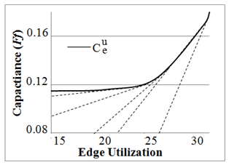
PGR: Capacitance Constraint
The unit capacitance of an edge typically is a piecewise linear convex function
For each line segment q, the edge capacitance can be written as without approximation
And the edge utilization is expressed as

Slide 15
PGR: Wirelength Constraint
Rerouting nets from congested regions or to lower metal layers can reduce interconnect power
but it may increase wirelength
Can control the tolerance parameter β to set an upper bound for the total wirelength

Slide 16
Our Contributions
Global Routing
Global Routing
Power Model for GR
Power Model for GR
Power Aware IP for GR
Power Aware IP for GR
Problem Decomposition
Two-phase approach to reduce complexity of IP
Decomposition into sub-problems
Power-aware route generation
MSV-based GR
MSV-based GR

Slide 17
PGR Complexity
(PGR)
All the constraints in PGR are linear but the objective expression is nonlinear
Utilize a two-phase approach to handle the nonlinearity
Phase1: Minimize total capacitance by rerouting nets, and obtain the estimation of edge capacitance
Phase2: Fix capacitance and consider net activity and voltage level

Slide 18
Phase 1: Minimize Total Capacitance
(PGR-P1)
Modify the objective to minimize total capacitance
Modify the third constraint to calculate the total capacitance C_{e} per edge
m_{q} and r_{q} are the slope and offset for the total edge capacitance respectively

Slide 19
Phase 2: Minimize Total Power
From the phase 1 solution , we can obtain an “effective” utilization for each edge
Similarly, we can also obtain “unit capacitance” for each edge (i.e., capacitance of one wire on one edge) based on the solution of phase 1

Slide 20
Phase 2 : Minimize Total Power
(PGR-P2)
Incorporate net activity and voltage level in the objective function to minimize total power directly
get estimated edge capacitance for each edge from phase 1, and consider it to be constant
but penalize the edge capacitance if over-utilized

Slide 21
Solving PGR1 and PGR2*
Wirelength optimized solution
Based on one set of initial route
Solve LP, get dual sol.
Power-aware edge weights
Setup edge weight
Price
Identify “promising” routes for each net by solving iterative LP relaxations via column generation
Identify new routes for each net
yes
Have new routes?
no
Branch
Solve IP via branch and bound
Solve IP
* [Wu, Davoodi, Linderoth, DAC’09, TCAD’11]
Notes:
Change font color

Slide 22
Power-Aware Route Generation
t_{a}
0.07
0.00
0.00
0.00
0.00
0.12
0.17
0.06
t'_{a}
v_{b}
0.07
t_{b}
0.10
t_{b}
0.85
0.07
0.85
0.85
0.03
0.85
0.07
0.04
0.11
0.07
0.04
u_{b}
Edge weights represent rate of improvement in objective
i.e., capacitance in PGR1 and power metric in PGR2 from previous round of LP
Weighted shortest path finds additional candidate routes to improve the objective
applied by replacing branches in an existing route from a previous LP iteration

Slide 23
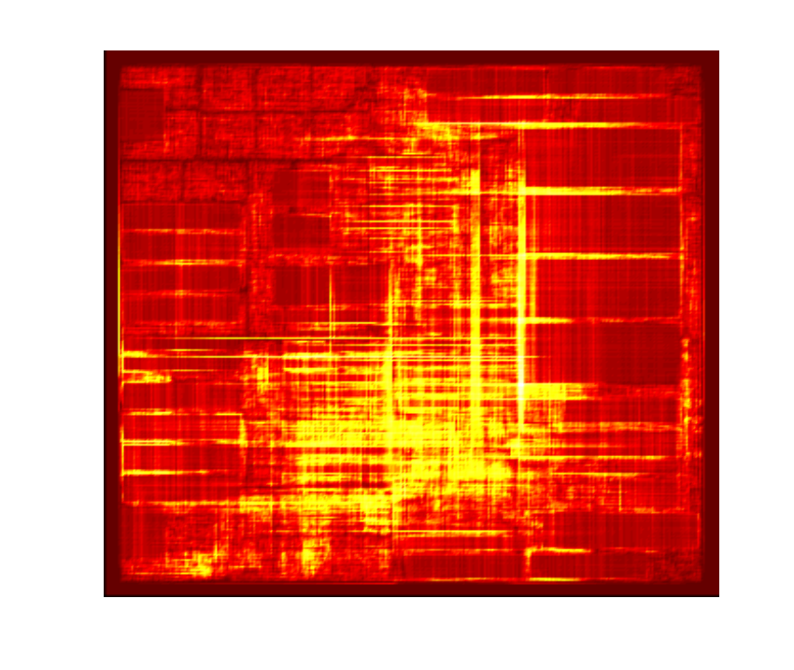
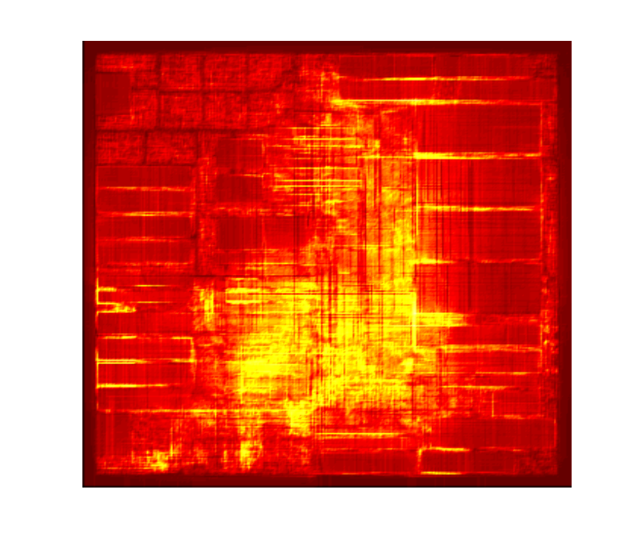
IP Decomposition*
4
6
3
9
1
2
5
8
7
12
11
10
(Before detouring)
(After detouring)
*[Wu, Davoodi, Linderoth, DAC’09, TCAD’11]

Slide 24
Simulation Setup
Random net activity generation
uniform distribution between 0.1 and 0.9
Two voltage levels 0.9 and 1.1V
Capacitance (area, fringe, coupling) for each layer from 45nm NANGATE library
based on the given edge utilization, we estimated wire spacing at each global bin
Price-and-branch was solved using CPLEX 9.0
submitted jobs via Condor to CS grid at UW-Madison

Slide 25
Simulation Flow
Initial solution: NTHU-Route 2.0 [Chang et al ICCAD08]
Voltage island generation [Chu et al ICCAD06]
timing analysis on ISPD08 benchmarks
Based on the voltage islands, inserted LCs
considered available white space
minimized number of LCs while trying to position them as close as possible to the sink terminals
Tolerable wirelength
degradation factor = 0
Initial Global Routing Solution
Voltage assignment & Inserting level converter
Power-optimized Global Routing

Slide 26
Benchmarks
Benchmark | # nets | #LC | # SP
adaptec1 | 177K | 20K | 130
adaptec2 | 208K | 17K | 195
adaptec3 | 368K | 43K | 359
adaptec4 | 401K | 36K | 296
adaptec5 | 548K | 85K | 454
newblue1 | 271K | 16K | 195
newblue2 | 374K | 47K | 312
Benchmark | # nets | #LC | # SP
newblue4 | 531K | 79K | 462
newblue5 | 892K | 84K | 658
newblue6 | 835K | 91K | 532
newblue7 | 1647K | 72K | 670
bigblue1 | 197K | 26K | 152
bigblue2 | 429K | 43K | 275
bigblue3 | 666K | 60K | 453
bigblue4 | 1134K | 51K | 509
Note: newblue3 is an un-routable benchmark, and therefore we didn’t consider it in this simulation

Slide 27
Simulation Results
Benchmark | Initial Solution |  |  | Phase 1 (%) |  |  | Phase 2 (%)
 | WL₀ | C | P | -WL | -C | -P | -WL | -C | -P
adaptec1 | 54.2 | 953 | 432 | 0.05 | 11.70 | 8.57 | 0.07 | 15.48 | 16.17
adaptec2 | 53.0 | 750 | 337 | 0.12 | 10.34 | 6.93 | 0.14 | 14.57 | 15.13
adaptec3 | 132.7 | 2287 | 1057 | 0.01 | 11.51 | 8.67 | 0.34 | 13.55 | 13.94
adaptec4 | 123.0 | 1614 | 751 | 0.02 | 12.16 | 8.46 | 0.04 | 16.92 | 17.2
adaptec5 | 158.7 | 2543 | 1200 | 0.38 | 8,60 | 6.08 | 0.43 | 10.23 | 10.88
newblue1 | 47.0 | 612 | 319 | 0.11 | 13.39 | 9.87 | 0.22 | 17.45 | 18.4
newblue2 | 77.6 | 895 | 453 | 0.04 | 14.19 | 7.87 | 0.09 | 19.2 | 19.34

Slide 28
Simulation Results
Benchmark | Initial Solution |  |  | Phase 1 (%) |  |  | Phase 2 (%)
 | WL₀ | C | P | -WL | -C | -P | -WL | -C | -P
newblue4 | 133.7 | 1955 | 928 | 0.02 | 13.39 | 9.61 | 0.54 | 17.45 | 17.61
newblue5 | 234.7 | 3405 | 1470 | 0.89 | 11.55 | 6.75 | 0.86 | 14 | 13.47
newblue6 | 180.2 | 2835 | 1367 | 0.62 | 12.56 | 9.35 | 0.57 | 16.35 | 17.8
newblue7 | 360.2 | 5004 | 2202 | 0.01 | 15.12 | 11.2 | 0.17 | 19.63 | 20.93
bigblue1 | 57 | 1110 | 619 | 0.23 | 10.68 | 7.2 | 0.16 | 12.17 | 12.56
bigblue2 | 92.4 | 1284 | 561 | 0.14 | 11.64 | 7.86 | 0.1 | 14.76 | 14.33
bigblue3 | 133 | 1665 | 815 | 0.91 | 15.22 | 10.99 | 0.93 | 20.25 | 20.31
bigblue4 | 233 | 3007 | 1254 | 0.18 | 16.03 | 12.12 | 0.28 | 22.31 | 22.46

Slide 29
Comparison - Wirelength
Since the wirelength degradation factor β was set to 0, no wirelength degradation was found over all benchmarks

Slide 30
Comparison – Capacitance & Power
After phase 1, the total capacitance and power has significant saving of 12.5% and 8.77% respectively
After phase 2, we can get additional 4.8% on capacitance and additional 7.93% on power saving

Slide 31
Conclusions
Proposed an IP formulation to minimize an interconnect power metric for global routing in multi-supply voltage domain
implemented as a two-phase approach to handle the nonlinearity in the IP formulation
price-and-branch procedure to systematically generate routes to reduce interconnect power
One-time optimization in the design flow, in effect achieves a balance in spreading congestion and rerouting nets to lower layers
without over-usage of each routing resource
without increase in wirelength

Slide 32
Thank You
Notes:
32

