Slide 1

A Parallel Integer Programming Approach to Global Routing
Tai-Hsuan Wu
Advisor: Prof. Azadeh Davoodi
Collaboration with Prof. Jeffrey Linderoth
Department of Electrical and Computer Engineering
University of Wisconsin-Madison
WISCAD Electronic Design Automation Lab http://wiscad.ece.wisc.edu

Slide 2
Overview of Global Routing
Logic Design
Placement & CTS
Physical Design
Global Routing
Routing
Track Assignment
Detail Routing
DFM
A Fundamental problem in VLSI
Even the simplest version of this problem is NP-complete [Leeuwen, VLSI Theory’84]
Post Layout Simulation
Tape out
Notes:
Add arrows

Slide 3
Global Routing - Problem Definition
A design is divided into grids (global bins)
A route is created for each net that connect adjacent cells
Capacity: model routing resources between adjacent bins
Overflow: amount of routing demand that exceeds capacity
Objective: minimizing total wire length and overflow
v11
v11
v12
v13
v14
cells
global bins
v21
v22
v23
v24
global bins
v31
v32
v33
v33
v34
global edges
global edges
v41
v42
v42
v43
v44
cap. = C

Slide 4
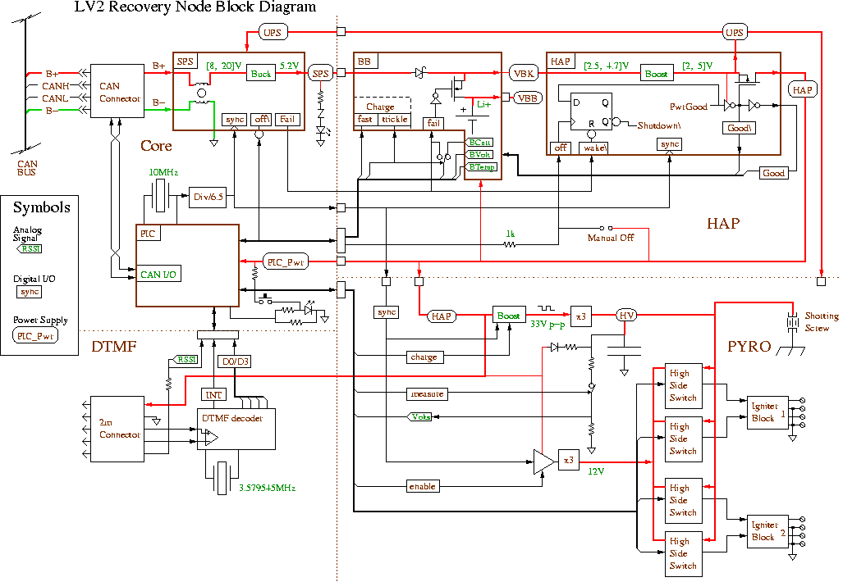

Complexity of Global Routing
Vias
Benchmark bigblue4:
More than 2M nets
Grid size – 403 x 405
Layers – 8
Notes:
3D grid-graph

Slide 5
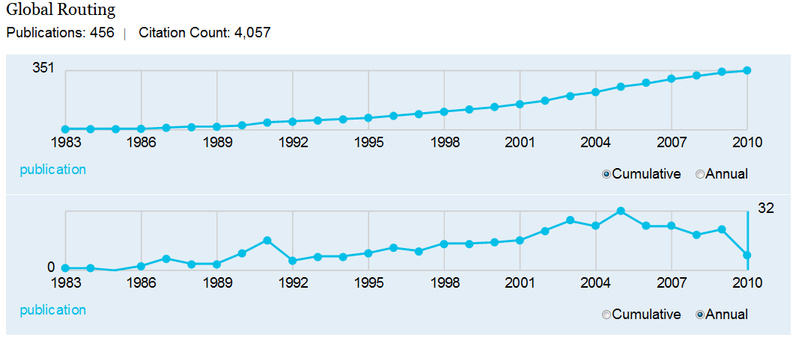
Previous Works
* Microsoft Academic Search with the keyword “Global Routing”.
Archer
Hierarchical GR
MaizeRouter
NTHU-Route 2.0
Sidewinder
Fast Route 4.0
[Ozdal, ICCAD’07]
[Yang, Opt.Letter’07]
[Moffitt, ASPDAC’08]
[Chang, ICCAD’08]
[Hu, SLIP’08]
[Pan, ASPDAC’09]
NTUgr
BoxRouter 2.0
BFGR
NCTU-Route
CGR
[Chen, ASPDAC’09]
[Cho, TCAD’09]
[Hu, ISPD’10]
[Liu, DAC’10]
[Shojaei, ISLPED’10]

Slide 6
Outline
Summary of
GRIP
GRIP: Global Routing via Integer Programming [DAC’09] [TCAD’11]
PGRIP
PGRIP
A Parallel Integer Programming Approach to Global Routing [DAC’10]
12 slides
Power-GRIP
Power-GRIP
Power-Driven Global Routing for MSV Domains [DATE’11]
18 slides

Slide 7
GRIP: Our Contributions
Global Routing
IP Formulation
Price and Branch
Problem
Decomposition
GRIP

Slide 8
GRIP: The IP Formulation
(ILP-GR)
T₁
S₂
T₂
S₁
Notes:
Assume 2 options for route 1
Binart variable

Slide 9
GRIP: Price-and-Branch
Based on one set of initial route
1.0
t_{b}
1.0
1.0
1.0
1.0
Price:
1.0
Solve LP, get dual sol.
1.0
1.0
1.0
1.0
1.0
99.0
Setup edge weight
99.0
Identify new routes for each net
1.0
1.0
1.0
t_{a}
Price:
Identify “promising” candidate routes for each net by solving iterative LP relaxations via column generation
yes
Have new routes?
Branch:
no
Solve IP
Branch:
Solve IP via branch and bound

Slide 10
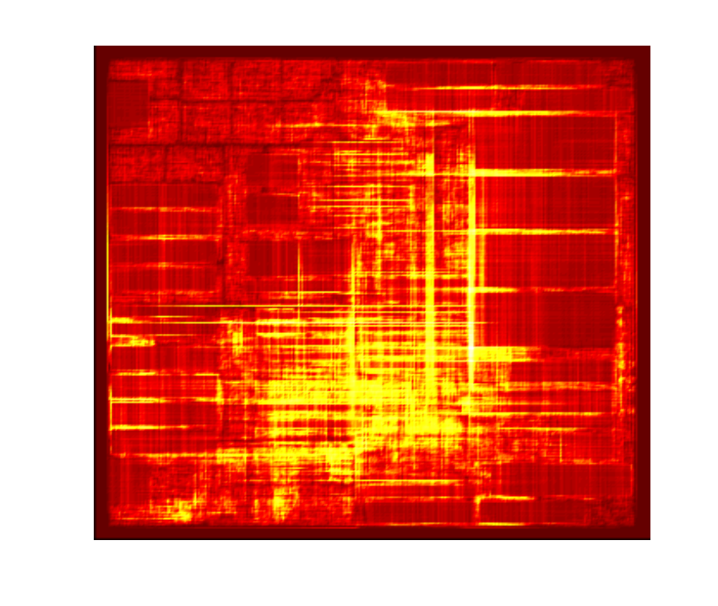
GRIP: Problem Decomposition
A subproblem is represented by
A rectangular area on the chip
A set of nets assigned to it
Subproblems should be defined to have similar complexity for: 1) workload balance, 2) avoiding overflow
GRIP’s strategy:
Recursive bi-partitioning to define the subproblem boundaries
Net assignment based on FLUTE* combined with dynamic detouring before solving each subproblem
adaptec1 benchmark
* [Chu, Wong--TCAD’08]

Slide 11
GRIP: Solving the Subproblems
4
6
3
9
Floating
1
2
Fixed
5
8
7
12
11
10

Slide 12
GRIP: Connecting Subproblems
Subproblem1
Subproblem2
0.0
0.0
0.0
0.0
0.0
0.0
0.0
0.0
0.0
0.0
Using IP-based procedure is essential to connect subproblems with low (or no) overflow

Slide 13
GRIP: Conclusions
First work to demonstrate that Integer Programming is applicable and allows obtaining significant improvement in the solution quality
9.23% and 5.24% in ISPD’07 and ISPD’08 benchmarks
Comparable or improved overflow in three unroutable benchmarks; after proposing an IP variation for overflow reduction in TCAD’11
However, even wall runtime (with the limited parallelism) prohibitively large; between 6 to 22 hours on a grid with CPUs of 2GB memory

Slide 14
Outline
Summary of
GRIP
Summary of GRIP
GRIP: Global Routing via Integer Programming
[DAC’09] [TCAD’11]
PGRIP
A Parallel Integer Programming Approach to Global Routing [DAC’10]
Power-GRIP
Power-GRIP
Power-Driven Global Routing for MSV Domains [DATE’11]

Slide 15
PGRIP: Motivation
Process all subproblems independently in parallel?
Routing inter-region nets without overflow is the main challenge
Subproblem 1
Subproblem 2
T_{a}
T_{b}
T_{a1}
T_{b2}
T_{b1}
T_{a2}

Slide 16
PGRIP: Overview
Goal: Remove synchronization barrier between subproblems
Allowing a much higher degree of parallelism without much degradation in wirelength or overflow
IP-based
patching
feedback
to enhance
connectivity
partial
routing
solution
Subproblem 1
Subproblem 2
…
Subproblem n
Define Subroblems
Define Subroblems
Connect Subroblems
Connect Subroblems
Initial Pricing
Initial Pricing
Patching
Patching
Adjusted Pricing
Adjusted Pricing

Slide 17
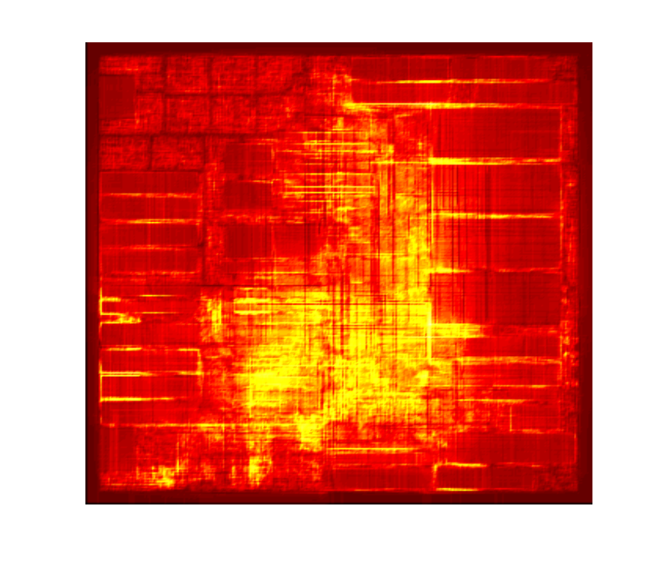
PGRIP: 1) Subproblem Definition
Quickly generate a routing solution
Work on a simplified 2-D grid-graph
Solve simplified LP relaxation version of the formulation by net fixing
(set to 10 minutes)
Recursive bi-partition to define boundaries of subproblems
To get subproblems with similar complexity, it balances number of nets in each subproblem
3. Traverse subproblems and apply some detouring to further enhance the net assignments

Slide 18
PGRIP: 2) Initial Pricing
Procedure
Apply pricing to generate candidate routes for each subproblem independently in a bounded-time
Allow inter-region nets to connect to anywhere on the subproblem boundaries
(set to 5 minutes)
Subproblem M
Subproblem L
(ILP-PGR)
T_{a}
T_{b}
Notes:
Initial Pricing
Assign different Q_e

Slide 19
PGRIP: 3) IP-Based Patching
The goal of the patching phase is to enhance connectivity
Patching problem
Input: “pseudo-terminal” locations per boundary per inter-region net
Output: a restricted window for each inter-region net on the boundary
Solved for each pair of adjacent boundaries
T1
T2
Notes:
Input vs Output

Slide 20
PGRIP: 3) IP-Based Patching
x_{a1}
x_{a2}
L_{a1}
Net n_{a}
x_{a3}
(ILP-Patch)
R_{a1}
x_{a4}
R_{a2}
L_{a2}
x_{b1}
x_{b2}
L_{b1}
Net n_{b}
x_{b3}
R_{b1}
x_{b4}
L_{b2}
R_{b2}
Notes:
Output of previous steps

Slide 21
PGRIP: 4) Adjusted Pricing
Subproblems solved independently
Apply adjusted pricing in which nets only allowed to connect within their provided restricted windows
Branching is then used to route each net from its candidate routes within each subproblem
(set to 20 minutes)
(set to 10 minutes)
Net n_{a}
Net n_{b}
Branching

Slide 22
PGRIP: 5) Connecting of Subproblems
Subproblems are connected simultaneously (in parallel)
Similar procedure as in GRIP
Inside each subproblem, the remaining edge capacities are allocated uniformly among its boundary connection problems
c
c
c
c

Slide 23
PGRIP: Simulation Setup
Pricing using MOSEK 5.0, Branching using CPLEX 6.5
All parallel jobs in CS grid at UW-Madison through Condor
Machines of similar speed and same 2GB memory
Runtime limits in PGRIP [target runtime: 75 minutes]
Defining subproblems:10 minutes
Initial pricing: 5 minutes
Adjusted pricing: 20 minutes
Branch-and-bound for solving subproblems: 10 minutes
Pricing to connect subproblems: 20 minutes
Branch-and-bound for connecting subproblems: 10 minutes

Slide 24
PGRIP: Comparison of Wirelength

Slide 25
PGRIP: Runtime
 | PGRIP |  |  | GRIP
 | #Parallel | WCPU (min) | TCPU (min) | E[#Parallel] | WCPU (min) | TCPU (min)
a1 (07) a2 (07) a3 (07) a4 (07) a5 (07) n1 (07) n2 (07) n3 (07) | 90 110 211 221 280 122 215 258 | 76 76 77 79 77 76 77 82 | 2101 2704 6319 5221 3175 2306 4192 14590 | 8.3 10.6 18.0 19.0 14.1 8.0 10.4 19.2 | 388 455 478 509 584 483 467 1430 | 2247 2677 5168 5258 7133 3076 5228 6768
n4 (08) n5 (08) n6 (08) n7 (08) b1 (08) b2 (08) b3 (08) b4 (08) | 255 504 459 725 124 243 326 453 | 77 80 78 86 76 77 78 82 | 2944 4953 2219 4788 956 3411 2690 3096 | 8.5 9.5 8.9 9.0 3.9 8.0 7.3 7.6 | 529 821 448 985 339 690 731 726 | 3974 6598 5096 5377 2770 3793 3448 4400
Average | 287 | 78 | 4104 | 11 | 629 | 4563

Slide 26
PGRIP: Conclusions
Removed synchronization barrier in GRIP
Achieve high-level of distributed processing
High use of IP—considered impractical for GR—shown to be practical when combined with distributed processing, allowing significant improvement in solution quality

Slide 27
Outline
Summary of
GRIP
Summary of
GRIP
GRIP: Global Routing via Integer Programming
[DAC’09] [TCAD’11]
PGRIP
PGRIP
A Parallel Integer Programming Approach to Global Routing [DAC’10]
Power-GRIP
Power-Driven Global Routing for MSV Domains [DATE’11]

Slide 28
Power-GRIP: Motivation
Interconnect power minimization
Reported to be around 30% of dynamic power for a 45nm high performance Intel microprocessor*
Can be significantly increased with wiring congestion and higher wire size at the higher metal layers
M6
M5
M4
M3
M2
M1
Why address at global routing?
Flexibility compared to detail routing
Metal layer and size known for each wire
Wire spacing and congestion can be approximated from utilization
*[R. Shelar and M. Patyra, ISPD 2010]

Slide 29
Power-GRIP: Our Contributions
Global Routing
Global Routing
Power Model for GR
Net decomposition based on supply voltage level
Estimate edge capacitance
Power aware IP for GR
Power aware IP for GR
Problem Decomposition
Problem Decomposition
MSV-based GR
MSV-based GR

Slide 30
Power-GRIP: Interconnect Modeling for MSV
level converter
cell
V_{L}
V_{H}
global bins
#1
#3
V_{H}
V_{L}
#2
V_{H}
V_{H}
Given
Voltage islands, each with either low (V_{L}) or high (V_{H}) voltage level
Placed level converters (LCs) based on the terminal locations
Decompose a net into sub-nets based on the LC locations
Ensures each decomposed net has only one supply level

Slide 31
Power-GRIP: Interconnect Power Modeling*
Total interconnect power is estimated as where f_{clk} is the frequency
Each (decomposed) net has corresponding switching activity α_{i}, supply voltage V_{i}, the capacitances of its sink cells and its route
For route t_{i} , the capacitance is the sum of the capacitances of the global routing edges in t_{i}
*[Shojaei, Wu, Davoodi, Basten, ISLPED 2010]

Slide 32
Power-GRIP: GR Edge Capacitance Modeling
The unit capacitance of each GR edge is a function of the metal layer l_{e}, wire width w_{e} and wire spacing s_{e}
Metal layer l_{e} is known for each GR edge, and we assume only one (minimum) wire width w_{e} for each metal layer
The spacing s_{e} for an edge is estimated from the edge utilization r_{e}
s_{e}
s_{e}
w_{e}
w_{e}
l_{e}

Slide 33
Power-GRIP: Our Contributions
Global Routing
Global Routing
Power Model for GR
Power Model for GR
Power Aware IP for GR
Problem Decomposition
Problem Decomposition
MSV-based GR
MSV-based GR

Slide 34
Power-GRIP: Motivational Example
n₁ : V_{L}, α=0.3
n₂ : V_{H}, α=0.7
n₃ : V_{L}, α=0.4
Wirelength-based GR
Power-aware GR

Slide 35
Power-GRIP: IP for Power Minimization
(IP-POW)

Slide 36
Power-GRIP: Objective of (IP-POW)
Minimize total interconnect power directly in the objective
The switching activity α_{i} and voltage level V_{i} are known (constant value) for each (decomposed) net
The capacitance of each GR edge is a variable, and will be determined during the optimization
Expressed as constraint
Penalize the unrouted nets by choosing a large M

Slide 37
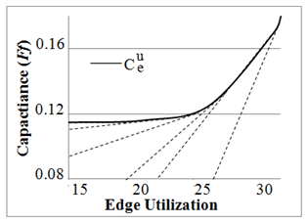
Power-GRIP: Capacitance Constraint of (IP-POW)
The unit capacitance of an edge is a piecewise linear convex function of edge utilization
For each line segment q, the edge capacitance is written as without approximation
The edge utilization is expressed as
NANGATE 45nm library

Slide 38
Power-GRIP: Wirelength Constraint of (IP-POW)
Rerouting nets from congested regions or to lower metal layers can reduce interconnect power
But it may increase wirelength
Can control the tolerance parameter β to set an upper bound for the total wirelength

Slide 39
Power-GRIP: Our Contributions
Global Routing
Global Routing
Power Model for GR
Power Model for GR
Power Aware IP for GR
Power Aware IP for GR
Problem Decomposition
Two-phase approach to linearize IP heuristically
Use price-and-branch for generating power aware routes
MSV-based GR
MSV-based GR

Slide 40
Power-GRIP: Complexity of (IP-POW)
(IP-POW)
All the constraints in (IP-POW) are linear but the objective expression is nonlinear
Utilize a two-phase approach to handle the nonlinearity
Phase1: Minimize total capacitance by rerouting nets, and obtain the estimation of edge capacitance
Phase2: Fix capacitance and consider net activity and voltage level

Slide 41
Phase 1: Minimize Total Capacitance
(POW-P1)
Modify the objective to minimize total capacitance
Modify the third constraint to calculate the total capacitance C_{e} per edge

Slide 42
Phase 2: Minimize Total Power
(POW-P2)
Incorporate net activity and voltage level in the objective function to minimize total power directly
Get estimated edge capacitance from phase 1, and consider it to be constant
But penalize the edge capacitance if over-utilized

Slide 43
Power-GRIP: Solving (POW-IP1) and (POW-IP2)
Based on one set of initial route
Price:
Identify “promising” routes for each net by solving iterative LP relaxations via column generation
Solve LP, get dual sol.
Power-aware edge weights
Setup edge weight
Identify new routes for each net
yes
Have new routes?
no
Branch:
Solve IP via branch and bound
Solve IP
Notes:
Change font color

Slide 44
Power-GRIP: Problem Decomposition
V_{L}
V_{H}

Slide 45
Power-GRIP: Simulation Setup
Random net activity generation
Two voltage levels 0.9 and 1.1V
Capacitance for each layer from 45nm NANGATE library
Price-and-branch was solved using CPLEX 12.0
Submitted jobs via Condor to CS grid at UW-Madison
Wirelength degradation is not allowed (β=0)

Slide 46
Power-GRIP: Simulation Flow
Initial solution: NTHU-Route 2.0 [Chang, ICCAD’08]
Implemented voltage island generation [Chu, ICCAD06]
Based on the voltage islands, inserted LCs using a proposed IP formulation
Tolerable wirelength
degradation factor = 0
Initial Global Routing Solution
Voltage assignment & Inserting level converter
Power-optimized Global Routing
Notes:
considered available white space
minimized number of LCs while trying to position them as close as possible to the sink terminals
Into backup slide

Slide 47
Power-GRIP: Comparison – Capacitance & Power
After phase 1, the total capacitance and power has significant saving of 12.5% and 8.8% respectively
After phase 2, we can get additional 4.8% on capacitance and additional 7.9% on power saving

Slide 48
Power-GRIP: Conclusions
Proposed an IP formulation to minimize an interconnect power metric for global routing in multi-supply voltage domain
Implemented as a two-phase approach to handle the nonlinearity in the IP formulation
Price-and-branch procedure to systematically generate routes to reduce interconnect power (similar to GRIP)
One-time optimization in the design flow, in effect achieves a balance in spreading congestion and rerouting nets to lower layers
Without over-usage of each routing resource
Without increase in wirelength

Slide 49
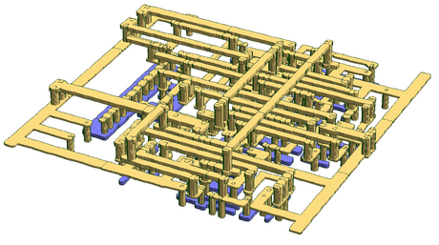
Thank You
Notes:
49

Slide 50

Backup Slides
Notes:
50

Slide 51
3-D Global Routing
BACKUP
Vias
global bins
Vertical edges
global edges
Horizontal edges
3-D Global Routing
Welcome to the Real World!!
Pure 2-D routers are considered as “degenerate” [Westra, SLIP’05]
Cost of vias change the game
Currently no academic routers can handle 3-D problem directly
2-D router + layer assignment
Via aware router (penalize bend wires)

Slide 52
Column Generation – Pricing Problem
BACKUP
Solve the relaxed Linear Programming of ILP-GR
Apply Column Generation to solve Linear Programming
Only explicitly include a subset of possible routes
Restricted Primal Problem:
Dual Problem:
Primal Solution
Dual Solution
If a route with
Then add this route to the Restricted Primal Problem may reduce the objective value

Slide 53
Identify New Routes
BACKUP
How to identify a new route with ?
Create initial routes using pattern routing
Solve LP, get dual sol.
Setup edge weight
T₁
Identify new routes for each net
e₂₈
yes
Have new routes?
e₆
S₁
no
Solve ILP

Slide 54
GRIP: Price-and-Branch
BACKUP
Pricing:
Systematically identify
candidate routes by solving linear program relaxation of (ILP-GR)
1.0
t_{b}
1.0
1.0
1.0
1.0
1.0
1.0
1.0
1.0
1.0
1.0
99.0
99.0
Branch:
Identify one route for each net from generated candidate routes
1.0
1.0
1.0
t_{a}

Slide 55
Floating Terminal
BACKUP
Attempts to give more flexibility to the congested subregions
T
T
S
auxiliary
node
Floating terminal
Fixed terminal
Notes:
Need to replace figures

Slide 56
GRIP: Solving the Subproblems
BACKUP
4
6
3
9
Floating
1
2
Fixed
5
8
7
12
11
10
0.0
0.0
0.0
0.0

Slide 57
PGRIP: 3) Patching
BACKUP
(ILP-Patch)
x_{a1}
x_{a2}
M_{a1}
Net n_{a}
x_{a3}
L_{a1}
x_{a4}
L_{a2}
M_{a2}
x_{b1}
x_{b2}
M_{b1}
Net n_{b}
x_{b3}
L_{b1}
x_{b4}
M_{b2}
L_{b2}
Notes:
Output of previous steps

Slide 58
PGRIP: IP-Based Patching (2)
BACKUP
G’(V’, E’)
c_{a1}
c_{a2}
c_{b1}
c_{b2}
c_{b3}
c_{b4}
v
c_{a3}
c_{a5}
c_{b5}
e
c_{a4}
c_{a6}
c_{b6}
(ILP-Patch)

Slide 59
PGRIP: Comparison of QoS
BACKUP
 | PGRIP |  | GRIP |  | FGR |  | FR 4.0 |  | NTHU 2.0
 | TOF | WL | TOF | WL(%) | TOF | WL(%) | TOF | WL(%) | TOF | WL(%)
a1 (07) a2 (07) a3 (07) a4 (07) a5 (07) n1 (07) n2 (07) n3 (07) | 0 0 0 0 0 0 0 41K | 82.3 83.4 186.5 173.2 241.5 84.9 123.3 156.3 | 0 0 0 0 0 0 0 52K | -1.56 -1.24 -0.58 -0.52 -1.07 -1.14 -1.55 -1.03 | 0 0 0 0 0 526 0 30K | 7.00 7.20 6.61 3.44 7.13 9.97 4.73 10.02 | 0 0 0 0 0 0 0 32K | 9.60 8.90 8.87 7.36 10.79 7.46 9.11 14.17 | 0 0 0 0 0 0 0 31K | 7.38 8.21 7.15 6.88 7.20 6.71 8.43 6.38
Average |  |  |  | -1.09% |  | 6.58% |  | 8.87% |  | 7.42%
n4 (08) n5 (08) n6 (08) n7 (08) b1 (08) b2 (08) b3 (08) b4 (08) | 132 0 0 54 0 0 0 176 | 124.9 223.8 172.0 338.4 54.0 86.5 126.5 221.1 | 152 0 0 74 0 0 0 186 | -0.44 -0.44 -0.88 -0.83 -0.54 -0.64 -0.24 -0.22 | 262 0 0 1458 0 0 0 414 | 3.65 3.95 4.61 3.37 5.81 5.38 4.20 4.54 | 144 0 0 62 0 0 0 152 | 6.78 5.47 5.83 5.17 6.72 9.50 3.24 8.50 | 138 0 0 68 0 0 0 162 | 4.29 3.38 2.78 4.22 3.49 4.50 3.22 4.30
Average |  |  |  | -0.53% |  | 4.44% |  | 6.40% |  | 3.77%

Slide 60
Power-GRIP: LC Placement
BACKUP
t_{i}
(IP-LC)
V_{L}
V_{H}
level converter
V_{H}
V_{L}
i₁
i₂
i₃
i₄
i₄
A_{v}
V_{H}

Slide 61
Power-GRIP: Decomposition of MSV nets
BACKUP
level converter
n₁ (v_{L})
s
s (v_{L})
t₂ (v_{H})
t₂
n₁ (v_{L})
cannot merge
n₃ (v_{H})
n₃ (v_{H})
can merge
t₃ (v_{H})
n₂ (v_{H})
t₃
n₂ (v_{H})
s
t₁ (v_{H})

Slide 62
Power-GRIP: GR Edge Capacitance Modeling
BACKUP
Metal layer l_{e} is known for each GR edge, and we assume only one (minimum) wire width w_{e} at GR stage
The spacing s_{e} for an edge is estimated from the edge utilization r_{e}
Area, fringe, and coupling capacitances for metal layer 1 with respect to edge utilization for a 45nm library (i.e., NANGATE library)
Notes:
Send to backup

Slide 63
Phase 1: Minimize Total Capacitance
BACKUP
(POW-P1)
Modify the objective to minimize total capacitance
Modify the third constraint to calculate the total capacitance C_{e} per edge
m_{q} and r_{q} are the slope and offset for the total edge capacitance respectively

Slide 64
Phase 2: Minimize Total Power
BACKUP
From the phase 1 solution , we can obtain an “effective” utilization for each edge
Similarly, we can also obtain “unit capacitance” for each edge (i.e., capacitance of one wire on one edge) based on the solution of phase 1

Slide 65
Power-GRIP: Power-Aware Route Generation
BACKUP
t_{a}
0.07
0.00
0.00
0.00
0.00
0.12
0.17
0.06
t'_{a}
v_{b}
0.07
t_{b}
0.10
t_{b}
0.85
0.07
0.85
0.03
0.07
0.04
0.11
0.07
0.04
u_{b}
Edge weights represent rate of improvement in objective
i.e., capacitance in (POW-P1) and power metric in (POW-P2) from previous round of LP
Weighted shortest path finds additional candidate routes to improve the objective
applied by replacing branches in an existing route from a previous LP iteration

Slide 66
Power-GRIP: Problem Decomposition
V_{L}
V_{H}

Slide 67
Power-GRIP: Benchmarks
BACKUP
Benchmark | # nets | #LC | # SP
adaptec1 | 177K | 20K | 130
adaptec2 | 208K | 17K | 195
adaptec3 | 368K | 43K | 359
adaptec4 | 401K | 36K | 296
adaptec5 | 548K | 85K | 454
newblue1 | 271K | 16K | 195
newblue2 | 374K | 47K | 312
Benchmark | # nets | #LC | # SP
newblue4 | 531K | 79K | 462
newblue5 | 892K | 84K | 658
newblue6 | 835K | 91K | 532
newblue7 | 1647K | 72K | 670
bigblue1 | 197K | 26K | 152
bigblue2 | 429K | 43K | 275
bigblue3 | 666K | 60K | 453
bigblue4 | 1134K | 51K | 509
Note: newblue3 is an un-routable benchmark, and therefore we didn’t consider it in this simulation
Notes:
Backup, put a buttom

Slide 68
Power-GRIP: Comparison - Wirelength
BACKUP
Since the wirelength degradation factor β was set to 0, no wirelength degradation was found over all benchmarks

