Slide 1

A Hybrid Approach for Fast and Accurate Trace Signal Selection for Post-Silicon Debug
Min Li and Azadeh Davoodi
Department of Electrical and Computer Engineering
University of Wisconsin-Madison
WISCAD Electronic Design Automation Lab http://wiscad.ece.wisc.edu/

Slide 2
Comparison of Verification Methods
Approach | Throughput (Hz)
System simulation | ~10³
RTL simulation | 10¹ to 10³
Gate simulation | 10⁻¹ to 10¹
Emulation | ~10⁵
FPGA prototyping | ~10⁶
Silicon | 10⁷ to 10⁹
[Table from Aitken, et al DAC’10]
Simulation is too slow!
4-8 orders of magnitude slower than silicon
e.g., for Pentium IV: 2 years of simulation = 2 min operation

Slide 3
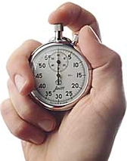
Post-Silicon Debug
Post-Silicon Debug (PSD) stage
Stage after the initial chip tape-out and before the final release of product
Involves finding errors causing malfunctions
Bugs found using real-time operation of a few manufactured chips with real-world stimulus
Bugs fixed through multiple rounds of silicon steppings
Has become significantly expensive and challenging
Mainly due to poor visibility of the internal signals inside the chips

Slide 4
Embedded Logic Analyzer (ELA)
On-chip ELA
Used to increase visibility to internal signals
Captures the values of a few flipflops (i.e., trace signals) real-time and stores them inside the Trace Buffer
Control Unit
Trigger signals
Trigger condition
Synchronization data
Trigger Unit
Offload Unit
Off-chip analysis
Trace signals
Sampling
Unit
Assertion flags
Trace Buffer
Assertion Checker
Traced data
The traced data are then extracted off-chip and analyzed to restore the remaining signals inside the chip as many as possible

Slide 5




Overview of Trace Buffer
Due to the limited on-chip area, the size of trace buffer is small
e.g., B : 8 to 32 signals and M: 1K to 8K cycles
Terminology
“Capture window” has a size of BxM
“Observation window” has a size of BxN where N << M
M
Trace buffer is an on-chip buffer of size BxM
B is the buffer bandwidth and identifies the number of signals which can be traced
M is the depth of buffer and is equal to the number of clock cycles that tracing is applied
Cycle 0, 1 ….M-1
$$S_{0}$$
$$S_{1}$$
B
…
$$S_{i}$$
1
0
0
…
1
…
$$S_{B−1}$$

Slide 6
Restoration Using Trace Signals
Restoration using “X-Simulation”
At each cycle of the capture window, forward and backward restoration steps are applied iteratively until no more signals can be restored
f₃
Forward
Restoration
f₁
f₂
0
0
0
0
f₅
Backward
Restoration
f₄
Traced flipflop
DFF\Cycle | 0 | 1 | 2 | 3
F1 | X | X | X | X
F2 | 0 | 1 | 1 | 0
F3 | X | X | X | X
F4 | X | X | X | X
F5 | X | X | X | X
1 | 1 | 0 | X
X | 1 | 1 | X
X | 0 | X | X

Slide 7

Restoration Using Traced Signals
Quality of restoration is measured by the State Restoration Ratio (SRR)
Measured within a capture window (BxM)
$SRR=\frac{B×M+\#restored signals}{B×M}=\frac{4+6}{4}=2.5$
Reflects the amount of restoration per trace signal per clock cycle
DFF\Cycle | 0 | 1 | 2 | 3
F1 | 1 | 1 | 0 | X
F2 | 0 | 1 | 1 | 0
F3 | X | 1 | 1 | X
F4 | X | X | X | X
F5 | X | 0 | X | X
Restored signal

Slide 8
Trace Signal Selection Problem
Challenges of PSD using trace buffers
Due to the small trace buffer size, the capture window is small
Different selections of the B trace signals can result in significantly different SRR
Trace signal selection problem
Given a trace buffer of size BxM
Select B flipflops for tracing such that the remaining internal signals can be restored as many as possible during M cycles corresponding to the capture window
Maximize the State Restoration Ratio (SRR)

Slide 9
Existing Trace Selection Algorithms
Empty trace set
All traces
included
Select one trace that leads to the largest SRR in each iteration
Prune one trace that leads to the smallest SRR in each iteration
No
No
Selected B traces?
B traces left?
Yes
Yes
Terminate
Terminate
Forward Greedy
Backward Pruning
Ko & Nicolici [DATE’08]
Liu & Xu [DATE’09]
Prabhakar & Xiao [ATS’09]
Basu & Mishra [VLSI’11]
Chatterjee & Bertacco [ICCAD’11]

Slide 10
Existing Trace Selection Algorithms
Also categorized based on the way SRR is approximated
Metric-based
Uses quick metrics to approximate SRR with high error but fast runtime
Ko & Nicolici [DATE’08]
Liu & Xu [DATE’09]
Prabhakar & Xiao [ATS’09]
Basu & Mishra [VLSI’11]
Davoodi & Shojaei [ICCAD’10]
Simulation-based
Uses X-Simulation to measure SRR accurately with backward pruning-travesal but still with a very long runtime
Chatterjee & Bertacco [ICCAD’11]

Slide 11
Simulation-Based Trace Selection
Much more accurate than metric-based
Simulation can directly consider signal correlations
Simulation accounts for the fact that a flipflop may be restored to different values within the observation window
Much slower than metric-based
Restoration of each gate is evaluated using X-Simulation for each clock cycle
DFF\Cycle | 0 | 1 | 2 | 3
F1 | X | X | X | X
F2 | 0 | 1 | 1 | 0
F3 | X | X | X | X
F4 | X | X | X | X
F5 | X | X | X | X
1 | 1 | 0 | X
X | 1 | 1 | X
X | 0 | X | X

Slide 12
Contributions
A hybrid trace signal selection algorithm
Blend of simulation and metrics
We propose a new set of metrics to quickly find a small number of top trace signal candidates at each step of the algorithm
Next, among the few top candidates, X-Simulation is used to accurately evaluate the SRR and select the best
We show our method has same or better solution quality compared to simulation-based approach with runtime as fast as the metric-based approaches

Slide 13
Overview of Our Algorithm
Based on forward-greedy trace signal selection
Proposed metrics
Reachability List of a flipflop f
A small subset of flipflops which are good candidates to be restored by f
Restorability Rate
Rate that each flipflop is restored using the trace signals selected so far
Restoration Demand of flipflop i from flipflop f
Where flipflop f is candidate for the next trace signal
Impact Weight of flipflop f
How much f can restore the untraced flipflops after accounting for restoration from the already-selected trace signals
Initialize metrics
Compute fast metrics to
find a small number of top candidates for tracing
Use a small number of X-Simulation to identify the best candidate (next trace) from the top candidates
Update metrics
No
Selected B traces?
Yes
Terminate

Slide 14

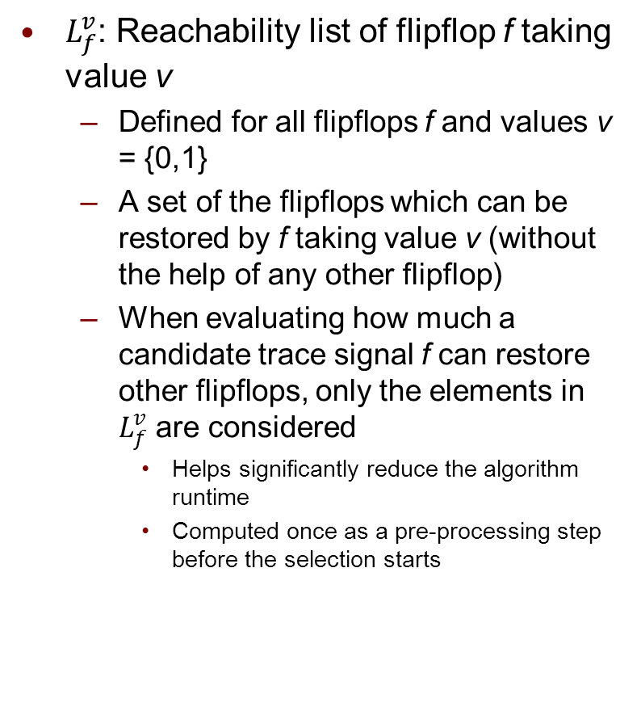
“Reachability List”
$L_{f}^{v}$: Reachability list of flipflop f taking value v
Defined for all flipflops f and values v = {0,1}
A set of the flipflops which can be restored by f taking value v (without the help of any other flipflop)
When evaluating how much a candidate trace signal f can restore other flipflops, only the elements in $L_{f}^{v}$ are considered
Helps significantly reduce the algorithm runtime
Computed once as a pre-processing step before the selection starts
f₃
f₁
f₂
f₅
f₄
$$L_{2}^{0}\text{= \{}f_{1}\text{, }f_{5}\text{\},} L_{2}^{1}\text{= \{}f_{1}\text{, }f_{3}\text{\}}$$

Slide 15
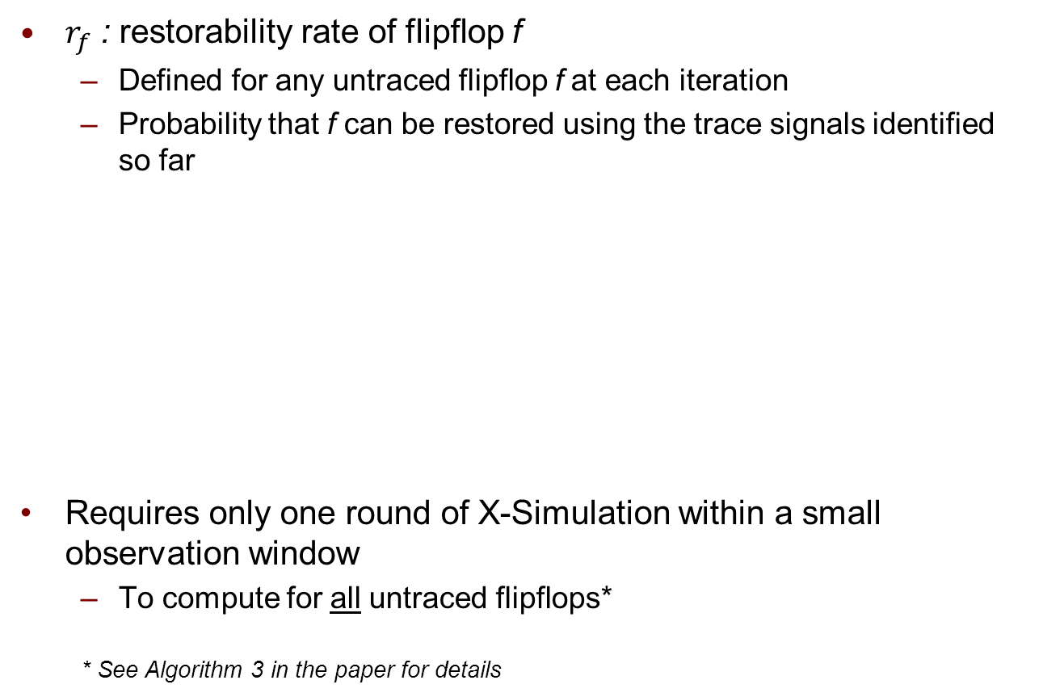

“Restorability Rate”
$r_{f}$ : restorability rate of flipflop f
Defined for any untraced flipflop f at each iteration
Probability that f can be restored using the trace signals identified so far
Requires only one round of X-Simulation within a small observation window
To compute for all untraced flipflops*
* See Algorithm 3 in the paper for details
DFF\Cycle | 0 | 1 | 2 | 3
F1 | 1 | 1 | 0 | X
F2 | 0 | 1 | 1 | 0
F3 | X | 1 | 1 | X
F4 | X | X | X | X
F5 | X | 0 | X | X
$$r_{3}=\frac{2}{4}$$

Slide 16

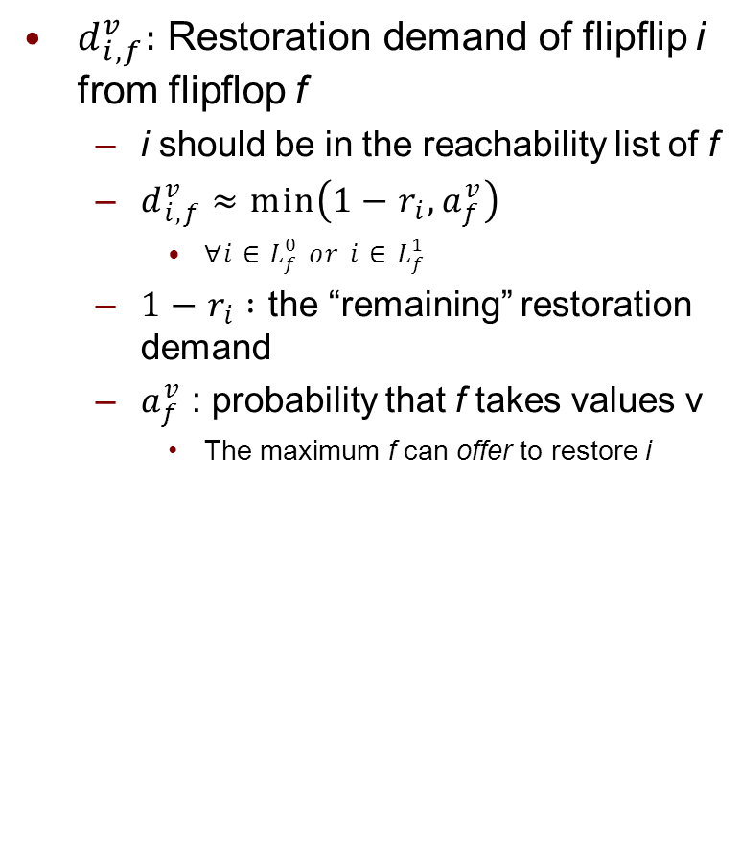
“Restoration Demand”
$d_{i,f}^{v}:$ Restoration demand of flipflip i from flipflop f
i should be in the reachability list of f
$d_{i,f}^{v}≈min\left(1−r_{i},a_{f}^{v}\right)$
$∀i∈L_{f}^{0} or i∈L_{f}^{1}$
$1−r_{i} :$ the “remaining” restoration demand
$a_{f}^{v}$ : probability that f takes values v
The maximum f can offer to restore i
f₃
f₁
f₂
f₅
f₄
Potentially-traced
$$d_{3,2}^{1}≈min(1−r_{3},a_{2}^{1})$$
This expression is just an upper-bound approximation of the actual demand however it can be evaluated very quickly!

Slide 17


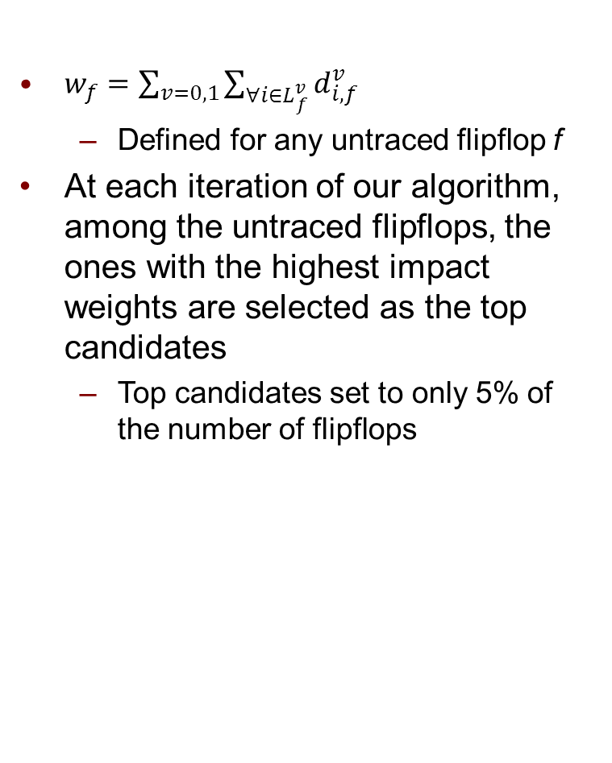
“Impact Weight”
$w_{f}=\sum_{v=0,1}{\sum_{∀i∈L_{f}^{v}}{d_{i,f}^{v}}}$
Defined for any untraced flipflop f
At each iteration of our algorithm, among the untraced flipflops, the ones with the highest impact weights are selected as the top candidates
Top candidates set to only 5% of the number of flipflops
f₃
f₁
f₂
f₅
f₄
$w_{2}$ = $d_{1,2}^{0}$ + $d_{5,2}^{0}$+ $d_{1,2}^{1}$ + $d_{3,2}^{1}$
$$L_{2}^{0}\text{= \{}f_{1}\text{, }f_{5}\text{\},} L_{2}^{1}\text{= \{}f_{1}\text{, }f_{3}\text{\}}$$

Slide 18
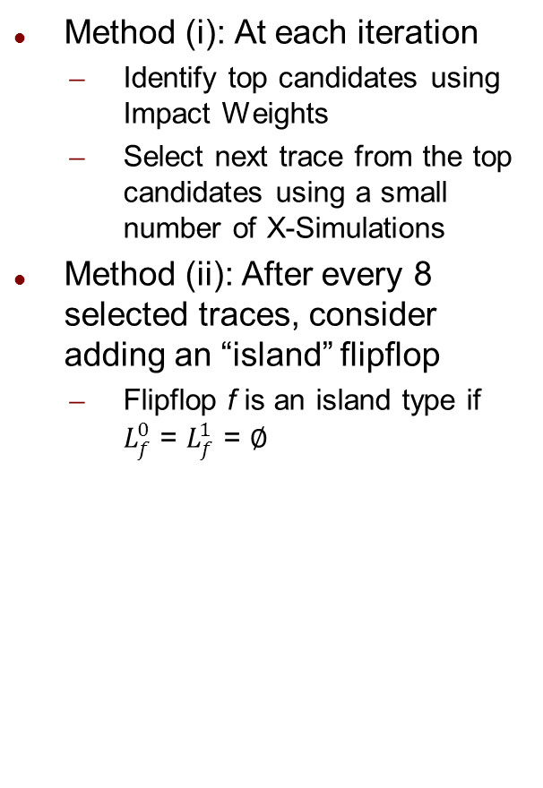
Trace Selection Process
Method (i): At each iteration
Identify top candidates using Impact Weights
Select next trace from the top candidates using a small number of X-Simulations
Method (ii): After every 8 selected traces, consider adding an “island” flipflop
Flipflop f is an island type if $L_{f}^{0}$ = $L_{f}^{1}$ = $∅$
Initialize metrics
Method (i) Select using Impact Weights
Select next trace signal
No
Selected 8X traces?
Update metrics
Yes
Method (ii) Consider adding an “island” signal
Selected B traces?
No
Yes
Terminate
Island flipflops will never be selected as a trace signal using Method (i)
Use X-Simulation to measure SRR to identify the best island
Few simulations because the number of islands are small (17% of the flipflops for S5378)

Slide 19
Simulation Setup
Evaluation metric
Use SRR to measure the restoration quality
Experimented with trace buffers of size (8, 16, 32) X 4K cycles
Comparison made with
METR: Metric-based: [Shojaei et al, ICCAD’10]
Mainly used for runtime comparison
Best reported runtime
SIM: Simulation-based: [Chatterjee et al, ICCAD’11]
Mainly used to compare solution quality
Best reported solution quality

Slide 20
Comparison of Runtime
Circuit | #DFF | #Traces | METR (sec) | SIM* (hr:min:sec) | Ours (sec)
S5378 | 163 | 8 | 8 | 00:06:50 | 5
 |  | 16 | 27 | 00:06:40 | 27
 |  | 32 | 66 | 00:05:30 | 28
S9234 | 145 | 8 | 6 | 00:07:28 | 26
 |  | 16 | 17 | 00:06:05 | 84
 |  | 32 | 38 | 00:04:10 | 86
S35932 | 1728 | 8 | 73 | 07:13:00 | 139
 |  | 16 | 167 | 07:12:00 | 208
 |  | 32 | 408 | 07:11:00 | 217
S38417 | 1564 | 8 | 3690 | 50:05:00 | 434 (8X faster)
 |  | 16 | 7620 | 50:04:00 | 2508 (3X faster)
 |  | 32 | 13428 | 50:02:00 | 2521 (5X faster)
S38584 | 1166 | 8 | 53 | 16:33:00 | 167
 |  | 16 | 140 | 16:32:00 | 741
 |  | 32 | 354 | 16:31:00 | 752
SIM significantly slower than METR and Ours
Ours has comparable or faster runtime than METR
* SIM ran on a quad-core machine using up to 8 threads

Slide 21
Comparison of Solution Quality I
Circuit | #Traces | SRR METR | SRR SIM | SRR Ours | Improvement
S5378 | 8 | 13.7 | 12.8 | 13.6 | +6.3%
 | 16 | 8.1 | 7.1 | 8.0 | +12.7%
 | 32 | 4.1 | 4.4 | 4.2 | -4.5%
S9234 | 8 | 8.4 | 9.1 | 9.8 | +4.3%
 | 16 | 5.8 | 6.6 | 6.8 | +3.0%
 | 32 | 3.4 | 3.6 | 3.6 | +0.0%
S35932 | 8 | 31.1 | 58.1 | 61.4 | +5.7%
 | 16 | 19.4 | 36.2 | 38.3 | +5.8%
 | 32 | 11.6 | 23.1 | 23.4 | +1.3%
S38417 | 8 | 17.6 | 29.4 | 51.4 | +74.5%
 | 16 | 13.1 | 17.8 | 30.1 | +12.9%
 | 32 | 9.7 | 20.0 | 17.5 | -12.5%
S38584 | 8 | 13.5 | 14.9 | 24.0 | +31.1%
 | 16 | 10.8 | 18.1 | 18.5 | +2.2%
 | 32 | 7.1 | 16.4 | 17.5 | +6.7%
Average |  |  |  |  | 10.0%
On average 10.0% improvement in SRR compared to SIM
SIM typically has much higher SRR than METR, especially in larger benchmarks

Slide 22
Identification using Impact Weights
How accurate are the top candidates identified by Impact Weights?
Use SRR to identify the “actual” top candidates (resulting in the highest SRR) by X-Simulation
Used as the golden case
Identify the top candidates obtained using Impact Weights which are also top candidates in the golden case

Slide 23
Comparison of Solution Quality II
Circuit | #Traces | SRR Ours-w/o SIM | SRR Ours | Improvement
S5378 | 8 | 13.4 | 13.6 | -1.5%
 | 16 | 7.9 | 8.0 | -1.3%
 | 32 | 4.0 | 4.2 | -4.8%
S9234 | 8 | 9.4 | 9.8 | -4.1%
 | 16 | 6.1 | 6.8 | -10.3%
 | 32 | 3.3 | 3.6 | -8.3%
S35932 | 8 | 31.6 | 61.4 | -48.5%
 | 16 | 18.9 | 38.3 | -50.7%
 | 32 | 11.3 | 23.4 | -51.7%
S38417 | 8 | 18.1 | 51.4 | -64.8%
 | 16 | 10.3 | 30.1 | -65.8%
 | 32 | 5.9 | 17.5 | -66.3%
S38584 | 8 | 18.3 | 24.0 | -23.8%
 | 16 | 14.8 | 18.5 | -20.0%
 | 32 | 10.7 | 17.5 | -38.9%
Ours-w/o SIM: Our algorithm when the next trace is the candidate with highest Impact Weight
X-Simulation is not used to find the best candidate
This experiment shows that X-Simulation is necessary

Slide 24
Comparison of Solution Quality III
Circuit | #Traces | SRR Ours-w/o Islands | SRR Ours | Improvement
S5378 | 8 | 12.5 | 13.6 | -8.1%
 | 16 | 7.8 | 8.0 | -2.5%
 | 32 | 4.1 | 4.2 | -2.4%
S9234 | 8 | 8.1 | 9.8 | -17.3%
 | 16 | 6.5 | 6.8 | -4.4%
 | 32 | 3.5 | 3.6 | -2.8%
S35932 | 8 | 61.4 | 61.4 | +0.0%
 | 16 | 38.3 | 38.3 | +0.0%
 | 32 | 23.4 | 23.4 | +0.0%
S38417 | 8 | 48.2 | 51.4 | -6.2%
 | 16 | 28.7 | 30.1 | -4.7%
 | 32 | 16.7 | 17.5 | -4.6%
S38584 | 8 | 23.9 | 24.0 | -0.4%
 | 16 | 18.5 | 18.5 | +0.0%
 | 32 | 17.5 | 17.5 | +0.0%
Ours-w/o Islands: Our algorithm when 8X traces are selected
Islands are not considered
This experiment shows that the solution quality of some benchmarks are influenced by the islands
Islands tend to have a larger impact on smaller trace buffer widths

Slide 25
Summary
We presented a new trace signal selection algorithm
Utilizes a small number of simulations with quickly-evaluated metrics at each iteration
Has comparable or better solution quality with respect to a simulation-based algorithm
Has similar runtime to a metric-based algorithm

Slide 26
Thank You!
Questions?
adavoodi@wisc.edu

Slide 27
Simulation-based Approximation of SRR
Done using X-Simulation but for an “observation window” instead of the entire the capture window
e.g., Chatterjee et al [ICCAD’11] shows the SRR computed for an observation window of 64 cycles is sufficiently close to the SRR corresponding to the capture window of 4K cycles
observation window << capture window
DFF\Cycle | 0 | 1
F1 | 1 | X
F2 | 0 | 1
F3 | X | 1
F4 | X | X
F5 | X | 0

Slide 28





Metric-based Approximation of SRR
Example
“Visibility” metric proposed by Liu, et al [DATE’09]
Visibility of a flipflop represents how much it can be restored using the currently-selected trance signals
Summation of visibility of all untraced flipflops is used as an estimate of SRR
f₃
f₁
f₂
f₅
f₄
Traced
Total Visibility = 2+1+1 = 4

Slide 29

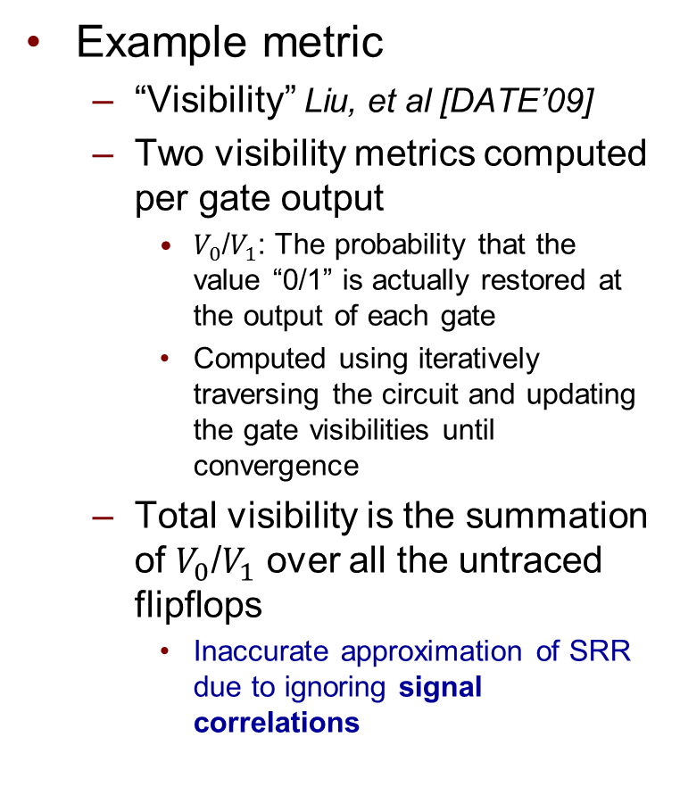





Metric-based Approximation of SRR
$$V_{0}=0.25$$
$$V_{1}=0.75$$
Example metric
“Visibility” Liu, et al [DATE’09]
Two visibility metrics computed per gate output
$V_{0}$/$V_{1}$: The probability that the value “0/1” is actually restored at the output of each gate
Computed using iteratively traversing the circuit and updating the gate visibilities until convergence
Total visibility is the summation of $V_{0}$/$V_{1}$ over all the untraced flipflops
Inaccurate approximation of SRR due to ignoring signal correlations
f₃
$$V_{0}=1$$
$$V_{1}=1$$
f₁
f₂
$$V_{0}=1$$
$$V_{1}=1$$
f₅
f₄
$$V_{0}=0.75$$
$$V_{1}=0.25$$
$$V_{0}=1$$
$$V_{1}=1$$
$$V_{0}=1$$
$$V_{1}=1$$
Traced
Visibility = 1+1+0.25+0.75+0.75+0.25 = 4

Slide 30
Comparison of Solution Quality IV
Circuit | #Traces | SRR Forward Greedy | SRR Ours | Improvement
S5378 | 8 | 13.5 | 13.6 | -0.7%
 | 16 | 7.9 | 8.0 | -1.3%
 | 32 | 4.2 | 4.2 | +0.0%
S9234 | 8 | 9.8 | 9.8 | +0.0%
 | 16 | 5.9 | 6.8 | -13.2%
 | 32 | 3.5 | 3.6 | -2.8%
S35932 | 8 | 59.3 | 61.4 | -3.4%
 | 16 | 37.4 | 38.3 | -2.3%
 | 32 | 22.3 | 23.4 | -4.7%
S38417 | 8 | 51.5 | 51.4 | +0.0%
 | 16 | 24.0 | 30.1 | -19.6%
 | 32 | 16.8 | 17.5 | -4.0%
S38584 | 8 | 25.1 | 24.0 | +4.6%
 | 16 | 20.7 | 18.5 | +11.9%
 | 32 | 18.0 | 17.5 | +2.9%
Forward greedy: Simulation combined with forward greedy selection strategy

Slide 31
Distribution of Impact Weights
Itr. 1
Itr. 2
Itr. 3
Observed after three iterations in benchmark S38417
Impact Weights of top candidates are much higher than the remaining signals

