Slide 1


Trace Signal Selection for Post-Silicon Debug
WISCAD Electronic Design Automation Lab http://wiscad.ece.wisc.edu/

Slide 2
Outline
Preliminaries
Single-mode
Multi-mode
Background and Preliminaries
Challenges of post-silicon debug
Post-silicon debug using trace buffers
The trace signal selection problem
Hybrid single-mode trace signal selection (SMTS)
Hybrid single-mode trace signal selection (SMTS)
A fast and high quality trace signal selection algorithm for a single-mode of operation
Multi-mode trace signal selection (MMTS)
Multi-mode trace signal selection (MMTS)
A fast and high quality trace signal selection algorithm for multi-mode of operation

Slide 3
Post-Silicon Debug (PSD)
Preliminaries
Single-mode
Multi-mode
Real-time operation of a few manufactured chips with real-world stimulus
Involves finding errors causing malfunctions
Fix through multiple rounds of Silicon Stepping/Revision
Has become significantly time-consuming and expensive
Tight Time-to-Market requirement
Formal verification and simulation tools do not scale as technology scales
Poor visibility inside the chip
Figure from Abramovici et al. [DAC’06]
PSD Overview
Restoration using TB
Prior Work
Control Signals

Slide 4
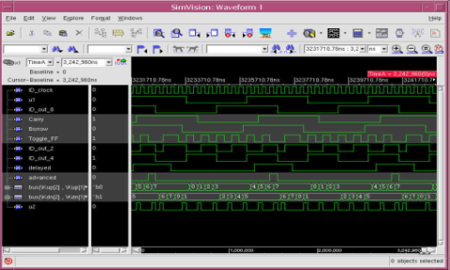

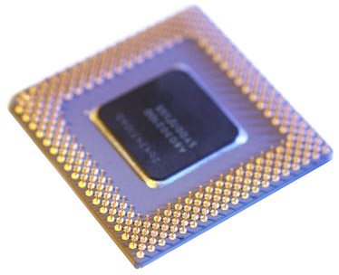
Overview of Techniques for PSD
Preliminaries
Single-mode
Multi-mode
Methods to increase visibility inside the chip during PSD:
Manual probing, e.g., Paniccia et al. [ITC’98]
Customized solutions for debugging microprocessors, e.g., Park et al. [DAC’08]
Recording the values of flipflops using:
Traditional Design-for-Test (DFT) structures (e.g., scan chains)
Trace buffer-based solutions (i.e., Embedded Logic Analyzer (ELA))
In pre-silicon every signal is observable
In post-silicon most internal signals become inaccessible
PSD Overview
Restoration using TB
Prior Work
Control Signals

Slide 5
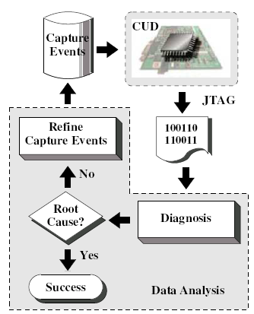
Debug using Trace Buffer
Preliminaries
Single-mode
Multi-mode
Use trace buffer technology
Trace buffer is embedded inside a Circuit-under-Debug (CUD)
Trigger an event in the CUD
Real-time capture values of a few selected flipflops which are stored in on-chip buffers
Extract and analyze
Figure from Yang et al. [DATE’09]
PSD Overview
Restoration using TB
Prior Work
Control Signals

Slide 6
Trace Buffer as A Part of ELA
Preliminaries
Single-mode
Multi-mode
Control Unit
Trigger signals
Trigger condition
Synchronization data
Trigger Unit
Offload Unit
Off-chip analysis
Trace signals
Assertion flags
Sampling
Unit
Trace Buffer
Assertion Checker
Traced data
On-chip ELA captures the values of the trace signals during real-time operation and stores them inside the trace buffer which are then extracted off-chip and analyzed
Only a few flipflops could be selected beforehand as trace signals. They should be able to restore the values of the remaining signals inside the chip as much as possible
PSD Overview
Restoration using TB
Prior Work
Control Signals

Slide 7







Overview of Trace Buffer
Preliminaries
Single-mode
Multi-mode
Trace buffer is an on-chip buffer of size BxM
B is the buffer bandwidth and identifies the number of signals which can be traced
M is the depth of buffer and is equal to the number of clock cycles when the trace signals are captured
B
$$S_{0}$$
$$S_{1}$$
…
$$S_{i}$$
…
$$S_{B−1}$$
$$0$$
$$1$$
M
…
$$i$$
1
0
0
…
1
…
M-1
“Capture window” has a size of BxM
“Observation window” has a size of BxN where N << M
PSD Overview
Restoration using TB
Prior Work
Control Signals

Slide 8
Restoration using Trace Signals
Preliminaries
Single-mode
Multi-mode
Restoration using “X-Simulation”
At each cycle of the capture window, forward and backward restoration steps are applied iteratively until no more signals can be restored
f₃
Forward
Restoration
f₁
f₂
0
0
0
0
f₅
Backward
Restoration
f₄
Traced flipflop
DFF\Cycle | 0 | 1 | 2 | 3
F1 | 1 | 1 | 0 | X
F2 | 0 | 1 | 1 | 0
F3 | X | 1 | 1 | X
F4 | X | X | X | X
F5 | X | 0 | X | X
PSD Overview
Restoration using TB
Prior Work
Control Signals

Slide 9
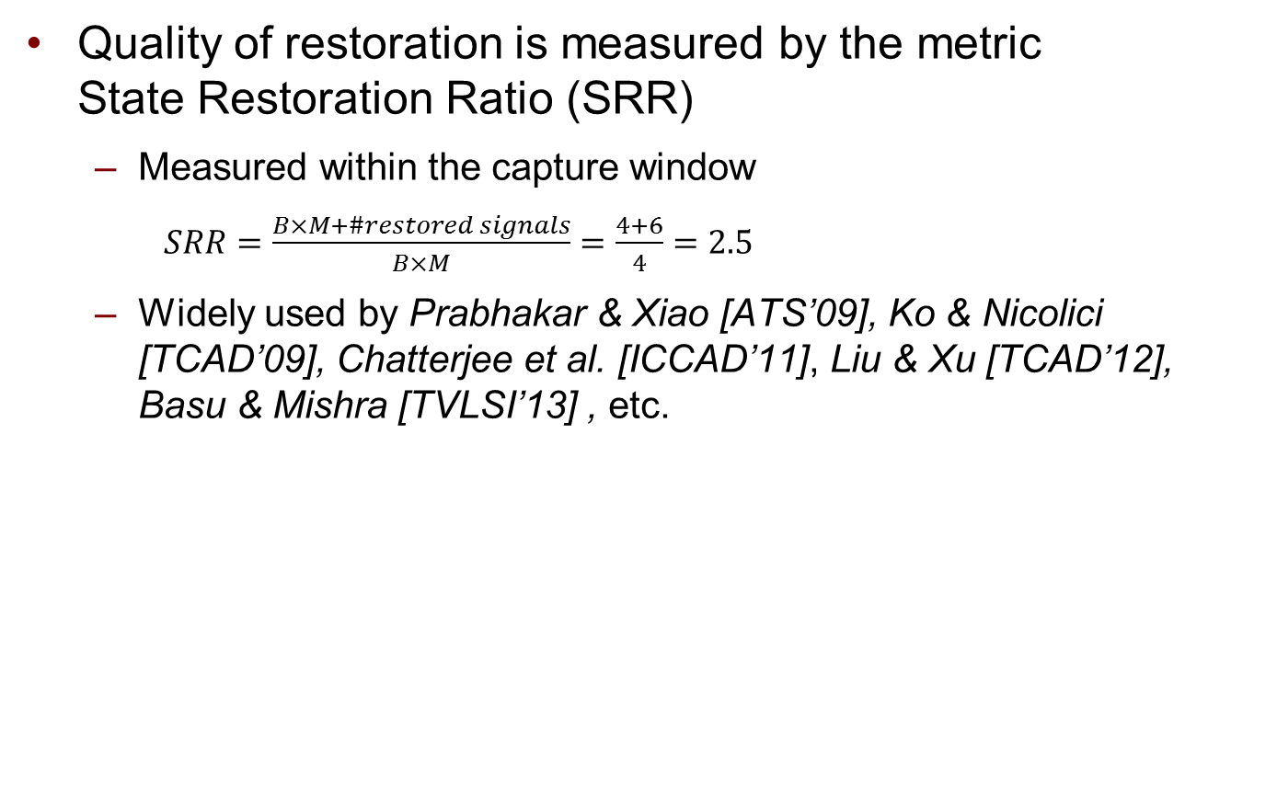
Restoration using Trace Signals
Preliminaries
Single-mode
Multi-mode
Quality of restoration is measured by the metric State Restoration Ratio (SRR)
Measured within the capture window
$SRR=\frac{B×M+\#restored signals}{B×M}=\frac{4+6}{4}=2.5$
Widely used by Prabhakar & Xiao [ATS’09], Ko & Nicolici [TCAD’09], Chatterjee et al. [ICCAD’11], Liu & Xu [TCAD’12], Basu & Mishra [TVLSI’13] , etc.
DFF\Cycle | 0 | 1 | 2 | 3
F1 | 1 | 1 | 0 | X
F2 | 0 | 1 | 1 | 0
F3 | X | 1 | 1 | X
F4 | X | X | X | X
F5 | X | 0 | X | X
Trace flipflop
Restored signal
PSD Overview
Restoration using TB
Prior Work
Control Signals

Slide 10
Trace Signal Selection Problem
Preliminaries
Single-mode
Multi-mode
Challenges of PSD using trace buffers
Due to limited on-chip white-spaces and memory, trace buffer size is small: trace buffer width (8~64 bits) and depth (1K~8K clock cycles)
Different selections of the B trace signals can result in significantly different SRR
Trace signal selection problem
Given a trace buffer of size BxM
Select B flipflops for tracing such that the remaining flipflops can be restored as many as possible during M cycles corresponding to the capture window
Maximize the State Restoration Ratio (SRR)
PSD Overview
Restoration using TB
Prior Work
Control Signals

Slide 11
Existing Trace Signal Selection Algorithms
Preliminaries
Single-mode
Multi-mode
Simulation-based
Uses X-Simulation to measure SRR accurately but it results in a very long runtime
Select trace signals in a backward greedy manner
Chatterjee et al. [ICCAD’11]
Metric-based
Uses metrics to approximate SRR with fast runtime but it results in high error
Selects trace signals in a forward greedy manner
Prabhakar & Xiao [ATS’09], Ko & Nicolici [TCAD’09], Liu & Xu [TCAD’12], Basu & Mishra [TVLSI’13]
All flipflops included
Prune one flipflop that leads to the smallest SRR in each iteration
No
B traces left?
Yes
Terminate
Empty trace set
Select one trace leading to the largest SRR in each iteration
No
B traces selected?
Yes
Terminate
PSD Overview
Restoration using TB
Prior Work
Control Signals

Slide 12
Measuring SRR in Simulation-based Techniques
Preliminaries
Single-mode
Multi-mode
Uses X-Simulation to measure SRR accurately
Due to the long runtime, performed for an “observation window” smaller than the capture window
e.g., Chatterjee et al. [ICCAD’11] shows that the SRR computed for an observation window of 64 cycles is sufficiently close to the SRR measured from a capture window of 4K cycles
observation window << capture window
DFF\Cycle | 0 | 1
F1 | 1 | X
F2 | 0 | 1
F3 | X | 1
F4 | X | X
F5 | X | 0
PSD Overview
Restoration using TB
Prior Work
Control Signals

Slide 13




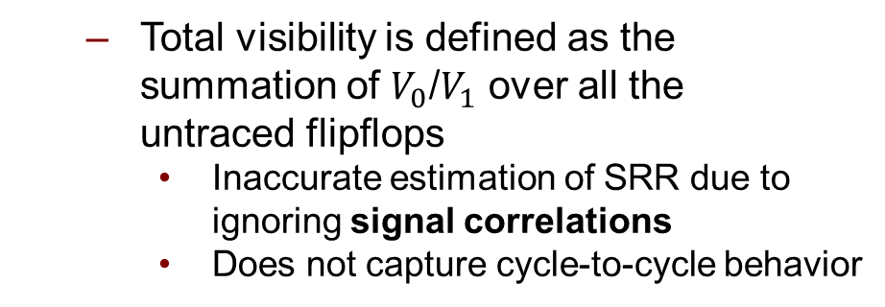
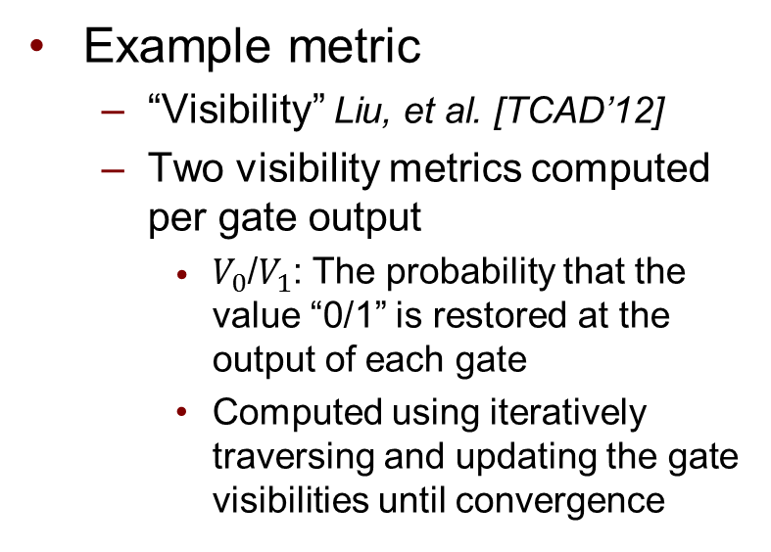
Metric-based Approximation of SRR
Preliminaries
Single-mode
Multi-mode
Example metric
“Visibility” Liu, et al. [TCAD’12]
Two visibility metrics computed per gate output
$V_{0}$/$V_{1}$: The probability that the value “0/1” is restored at the output of each gate
Computed using iteratively traversing and updating the gate visibilities until convergence
$$V_{0}=0.25$$
$$V_{1}=0.75$$
f₃
$$V_{0}=1$$
$$V_{1}=1$$
f₁
f₂
$$V_{0}=1$$
$$V_{1}=1$$
f₅
f₄
$$V_{0}=0.75$$
$$V_{1}=0.25$$
$$V_{0}=1$$
$$V_{1}=1$$
$$V_{0}=1$$
$$V_{1}=1$$
Total visibility is defined as the summation of $V_{0}$/$V_{1}$ over all the untraced flipflops
Inaccurate estimation of SRR due to ignoring signal correlations
Does not capture cycle-to-cycle behavior
Trace flipflop
Visibility = 1+1+0.25+0.75+0.75+0.25 = 4
PSD Overview
Restoration using TB
Prior Work
Control Signals

Slide 14
Comparison
Preliminaries
Single-mode
Multi-mode
Simulation-based much more accurate than metric-based
Simulation can directly consider signal correlations
Simulation accounts for the fact that a flipflop may be restored to different values within the observation window
Simulation-based much slower than metric-based
Restoration of each gate is evaluated using X-Simulation for each clock cycle however in metric-based the “0/1” visibility per gate is computed once
DFF\Cycle | 0 | 1 | 2 | 3
F1 | 1 | 1 | 0 | X
F2 | 0 | 1 | 1 | 0
F3 | X | 1 | 1 | X
F4 | X | X | X | X
F5 | X | 0 | X | X
PSD Overview
Restoration using TB
Prior Work
Control Signals

Slide 15
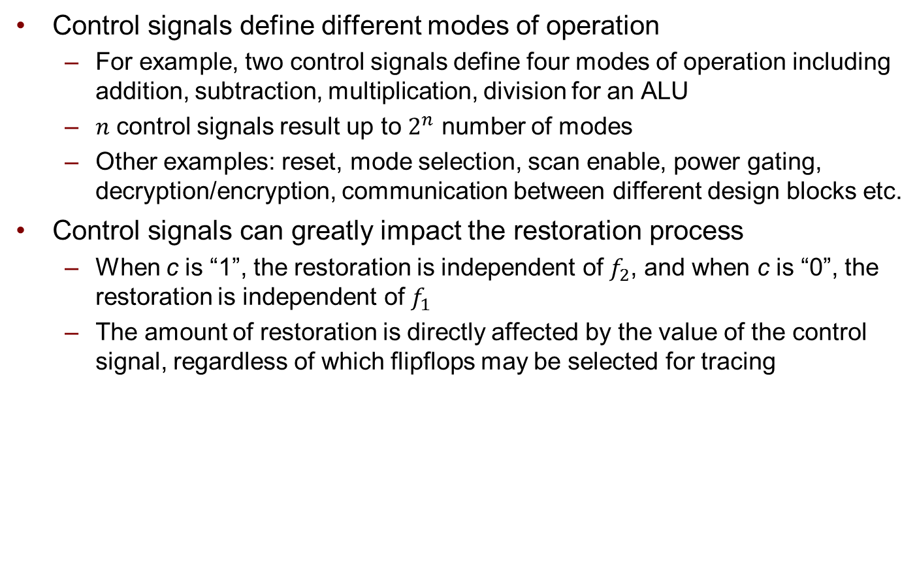
Impact of Control Signals
Preliminaries
Single-mode
Multi-mode
Control signals define different modes of operation
For example, two control signals define four modes of operation including addition, subtraction, multiplication, division for an ALU
$n$ control signals result up to $2^{n}$ number of modes
Other examples: reset, mode selection, scan enable, power gating, decryption/encryption, communication between different design blocks etc.
Control signals can greatly impact the restoration process
When c is “1”, the restoration is independent of $f_{2}$, and when c is “0”, the restoration is independent of $f_{1}$
The amount of restoration is directly affected by the value of the control signal, regardless of which flipflops may be selected for tracing
f₂
control signal
c
f₃
f₁
PSD Overview
Restoration using TB
Prior Work
Control Signals

Slide 16
Considering Control Signals During Selection
Preliminaries
Single-mode
Multi-mode
Control signals have been considered during trace signal selection
Values of control signals are randomly changed
In previous work e.g. Ko & Nicolici [TCAD’09]
Inaccurately shows high restoration e.g. when reset is activated but bugs are expected to happen when reset is deactivated
Trace signals are selected for a single mode of operation
It means to keep the control signals constant throughout the selection process to the values corresponding that mode of operation
In various works including Chatterjee et al. [ICCAD’11], Liu & Xu [TCAD’12], Basu & Mishra [TVLSI’13], etc.
May yield to poor restoration if a bug is observed in another mode of operation
PSD Overview
Restoration using TB
Prior Work
Control Signals

Slide 17
Contributions
Preliminaries
Single-mode
Multi-mode
A hybrid trace signal selection algorithm for a single-mode of operation
Uses a “right blend” of new metrics with a small number of X-Simulations during the trace signal selection
Achieves a solution quality as good as simulation-based algorithms and runtime as fast as metric-based algorithms
Multi-mode trace signal selection algorithm
Propose the trace signal selection problem when considering restoration over all the operation modes
We show it achieves a much higher restoration over all the operation modes compared to other algorithms
Automated identification of control signals
Propose a procedure to identify the control signals in a gate-level circuit
Identified control signals are fed into the single-mode and multi-mode trace signal selection problems

Slide 18
Outline
Preliminaries
Single-mode
Multi-mode
Background and Preliminaries
Hybrid single-mode trace signal selection (SMTS)
Multi-mode trace signal selection (MMTS)

Slide 19
Overview of Our Framework
Preliminaries
Single-mode
Multi-mode
Initialize metrics
Method (i) forward-greedy selection guided by metrics
Select next trace signal
No
Selected 8X traces?
Update metrics
Yes
No
Selected B traces?
Method (ii) Consider adding an “island” flipflops as the next trace signal
Yes
Terminate
Method (i) uses a “forward-greedy” strategy to select the next trace signal guided by the metrics
Method (ii) uses a non-greedy selection strategy by adding the “island” flipflops
Overview
Metrics
Selection Process
Simulation Results

Slide 20
Contributions
Preliminaries
Single-mode
Multi-mode
A new set of metrics are able to quickly find a small number of top trace signal candidates in order to select the best one as the next trace signal at each iteration of the algorithm
After identifying the top candidates, a few number of X-Simulations are used to accurately evaluate the SRR and select the best
Metrics are computed fast
Metrics that do not require any X-Simulation
“Impact Weight” and “Restoration Demand”
Metrics that require a small number of X-Simulations
“Reachability List” and “Restorability Rate”
Overview
Metrics
Selection Process
Simulation Results

Slide 21

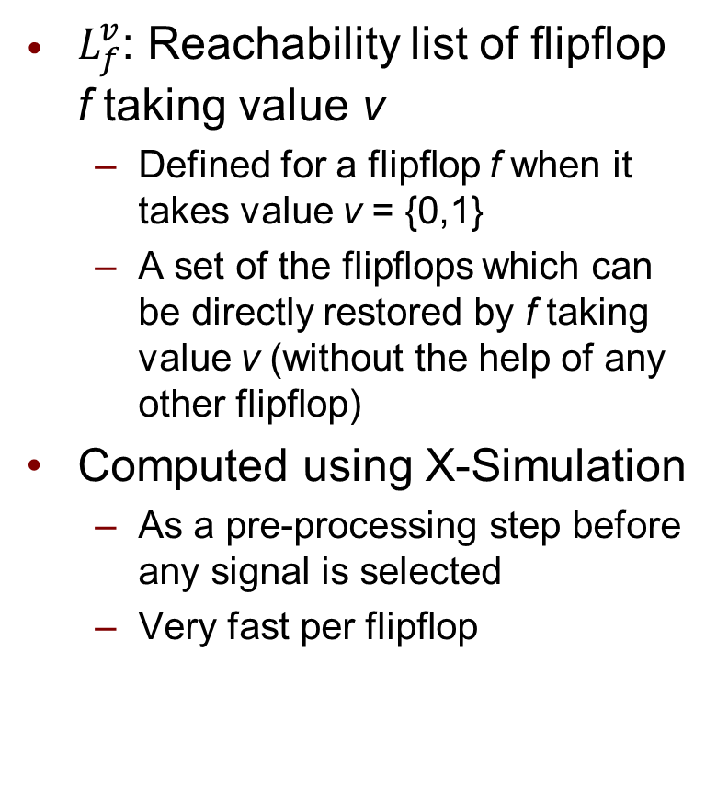
“Reachability List”
Preliminaries
Single-mode
Multi-mode
$L_{f}^{v}$: Reachability list of flipflop f taking value v
Defined for a flipflop f when it takes value v = {0,1}
A set of the flipflops which can be directly restored by f taking value v (without the help of any other flipflop)
Computed using X-Simulation
As a pre-processing step before any signal is selected
Very fast per flipflop
Reachability List
Restorability Rate
Restoration Demand
Impact Weight
f₃
f₁
f₂
f₅
f₄
$$L_{2}^{0}\text{= \{}f_{1}\text{, }f_{5}\text{\},} L_{2}^{1}\text{= \{}f_{1}\text{, }f_{3}\text{\}}$$
Overview
Metrics
Selection Process
Simulation Results

Slide 22
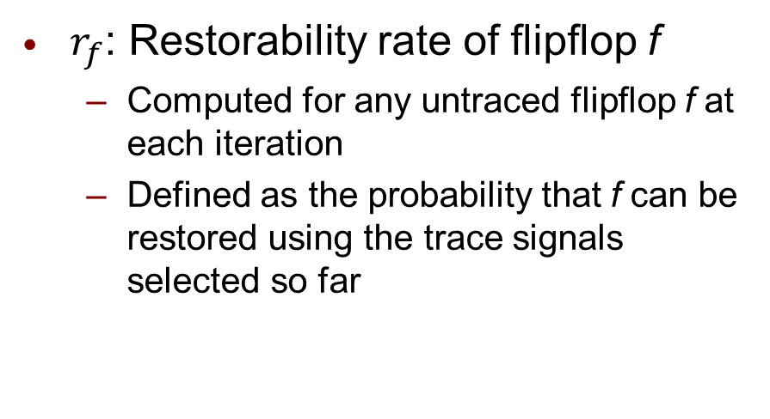
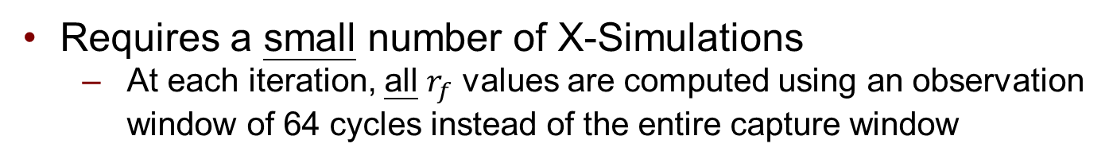
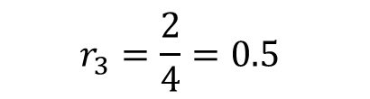
“Restorability Rate”
Preliminaries
Single-mode
Multi-mode
$r_{f}$: Restorability rate of flipflop f
Computed for any untraced flipflop f at each iteration
Defined as the probability that f can be restored using the trace signals selected so far
Reachability List
Restorability Rate
Restoration Demand
Impact Weight
Requires a small number of X-Simulations
At each iteration, all $r_{f}$ values are computed using an observation window of 64 cycles instead of the entire capture window
DFF\Cycle | 0 | 1 | 2 | 3
F1 | 1 | 1 | 0 | X
F2 | 0 | 1 | 1 | 0
F3 | X | 1 | 1 | X
F4 | X | X | X | X
F5 | X | 0 | X | X
$$r_{3}=\frac{2}{4}=0.5$$
Overview
Metrics
Selection Process
Simulation Results

Slide 23

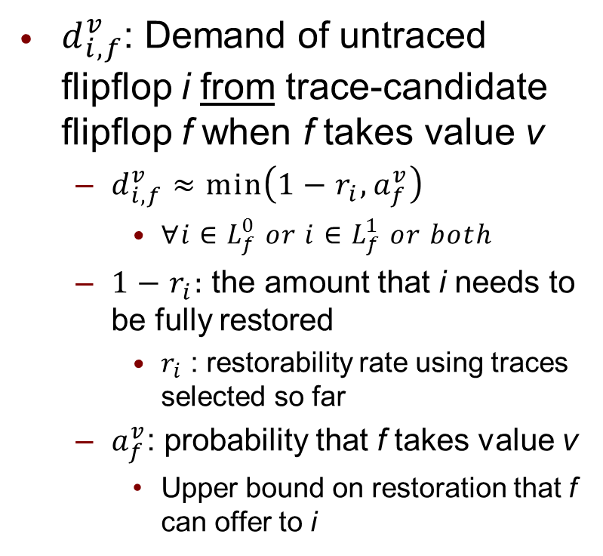
“Restoration Demand”
Preliminaries
Single-mode
Multi-mode
$d_{i,f}^{v}$: Demand of untraced flipflop i from trace-candidate flipflop f when f takes value v
$d_{i,f}^{v}≈min\left(1−r_{i},a_{f}^{v}\right)$
$∀i∈L_{f}^{0} or i∈L_{f}^{1} or both$
$1−r_{i}:$ the amount that i needs to be fully restored
$r_{i}$ : restorability rate using traces selected so far
$a_{f}^{v}$: probability that f takes value v
Upper bound on restoration that f can offer to i
Reachability List
Restorability Rate
Restoration Demand
Impact Weight
f₃
f₁
f₂
f₅
f₄
Trace-signal-candidate
Already-traced
$$d_{3,2}^{1}≈min(1−r_{3},a_{3}^{1})$$
Overview
Metrics
Selection Process
Simulation Results

Slide 24


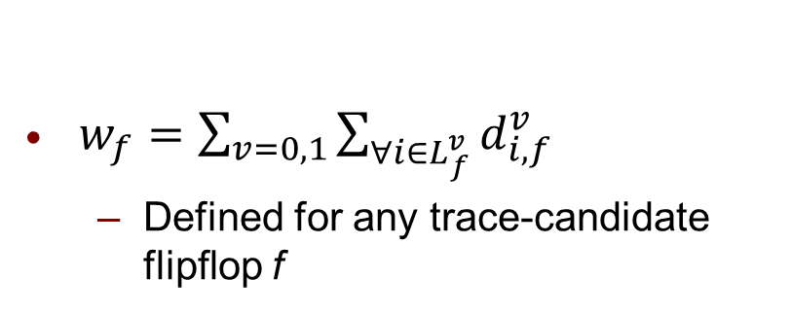
“Impact Weight”
Preliminaries
Single-mode
Multi-mode
$w_{f}=\sum_{v=0,1}{\sum_{∀i∈L_{f}^{v}}{d_{i,f}^{v}}}$
Defined for any trace-candidate flipflop f
Reachability List
Restorability Rate
Restoration Demand
At each iteration of our algorithm, impact weights are computed to identify a small number of top candidates
Top candidate are the 5% with the highest impact weights
Impact Weight
f₃
f₁
f₂
f₅
f₄
Trace-signal-candidate
$$L_{2}^{0}\text{= \{}f_{1}\text{, }f_{5}\text{\},} L_{2}^{1}\text{= \{}f_{1}\text{, }f_{3}\text{\}}$$
$w_{2}$ = $d_{1,2}^{0}$ + $d_{5,2}^{0}$+ $d_{1,2}^{1}$ + $d_{3,2}^{1}$
Overview
Metrics
Selection Process
Simulation Results

Slide 25
Trace Signal Selection Process
Preliminaries
Single-mode
Multi-mode
Method (i): Select the next trace signal from the top candidates
Use X-Simulation to measure SRR for each top candidate
The next trace signal is the one with the highest SRR among the top candidates
Initialize metrics
Method (i) Select guided by impact weight
Select the next trace signal
No
Selected 8X traces?
Update metrics
Yes
Method (ii) Consider adding an “island” flipflop
No
Selected B traces?
Yes
Terminate
The number of X-Simulations is few
To accelerate the process
Parallel execution of X-Simulation
Incremental update of the metrics
Overview
Metrics
Selection Process
Simulation Results

Slide 26
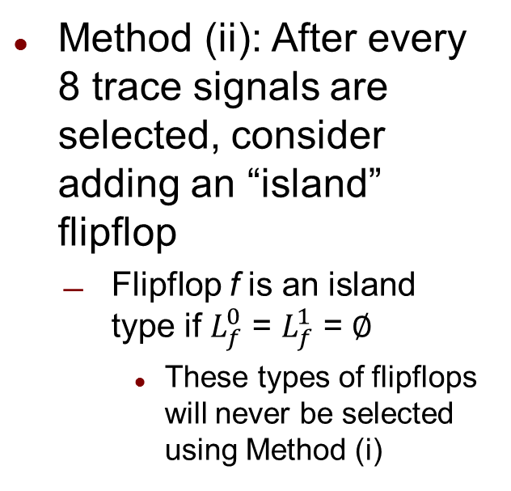
Trace Signal Selection Process
Preliminaries
Single-mode
Multi-mode
Method (ii): After every 8 trace signals are selected, consider adding an “island” flipflop
Flipflop f is an island type if $L_{f}^{0}$ = $L_{f}^{1}$ = $∅$
These types of flipflops will never be selected using Method (i)
Initialize metrics
Method (i) Select guided by impact weight
Select the next trace signal
No
Selected 8X traces?
Update metrics
Yes
Method (ii) Consider adding an “island” flipflop
Selected B traces?
No
Yes
Terminate
Use X-Simulation to measure SRR to identify the best island flipflop
Few X-Simulations because the number of islands are small (17% of the flipflops for S5378)
Overview
Metrics
Selection Process
Simulation Results

Slide 27
Simulation Setup
Preliminaries
Single-mode
Multi-mode
Simulation Setup
Use SRR to measure the restoration quality
Experimented with trace buffers of size (8, 16, 32) X 4K
Comparison made with
METR: Metric-based: Shojaei et al. [ICCAD’10]
Mainly used for runtime comparison
One of the best reported runtime
SIM: Simulation-based: Chatterjee et al. [ICCAD’11]
Mainly used to compare solution quality
Best reported solution quality
Other Metric-based:
Liu & Xu [TCAD’12]
Ko & Nicolici [TCAD’09]
Basu & Mishra [TVLSI’13]
Overview
Metrics
Selection Process
Simulation Results

Slide 28
Comparison of SRR
Preliminaries
Single-mode
Multi-mode
Circuit | #Traces | METR | SIM | Ours | Impr.-METR | Impr.-SIM
S5378 | 8 | 13.7 | 12.8 | 13.6 | -0.7% | +6.3%
 | 16 | 8.1 | 7.1 | 8.0 | -1.2% | +12.7%
 | 32 | 4.1 | 4.4 | 4.2 | +2.4% | -4.5%
S9234 | 8 | 8.4 | 9.1 | 9.8 | +16.7% | +4.3%
 | 16 | 5.8 | 6.6 | 6.8 | +17.2% | +3.0%
 | 32 | 3.4 | 3.6 | 3.6 | +5.9% | +0.0%
S35932 | 8 | 31.1 | 58.1 | 61.4 | +97.4% | +5.7%
 | 16 | 19.4 | 36.2 | 38.3 | +97.4% | +5.8%
 | 32 | 11.6 | 23.1 | 23.4 | +101.7% | +1.3%
S38417 | 8 | 17.6 | 29.4 | 51.4 | +192.0% | +74.5%
 | 16 | 13.1 | 17.8 | 30.1 | +129.8% | +12.9%
 | 32 | 9.7 | 20.0 | 17.5 | +80.4% | -12.5%
S38584 | 8 | 13.5 | 14.9 | 24.0 | +77.8% | +31.1%
 | 16 | 10.8 | 18.1 | 18.5 | +71.3% | +2.2%
 | 32 | 7.1 | 16.4 | 17.5 | +146.5% | +6.7%
Avg. |  |  |  |  | +69.0% | 10.0%
Overview
Metrics
Selection Process
Simulation Results

Slide 29
Comparison of Runtime
Preliminaries
Single-mode
Multi-mode
Circuit | #DFF | #Traces | METR (sec) | SIM* (hr:min:sec) | Ours (sec) | Impr.METR(sec)
S5378 | 163 | 8 | 8 | 00:06:50 | 5 | +3
 |  | 16 | 27 | 00:06:40 | 27 | 0
 |  | 32 | 66 | 00:05:30 | 28 | +38
S9234 | 145 | 8 | 6 | 00:07:28 | 26 | -20
 |  | 16 | 17 | 00:06:05 | 84 | -67
 |  | 32 | 38 | 00:04:10 | 86 | -48
S35932 | 1728 | 8 | 73 | 07:13:00 | 139 | -66
 |  | 16 | 167 | 07:12:00 | 208 | -41
 |  | 32 | 408 | 07:11:00 | 217 | +191
S38417 | 1564 | 8 | 3690 | 50:05:00 | 434 | +3255(8X)
 |  | 16 | 7620 | 50:04:00 | 2508 | +5112(3X)
 |  | 32 | 13428 | 50:02:00 | 2521 | +10907(5X)
S38584 | 1166 | 8 | 53 | 16:33:00 | 167 | -114
 |  | 16 | 140 | 16:32:00 | 741 | -601
 |  | 32 | 354 | 16:31:00 | 752 | -389
* Ran SIM on a quad-core machine using up to 8 threads
Overview
Metrics
Selection Process
Simulation Results

Slide 30
Comparison with Other Metric-based Algorithms
Preliminaries
Single-mode
Multi-mode
Compared separately because the control signals are set differently from one to another
Liu & Xu [TCAD’12]
Ours has a significant SRR improvement of on average 136.02%
Ko & Nicolici [TCAD’09]
Ours has a significant SRR improvement of on average 105.32%
Basu & Mishra [TVLSI’13]
Ours has an SRR improvement of on average 6.5%
Runtimes of our approach are much better as Basu & Mishra runs almost 5X longer on average
Overview
Metrics
Selection Process
Simulation Results

Slide 31
Identifying the Top Candidates
Preliminaries
Single-mode
Multi-mode
67.8
44.5
31.6
3.7
Itr. 1
9.0
Itr. 2
Itr. 3
3.0
8.0
4.0
4.0
Report the Impact Weights in three iterations of S38417
Impact Weights of the top candidates close to each other
Impact Weights of the remaining signals much lower than the top candidates
Therefore, Impact Weight is able to identify the top candidates
Overview
Metrics
Selection Process
Simulation Results

Slide 32
Summary
Preliminaries
Single-mode
Multi-mode
We presented a hybrid trace signal selection algorithm
Utilized a small number of X-Simulations with quickly-evaluated metrics at each iteration
Had comparable or better solution quality
Compared to a simulation-based algorithm which had the best reported solution quality
Had similar runtime to a metric-based algorithm
Which had one of the fastest runtimes
Our algorithm considered a single mode of operation
For example for benchmark S35932 with 4 different modes of operation
We solve the SMTS problem for each mode and we measure the solution quality separately and report the average SRR value of all the modes
Next, we discuss the multi-mode trace signal selection problem

Slide 33
Outline
Preliminaries
Single-mode
Multi-mode
Background and Preliminaries
Hybrid single-mode trace signal selection (SMTS)
A trace signal selection algorithm
Maximizes the restoration over all the operation modes
Avoids a purely greedy selection strategy
Has a better solution quality than various algorithms
Multi-mode trace signal selection (MMTS)

Slide 34
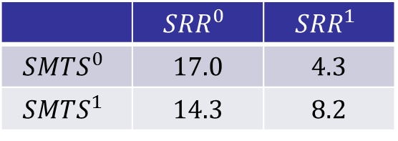
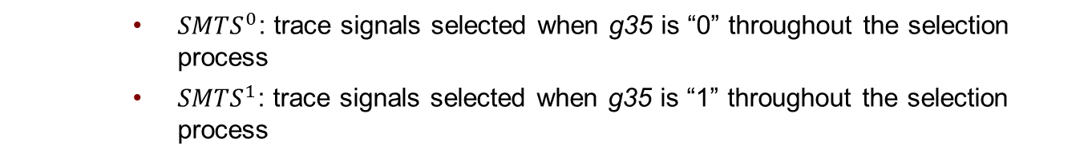
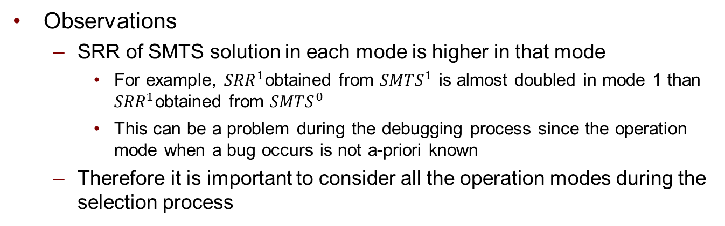
Motivation for Multi-Mode Trace Signal Selection
Preliminaries
Single-mode
Multi-mode
Case study of S38584
 | $${SRR}^{0}$$ | $${SRR}^{1}$$
$${SMTS}^{0}$$ | 17.0 | 4.3
$${SMTS}^{1}$$ | 14.3 | 8.2
Ran our single mode trace selection procedure for two different modes of operation
${SMTS}^{0}$: trace signals selected when g35 is “0” throughout the selection process
${SMTS}^{1}$: trace signals selected when g35 is “1” throughout the selection process
For each solution evaluated the SRR for modes 0 and 1
Observations
SRR of SMTS solution in each mode is higher in that mode
For example, ${SRR}^{1}$obtained from ${SMTS}^{1}$ is almost doubled in mode 1 than ${SRR}^{1}$obtained from ${SMTS}^{0}$
This can be a problem during the debugging process since the operation mode when a bug occurs is not a-priori known
Therefore it is important to consider all the operation modes during the selection process
MMTS
Mode Merging
Algorithm
Simulation Results

Slide 35
Contributions
Preliminaries
Single-mode
Multi-mode
Extending the problem definition when considering multiple modes
Mode Merging
A procedure to reduce the number of modes by merging the modes with “similar restoration maps”
Algorithm
A procedure based on perturbing an initial single-mode optimized solution (selected from a suitable “start” mode) to improve the restorability over all the modes
Our algorithm can finish in reasonable runtime with solution quality close to a reference case which defines an upper bound on the best attainable solution quality

Slide 36
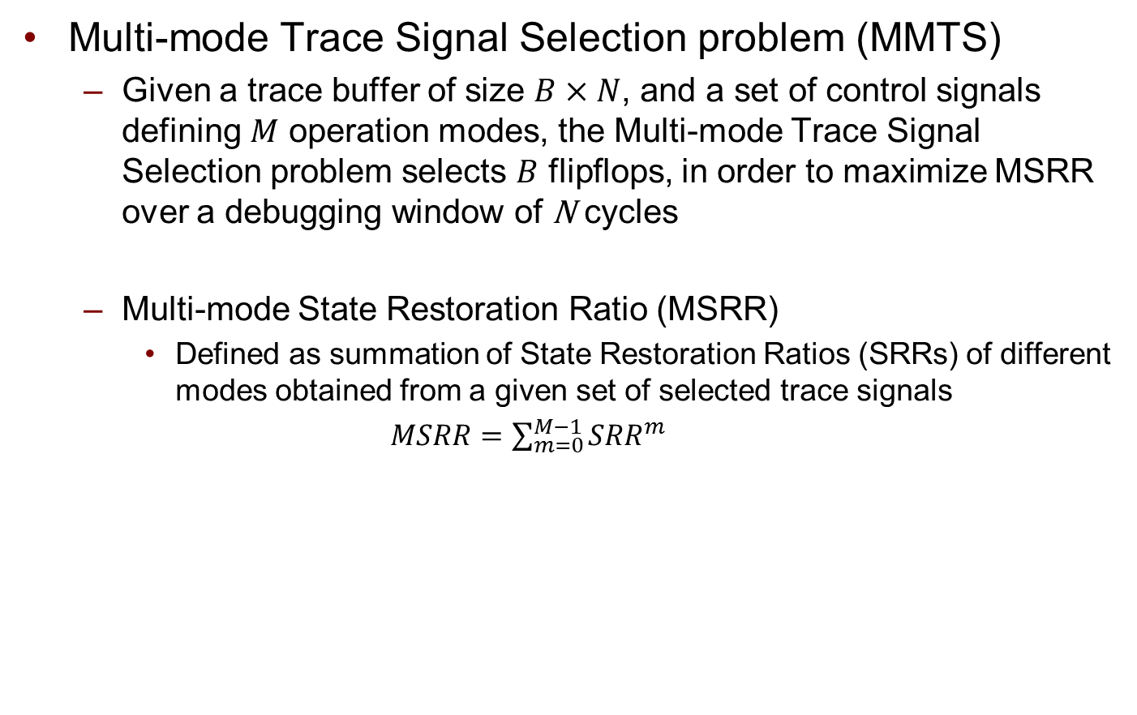
Multi-mode Trace Signal Selection Problem
Preliminaries
Single-mode
Multi-mode
Multi-mode Trace Signal Selection problem (MMTS)
Given a trace buffer of size $B×N$, and a set of control signals defining $M$ operation modes, the Multi-mode Trace Signal Selection problem selects $B$ flipflops, in order to maximize MSRR over a debugging window of N cycles
Multi-mode State Restoration Ratio (MSRR)
Defined as summation of State Restoration Ratios (SRRs) of different modes obtained from a given set of selected trace signals
$MSRR=\sum_{m=0}^{M−1}{{SRR}^{m}}$
MMTS
Mode Merging
Algorithm
Simulation Results

Slide 37
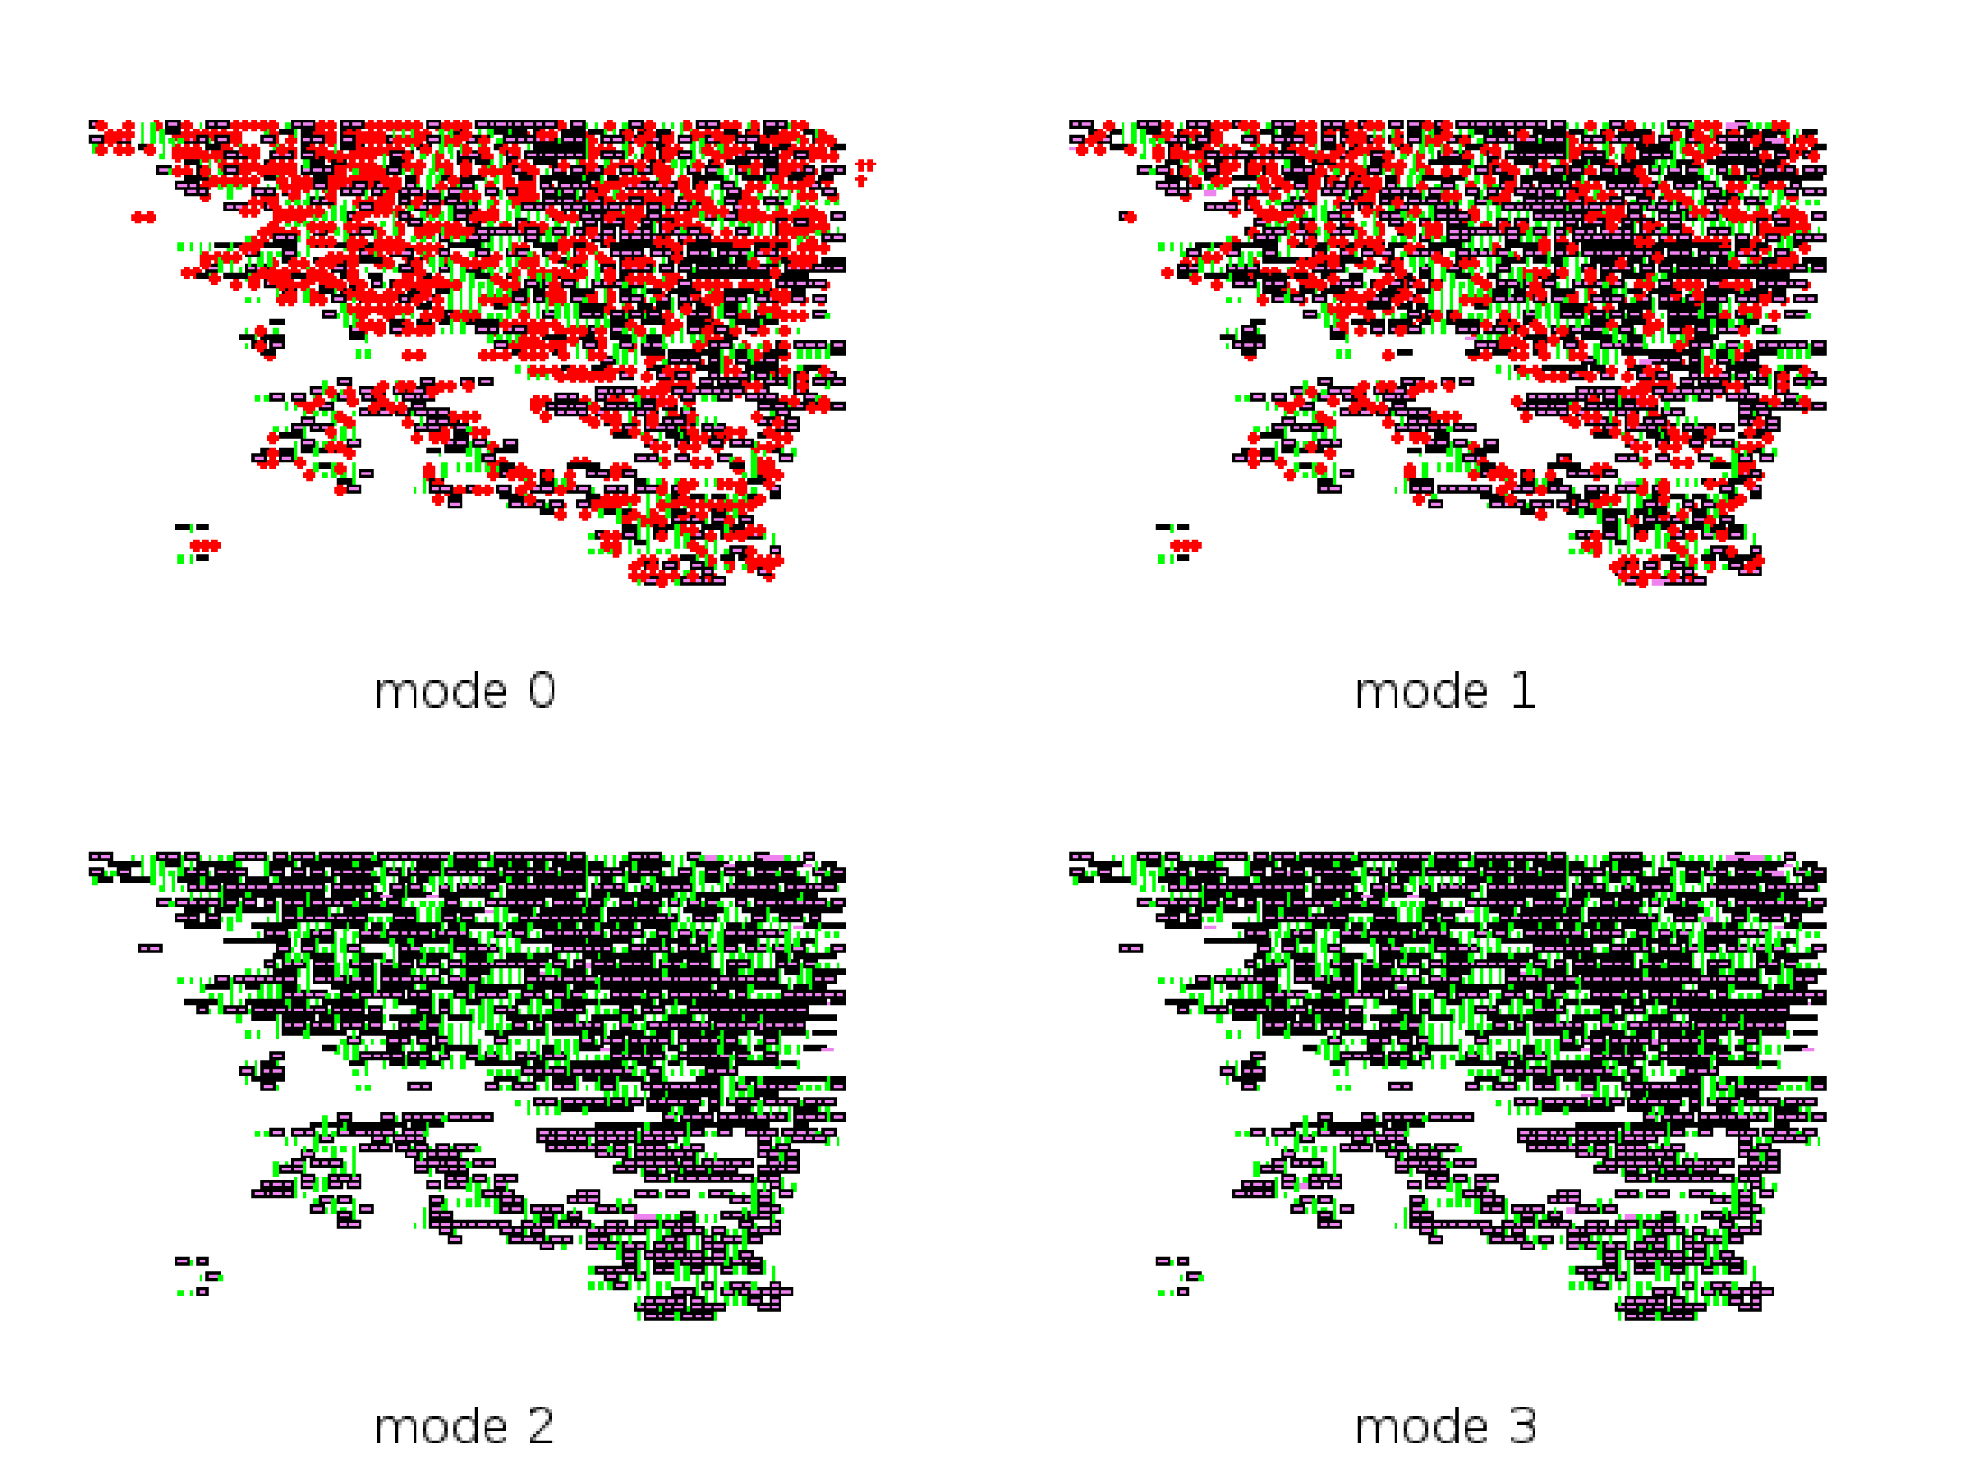
Mode Merging: Motivation
Preliminaries
Single-mode
Multi-mode
Restoration map for S35932
Two control signals are set to four values corresponding to four operation modes
Four restoration maps are generated when no trace signal is selected yet
In each restoration map
Green pixel: gate restored to 0
Black pixel: gate restored to 1
Red pixel: unrestored gate
Observations
There are modes with similar restoration maps and can be merged into a single mode
In this case, modes 0 and 1 can be merged, so are modes 2 and 3
MMTS
Mode Merging
Algorithm
Simulation Results

Slide 38

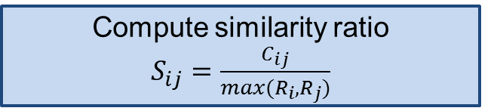
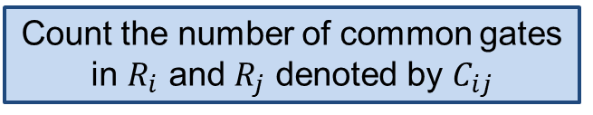

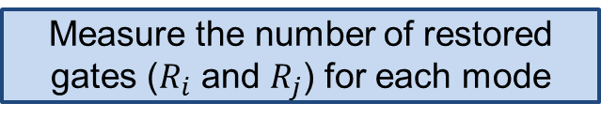
Mode Merging: Procedure
Preliminaries
Single-mode
Multi-mode
Consider two modes $m_{i}$ and $m_{j}$
Merging two modes
Once two modes are merged, they are considered as one mode
The values of the control signals will correspond to the values of one of the merged modes
The rest of the modes are merged in the same way until no modes can be merged
Measure the number of restored gates ($R_{i}$ and $R_{j}$) for each mode
Count the number of common gates in $R_{i}$ and $R_{j}$ denoted by $C_{ij}$
Compute similarity ratio $S_{ij}=\frac{C_{ij}}{\max{(R_{i},R_{j})}}$
$S_{ij}≥ α$ ?
Y
Merge the two modes into one
MMTS
Mode Merging
Algorithm
Simulation Results

Slide 39
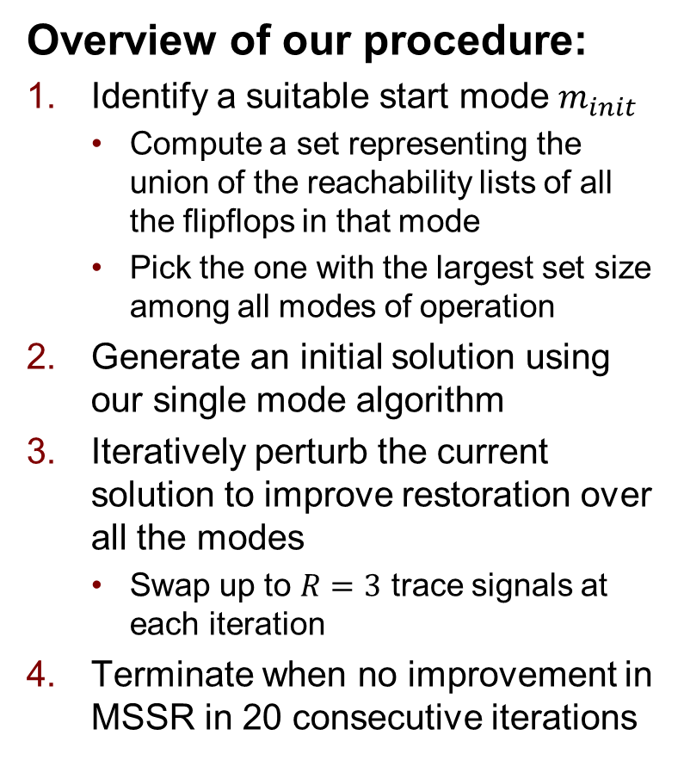

IteM: Iterative Multi-mode Trace Signal Selection
Preliminaries
Single-mode
Multi-mode
Overview of our procedure:
Identify a suitable start mode $m_{init}$
Compute a set representing the union of the reachability lists of all the flipflops in that mode
Pick the one with the largest set size among all modes of operation
Generate an initial solution using our single mode algorithm
Iteratively perturb the current solution to improve restoration over all the modes
Swap up to $R=3$ trace signals at each iteration
Terminate when no improvement in MSSR in 20 consecutive iterations
Find $m_{init}$
Generate an initial solution
Iteratively perturb the solution
20 itr. W/O improvement?
No
Yes
Termination
MMTS
Mode Merging
Algorithm
Simulation Results

Slide 40
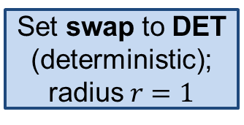
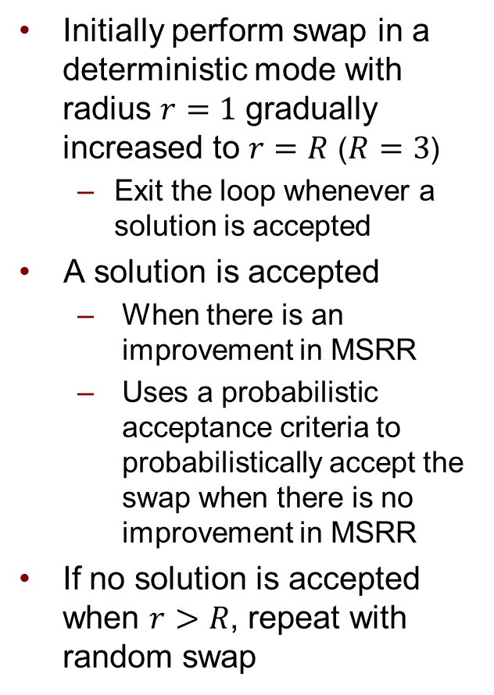
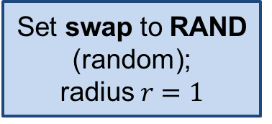
Overview of Swap in One Iteration
Preliminaries
Single-mode
Multi-mode
Initially perform swap in a deterministic mode with radius $r=1$ gradually increased to $r=R$ ($R=3$)
Exit the loop whenever a solution is accepted
A solution is accepted
When there is an improvement in MSRR
Uses a probabilistic acceptance criteria to probabilistically accept the swap when there is no improvement in MSRR
If no solution is accepted when $r>R$, repeat with random swap
START
Set swap to DET (deterministic);
radius $r=1$
Set swap to RAND
(random);
radius $r=1$
Swap r signals
Accept
?
r++
N
Y
r > R
?
Y
Swap is DET ?
N
Y
swap RAND
r=1 signal
N
DONE
MMTS
Mode Merging
Algorithm
Simulation Results

Slide 41
Features of Our Swapping Procedure
Preliminaries
Single-mode
Multi-mode
Swapping procedure is non-greedy
Perturbation radius is gradually increased in each iteration
Makes small perturbation around the current solution
Allows not getting trapped in local minima by gradually increasing the radius
Probabilistic acceptance criteria
Similar to simulated annealing
Allows exploring the search space and accepting bad solutions
MMTS
Mode Merging
Algorithm
Simulation Results

Slide 42
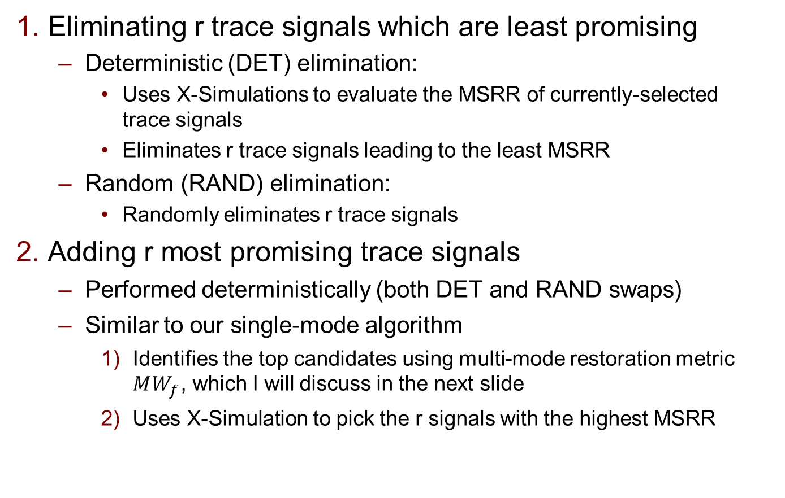
Swapping r Trace Signals
Preliminaries
Single-mode
Multi-mode
Eliminating r trace signals which are least promising
Deterministic (DET) elimination:
Uses X-Simulations to evaluate the MSRR of currently-selected trace signals
Eliminates r trace signals leading to the least MSRR
Random (RAND) elimination:
Randomly eliminates r trace signals
Adding r most promising trace signals
Performed deterministically (both DET and RAND swaps)
Similar to our single-mode algorithm
Identifies the top candidates using multi-mode restoration metric ${MW}_{f}$, which I will discuss in the next slide
Uses X-Simulation to pick the r signals with the highest MSRR
MMTS
Mode Merging
Algorithm
Simulation Results

Slide 43

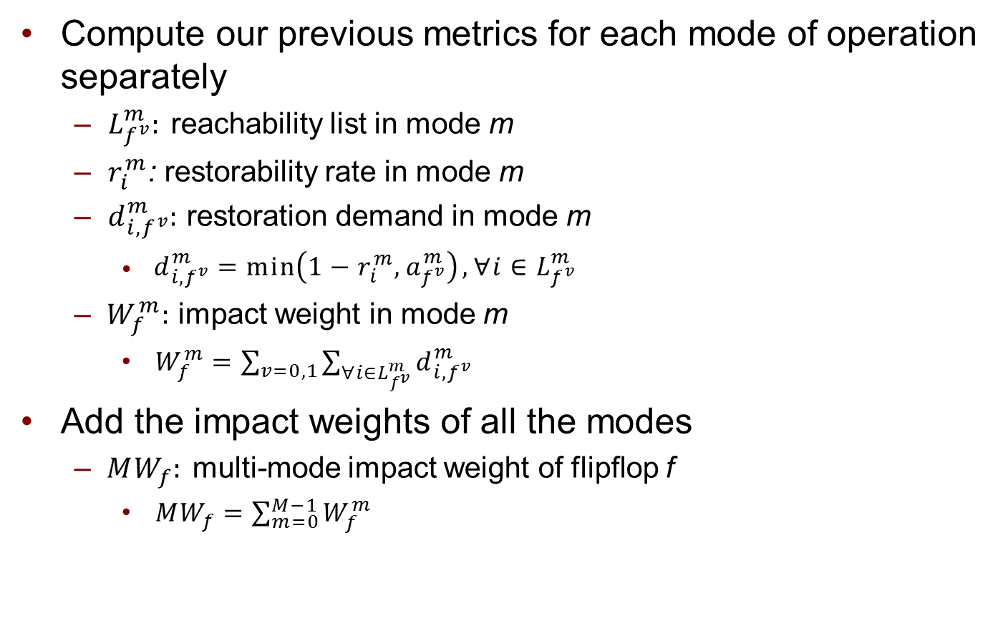




Multi-Mode Impact Weight: ${MW}_{f}$
Preliminaries
Single-mode
Multi-mode
Compute our previous metrics for each mode of operation separately
$L_{f^{v}}^{m}:$ reachability list in mode m
$r_{i}^{m}$: restorability rate in mode m
$d_{i,f^{v}}^{m}$: restoration demand in mode m
$d_{i,f^{v}}^{m}=\min\left(1−r_{i}^{m},a_{f^{v}}^{m}\right),∀i∈L_{f^{v}}^{m}$
$W_{f}^{m}:$ impact weight in mode m
$W_{f}^{m}=\sum_{v=0,1}{\sum_{∀i∈L_{f^{v}}^{m}}{d_{i,f^{v}}^{m}}}$
Add the impact weights of all the modes
${MW}_{f}$: multi-mode impact weight of flipflop f
${MW}_{f}=\sum_{m=0}^{M−1}{W_{f}^{m}}$
Reachability List
Restorability Rate
Restoration Demand
Impact Weight
$$W_{f}^{0}$$
$$W_{f}^{1}$$
…
$$W_{f}^{M−1}$$
$${MW}_{f}$$
MMTS
Mode Merging
Algorithm
Simulation Results

Slide 44
Simulation Setup
Preliminaries
Single-mode
Multi-mode
Simulation Setup
Use MSRR to measure the restoration quality
Also compared with an upper bound on MSRR
Experimented with trace buffers of size 64 X 2K
MMTS
Mode Merging
Algorithm
Simulation Results

Slide 45
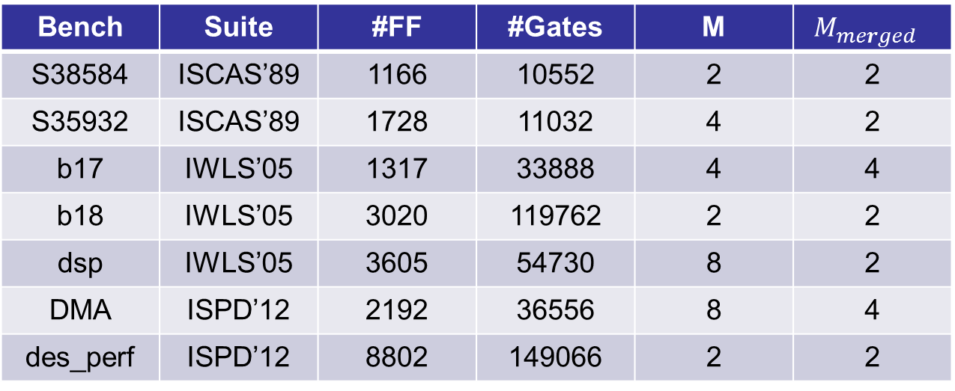
Impact of Mode Merging
Preliminaries
Single-mode
Multi-mode
Bench | Suite | #FF | #Gates | M | $$M_{merged }$$
S38584 | ISCAS’89 | 1166 | 10552 | 2 | 2
S35932 | ISCAS’89 | 1728 | 11032 | 4 | 2
b17 | IWLS’05 | 1317 | 33888 | 4 | 4
b18 | IWLS’05 | 3020 | 119762 | 2 | 2
dsp | IWLS’05 | 3605 | 54730 | 8 | 2
DMA | ISPD’12 | 2192 | 36556 | 8 | 4
des_perf | ISPD’12 | 8802 | 149066 | 2 | 2
All benchmarks (excluding S38584 and S35932) are much larger compared to the ISCAS’89 used in prior works
In three benchmarks, the number of modes can be reduced by at least half and at most 4X
MMTS
Mode Merging
Algorithm
Simulation Results

Slide 46
Impact of Mode Merging on MSRR and Runtime
Preliminaries
Single-mode
Multi-mode
MSRR Comparison
MSRR for with/without mode merging are similar
Runtime Comparison
Runtime reduction is significant
W Merge
W/O Merge
MMTS
Mode Merging
Algorithm
Simulation Results

Slide 47
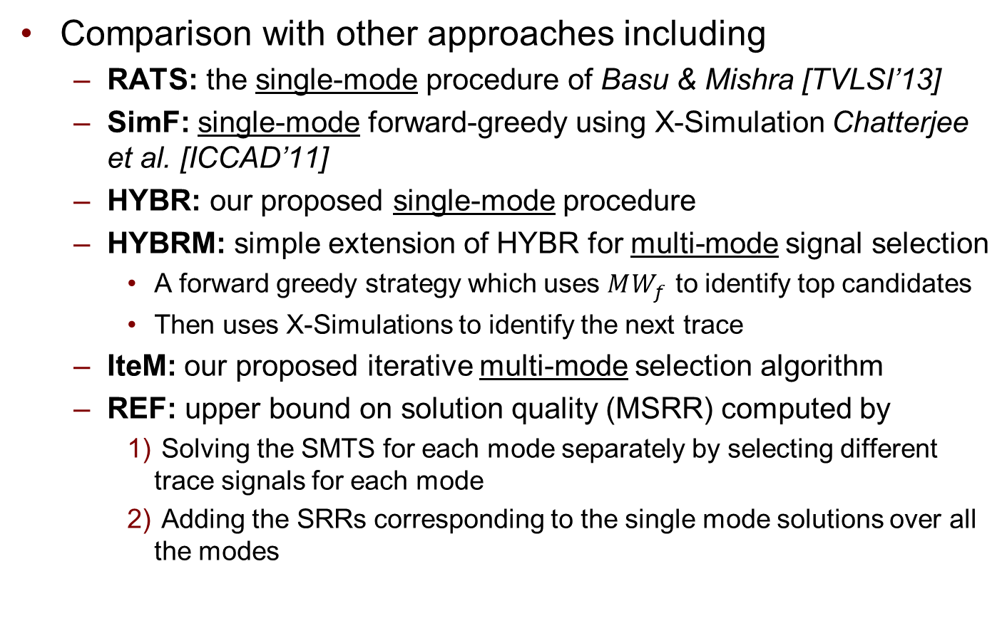
Implemented Approaches
Preliminaries
Single-mode
Multi-mode
Comparison with other approaches including
RATS: the single-mode procedure of Basu & Mishra [TVLSI’13]
SimF: single-mode forward-greedy using X-Simulation Chatterjee et al. [ICCAD’11]
HYBR: our proposed single-mode procedure
HYBRM: simple extension of HYBR for multi-mode signal selection
A forward greedy strategy which uses ${MW}_{f}$ to identify top candidates
Then uses X-Simulations to identify the next trace
IteM: our proposed iterative multi-mode selection algorithm
REF: upper bound on solution quality (MSRR) computed by
Solving the SMTS for each mode separately by selecting different trace signals for each mode
Adding the SRRs corresponding to the single mode solutions over all the modes
MMTS
Mode Merging
Algorithm
Simulation Results

Slide 48
Comparison of MSRR
Preliminaries
Single-mode
Multi-mode
Bench | REF | RATS | HYBR | HYBRM | SimF | IteM
S38584 | 25.20 | 0.86 | 0.85 | 0.95 | 0.95 | 0.99
S35932 | 66.40 | 0.64 | 0.74 | 0.91 | 0.65 | 0.91
b17 | 7.90 | N/A | 0.62 | 0.76 | 0.58 | 0.94
b18 | 5.90 | N/A | 0.50 | 0.61 | 0.92 | 0.80
dsp | 42.80 | N/A | 0.41 | 0.37 | 0.88 | 0.92
DMA | 50.67 | 0.76 | 0.88 | 0.84 | 0.89 | 0.92
des_perf | 77.60 | N/A | 0.97 | 0.98 | 0.98 | 0.99
Average | 1.00 | N/A | 0.71 | 0.77 | 0.83 | 0.93
REF column reports an upper bound on MSRR and the remaining columns are normalized with respect to REF
IteM performs better than other methods
MMTS
Mode Merging
Algorithm
Simulation Results

Slide 49
Comparison of Runtime
Preliminaries
Single-mode
Multi-mode
Bench | RATS | HYBR | HYBRM | SimF | IteM
S38584 | 0.1 | 2 | 4 | 19 | 13
S35932 | 0.1 | 2 | 5 | 14 | 15
b17 | > 24hrs | 1 | 4 | 19 | 24
b18 | > 24hrs | 4 | 119 | 2151 | 90
dsp | > 24hrs | 2 | 28 | 92 | 251
DMA | 5 | 7 | 38 | 99 | 125
des_perf | > 24hrs | 16 | 24 | 469 | 94
Runtime is reported in minutes
RATS, although fast for the ISCAS’89 benchmarks, didn’t scale for the large benchmarks (took more than 24hrs)
RATS and SimF do not scale well over some benchmarks
The runtime of IteM is reasonable given the large size of the benchmarks comparable to SimF and HYBRM
MMTS
Mode Merging
Algorithm
Simulation Results

Slide 50
Summary of MMTS
Preliminaries
Single-mode
Multi-mode
We proposed the multi-mode trace signal selection problem and algorithm
Experimental results showed that our algorithm performed better than various single-mode and multi-mode algorithms, with a high solution quality comparable to the reference case

Slide 51
Conclusions
We proposed a hybrid SMTS algorithm
Obtained the best solution quality with the best runtime
First to study the MMTS problem
Showed that it achieved the best multi-mode restoration with reasonable runtime
Also proposed a procedure for automated identification of control signals
They were fed into our single-mode and multi-mode trace signal selection problem
Correctly identified same control signals as Ko et al [PhD Thesis]

Slide 52
Thank You!

Slide 53
References
K. Basu and P. Mishra. RATS: restoration-aware trace signal selection for post-silicon validation. In IEEE TVLSI, 2013
D. Chatterjee, C. McCarter, and V. Bertacco. Simulation-based signal selection for state restoration in silicon debug. In ICCAD, 2011
M. Li and A. Davoodi. A hybrid approach for fast and accurate trace signal selection for post-silicon debug. In DATE, 2013
H. F. Ko and N. Nicolici. Algorithms for state restoration and trace signal selection for data acquisition in silicon debug. In IEEE Trans. on CAD, 2009
X. Liu and Q. Xu. On signal selection for visibility enhancement in trace-based post-silicon validation. In IEEE Trans. on CAD, 2012
H. F. Ko. New algorithms and architectures for post-silicon validation. PhD thesis, McMaster University, 2009.
M. Paniccia, T. M. Eiles, V. R. M. Rao, and W. M. Yee. Novel optical probing technique for flip chip packaged microprocessors. In International Test Conference, pages 740–747, 1998

Slide 54
Comparison with Forward-greedy Selection Strategy Based on Pure Simulation
Circuit | #Traces | Forward Greedy W Simulation | Ours | Improvement
S5378 | 8 | 13.5 | 13.6 | +0.7%
 | 16 | 7.9 | 8.0 | +1.3%
 | 32 | 4.2 | 4.2 | 0.0%
S9234 | 8 | 9.8 | 9.8 | 0.0%
 | 16 | 5.9 | 6.8 | +15.3%
 | 32 | 3.5 | 3.6 | +2.9%
S35932 | 8 | 59.3 | 61.4 | +3.5%
 | 16 | 37.4 | 38.3 | +2.4%
 | 32 | 22.3 | 23.4 | +4.9%
S38417 | 8 | 51.5 | 51.4 | -0.2%
 | 16 | 24.0 | 30.1 | +25.4%
 | 32 | 16.8 | 17.5 | +4.2%
S38584 | 8 | 25.1 | 24.0 | -4.4%
 | 16 | 20.7 | 18.5 | -10.6%
 | 32 | 18.0 | 17.5 | -2.8%
Avg. |  |  |  | +2.8%
Apply simulation on all untraced flipflops to select the one with the highest SRR. Traces are selected using forward-greedy selection strategy

Slide 55
Impact of X-Simulation on SRR
Circuit | #Traces | Ours W/O Simulation | Ours | Improvement
S5378 | 8 | 13.4 | 13.6 | +1.5%
 | 16 | 7.9 | 8.0 | +1.3%
 | 32 | 4.0 | 4.2 | +5.0%
S9234 | 8 | 9.4 | 9.8 | +4.3%
 | 16 | 6.1 | 6.8 | +11.5%
 | 32 | 3.3 | 3.6 | +9.1%
S35932 | 8 | 31.6 | 61.4 | +94.3%
 | 16 | 18.9 | 38.3 | +102.6%
 | 32 | 11.3 | 23.4 | +107.1%
S38417 | 8 | 18.1 | 51.4 | +184.0%
 | 16 | 10.3 | 30.1 | +192.2%
 | 32 | 5.9 | 17.5 | +196.6%
S38584 | 8 | 18.3 | 24.0 | +31.1%
 | 16 | 14.8 | 18.5 | +25.0%
 | 32 | 10.7 | 17.5 | +63.6%
Avg. |  |  |  | +68.6%
The difference is without using simulation among the top candidates and simply picking the one with the highest impact weight as the next trace signal

Slide 56
Impact of Island Flipflops on SRR
Circuit | #Traces | Ours W/O Islands | Ours | Improvement
S5378 | 8 | 12.5 | 13.6 | +8.8%
 | 16 | 7.8 | 8.0 | +2.6%
 | 32 | 4.1 | 4.2 | +2.4%
S9234 | 8 | 8.1 | 9.8 | +21.0%
 | 16 | 6.5 | 6.8 | +4.6%
 | 32 | 3.5 | 3.6 | +2.9%
S35932 | 8 | 61.4 | 61.4 | 0.0%
 | 16 | 38.3 | 38.3 | 0.0%
 | 32 | 23.4 | 23.4 | 0.0%
S38417 | 8 | 48.2 | 51.4 | +6.6%
 | 16 | 28.7 | 30.1 | +4.9%
 | 32 | 16.7 | 17.5 | +4.8%
S38584 | 8 | 23.9 | 24.0 | +0.4%
 | 16 | 18.5 | 18.5 | 0.0%
 | 32 | 17.5 | 17.5 | 0.0%
Avg. |  |  |  | +3.9%
The difference is only without adding the island flipflops whenever 8 traces are selected

Slide 57
Correctly Identified Top Candidates
Ran on S38417
At each iteration, recorded the indexes of the top candidates identified using the impact weight metric
Then applied a variation in which the top candidates at each iteration are found using X-Simulation
Compared the two sets and reported the percentage of flipflops which are common, for the same number of top candidates
More than 90% of the top candidates are correctly identified

Slide 58
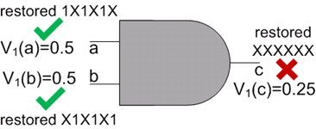

Impact of Signal Correlation On The Accuracy of Metric Computation
Compute the “visibility” metric for the output pin of an AND gate
Based on two input pins, each has $v_{1}= 0.5$
But actual restored values for the two pins are interleaved
$v_{1}(c)$ should actually be 0 but computed as 0.25

Slide 59

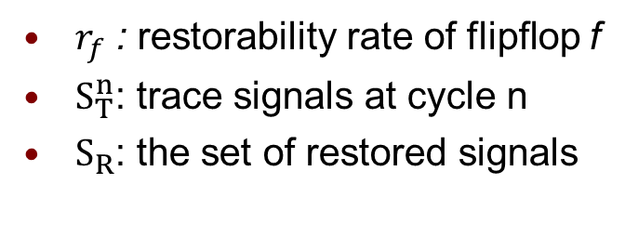
Computation of “Restorability Rate”
Based on X-Simulation for an observation window of n=64 cycles
At each call of X-Simulation, the previously-restored signals and the trace signals selected from the current iteration are used to restore new signals
Runtime complexity of the algorithm dominated by the 64 calls to X-Simulations
However, the restorability rates of all the untraced flipflops are computed within one call of the algorithm
Alg: Restorability Rate
1: $r_{f}=0,∀f∈F,S_{R}=∅$
2: for n = 1 to 64 do
3: $S_{R}$=X-Simulation($S_{T}^{n}∪S_{R}$)
4: for each $f∈F$ do
5: $r_{f}=r_{f}+1 if f is in{ S}_{R}$
6: end for
7: end for
8: $r_{f}=\frac{r_{f}}{64},∀f∈F$
$r_{f}$ : restorability rate of flipflop f
$S_{T}^{n}$: trace signals at cycle n
$S_{R}$: the set of restored signals

Slide 60
Comparison of SRR with Liu & Xu
Circuit | #Traces | Liu & Xu | Ours | Improvement
S35932 | 8 | 19.2 | 83.0 | +331.4%
 | 16 | 14.0 | 45.0 | +222.4%
 | 32 | 8.7 | 23.0 | +165.0%
S38417 | 8 | 64.0 | 96.0 | +50.0%
 | 16 | 38.1 | 67.0 | +75.7%
 | 32 | 21.1 | 44.0 | +108.9%
S38584 | 8 | 18.6 | 52.0 | +179.3%
 | 16 | 18.6 | 30.9 | +65.9%
 | 32 | 14.2 | 17.9 | +25.7%
Avg. |  |  |  | +136.0%
For S38584, “g35” is set to “1”
For S35932, “RESET” is set to “1” while “TM0” and “TM1” can randomly change
S38417 does not have any control signal

Slide 61
Comparison of SRR with Ko & Nicolici
Circuit | #Traces | Ko & Nicolici | Ours | Improvement
S38584-R | 8 | 127.2 | 160.3 | +26.0%
 | 16 | 65.6 | 84.1 | +28.3%
 | 32 | 37.4 | 43.0 | +15.2%
S35932-R | 8 | 254.9 | 256.0 | +0.5%
 | 16 | 127.8 | 128.8 | +0.8%
 | 32 | 64.6 | 64.7 | +0.2%
S38584-D | 8 | 19.0 | 83.3 | +338.5%
 | 16 | 10.6 | 45.1 | +327.5%
 | 32 | 6.3 | 23.2 | +267.3%
S35932-D | 8 | 41.5 | 62.8 | +51.5%
 | 16 | 39.3 | 42.3 | +7.7%
 | 32 | 24.8 | 27.7 | +11.8%
S38417 | 8 | 19.6 | 52.1 | +165.7%
 | 16 | 11.2 | 30.8 | +174.2%
 | 32 | 6.73 | 17.8 | +164.8%
Avg. |  |  |  | +105.3%
“-R” case every signal is randomly changed for benchmarks excluding S38417
“-D” case for S35932, average the 4 modes

Slide 62
Comparison of SRR with Basu & Mishra
Circuit | #Traces | Basu & Mishra | Ours | Improvement
S38584-R | 8 | 155 | 156 | +0.6%
 | 16 | 82 | 83 | +1.2%
 | 32 | 42 | 42 | 0.0%
S35932-R | 8 | 188 | 192 | +2.1%
 | 16 | 96 | 99 | +3.1%
 | 32 | 50 | 52 | +4.0%
S38584-D | 8 | 78 | 83 | +6.4%
 | 16 | 40 | 45 | +12.5%
 | 32 | 20 | 23 | +15.0%
S35932-D | 8 | 95 | 96 | +1.1%
 | 16 | 60 | 67 | +11.7%
 | 32 | 35 | 44 | +25.7%
S38417 | 8 | 55 | 52 | -5.5%
 | 16 | 29 | 31 | +6.9%
 | 32 | 16 | 18 | +12.5%
Avg. |  |  |  | +6.5%
“-R” case every signal is randomly changed for benchmarks excluding S38417
“-D” case is same as Liu & Xu

Slide 63
Comparison of Runtime with Basu & Mishra
Circuit | #Traces | Basu & Mishra | Ours | Basu & Mishra / Ours
S38584-R | 8 | 320 | 55 | 5.8
 | 16 | 341 | 70 | 4.9
 | 32 | 409 | 313 | 1.3
S35932-R | 8 | 336 | 43 | 7.8
 | 16 | 378 | 67 | 5.6
 | 32 | 411 | 110 | 3.7
S38584-D | 8 | 322 | 35 | 9.2
 | 16 | 354 | 55 | 6.4
 | 32 | 421 | 217 | 1.9
S35932-D | 8 | 345 | 41 | 8.4
 | 16 | 389 | 58 | 6.7
 | 32 | 441 | 97 | 4.5
S38417 | 8 | 529 | 116 | 4.6
 | 16 | 571 | 256 | 2.2
 | 32 | 649 | 443 | 1.5
Avg. |  |  |  | 4.98
Runtime shown in seconds

Slide 64
Experimental Results for Control Signal Identification
Circuit | #PIs | #Control Signals | %Candidates | Runtime(sec)
S38584 | 38 | 1 | 5.3% | 2.19
S35932 | 35 | 2 | 8.6% | 2.35
b17 | 37 | 2 | 16.2% | 0.76
b18 | 36 | 1 | 2.8% | 1.62
dsp | 586 | 3 | 0.9% | 8.49
dMA | 682 | 3 | 1.8% | 6.63
des_perf | 234 | 1 | 0.4% | 11.55
Avg. | 235 | 1.86 | 5.1% | 4.80

Slide 65
Accelerating the Selection Process
Incremental update of the restoration map
New signal values only restored at cycles which are previously unknown; already restored values remain unchanged
Temporarily store the restoration map after a new trace is selected
At each iteration, performed X-Simulation based on the value of new trace signals and the temporary restoration map; restoration effort is saved for already restored signal values
Parallel X-Simulation on multiple candidates
Make multiple copies of the circuit, with each one attached to one set of candidate trace signals
Apply X-Simulation to each set simultaneously
After obtaining the SRR, reuse the memory of each copy and attach them to new candidate trace sets
The idea of using extra “memory to trade for speed”

Slide 66

Multi-Mode Metrics: Reachability List
$L_{f^{v}}^{m}:$ reachability list in mode m
Defined for a specific mode m
Example: $L_{f_{3}^{1}}^{c=0}=\left\{f_{1},f_{2}\right\}$ $L_{f_{3}^{0}}^{c=0}=∅{ L}_{f_{3}^{0}}^{c=1}=∅$ $L_{f_{3}^{1}}^{c=1}=\{f_{1}\}$
f₂
c
f₃
f₁

