Slide 1


Multi-Mode Trace Signal Selection for Post-Silicon Debug
Min Li and Azadeh Davoodi
Department of Electrical and Computer Engineering
University of Wisconsin-Madison
WISCAD Electronic Design Automation Lab http://wiscad.ece.wisc.edu/
Notes:
Title?

Slide 2
Outline
Preliminaries
Overview of post-silicon debug (PSD) using trace buffers
Review of restoration process and previous works
Introduction to restoration using control signals and operation modes
Motivation of multi-mode trace selection (MMTS)
An iterative MMTS algorithm
New metrics for trace signal selection
Mode merging and iterative selection process
Experimental results

Slide 3
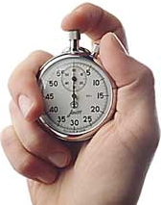
Post-Silicon Debug
Real-time operation of a few manufactured chips with real-world stimulus
Involves finding errors causing malfunctions
Fix through multiple rounds of Silicon Stepping/Revision
Has become significantly time-consuming and expensive
Tight Time-to-Market requirement
Formal verification and simulation tools do not scale as technology scales
Poor visibility inside the chip

Slide 4
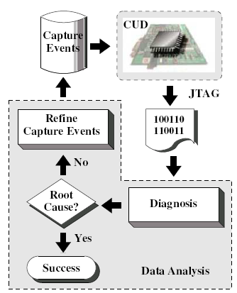
Debug using Trace Buffers
Use trace buffer technology
Trigger an event in the CUD
Real-time capture traces on a few selected state elements through on-chip buffer
Extract and analyze
Reveals internal states at real-time operation
Off-chip state restoration
[Figure from Yang, et al DATE09]

Slide 5
Trace Signal Selection Problem
Limitation
Small trace buffer width (8~32 bits) and depth (1K~8K clock cycles)
Limited on-chip white spaces
Automated trace selection
Need to select a subset of state elements to trace such that the visibility of internal signals is maximized
Based on algorithms rather than hints and experiences

Slide 6










Restoration Using Traced Signals
f₃
Forward
Propagation
State Restoration Ratio (SRR):
# tot. FF restored
# tot. FF traced
e.g. in this example 11/4=2.75
f₂
0
f₁
0
f₅
0
Backward
Justification
0
f₄
DFF\Cycle | 0 | 1 | 2 | 3 | 4
F1 | X | X | X | X | X
F2 | 0 | 1 | 1 | 0 | X
F3 | X | X | X | X | X
F4 | X | X | X | X | X
F5 | X | X | X | X | X
1 | 1 | 0 | X | X
X | 1 | 1 | X | X
X | 0 | X | X | 0

Slide 7
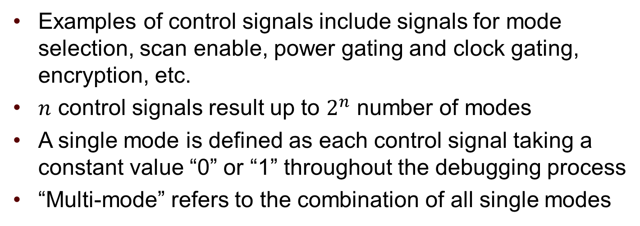
Control Signals and Modes
f₂
control signal
c
f₃
f₁
Examples of control signals include signals for mode selection, scan enable, power gating and clock gating, encryption, etc.
$n$ control signals result up to $2^{n}$ number of modes
A single mode is defined as each control signal taking a constant value “0” or “1” throughout the debugging process
“Multi-mode” refers to the combination of all single modes

Slide 8
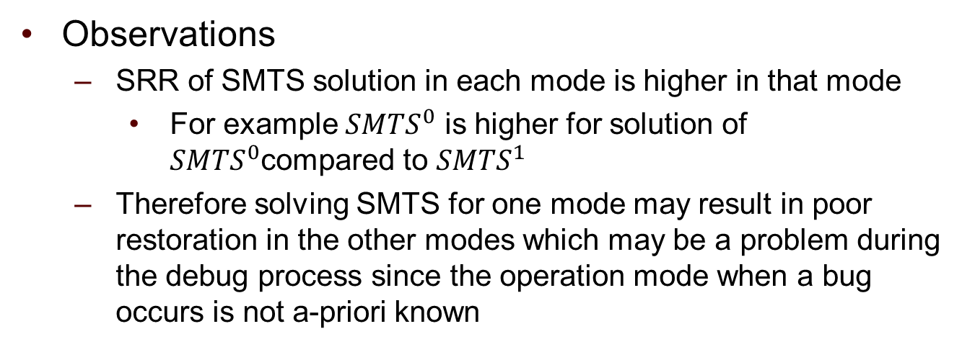
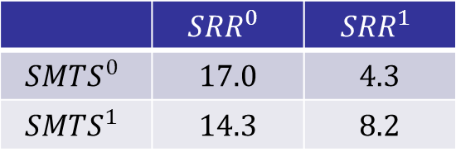
Need to Consider Multiple Modes
Case study of S38584
For each solution evaluated the SRR for mode 0 and 1
 | $${SRR}^{0}$$ | $${SRR}^{1}$$
$${SMTS}^{0}$$ | 17.0 | 4.3
$${SMTS}^{1}$$ | 14.3 | 8.2
Ran single mode trace selection (SMTS) procedure (of Li & Davoodi [DATE’13]) twice, for modes 0 and 1, to select two different sets of trace signals
For each solution evaluated the SRR for mode 0 and 1
Observations
SRR of SMTS solution in each mode is higher in that mode
For example ${SMTS}^{0}$ is higher for solution of ${SMTS}^{0}$compared to ${SMTS}^{1}$
Therefore solving SMTS for one mode may result in poor restoration in the other modes which may be a problem during the debug process since the operation mode when a bug occurs is not a-priori known

Slide 9
Previous Works
Previous works give procedures for solving the trace selection problem for a single operation mode
Ko & Nicolici [DATE’08]
Liu & Xu [DATE’09]
Prabhakar & Xiao [ATS’09]
Basu & Mishra [VLSI’11]
D. Chatterjee [ICCAD’11]: pure simulation with backward elimination
Li & Davoodi [DATE’13]: a hybrid algorithm combining fast metric and accurate simulation
Two major drawbacks of applying single mode trace selection algorithms for multi-modes
Traces selected for different modes may have little in common
Traces selected for one mode may not be good for other modes

Slide 10
Contributions
A new metric and problem definition when considering multiple modes
Multi-mode State Restoration Ratio (MSRR)
Multi-Mode Trace Selection problem (MMTS)
Algorithms for solving MMTS including
A procedure to reduce the number of modes by merging the modes with “similar” restoration maps
A procedure based on perturbing an initial single-mode optimized solution (selected from a suitable “start” mode) to improve the restorability over all the modes

Slide 11
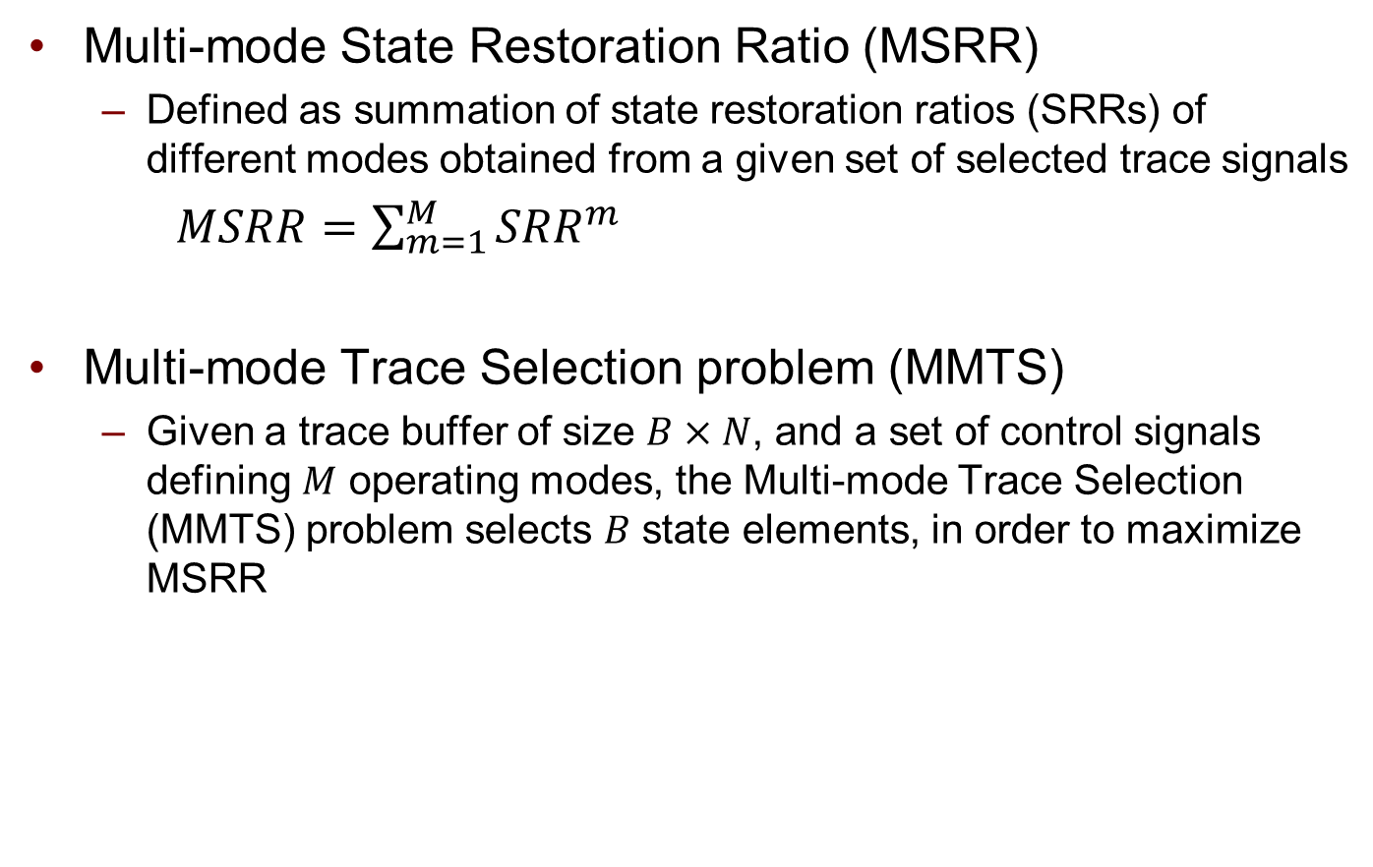
Multi-mode Trace Selection Problem
Multi-mode State Restoration Ratio (MSRR)
Defined as summation of state restoration ratios (SRRs) of different modes obtained from a given set of selected trace signals
$MSRR=\sum_{m=1}^{M}{{SRR}^{m}}$
Multi-mode Trace Selection problem (MMTS)
Given a trace buffer of size $B×N$, and a set of control signals defining $M$ operating modes, the Multi-mode Trace Selection (MMTS) problem selects $B$ state elements, in order to maximize MSRR

Slide 12
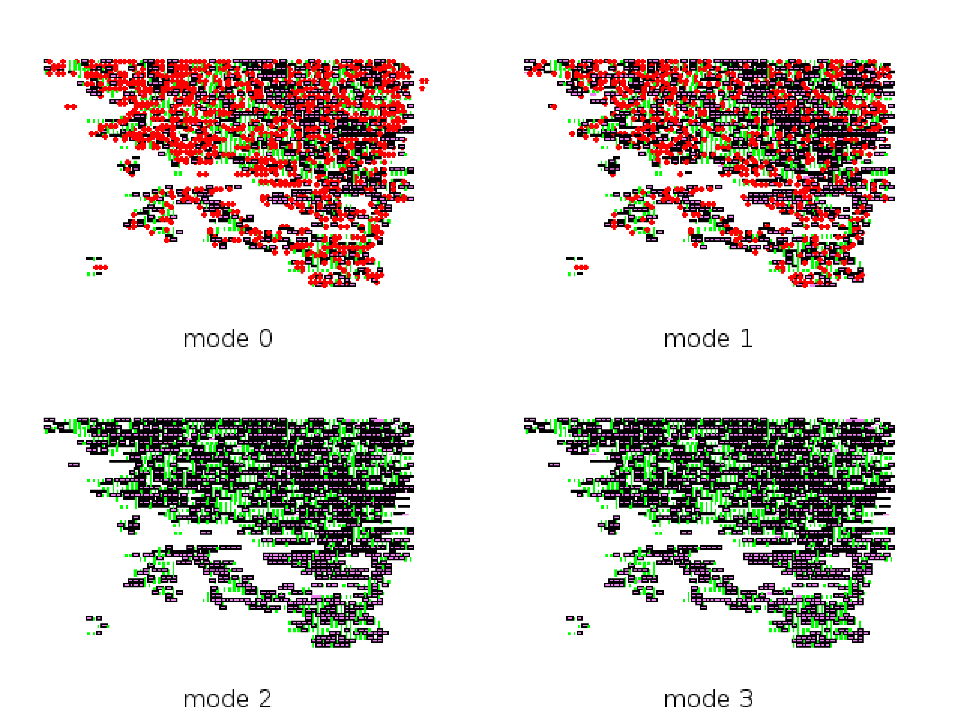
Mode Merging: Motivation
For S35932 we plotted four restoration maps when each of its four operation modes are set to the corresponding values (when no trace signal is selected yet)
In each restoration map
Green pixel: gate restored to 0
Black pixel: gate restored to 1
Red pixel: unrestored gate
Observations
Modes with similar restoration maps can be merged into a single mode
In this case, modes 0 and 1 can be merged, so is modes 2 and 3c

Slide 13
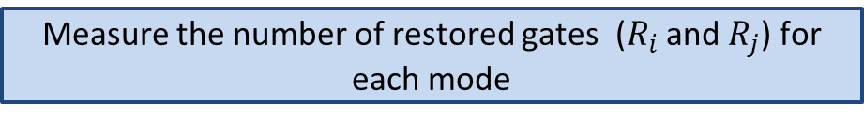


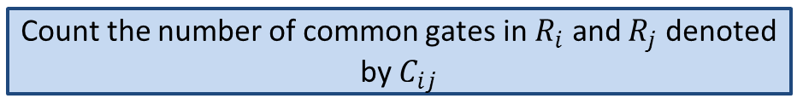

Mode Merging: Procedure
Consider any two modes $m_{i}$ and $m_{j}$
Measure the number of restored gates ($R_{i}$ and $R_{j}$) for each mode
Count the number of common gates in $R_{i}$ and $R_{j}$ denoted by $C_{ij}$
Compute similarity ratio $S_{ij}=\frac{C_{ij}}{\max{(R_{i},R_{j})}}$
$S_{ij}≥ α$ ?
Y
N
Merged the two modes (into one of the modes)
Can’t merge the two modes

Slide 14

MMTS Procedure: Metrics
$L_{f^{v}}^{m}:$ reachability list in mode
The set of state elements which can be restored solely by flipflop f when f takes value v (0 or 1) and control signals take constant values corresponding to mode m
Example : $L_{f_{3}^{0}}^{c=0}=∅$ $L_{f_{3}^{1}}^{c=0}=\left\{f_{1},f_{2}\right\}{ L}_{f_{3}^{0}}^{c=1}=∅$ $L_{f_{3}^{1}}^{c=1}=\{f_{1}\}$
f₂
c
f₃
f₁

Slide 15
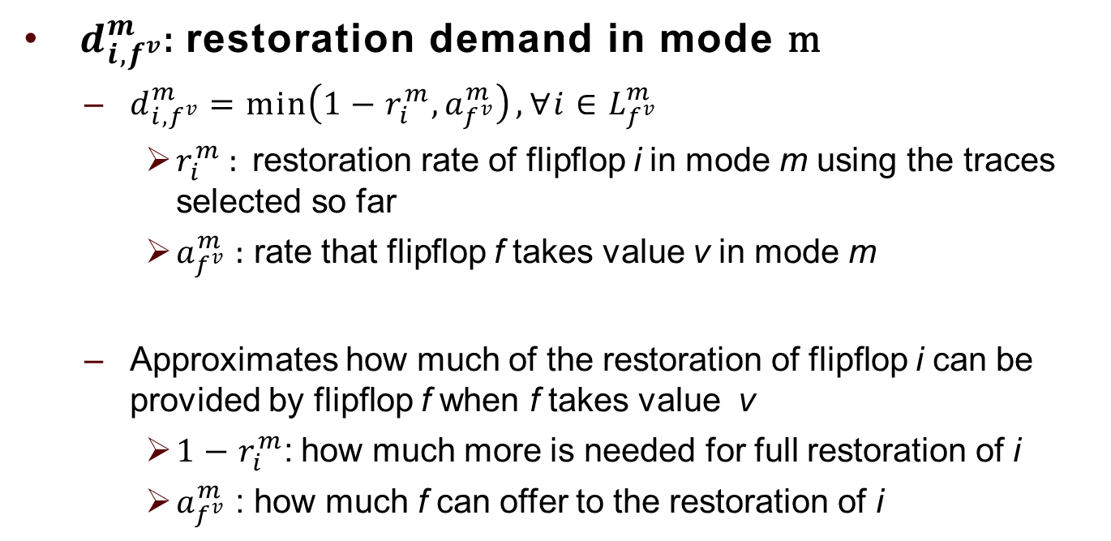
MMTS Procedure: Metrics
${ d}_{i,f^{v}}^{m}$: restoration demand in mode m
$d_{i,f^{v}}^{m}=\min\left(1−r_{i}^{m},a_{f^{v}}^{m}\right),∀i∈L_{f^{v}}^{m}$
$r_{i}^{m}$ : restoration rate of flipflop i in mode m using the traces selected so far
$a_{f^{v}}^{m}$ : rate that flipflop f takes value v in mode m
Approximates how much of the restoration of flipflop i can be provided by flipflop f when f takes value v
$1−r_{i}^{m}$: how much more is needed for full restoration of i
$a_{f^{v}}^{m}$ : how much f can offer to the restoration of i

Slide 16
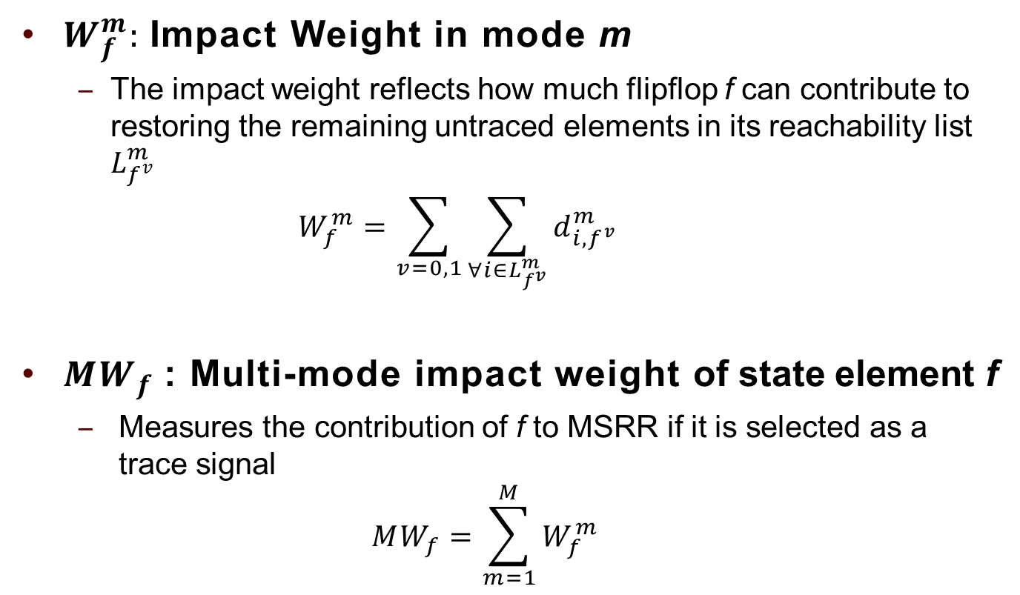
MMTS Procedure: Metrics
$W_{f}^{m}:$Impact Weight in mode m
The impact weight reflects how much flipflop f can contribute to restoring the remaining untraced elements in its reachability list $L_{f^{v}}^{m}$
$$W_{f}^{m}=\sum_{v=0,1}{\sum_{∀i∈L_{f^{v}}^{m}}{d_{i,f^{v}}^{m}}}$$
${MW}_{f}$: Multi-mode impact weight of state element f
Measures the contribution of f to MSRR if it is selected as a trace signal
$${MW}_{f}=\sum_{m=1}^{M}{W_{f}^{m}}$$

Slide 17
IteM: Iterative Multi-mode Trace Selection
Overview of our procedure:
Identify a suitable start mode minit
For each mode compute a set representing the union of the reachability lists for all the flipflops in that mode, and then let the start mode to be the one which has the highest size for this set
Find an initial solution to maximize the SRR in mode minit
Generated using Li & Davoodi [DATE’13]
Iteratively perturb the current solution for better multi-mode restoration
Has a a non-greedy nature
Is based on a gradually-increasing perturbation radius r within each iteration
Specifically, at each iteration, up to R=3 number of trace signals in the current solution may be swapped
The process terminates upon observing no improvements in MSSR in 20 consecutive iterations

Slide 18
IteM: Iterative Multi-mode Trace Selection
Overview of swap for R trace signals:
Gradually increases the perturbation radius from r=1 to r=R
Uses a probabilistic acceptance criteria similar to simulated annealing to probabilistically accept the swaps when there is no improvement in MSRR
START
Set swap to DET (deterministic);
radius r=1
Set swap to
RAND
(random);
radius r=1
Swap r signals
Accept
?
r++
Y
N
Y
N
r > R
?
Y
Swap is DET ?
swap RAND
r=1 signal
N
DONE

Slide 19
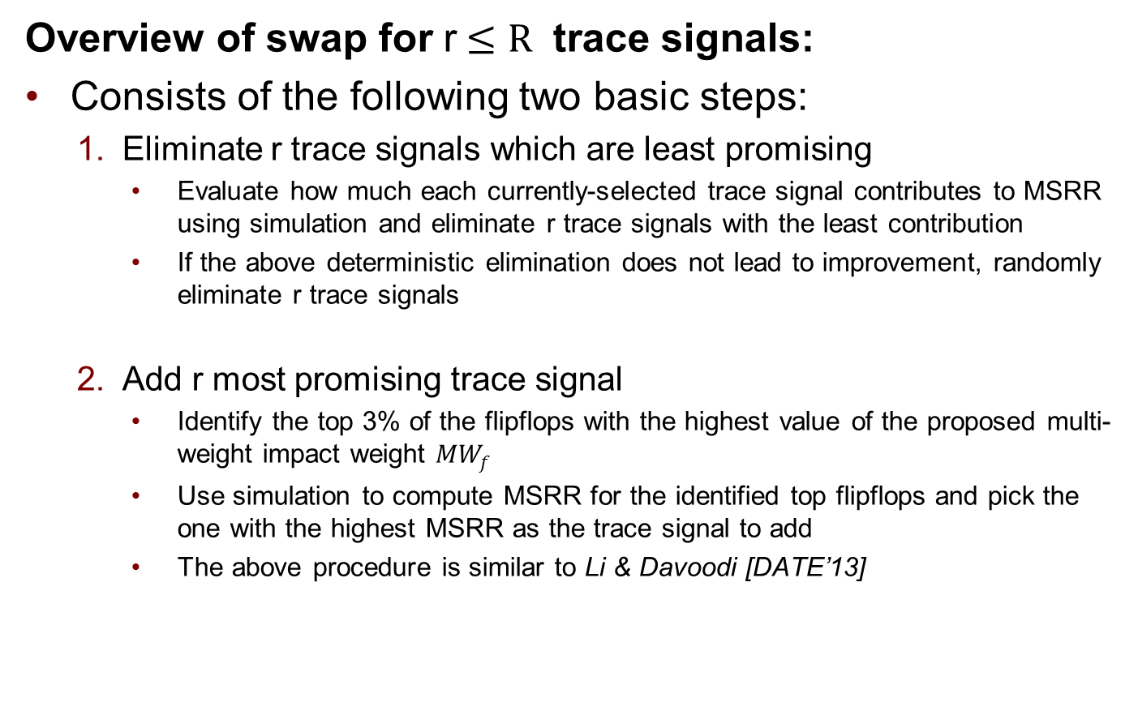
IteM: Iterative Multi-mode Trace Selection
Overview of swap for r$≤R$ trace signals:
Consists of the following two basic steps:
Eliminate r trace signals which are least promising
Evaluate how much each currently-selected trace signal contributes to MSRR using simulation and eliminate r trace signals with the least contribution
If the above deterministic elimination does not lead to improvement, randomly eliminate r trace signals
Add r most promising trace signal
Identify the top 3% of the flipflops with the highest value of the proposed multi-weight impact weight ${MW}_{f}$
Use simulation to compute MSRR for the identified top flipflops and pick the one with the highest MSRR as the trace signal to add
The above procedure is similar to Li & Davoodi [DATE’13]

Slide 20
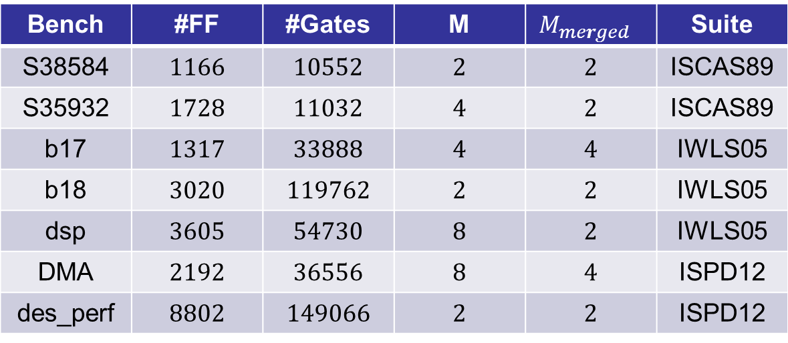
Experimental Results
Benchmark Information
Bench | #FF | #Gates | M | $$M_{merged }$$ | Suite
S38584 | 1166 | 10552 | 2 | 2 | ISCAS89
S35932 | 1728 | 11032 | 4 | 2 | ISCAS89
b17 | 1317 | 33888 | 4 | 4 | IWLS05
b18 | 3020 | 119762 | 2 | 2 | IWLS05
dsp | 3605 | 54730 | 8 | 2 | IWLS05
DMA | 2192 | 36556 | 8 | 4 | ISPD12
des_perf | 8802 | 149066 | 2 | 2 | ISPD12
All benchmarks (excluding S38584 and S35932) are much larger compared to the ISCAS’89 used in prior works
dsp has the maximum reduction in the number of modes, from 8 to 2, due to mode merging

Slide 21
Implemented Approaches
RATS: implemented the single-mode procedure of Basu & Mishra [VLSI’11]
HYBR: single-mode procedure of Li & Davoodi [DATE’13] (our previous work)
SimF: single-mode forward-greedy selection based on simulation
HYBRM: simple extension of HYBR for multi-mode signal selection
IteM: the proposed iterative multi-mode selection procedure (this work)
REF: upper bound computed by adding the highest attainable SRR per mode
Highest SRR/mode computed by solving the single-mode trace selection in that mode using various algorithms

Slide 22
Comparison of MSRR
Bench | REF | RATS | HYBR | SimF | HYBRM | IteM
S38584 | 25.20 | 0.86 | 0.85 | 0.95 | 0.95 | 0.99
S35932 | 66.40 | 0.64 | 0.74 | 0.65 | 0.91 | 0.91
b17 | 7.90 | N/A | 0.62 | 0.58 | 0.76 | 0.94
b18 | 5.90 | N/A | 0.50 | 0.92 | 0.61 | 0.80
dsp | 42.80 | N/A | 0.41 | 0.88 | 0.37 | 0.92
DMA | 50.67 | 0.76 | 0.88 | 0.89 | 0.84 | 0.92
des_perf | 77.60 | N/A | 0.97 | 0.98 | 0.98 | 0.99
Average | 1.00 | N/A | 0.71 | 0.83 | 0.77 | 0.93
REF column reports MSRR and the remaining columns are normalized with respect to REF
Observations: IteM consistently performs better than other methods

Slide 23
Comparison of Runtime
Bench | RATS | HYBR | SimF | HYBRM | IteM
S38584 | 0.1 | 2 | 19 | 4 | 13
S35932 | 0.1 | 2 | 14 | 5 | 15
b17 | < 24hrs | 1 | 19 | 4 | 24
b18 | < 24hrs | 4 | 2151 | 119 | 90
dsp | < 24hrs | 2 | 92 | 28 | 251
DMA | 5 | 7 | 99 | 38 | 125
des_perf | < 24hrs | 16 | 469 | 24 | 94
Runtime is reported in minutes
RATS, although fast for the ISCAS89 benchmarks, didn’t scale for the large benchmarks (took more than 24hrs)
The runtime of IteM is reasonable given the large size of the benches and comparable with HYBRM which is based on simple extension of the very fast HYBR

Slide 24
Conclusions
We proposed the multi-mode trace signal selection problem (MMTS)
We introduced a strategy to merge the modes with similar restoration maps
We proposed an algorithm to solve the problem based on iterative perturbation of an initial solution obtained from a single but suitable start mode
Experimental results showed that the iterative algorithm performs better than various single-mode or multi-mode algorithms, with a high solution quality comparable to the reference case

Slide 25
References
K. Basu and P. Mishra. RATS: restoration-aware trace signal selection for post-silicon validation. In IEEE TVLSI, 2013
D. Chatterjee, C. McCarter, and V. Bertacco. Simulation-based signal selection for state restoration in silicon debug. In ICCAD, 2011
M. Li and A. Davoodi. A hybrid approach for fast and accurate trace signal selection for post-silicon debug. In DATE, 2013
H. F. Ko and N. Nicolici. Algorithms for state restoration and trace signal selection for data acquisition in silicon debug. In IEEE Trans. On CAD, 2009
X. Liu and Q. Xu. On signal selection for visibility enhancement in trace-based post-silicon validation. In IEEE Trans. on CAD, 2012

Slide 26
Thank You!

Slide 27
Experimental Results
Comparison of Merged/Unmerged Cases
Apply the iterative algorithm on the three benches having mode reduction (merged)
For “W Merge” case, randomly pick one mode to represent the modes merged
For MSRR comparison, raw numbers are shown (without normalization). For runtime comparison, results of the “W/O Merge” case are normalized to “W Merge”
Mode merging can significantly reduce the runtime while obtaining a comparable solution quality
W Merge
W/O Merge

