Slide 1
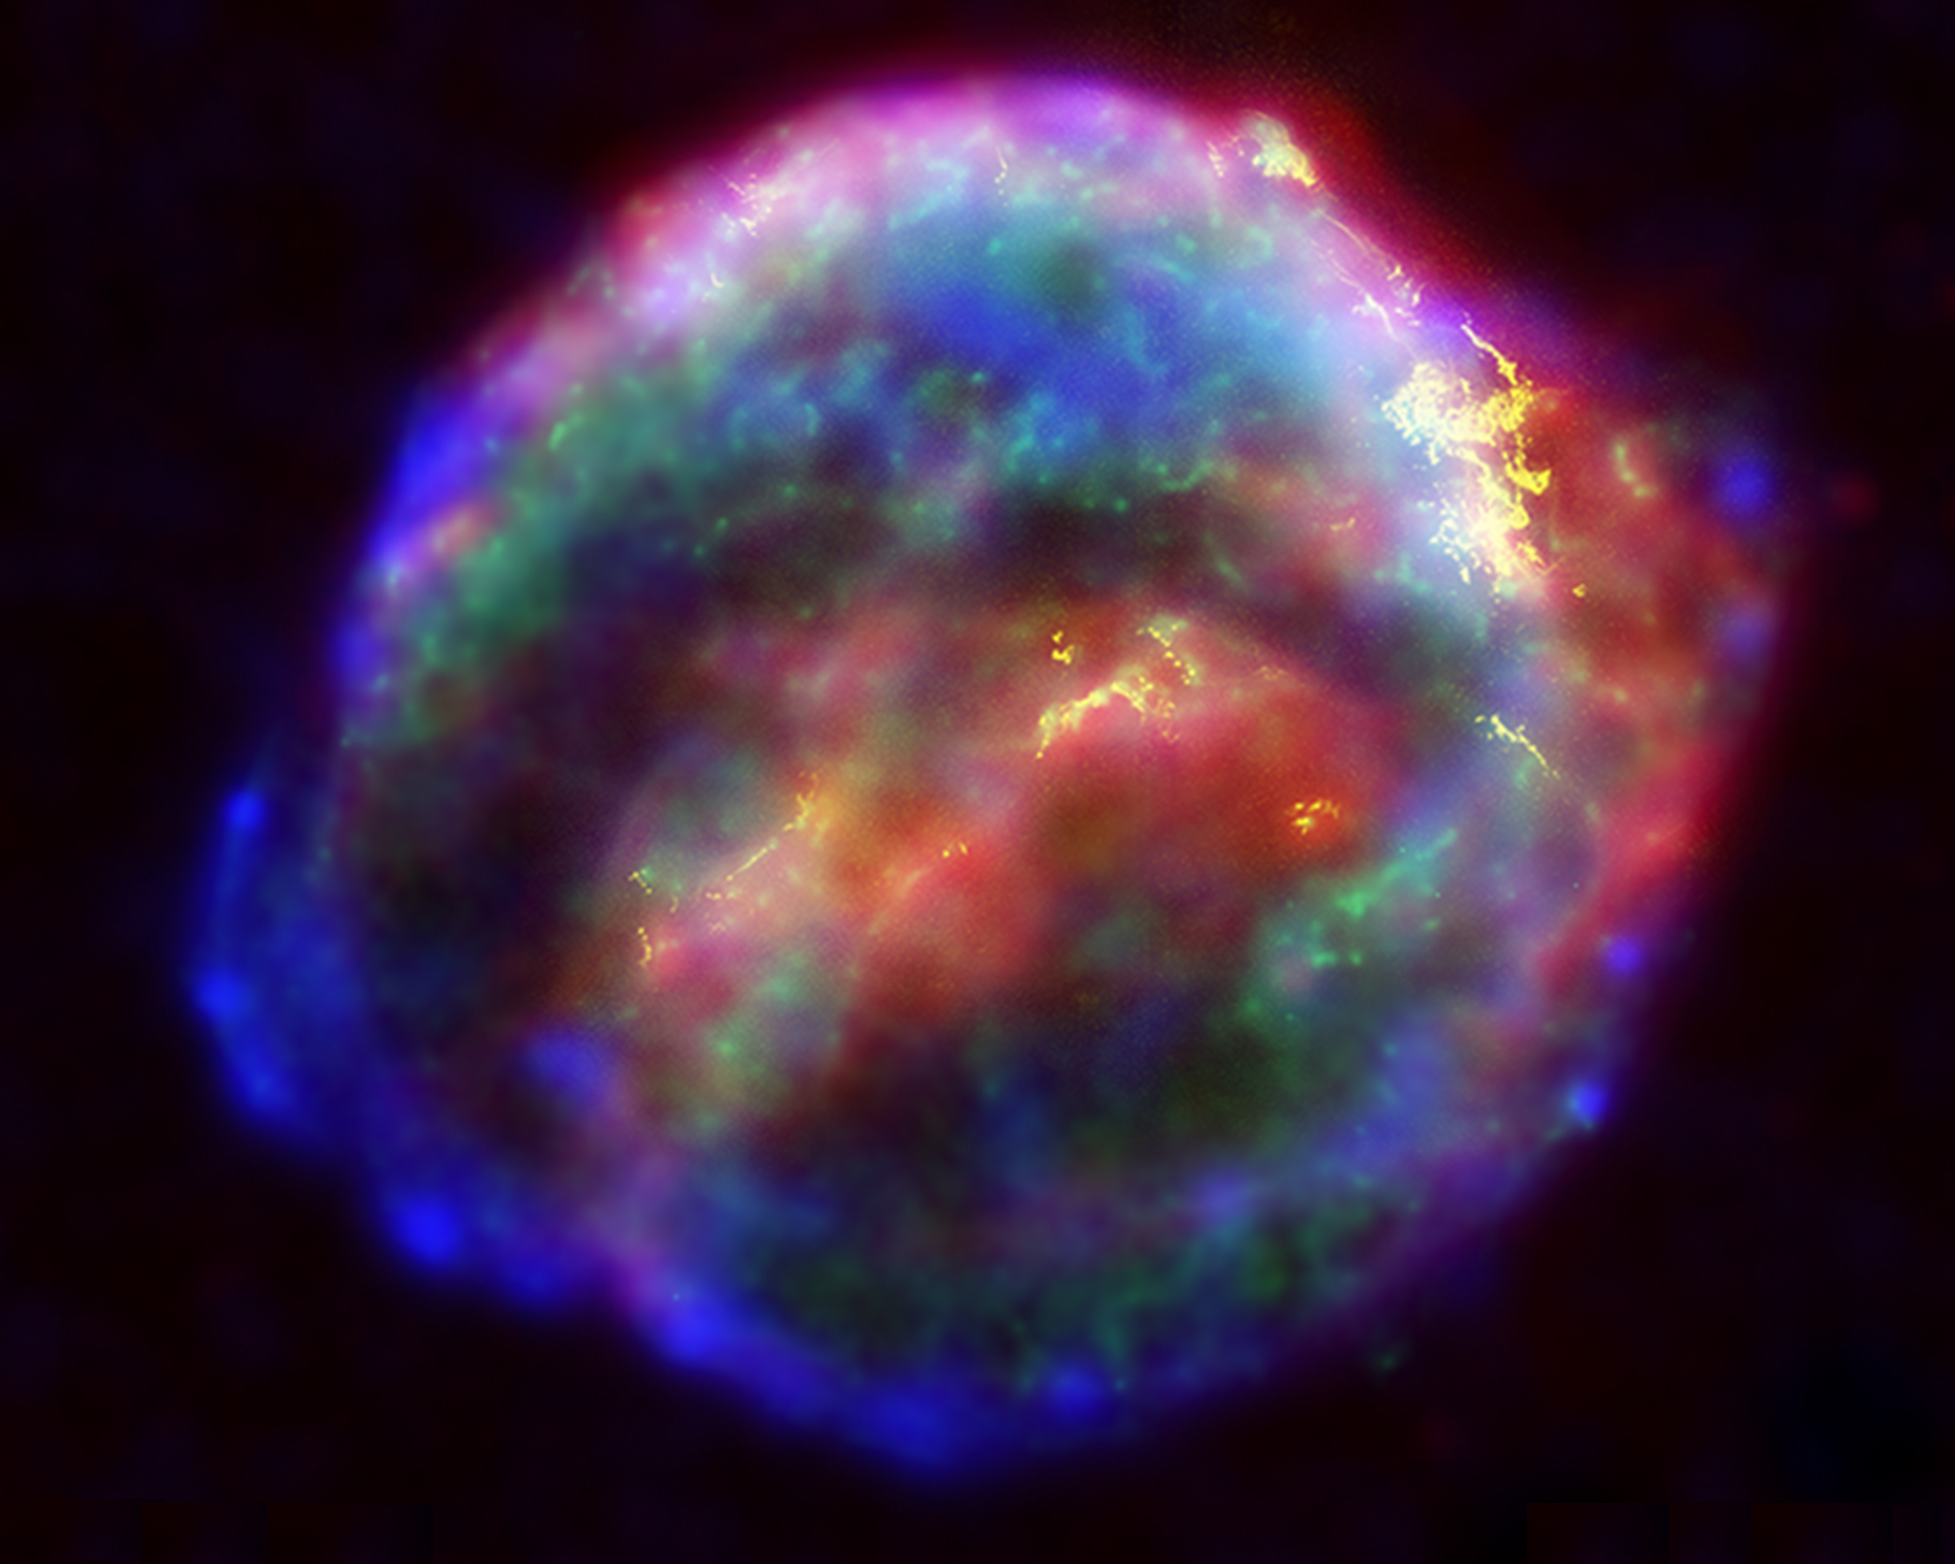
Modeling Supernovae Remnants
SN 1604 Kepler’s SN

Slide 2
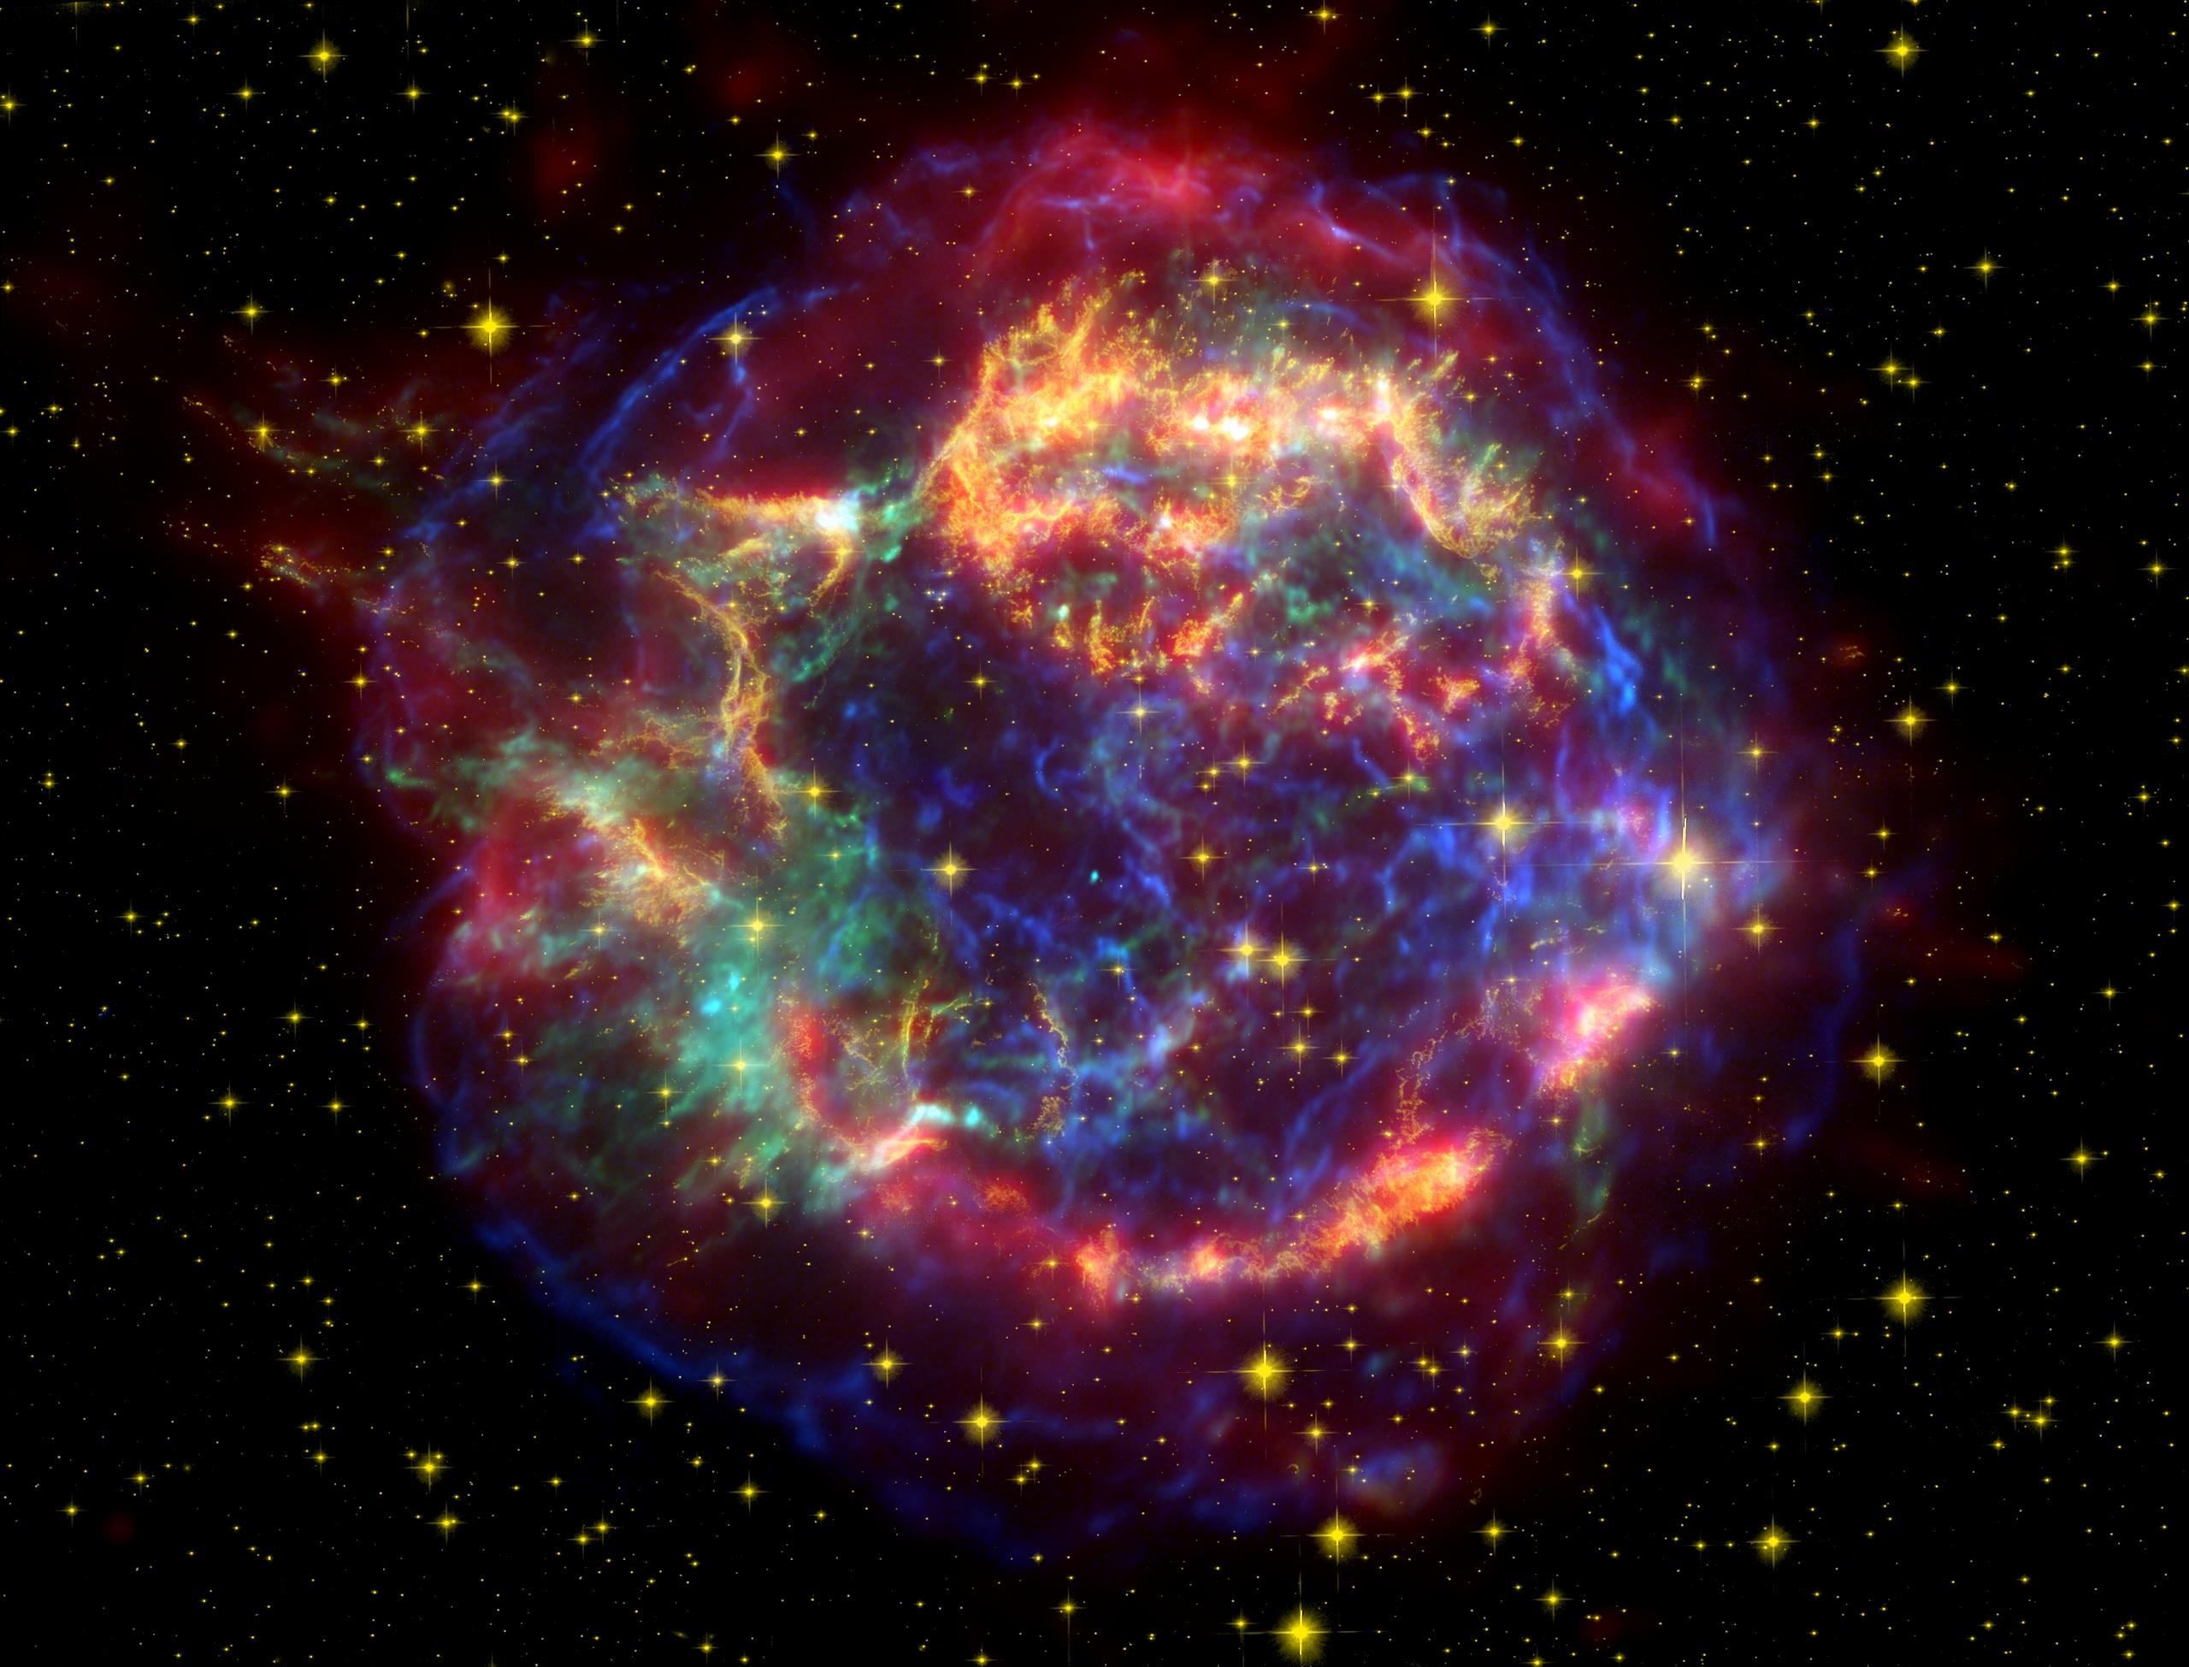
Cassiopeia A

Slide 3
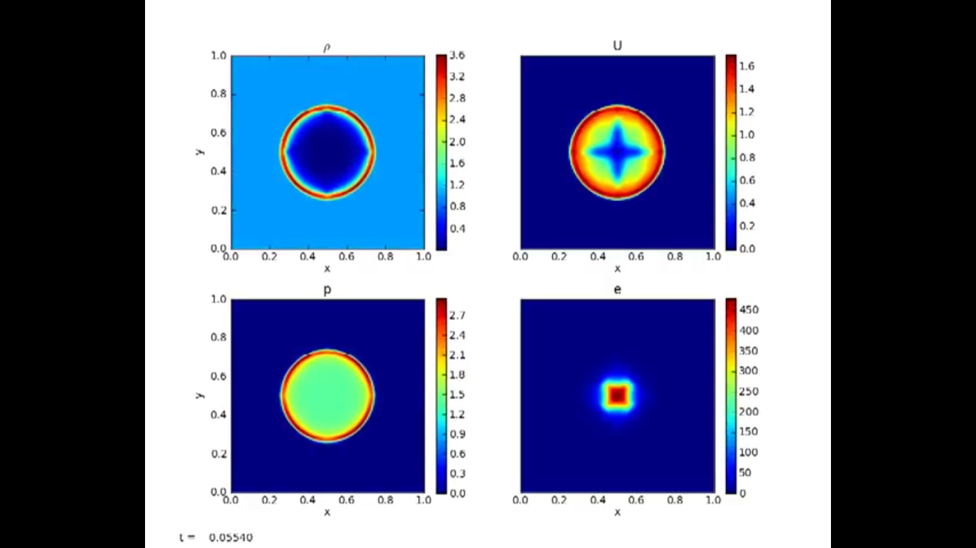
Pyro – The Sedov Explosion
https://zingale.github.io/pyro2/

Slide 4
Project
Assess which supernovae remnants we can model in the Sedov-Taylor adiabatic expansion phase.
Experiment with Pyro using different blast initial conditions to determine how best to model various supernova remnants.
Determine how shock speed and temperature depend on initial conditions.

