Slide 1
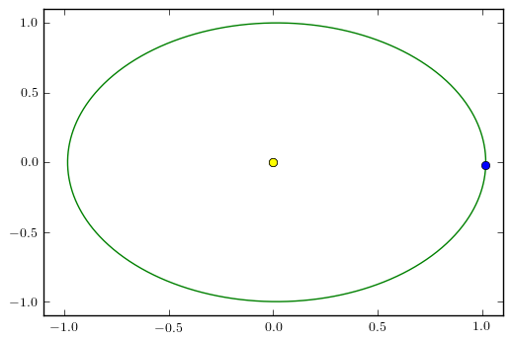
Modelling Planetary Orbits

Slide 2
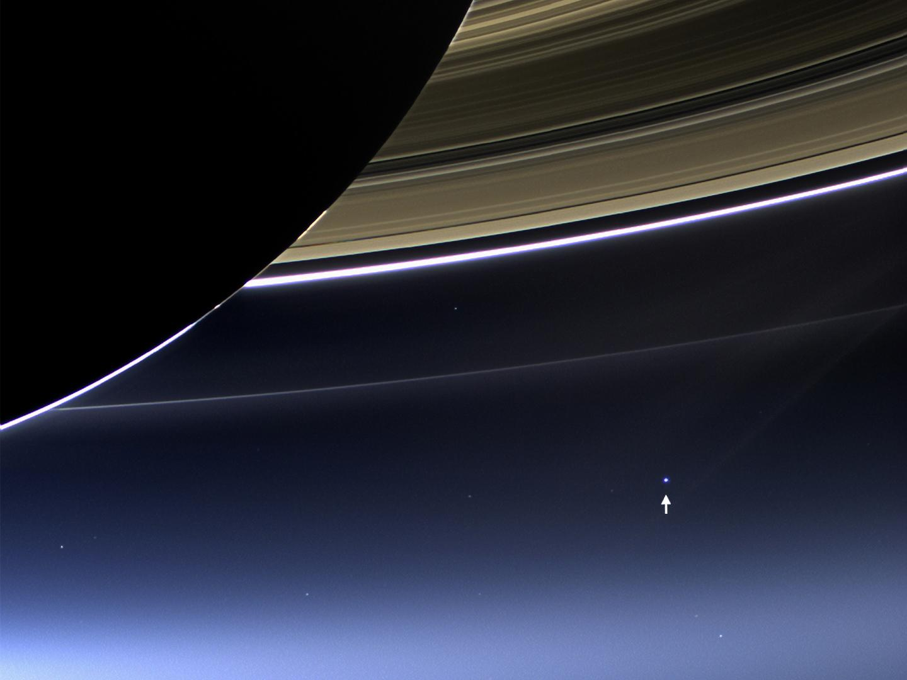
The Earth From Saturn – Cassini
https://saturn.jpl.nasa.gov/resources/5868/

Slide 3
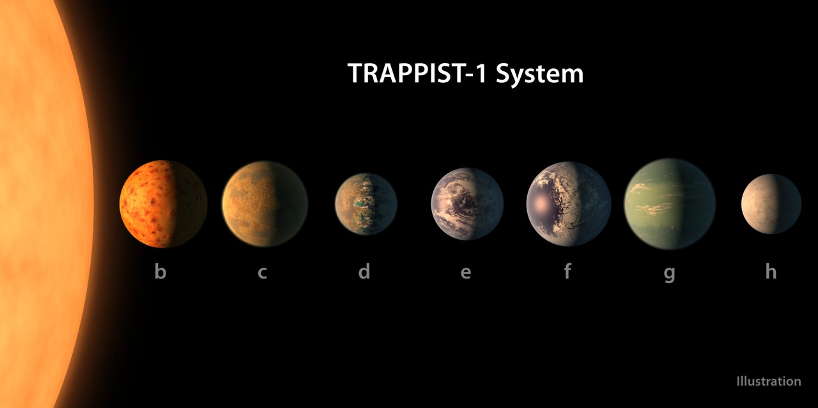
Newly Discovered – Trappist!
http://www.trappist.one/#system

Slide 4
Project
For either our Solar System or Trappist-1:
  Model the planetary orbits around the sun, accounting only for the sun’s gravity
  Study orbital perturbations arising from including gravitation from massive planets (e.g. Jupiter)
  How would solar transits look for each planet from faraway?

Slide 5
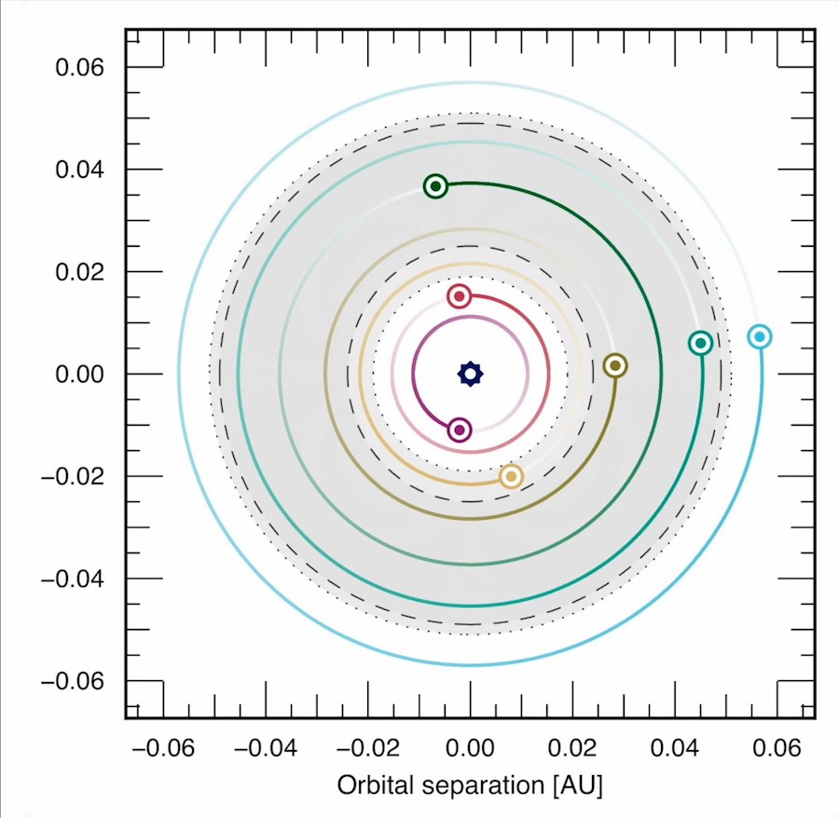
http://www.trappist.one/#system

