Slide 1
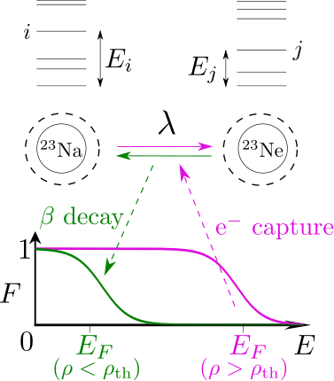
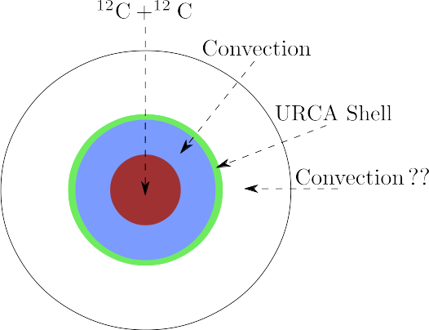
Urca Process In White Dwarfs
(Toki,Suzuki,Nomoto,Jones & Hirschi 2013)
Notes:
URCA (which nuclides)
Convection (driven by C-burning)
Neutrino free-streaming

Slide 2
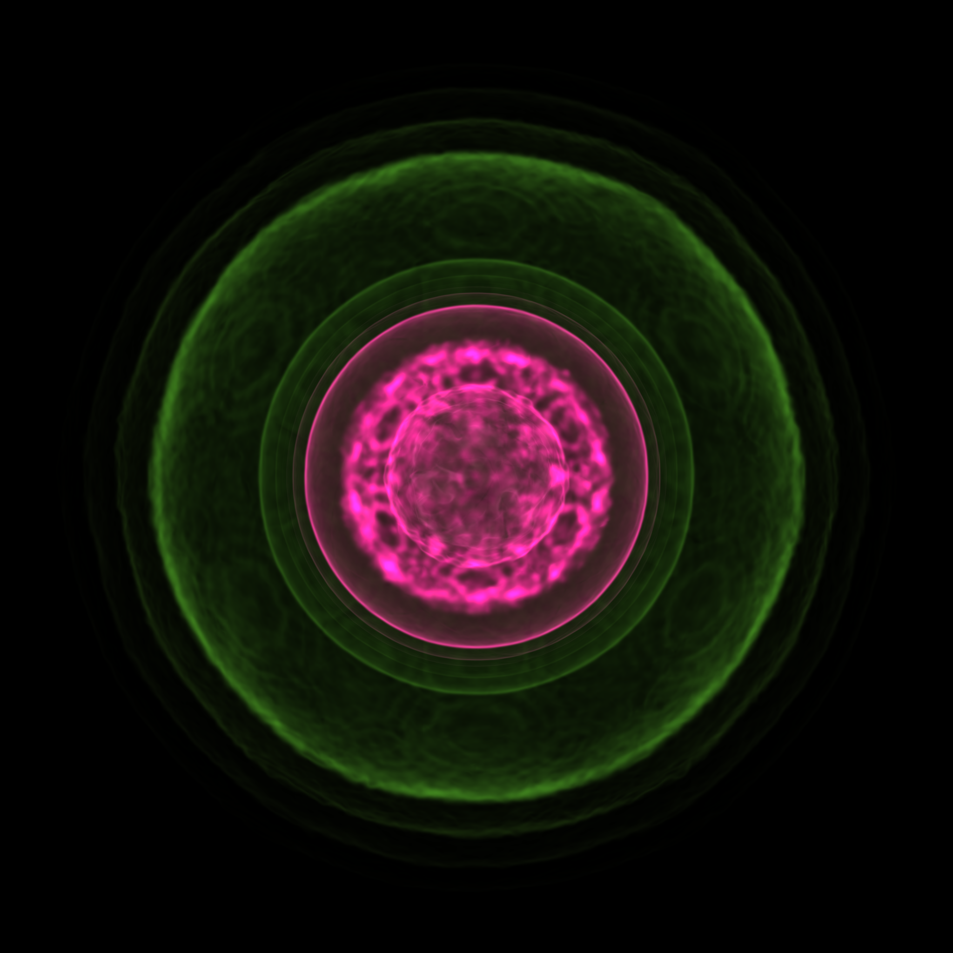

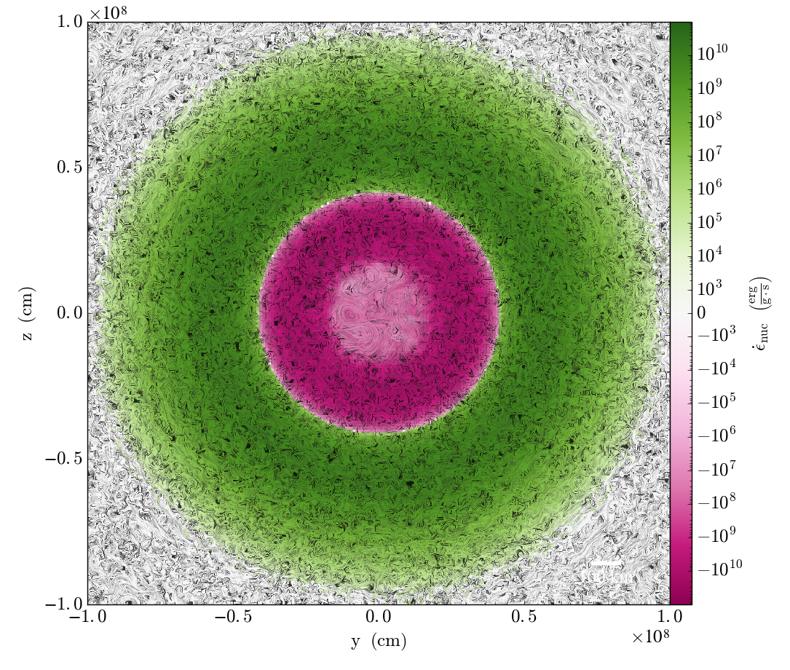
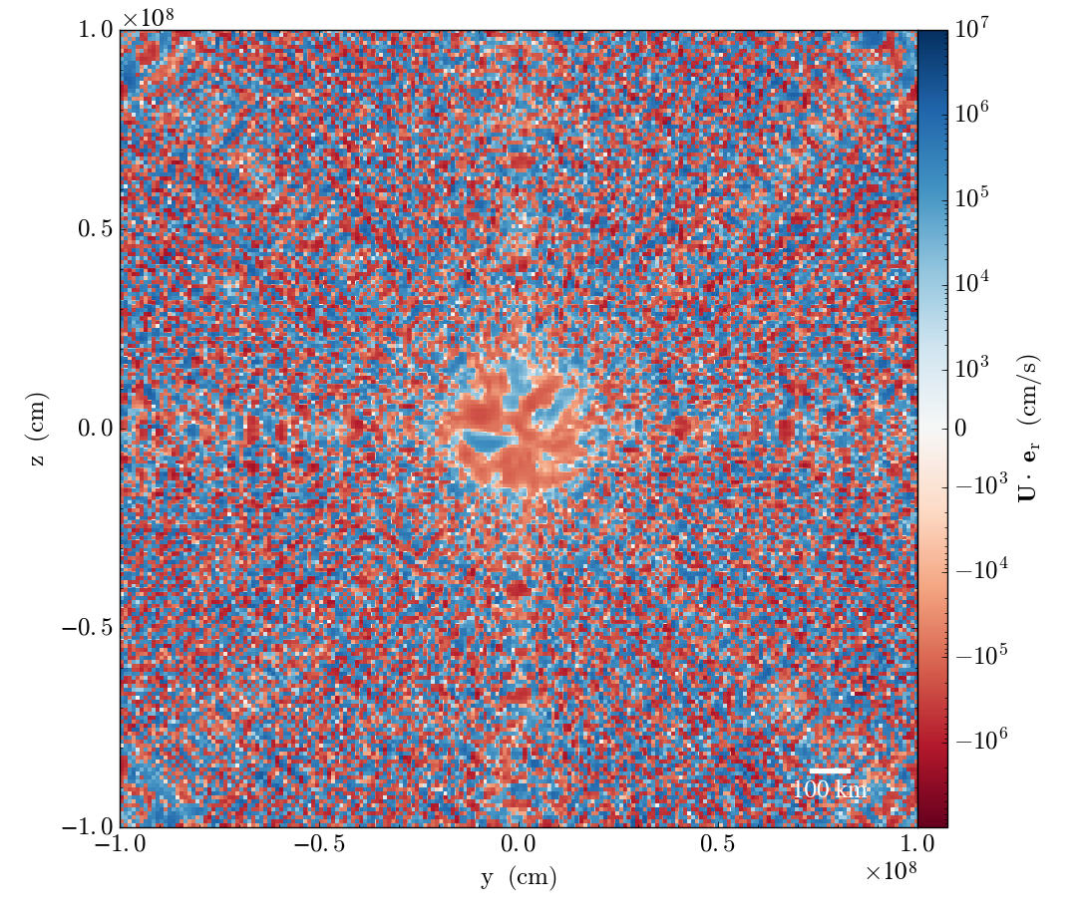
White Dwarf Urca Process

Slide 3
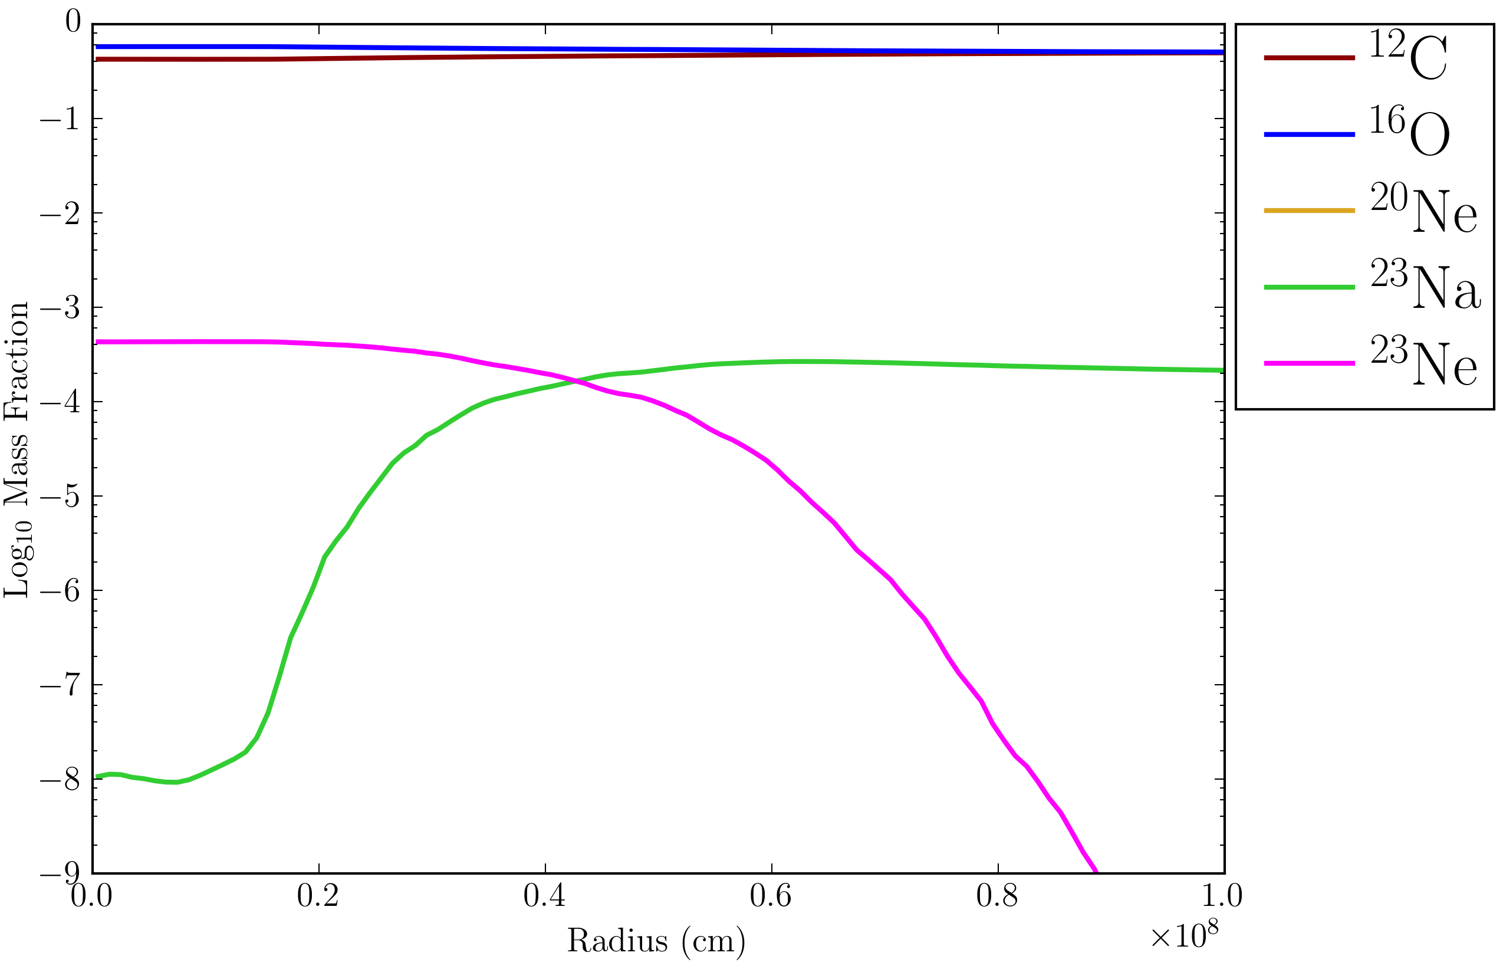
White Dwarf Urca Abundances

Slide 4
Project
Use pyreaclib to construct a reaction network that links the nuclides that have a role in carbon fusion, electron capture, and beta decay.
Determine the nucleosynthesis properties of the system and assess the dependence on:
  Density
  Temperature
  Composition

