Slide 1
Dashboard Panel Plugin
Michelle Tsai, Software Engineer, Advantech

Slide 2
Agenda
Plugin folder contents
Events of panel
Customize Plugin
Upload Plugin

Slide 3
Plugin folder Contents
File | Functions
Package.json | NPM Package list
Gruntfile | Grunt build script
dist | Build result files
src | Plugin.json (Plugin Information) Module.js (Plugin Loader) xxx_ctrl (Plugin Controller) Module.html (Plugin main view) Editor.html (editor page)

Slide 4
Plugin folder Contents – Package.json
Key | Definitions
name | Panel name
Version | Maintain version
devDependencies | npm packages for developer
dependencies | npm packages for running

Slide 5
Plugin folder Contents - Plugin.json
Key | Definitions
type | Panel or datasource
Name | Panel name
Id | Panel id (Can not duplicated)
Info | Description Author Name url Logo Version Updated
Dependencies | Running dependences

Slide 6

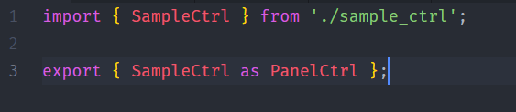
Plugin folder Contents – module.js

Slide 7
Events of Panel
Events | functions
render | Triggered when panel refresh
data-received | Triggered on data refresh
data-error | Used to handle errors on dashboard refresh
init-edit-mode | Used to add tabs when editing a panel
data-snapshot-load | Triggered to load data when in snapshot mode

Slide 8
Go Together,
We Go Far and Grow Big

