Slide 1
Operating Systems COMS(3010) Introduction

Slide 2
RESOURCES
Books
Prescribed
Thomas Anderson and Michael Dahlin. Operating Systems: Principles and Practice (2nd Edition) (A&D) (available from Van Schaik at Matrix)
Recommended
K. N. King. C Programming: A Modern Approach (2nd edition) (King)
Remzi H. Arpaci-Dusseau and Andrea C. Arpaci-Dusseau. Operating systems: Three Easy Pieces. (freely available here) (A&A)
Supplemental
Linux Kernel Development (3rd edition)
Understanding the Linux Kernel (3rd edition)
Website
https://wits-coms3010.github.io/info.html

Slide 3
Why is COMS3010 important
Some of you will actually design and build operating systems or components of them.
Perhaps more now than ever

Slide 4
Why is COMS3010 important
Some of you will actually design and build operating systems or components of them.
Perhaps more now than ever
Many of you will create systems that utilize the core concepts in operating systems.
Whether you build software or hardware
The concepts and design patterns appear at many levels

Slide 5
Why is COMS3010 important
Some of you will actually design and build operating systems or components of them.
Perhaps more now than ever
Many of you will create systems that utilize the core concepts in operating systems.
Whether you build software or hardware
The concepts and design patterns appear at many levels
All of you will build applications, etc. that utilize operating systems
The better you understand their design and implementation, the better use you’ll make of them.

Slide 6
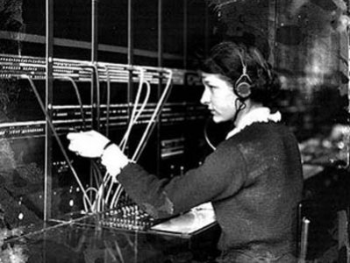
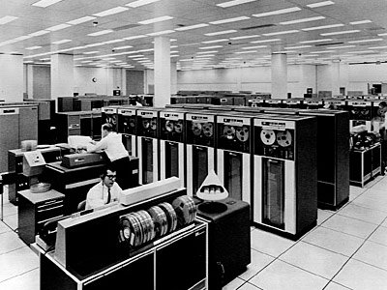
OS ? What is it ?
Switchboard Operator
Computer Operator

Slide 7
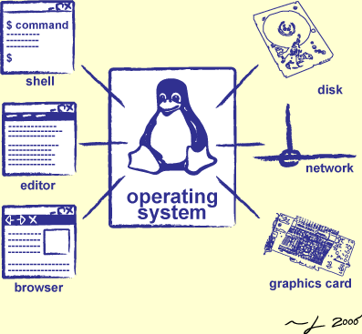
OS ? What is it ?
Switchboard Operator
Computer Operator
Software Operator

Slide 8
OS ? What is it ?
OK, well what is a system then

Slide 9
OS ? What is it ?
OK, well what is a system then?
A set of things working together as parts of a mechanism or a interconnecting network

Slide 10
OS ? What is it ?
Special layer of software that provides application software access to hardware resources
Convenient abstraction of complex hardware devices
Protected access to shared resources
Security and authentication
Communication amongst logical entities
HARDWARE
APP
OS
APP
APP
APP

Slide 11
ROLES of OS’s
There are 3 MAIN roles of any OS
Referee
Illusionist
Glue

Slide 12

ROLES of OS’s
Referee
Manage sharing of resources between different applications running on the same machine
Stopping and Starting of programs
Isolation of applications from each other
Deciding which applications get resources when
Protect itself and other programs from malicious software

Slide 13

ROLES of OS’s
Illusionist
Provide clean, easy to use abstractions of physical resources
Provides the illusion that a program has infinite memory
Provides the illusion that a program has the computers CPU all to itself
Allows programs to be written independently of the resources available
Since applications are written at a higher level of abstraction, the operating system can invisibly change the amount of resources allocated to each application

Slide 14

ROLES of OS’s
Glue
Provide a set of common services that facilitate sharing among applications
Cut/Paste works uniformly across the system
A file written by one application can be read by another
Common user interface routines which give applications a similar look and feel
Provides a layer separating applications from I/O devices

Slide 15
ROLES of OS’s
Referee
Manage sharing of resources, Protection
Resource allocation, isolation, communication
Illusionist
Provide clean, easy to use abstractions of physical resources
Infinite memory, dedicated machine
Higher level objects: files, users, messages
Masking limitations, virtualization
Glue
Common services
Storage, Window system, Networking
Sharing, Authorization
Look and feel

Slide 16
How does an OS do this?
Hardware
Software
Memory
Processor
Storage
Other Hardware
Networks
Displays
Inputs
Ect.

Slide 17
How does an OS do this?
From our Perspective
OS
Hardware
Software
Memory
Processor
Storage
Other Hardware
Networks
Displays
Inputs
Ect.

Slide 18
How does an OS do this?
Programs Perspective
OS Hardware Virtualization
Hardware
Virtual Hardware
Software
Memory
Address Space
Processor
Process
Storage
Files
Other Hardware
Networks
Displays
Inputs
Ect.
Sockets
Windows
Drivers
Virtual Ect.

Slide 19
OS Basics : Program - Process
OS
Hardware
Software
Memory
Processor
Storage
Other Hardware
Networks
Displays
Inputs
Ect.

Slide 20
OS Basics : Program - Process
OS
Hardware
Software
Memory
Program
Processor
Storage
Other Hardware
Networks
Displays
Inputs
Ect.

Slide 21
OS Basics : Program - Process
OS
Hardware
Software
Memory
Program
Processor
registers
Storage
Other Hardware
Networks
Displays
Inputs
Ect.

Slide 22
OS Basics : Program - Process
OS
Hardware
Software
Memory
Program
Processor
registers
OS
Storage
Other Hardware
Networks
Displays
Inputs
Ect.

Slide 23
OS Basics : Context Switch
OS
Hardware
Software
Memory
Program
Processor
registers
OS
Interrupt
Storage
Other Hardware
Networks
Displays
Inputs
Ect.

Slide 24
OS Basics : Context Switch
OS
Hardware
Software
Memory
Program
Processor
registers
registers
OS
Storage
Other Hardware
Networks
Displays
Inputs
Ect.

Slide 25
OS Basics : Scheduling
OS
Hardware
Software
Memory
Program
Processor
registers
OS
Storage
Other Hardware
Networks
Displays
Inputs
Ect.

Slide 26
OS Basics : Loading
Hardware
Software
Memory
Program
Processor
registers
OS
Storage
Other Hardware
Networks
Displays
Inputs
Ect.

Slide 27
OS Basics : Loading
Hardware
Memory
Program
Processor
registers
OS
Other Hardware
Storage
Networks
Displays
Inputs
Ect.
Software

Slide 28
OS Basics : Protection
Hardware
Memory
Program
Processor
registers
OS
Boundary
Other Hardware
Storage
Networks
Displays
Inputs
Ect.
Software

Slide 29
What happens when multiple applications share resources?
Sharing is central to the functionality of most computers
The OS must somehow keep all of the activities separate and yet allow all access to the full capacity of the machine
Job of the referee
Resource Allocation
The OS must allocate resources to each application when required
Isolation
An error in one application should not disrupt other applications or the OS itself
Communication
The OS must setup communication boundaries but also allow them to be crossed when appropriate

Slide 30
What happens when applications need more resources than the hardware provides?
A computer only has a finite amount of resources
Limited processors, physical memory, network bandwidth, disk space
The OS must mask the restrictions inherent in computer hardware
Job of the illusionist
Virtualization
Provides the application with the illusion of infinite resources
Taking Virtualization further we can virtualize the entire computer
Running an OS as an application on top of another OS
This is called a Virtual Machine (VM)
The Guest OS thinks it is running on physical devices but this is another illusion generated by the OS underneath

Slide 31
What is the purpose of a virtual machine?
One benefit is Portability
Consider a program that only works on a specific system, we could still use that program on a VM running that system
Debugging
If an OS can be run as an application, developers can set breakpoints and step through the OS as if it were a regular application

Slide 32
Can we raise the level of abstraction above bare hardware?
YES
By providing a set of common, standard services to applications, allows developers to simplify and standardize their design
By providing common services we can also allow for communication between applications
Job of the Glue

Slide 33
Are the roles of the referee, illusionist and the glue unique to operating systems?
NO
Many complex software have the same challenges an OS has
Cloud Computing
Referee – How are resources allocated between competing applications running in the cloud
Illusionist – Cloud resources are always changing, what abstractions isolate developers from these hardware changes
Glue – Clouds often distribute work across different machines, what abstractions should the cloud provide to coordinate and share data between these machines

Slide 34
Are the roles of the referee, illusionist and the glue unique to operating systems?
NO
Many complex software have the same challenges an OS has
Multiplayer Games
Referee – Many games offload work onto client machines to reduce server load, How do game designers set limits for extensions to prevent unfair play
Illusionist – If objects in the game are spread across client and server, is that distinction evident to extensions or is it abstracted
Glue – How should a developer design their API’s to make it easier to foster a community of developers

Slide 35
Are the roles of the referee, illusionist and the glue unique to operating systems?
NO
Many complex software have the same challenges an OS has
Database System
Referee – How should resources be allocated to various users of the database
Illusionist – How does the database mask machine failures to ensure data integrity
Glue – What common services make it easier to develop database applications

Slide 36
What design goals should we look for in an Operating System?
Reliability and Availability
Security
Portability
Performance
Adoption

Slide 37

Where did we come from? Where did we go?
MVS
Multics
MS/DOS
VMS
VM/370
UNIX
BSD UNIX
Mach
Windows
Windows NT
VMWare
Linux
NEXT
MacOS
MacOS X
Windows 10
Android
iOS
Genealogy of Operating Systems

