Slide 1
Operating Systems COMS(3010A) Kernels and Processes 1

Slide 2
Recap
What an OS is
The Roles it plays
Basic OS functionality
The importance of OS
OS Design similarities

Slide 3

The Kernel
Protection – The isolation of potentially misbehaving applications and users so that they do not corrupt other applications or the OS itself.
?
?
?

Slide 4
The Kernel
Protection – The isolation of potentially misbehaving applications and users so that they do not corrupt other applications or the OS itself.
Protection was required to achieve some of the goals of OS
Reliability – preventing bugs from one program from affecting another
Security – preventing malicious software or users from infecting your system
Privacy – preventing users from accessing unauthorized data
Fair resource allocation – preventing applications from hogging resources
Implementing protection is the job of an OS’s Kernel

Slide 5
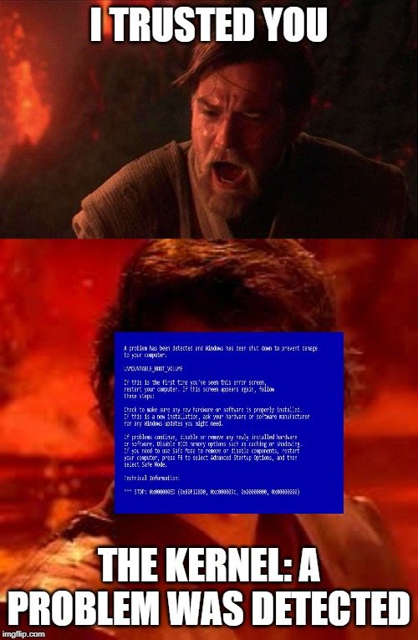
The Kernel
The Kernel is the lowest level of software running on the system
Has full access to all of the machine hardware
“Trusted” to do anything with the hardware

Slide 6
The Kernel
The Kernel is the lowest level of software running on the system
Has full access to all of the machine hardware
“Trusted” to do anything with the hardware
Everything else – considered “Untrusted”
This software is run in a restricted environment with less than complete access to the full power of the hardware
APP
APP
APP
Untrusted
OS KERNEL
Trusted
HARDWARE

Slide 7
Do applications need to implement protection?
Of course
Just like the OS needs to safely execute untrusted software, so too does an application
Web browser executing embedded JavaScript to draw a webpage
Without protection an embedded virus could be forwarding keystrokes' to an attacker

Slide 8
A Process
The execution of an application program with restricted rights
The abstraction for protected execution provided by the OS
The process requires permission from the OS kernel to:
access memory of other processes
read and write to disk
change hardware settings
Once again it’s the idea of the OS kernel mediating and checking a processes access to hardware

Slide 9

The Process Abstraction
Machine Instructions
Source Code
Executable Image
Executable instruction
Process
Programmer
Data
Static variables
Heap
Dynamically allocated structures
Stack
Local Variables
Designs and edits some code
Compiler converts code into a sequence of machine instructions, as well as static data
To run the program the OS copies the instructions and data into physical memory
Machine Instructions
OS Kernel
Data
Heap
Stack

Slide 10
How do we run multiple copies of the same program?
The OS can make multiple copies of the programs’
instructions
data
stack
heap
Machine Instructions
Machine Instructions
Machine Instructions
Machine Instructions
Process
Data
Process
Data
Process
Heap
Data
Process
Heap
Data
Stack
Heap
Stack
Heap
Stack
Stack

Slide 11
How do we run multiple copies of the same program?
The OS can make multiple copies of the programs’
instructions
data
stack
heap
Better way is to reuse memory where possible
just store one instance of instructions
This will be discussed in later lectures
Machine Instructions
Machine Instructions
Machine Instructions
Machine Instructions
Data
Data
Data
Data
Heap
Heap
Heap
Heap
Stack
Stack
Stack
Stack

Slide 12
What is the difference between a process and a program?
Process is an instance of a program
Just like an object is an instance of a class
This means for each instance of a program there is a process in memory with its own copy of the program

Slide 13
How do we keep track of all these instances?
The OS uses a data structure called a process control block (PCB) to keep track of the various processes
The PCB stores :
Where a process is stored in memory
Where the executable image is on the disk
Which user asked to execute the process
Which privileges the process has

Slide 14
How do we prevent a process accessing another?
Machine Instructions
CPU
Process
Program Counter
Data
Heap
Stack

Slide 15
How do we prevent a process accessing another?
OpCode
BR
LOAD
ADDA
Machine Instructions
CPU
Process
Program Counter
Data
Heap
Stack
Machine Instructions
Process
Data
Heap
Stack

Slide 16
How do we prevent a process accessing another?
OpCode
BR – branch to another instruction
LOAD – load a value into a register
ADDA – add a value to the accumulator
How do we prevent a process from manipulating another.
Machine Instructions
CPU
Process
Program Counter
Data
Heap
Stack
Machine Instructions
Process
Data
Heap
Stack

Slide 17
Kernel Checks
OpCode
BR – branch to another instruction
LOAD – load a value into a register
ADDA – add a value to the accumulator
How do we prevent a process from manipulating another.
CPU
Machine Instructions
Program Counter
Kernel
Process
Data
Heap
Stack
Machine Instructions
Simple approach would be to have the kernel check each instruction to see if it had permission.
Process
Data
Heap
Stack

Slide 18
How can we speed up this approach?
Most instructions are perfectly safe
So we only have to check those instructions we could pose risk
CPU
Machine Instructions
Program Counter
Kernel
Process
Data
Heap
Stack
Machine Instructions
Process
Data
Heap
Stack

Slide 19
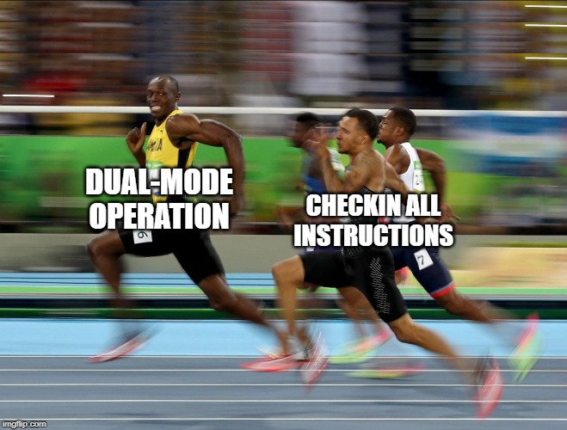
How can we speed up this approach?
Most instructions are perfectly safe
So we only have to check those instructions we could pose risk
To accomplish this we implement the same checks on the hardware level
This is called dual-mode operation, represented by a single bit in the processor which represents its’ status

Slide 20
Dual Mode Operation
CPU
Mode Register
In User Mode
The processor checks instruction
In Kernel Mode
The processor executes the instructions
Machine Instructions
Program Counter
Process
Data
Heap
Stack
Machine Instructions
Simple approach would be to have the kernel check each instruction to see if it had permission.
Dual-Mode approach allows increased efficiency as we only when we do not trust the process
Process
Data
Heap
Stack

Slide 21
What instructions can’t a process execute?
Privileged Instructions
Instructions available in kernel mode but not in user mode
Change privilege levels
Access memory
Disable/Enable interrupts

Slide 22
How are processes restricted from accessing memory of others?
Physical Memory
Memory Protection
Utilizes the Base and Bound registers in the CPU
Base = stores starting point in memory of a program
Bound = stores the size of a program
Base
Machine Instructions
Data
Heap
Now if an instruction is trying to access a memory address, that address will be checked within the CPU to see if it falls within the memory region defined by Base and Bound
Stack
Base + Bound

Slide 23
What are the problems of Base and Bound Memory allocation?
Does not allow for sharing of memory between processes
Cant utilize shared libraries
Does not accommodate Expandable heap and stack
Cant have non-contiguous memory
Leads to Memory Fragmentation
Does not allow for programs to be relocated in memory

Slide 24

Virtual Memory
The solution to these problems is Virtual Memory and the concept of Virtual Addresses

Slide 25
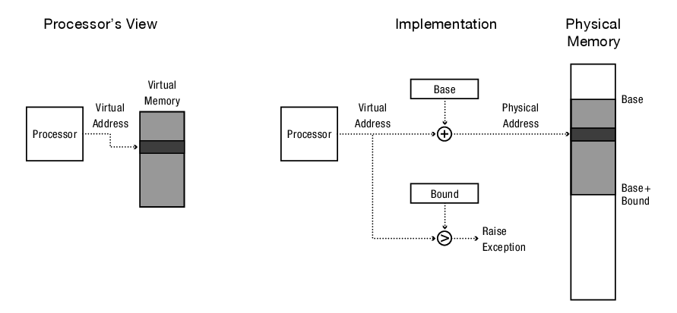
Virtual Memory
The solution to these problems is Virtual Memory and the concept of Virtual Addresses
With Virtual addresses every process’s memory begins at 0 and has the entire systems memory available
The hardware then translates between Virtual Addresses and Physical addresses
A naive translation : Virtual Address + Base register value = Physical Address

Slide 26
How does a kernel regain control from a runaway process?
Timer Interrupts
Since through process isolation we give the process the illusion of being fully in control, we need a way to regain control of the processor
For example when a program becomes non responsive and a user chooses to close it
Additionally, the OS needs to regain control in normal operation as well
For example if you are typing, listening to music and downloading a file
The OS needs to be able to switch between tasks smoothly
This is handled by a device called a hardware timer
The hardware timer is used to interrupt the processor after a certain delay
After a specified delay, the CPU transfers control from the user process to the kernel running in kernal mode

Slide 27

Types of Mode Transfer
The next question is how to safely transfer to and from our different modes
These transitions are not rare
Safe, Fast and Efficient

Slide 28
User to Kernel Mode
3 reasons for the kernel to take control
Interrupts – Asynchronous event
Processor Exceptions – Synchronous event
System Calls – Synchronous event
Asynchronous event = triggered by external events
Synchronous event = triggered by process execution
We use the term trap to refer to any asynchronous transfer of control from user to kernel (less privileged to more)

Slide 29
Interrupts
Asynchronous signal to the processor indicating some event occurred that the processor should look at
As the process executes instructions it will check if an interrupt has occurred
If Yes = completes or stalls processing current instruction, saves current execution state then starts executing a interrupt handler in the kernel
If No = continues with current instruction processing
For different interrupts we have different handlers

Slide 30
Different Interrupts
Timer Interrupt
Checks if current process is being responsive to user input, used to detect infinite loops
Switches between processes to ensure that each process gets a turn
I/O requests
A mouse triggers an interrupt every time a click is detected

Slide 31
Processor Exceptions
Hardware event caused by a user program behavior that causes a control transfer from user to kernel mode
As with interrupts ; completes or stalls processing current instruction, saves current execution state then starts executing a exception handler in the kernel
Examples of exceptions
Process attempts to perform privileged instruction
Access memory outside of own memory region
Division of integers by zero
Writing to read-only memory
In these cases the OS simply stops execution of the process and returns an error code

Slide 32
System Calls
Lastly, user processes can transition willing into kernel in order to request that the kernel perform an operation on the user’s behalf
A System call is any procedure provided by the kernel that can be called from user level.
As with interrupts/Exceptions ; saves current execution state then starts executing a pre-defined handler in the kernel
Examples of System Calls
Create (fork) / terminate processes
Wait command
Create/Delete files
Get/Set DateTime
Get/Set File permissions

Slide 33
Kernel to User
There are several types of transitions from kernel to user
New Processes
Resuming after an Interupt, Exception or System Call
Context Switching
User-level Upcalls

Slide 34
New Processes
To start a New Process
Kernel copies program into memory
Sets program counter to the start of the process
Switches to user mode

Slide 35
Resuming
To resume a process after the kernel finishes handling the interrupt
Restores the program counter to the instruction of the interrupted program
Restores the registers
This information is found in the saved state
Switches to user mode

Slide 36
Context Switches
To switch to another process after receiving an interrupt
Kernel saves current state of execution of the current process
Kernel then resumes another process by loading its current state
Switches to user mode

Slide 37
User-level Upcalls
Upcalls are virtualized interrupts and exceptions which allows user programs to receive asynchronous notifications of events
It is Kernel Interrupt handling except at user level

Slide 38
Summary
CPU
Mode : User
Machine Instructions
1. Instructions are processed
Program Counter
Process
Data
Heap
Stack
Machine Instructions
OS Kernel
Data
Heap
Stack

Slide 39
Summary
CPU
Mode : User
Machine Instructions
2. Interrupt Occurs
1. Instructions are processed
Program Counter
Process
Data
Heap
Stack
Machine Instructions
OS Kernel
Data
Heap
Stack

Slide 40
Summary
CPU
Mode : User
Machine Instructions
2. Interrupt Occurs
1. Instructions are processed
Program Counter
Process
Data
Heap
Stack
Machine Instructions
Saved state of the process
OS Kernel
Data
3. State of processor is saved
Heap
Stack

Slide 41
Summary
CPU
Mode : User
Machine Instructions
2. Interrupt Occurs
1. Instructions are processed
Program Counter
Process
Data
Heap
Stack
Machine Instructions
Saved state of the process
OS Kernel
Data
3. State of processor is saved
Heap
Stack
3. Stored in the PCB in the stack

Slide 42
Summary
3. Mode Change
CPU
Mode : Kernel
Machine Instructions
2. Interrupt Occurs
1. Instructions are processed
Program Counter
Process
Data
Heap
Stack
Machine Instructions
Saved state of the process
OS Kernel
Data
3. State of processor is saved
Heap
Stack
3. Stored in the PCB in the stack

Slide 43
Summary
1. Interrupt Processed
CPU
Mode : Kernel
Machine Instructions
Program Counter
Process
Data
Heap
Stack
Machine Instructions
Saved state of the process
OS Kernel
Data
2. State of processor is loaded
Heap
Stack
2. Loaded from the PCB in the stack

Slide 44
Summary
2. Mode Change
1. Interrupt Processed
CPU
Mode : Kernel
Machine Instructions
Program Counter
Process
Data
Heap
Stack
Machine Instructions
Saved state of the process
OS Kernel
Data
2. State of processor is loaded
Heap
Stack
2. Loaded from the PCB in the stack

Slide 45
Summary
2. Mode Change
1. Interrupt Processed
CPU
Mode : Kernel
Machine Instructions
3. Instructions are processed
Program Counter
Process
Data
Heap
Stack
Machine Instructions
Saved state of the process
OS Kernel
Data
2. State of processor is loaded
Heap
Stack
2. Loaded from the PCB in the stack

Slide 46
Implementing Safe Mode Transfer
Care needs to be taken when implementing mode transfer to ensure malicious programs cannot gain access to the kernel
Limited entry
To transfer control to the kernel, the hardware must ensure that the entry point to the kernel is one setup by the kernel
Atomic changes to processor state
Changing of program counter, mode, stack and memory protection are all changed at the same time
Transparent, restartable execution
Interrupts should be invisible to the user processes

Slide 47
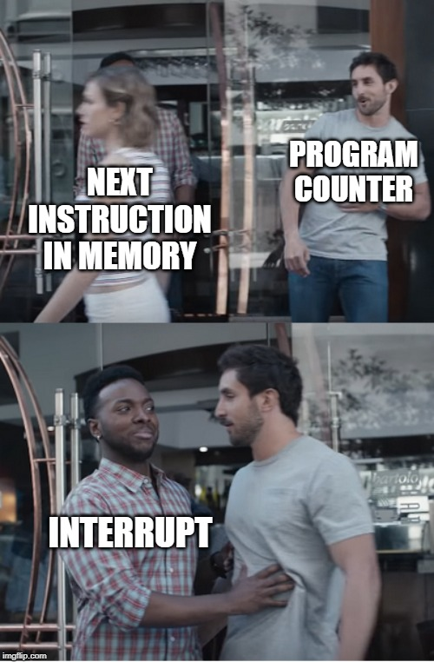
Implementing Safe Mode Transfer
On an interrupt the processor saves its current state to memory, changes to kernel mode and jumps to the exception/interrupt handler

Slide 48
Implementing Safe Mode Transfer
3. Mode Change
CPU
Mode : Kernel
Machine Instructions
1. Instructions are processed
2. Interrupt Occurs
Processor Register
Program Counter
Process
Data
Heap
Stack
4. Register points to Interrupt Vector Table
Machine Instructions
Saved state of the process
OS Kernel
Data
3. State of processor is saved
Heap
Stack
3. Stored in the PCB in the stack

Slide 49
Implementing Safe Mode Transfer
CPU
Mode : Kernel
Machine Instructions
Processor Register
Program Counter
Process
Data
Heap
Stack
4. Register points to Interrupt Vector Table
Machine Instructions
Timer Interrupt
OS Kernel
Interrupt Vector Table
Data
Divide by Zero
Heap
Stack
System Call

Slide 50
Interrupt Vector Table
The processor has a special register that in the event of an interrupt points to the corresponding interrupt handler.
The handler are found in a special part of a kernels stack memory called the Interrupt vector table
The format of the vector is processor specific
x86 Architecture
0- 31 exception handlers
32 – 255 interrupt handlers
Timer Interrupt
Interrupt Vector Table
Divide by Zero
System Call
Since the hardware determines which device caused the exception the hardware will be able to use the correct handler

Slide 51
Interrupt Stack
3. Mode Change
CPU
Mode : Kernel
Machine Instructions
1. Instructions are processed
2. Interrupt Occurs
Another
Processor Register
Processor Register
Program Counter
Process
Data
Heap
Stack
4. Register points to Interrupt Vector Table
3. Location of saved process stored in another register
Machine Instructions
Saved state of the process
OS Kernel
Data
3. State of processor is saved
Heap
Stack
3. Stored in the PCB in the stack

Slide 52
Interrupt Stack
Interrupt/Exception/System Call occurs
Process halted
Stack pointer set to base of kernel stack
Hardware saves(pushes) process’s registers to interrupt stack in kernel
Control switched to kernel
Kernel does its job
When returning from Interrupt/Exception/System Call
The saved registers are loaded(popped)
Process continues from where it left off

Slide 53
Why not just store it on the user-level stack?
Two reasons
Reliability – The process’s user-level stack might be invalid due to some bug
Security – Other threads in a multiprocessor running the same process can modify user memory during a system call. The user program might then be able to modify the kernel’s return address

