Slide 1
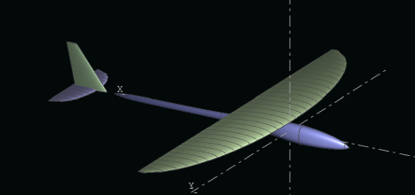
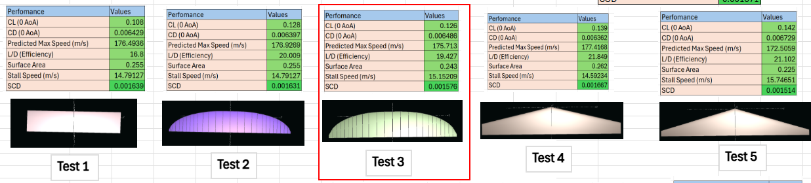
Celeritas UAV
Celeritas is a fixed-wing, propeller-powered unmanned aerial vehicle (UAV) with a primary design focus on achieving high speed while maintaining aerodynamic efficiency and operational stability. The airframe incorporates lightweight materials, with a majority Glass Reinforced Fibre (GRF) construct, and a streamlined geometry to minimize drag and maximize thrust-to-weight ratio. A high-performance propulsion system was integrated to deliver sustained power at elevated speeds without compromising reliability. The end goal of this project was to challenge ourselves to design and manufacture an aircraft capable of going as fast as possible within the space of 2 months and below a cost of £1000 all up, with a goal of testing and flying occurring in the background beyond this timeframe.
Team Members:
Ashton Hill
Ted Finn
Will Johnson
Thom Clark
Inesh Sagar
Maximilian Roche-Kuroda
BIG TEAM PHOTO
Design:
The design phase of our fixed-wing UAV combined aerodynamic analysis with structural and geometric modelling to ensure a balance between performance, stability, and manufacturability. We used XFLR5 extensively throughout this phase to evaluate the aerodynamic characteristics of our proposed configurations. This helped with getting a good idea for performance values of the aircraft, but meant we had to overengineer some aspects to account for the viscous flight environment due to XLFR5 only modelling in a laminar scenario and adding a viscous factor onto calculations, making it better for ball-parking in our setting that highly accurate predications. This included conducting aerofoil analyses to compare candidates and ultimately selecting a MH30 aerofoil based on its extremely low drag characteristics, stall behaviour, and suitability for our mission profile. XFLR5 also allowed us to study wing planform variations, tail sizing, and centre of gravity placement, providing insights into longitudinal and lateral stability. From these simulations, we generated performance predictions such as maximum lift coefficient, expected cruise lift-to-drag ratio, and estimated stall speed of 15m/s. Parallel to the aerodynamic work, we developed detailed 3D CAD models in SolidWorks. All data used and gathered from this work was complied into the form of a large, parametric spreadsheet which allows for easy changed to be made to small aspects and thus look at the impact this would have had. One example of this was our increased wingspan. Originally planning to go for a 1.2m wingspan, this was changed to be 1.36m, allowing us to make the wing thinner and in turn a better aspect ratio, and thus lift-to-drag ratio.
Photo of the CAD
Starting from conceptual sketches and characteristics from XLFR5, we refined the fuselage, wing, and tail geometries to ensure proper integration of internal components such as the servos, wiring, pitot tube and avionics. We looked at expanding the fuselage to ensure a good internal volume for future upgrades, allowing for potential to house larger batteries and more advanced systems. This also made mounting the wing securely a lot easier given the plan for manufacture of the aircraft was to make the wing detachable for easy transit. SolidWorks enabled us to assess manufacturability, weight distribution, and structural feasibility. For example, we iterated the internal layout to achieve a projected total weight of 2.5kg reduction work and positioned the main spar and landing gear to optimize structural efficiency. By alternating between aerodynamic simulation in XFLR5 and CAD refinement in SolidWorks, we were able to iterate quickly on design trade-offs. We were also able to conduct rough CFD analyses in SolidWorks which allowed for a better understanding of aerodynamic deficiencies in parts as we were designing them and where to look at streamlining. The resulting design not only meets the mission requirements but also provides a solid foundation for the future of the aircraft and its opportunities to be taken further in the future.
Table of various wing planforms trialled for use within XLFR5.

Slide 2
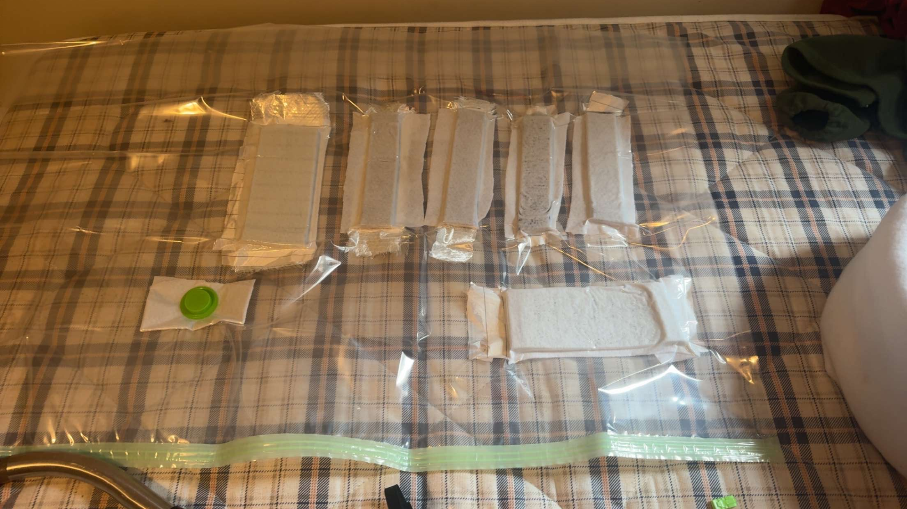
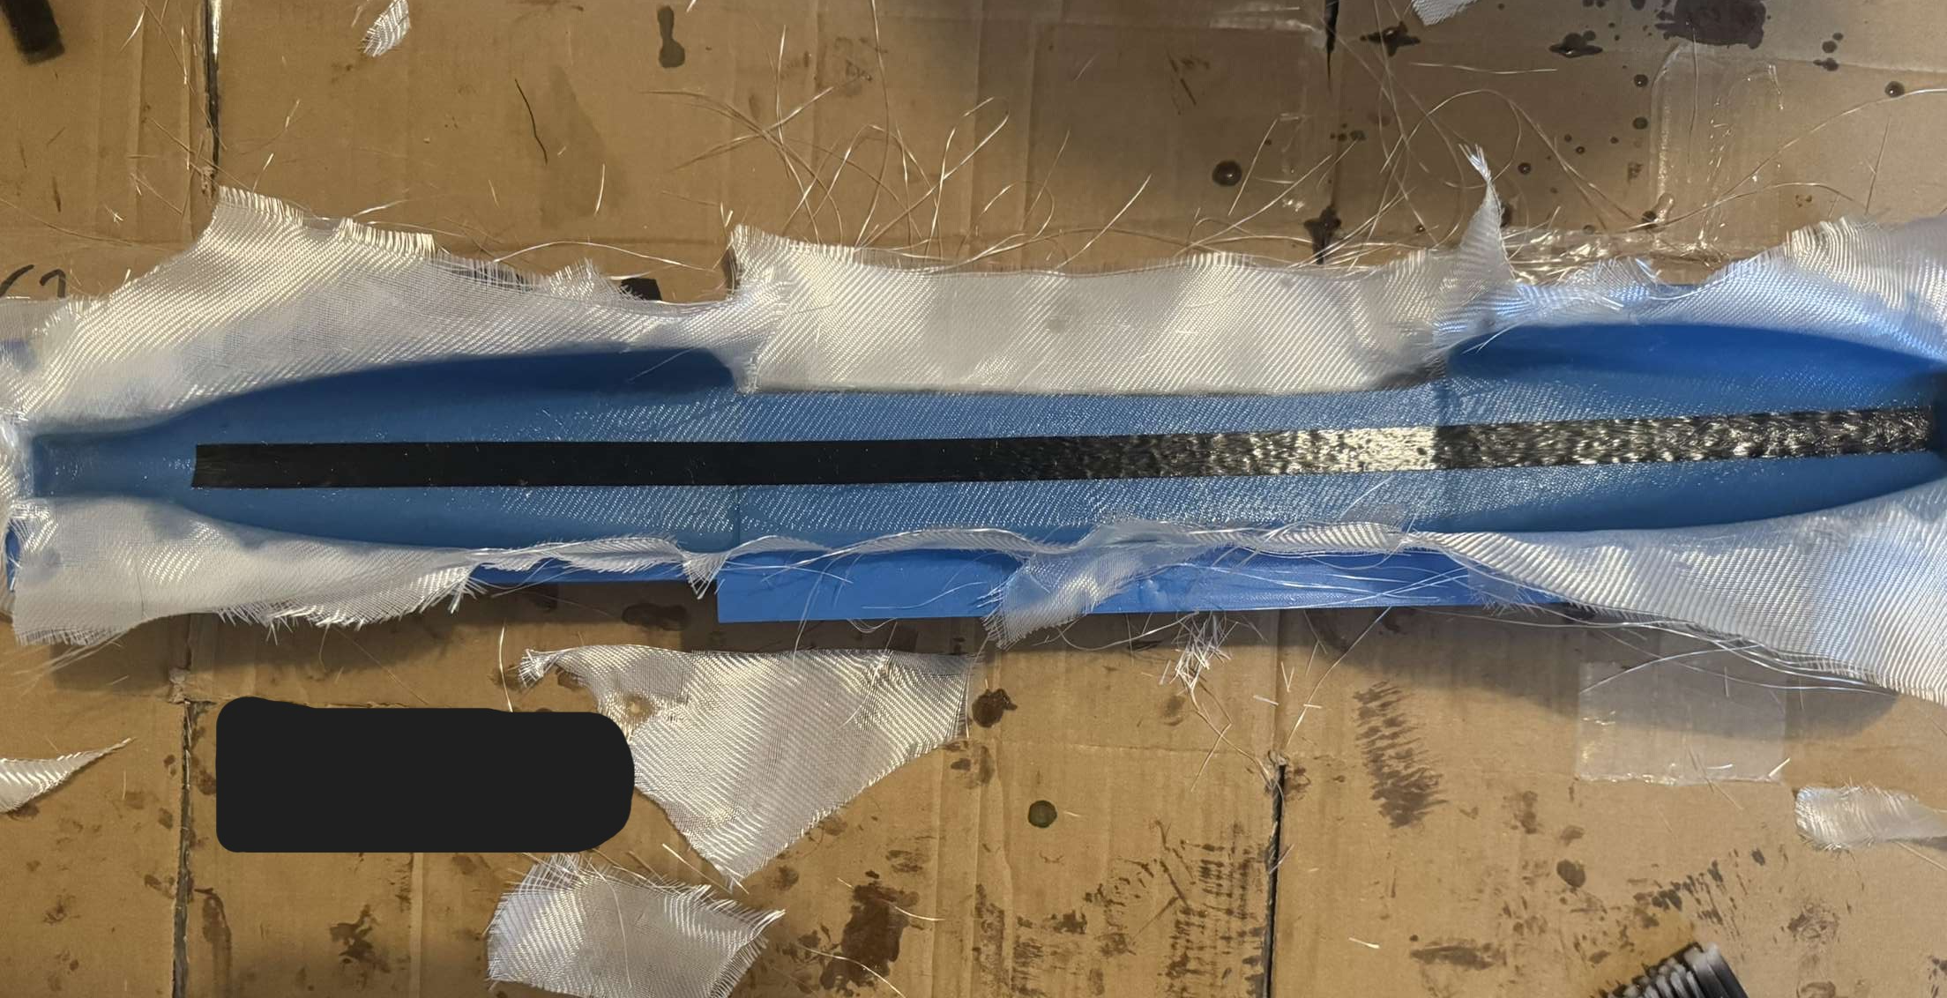
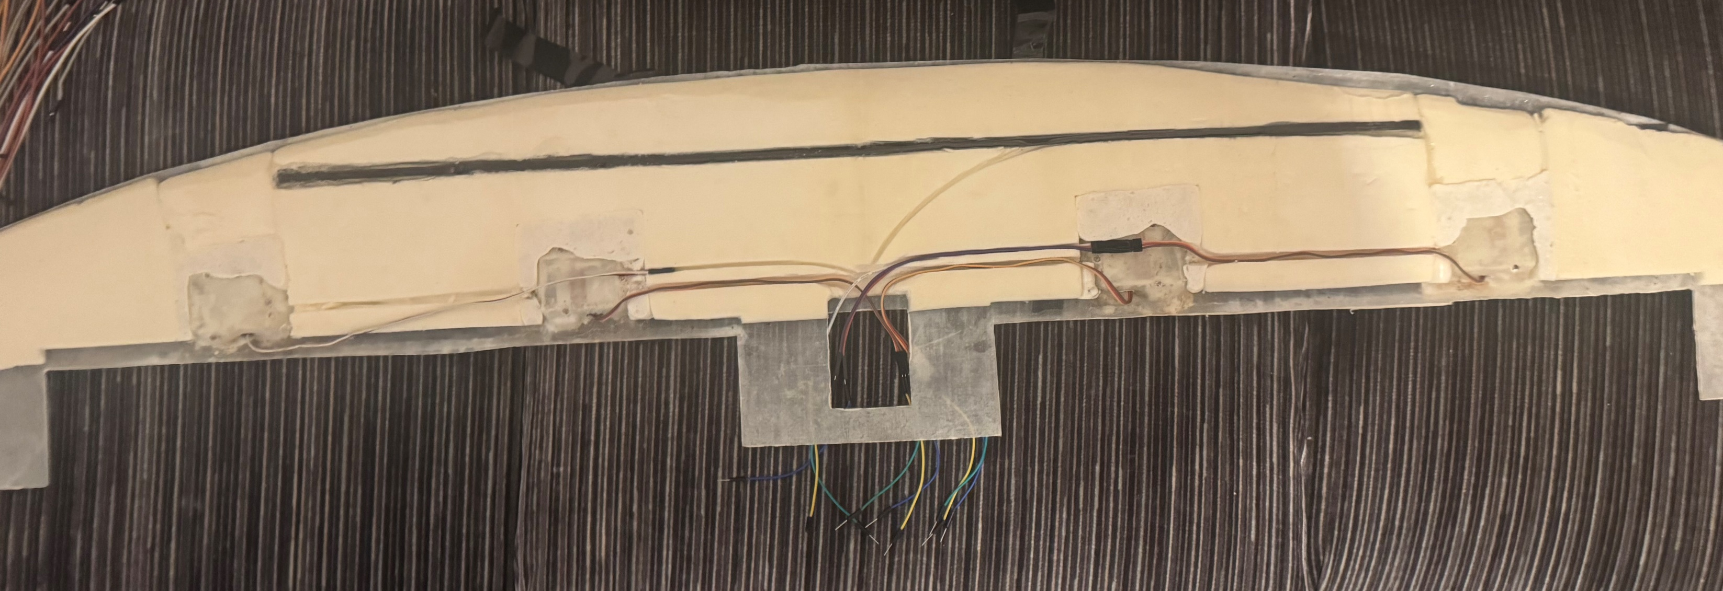
Manufacture:
The manufacturing phase of the project lasted approximately six weeks. To ensure we met this timeframe, we began work on components that were already finalised while design work on other aspects continued in parallel. Most of the aircraft was constructed from Glass Reinforced Fibre (GRF), chosen for several key reasons. GRF offers an excellent strength-to-weight ratio, is more cost-effective than carbon fibre, and is relatively easy to handle during fabrication. Another major factor in selecting GRF was its favourable RF properties, as it does not block signal transmission - an essential consideration for an RF-controlled aircraft.
To shape the UAV components, we created custom moulds using 3D printing. This provided the flexibility to produce complex aerodynamic forms that would have been difficult or expensive with traditional tooling. It also enabled rapid prototyping, allowing us to quickly iterate designs and generate moulds at a relatively fast pace. Producing moulds in-house reduced costs and lead times, while also giving us greater control over accuracy and customization.
The primary GRF components included the wing, fuselage, and tail fin. Each was produced in two parts: top and bottom for the wing, and left and right halves for the fuselage and tail fin. These were all manufactured using wet layup techniques, with different ply combinations and fibre orientations to achieve strength where it was needed most. The top of the wing, for example, incorporated a three-ply layup consisting of two layers of 100gsm 2x2 twill and one layer of 340gsm biaxial fibre, providing enhanced torsional and bending strength. Other components primarily used 100gsm 2x2 twill in various rotations, with additional reinforcement plies added to high-stress areas. Some elements required more delicate layup work, such as the bottom half of the wing. This mould incorporated 3D-printed positive mounts for the servos, allowing them to be installed externally while remaining completely flush with the wing surface.
Once components were layed, they would be vacuum sealed and left for 36 hours to cure. Following this, they could be removed and trimmed to size. Beyond this, the process of joining them together and finishing parts would take place. To complete the wing's internal structure, we used PIR foam due to its cost effectiveness and ease to work with. This allowed for routing of wire lines and including the pitot tube setup within the parts. The wingtips of the aircraft were 3D-printed and colour coded for orientation identification during flight. The wing incorporates a 4mm carbon spar for additional bending strength as well
This largely consisted of firstly applying
Initial aerofoil prototypes using various plies and combinations of 100gsm 2x2 twill and 320gsm Biaxial fibre.
Lay-up of one side of the fuselage ready to be vacuum sealed. The black strip is Carbon Tow tape, providing localised extra strength in bending.
Lay-up of one side of the fuselage ready to be vacuum sealed. The black strip is Carbon Tow tape, providing localised extra strength in bending.
Final setup config:
Motor: T-Motor Velox V3115 1050kV
Prop: APC 9x9
ESC: T-Motor Flame 80A
Battery: Overlander 6s 2900mAh Receiver: FrSky X8R 2.4GHz Telemetry Receiver
Final Weight: 2.6Kg
Servos: 4x KST X10 10mm Servos (Flaps & Ailerons), 1x EMAX ES3054 Digital Servo (Elevator)
Achieved Top Speed:

