Slide 1
BGF-117：腰果酚聚氧乙烯醚

Slide 2

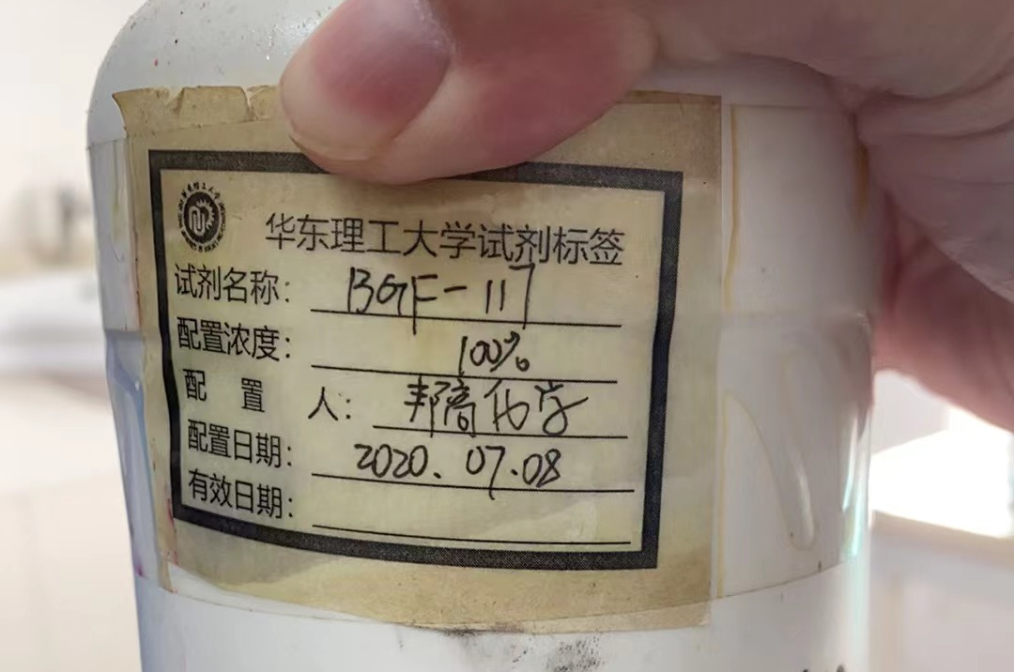
试剂
上海帮高化学产品
环保型乳化剂BGF系列（腰果酚聚氧乙烯醚）
http://www.bronkow.com.cn/index.html

Slide 3
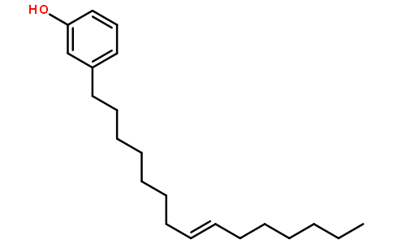
腰果酚结构
英文名Cardanol，CAS NO. 501-26-8
腰果酚结构：

Slide 4
腰果酚Cardanol
Cardanol is a renewable non-edible co-product of cashew nut industry.
This is an abundant renewable resource with unique structure.
Cardanol is gaining increased attention in both industrial and academic communities for the synthesis of additives and polymers.
Cardanol is particularly used as surfactant, plasticizer, epoxy or phenolic monomers.

Slide 5
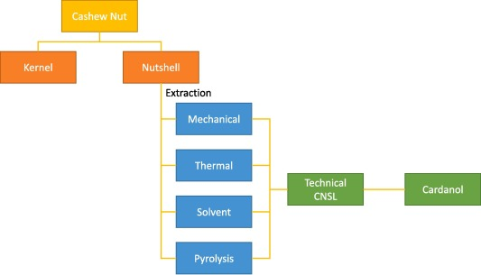
腰果酚提取
Cardanol comes from Cashew Nutshell Liquid CNSL, co-produced during of cashew nuts industry.

Slide 6
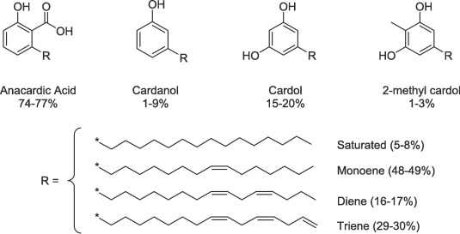
腰果酚提取
CNSL contains four main components: anacardic acid, cardanol, cardol and 2-methyl cardol.

Slide 7
腰果酚提取
Commercial-grade CNSL contains virtually no anacardic acid due to the decarboxylation reaction occurring during the roasting process, which converts anacardic acid to cardanol
CNSL components are themselves mixtures of four constituents differing in the number of side chain unsaturations. Indeed this chain can be saturated (5–8%), or in the form of monoene (48–49%), diene (16–17%) or triene (29–30%)

Slide 8
腰果酚难以化学合成
Cardanol is very difficult to obtain according to conventional routes of chemical synthesis insofar as the aliphatic side chain is in the meta position with respect to the phenol group which generally directs all the substitutions in ortho and/or para positions.

Slide 9
腰果酚聚氧乙烯醚
腰果酚
腰果酚聚氧乙烯醚

Slide 10
腰果酚聚氧乙烯醚
本产品主要原料为天然腰果壳油提取精制而成，属于生物多烯酚成份，可生物降解性优于AEO产品。经生物降解后的产物不含APEO及NPEO，不影响生物内分泌系统，不会造成生态危害，是一种高生物降解性和环境友好型的非离子表面活性剂，是替代壬基酚聚氧乙烯醚、脂肪醇聚氧乙烯醚的理想选择，本产品溶于大多数有机溶剂，与大多数阴离子、非离子表面活性剂有良好的配伍性能,为NP/TX系列产品理想的全性能替代产品。

Slide 11
标题
文字
Text

Slide 12
标题
文字
Text

Slide 13
标题
文字
Text

