Slide 1

FinSightOps
An Agentic AI Finance & Audit Team on AWS
AWS-native multi-agent auditing, augmented with external MCP integrations
Amazon Bedrock AgentCore
Multi-Agent
External MCP
Human-in-the-Loop
> accenture | aws
AABG FY26 Hackathon · 10 July 2026

Slide 2




The Problem
Financial close and audit is slow, manual, and error-prone — and it doesn't scale with the team.
Weeks of manual review
Errors slip through
Analysts reconcile P&L, balance sheets and receipts by hand across disconnected files — a multi-day effort every cycle.
Misclassified entries, foot errors and unbalanced statements are caught late, if at all, creating audit and compliance risk.
Duplicate & tampered receipts
Data lives everywhere
Tampered or resubmitted receipts are near-impossible to spot at volume with the naked eye.
Ledgers, ERP and accounting systems are siloed, so no one has a single, verifiable audit picture.
> accenture | aws
AABG FY26 Hackathon · Team FinSightOps

Slide 3




Our Solution
A supervisor agent orchestrates four specialist agents — a virtual audit team that reviews every statement in minutes, not weeks.
HOW IT WORKS
THE AGENT TEAM
1
Ingest
Users upload P&L, balance sheet & receipts. Textract extracts every figure.
P&L Analysis
Balance Sheet
2
Reason
Margins, trends & anomaly flags
Assets = Liabilities + Equity checks
Supervisor routes work to specialist agents; each pulls its own AWS + MCP tools.
Receipt Authenticity
Reconciliation
3
Reconcile
Findings are cross-checked; flagged items go to a human for approval.
Flags duplicate & tampered receipts
Ties receipts to P&L, unifies findings
> accenture | aws
AABG FY26 Hackathon · Team FinSightOps

Slide 4
How It Works — In Plain Terms
The same virtual audit team, told as a story — no AWS knowledge needed to follow it.
1 · Upload
P&L, balance sheet, receipts
2 · AI team reviews
Every figure read & checked
3 · Findings sorted
Clean pass · risky flagged
4 · Human approves
Reviewer signs off flagged
5 · Report
Dashboard + team notified
In one line: weeks of manual review become minutes — with a human always approving anything risky.
> accenture | aws
AABG FY26 Hackathon · Team FinSightOps

Slide 5
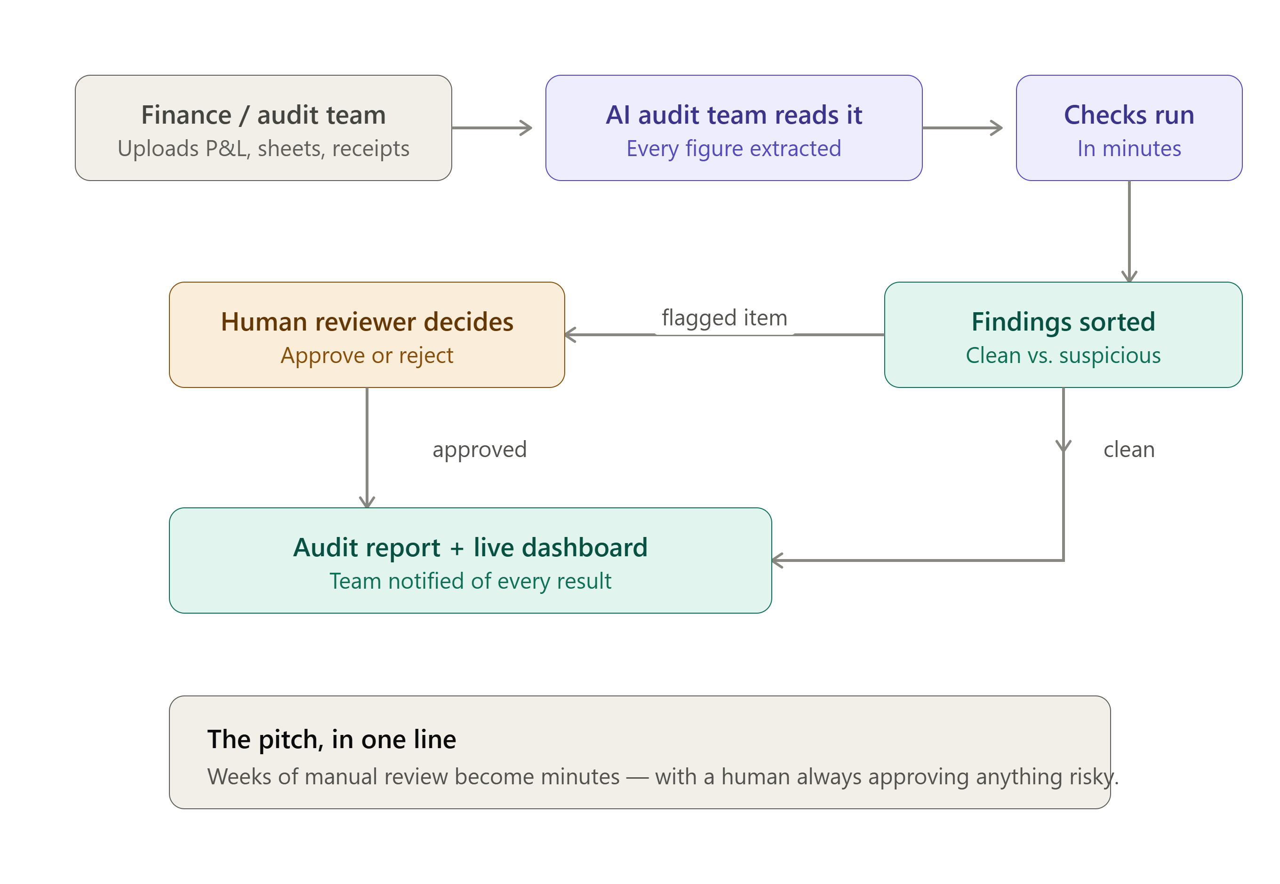
Business Flow
The same virtual audit team, told as a story — no AWS knowledge needed to follow it.
In one line: weeks of manual review become minutes — with a human always approving anything risky.
> accenture | aws
AABG FY26 Hackathon · Team FinSightOps

Slide 6
High-Level Architecture
The whole system in a few moving parts — how a document becomes an approved audit.
Users & web
CloudFront · Cognito · API GW
Amazon Bedrock AgentCore
Human-in-the-loop & output
Step Functions · SNS/Slack · QuickSight
Supervisor agent · routes & reconciles
Ingestion
Amazon S3 · Textract OCR
P&L · Balance · Receipt · Reconciliation
4 specialist agents
External MCP · via Gateway
QuickBooks · SAP · SEC EDGAR · Slack
AWS tools: Athena · Lambda · DynamoDB
Security (cross-cutting): Secrets Manager · IAM least-privilege · no hardcoded credentials
> accenture | aws
AABG FY26 Hackathon · Team FinSightOps

Slide 7

























System Architecture
AWS-native services orchestrated by Amazon Bedrock AgentCore; external systems of record connect through MCP.
EXTERNAL MCP
Cloud
Routing
User
AWS Amplify
Amazon CloudFront
API Gateway
Bedrock AgentCore
Bedrock (Claude)
Rekognition
QuickBooks / Xero
FinSightOps Web Portal
Finance Analyst
via AgentCore Gateway
SAP / ERP
Auditor / Manager
Amazon Cognito
Amazon Route 53
Amazon Textract
AWS Lambda
Amazon S3
Fraud Detector
SEC / Tax Reg
Slack / Teams
Secrets Manager
Amazon DynamoDB
Amazon Athena
Amazon QuickSight
Step Functions
Amazon SNS
results & alerts
> accenture | aws
AABG FY26 Hackathon · Team FinSightOps

Slide 8
Sequence — A Single Audit Run
Who calls whom, in order — from upload to a human-approved report.
Analyst
Finance user
Web & API
Cognito · API GW
Supervisor
AgentCore
Specialist agents
×4 parallel
AWS tools + MCP
tools & systems
HITL & output
approve · alert · report
1 Upload docs · Cognito auth
2 Trigger audit run (S3)
3 Textract OCR → figures
4 Route work → agents (parallel)
5 AWS tools + MCP lookups
6 Return explainable findings
7 Reconcile · flagged → human approval
8 Report + dashboard · Slack alert
> accenture | aws
AABG FY26 Hackathon · Team FinSightOps

Slide 9










AWS Services & Their Functions
Everything runs AWS-native — serverless where possible, secured with IAM roles and Secrets Manager.
Bedrock AgentCore
Amazon Bedrock (Claude)
Amazon Textract
Runtime + Gateway that hosts and orchestrates the agent team
Reasoning engine for analysis, explanation & synthesis
OCR — extracts figures from statements & receipts
Amazon S3
Amazon Athena
AWS Lambda
Encrypted document store for all uploaded artifacts
Queries historical financials for anomaly baselines
Serverless rules engine for balance-sheet checks
Amazon Rekognition + Textract
Amazon DynamoDB
AWS Step Functions
Duplicate & tamper heuristics: metadata, hashing, vision
Low-latency cross-checks across the three documents
Human-in-the-loop approval workflow for flagged items
Amazon QuickSight
Amazon SNS
Secrets Manager + IAM
Audit dashboards & the final report
Real-time alerts to reviewers on flagged findings
No hardcoded credentials — least-privilege access
> accenture | aws
AABG FY26 Hackathon · Team FinSightOps

Slide 10




External MCP Integrations
Agents reach real systems of record through Model Context Protocol servers — surfaced as tools via AgentCore Gateway.
QuickBooks / Xero MCP
SAP / ERP MCP
Pulls live ledger entries, invoices and expense records so agents audit against the real books — not a stale export.
Reads enterprise financial master data and journal entries for org-wide statements and cross-entity reconciliation.
Regulatory MCP (SEC EDGAR / tax rules)
Slack / Teams MCP
Validates classifications and disclosures against current filing and tax rules for compliance-grade findings.
Routes flagged items and approval requests to reviewers in-channel, closing the human-in-the-loop instantly.
Why MCP: standardised, credential-scoped tool access means we plug into any system of record without custom glue code — and swap providers without touching the agents.
> accenture | aws
AABG FY26 Hackathon · Team FinSightOps

Slide 11



Cost Breakdown
Estimated hackathon-MVP spend for one 4-week hack period — serverless & on-demand keep it well under the $100 credit.
EST. TOTAL / HACK PERIOD
$67
vs. $100 AWS credit · ~33% headroom
External MCP servers run on the vendor side — $0 AWS compute; only minimal egress.
Serverless (Lambda, Step Functions, on-demand DynamoDB) means we pay only per audit run.
FinOps guardrails: Bedrock token caps, AgentCore session timeouts, CloudWatch budget alarms.
> accenture | aws
AABG FY26 Hackathon · Team FinSightOps

Slide 12
MVP Scope — What We Demo on 14 Aug
Scoped to what we can build and demo in the hack window — everything else is on the roadmap.
In scope — the agent team
In scope — the core flow
Supervisor + specialist agents (P&L, balance sheet, receipt, reconciliation), running end-to-end on AWS.
Upload → Textract OCR → agents reason → Step Functions human approval → SNS/Slack alert + report.
In scope — one live integration
Deferred to v2
One real MCP connector live (SEC EDGAR or QuickBooks sandbox); remaining systems of record are mocked.
Amazon Fraud Detector, full QuickSight seats, and live SAP / ERP — all on the 3-month roadmap.
Guardrails held: AWS-native only · $100 credit (est. $67) · team-level impact · live demo · no hardcoded credentials.
> accenture | aws
AABG FY26 Hackathon · Team FinSightOps

Slide 13
Built to Last
Responsible-AI by design, and a clear path to production.
RESPONSIBLE AI
ROADMAP — v2 IN 3 MONTHS
1
Now
4 agents, 3 document types, single-team demo on AWS.
Explainable
Each agent returns an independent, traceable finding — no black-box verdicts.
2
+1 mo
Add cash-flow & tax agents; Fraud Detector, QuickSight seats, connectors (NetSuite, Workday).
Governed
Bedrock Guardrails + full observability on every agent action.
3
+2 mo
Continuous audit — auto-trigger on new uploads via S3 events.
4
+3 mo
Org-wide rollout with per-entity dashboards and SSO.
Human-in-the-loop
No flagged item is actioned without human approval via Step Functions.
FinSightOps — audit at machine speed, with a human always in command.
> accenture | aws
AABG FY26 Hackathon · Team FinSightOps

