Slide 1

FinSightOps
An Agentic AI Finance & Audit Team on AWS
AWS-native multi-agent auditing on the Strands Agent Framework. Four specialist agents turn uploaded documents into a reconciled set of statements, with every result on one dashboard.
Strands Agent Framework
Multi-Agent
Amazon Bedrock
Serverless
> accenture | aws
AABG FY26 Hackathon · Team LLaMie
Notes:
Open with the one-liner: 'Weeks of manual review become minutes, and every figure stays traceable to the document it came from.' 20 seconds, then move. Demo is 14 August.

Slide 2
The Problem
Financial close and audit is slow, manual and error-prone, and it does not scale with the team.
1
2
3
Weeks of manual review
Errors slip through
No single audit picture
Analysts post entries and reconcile P&L, balance sheets and receipts by hand across disconnected files, causing a multi-day effort every cycle.
Misclassified entries, foot errors and unbalanced statements are caught late, if at all, creating audit and compliance risk.
Postings, statements and supporting documents live in different places, so nobody can see the whole chain from receipt to reported figure.
The judgment is expert work. The posting, the totalling and the cross-checking are not, and that is exactly the part software should have taken over.
> accenture | aws
AABG FY26 Hackathon · Team LLaMie
3
Notes:
30 seconds. The expensive human hours go into posting and cross-checking, not judgment. That sets up why the work is split across specialist agents.

Slide 3
Our Solution
Four specialist agents on the Strands Agent Framework: a virtual audit team that closes the books in minutes, not weeks.
HOW IT WORKS
THE AGENT TEAM
1
Ingest
Four Strands agents · AWS Lambda + Amazon Bedrock (Claude) · one shared results store
Documents are uploaded to S3. Textract extracts every figure; the upload itself starts the run.
1
Ledger
2
P&L Analysis
2
Reason
Double-entry posting → trial balance
Margins, trends & anomaly flags
Each agent is a Strands agent (a model, a prompt and its own tools) running in its own Lambda.
3
Report
3
Balance Sheet
4
Reconciliation
Every agent writes its result to DynamoDB, and the dashboard shows the whole chain in one place.
Assets = Liabilities + Equity checks
Ties records together, unifies findings
Each agent returns an independent, traceable finding. No black-box verdict.
> accenture | aws
AABG FY26 Hackathon · Team FinSightOps
4
Notes:
45 seconds. Key line for judges: four specialists, each with a narrow job, each a Strands agent in its own Lambda. Explainability comes from the separation — every finding is attributable to one agent and persisted with its evidence.

Slide 4
How It Works — The Audit Pipeline
FinSightOps front end — analysts upload P&L, balance sheet and receipts
2
1
P&L Agent
4
S3 — Ingest & Extract
Ledger Agent
in parallel, off the same trial balance
Reconciliation Agent
upload event starts the run
Textract OCR → figures
double entry → trial balance
nothing written unless it balances
3
ties the records together
and explains differences
Balance Sheet Agent
Amazon DynamoDB — results store trial balance · P&L · balance sheet · reconciliation, each written with its evidence
Dashboard — the front end reads every result straight from DynamoDB
Every agent is a Strands agent in its own Lambda, reasoning through Bedrock. All arithmetic is Python. The model classifies and explains, it never adds up a column.
> accenture | aws
AABG FY26 Hackathon · Team FinSightOps
5
Notes:
60 seconds, left to right then down. Three beats: (1) an upload to S3 is the trigger — no one presses go; (2) the ledger agent is the gate, and the two statement agents run off the trial balance it produces; (3) every agent persists its result to one DynamoDB table, which is exactly what the dashboard reads — so the judge is looking at real stored output, not a rendered summary.

Slide 5
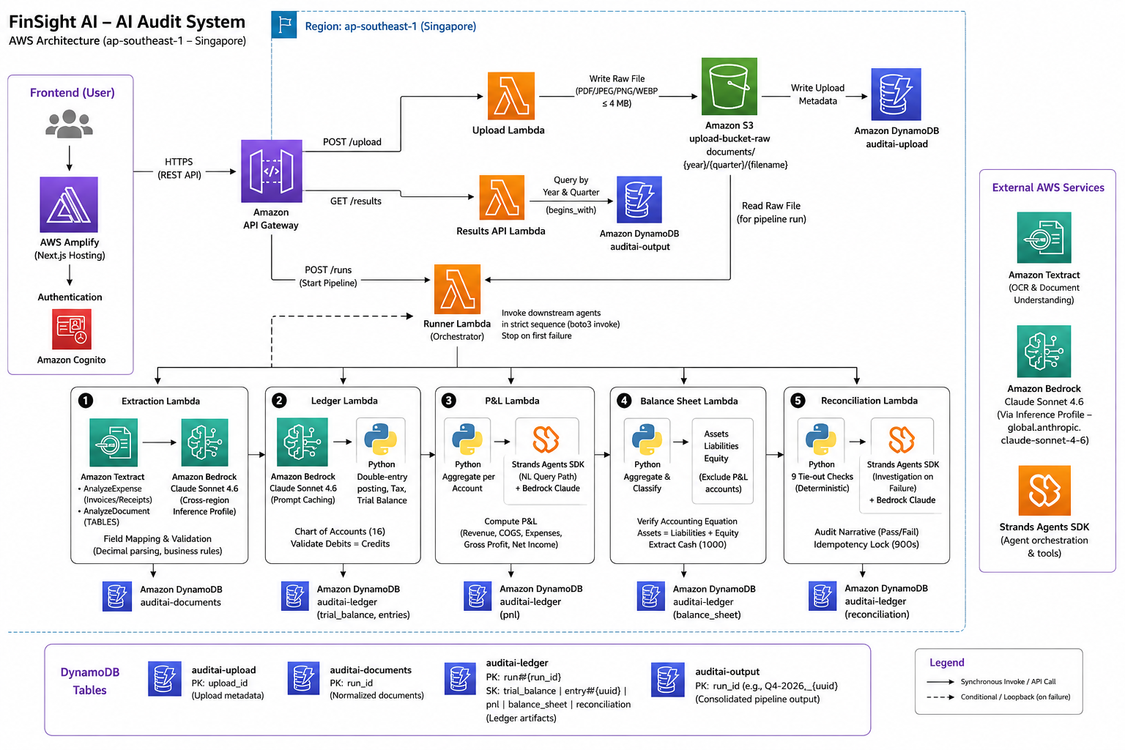
System Architecture
> accenture | aws
AABG FY26 Hackathon · Team FinSightOps
6
Notes:
Place the AWS architecture diagram in the frame on this slide. Narrate it in about 45 seconds, then move on: the logical pipeline is already covered on the previous slide, so keep this one to the services and how they connect.

Slide 6
Sequence — A Single Audit Run
Who calls whom, in order, from upload to a dashboard full of results.
1
2
3
4
ANALYST → S3
S3 → EXTRACTION
→ LEDGER AGENT
LEDGER → DYNAMODB
Upload P&L, balance sheet and receipts
Upload event fires · Textract OCR → figures
Post double-entry · trial balance must balance
Trial balance persisted with its postings
5
6
7
8
→ P&L + BALANCE SHEET
AGENTS → DYNAMODB
→ RECONCILIATION AGENT
→ DYNAMODB → DASHBOARD
Both statements computed off it, in parallel
Each statement persisted with its evidence
Reads both, ties out, explains differences
Result persisted; front end shows every stage
Step 3 is the gate; steps 4, 6 and 8 are why the dashboard can be trusted. Nothing downstream runs against a trial balance that doesn't balance, and every stage persists its own result, so what you see on screen is stored output, not a summary generated at render time.
> accenture | aws
AABG FY26 Hackathon · Team FinSightOps
7
Notes:
This is the slide for a technical judge. Don't read all eight steps — narrate 2, 3, 5 and 8. If they ask what happens when an agent fails, that's in the appendix.

Slide 7
01
UPLOAD AGENT
Upload Agent
Entry point — accepts raw financial documents from the frontend and stores them in S3
PURPOSE & LOGIC
QUARTER DERIVATION LOGIC
▸ Receives multipart/form-data from Next.js via Amplify → API Gateway → Lambda
month = documentDate.month
▸ Validates doc type (invoice | balance_sheet | bank_statement | receipt) and MIME type
if month <= 3 → Q1
▸ Derives financial year & quarter from documentDate using calendar-year buckets
elif month <= 6 → Q2
▸ Stores raw file in S3 under documents/{year}/{quarter}/{filename}
elif month <= 9 → Q3
▸ Writes upload metadata record to DynamoDB (auditai-upload)
else → Q4
s3_key = documents/{year}/{Q}/{filename}
INPUT / OUTPUT
AWS SERVICES
INPUT
HTTP POST multipart: file (PDF/JPEG/PNG/WEBP ≤ 4 MB), fileName, contentType, documentType, documentDate
◆ S3 (upload-bucket-raw) — raw document store
OUTPUT
HTTP 200 → { uploadId, fileId, s3Key, financialYear, quarter, fileSizeBytes }
◆ DynamoDB (auditai-upload) — upload metadata
◆ API Gateway — HTTP routing from frontend
◆ AWS Amplify — Next.js hosting + auth
Max file size: 4 MB · Supported types: PDF · JPEG · PNG · WEBP · Base currency: MYR

Slide 8
02
RUNNER AGENT
Runner Agent
Orchestrator — chains all downstream agents in strict sequence via synchronous Lambda invocations
TWO INVOCATION MODES
NEW DOCUMENT { run_id, doc_type, bucket, s3_key } → full pipeline from S3 fetch to reconciliation RESUME { resume: true, run_id, doc_type, doc_id } → skips extraction, resumes from Ledger after human approval
0
1
▶
2
3
4
5
6
Fetch S3
Extraction
Review Gate
Read DynamoDB
Ledger
P&L
Balance Sheet
Reconciliation
Pull raw bytes
from bucket
Textract + Claude
normalise
pending_review?
Stop here
Fetch full doc
from auditai-docs
Post journal
entries
Revenue −
COGS − Expenses
Assets = Liab
+ Equity
9 tie-out
checks
FAILURE SEMANTICS
FINAL OUTPUT → auditai-output
▸ Stops at first failing stage — returns pipeline_status naming exact failure point
▸ Composite run_id = {original_run_id}_{uuid4} (embeds FY + quarter prefix)
▸ e.g. "pnl_failed", "balance_sheet_failed", "s3_fetch_failed"
▸ Contains: extraction_summary, ledger_output, pnl_output, balance_sheet_output, reconciliation_output
▸ Floats converted to Decimal before final DynamoDB write
▸ completed_at ISO 8601 timestamp written on success
boto3 synchronous invoke() · Step Functions planned for future iteration

Slide 9
03
EXTRACTION AGENT
Extraction Agent
OCR via Amazon Textract → field normalisation via Claude Sonnet 4.6 → validation → DynamoDB
TEXTRACT ROUTING BY DOC TYPE
VALIDATION & REVIEW TRIGGERS
AnalyzeExpense → invoice · receipt · purchase_invoice
⚠ Σ line items ≠ stated subtotal
Understands VENDOR_NAME, TOTAL, TAX, LINE_ITEMS as semantic fields
⚠ subtotal + tax ≠ total
AnalyzeDocument/TABLES → statement · trial_balance · ledger · journal
⚠ Textract TOTAL ≠ Claude total
Captures grid cells AND page-level header text (company name, currency, dates)
⚠ Currency ≠ MYR (FX conversion needed)
⚠ Textract min confidence < 80%
CLAUDE NORMALISATION RULES
⚠ Required field unreadable (vendor · date · total · currency)
⚠ Tabular: total_debit ≠ total_credit (trial_balance / ledger)
▸ Amounts → numbers with exactly 2 decimal places (never string, never float)
Any trigger → status = "pending_review" | Clean doc → status = "normalized"
▸ Claude never computes totals — "40 seats @ $75" with no printed total → null
MONEY DISCIPLINE
json.loads(raw, parse_float=Decimal) · to_dynamo() raises TypeError on float · all amounts quantized to 0.01
▸ Absent fields → null (NOT listed in unreadable_fields)
▸ Illegible printed fields → listed in unreadable_fields
INPUT / OUTPUT
▸ Date → YYYY-MM-DD | Currency → ISO 4217 code
INPUT
Multipart form-data: run_id, doc_type, file (bytes from Runner)
OUTPUT
auditai-documents DynamoDB item (expense or tabular schema) + HTTP summary → Runner
Schema version: 1.1 · Model: global.anthropic.claude-sonnet-4-6 · Table: auditai-documents (PK=run_id, SK=doc_type#doc_id)

Slide 10
04
LEDGER AGENT
Ledger Agent
Classifies line items via Bedrock → posts double-entry journal entries → builds trial balance
DOUBLE-ENTRY POSTING RULES
TRIAL BALANCE FORMULA
OUTFLOW (receipt / purchase_invoice — we paid)
per account code:
DEBIT <classified expense/COGS> (line amount)
total_debit = Σ all debits posted to code
CREDIT 1000 Cash (line amount)
total_credit = Σ all credits posted to code
DEBIT 6500 Prof/IT Services (tax amt, if any)
net_balance = total_debit − total_credit
CREDIT 1000 Cash (tax amt, if any)
grand check:
INFLOW (invoice — we billed a client)
is_balanced = Σ total_debit == Σ total_credit
BEDROCK LINE-ITEM CLASSIFICATION
DEBIT 1100 Accounts Receivable (line amount)
▸ Cloud hosting · SaaS · IT support · consulting → 6500
CREDIT 4000 Revenue (line amount)
▸ Food · beverages · client dinners · team meals → 6200
▸ Goods for resale · raw materials → 5000
DEBIT 1100 Accounts Receivable (tax amt, if any)
▸ Office stationery · small desk equipment → 6300
CREDIT 2000 Accounts Payable (stand-in for Tax Payable)
▸ Electricity · water · internet bills → 6400
▸ Salaries · wages · payroll → 6000
Ambiguous → closest match + confidence = "low" · Prompt-cached system prompt
INPUT / OUTPUT
▸ Office / warehouse rent → 6100
INPUT
Full extraction document dict (from auditai-documents re-read by Runner)
OUTPUT
auditai-ledger: SK=trial_balance + SK=entry#{uuid} per line · returns { status: "balanced", trial_balance, journal_entry_count }
REFUSES to write if unbalanced · Model: global.anthropic.claude-sonnet-4-6 (prompt caching) · Table: auditai-ledger

Slide 11
05
P&L AGENT
Profit & Loss Agent
Queries journal entries for the run → aggregates by account type → computes Gross Profit & Net Income
ACCOUNT AGGREGATION LOGIC
CALCULATION FORMULA
Expense-style entry:
total_revenue = Σ revenue_items.values()
debit_account += amount (debit side)
total_cogs = Σ cogs_items.values()
credit_account += amount (credit side)
total_expenses = Σ expense_items.values()
Tabular-style entry:
account_code debit += debit
gross_profit = total_revenue − total_cogs
P&L CLASSIFICATION
account_code credit += credit
net_income = gross_profit − total_expenses
Revenue
account_type == "Revenue" AND net_credit > 0 → net_credit
COGS
account_type == "COGS" AND net_debit > 0 → net_debit
⚠ Gross Profit ≠ Net Income — two distinct figures
Expense
account_type == "Expense" AND net_debit > 0 → net_debit
Gross = margin before overhead
Skip
Asset · Liability · Equity → excluded (Balance Sheet only)
Net = what remains after all operating costs
TWO INVOCATION PATHS
AUTOMATED { run_id } → deterministic Python, DynamoDB Query (not Scan), writes SK=pnl AD-HOC { query: "P&L for Q1 2026" } → Strands Agents + Bedrock Claude natural-language path, writes period-keyed record
INPUT
{ run_id }
OUTPUT
auditai-ledger PK=run#{run_id} SK=pnl → { status, period, revenue_items, cogs_items, expense_items, total_revenue, total_cogs, gross_profit, net_income }

Slide 12
06
BALANCE SHEET AGENT
Balance Sheet Agent
Reads P&L net income → aggregates assets, liabilities, equity → verifies accounting equation
ACCOUNT CLASSIFICATION
BALANCE SHEET FORMULA
Asset
net = debit − credit (if > 0 → include)
total_assets = Σ assets.values()
Normal debit balance
total_liabilities = Σ liabilities.values()
Liability
net = credit − debit (if > 0 → include)
total_equity = Σ equity.values()
Normal credit balance
(includes "Current Period Net Income"
read from P&L item → net_income)
Equity
net = credit − debit (if > 0 → include)
Normal credit balance
is_balanced = (total_assets ==
Rev/COGS/Exp
EXCLUDED — flow into Net Income line instead
total_liabilities + total_equity)
Not on balance sheet
imbalance = |total_assets − (L + E)|
⚡ DEPENDENCY: P&L must have run first for this run_id — agent reads SK=pnl to get net_income. Returns error "missing_pnl" if absent.
🛑 HARD STOP: If is_balanced = false → REFUSES to write to DynamoDB. Same discipline as Ledger Agent on imbalance.
bs["cash"] = debit_1000 − credit_1000
INPUT / OUTPUT
(explicit cash field for Reconciliation)
INPUT
{ run_id } + reads SK=pnl for net_income + queries all SK=entry# records
OUTPUT
auditai-ledger PK=run#{run_id} SK=balance_sheet → { status, assets, liabilities, equity, cash, total_assets, total_liabilities, total_equity, is_balanced }
No Bedrock calls — pure Python Decimal arithmetic · DynamoDB Query (not Scan) for entries

Slide 13
07
RECONCILIATION AGENT
Reconciliation Agent
9 arithmetic tie-out checks in Python → Strands + Claude writes the audit narrative → idempotency lock
PROCESSING PHASES (model used ONLY in Phase 4)
1
Read Artifacts
2
Run 9 Checks
3
PASS / FAIL
4
Bedrock Prose
5
Persist
trial_balance
pnl · balance_sheet
Decimal math
no LLM
Pure Python
decision
Claude writes
audit narrative
Write to
auditai-ledger
9 TIE-OUT CHECKS (all Python Decimal)
IDEMPOTENCY LOCK
CRITICAL
CRITICAL
CRITICAL
▸ Conditional PutItem on SK=reconciliation_lock
trial_​balance_​balanced
assets_​equal_​liab_​plus_​equity
net_​income_​ties_​to_​pnl
▸ expires_at = now + 900s — prevents duplicate Bedrock calls
total_debit == total_credit
total_assets == total_liabilities + total_equity
equity["Current Period Net Income"] == pnl.net_income
▸ Existing result returned immediately (durable dedup)
WARN
WARN
CRITICAL
▸ Lock released on exception → allows retry
revenue_​ties_​to_​ledger
expenses_​tie_​to_​ledger
pnl_​arithmetic
STRANDS INVESTIGATION (FAIL path only)
pnl.total_revenue == Σ Revenue net credits in TB
pnl.total_operating_expenses == Σ Expense net debits in TB
gross_profit == revenue − cogs AND net_income == GP − expenses
▸ get_chart_of_accounts — orient before investigating
WARN
OPTIONAL
CRITICAL
▸ get_account_postings — find which entries broke a check
cash_​agrees_​with_​ledger
bank_​vs_​book_​cash
journal_​entry_​count_​nonzero
bs.cash == debit_1000 − credit_1000 in trial balance
book_cash + deposits_in_transit − outstanding_cheques == bank_balance
journal_entry_count > 0
▸ get_unmatched_bank_lines — explain bank difference
▸ Budget: MAX_TOOL_CALLS (default 4) to cap Bedrock cost
INPUT
{ run_id } + reads trial_balance · pnl · balance_sheet from auditai-ledger + optional bank statement from auditai-documents
OUTPUT
auditai-ledger SK=reconciliation → { status: PASS|FAIL, checks[], exceptions[], narrative, reconciliation (bank recon or SKIPPED) }
▸ PASS path → simple narrative, no tools, ~$0.02/run
bank_vs_book_cash check SKIPPED if no bank statement exists — disclosed in narrative, not counted as failure

Slide 14
08
RESULTS API
Results API
Returns the latest completed pipeline result for a given financial year and quarter
PURPOSE & LOGIC
END-TO-END PIPELINE SUMMARY
▸ Exposed via API Gateway → Lambda → DynamoDB Scan
01
Upload Agent
▸ Accepts { financial_year, quarter } e.g. { 2026, "Q4" }
S3 + auditai-upload
▸ Builds prefix = "{year}-{quarter}" (e.g. "2026-Q4")
02
Runner Agent
Orchestrates all lambdas
▸ Scans auditai-output for run_id begins_with prefix
03
Extraction Agent
▸ Returns item with the latest completed_at timestamp
Textract + Claude → auditai-documents
▸ CORS headers on every response — frontend safe
04
Ledger Agent
Double-entry → auditai-ledger entries
▸ HTTP 404 if no records found for that prefix
05
P&L Agent
FINAL OUTPUT STRUCTURE (from auditai-output)
Gross Profit + Net Income → SK=pnl
pipeline_status "success" | "awaiting_human_review" | stage_failed
06
Balance Sheet Agent
Assets = L + E → SK=balance_sheet
run_id {FY}-{Q}_{original_run_id}_{uuid4}
07
Reconciliation Agent
completed_at ISO 8601 UTC timestamp
9 checks + narrative → SK=reconciliation
extraction_summary doc_id, status, review_reasons, total_amount, currency
08
Results API
ledger_output trial_balance, journal_entry_count, status: "balanced"
→ auditai-output (FY + Q prefix scan)
pnl_output revenue, cogs, expenses, gross_profit, net_income, period
INPUT
{ financial_year: 2026, quarter: "Q4" } via API Gateway → Lambda
OUTPUT
HTTP 200 → latest full pipeline result JSON | HTTP 404 if no records found
balance_sheet_output assets, liabilities, equity, total_*, is_balanced
reconciliation_output status: PASS|FAIL, checks[], narrative, exceptions[]
auditai-output table · Decimal serialised via custom JSONEncoder · run_id prefix = "{year}-{quarter}"

Slide 15
Business Impact & Relevance
What changes for the finance team on the Monday after this ships.
Weeks become minutes. The close work that spans days of manual posting and cross-checking runs as one unattended pass over the same documents.
Replaces the keying, not the judgment. The reviewer opens a dashboard with the postings, both statements and the differences already laid out.
One audit picture. Every stage is stored in the same place, so a figure can be traced back through the trial balance to the document it came from.
Explainable by construction. Each agent persists its own finding with its evidence, so a reviewer sees why a figure moved, not just that it did.
Portable across teams. No client-specific assumptions and no fixed currency. Point it at any document set and chart of accounts.
Documents to statements
in a single unattended run
Every finding
attributable to one agent
Every figure
traceable to its source document
Relevance test: the parts we automated are the parts finance teams actually complain about.
> accenture | aws
AABG FY26 Hackathon · Team FinSightOps
10
Notes:
If anyone has a citable figure for hours spent on manual close work, add it — but only if it can be sourced. The strongest point is traceability: it is what makes the output usable in a real engagement rather than a demo.

Slide 16
Technical Implementation
Six services, four agents, and arithmetic that is never guessed.
THE STACK
THE RULES WE BUILT AGAINST
Strands Agent Framework
Deterministic math, LLM judgment. Every total and balance check is computed in Python. The model classifies and explains, it never adds up a column.
The double-entry gate. If debits don't equal credits, nothing is written and nothing downstream runs. A wrong ledger is worse than an empty one.
Money is Decimal to 2 dp, never float, at every boundary where model output is parsed.
Every stage persists its own result, so any agent can be re-run alone and the dashboard always reads stored output.
Least privilege everywhere. Scoped IAM roles per function, and no credential is ever in code or a prompt.
AWS's open-source agent SDK. Each agent is a model, a prompt and its own tools, in plain Python
Amazon Bedrock
the reasoning behind every agent: classification, comparison and explanation
AWS Lambda
one function per agent; the S3 upload event starts the run, no scheduler needed
Amazon S3 + Textract
encrypted document store, and structured figures extracted from every uploaded document
Amazon DynamoDB + IAM
the results store every agent writes to and the dashboard reads, under least-privilege roles
Region gotcha we hit and solved: a bare Claude model id returns a 400 in our region. Newer models are reachable only through a cross-Region inference profile, and IAM must grant the inference-profile ARN, not just the model.
> accenture | aws
AABG FY26 Hackathon · Team FinSightOps
11
Notes:
Strongest technical line: 'we do not trust an LLM with arithmetic, and we don't have to.' Second: the double-entry gate — the system refuses to produce statements from books that don't balance. If asked why Strands over a managed runtime, the answer is on the innovation slide.

Slide 17
Innovation & Creativity
of score
1
Four specialists, not one mega-prompt
2
Strands: agents as plain Python
Each agent has a narrow job, its own tools and its own finding. That makes the system testable, replaceable and explainable one agent at a time.
The framework is an open-source SDK, not a managed runtime. An agent is a model, a prompt and a few tools, so it runs in a Lambda, tests on a laptop, and costs nothing itself.
3
A split brain
4
A ledger, not a shortcut
Python owns arithmetic, Claude owns judgment. The real design work was deciding which questions are judgment calls and which are just sums.
Statements are never generated straight from documents. Everything posts through a trial balance first, which is the only reason the reconciliation can tie out at all.
5
One results store as the source of truth
Every stage writes its own output to DynamoDB, so the dashboard renders stored results rather than a summary, and any agent can be re-run without repeating the run.
> accenture | aws
AABG FY26 Hackathon · Team FinSightOps
12
Notes:
Lead with 2 for a cloud judge and 4 for a finance judge. Number 2 is the one worth defending out loud: choosing an open SDK over a managed agent runtime means no proprietary orchestration to unpick later, and the framework itself adds nothing to the bill.

Slide 18
Scalability & Feasibility
of score
What we run on 14 Aug, and what changes when volume arrives.
TODAY — the MVP
NEXT — no rewrite required
Four Strands agents over three document types, one team.
Cash-flow and tax agents are added the same way: a new agent in its own Lambda, not a redesign.
Agents run in sequence, chained by events and direct invocation.
A managed orchestrator runs the two statement agents as true parallel branches, with retries.
Every upload triggers its own run automatically.
Continuous audit across sources, with per-entity partitions in the same results table.
Serverless throughout: Lambda, DynamoDB, S3, Textract.
Same components, higher limits. Nothing to re-platform and no servers to resize.
Feasibility, evidenced: everything on the left is running inside the hack window, on six managed services, within the credit. Nothing on the right depends on a component we haven't already used.
> accenture | aws
AABG FY26 Hackathon · Team FinSightOps
13
Notes:
One-line version: adding capability here means adding an agent, not rebuilding the system. Be honest about the first ceiling — synchronous Textract throughput and Bedrock quotas, both of which have known managed answers.

Slide 19
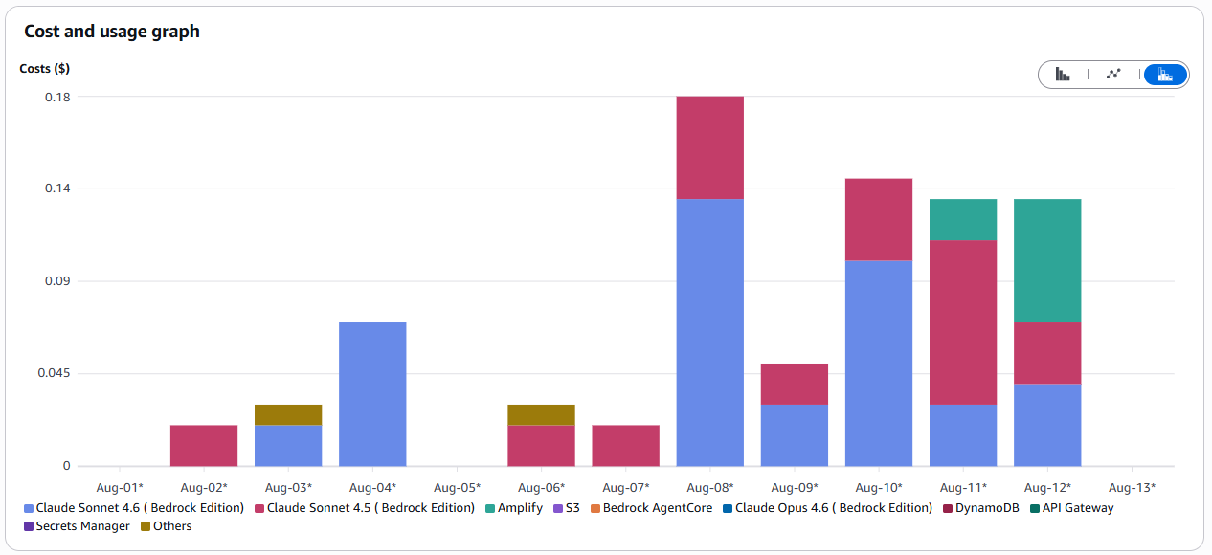
Cost Effectiveness
of score
What we estimated, and what we actually spent.
ESTIMATED
ACTUAL, AFTER THE FINAL RUN
AWS CREDIT
$36
$0.79
$100
for one 4-week hack period
measured in AWS Billing
the ceiling we were given
AWS Cost Explorer, spend after the final run
The framework itself is free. Strands is open source, so we pay for Bedrock inference and Lambda execution only. Serverless throughout means we pay per audit run, not per hour, and the arithmetic we kept in Python is inference never bought.
> accenture | aws
AABG FY26 Hackathon · Team FinSightOps
14
Notes:
ACTION BEFORE 14 AUG: replace the '$ __' with the real figure from AWS Billing and paste a Cost Explorer screenshot into the frame on the right. The point to land is that we did not come in under the credit by accident, we came in under it by removing everything the audit did not need. Bedrock inference is the only line that grows meaningfully at production volume.

Slide 20
Sustainability
Compute in proportion to work actually done.
Nothing idles
Fewer tokens by design
Every component scales to zero between runs. No server is powered on waiting for a document. Compute exists only while one is being processed.
Inference is the energy-intensive part of this system. Computing every total in Python and capping output per agent cuts how much inference happens, not just what it costs.
A smaller footprint by subtraction
We don't store what we won't read
Six services instead of sixteen. Every component we removed is infrastructure that no longer runs, monitors or stores anything on our behalf.
S3 lifecycle rules, short log retention, and one canonical copy per document rather than the same file scattered across systems.
Paperless end to end
The audit trail is digital from upload to dashboard, with no printed ledgers, no filed receipts and no documents couriered between reviewers.
Honest framing: we make no claim about the grid behind the region. What we can claim is that this design consumes compute only in proportion to work actually done.
> accenture | aws
AABG FY26 Hackathon · Team FinSightOps
15
Notes:
Sustainability is 5% — spend 30 seconds. Scale-to-zero and the subtraction point are the two credible claims. Resist inventing a carbon figure; the honest framing at the bottom scores better than a made-up percentage.

Slide 21
Built to Last
Responsible-AI by design, and a clear path to production.
RESPONSIBLE AI
ROADMAP — v2 IN 3 MONTHS
Explainable
Now
Four agents, three document types, single-team demo on AWS.
✓
Each agent returns an independent finding with its evidence. No black-box verdicts.
+1 mo
Cash-flow and tax agents; richer dashboard views over the same results store.
Auditable
✓
Every stage is persisted, so any reported figure traces back through the trial balance to a document.
Managed orchestration for true parallel execution and automatic retries.
+2 mo
Governed
✓
+3 mo
Org-wide rollout with per-entity dashboards and connections to live systems of record.
Scoped IAM roles per agent and CloudWatch observability on every agent action.
FinSightOps — audit at machine speed, with every figure traceable to its source.
> accenture | aws
AABG FY26 Hackathon · Team FinSightOps
16
Notes:
Judges ask 'what would you do with more time' — this is the pre-baked answer. Everything on the roadmap is an addition to the current design, not a replacement of it.

Slide 22
Prototype Demo
A live run from upload to dashboard, with a recorded fallback ready.
RUN SHEET
1
Upload the document set from the portal
2
Ledger posts every entry; the trial balance balances
3
P&L and balance sheet compute off that trial balance
Recorded demo
4
Reconciliation surfaces and explains the difference
video to be embedded here as the backup for the live run
5
Dashboard shows every stored result, stage by stage
Every figure on screen is read back from DynamoDB, so what the judges see is stored output rather than a rendered summary.
> accenture | aws
AABG FY26 Hackathon · Team FinSightOps
17
Notes:
ACTION BEFORE 14 AUG: embed the recorded run in the frame on the left (Insert > Video > This Device, then set it to play full screen). Open the live portal in a second window before you start. If the live run has not reached the ledger stage within about fifteen seconds, say 'let me show you the recorded run' and play it. Do not debug on stage.

Slide 23
Thank you
FinSightOps: audit at machine speed, with every figure traceable to its source.
Team FinSightOps · AABG FY26 Hackathon
> accenture | aws
AABG FY26 Hackathon · Team FinSightOps
Notes:
Leave this on screen during questions. Do not summarise the deck again.

