Slide 1
Universal Asynchronous RX/TX
3/17/2014
Richard Kuo
Assistant Professor

Slide 2
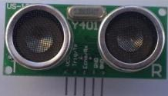
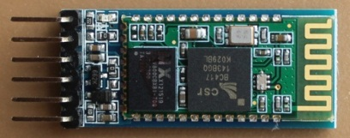
OutLine
UART Interface Introduction
  10.NuMicro_UART.ppt
Exercise：UART Basic Transmission (Smpl_DrvUART)
Exercise : RS485 Basic Transmission (Smpl_RS485)
Exercise : use UART connecting to Ultrasound Sensor (Smpl_UART0_SRF04)
Exercise：use UART connecting to Bluetooth module
  (Smpl_UART0_HC05)
Exercise：use UART0 connecting to Bluetooth module, UART1 connecting to US100/SRF04 (Smpl_UART_BT_US100)

Slide 3
UART pins
Based on NUC140 LQFP 100pin
UART0
  RX0/GPB0 : pin32
  TX0/GPB1 : pin33
UART1
  RX1/GPB4 : pin19
  TX1/GPB5 : pin20
UART2
  RX2/GPD14 : pin38
  TX2/GPD15 : pin39

Slide 4
UART (Universal Asynchronous Receiver Transimitter)
Drive
Drive
Drive
Drive
Drive
Drive
Drive
Drive
Drive
Drive
Drive
Serial
Transmit
Start
Bit
Data
Bit 0
Data
Bit 1
Data
Bit 2
Data
Bit 3
Data
Bit 4
Data
Bit 5
Data
Bit 6
Data
Bit 7
Parity
Bit
Stop
Bit
LSB
MSB
Sample
Sample
Sample
Sample
Sample
Sample
Sample
Sample
Sample
Sample
Sample
Serial
Receive
Start
Bit
Data
Bit 0
Data
Bit 1
Data
Bit 2
Data
Bit 3
Data
Bit 4
Data
Bit 5
Data
Bit 6
Data
Bit 7
Parity
Bit
Stop
Bit
LSB
MSB

Slide 5
UART Baud Rate : Cycle Time & Interrupt
Baud Rate | Cycles per Timer Tick (at 3.57MHz) | Worst-Case Interrupt Cycle Count | Bandwidth Used by UART (%)
9600 | 372 | 19 | 5.1%
19200 | 186 | 19 | 10.2%
28800 | 124 | 19 | 15.3%
57600 | 62 | 19 | 31.6%
115200 | 31 | 19 | 61.3%

Slide 6
RS-232 DB9 Connector
1
Data Carrier Detect
6
Data Set Ready
2
Receive Data
7
Request To Send
3
Transmit Data
8
Clear To Send
4
Data Terminal Ready
9
Ring Indicator
5
Signal Ground

Slide 7
RS-232/422/485 Comparison
 | RS-232 | RS-422 | RS-485
No. of Driver | 1 | 1 | 32
No. of Receiver | 1 | 10 | 32
Mode of Operation | Half duplex Full duplex | Half duplex | Half duplex
Max. Distance | 15m | 1200m | 1200m
Max. Speed at 12m | 20Kbps | 10Mbps | 35Mbps
Max. Speed at 1200m | 1Kbps | 100Kbps | 100Kbps
Min. Output Voltage | +-5V | +-2.0V | +-1.5V
Max. Output Voltage | +-25V | +-6V | -7~12V
Receiver Input Range | +-15V | +-10V | -7~12V

Slide 8
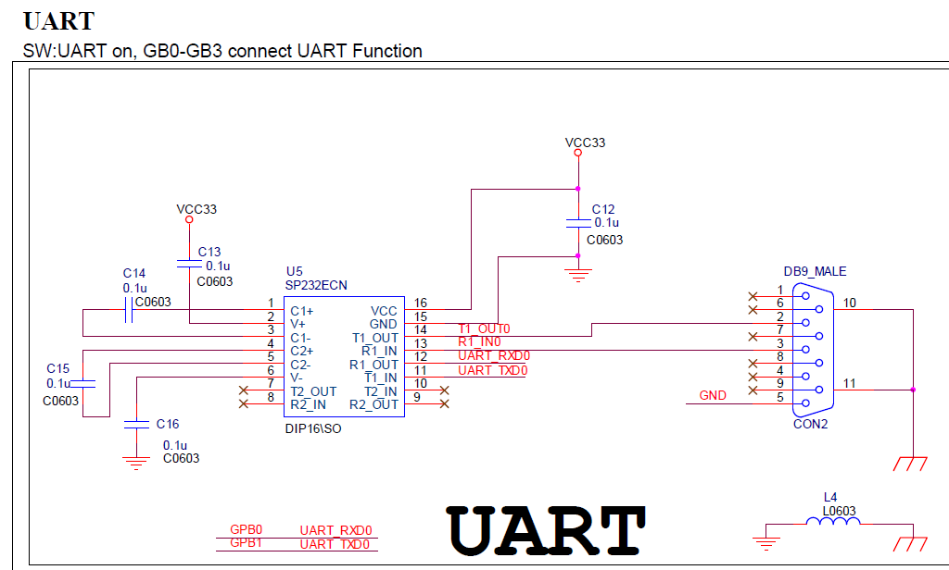
UART schematic
SP232-TX
to DB9 pin2 RX
SP232-RX
from DB9 pin3 TX

Slide 9
NuMicro MCU UART function
Provide up to 3 UART ports
  programmable baud-rate
  programmable serial-interface
  Built-in TX/RX buffers (FIFO)
    UART0 FIFO = 64 bytes
    UART1 FIFO = 16 bytes
    UART2 FIFO = 16 bytes
Support hardware flow-control (/CTS及/RTS) on UART0 & UART1
Support IrDA SIR function (Infrared transmission use)

Slide 10
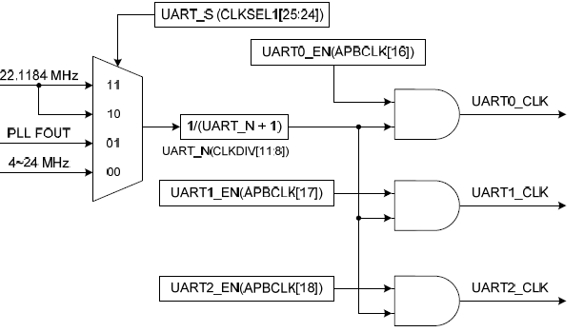
UART Clock Selection

Slide 11
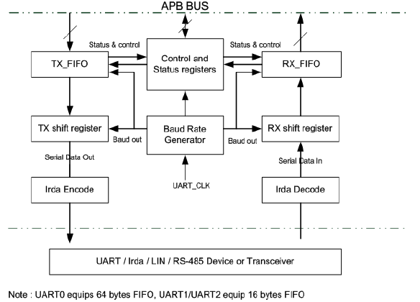
UART Block Diagram

Slide 12
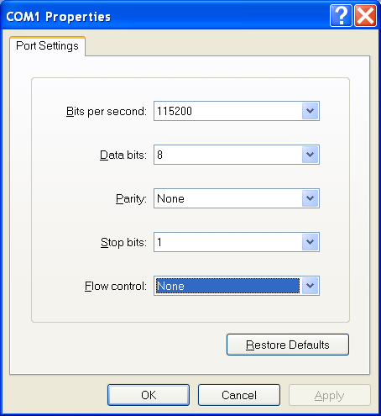
UART Setting
Even, odd or no-parity
5 ~ 8bits
1 ~ 2bits
Mode | DIV_X_EN | DIV_X_ONE | Divider X | BRD | Baud rate equation
Mode 0 | Disable | 0 | B | A | UART_CLK / [16 * (A+2)]
Mode 1 | Enable | 0 | B | A | UART_CLK / [(B+1) * (A+2)] , B must >= 8
Mode 2 | Enable | 1 | B | A | UART_CLK / (A+2), A must >=3

Slide 13
UART Transmission Baud Rate
System source = 22.1184MHz
Baud rate | Mode0 | Mode1 | Mode2
921600 | x | A=0,B=11 | A=22
460800 | A=1 | A=1,B=15 A=2,B=11 | A=46
230400 | A=4 | A=4,B=15 A=6,B=11 | A=94
115200 | A=10 | A=10,B=15 A=14,B=11 | A=190
57600 | A=22 | A=22,B=15 A=30,B=11 | A=382
38400 | A=34 | A=62,B=8 A=46,B=11 A=34,B=15 | A=574
19200 | A=70 | A=126,B=8 A=94,B=11 A=70,B=15 | A=1150
9600 | A=142 | A=254,B=8 A=190,B=11 A=142,B=15 | A=2302
4800 | A=286 | A=510,B=8 A=382,B=11 A=286,B=15 | A=4606

Slide 14
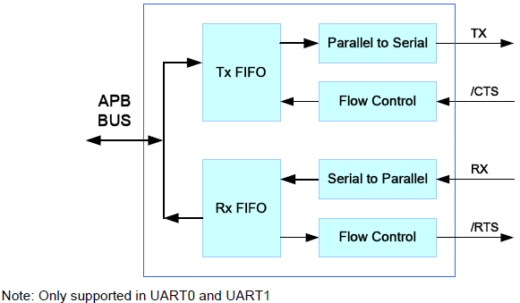
UART Auto Flow Control

Slide 15
RS485 Function Mode
UART support RS485 9-bit mode function
  Bit 9 = 1 : Address byte, 0 : Data byte
Support 3 operation modes :
RS-485 Normal Multidrop Operation Mode (NMM)
  UART_FCR[RS485_RX_DIS] is enabled to ignore data until an address byte is detected (bit9=1)
  UART_FCR[RS485_RX_DIS] is disabled to receive any data
RS-485 Auto Address Detection Operation Mode (AAD)
  The receiver will ignore any data until an address byte is detected (bit9 = 1) and the address byte match the UA_RS-485[ADDR_MATCH] value
RS-485 Auto Direction Control Operation Model (AUD)
  Using RTS as output control signal for RS485 transciever
  LEV_RTS to set RTS active level

Slide 16
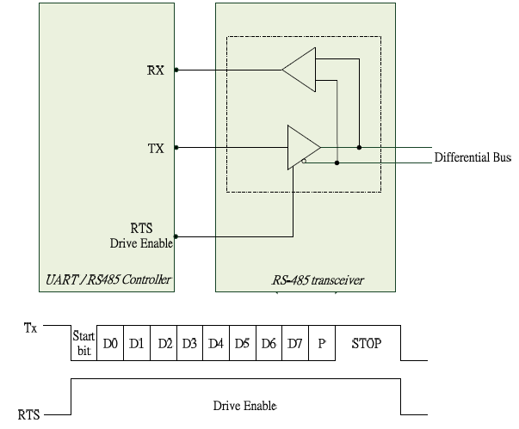
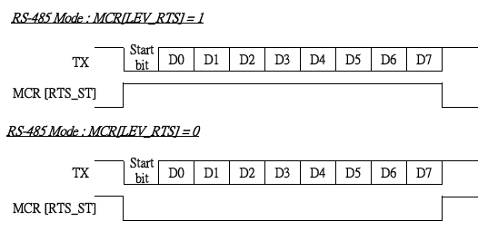
RS485 connected to the transceiver
RTS level setting
RTS signal pin as TX OE

Slide 17
UART0 initialization example
int32_t main (void)
{
STR_UART_T param;
/* GPIO initial */
DrvGPIO_InitFunction(FUNC_UART0);
/* Enable and Select UART clock source*/
UNLOCKREG();
/* Enable the 12MHz oscillator oscillation */
DrvSYS_SetOscCtrl(E_SYS_XTL12M, 1);
/* Waiting for 12M Xtal stalble */
SysTimerDelay(5000);
/* HCLK clock source. 0: external 12MHz; 4:internal 22MHz RC oscillator */
DrvSYS_SetHCLKSource(0);
LOCKREG();
/*Open UART0*/
param.u32BaudRate = 115200;
param.u8cDataBits = DRVUART_DATABITS_8;
param.u8cStopBits = DRVUART_STOPBITS_1;
param.u8cParity = DRVUART_PARITY_NONE;
param.u8cRxTriggerLevel = DRVUART_FIFO_1BYTES;
param.u8TimeOut = 0;
DrvUART_Open(UART_PORT0, &param);

Slide 18
Smpl_UART0
TX at main loop
RX at UART interrupt handler
UART connection (digital I/O without transceiver)
  UART-RX0 connected to another board’s TX0
  UART-TX0 connected to another board’s RX0

Slide 19
Smpl_UART0
//
// Smpl_UART0 : while loop for UART0-TX keep transmitting 8 bytes string
// : IRQ routine for UART0-RX keep receiving 8 bytes string & print to LCD
// : need two learning board to perform UART communication (TX & RX at the same time)
//
// Nu-LB-NUC140
// pin32 GPB0/RX0 to another board's UART TX
// pin33 GPB1/TX0 to another board's UART RX
#include <stdio.h>
#include "NUC1xx.h"
#include "GPIO.h"
#include "SYS.h"
#include "UART.h"
#include "LCD.h"
volatile uint8_t comRbuf[16];
volatile uint16_t comRbytes = 0;
volatile uint16_t comRhead = 0;
volatile uint16_t comRtail = 0;
char TEXT1[16] = "TX: sending... ";
char TEXT2[16] = "RX: ";

Slide 20
Smpl_UART0
void UART_INT_HANDLE(void)
{
uint8_t i;
uint8_t bInChar[1] = {0xFF};
while(UART0->ISR.RDA_IF==1)
{
DrvUART_Read(UART_PORT0,bInChar,1);
if(comRbytes < 8) // check if Buffer is full
{
comRbuf[comRbytes] = bInChar[0];
comRbytes++;
}
else if (comRbytes==8)
{
comRbytes=0;
sprintf(TEXT2+4,"%s",comRbuf);
print_Line(2,TEXT2);
}
}
}

Slide 21
Smpl_UART0
int32_t main()
{
uint8_t i =0;
uint8_t dataout[9] = "NuMicro0";
STR_UART_T sParam;
UNLOCKREG();
DrvSYS_Open(48000000);
LOCKREG();
init_LCD();
clear_LCD();
print_Line(0,"Smpl_UART0 ");
/* Set UART Pin */
DrvGPIO_InitFunction(E_FUNC_UART0);
/* UART Setting */
sParam.u32BaudRate = 9600;
sParam.u8cDataBits = DRVUART_DATABITS_8;
sParam.u8cStopBits = DRVUART_STOPBITS_1;
sParam.u8cParity = DRVUART_PARITY_NONE;
sParam.u8cRxTriggerLevel= DRVUART_FIFO_1BYTES;
/* Set UART Configuration */
if(DrvUART_Open(UART_PORT0,&sParam) != E_SUCCESS);
DrvUART_EnableInt(UART_PORT0, DRVUART_RDAINT, UART_INT_HANDLE);
while(1)
{
dataout[7] = 0x30 +i;
DrvUART_Write(UART_PORT0, dataout,8);
i++;
if (i>=10) i = 0;
sprintf(TEXT1+14,"%d",i);
print_Line(1,TEXT1);
DrvSYS_Delay(5000000);
}
//DrvUART_Close(UART_PORT0);
}

Slide 22
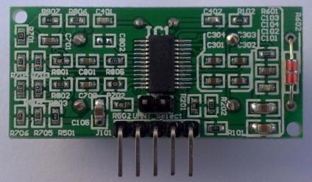
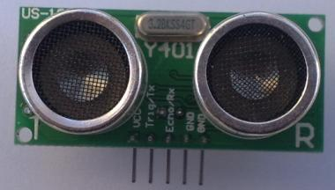
Ultrasound Sensor (SRF04 / US100)
SRF04/US100 ultrasound sensor can range 2cm~4.5m distance，wide operating voltage range at 2.4~5.5V，low static current <2mA，built-in temperature sensor for self-compensation of distance, GPIO/UART as interface
Pin Connections
  Pin 1 : Vcc
  Pin 2 : TX to NUC140 TX
  Pin 3 : RX to NUC140 RX
  Pin 4 : Gnd to Gnd
  Pin 5 : Gnd to Gnd

Slide 23
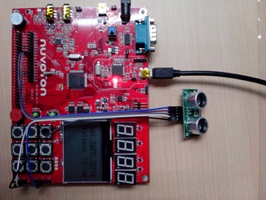
Smpl_UART0_SRF04

Slide 24
Smpl_UART0_SRF04
int32_t main()
{
uint32_t distance;
uint8_t write_byte[1];
uint8_t read_byte[2];
char TEXT[16] = " ";
STR_UART_T sParam;
UNLOCKREG();
DrvSYS_Open(48000000);
LOCKREG();
DrvGPIO_InitFunction(E_FUNC_UART0); // Set UART pins
/* UART Setting */
sParam.u32BaudRate = 9600;
sParam.u8cDataBits = DRVUART_DATABITS_8;
sParam.u8cStopBits = DRVUART_STOPBITS_1;
sParam.u8cParity = DRVUART_PARITY_NONE;
sParam.u8cRxTriggerLevel = DRVUART_FIFO_1BYTES;
/* Set UART Configuration */
if(DrvUART_Open(UART_PORT0,&sParam) != E_SUCCESS);
init_LCD(); // initialize LCD panel
clear_LCD(); // clear LCD panel
print_Line(0, "Smpl_UART0_SRF04");
while(1)
{
write_byte[0]=0x55; // trigger SRF04
DrvUART_Write(UART_PORT0,write_byte,1);
DrvUART_Read(UART_PORT0,read_byte,2);
distance = read_byte[0]*256 + read_byte[1];
sprintf(TEXT+0,"Distance: %dmm",distance);
print_Line(1, TEXT);
}
}

Slide 25
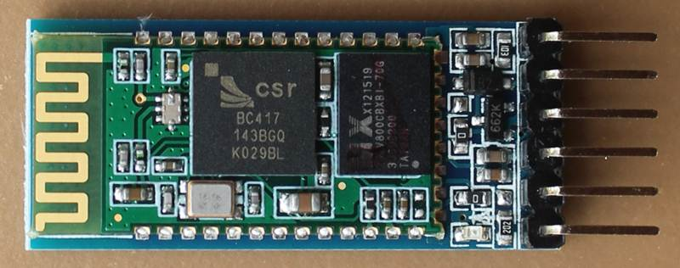
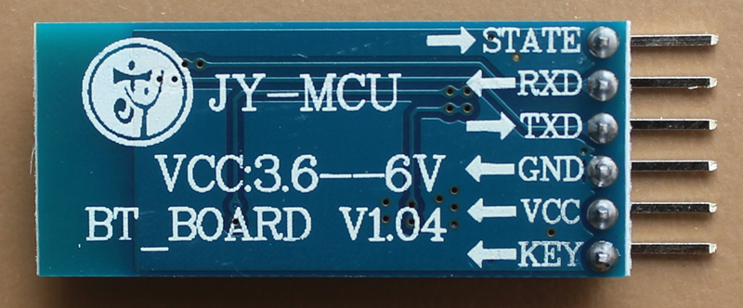
Bluetooth module
Connections
N.C.
MCU TX
MCU RX
GND
VCC
N.C.
HC-05 can operate at 5V

Slide 26
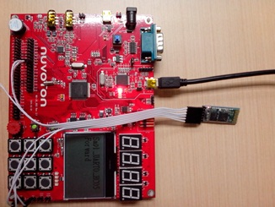
Smpl_UART0_HC05

Slide 27
Smpl_UART0_HC05
#define DATASIZE 8
int32_t main()
{
uint8_t read_buf[16] = " ";
char TEXT[16] = " ";
STR_UART_T sParam;
UNLOCKREG();
DrvSYS_Open(48000000);
LOCKREG();
DrvGPIO_InitFunction(E_FUNC_UART0); // Set UART pins
/* UART Setting */
sParam.u32BaudRate = 9600;
sParam.u8cDataBits = DRVUART_DATABITS_8;
sParam.u8cStopBits = DRVUART_STOPBITS_1;
sParam.u8cParity = DRVUART_PARITY_NONE;
sParam.u8cRxTriggerLevel= DRVUART_FIFO_1BYTES;
/* Set UART Configuration */
if(DrvUART_Open(UART_PORT0,&sParam) != E_SUCCESS);
init_LCD(); // initialize LCD panel
clear_LCD(); // clear LCD panel
print_Line(0, "Smpl_UART0_HC05"); // print title
while(1) {
// read 8 bytes from bluetooth
DrvUART_Read(UART_PORT0,read_buf,DATASIZE);
sprintf(TEXT,"%s",read_buf); // display on LCD
print_Line(1, TEXT);
}
}
Note: Smartphone app can transmit bytes as command to MCU, then control output

Slide 28
Ultrasound Sensor + MCU + Bluetooth
MCU read ultrasound sensor, then send data through Bluetooth to PC/Smartphone
Step1. connecting HC05 & US100 onto Nu-LB-NUC140 (UART port 0 & 2)
Step2. build & download Smpl_UART_BT_US100 code to NUC140
Step3. add bluetooth device to PC/Smartphone
  HC-05 pairing password = 1234
Step4. open Terminal on PC/Smartphone
  Terminal set baud rate = 9600, 8-bit data, no parity, no flow-control
  Connect to BT device
Step5. see data displaying on terminal
Note: UART1 connected to LIN circuit which make it get wrong reading from US100

Slide 29
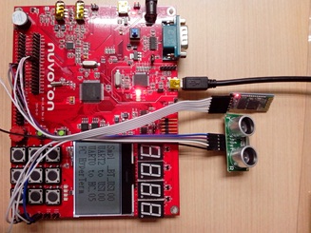
Smpl_UART_BT_US100

Slide 30
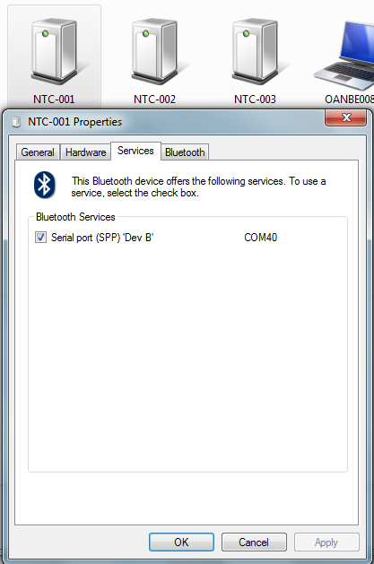
Add Bluetooth Device
device added
com port no.
Note: after the device is added, check its property to find its com port number

Slide 31
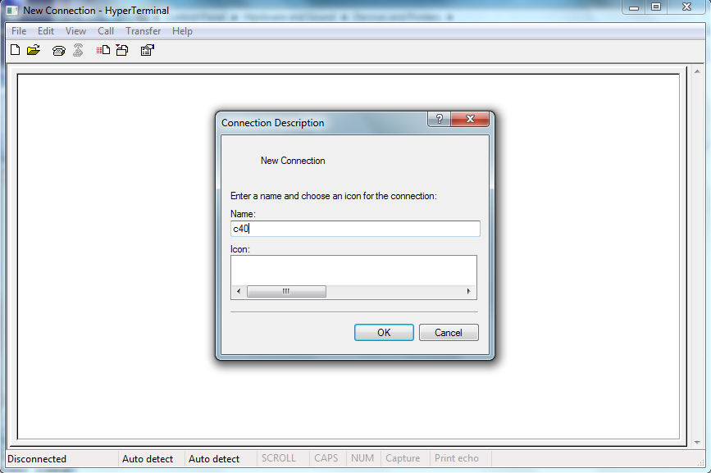
Open PC HyperTerminal

Slide 32
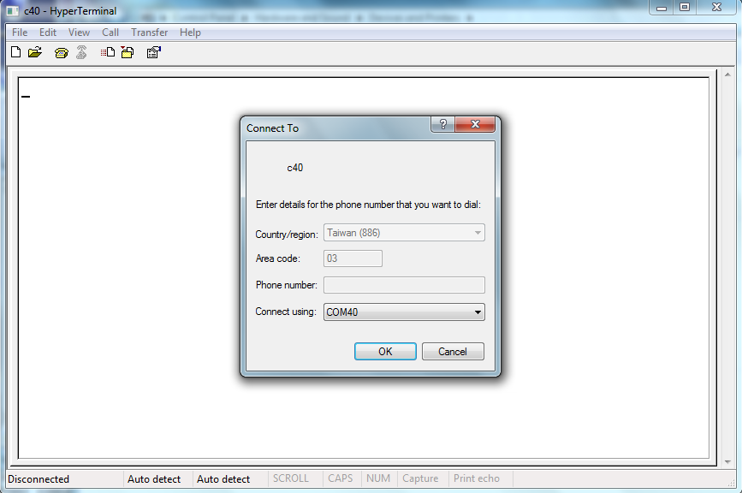
Select HyperTerminal connecting com port

Slide 33
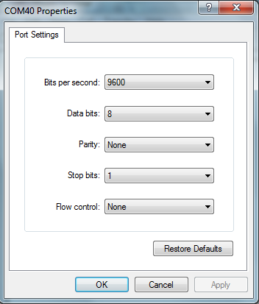
Setup com port parameter

Slide 34
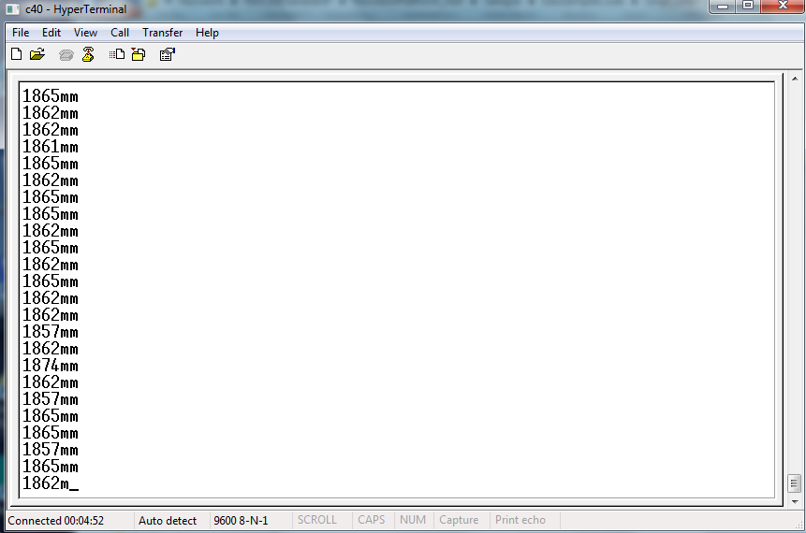
See output on HyperTerminal

Slide 35
Smpl_UART_BT_US100
#define DATASIZE 8
int32_t main()
{
uint16_t distance;
uint8_t write_byte[1];
uint8_t read_byte[2];
uint8_t dataout[DATASIZE];
STR_UART_T sParam;
UNLOCKREG();
DrvSYS_Open(48000000);
LOCKREG();
init_LCD();
clear_LCD();
print_Line(0,"Smpl _BT_US100");
print_Line(1,"UART2 to US100");
print_Line(2,"UART0 to HC-05");
print_Line(3,"PC HyperTerm ");
/* Set UART Pin */
DrvGPIO_InitFunction(E_FUNC_UART0);
DrvGPIO_InitFunction(E_FUNC_UART2);
/* UART Setting */
sParam.u32BaudRate = 9600;
sParam.u8cDataBits = DRVUART_DATABITS_8;
sParam.u8cStopBits = DRVUART_STOPBITS_1;
sParam.u8cParity = DRVUART_PARITY_NONE;
sParam.u8cRxTriggerLevel= DRVUART_FIFO_1BYTES;
/* Set UART Configuration */
if(DrvUART_Open(UART_PORT0,&sParam) != E_SUCCESS);
if(DrvUART_Open(UART_PORT2,&sParam) != E_SUCCESS);
while(1)
{
write_byte[0]=0x55; // trigger SRF04
DrvUART_Write(UART_PORT2,write_byte,1);
DrvUART_Read(UART_PORT2,read_byte,2);

Slide 36
Smpl_UART_BT_US100
distance = read_byte[0]*256 + read_byte[1];
dataout[0] = 0x30 + distance /1000;
distance = distance - distance /1000 * 1000;
dataout[1] = 0x30 + distance /100;
distance = distance - distance /100 * 100;
dataout[2] = 0x30 + distance/10;
distance = distance - distance /10 * 10;
dataout[3] = 0x30 + distance;
dataout[4] = 'm';
dataout[5] = 'm';
dataout[6] = 0x0d;
dataout[7] = 0x0a;
DrvUART_Write(UART_PORT0,dataout,DATASIZE); // send to Bluetooth
}
}

Slide 37
Important Notice !
This educational material are neither intended nor warranted for usage in systems or equipment, any malfunction or failure of which may cause loss of human life, bodily injury or severe property damage. Such applications are deemed, “Insecure Usage”.
Insecure usage includes, but is not limited to: equipment for surgical implementation, atomic energy control instruments, airplane or spaceship instruments, the control or operation of dynamic, brake or safety systems designed for vehicular use, traffic signal instruments, all types of safety devices, and other applications intended to support or sustain life.
All Insecure Usage shall be made at user’s own risk, and in the event that third parties lay claims to the author as a result of customer’s Insecure Usage, the user shall indemnify the damages and liabilities thus incurred by using this material.
Please note that all lecture and sample codes are subject to change without notice. All the trademarks of products and companies mentioned in this material belong to their respective owners.

