Slide 1
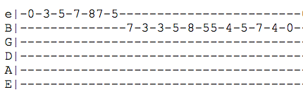
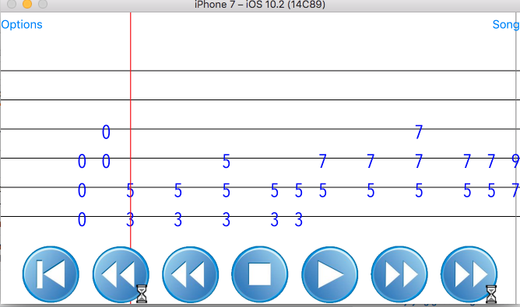
Band Songbook
William J. Liddy and Chris Tsuei
Case School of Engineering, Case Western Reserve University, Cleveland, Ohio
INTRODUCTION
PROJECT GOALS
RESULTS
CONCLUSIONS
Musicians that play rock or popular style music are often unable to read formal sheet music. As an alternative, a system of music notation named “tablature”, or tab for short, provides an easy way for a string players (guitar players, bass players) to figure out how to play their part without requiring any formal training.
When musicians in these types of bands gather to practice, they often like to try to play new songs, both for fun and for serious consideration to add to their repertoire. Taking the time to work out how to play a new song by ear is difficult and time-consuming. So, they often use the internet to access tabs, and read these tabs while playing along with the rest of the band. Though this approach is extremely common, it has many problems.
Tablature is ambiguous. The rhythm of tab is unclear. The musician cannot be sure how long to play each note, when to release each note, and the style of which to play each note.
Tablature is sometimes incorrect. Tablature submitted to websites can vary widely in arrangement. For example, one musician may find a tab for the studio version of a song while another is using a tab for the radio edit.
Tablature is difficult to play with. On a device such as a phone or a laptop, the musician must scroll through the tab to read it, which is impossible while playing music at the same time. If the tab is printed, they still have to turn the page. Additionally, it is difficult to read tablature and sing from a lyrics sheet at the same time for those musicians who are doing both.
The goal of our project is to allow musicians in a band to simultaneously read through music while avoiding the problems with accessing tabs form internet sources (rhythmic ambiguity, incorrect note entries, scrolling). To accomplish this, we built an app for iOS and Android devices. The app, titled “Band Songbook”, allows band members (presumably all in the same room) to read through tab together while avoiding the issues with internet tab sources.
To handle the problem with tab ambiguity, we leverage a file format called “musicXML” which contains all of the information about a popular song in both standard notation and tab format. This allows us to display the music in tab notation while also assuring the rhythmic value is displayed. We make use of a ”scrolling” tab that shows players when to play a note. This system makes it clear when the players are supposed to be playing, and alleviates the scrolling problem. There are also a number of musicXML editors out there, making it easy for arrangers to arrange music. That is all of the parts contained in the musicXML file will line up with each other
We will also allow each user to make small, rudimentary edits for their part, such as adjusting a note value, extending or deleting a note, or making an annotation. These edits, once finalized, are saved back onto the bandleaders’ device.
Our app is unique because it is the first to offer cross-platform synchronized playback of musicXML files. Many apps are out there that can display scrolling musicXML, but our use of networking to support bands is the niche we aim to fill
To facilitate communications between the devices, an ad-hoc TCP Server was written in Ruby. The server was deployed onto an EC2 node.
On launching the app, users are greeted with a title screen asking for the group that they would like to join or create, and then the name:
After entering that data, the bandleader, or creator of the group, selects the songs that they want to play.
Finally, the

