Slide 1
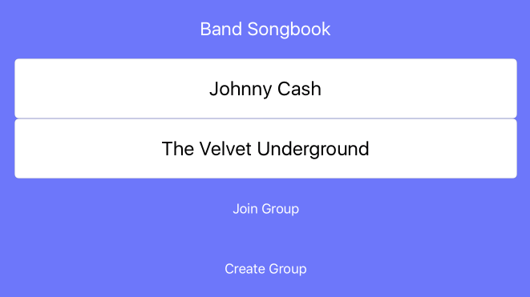
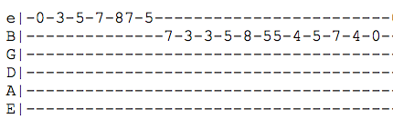
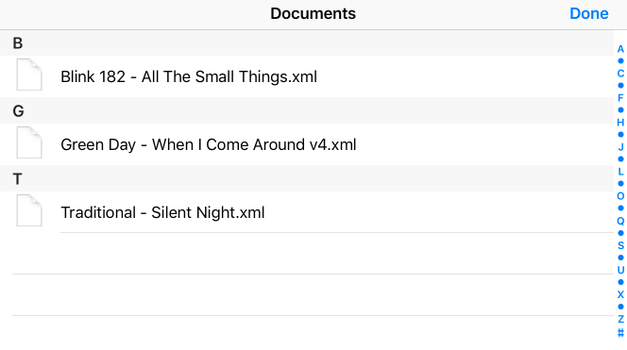
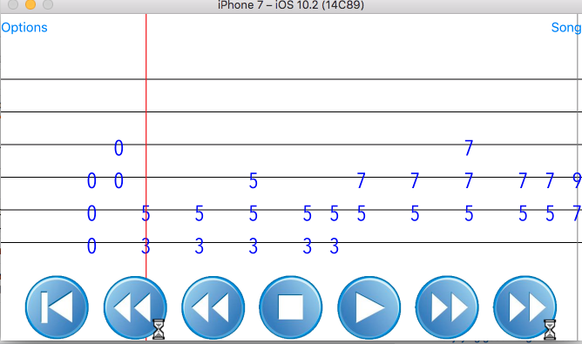
Band Songbook
William J. Liddy and Chris Tsuei
Case School of Engineering, Case Western Reserve University, Cleveland, Ohio
INTRODUCTION
PROJECT GOALS
RESULTS
FUTURE WORK
Musicians that play rock or popular style music are often unable to read formal sheet music. As an alternative, a system of music notation named “tablature”, or tab for short, provides an easy way for string players (guitar players, bass players, etc.) to figure out how to play their part without requiring any formal training.
When musicians in these types of bands gather to practice, they often like to try to play new songs, both for fun and for serious consideration to add to their repertoire. Taking the time to work out how to play a new song by ear is difficult and time-consuming. So, they often use the internet to access tabs, and read these tabs while playing along with the rest of the band. Though this approach is extremely common, it has many problems.
Tablature is ambiguous. The rhythm of tab is unclear. The musician cannot be sure how long to play each note, when to release each note, and the style of which to play each note.
Tablature is sometimes incorrect. Tablature submitted to websites can vary widely in arrangement. For example, one musician may find a tab for the studio version of a song while another is using a tab for the radio edit.
Tablature is difficult to play with. On a device such as a phone or a laptop, the musician must scroll through the tab to read it, which is impossible while playing guitar at the same time. If the tab is printed, they still have to turn the pages. Additionally, it is difficult to read tablature and sing from a lyrics sheet at the same time for those musicians who are doing both.
The goal of our project is to allow musicians in a band to simultaneously read through music while avoiding the problems with accessing tabs form internet sources (rhythmic ambiguity, incorrect note entries, scrolling). To accomplish this, we built an app for iOS and Android devices. The app, titled “Band Songbook”, allows band members (presumably all in the same room) to read through tab together while avoiding the issues with internet tab sources.
To handle the problem with tab ambiguity, we leverage a file format called “musicXML” which contains all of the information about a popular song in both standard notation and tab format. This allows us to display the music in tab notation while also assuring the rhythmic value is accounted for. We make use of a ”scrolling” tab that shows players when to play a note. This system makes it clear when the players are supposed to be playing, and alleviates the scrolling problem stated in the introduction. There are also a number of musicXML editors out there, making it easy for arrangers to arrange music in this format. This assures that all of the parts contained in the musicXML file will line up with each other.
We will also allow each user to make small, rudimentary edits for their part, such as adjusting a note value, extending or deleting a note, or making an annotation. These edits, once finalized, are saved back onto the bandleaders’ device.
Our app is unique because it is the first to offer cross-platform synchronized playback of musicXML files. Many apps are out there that can display scrolling musicXML, but our use of networking to support bands is the niche we aim to fill.
To facilitate communications between the devices, an ad-hoc TCP Server was written in Ruby. The server was deployed onto an EC2 node.
On launching the app, users are greeted with a title screen asking for their name and also the name of the group that they would like to join or create.
After entering that data, the user is redirected to a lobby screen, where they can see all the other band members in the session. The bandleader, or the creator of the session, browses their device for the song (s) they want to play.
Finally, each user selects the part they desire, and playback is synchronized across all devices.
Our application provides an effective way for bands to practice together. However, given the lack of popularity of musicXML files, we imagine that, in order to play most songs, users will find songs in the more popular (but proprietary and much harder to parse!) Guitar Pro file format, download them onto a PC, convert them to musicXML using some program (such as TuxGuitar), and then transfer the files onto their phone. In practice, we believe most users will be unwilling to do all of this work.
There are a few ways to solve this problem. One solution is to give our server the capability to convert Guitar Pro files to musicXML files, and vice versa if the file is edited during playback. One issue with this approach is that the Guitar Pro file that a user uploads might be poorly written and not actually line up with the song, so they would still have to preview the Guitar Pro file first. Additionally, annotations in the musicXML file that users create would not be converted back to the Guitar Pro format.
Another approach would be to have a curated collection of popular songs in musicXML format housed in a database on our server. Users could upload their own songs publicly, and other users could vote on them based on how true they are to the original. This approach could help to kick start the popularity of the musicXML format, which we find to be superior to the Guitar Pro format.
ACKNOWLEDGEMENTS
We would like to thank Professor Gultekin Ozsoyoglu for his guidance and feedback. We would also like to thank Yiqian “Ted” Chen for beta-testing the application and helping us prepare this poster. We would also like to thank the staff at Kelvin Smith Library for continuously letting us borrow iPads for testing.

