Slide 1

Portfolio Project
Wendell Salas
MIS 581 Capstone: Business Intelligence and Data Analytics
Dr. Jamia Mills
March 12, 2023
Notes:
Hello, I'm Wendell Salas and this is my presentation for my MIS 581 Portfolio Project.

Slide 2
Objectives
MIS 581 Capstone Portfolio Project
Introduction
Reason
Method
Results
Conclusion
Notes:
In this presentation I will give a brief introduction to my project, the reason for this study, discuss the methods used in the analysis, the results that were obtained, and the conclusions derived from the results.

Slide 3
Introduction
Property Tax Revenue Based Approach for Determining When to Plug and Abandon Low Production Oil and Gas Wells
Impact on Property Taxes
Positive Impacts from Well Production (Weber et al, 2016; Lee & Plummer, 2011; and Newell & Raimi, 2018)
Negative Impacts from Residential Home Valuations (Stephens & Weinstein, 2019)
Orphaned Wells
239 Orphaned Wells in Colorado in 2020 (Press, 2021)
Over 2 Million Orphaned Wells throughout the US (EPA, 2019)
Notes:
There have been past studies that discussed the benefits that come from Oil and Gas development through the revenue generated from property taxes. Additionally, there have been studies that discussed the impacts of Oil and Gas development on home values. These studies tried to quantify both the positive and negative effects of Oil & Gas development. The study by Stephens & Weinstein (2019) mentioned how difficult it can be to quantify the substitution affects between the revenue that is brought in from the wells and the revenue loss associated with reduced home valuations. This study takes on the challenge of trying to quantify this substitution effect by looking at how it may impact property tax revenues for local communities.
Another concern of Oil and Gas operations is the issue with orphaned wells. Orphaned wells are wells that are no longer associated with a viable operating entity. These wells become wards of the State and it then becomes the responsibility of State government to remediate these sites at the tax payer's expense.

Slide 4
Reason
Can we develop a process to quantify if an Oil & Gas Well no longer generates enough property tax revenue to offset the detrimental effect the well has on residential property tax revenues for homes that are within one mile of the well’s location?
Notes:
The reason for undertaking this study was to help find a repeatable process that could aid local government decision makers on identifying Oil and Gas properties that should be considered for remediation based on their ability to offset property tax revenue loss from their proximity to residential developments. We hope that identifying these Wells early will also allow local government to get the Oil and Gas Operators to remediate these locations before they become orphaned wells.

Slide 5
Method
Assessor Data
(Boulder County Assessor, 2023; Boulder County Geospatial Open Data, 2023)
COGCC Data
(Colorado Oil & Gas Commision, 2023a; Colorado Oil & Gas Commision, 2023b)
Combining the Data
Notes:
This analysis used publicly available data files from the Boulder County Assessor's and the Colorado Oil and Gas Conservation Commission's websites.
Both data sources had latitudinal and longitudinal coordinates associated with individual properties for the Assessor's data and for the well head locations in the COGCC's data.
To Combine these two datasets we used a custom R-script to compare each well's coordinates with those of all residential properties in Boulder County based on the two Circles of Influence that were used for this study. The criteria for the Circles of Influence and the effects on property taxes from residential homes was derived from the study by Stephens & Weinstein (2019).

Slide 6
Method
Assessor Data
Account_Parcels
Owner_Address
Values
Individual Well Property Tax
Notes:
The Assessor's data consisted of four main datasets.
The Account_Parcels dataset contained the relationships between individual accounts and the land line parcel numbers associated with each account.
The Owner_Address data contained each accounts mill levy, and lat and long coordinates associated with each parcel's location.
The Values dataset contained all of the assessment values and estimated property taxes for each account.
Furthermore, we were able to obtain the property tax information for each well in Boulder County from the Assessor's database.

Slide 7
Method
COGCC Data
Well Production Data
Well Spot Location Data
Individual Well Property Tax
Notes:
From the COGCC's website we were able to get the 2022 Well Production data for all wells in Boulder County.
We then combined this data with the Well Spot Location Data, which had all of the lat and long coordinates for each wellhead.
The two COGCC datasets were then combined with the 2022 property tax information, for each well, that was obtained from the County Assessor's database.

Slide 8




1 Mile
Circle of Influence
Homes within 1,000 ft are considered to be in view of the Oil and Gas Well.
These homes see a 0.8% degradation to their assessed value
Homes between 1,000 ft and 1 mile of an Oil and Gas well are considered not-in-view of a well, but do see some influence.
These homes see a 0.1% degradation to their assessed values.
Homes outside of the 1 mile radius are not included in the analysis.
1,000 ft
Notes:
The Stephens & Weinstein (2019) study looked at the effects of Oil and Gas well development from the perspective of the individual homes. Our study will reverse that perspective and look at it from the Oil & Gas Well's effect on homes within its circles of influence. Based on the results from the Stephens & Weinstein (2019) study, we will take their analysis findings and apply it to determine the total property tax revenue effect that a single well will have on homes that fall within a 1,000 ft. circle and a 1 mile circle. Stephens & Weinstein's (2019) study calculated that homes with views of existing well sites had a reduction in value of 0.8% compared to homes that did not have views of well sites. They also found that homes that were located within a 1 mile radius of where Oil and Gas wells were located still experienced a decline of 0.1% of their valuations compared to homes that were further away than 1 mile (Stephens & Weinstein, 2019). For this study, we will identify homes that are within the 1,000 ft. circle as home that are within view of a well, and hence experience the higher valuation loss. Homes that fall between the 1,000 ft. and 1 mile circle will be designated as homes that experience the lower amount of property valuation loss, due to their proximity to Oil & Gas operations.

Slide 9
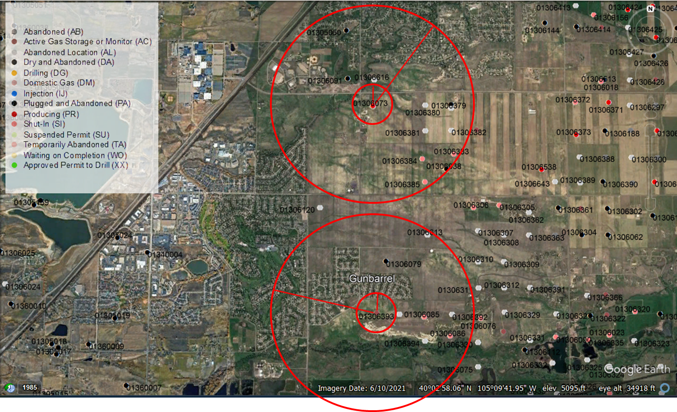
Notes:
This image shows two actual well locations and their proximity to the surrounding residential developments in our study area. The well to the north is a producing Oil and Gas well and the well to the south is a shut-in well. The smaller inner circle is the 1,000 ft. perimeter and the outer circle is the 1 mile perimeter. We can see the variations in population densities that surround these two wells. Some areas have densely populated suburban developments, while others are less densely populated rural residences. We can see that there is potential for hundreds of homes to be impacted by Oil & Gas development in these areas.

Slide 10
Results (Combining the two datasets)
Residential Dataset
104,826 residential properties
COGCC Dataset
285 well locations
Used R scripts to build a third dataset
Calculated all distances between each well to every home
Removed any home further away than 1 mile
Built two counts
Homes within 1,000 ft
Homes within 1 mile
Sum of home property tax
Notes:
After the initial data exploration and cleaning of each dataset, we used our custom R program to calculate the distances between each well in the COGCC dataset verses each home in the Residential dataset. The R program uses special logic to count all homes within a 1,000 ft. distance from each well, and all homes within the 1,000 ft. to 1 mile distance from each well. Homes that fall outside of the 1 mile circle from a specific well, were not counted. The homes that did fall within the 1 mile distance had their property taxes summed up and associated with the well that the distances were calculated from. This information was then merged with specific attributes from the COGCC dataset to create a third output dataset. This third dataset will be used to calculate the effect each well has on the property tax revenues from the homes within their circle of influence and then incorporated into our model in the SAS software.

Slide 11
Results (Multiple-Linear Regression)
Used parameters from the third dataset to build a Multiple-Linear Regression Model
Trying to identify attributes that could predict if a well should be considered for remediation
Identified 4 Attributes
Gas Sales
Well Property Tax
Average Home Property Tax
Property Tax Effect for Homes within a 1 Mile Radius
Notes:
The results and calculations from the R program's output were then used in our SAS program to develop a Multiple-Linear Regression model to see if we could predict which wells would be good candidates for remediation based on their production, the number of homes within their circles of influence, their effects on residential property taxes, and the property tax assessments.

Slide 12
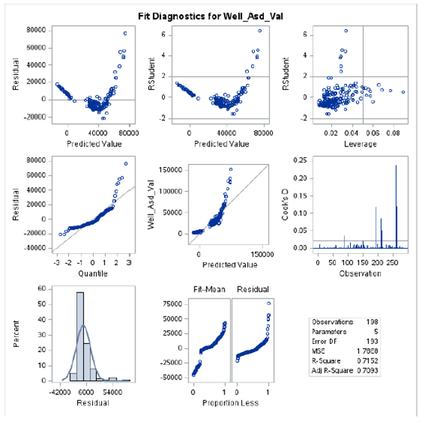
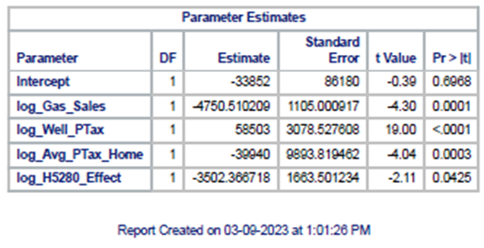
Results (Multiple-Linear Regression; Cont.)
This analysis used a Multiple-Linear Regression model with Stepwise selection.
Out of 16 variables four were found to be significant.
The model suffers from a large Standard Error.
Notes:
Our Multiple-Linear Regression model used Stepwise selection to eliminate non-statistically significant variables from the prediction model.
Out of the original 16 variables, four were found to have a significant effect on determining if a well should be considered for remediation.
While we were able to develop a model that could predict if a well should be considered for remediation, due to difficulties encountered when attempting to normalize the data, this model suffers from a large Standard Error. Further refinement of the model will need to be made to reliably use its results.

Slide 13
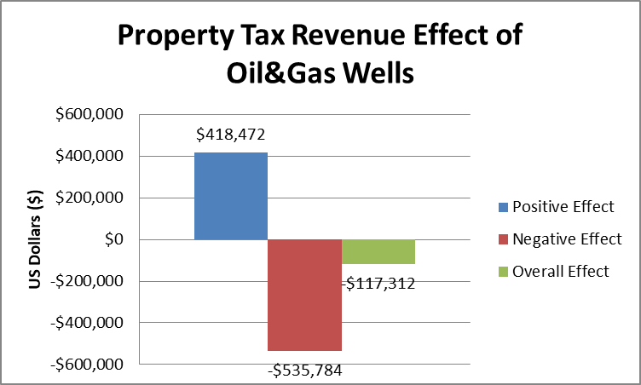
Conclusion
Multiple-Linear Regression Model
Data Normalization
Multi-Year Analysis
Switch to Different Model
123 Wells
Insufficient Property Tax Generation
Should be considered for Remediation
167 Wells
Sufficient Property Tax Generation
Not Enough to Offset Negative Well Effect
Total Negative Effect
Loss of approximately $267,892 from local school funding in 2022
Notes:
While our model still needs work before we can reliably use it to predict which wells should be considered for remediation, we were able to identify four attributes with significant contributions to help us identify wells to consider for remediation.
There is still work to be done with parameter normalization to help further refine this model. Furthermore, we could consider using multiple years' worth of data to help build better trends for more effective predictions. Moreover, we may want to explore other models for this analysis that are better at handling non-normalized data.
Our calculations were able to quantify what the effect of Oil and Gas operations were for nearby residential properties with respect to property taxes for the county. We discovered that out of the 285 wells, 123 were generating insufficient property tax revenue to offset their effect on the homes that fell within their circle of influence. The positive effects of property tax revenue from the other 167 wells was not enough to offset the loss from the 123 insufficient wells, generating an overall negative property tax revenue effect of around $117,000.
The lion's share of property taxes goes to fund local schools, generally slightly over 50%. The negative effect from the loss of approximately $536,000 from residential property tax revenue equates to a loss of around $268,000 from local school funding for 2022.
By identifying these underperforming wells early, local leaders can work with the Oil & Gas Operators to remediate these locations, gain back the property tax revenue loss, and prevent them from becoming orphaned wells.

Slide 14
References
Boulder County Assessor. (2023). Assessor’s Property Data Download. https://bouldercounty.gov/property-and-land/assessor/data-download/
Boulder County Geospatial Open Data. (2023). Address Points. https://opendata-bouldercounty.hub.arcgis.com/datasets/bouldercounty::address-points/about
Colorado Oil & Gas Commission. (2023a). Well Surface Location Data. COGCC Downloads Portal. https://cogcc.state.co.us/data2.html#/downloads
Colorado Oil & Gas Commission. (2023b). Yearly Well Production for Boulder County. COGCC COGIS Database. https://cogcc.state.co.us/data.html#/cogis
EPA. (2019, April 11). Inventory of U.S. Greenhouse Gas Emissions and Sinks | US EPA. US EPA. https://www.epa.gov/ghgemissions/inventory-us-greenhouse-gas-emissions-and-sinks
Lee, T., & Plummer, E. (2011). Valuation of Oil and Gas Properties and Their Contribution to School District Tax Revenues Evidence from Texas. Journal of Property Tax Assessment & Administration, 8(3), 5–17.
Newell, R.G., & Raimi, D. (2018). The fiscal impacts of increased U.S. oil and gas development on local governments. Energy Policy. Vol. 117, ppg. 14-24. https://doi.org/10.1016/j.enpol.2018.02.042
Press, T. A. (2021, April 1). Joe Biden’s plan would spend $16B to clean up old mines and oil wells and support jobs to do it. The Colorado Sun. https://coloradosun.com/2021/04/01/orphan-wells-clean-up-colorado-biden-bennet/
Stephens, H. M., & Weinstein, A. L. (2019). Household valuation of energy development in amenity‐rich regions. Growth & Change, 50(4), 1375–1410. https://doi.org/10.1111/grow.12335
Weber, J. G., Burnett, J. W., & Xiarchos, I. M. (2016). Broadening Benefits from Natural Resource Extraction: Housing Values and Taxation of Natural Gas Wells as Property. Journal of Policy Analysis & Management, 35(3), 587–614. https://doi.org/10.1002/pam.21911
Notes:
Thank you for your time. This concludes my presentation.

